Slide 2
Survey spectra detail in region of Sn3d and In3d peaks

Slide 3
Atomic concentration ratios based on survey data
--------------------------
Atomic Concentration Table
--------------------------
C1s O1s In3d5 Sn3d
0.314 0.733 4.530 8.288 RSF
57.911 128.614 927.656 1680.908 CorrectedRSF
23.39 50.14 24.82 1.64 3.ITOSA3C1
22.86 48.46 25.11 3.58 4.ITOSA4F3
18.99 50.37 26.78 3.86 5.ITOSA4F2
21.75 49.66 25.57 3.03 Mean
2.40 1.05 1.06 1.21 Standard Deviation

Slide 4
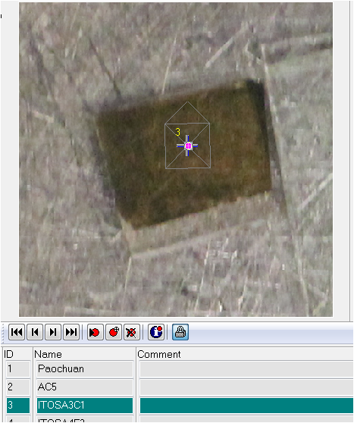
ITOSA3C1 Depth profile atomic concentration ratio no Zalar rotation

Slide 5
ITOSA3C1 sputter cycles In3d

Slide 6
ITOSA3C1 sputter cycles O1s

Slide 7
ITOSA3C1 sputter cycles Sn3d

