Slide 1
📊 AI-Generated Report
Generated with intelligent summarization and visualization.

Slide 2
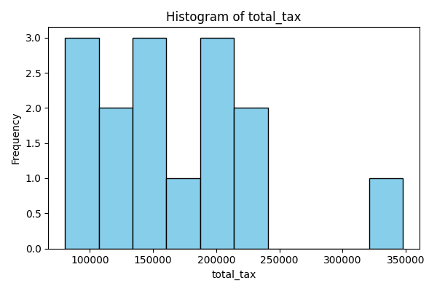
Top 15 Cities by Total Taxes Collected
Global ranking of cities with the highest tax revenue from orders.
1. Toronto, Canada – $347,572.92
2. Seattle, USA – $238,551.46
3. San Jose, USA – $234,103.22
4. Montréal, Canada – $210,131.32
5. London, UK – $204,385.51

Slide 3
Key Insight: Toronto and U.S. Tech Hubs Dominate
Toronto leads globally, followed by U.S. tech centers:
- Seattle ($238K)
- San Jose ($234K)
- Sunnyvale ($140K)
Reflects high commercial activity in innovation clusters.

Slide 4
Key Insight: New York vs. Brooklyn Tax Disparity
New York ranks 10th ($134K) despite being a major metro area.
Brooklyn appears separately at #13 ($88K).
Highlights regional economic fragmentation.

Slide 5
Key Insight: Canadian Cities Show Strong Performance
Four Canadian cities in the top 15:
1. Toronto (#1)
4. Montréal (#4)
11. Ottawa (#11)
12. Vancouver (#12)
Indicates robust cross-border commerce and local demand.

Slide 6
Regional Revenue Trends Overview
Analysis aggregates tax data from orders grouped by city.
Identifies global and regional patterns in consumer spending and tax collection.
Supports strategic decisions for market expansion and resource allocation.

