Slide 1


Indonesia Egg Price
Forecasting
A regime-aware approach to market volatility and calendar risk
Prepared by: Quratul Nurlina Oktavialin Thahir
Final Project · Student Bootcamp Offline Data Analytics · Dibimbing Batch #3

Slide 2
Table of Contents
01
About Author
02
Project Overview
Professional background & education
Defining the analysis direction
03
Problem Statement
04
Data Understanding & Preparation
Framing the research question & scope
Dataset scope and cleaning process
05
Exploratory Data Analysis
06
Modeling & Forecasting
Price distribution, outliers & regional trends
Split selection, model comparison & regime-aware SARIMA
07
Dashboard Analysis
08
Conclusions & Recommendations
2 Tableau dashboards
Strategy for commercial and policy stakeholders

Slide 3








About Author
Profile
Economics & Management graduate from Université Grenoble Alpes (France), with hands-on experience across business operations and data analytics. Currently finishing an intensive data analytics bootcamp, working mainly in Python, SQL, Tableau, and time-series forecasting.
Education
Université Grenoble Alpes (2017-2020)
Major: Economics & Management
Professional Experience
Family Business Grha Oto (2023-2026)
Focus: Operations Management, Digital Transformation

Slide 4
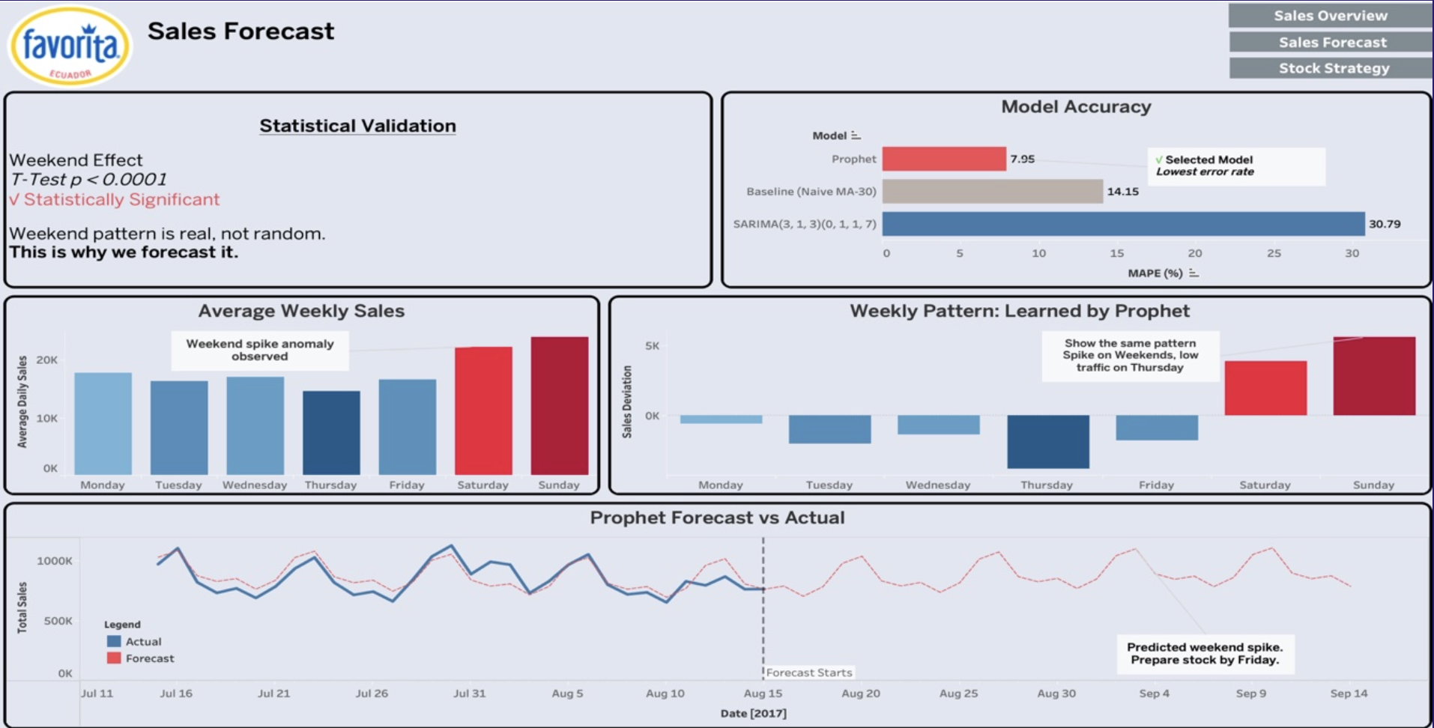
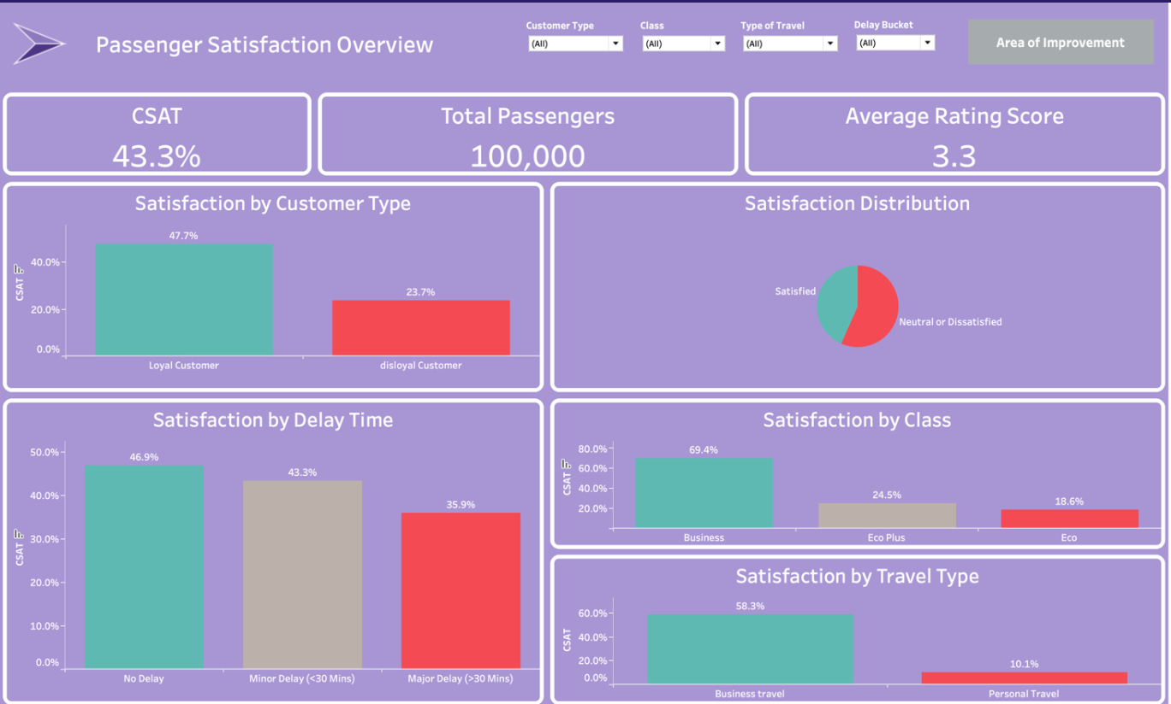
Project Overview
Strategic Regional Growth Analysis
1
Retail Time Series Analysis
Tools: Python, Tableau
Problem: Ecuadorian retailer Corporación Favorita needed to forecast daily sales per product category to plan stock accurately and avoid over/understocking.
Result: Discovered a statistically significant weekend sales anomaly across all product categories and built a Prophet forecasting model that successfully predicted the recurring weekly spike pattern.
Recommendation: Prophet Stock preparation timing, category-specific inventory prioritization, and promotion calendar redesign based on data-driven demand patterns rather than assumptions.
Strategic Regional Growth Analysis
2
Airline Satisfaction Analysis
Tools: Python, Tableau
Problem: A low-cost airline needed to understand which service touchpoints most influence passenger satisfaction.
Result: Online boarding emerged as the strongest driver of satisfaction.
Recommendation : Prioritize the boarding experience to lift overall CSAT.

Slide 5
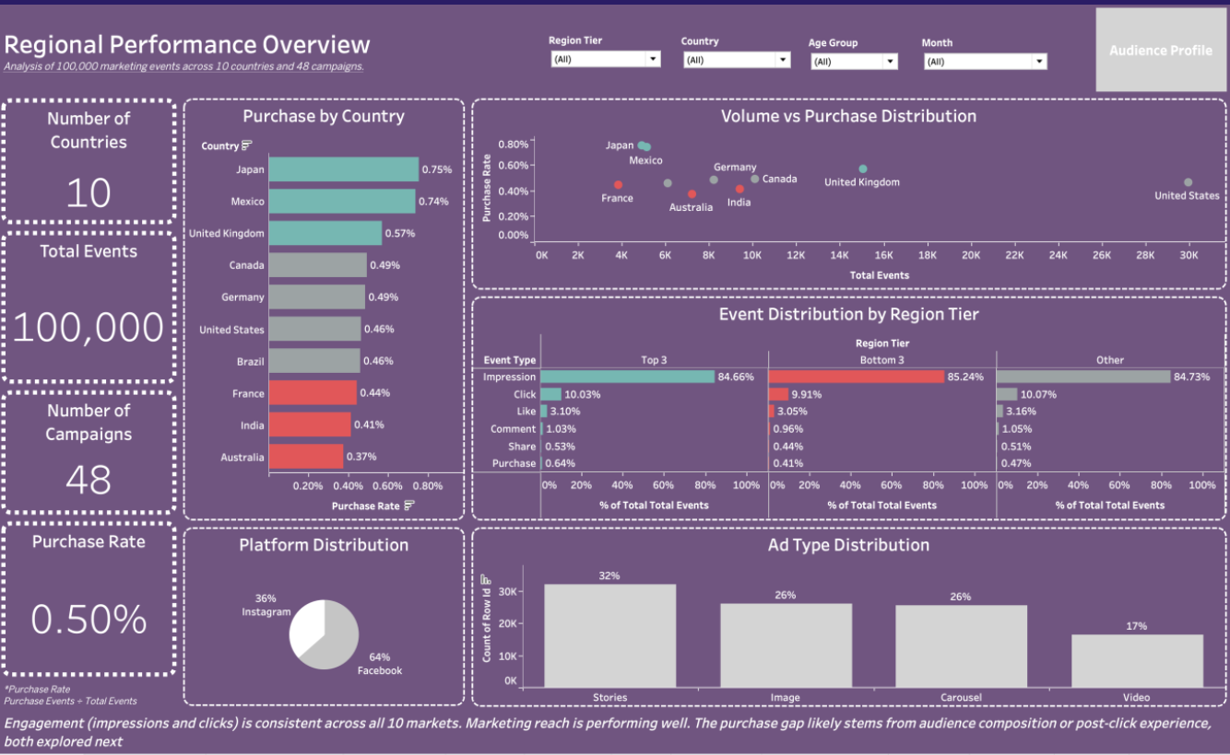
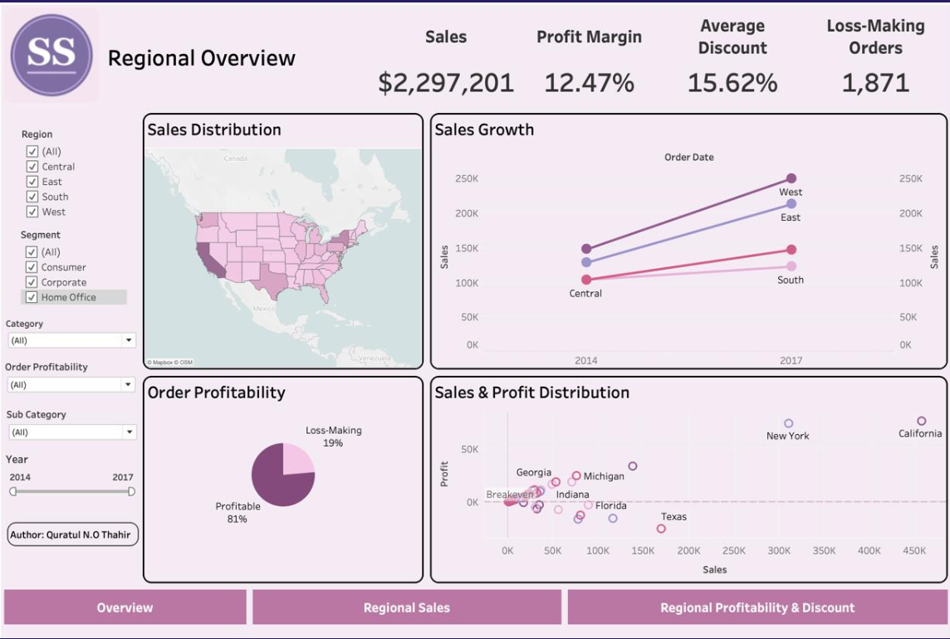
Project Overview
Strategic Regional Growth Analysis
3
Strategic Regional Growth Analysis
Tools: Python, Tableau
Problem: Marketing wanted to know how well ad spend converted into purchases across platforms and regions, using a standard conversion-rate framework.
Result: User journeys proved untraceable in the dataset, so the metric was pivoted to Purchase Rate (Purchases ÷ Total Events) after verifying the data structure.
Recommendation : Audit post engagement and trial campaigns in underperforming regions.
Strategic Regional Growth Analysis
4
Superstore Retail Analysis
Tools: Python, Tableau
Problem: A retail superstore needed to identify which regions and discount practices were eroding profit despite healthy sales volume.
Result: Statistics Test proved region significantly affects profit. The Central region's heavy discounting was the root cause.
Recommendation : Tighter discount caps for the Central and South regions.

Slide 6
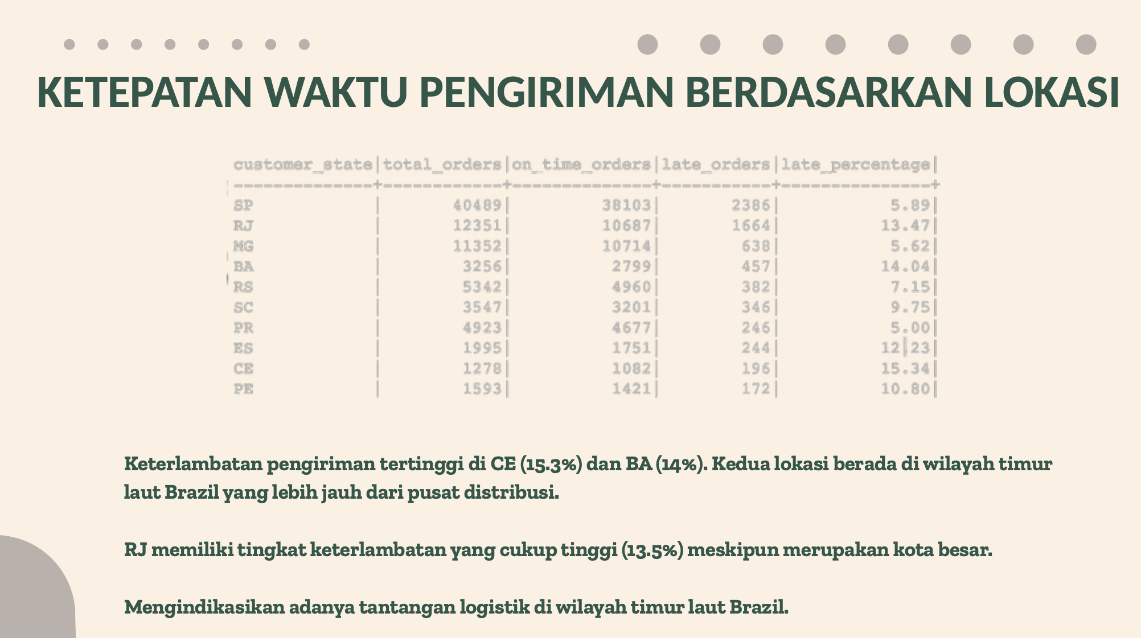
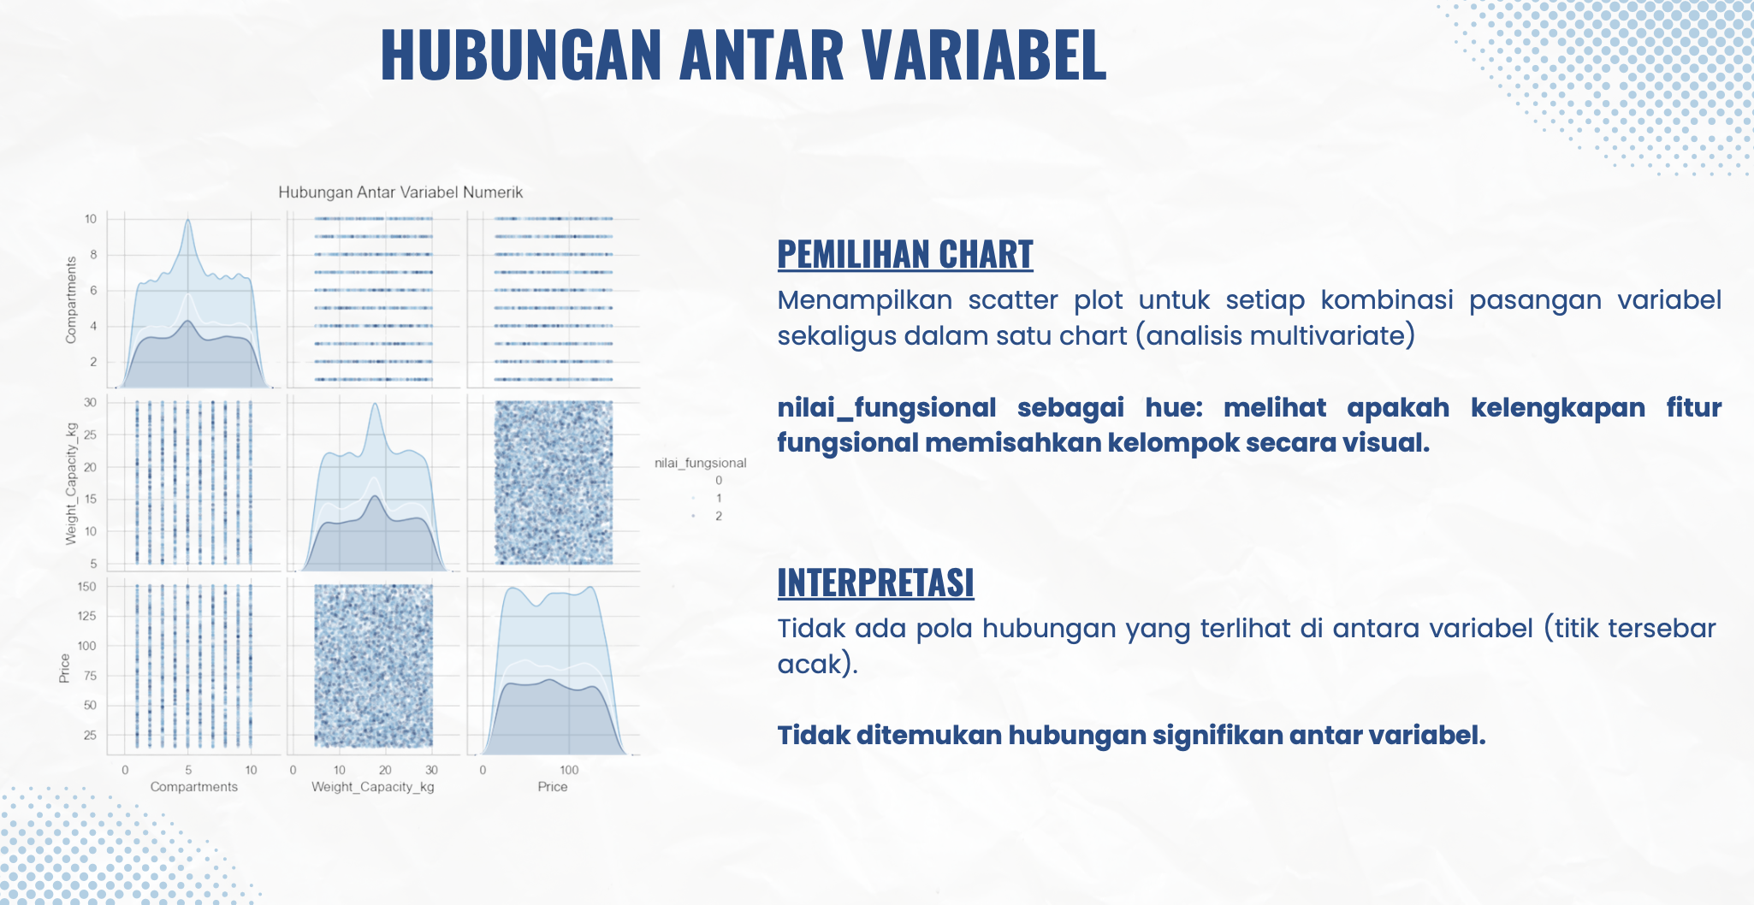
Project Overview
Strategic Regional Growth Analysis
5
Olist E-Commerce
Tools: SQL
Problem: Olist wanted to understand how customer geography shapes shopping patterns and delivery performance across Brazil.
Result: Northeastern Brazil showed strong demand paired with weak delivery performance.
Recommendation : Expand logistics coverage there and introduce a loyalty program to protect margins
6
Student Bags Analysis
Tools: Python
Problem: A bag retailer assumed waterproofing and laptop-compartment features justified a price premium and wanted this tested before using it in pricing strategy.
Result: The price difference was under $1 and not statistically significant (p > 0.05)
Recommendation : Pair this dataset with real sales data before using it for pricing decisions.

Slide 7
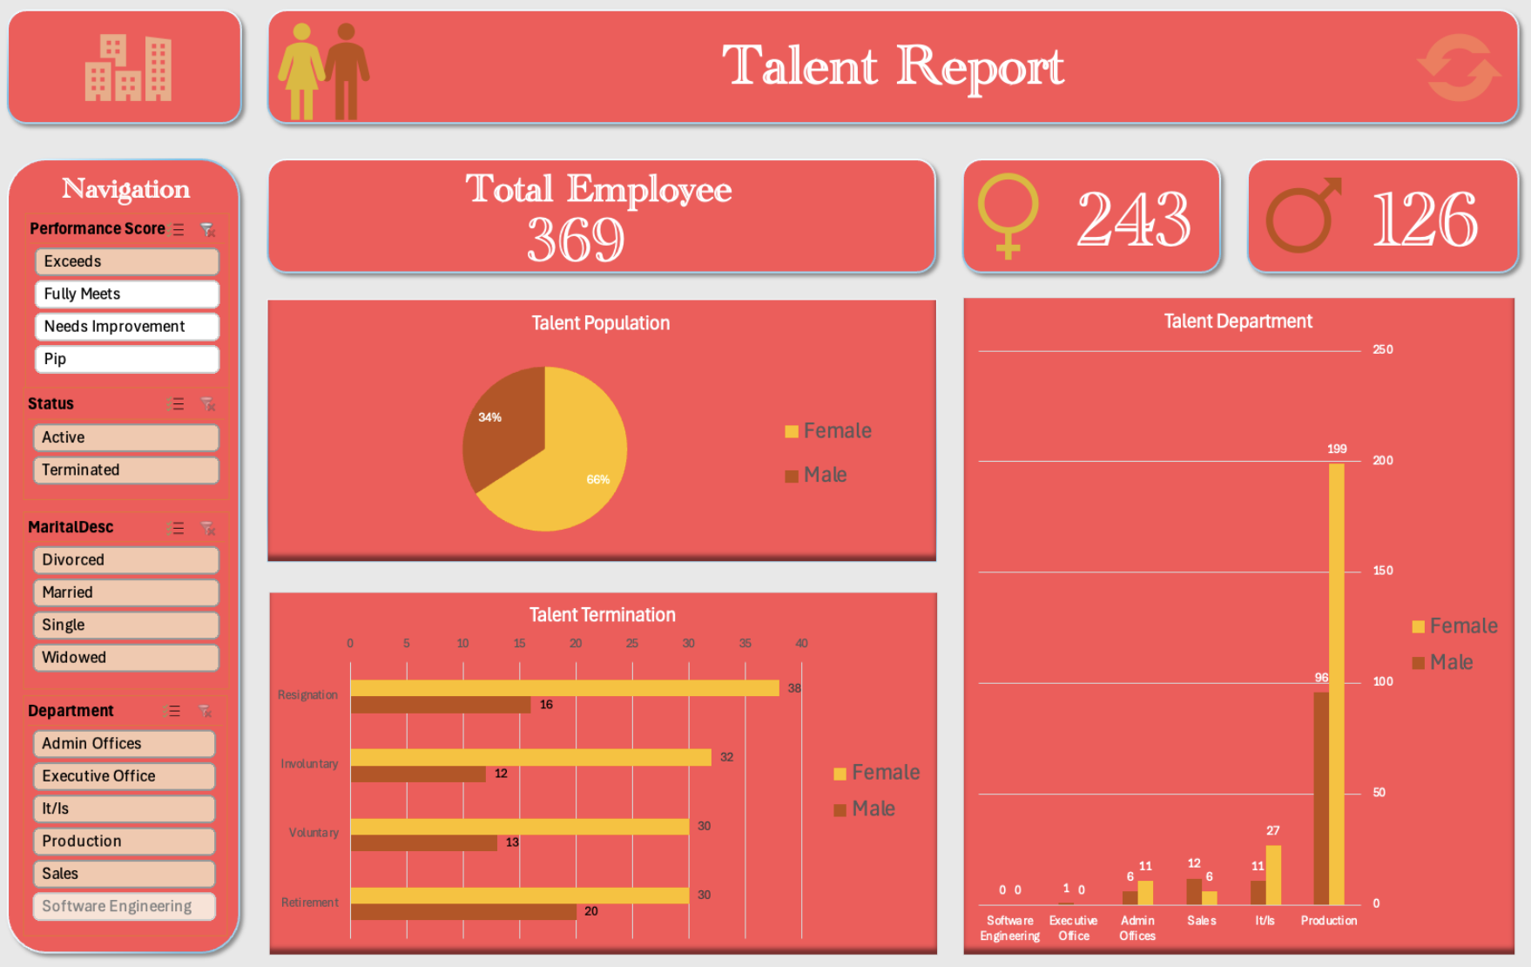
Project Overview
Strategic Regional Growth Analysis
7
HR Workforce Analysis
Tools: Excel
Problem: Leadership wanted to know whether top talent was being placed and promoted where it could have the most strategic impact.
Result: Top performers (top 10%) were concentrated in Production rather than strategic roles, and 0% of executives were female despite 66% of top performers being female.
Recommendation : Targeted STEM recruitment and transparent promotion paths

Slide 8
Background and Problem Statement
Background
Eggs sit at the center of Indonesia's food security picture. Affordable, nutrient-dense, and consumed across every income bracket. Yet prices don't move steadily; they swing sharply around Ramadan, national holidays, and supply shocks, each capable of straining household budgets exactly when demand is highest. This volatility isn't just a market inconvenience. It's a direct challenge to the kind of food resilience SDG 2: Zero Hunger calls for. Since many of these demand-heavy events are predictable in timing. A well-built forecast offers something rare: the chance to prepare ahead of a price shock, rather than absorb it after the fact.
PROBLEM STATEMENT
Can Indonesia's egg prices be forecast reliably enough to support procurement and policy decisions?
Sub-Questions:
What does Indonesia's egg price behavior look like?
How much of price volatility can a statistical model actually predict?
What happens when the forecast is tested against a real, unseen outcome?
Source: World Food Programme (WFP) Global Food Prices dataset.

Slide 9
Data Understanding
WFP Global Food Prices dataset | Source: World Food Programme (HDX) link
Collection method: Officers were deployed to gather direct records from the field
1,847,522
16
4
Rows Observations
Columns / Features
Years
2022–2025
Key Columns
Dimension
date
Dimension
market
Monthly price observation date
Market name (province/city level)
Dimension
commodity
Measure
usdprice
Commodity type
Price per unit in USD

Slide 10
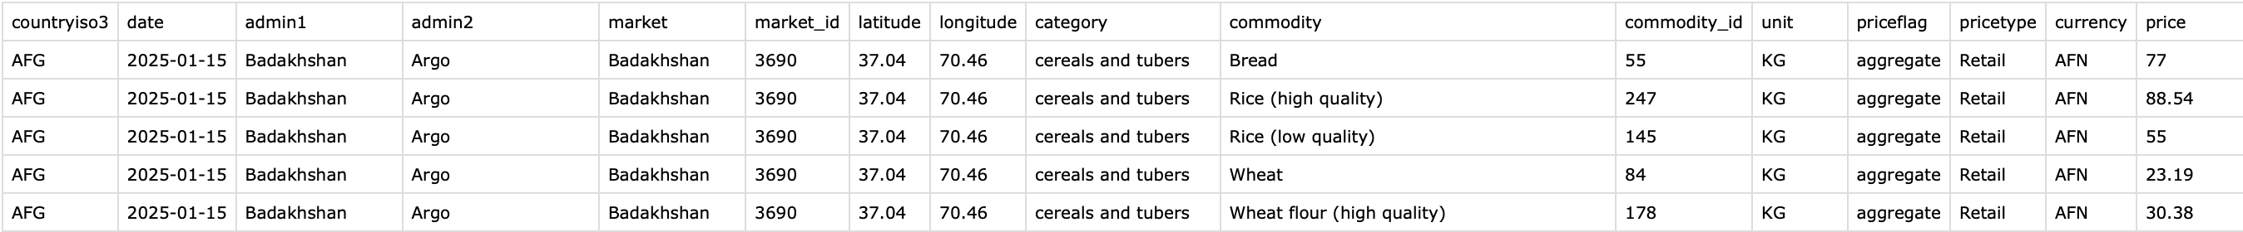
Column | Description
countryiso3 | ISO3 country code
date | Price observation date
admin1 | Province administrative region
admin2 | District administrative region
market | Specific market where price was recorded
market_id | Unique identifier for the market
latitude | Market's geographic latitude
longitude | Market's geographic longitude
category | Broad commodity category
commodity | Specific commodity name
commodity_id | Unique identifier for the commodity
Column | Description
unit | Unit of measurement (KG)
priceflag | Data provenance: actual/aggregate
pricetype | Retail (consumer price) or wholesale (distributor price)
currency | Local currency of the recorded price (e.g., IDR)
price | Price in local currency
usdprice | Price converted to USD (standardizedcomparison)
Dataset Overview

Slide 11



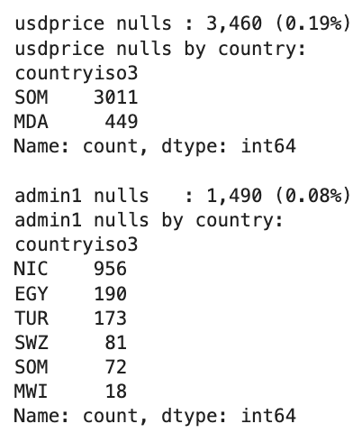
Data Preparation
Data Preparation
Data Quality Findings
01
Import & Inspection
Load the WFP CSV with pandas; check shape, data types, missing values, and duplicates.
Missing Values
Missing values in usdprice and various categorical columns. Handled by imputing 0 for usdprices and “Unknown” for others.
02
Consistency & Standardization
Standardize market and commodity name spelling/casing; confirm unit and currency consistency across records.
Duplicate Rows
0 duplicates found.
03
Data Type Conversion
Consistent Format
The date column is converted to datetime to enable time-component extraction and regime segmentation.
All categorical columns verified consistent.
04
Feature Engineering
New features are created to support analysis and modeling.
05
Monthly Aggregation
Raw price observations are aggregated to a consistent monthly series per market and commodity to stabilize the regime-detection and forecasting pipeline.
Notes:
Insert df info

Slide 12
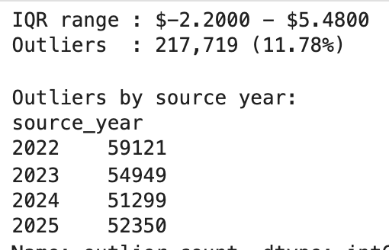
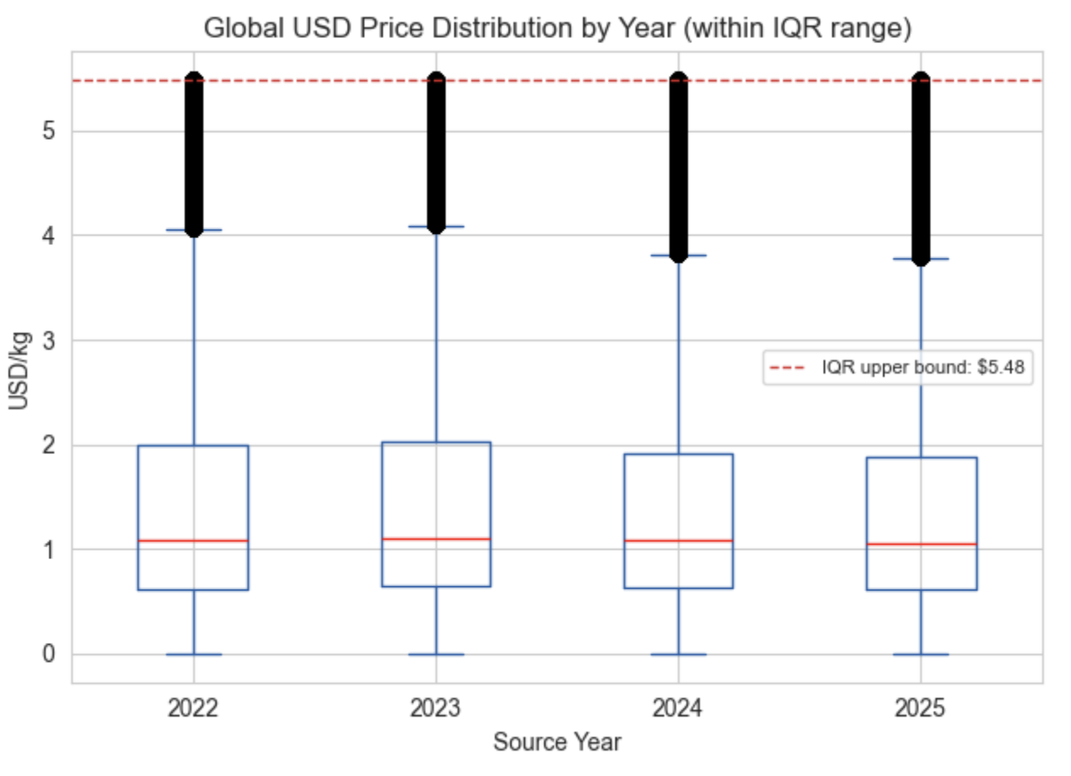
Global Outlier
Exploratory Outlier Detection
The IQR method is applied globally first (across all countries and commodities) to understand overall data quality, using standard IQR bounds (Q1 − 1.5×IQR, Q3 + 1.5×IQR).
Outlier range %:
11,78% of global rows flagged
Decision
Outliers are flagged, not removed.
Reason
These outliers represent genuine price extremes across different countries and commodities, not data entry errors. Removing them would distort cross-country comparisons and hide legitimate market events.
Notes:
Change to extreme price

Slide 13
Exploratory Data Analysis
Global
Indonesian deep-dive

Slide 14
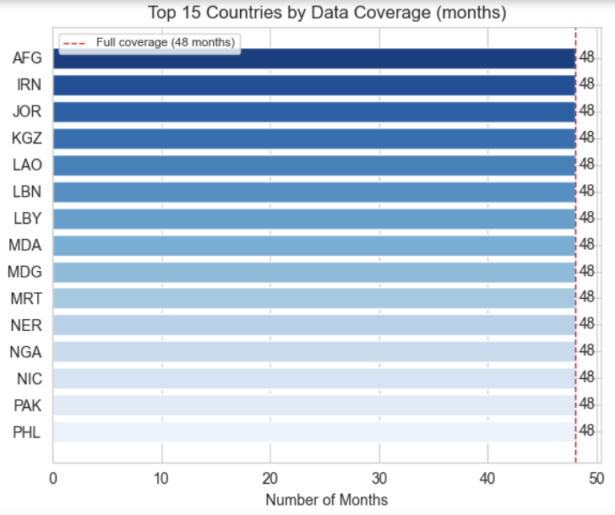
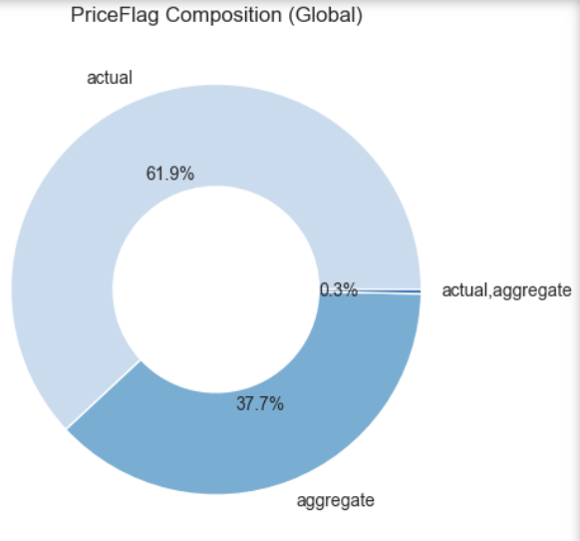
Global Overview
Global Data Coverage
Data coverage and observation type were examined across all countries, since inconsistent coverage or a high share of estimated (non-actual) data would undermine reliability at the country level.
Coverage & Priceflag finding
Top 15 countries show full 48-month coverage. The complete training window this analysis requires. Countries below this threshold were deprioritized during country selection.
61.9% of global observations are actual (directly field-observed), 37.7% are aggregate (WFP-estimated), and 0.3% are a mix of both.
Why it matters
Full coverage and a healthy share of directly-observed data are two separate quality dimensions. A country could have complete monthly coverage but be entirely aggregate (estimated), or vice versa.

Slide 15
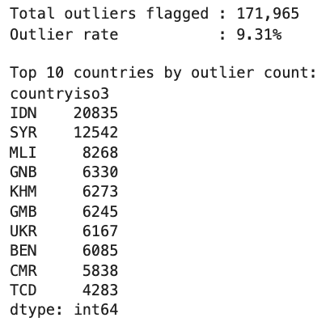
Outlier by Country
Outlier Detection
The IQR method is grouped by countries (across all commodities), using standard IQR bounds (Q1 − 1.5×IQR, Q3 + 1.5×IQR)
Results
171,965 outliers flagged (9,31% outlier rate)
By Country
Indonesia (IDN) sits at the top of the list with 20,835 flagged outliers nearly double Syria’s 12,542 (2nd), suggesting an unusually wide gap in commodity pricing that makes it worth further investigation.
Decision
Outliers are kept, not removed.
Reason
Outliers represent genuine price extremes, not data entry errors. Removing them would hide the legitimate market events.
Indonesia had the highest absolute number of flagged observations. Because countries contain different numbers of records, this was treated as an exploratory signal.

Slide 16
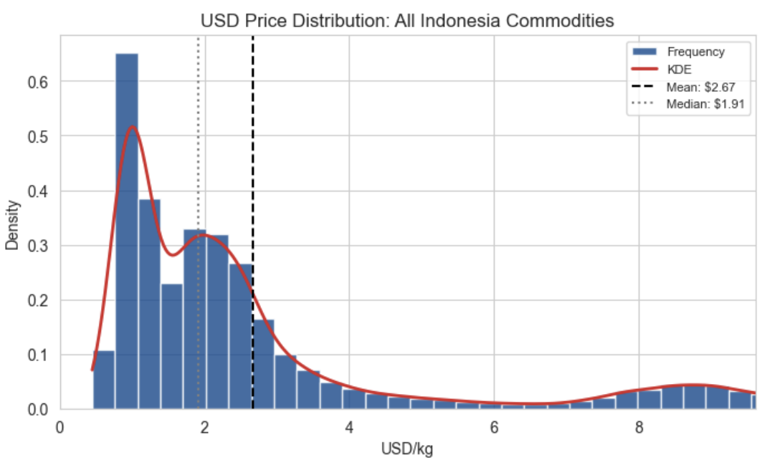
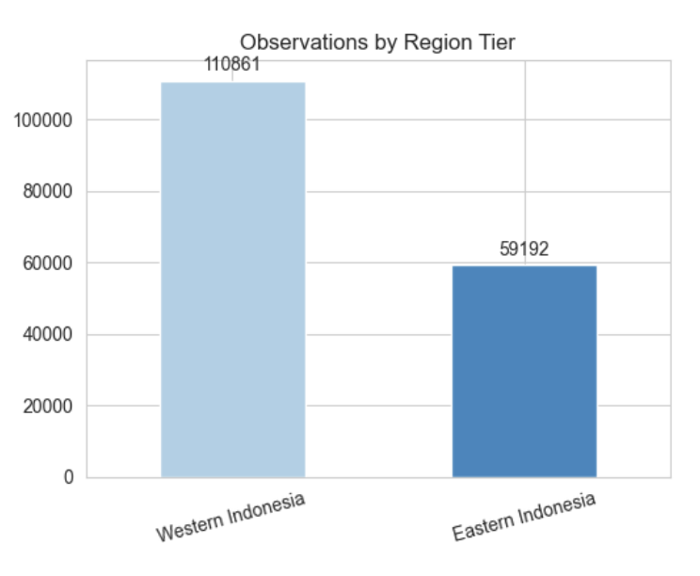
Indonesia’s Commodity Overview
Distribution Analysis
Price distributions were examined across Indonesia’s commodities using histogram.
Finding
Distribution is right-skewed with a small number of high-priced commodities (primarily beef) pulling the overall average upward.
It means most commodities sit at the lower end of pricing, with a few more expensive commodities.
Technical Consequences
Machine learning models would likely capture the lower side while underestimating the minority.
Regional Data Density
Observation counts are uneven across Indonesia: Western Indonesia accounts for 110,861 observations vs. Eastern Indonesia's 59,192 (roughly a 2:1 ratio). This reflects Western Indonesia's denser market network (more provinces, more populous regions) rather than a data quality issue.
Notes:
It shows gap because most of the commodity sits at the lower end whereas some more pricey. Technical side → model will mostly capture the lower side

Slide 17
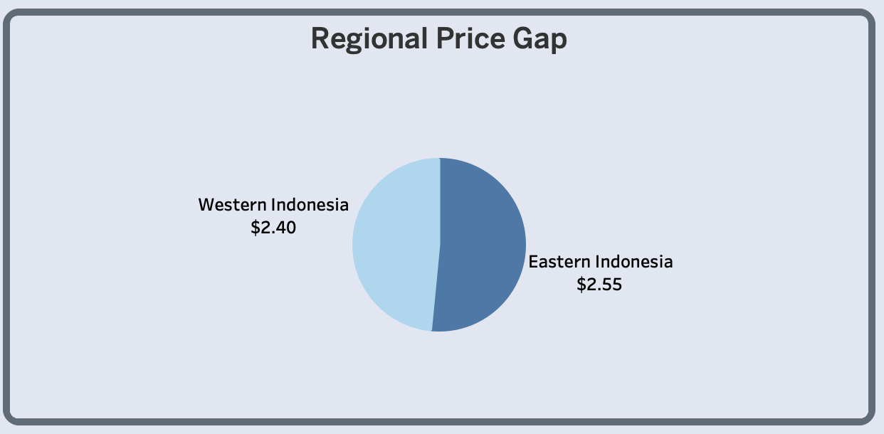
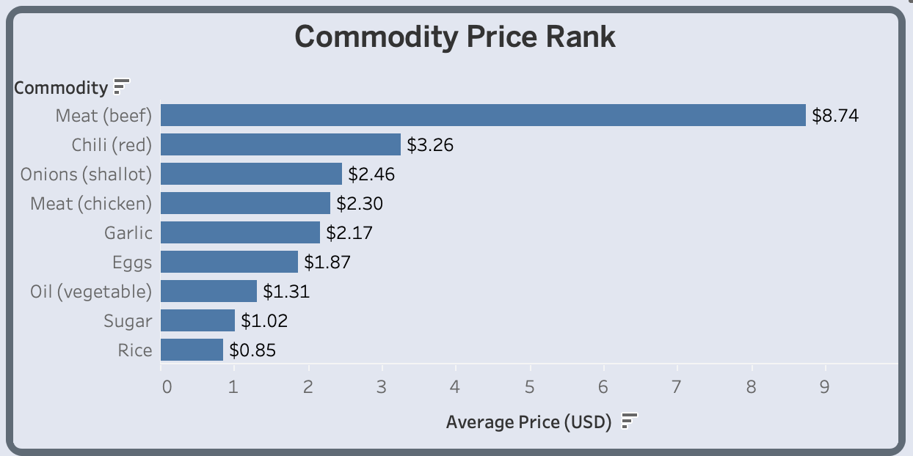
Indonesia’s Commodity Overview
34
9
220
Provinces
Commodity
Market
Regional Price Gap
Eastern Indonesia averages $2.55, roughly 6% higher than Western Indonesia's $2.40, a pattern consistent across the commodity basket, not isolated to one product. This reflects longer supply chains and higher logistics costs across Indonesia's eastern archipelago.
Commodity Price Rank
This rank reflects more of pricing gaps across commodities in Indonesia where Beef sits in a tier of its own, priced over 2.5x higher than the next commodity (Chili at $3.26).

Slide 18
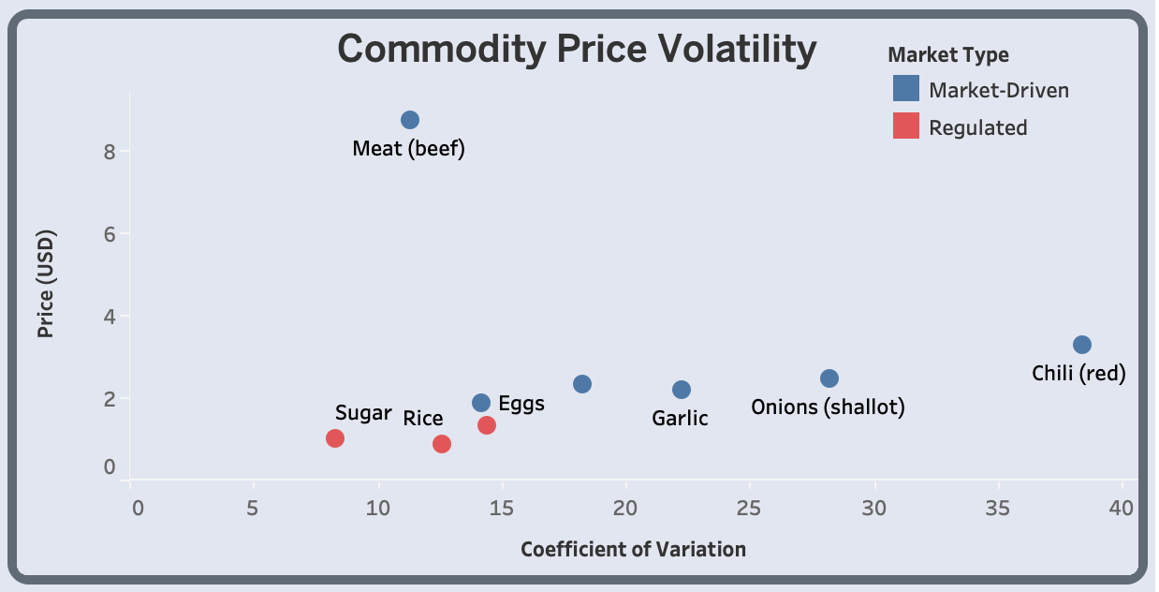
Indonesia’s Commodity Overview
Commodity Price Volatility
Volatility (Coefficient of Variation) varies dramatically across Indonesia's commodity basket. Eggs sit at a notably low CV (~14%, less than 20%) among market-driven commodities, positioned close to the regulated cluster despite having no government price intervention.
Why this matters
Regulated commodities (Sugar, Rice, Oil) show artificially suppressed volatility due to price controls, not genuine market stability.
Among the unregulated market-driven commodities (blue), eggs are the most stable. Meat (beef) is generally seen as a premium commodity due to its high price.
Therefore, this combination (low volatility without price regulation) makes eggs the cleanest available signal for further analysis in this dataset.
Notes:
Explain coefficient of variation (volatility)

Slide 19
Variable Selection
Criterion | Rice | Sugar | Oil | Garlic | Onions | Chilli | Chicken | Beef | Eggs
No price regulation |  |  |  | ✔️ | ✔️ | ✔️ | ✔️ | ✔️ | ✔️
Low volatility | ✔️ | ✔️ | ✔️ |  |  |  | ✔️ | ✔️ | ✔️
Broad consumption | ✔️ | ✔️ | ✔️ | ✔️ | ✔️ | ✔️ | ✔️ |  | ✔️
Selected |  |  |  |  |  |  |  |  | ✅
Selection Summary
Indonesia is selected as the country of focus with 220 markets across 34 provinces, and clear food security relevance with a notably high global outlier count (the highest of any country) further signaling a market with frequent, genuine price volatility worth investigating in depth.
Eggs are the only commodity passing all three selection criteria simultaneously: no government price intervention, low volatility, and broad consumption across income levels. This combination makes eggs the most methodologically sound choice for further analysis.
Chicken meets similar criteria and was a close second candidate. Eggs were ultimately selected for their marginally lower volatility and broader relevance, relatively affordable and widely consumed protein but chicken would be a reasonable extension for future analysis.
With both country and commodity formally selected, the remainder of this analysis focuses exclusively on Indonesia's egg market.
Notes:
Check for broad consumption source

Slide 20
Analysis Phase
Indonesia’s Egg Commodity

Slide 21



Objectives
Forecasting
Understand Price Behavior
Identify any price patterns in Indonesia's egg market from the WFP dataset.
Build and compare forecasting models to find the most reliable one for egg prices.
Deliver Data-Driven Recommendations
Translate price patterns and regime shifts into recommendations for commercial and policy use.

Slide 22
Key Feature Engineering
Feature Name | Formula | Notes
year, month | df['date'].dt.year / .month | Time components for trend and seasonal analysis
is_outlier | Per-country IQR method on usdprice | Flags statistical outliers
region_tier | Province mapped to Eastern/Western Indonesia | Enables regional price comparison

Slide 23
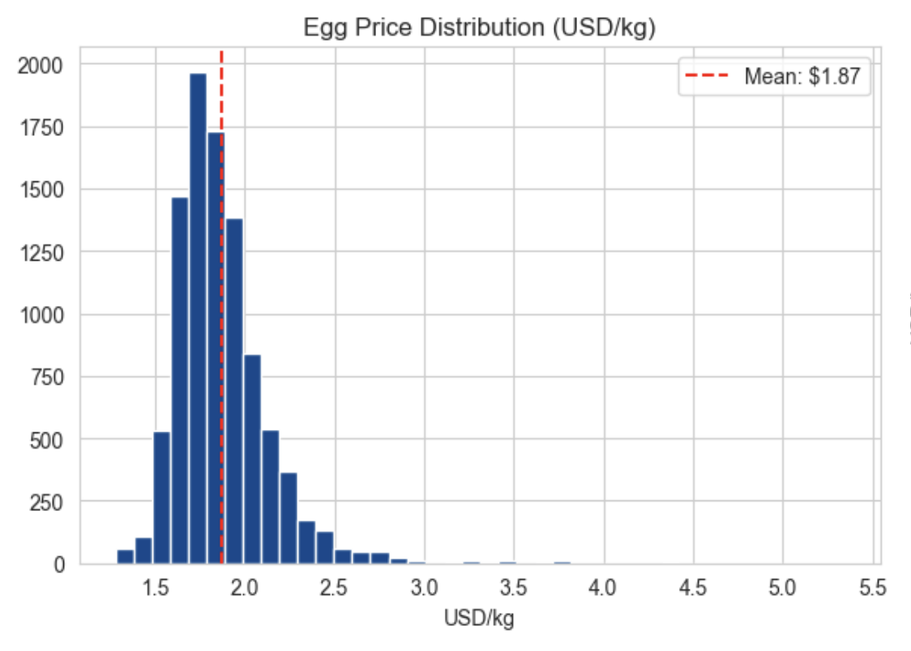
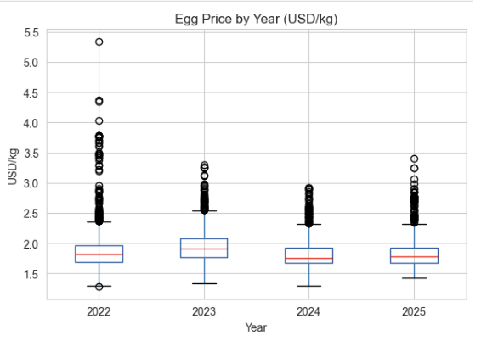
Indonesia’s Egg Price Distribution
Price Distribution
Egg prices are right-skewed, signals occasional sharp price spikes rather than a normal spread. A first hint that the market has periodic shocks layered on a stable baseline.
Outliers
The typical price stayed steady from 2022 to 2025, but every single year had a few of unusually high spikes. 2022 saw the most extreme jumps, with prices reaching as high as $5.5/kg in some markets.
By 2024–2025, those spikes were still happening, but they weren't nearly as dramatic. It’s a sign that the market's price shocks have been calming down.
Why it matters
This uneven pattern matters for how the forecast is built. Treating egg prices as if they follow a simple, even curve would underestimate how sharp a price spike can get. And a plain trend line wouldn't pick up on something important: each year's shocks have been getting a little less extreme than the last. It reinforces the case for a regime-aware model that separates the stable baseline from transient shocks.
Notes:
Not normally distributed, it means it’s imbalanced

Slide 24
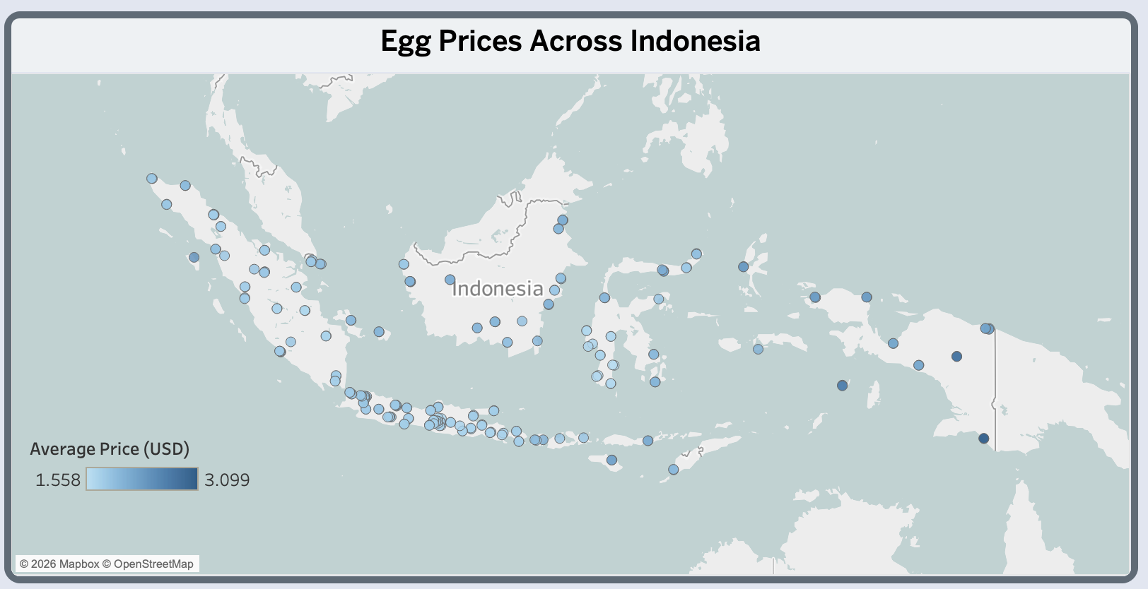
Indonesia’s Egg Market Overview
Regional distribution
Average prices vary meaningfully across Indonesia's markets, Coverage spans Sumatra, Java, Kalimantan, Sulawesi, and Papua, with denser clusters in western Indonesia and a sparser, comparatively higher-priced set of markets further east. This may be reflected by different local production levels, market concentration and infrastructure in this eastern region.
Why it matters
A market in Java and a market in Papua might be paying very different prices for eggs on the exact same day. For a business, that means relying on the national average alone could mean paying too much or too little, depending on where the eggs come from.
For food security, the places paying the most for eggs (mostly in eastern Indonesia) are also the farthest from the supply routes that could bring prices down.

Slide 25
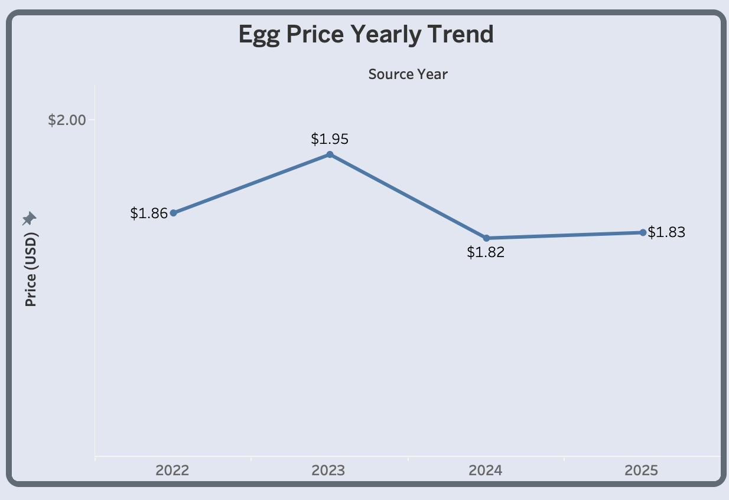
Egg’s Price Trend
Overview
Egg prices in Indonesia followed phases between 2022 and 2025:
Gradual rise (2022 - 2023): prices climbed steadily to a peak of $1.95/kg
Sharp correction (2023 - 2024): prices fell back down as the market absorbed the shock
Stabilization phase (2024 – 2025): prices stabilized post crisis
The 2023 peak coincides with a corn feed cost crisis. Corn is the primary input for poultry feed in Indonesia, and elevated global corn prices combined with El Niño-driven supply pressure pushed egg production costs sharply upward.
This isn't random noise. It's a genuine structural break. A model that doesn't account for this shift risks either overreacting to the spike (assuming prices will keep rising) or underreacting to the new stable baseline. This motivates the regime-aware approach covered later.
Source
All About Feed (2024). Indonesia: Poultry industry crisis triggers feed market turbulence. LINK
Notes:
Highlight the shock in 2023

Slide 26
Split Ratio & Stationarity Test
Split | Train Months | Test Months | Train End | Test Start | Seasonal | MAPE
70/30 | 33 | 15 | 2024-09 | 2024-10 | (0, 0, 0, 12) | 2,21%
75/25 | 36 | 12 | 2024-12 | 2025-01 | (0, 0, 0, 12) | 5,53%
80/20 | 38 | 10 | 2025-02 | 2025-03 | (0, 0, 0, 12) | 2,64%
85/15 | 40 | 8 | 2025-04 | 2025-05 | (0, 0, 1, 12) | 4,22%
90/10 | 43 | 5 | 2025-07 | 2025-08 | (0, 0, 1, 12) | 2,40%
Split Ratio Selection Summary
70/30, 75/25, and 80/20 all settled into a non-seasonal (0,0,0,12) fit. Their MAPE looks competitive, but a model that dropped seasonality means it stopped trying to capture the yearly egg price cycle at all. Only two splits (85/15 and 90/10) kept the seasonal pattern in the model. 90/10 shows the lowest error (2.40%), but its test window is only 5 months long. 6 months is the minimum needed for a fair test, so that low number is more likely luck than a true reflection of how well the model performs.
Selected: 85/15
40 training months and an 8-month test window is long enough to hold up and still confirms a genuine seasonal SARIMA fit. Its 4.22% MAPE is higher than 90/10’s, but it’s the honest number, earned by proving seasonality rather than by a lucky window.
Stationarity Test
ADF test on the training data: p = 0.0436 which shows borderline stationary.
2023 shock motivated regime-aware modeling over a single fixed-parameter approach.
Notes:
More research on the tech side. Stationarity impact

Slide 27
Model Comparison
Model | MAPE | Notes
Baseline (MA-3) | 1,63% | Simple moving-average benchmark
SES | 2,24% | Best simple statistical model. Tracks recent price level closely
SARIMA (standard) | 4,22% | Fits one pattern to the whole series, missing the 2023 regime shift
Holt-Winters | 4,41% | Seasonality zeroed out
Prophet | 4,96% | Overfitted seasonality
Holt-Winters Trend | 8,95% | Trend overshoot, no seasonal component
Regime-aware Adaptive SARIMA | 1,65% | Adapts to abnormality/regime shifts
Model Selection Summary
The baseline achieved the lowest MAPE at 1.63%. Regime-aware adaptive SARIMA performed nearly as well at 1.65% and was selected for its structural awareness rather than superior point accuracy.
Every standard statistical model (SARIMA, Holt-Winters, Prophet, Holt's Linear) performed worse than Baseline because none of them account for the regime shift caused by the 2023 feed cost crisis.
Regime-Aware Adaptive SARIMA closes that gap by detecting and adapting to the structural breaks in the data rather than assuming one fixed pattern across the entire series. It is selected not because it beats Baseline outright, but because it's the only model that combines Baseline-level accuracy with genuine seasonal and structural awareness, making it the more reliable choice for forecasting beyond the training window.
Notes:
Regime aware sarima is based on abnormality

Slide 28
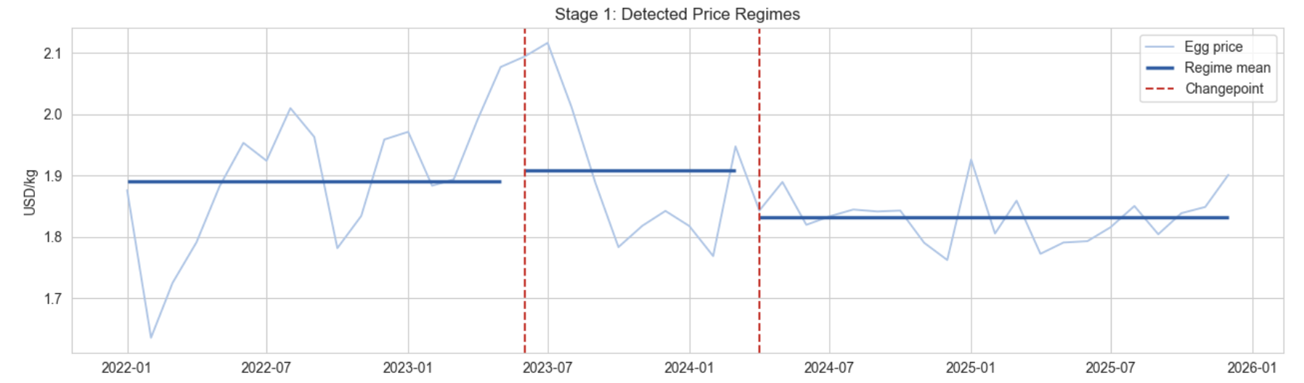
Advanced Modeling : Regime Aware Forecasting
Test data starts in May 2025
Regime Detection
The price series was segmented into three regimes based on two structural breaks corresponding to the corn feed crisis and post-crisis normalization.
Each regime shows a distinct mean price level, confirming the market didn't move on one continuous trend, but shifted between discrete phases.
Changepoints were detected using training data only, while the test period remained unseen until evaluation.
Adaptive Model Limitation
The adaptive model doesn't predict a break before it happens, no model can. Its advantage comes from correcting faster once new data confirms a shift has occurred, rather than staying anchored to an outdated regime. This is the operational case for walk-forward forecasting: refit monthly as new prices are published, rather than committing to a single static model.
Model | MAPE
Static | 4,22%
Adaptive | 1,65%
Error reduction | ~61%

Slide 29
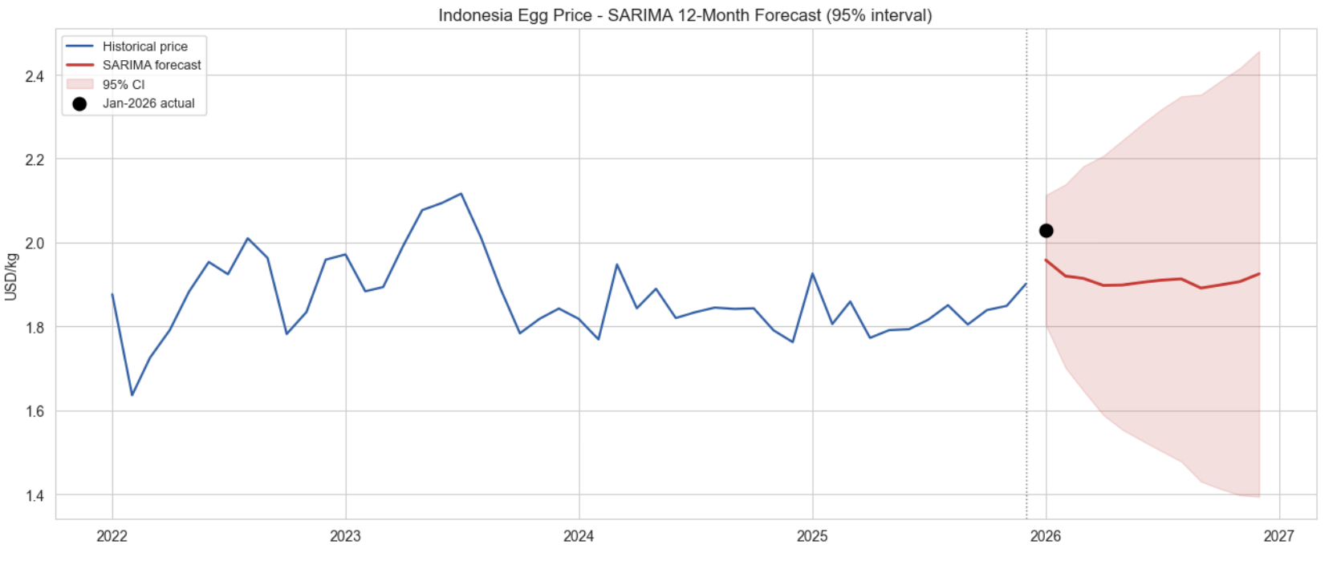
Final Forecast (Using Regime Aware Approach)
12-Month Forecast
The final regime-aware SARIMA model projects egg prices through January to December 2026.
Uncertainty Widens the Horizon
The 95% confidence interval starts narrow in January and widens substantially by December. A mathematically expected property of forecasting further from the last known data point, and a genuine signal: confidence in month 1 is much higher than confidence in month 12.
January 2026: Forecast vs Actual
The gap is explained by Ramadan falling in February 2026, the earliest date in the training dataset's history, pulling pre-Ramadan demand into January for the first time.
No model trained on 2022–2025 history had precedent for this specific lunar calendar shift, but the model's uncertainty band was wide enough to still capture the actual outcome.
Notes:
Add why no attempt in sarimax with exogenous variable (ramadan)

Slide 30
Dashboard Outputs
2 Interactive Dashboards · Tableau Public
Indonesia’s Commodity Overview
Forecast

Slide 31
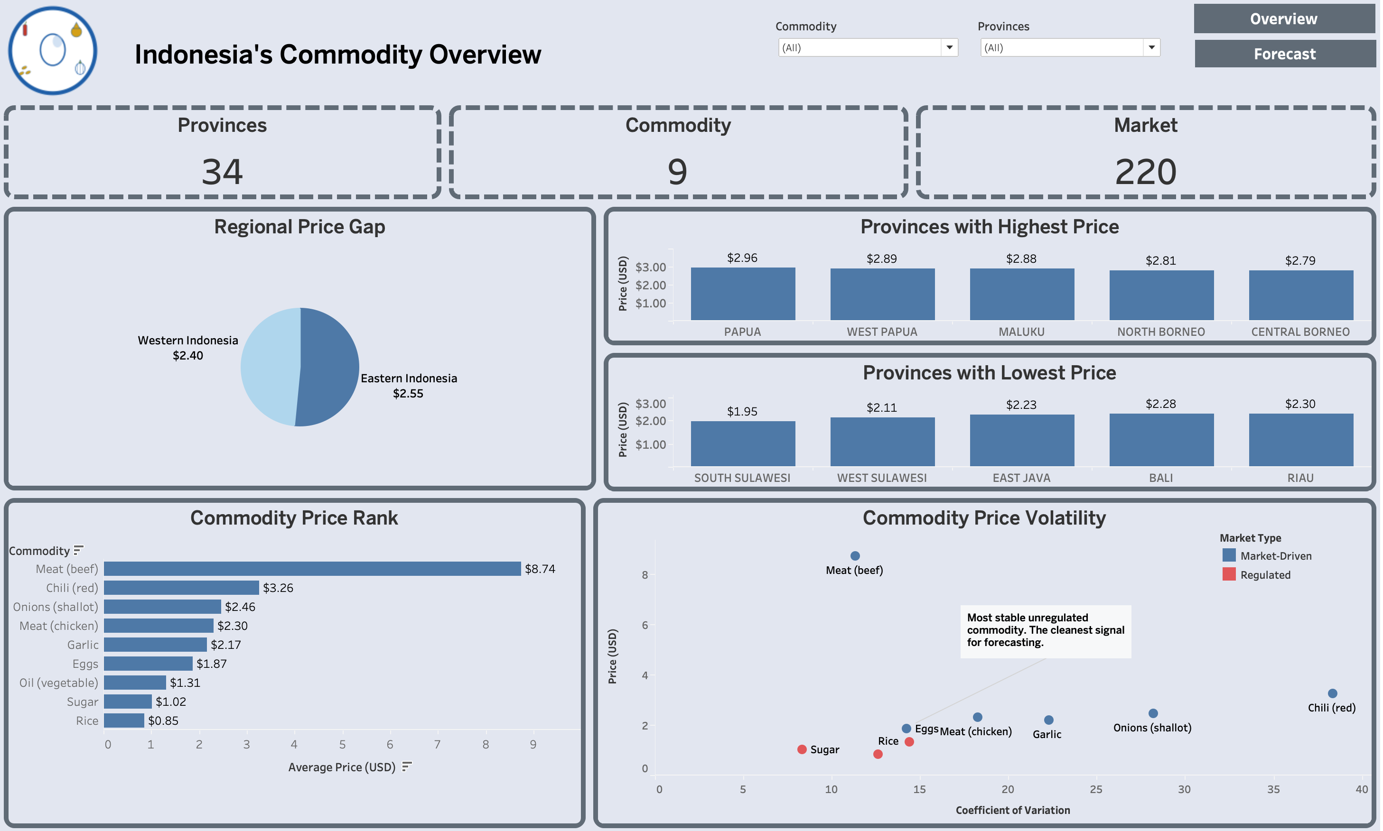
Dashboard 1: Indonesia’s Commodity Overview

Slide 32
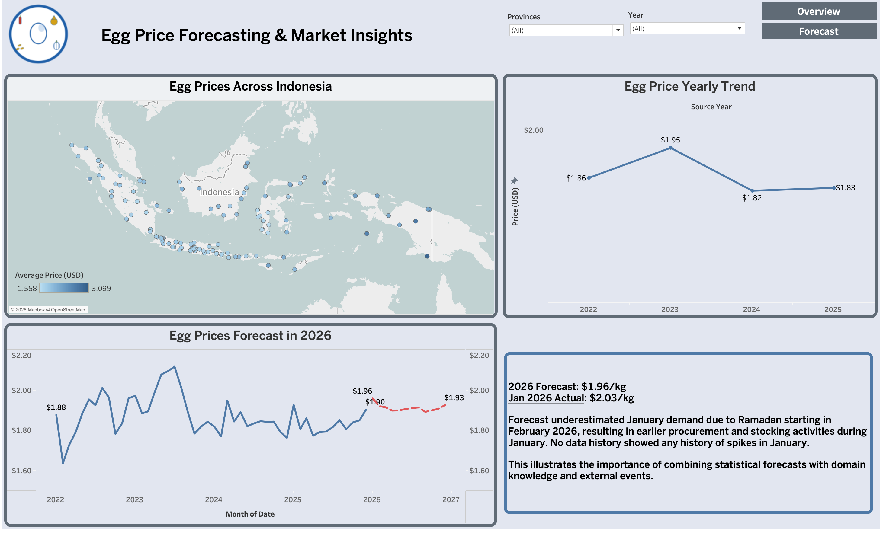
Dashboard 2: Egg Forecast
Note: the dashboard version displays the point forecast only for readability. The full model output, including the 95% confidence interval already shown earlier.

Slide 33
Conclusions & Recommendations
Commercial Recommendation
Use the forecast as an early-warning tool for inventory planning, particularly before predictable high-demand periods. Build a buffer stock around those periods each year. (like Ramadan, Christmas, etc.)
Regional retailers across the Gulf already apply this principle, pre-positioning inventory weeks ahead of Ramadan rather than reacting to shortages after they occur (The Media Line, 2026).
01
Egg prices in Indonesia moved through two very different chapters over the past four years: a real market shock in 2023 that no model saw coming, followed by a calmer stretch where fancy forecasting tools didn't add much value over simply looking at recent prices.
After testing different approaches, the clearest lesson wasn't which one "won”. It's that the right tool depends on the moment. Simple methods work fine when the market is calm, but a smarter, adaptive approach pays off specifically when things are shifting, reducing error by approximately 61% compared with static SARIMA during the 2023–2024 transition.
The January 2026 check-in taught a similar lesson. The range of possible outcomes the model predicted still covered what happened. The gap came down to Ramadan falling earlier than it ever had in the four years of data used to build the model, pulling holiday demand into a month that had never seen a spike before. The point forecast missed the January increase, although the actual price remained within the uncertainty level.
That's exactly why statistics alone isn't enough here. A model can learn from the past, but it can't know what it's never been shown. Recognizing that gap, and stepping in with real-world judgment when it appears, is still a human job.
Policy Recommendation
Extend this regime-detection approach to other unregulated staples. Government agencies can combine the forecast, uncertainty range and regional price differences with current supply information to identify where intervention may be needed, such as coordinating distribution, monitoring potential shortages or preparing market-stabilization measures.
This direction is backed by emerging research: a 2026 Indonesian study on multi-commodity food price forecasting ahead of Eid Al-Fitr independently confirms that Indonesian food prices require dedicated, calendar-aware forecasting around Ramadan (Murtani, Kobi, & Imelda, 2026).
02
Notes:
Add links for the journal links

Slide 34
Reflection
01
What this dataset cannot answer
With only 4 years of data and just one major price shock, we can't cleanly tell apart "this happened because of Ramadan" from "this happened because of the 2023 feed crisis" as they overlapped in the only window we had. We'd need several more years of data to separate the two properly.
02
What changed during the analysis process
We started out trying to build the most advanced model possible. A failed attempt to bake Ramadan directly into the model (which made things much worse) also pushed the final answer toward a human-in-the-loop approach instead of a purely statistical one. The initial pipeline contained data leakage in changepoint detection, so the process was corrected to use training data only and all test results were recalculated.
03
What still needs to be validated?
We've only checked the forecast against one real month so far (January 2026). More months are needed to know if this was a one-off or a pattern. It's also worth checking whether other everyday foods (like chicken), not just eggs, show the same Ramadan-driven blind spot.

Slide 35
Q&A

