Slide 1
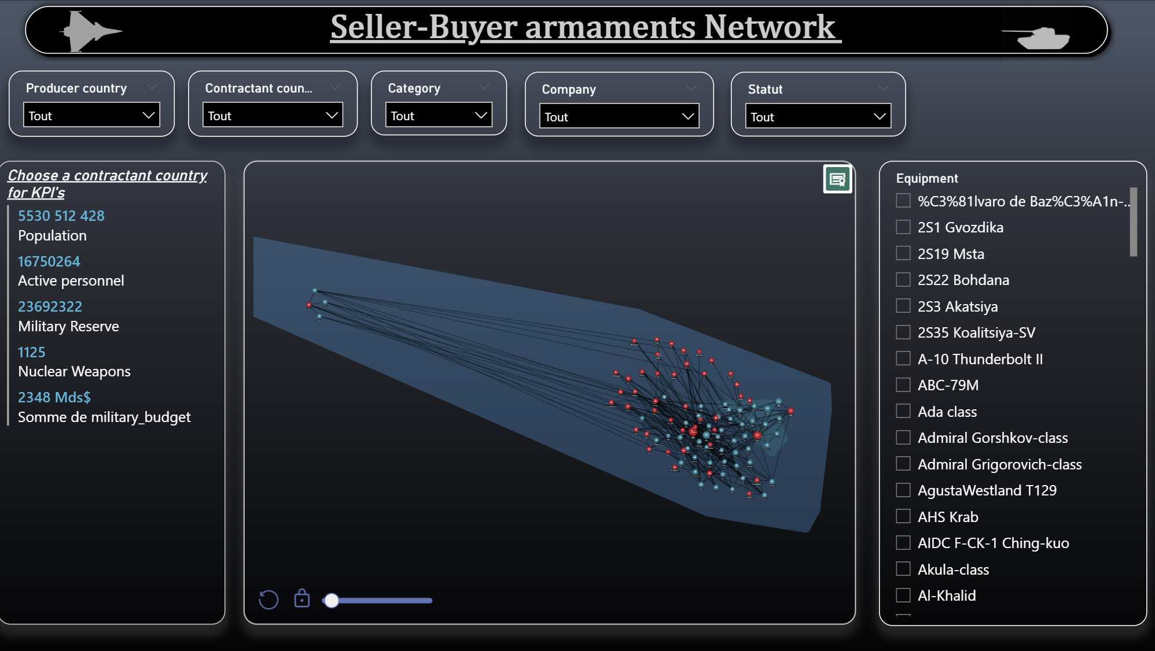

Slide 2
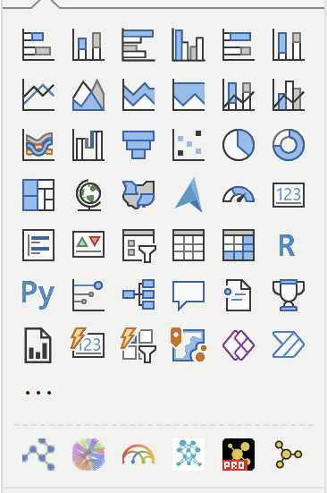
Seller-Buyer armaments Network Presentation
Slicers You can choose: - producer country - contractant (or buyer) country
Category of equipment
Equipment
Company
Statut (if the equipment is active or not)
Network grap developed by powerviz
KPI panel:
To see country specific information, click on « contractant country » slicer. Then we can see different number such as Population, active personnel, military reserve etc…

Slide 3
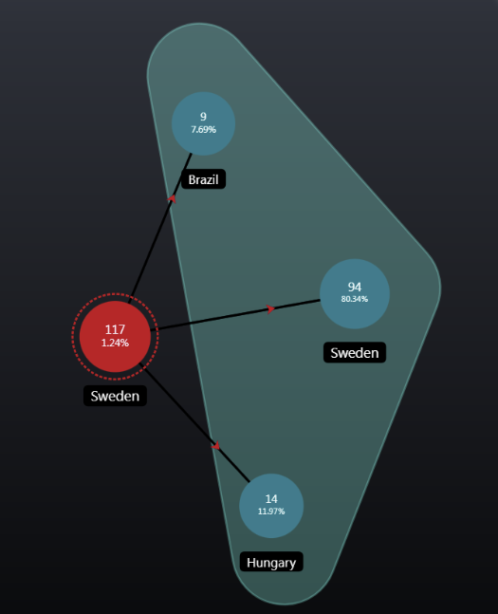
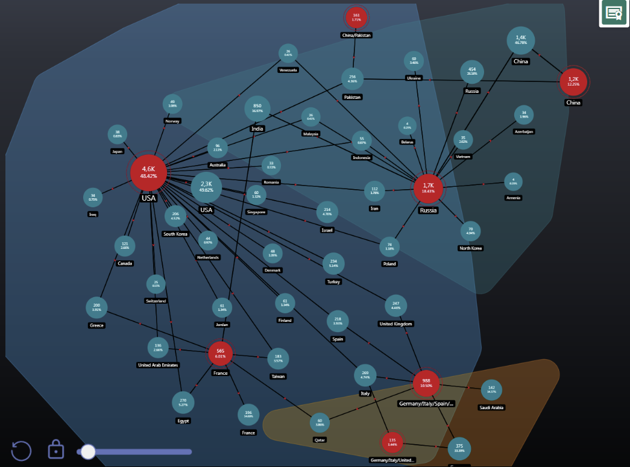
Use case : Multirole
Multirole Category Network Overview
This visualization displays our network when the multirole category is selected:
🔴 Red nodes represent producer countries
🔵 Blue nodes represent buyer countries
⚫ Black links indicate trade flows between producers and buyers
Each node shows the quantity of equipment sold or purchased between countries. These quantities dynamically update based on slicer selections.
☁️ Cluster Visualization
The visuals also highlight clusters, represented by different colored “clouds,” which group countries based on shared trade relationships.
The multirole producers featured in this network include:
USA
China
China/Pakistan
Russia
France
Germany/Spain/Italy
Germany/UK/Italy
Sweden
For example, China and Russia appear in the same cluster because Russia exports aircraft such as the Sukhoi Su-30 and Su-35 to China.
Meanwhile, the USA occupies a central position in the network and shares its cluster (shown in blue) with France, as both countries export multirole equipment to several common buyers—such as India, Egypt, and the UAE.

Slide 4
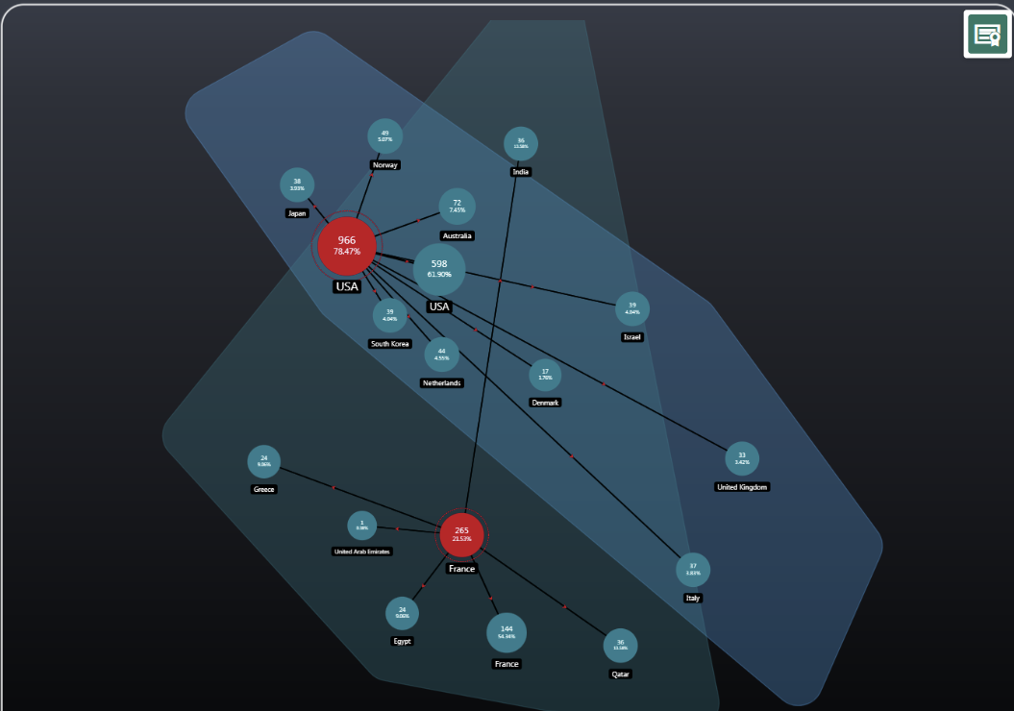
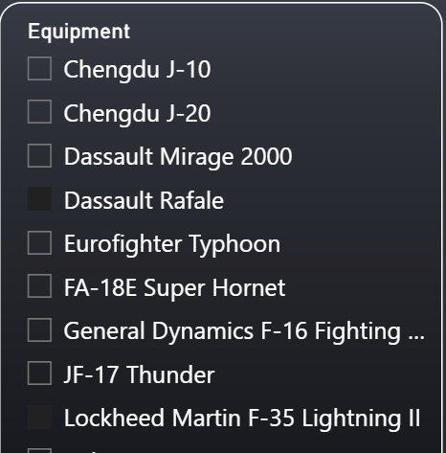
Zooming In: From Strategic Alliances to Direct Competition
In the previous slide, we observed that France and the USA share several common buyers when we look at the aggregated multirole category. This overlap highlights strategic alignment and alliance-building between the two countries, as they tend to export to similar partners.
However, when we narrow the focus to two specific multirole aircraft—Dassault Rafale (France) and Lockheed Martin F-35 (USA)—the picture changes.
Despite both being advanced multirole platforms with comparable capabilities, each is sold to distinct sets of countries, revealing a clear competitive dynamic between the two manufacturers.
🌐 What the Network Reveals
This network visualization provides two key insights:
Strategic integration and alliance clustering: Countries grouped by shared defense relationships and procurement patterns.
Commercial competition: When specific equipment is selected, the network exposes rivalry between manufacturers and exporting nations.

Slide 5
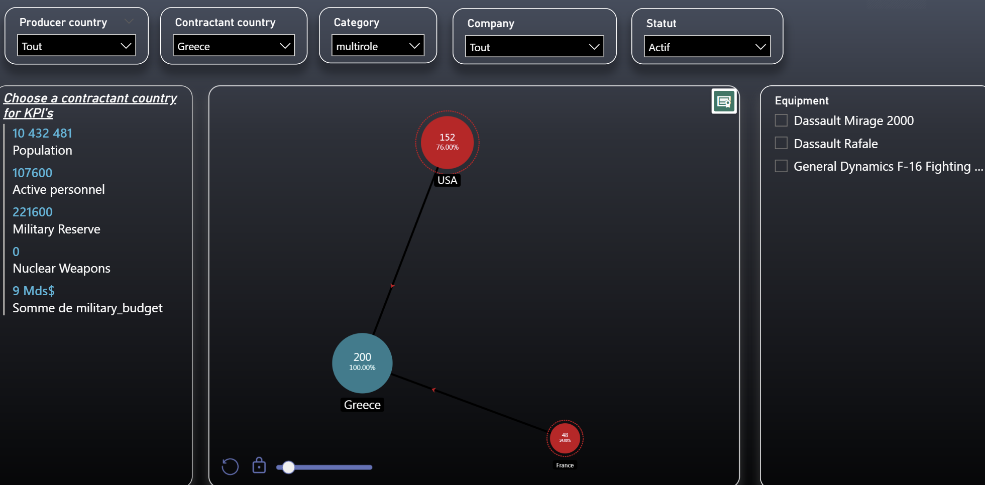
Use case : Multirole
Buyer = Greece

Slide 6
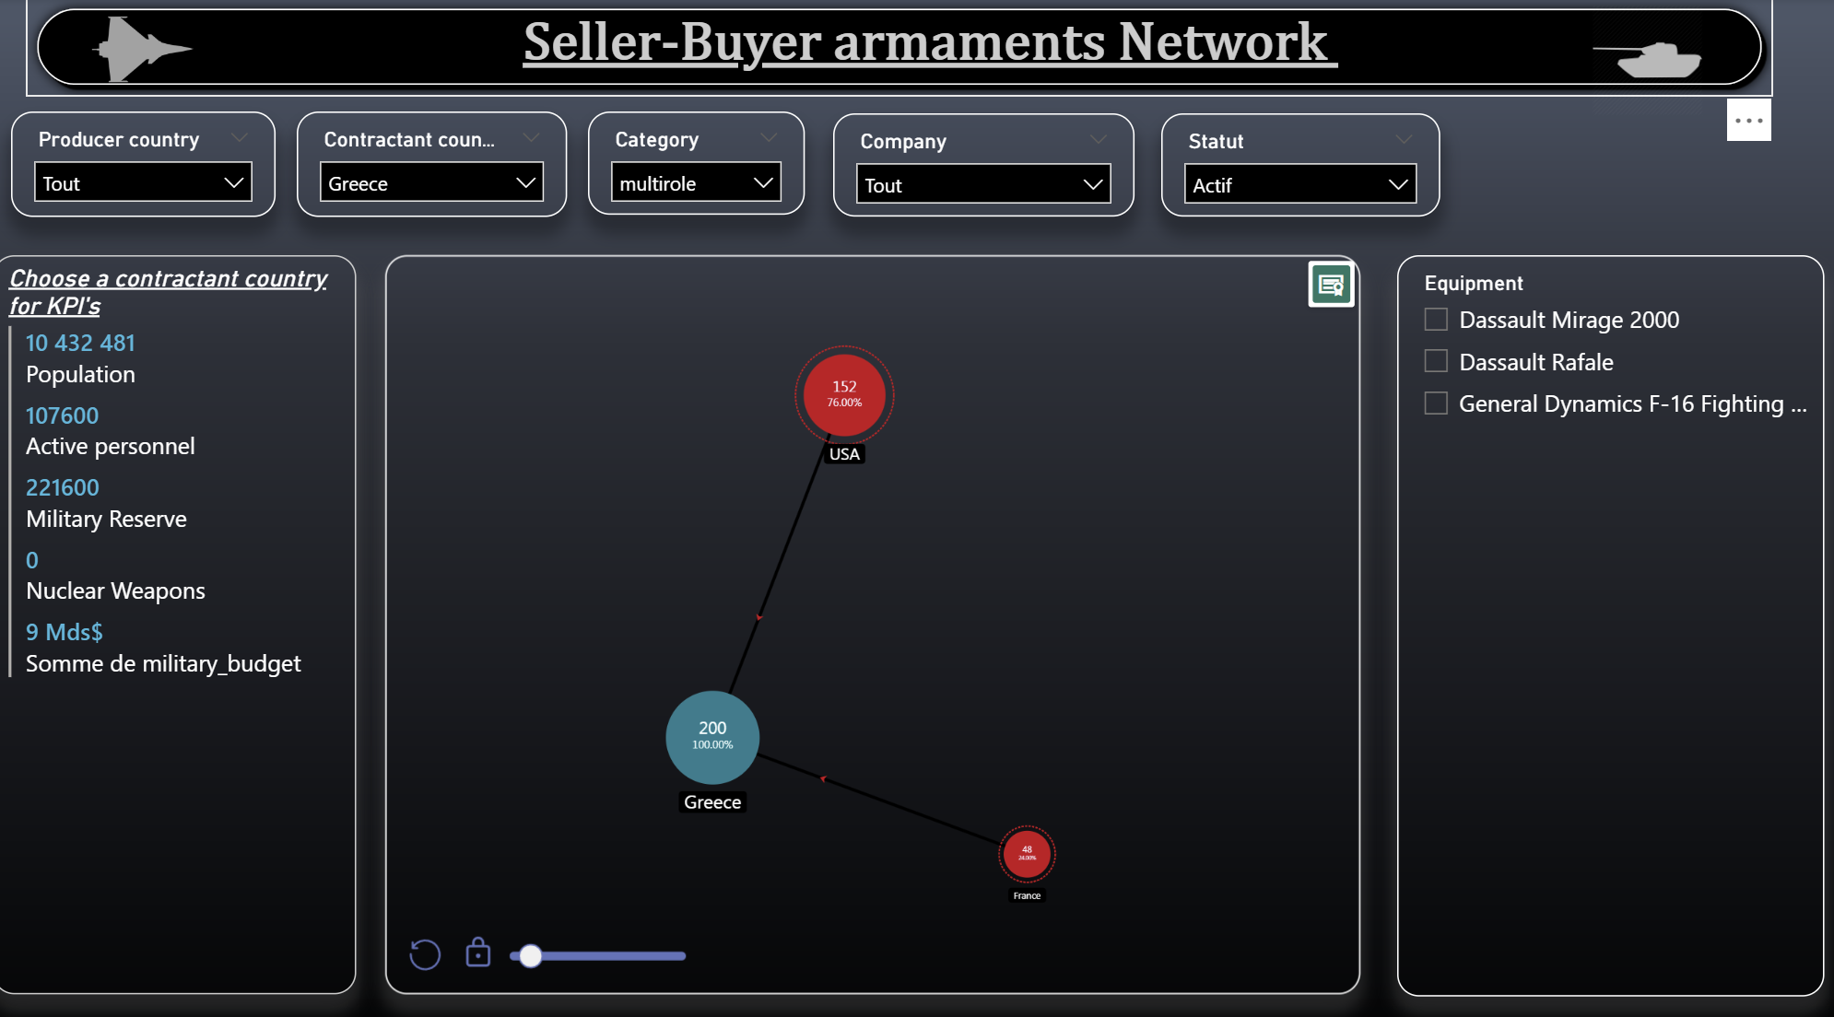
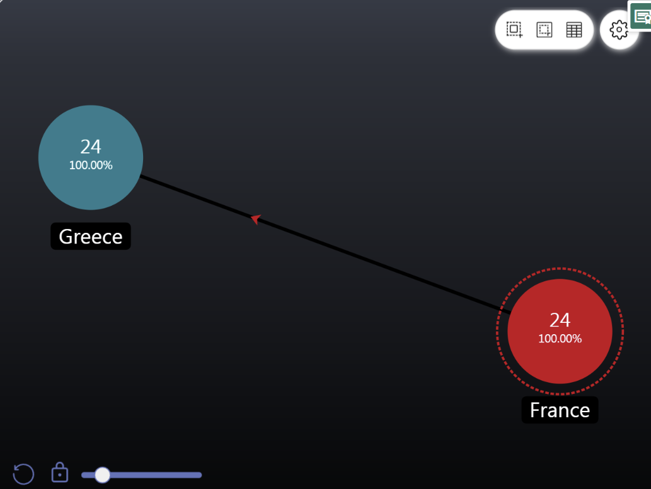
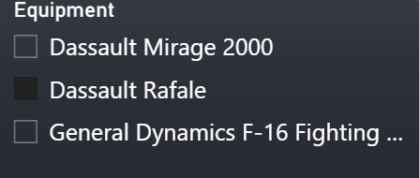
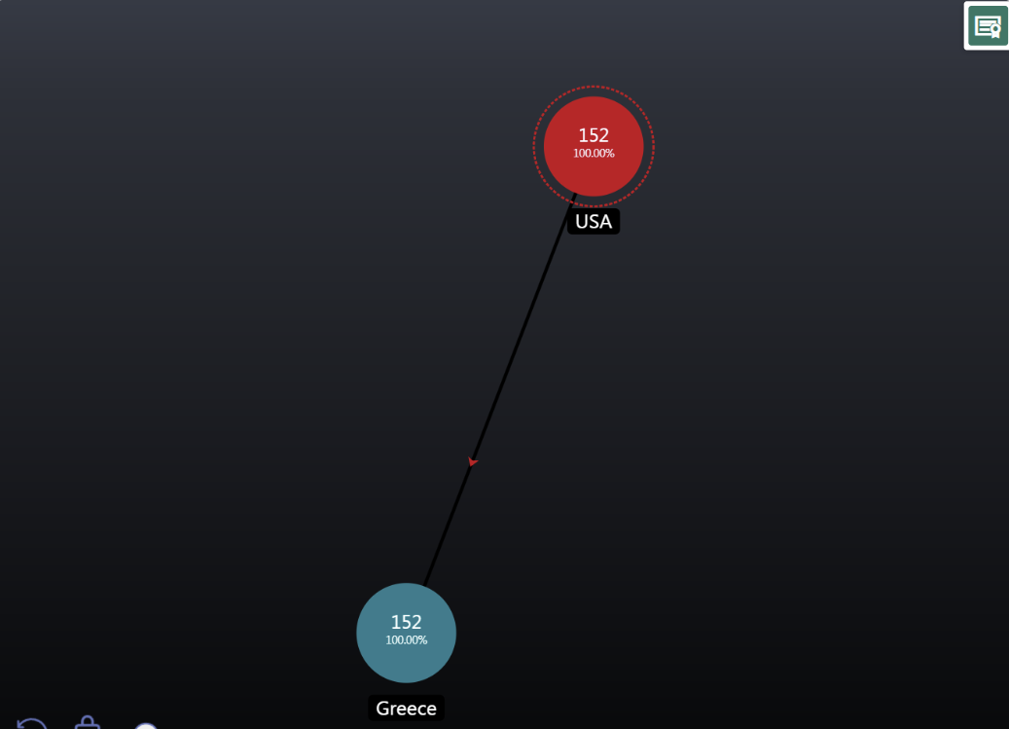
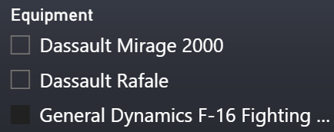
Greece’s Multirole Procurement: A Case of Dual Partnerships
When we focus on Greece in the network, we observe that the country sources multirole aircraft from two distinct suppliers:
USA: General Dynamics F-16
France: Dassault Rafale and Dassault Mirage 2000
By selecting each specific multirole aircraft in the equipment filter, we can view the exact quantities purchased by Greece from each supplier. This allows us to analyze procurement patterns and compare the strategic weight of each partnership.
This example illustrates how a single country can maintain diversified defense relationships, balancing alliances and operational needs across multiple suppliers.

