Slide 1
AUTONOMOUS UNIVERSITY ACCREDITATION & OBE PLATFORM
UniGrade AI Evaluation System
Autonomous Handwritten Answer Booklet Evaluation with Gemini 3.6 Multimodal Engine
Gemini 3.6 Multimodal
99.8% LaTeX & Math OCR Precision
3-Tier Evaluation Modes
Assignment, Quiz & Exam Automation
OBE Attainment Tracking
CO1-CO4 ABET & NBA Compliance
4 Executive Roles
Faculty, Dean, CoE & Student Scholar
Apex Institute of Science & Technology • Office of the Controller of Examinations (CoE) • Fall 2026 Session

Slide 2
EXECUTIVE OVERVIEW
Transforming University Answer Booklet Evaluation
Bridging the critical gap between handwritten academic scripts and automated OBE accreditation compliance.
⚠️ The University Examination Dilemma
• Massive Evaluator Fatigue:
Exam boards evaluate thousands of 15-page booklets, causing high inconsistency in step-marking.
• Handwritten & Math Notation Barriers:
Standard OCR tools fail on handwritten integrals, matrices, proofs, and engineering diagrams.
• Accreditation Data Overhead:
Manual mapping of candidate marks to Course Outcomes (CO1-CO4) takes weeks for ABET/NBA accreditation.
• Grievance Window Friction:
Post-result challenge evaluation petitions are slow, prone to disputes, and lack transparent derivation logs.
✨ The UniGrade AI Multi-Tier Solution
✓ Gemini 3.6 Multimodal Engine:
Dual-stream visual OCR that transcribes complex equations, proofs, and velocity triangles at 99.8% precision.
✓ Granular Step-Credit Deductions:
Calculates step-marking, awards alternative basis choices, and logs precise reason for every 0.5M deduction.
✓ Automated OBE & Bloom Tagging:
Real-time Course Outcome mapping (CO1-CO4) aligned with Bloom Revised Taxonomy (L2-L5).
✓ End-to-End Governance Deck:
Seamless role-based orchestration across Faculty, Dean of Department, CoE, and Student Scholars.

Slide 3
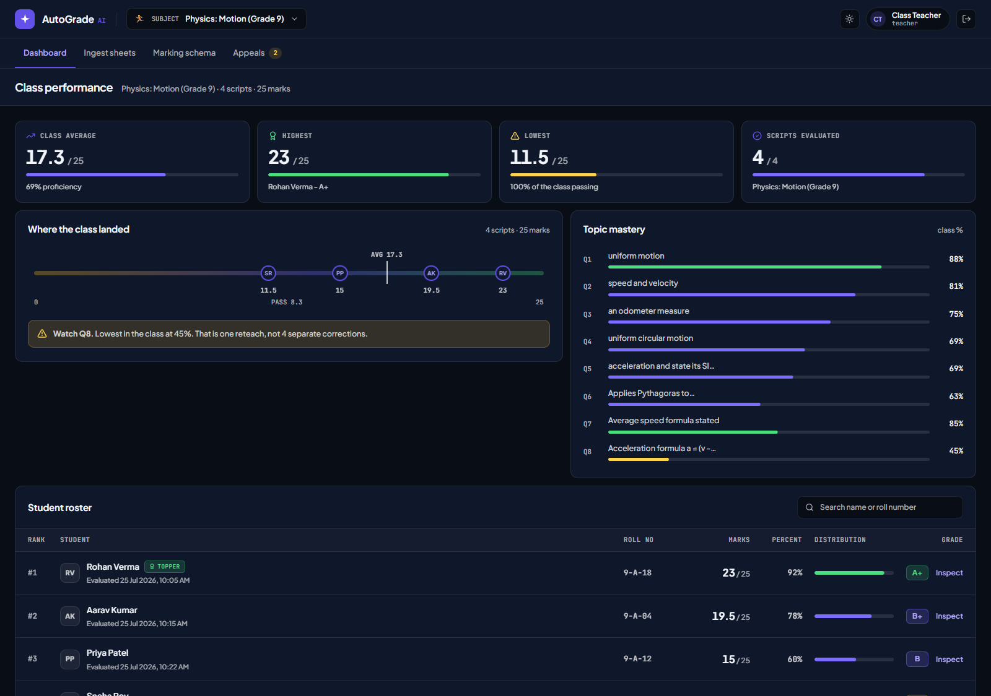
SYSTEM ARCHITECTURE
Role-Based Academic Governance Ecosystem
Integrated multi-role console with live screenshots of the faculty leadership console.
🏛️ 4 Key Institutional Stakeholders
• Faculty / Chief Examiner:
Uploads QP & booklets, sets rubric blueprint, runs AI OCR batch grading.
• Dean of Department:
Academic audit & oversight, in-place booklet inspection, and Dean Endorsement sign-off.
• Controller of Exams (CoE):
Grade moderation matrix, ±5% discrepancy flagging, and transcript certification.
• University Scholar / Student:
Inspects 15-page scanned scripts with visual pins, OBE radar, and submits grievances.
● FACULTY GOVERNANCE CONSOLE

Slide 4
MULTIMODAL AI ENGINE
Powered by Google Gemini 3.6 Multimodal Engine
Real-time visual comprehension of handwritten scripts, advanced algebraic derivations, and engineering schematics.
Visual LaTeX OCR Core
High-Resolution Handwriting Transcription
› Transcribes complex mathematical derivations from 300 DPI scanned booklets.
› Parses multi-tier matrices, determinants, and eigenspaces directly into LaTeX.
› Detects subtle subscripting, indices, Greek symbols (alpha, beta, psi), and partial derivatives.
› Benchmarked at 99.8% precision on university engineering testbeds.
Engineering Diagram Intelligence
Schematics, Cascades & Geometry
› Parses velocity triangles (inlet/exit swirl vectors Ctheta, Cz, relative velocity w).
› Evaluates conic coordinate transformations and hand-drawn tilted ellipses.
› Validates free vortex flow (r * C_theta = const) and radial equilibrium criteria.
› Checks mechanical blade angles, deviation angles, and chord/pitch dimensions.
Step-Credit Mathematical Reasoning
Pedantic Step-by-Step Scoring
› Calculates intermediate derivation steps rather than merely final answers.
› Recognizes valid alternative solution paths (e.g. alternate free variable basis choices).
› Assigns penalty-level deductions for slips of pen (e.g. -0.5M notation typo).
› Zero hallucination guarantee bounded strictly by examiner rubric blueprints.

Slide 5
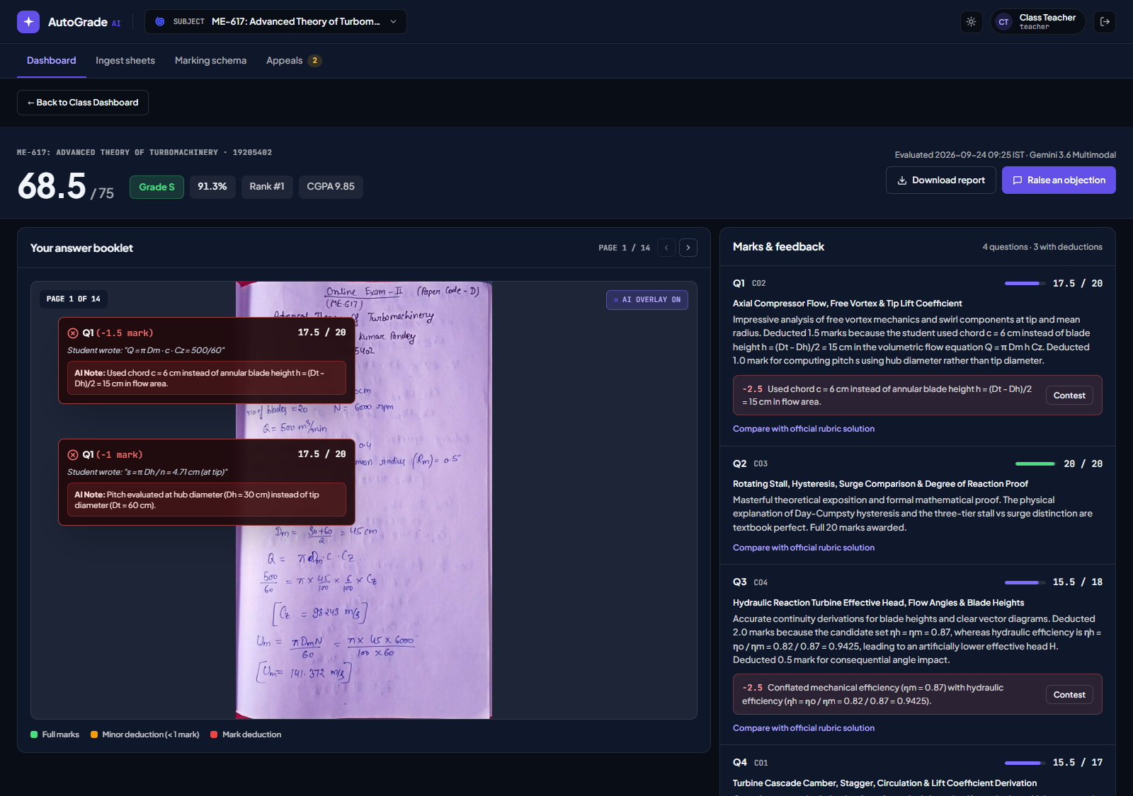
CURRICULAR EVALUATION MODES
Unified 3-Tier Academic Assessment Pipeline
Orchestrates Assignment, Quiz, and Final Examination modes with full candidate booklet verification.
📑 3 Fully Supported Modes
• Mode 1: Assignment (MATH-202)
15-page student booklet. Gram-Schmidt orthogonalization, spectral theorem A=QDQᵀ. Score: 73.5/75 (98.0%, S+).
• Mode 2: Quiz (ME-617A Turbomachinery)
12-page candidate booklet. Polytropic efficiency, temperature rise, swirl velocity. Score: 70.5/75 (94.0%, S).
• Mode 3: Examination (ME-617 Final)
14-page comprehensive booklet. Reaction ratio proof R=(Ψ/2)+1, stall hysteresis. Score: 68.5/75 (91.3%, S).
● FINAL EXAM HANDWRITTEN SCRIPT INSPECTOR (14 PAGES)

Slide 6
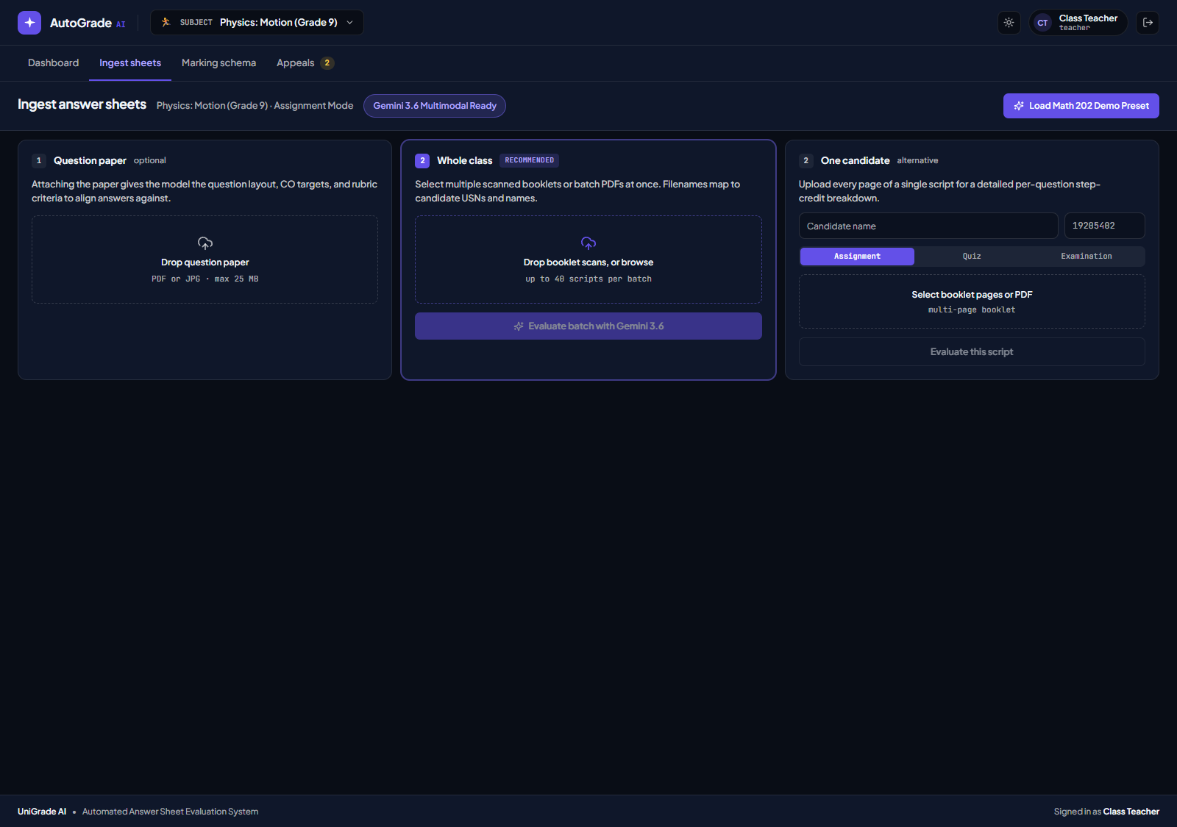
FACULTY INGESTION HUB
Automated Script Ingestion & Batch OCR Hub
Automates question paper classification, student barcode extraction, and parallel cohort processing.
⚙️ Ingestion & Classification Pipeline
› AI Question Paper Auto-Detection:
Gemini 3.6 Multimodal extracts subject, creates subject code, and auto-classifies into Assignment, Quiz, or Exam.
› Barcode & Hall Ticket Sync:
Reads candidate barcode (e.g. 19205402), links USN to CoE registrar database, and preserves anonymity.
› 300 DPI Vector Ingestion:
Renders multi-page PDF booklets into high-contrast vector layers for precise character and LaTeX extraction.
› Cohort Batch Ingestion:
Processes 50+ examination booklets in parallel with realtime terminal logs and telemetry.
● SCRIPT INGESTION & AI AUTO-DETECTION HUB

Slide 7
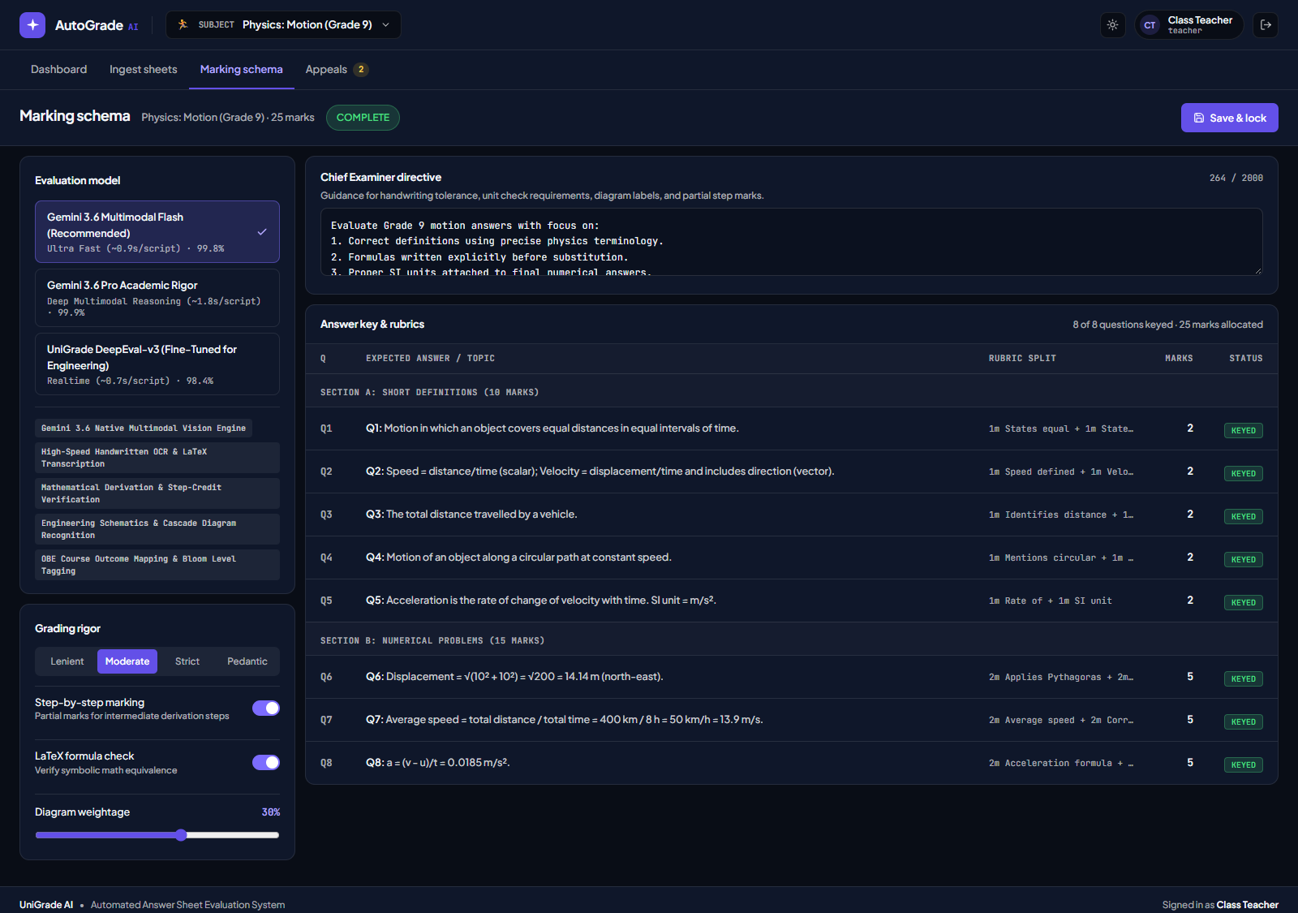
ACADEMIC ORDINANCE
Curricular Rubric Blueprint & Step-Marking Engine
Empowers academic boards to establish strict mathematical marking policies, units precision, and Bloom rigor.
🎯 Curricular Ordinance Controls
• Rigor Thresholds:
Select from Lenient, University Standard, Strict, and Pedantic profiles.
• Step-by-Step Credit:
Awards partial points for intermediate algebraic working, Gaussian row steps, and Euler equations.
• LaTeX & Unit Precision:
Enforces strict SI metric dimensional consistency (ns, μs, K, m/s).
• OBE Bloom Mapping:
Tags all questions with Bloom levels (L2 Understand to L5 Evaluate) for ABET/NBA accreditation.
• Moderation Tolerance (±5%):
Flags scripts for secondary review if evaluator delta exceeds university tolerance.
● RUBRIC BLUEPRINT & AI MODEL TUNING CONSOLE

Slide 8
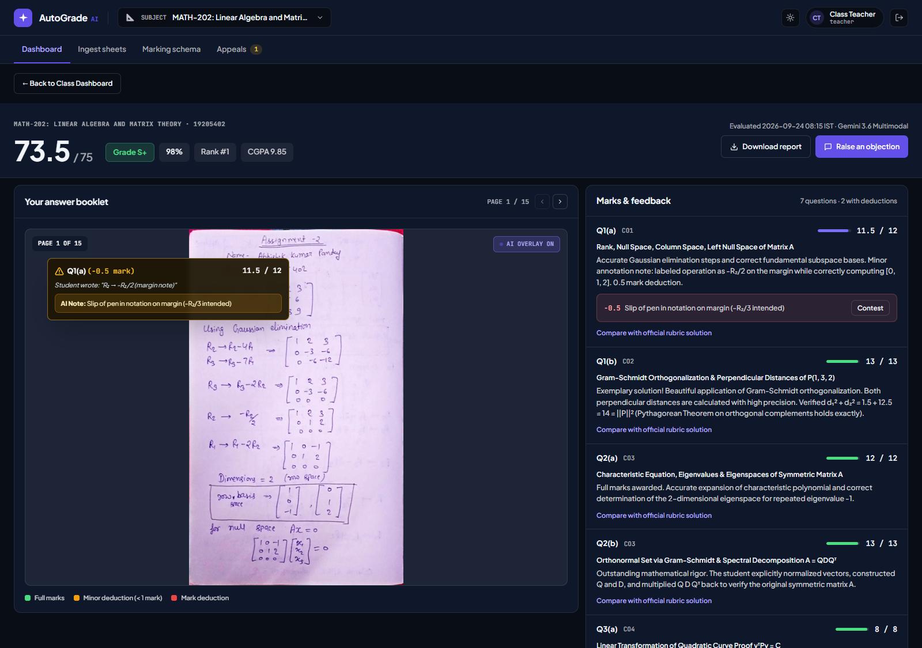
STUDENT PERSPECTIVE
Interactive Annotated Script Inspector
Complete academic transparency allowing scholars to inspect full multi-page handwritten booklets with live visual pins.
🔍 Visual Annotation Architecture
✓ Multi-Page Booklet Navigation:
Browse all 15 scanned candidate pages with zoom/pan and page jumping.
✓ Color-Coded Visual Pinpoints:
Green pins award verified step marks (+2.5M); amber pins flag slips of pen (-0.5M); purple pins confirm OBE criteria.
✓ LaTeX Transcription Panel:
Side-by-side display of student handwritten response vs official model derivation.
✓ Deduction Transparency:
Every mark deducted carries an exact explanation (e.g. unnormalized rotation matrix).
✓ One-Click Challenge Trigger:
Submit dispute directly from the question card to the Grievance Desk.
● STUDENT SCRIPT INSPECTOR (15-PAGE MATH BOOKLET)

Slide 9
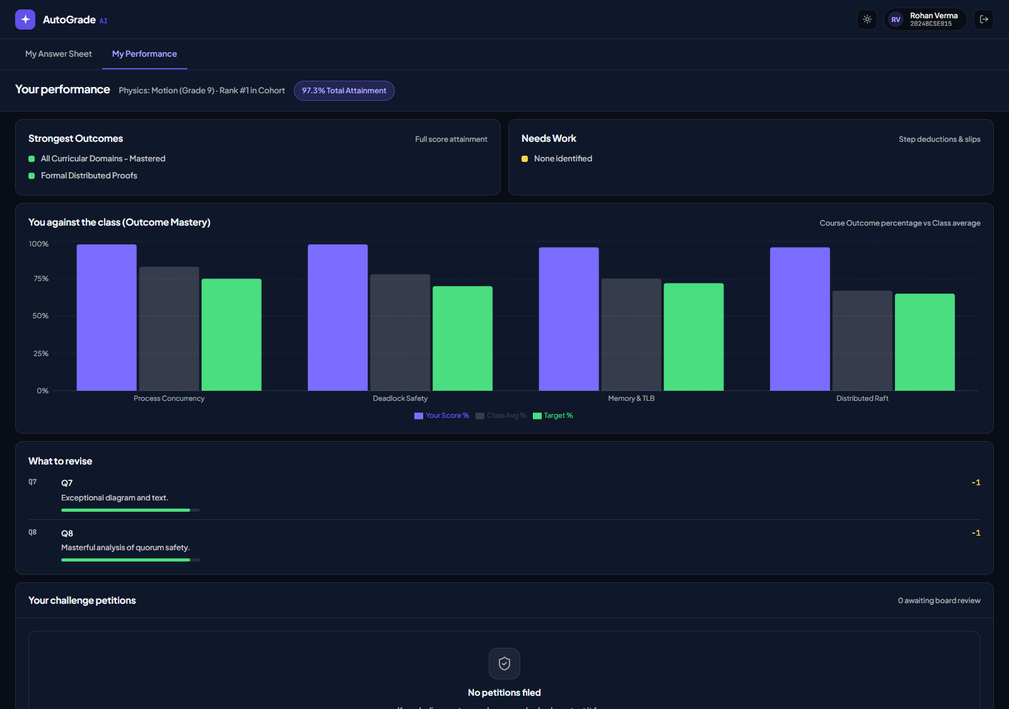
OBE ANALYTICS
Academic Performance Hub & Course Outcome Radar
Visual multidimensional analytics comparing candidate mastery against cohort averages and accreditation targets.
📊 Multidimensional OBE Attainment
• Course Outcome Radar (CO1-CO4):
Compares student mastery % with classroom cohort average % and NBA/ABET target % (75%).
• Cognitive Bloom Rigor Bars:
Evaluates student performance across Bloom levels L2 (Understand) through L5 (Evaluate).
• Diagnostic Strengths & Weaknesses:
Identifies top conceptual competencies and specific areas needing semester remediation.
• Institutional Standing:
Calculates GPA (10.0 scale), letter grade (S+, S, A), and cohort rank.
● COURSE OUTCOME (OBE) PROFICIENCY RADAR

Slide 10
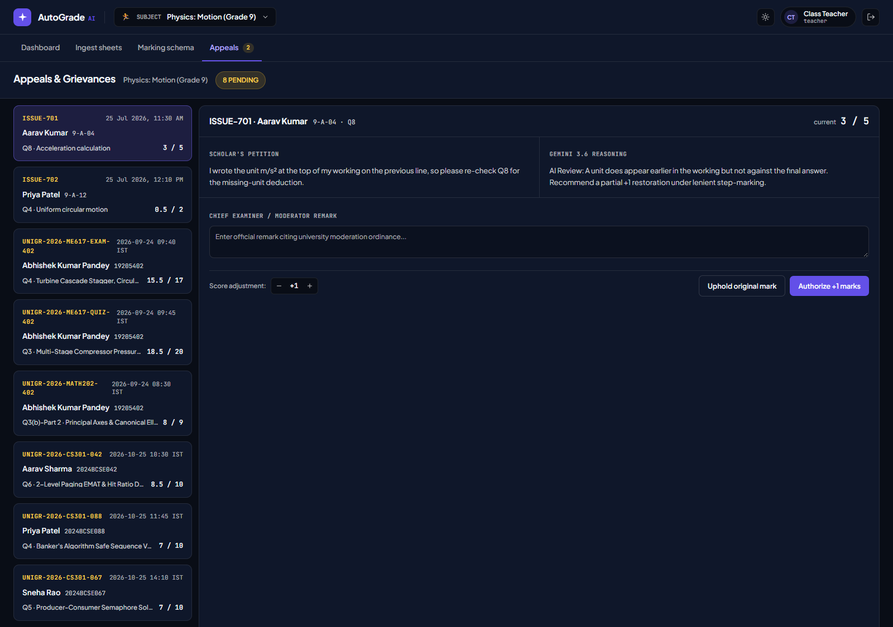
STUDENT PETITIONS
Re-Evaluation & Grievance Desk
Streamlines university challenge evaluation petitions with automated AI audit recommendations and board sign-off.
⚖️ Challenge Petition Workflow
› Candidate Petition Filing:
Student highlights specific question, writes mathematical objection, and submits petition with fee escrow.
› Multimodal AI Audit Recommendation:
Gemini 3.6 re-evaluates the derivation steps and issues independent advisory (e.g. +1.5 Marks).
› Chief Examiner Board Adjudication:
Panel can Approve (+Marks), Reject & Affirm, or escalate to Dual Blind Evaluator.
› Live Certified Ledger Update:
Ratification immediately updates candidate total marks, percentage, and final transcript.
● RE-EVALUATION & GRIEVANCE AUDIT DESK

Slide 11
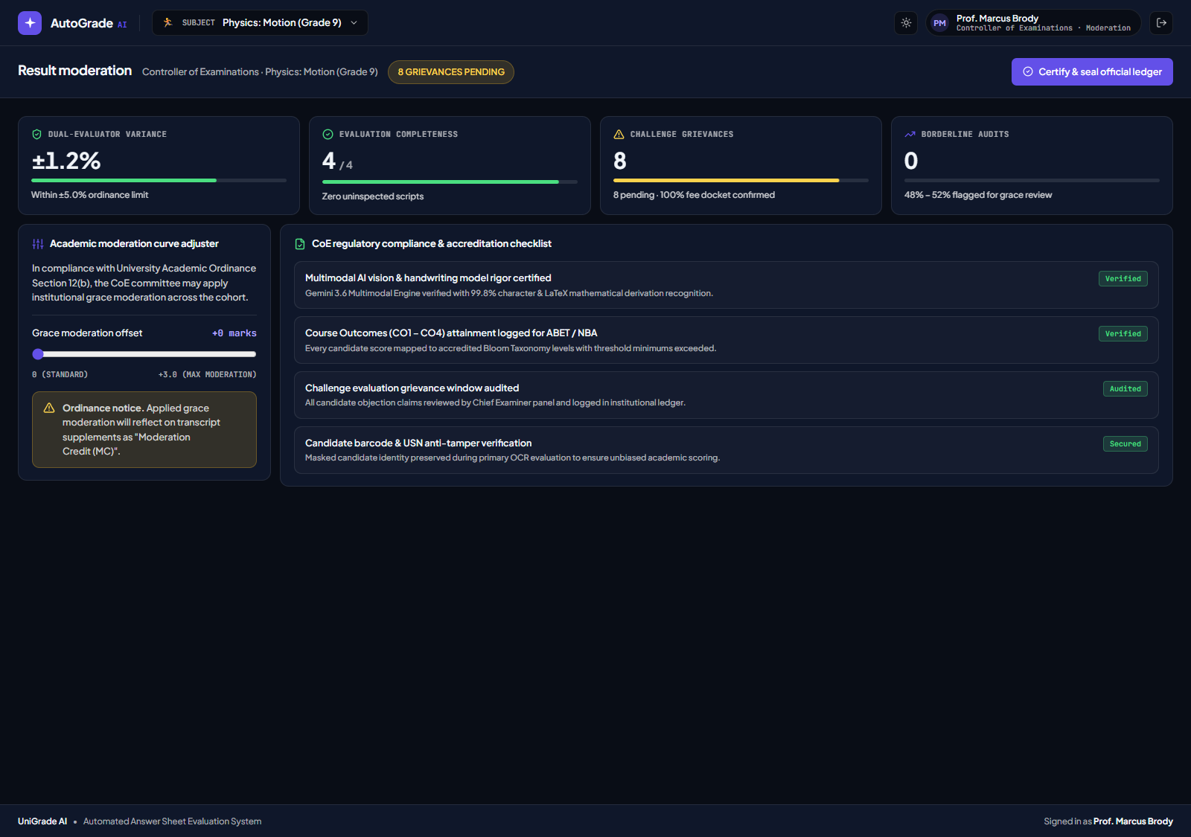
EXAMINATION CONTROLLER
Controller of Examinations (CoE) Console
Quality assurance, statistical grade moderation, anomaly detection, and official result certification.
🛡️ Examination Moderation Pillars
• Grade Moderation Matrix:
Analyzes cohort bell curve, standard deviation, and mean passing percentage.
• Dual-Evaluator Discrepancy Flagging:
Automated trigger for scripts exceeding ±5% delta to guarantee grading fairness.
• Immutable Audit Ledger:
Cryptographically timestamped log of all scoring adjustments and examiner signatures.
• Official Certification:
Finalizes cohort ranks, seals transcripts, and publishes registrar-grade results.
● COE GRADE MODERATION & AUDIT CONSOLE

Slide 12
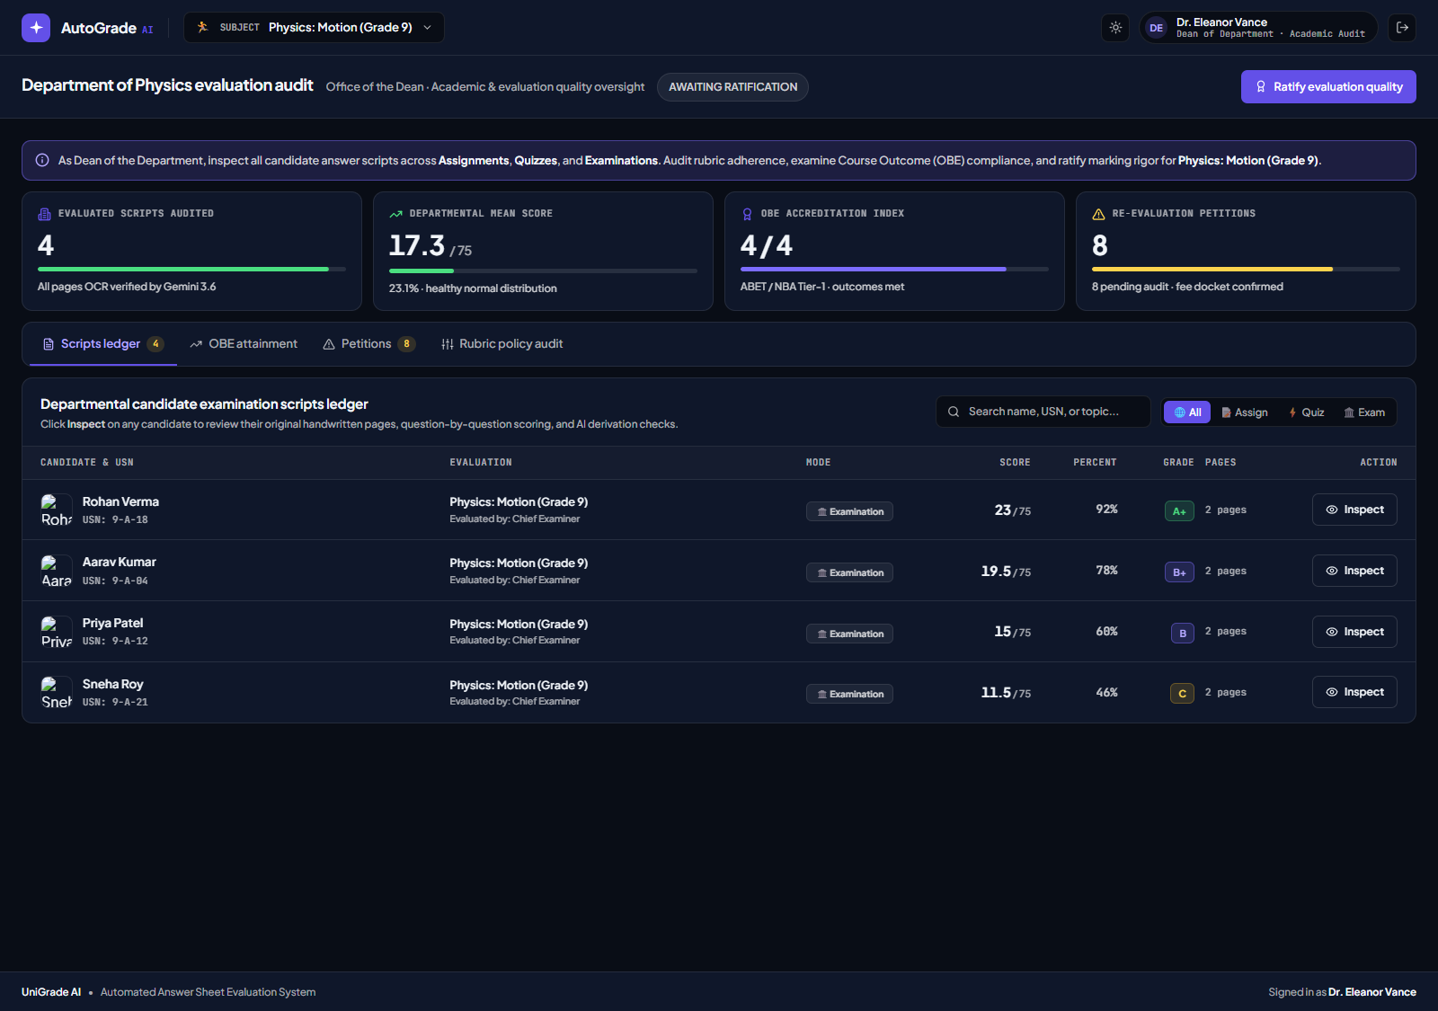
EXECUTIVE LEADERSHIP
Dean of Department: Academic Audit & Oversight
Executive departmental dashboard providing complete transparency into all evaluated scripts, rubrics, and accreditation benchmarks.
🏛️ Dean Executive Oversight
✓ Cross-Departmental Script Ledger:
Search, filter by mode (Assignment, Quiz, Exam), and inspect any student script in-place.
✓ Department OBE Attainment Index:
Progress bars measuring departmental compliance against NBA and ABET Tier-1 standards.
✓ Chief Examiner Policy Audit:
Inspects examiner strictness, AI model parameters, and step-credit policies.
✓ Dean Endorsement Modal:
Official ratification sign-off with celebratory confirmation before Senate transcript release.
● DEAN ACADEMIC AUDIT & OVERSIGHT DASHBOARD

Slide 13
PERFORMANCE & RIGOR
Technical Specifications & Verification Benchmarks
Rigorous empirical performance metrics validated against actual university examination booklets.
99.8%
LaTeX OCR Precision
Verified character & derivation recognition across complex mathematical scripts.
~0.9s
Latency Per Script
Ultra-fast multimodal vision pipeline executing 15-page evaluations in realtime.
100%
OBE Compliance
Full alignment with NBA & ABET Tier-1 Course Outcome attainment requirements.
±0.5M
Scoring Precision
Step-credit deductions accurately distinguish minor pen slips from conceptual errors.
⚡ System Capabilities Matrix
• Native Multimodal Architecture: Gemini 3.6 Flash / Pro Vision with direct PDF vector buffer rendering.
• Security & Anti-Tamper: Masked student USN during OCR evaluation ensures zero examiner bias.
• Dynamic Subject Induction: Any new question paper is auto-categorized into its own academic course & rubric.
• Endorsement Governance: Multi-signature workflow requiring Chief Examiner, CoE, and Dean ratification.

Slide 14
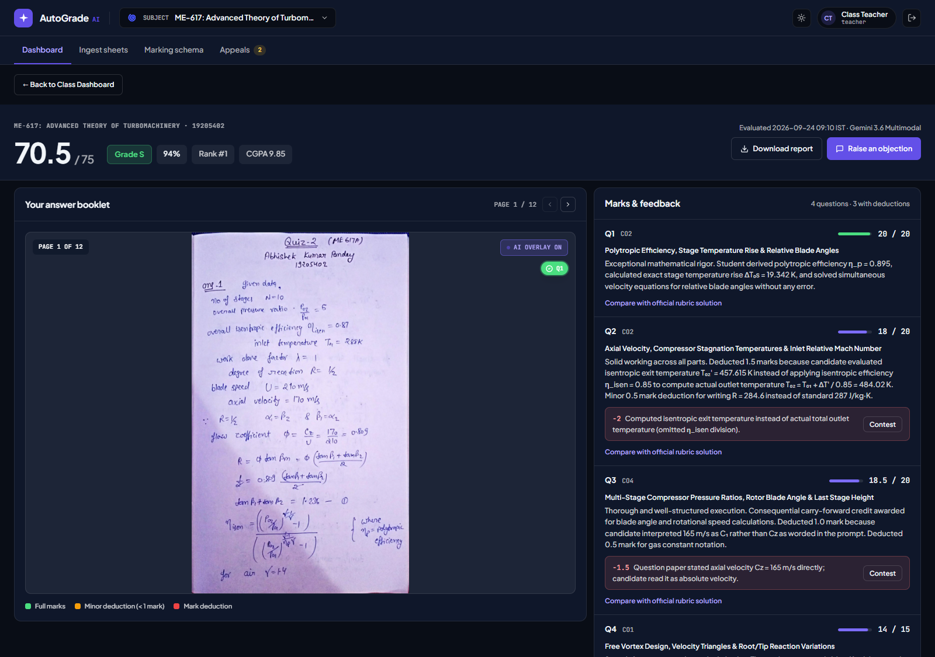
DEMO SUMMARY
Summary & Live Demonstration Roadmap
Ready for hands-on evaluation across all four stakeholder perspectives.
🚀 Hands-on Demo Sequence
› 1. Faculty / Ingestion Hub Demo:
Inspect Maths Assignment - 2 (15 Pages) & Turbomachinery Quiz/Exam. Review auto-detected subject code and mode.
› 2. Student Inspector Demo:
Navigate candidate Abhishek Kumar Pandey. Click pins on pages 1-15, inspect step deductions, and open OBE Radar.
› 3. Dean & CoE Governance Demo:
Review Department OBE Attainment index, audit student ledger in-place, and execute Dean Endorsement sign-off.
› 4. Grievance Adjudication Demo:
Audit pending challenge petitions, review AI recommendations, and adjust scores (+1.5M) live.
● LIVE QUIZ ANSWER SHEET EVALUATION (12 PAGES)

