Slide 1
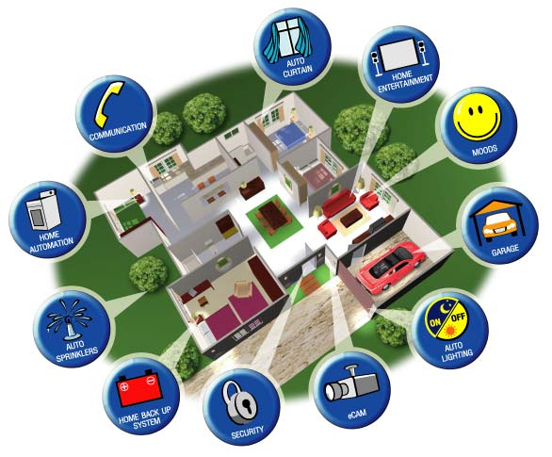
Varga Barna HKH03C Project

Slide 2

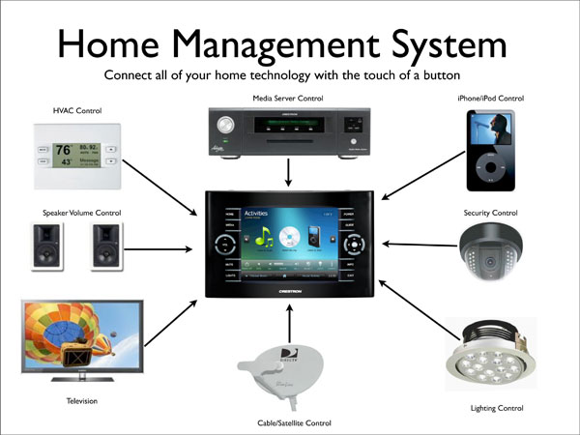
What is it?

Slide 3
What is it good for?

Slide 4
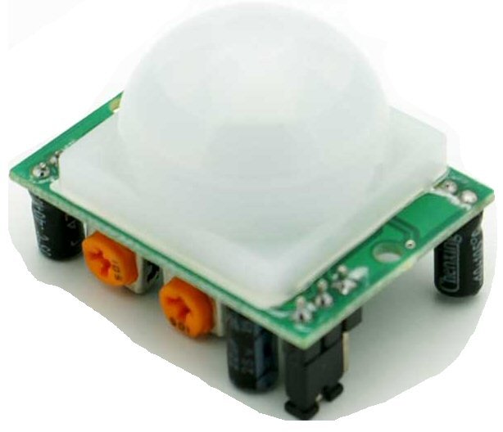
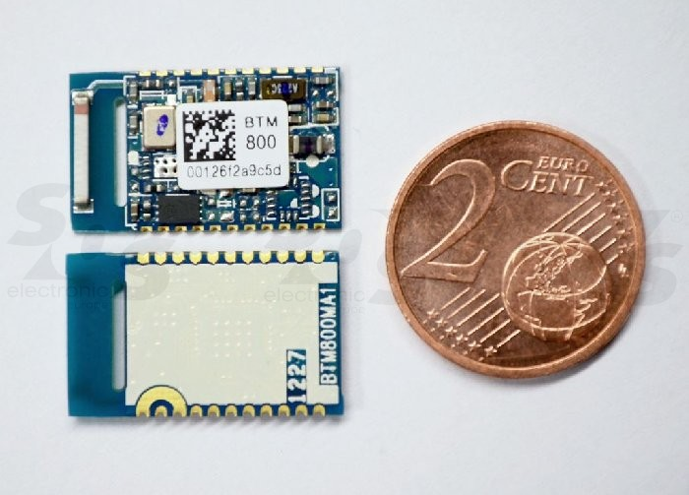
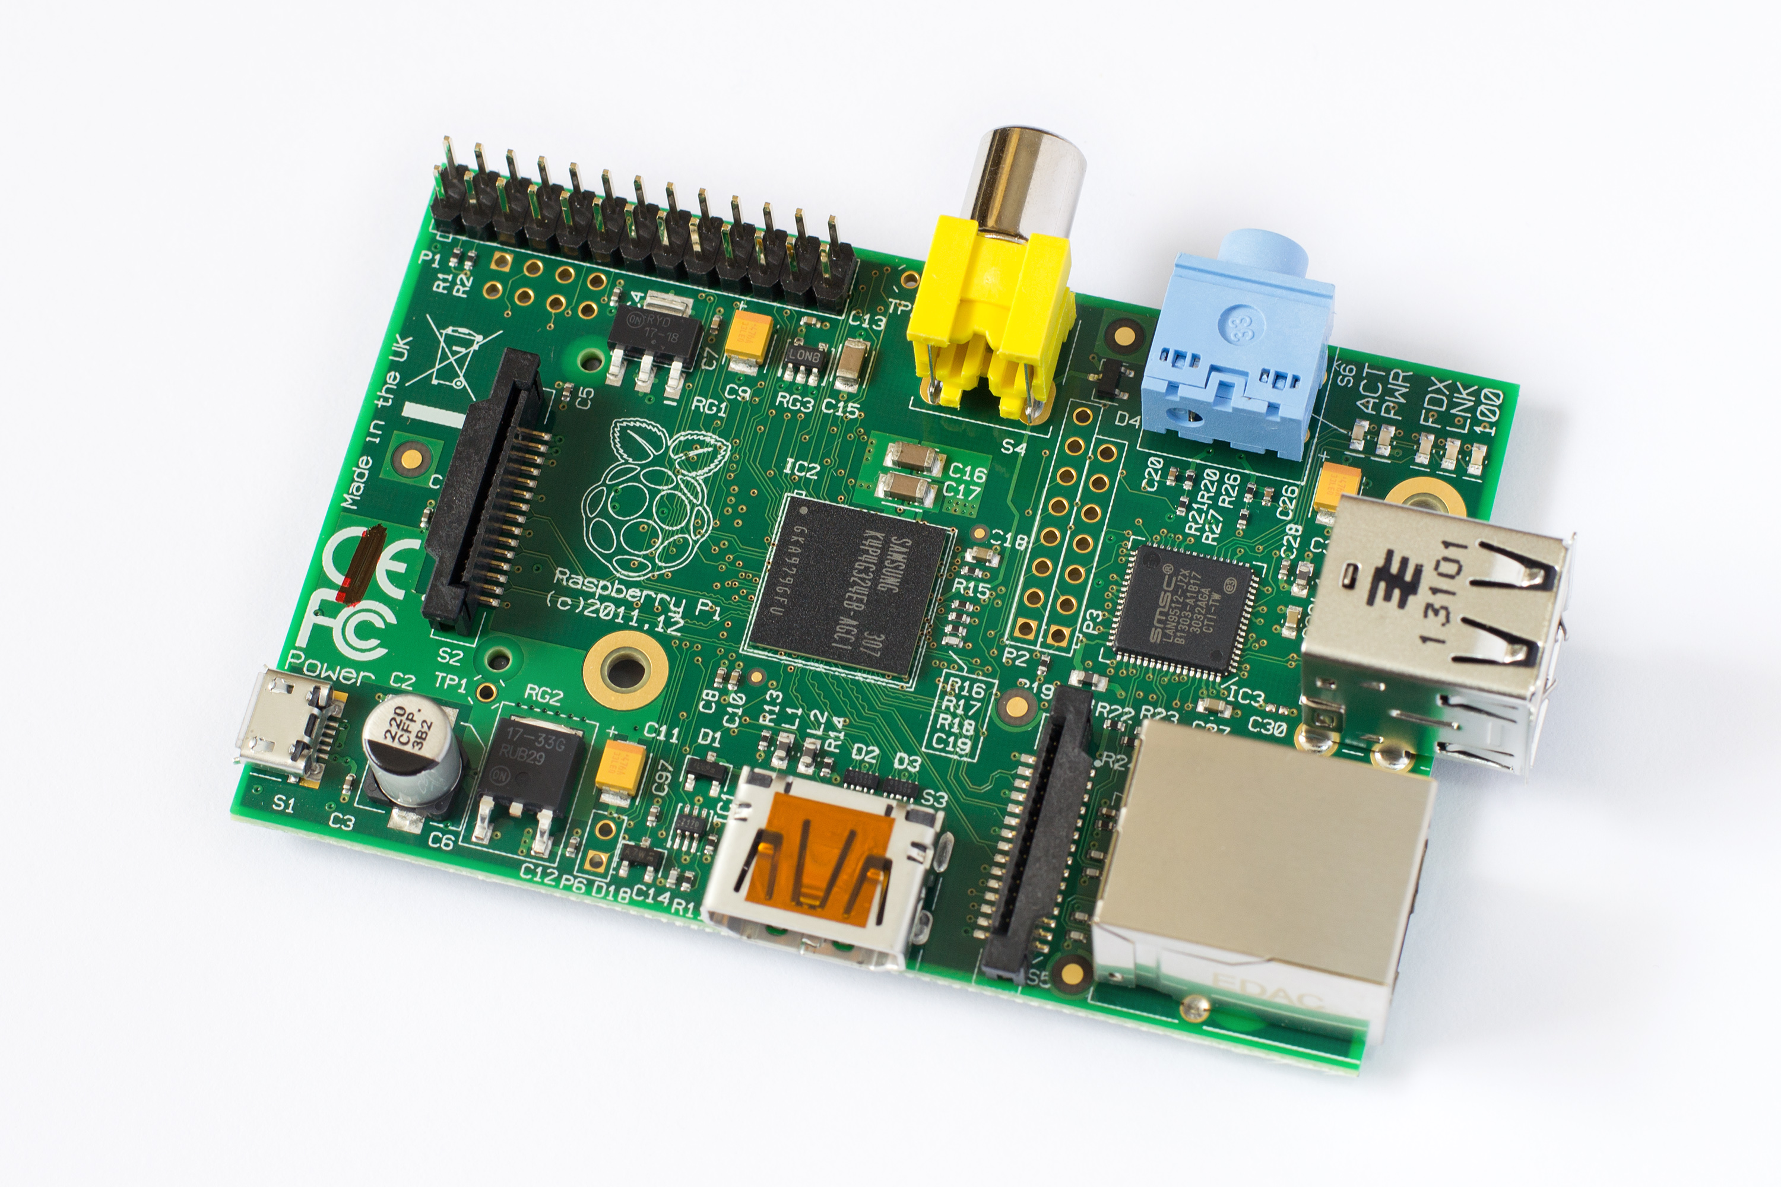

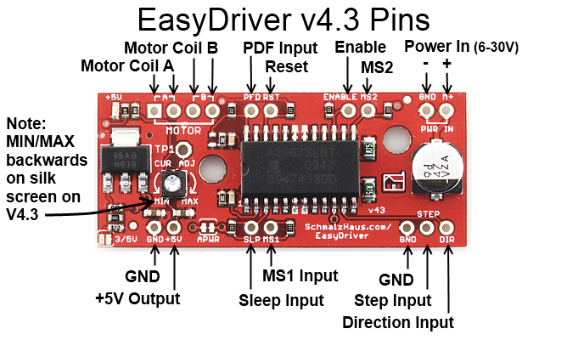
Used Components

Slide 5
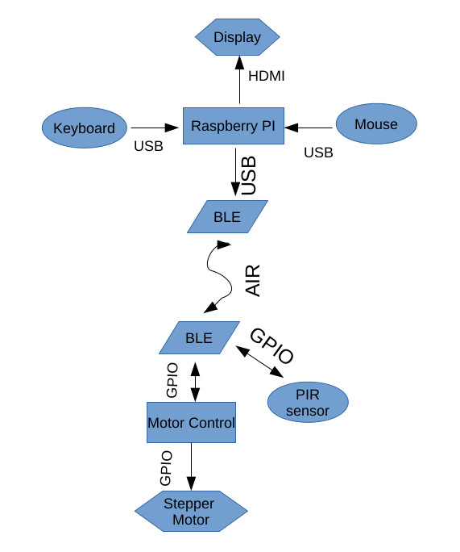
Design

Slide 6
What progress have I made?

Slide 7
What is the next/future steps?

Slide 8
Future Improvements

Slide 9

Questions??

Slide 10

Thank You!!

