Slide 1
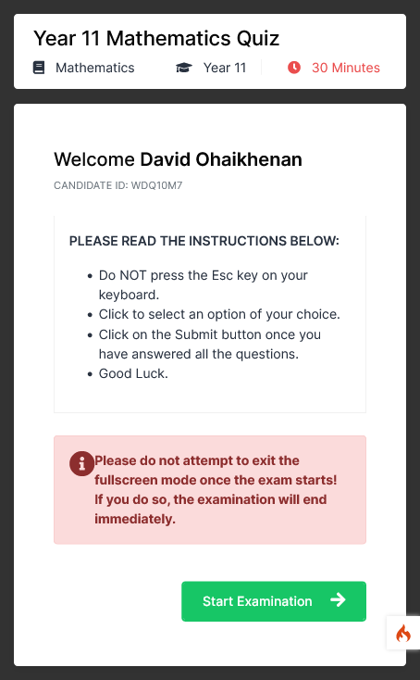

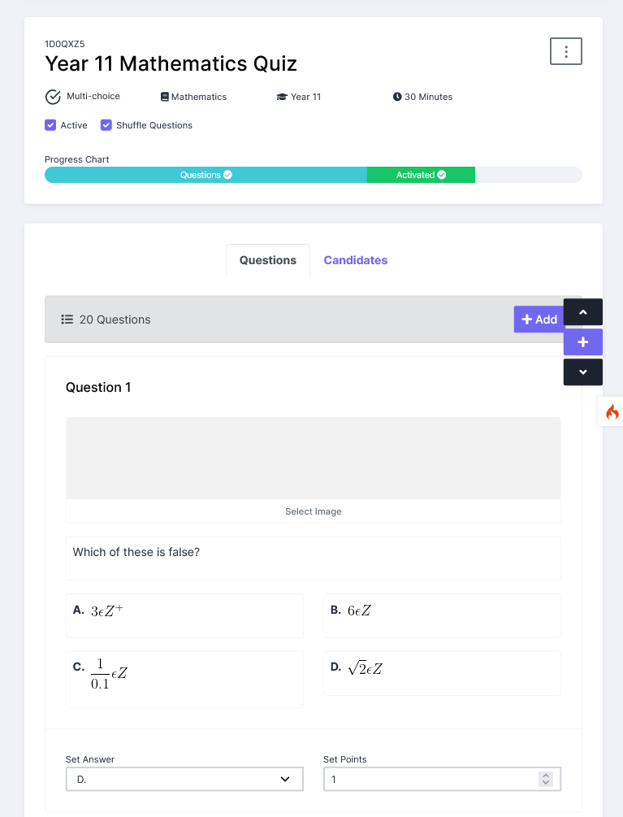

Not all assessments are created equal
Find out how Questa is helping smart educators like you to craft and setup quality and engaging assessments for their students.
https://pharmos.xyz/cbt_app

Slide 2

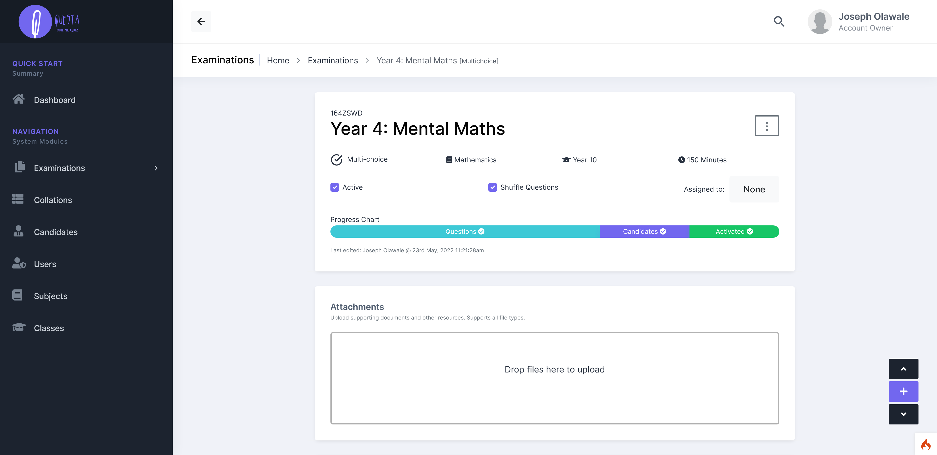
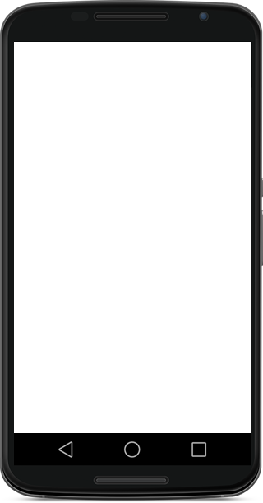
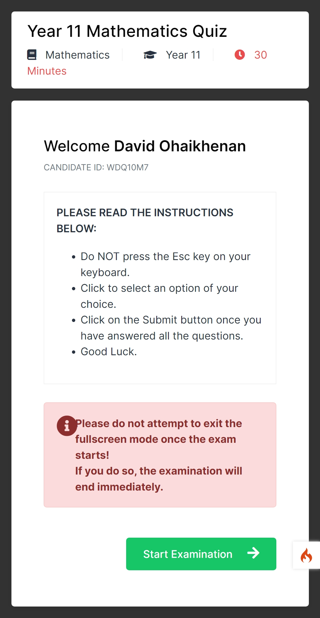
Not all assessments are created equal
Find out how Questa is helping smart educators like you to craft and setup quality and engaging assessments for their students.
https://questaonline.xyz

