Slide 1

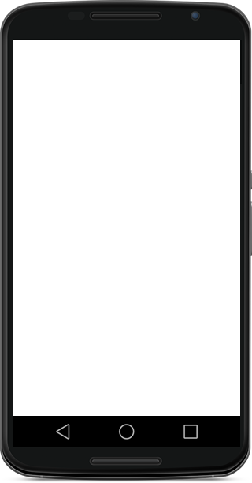
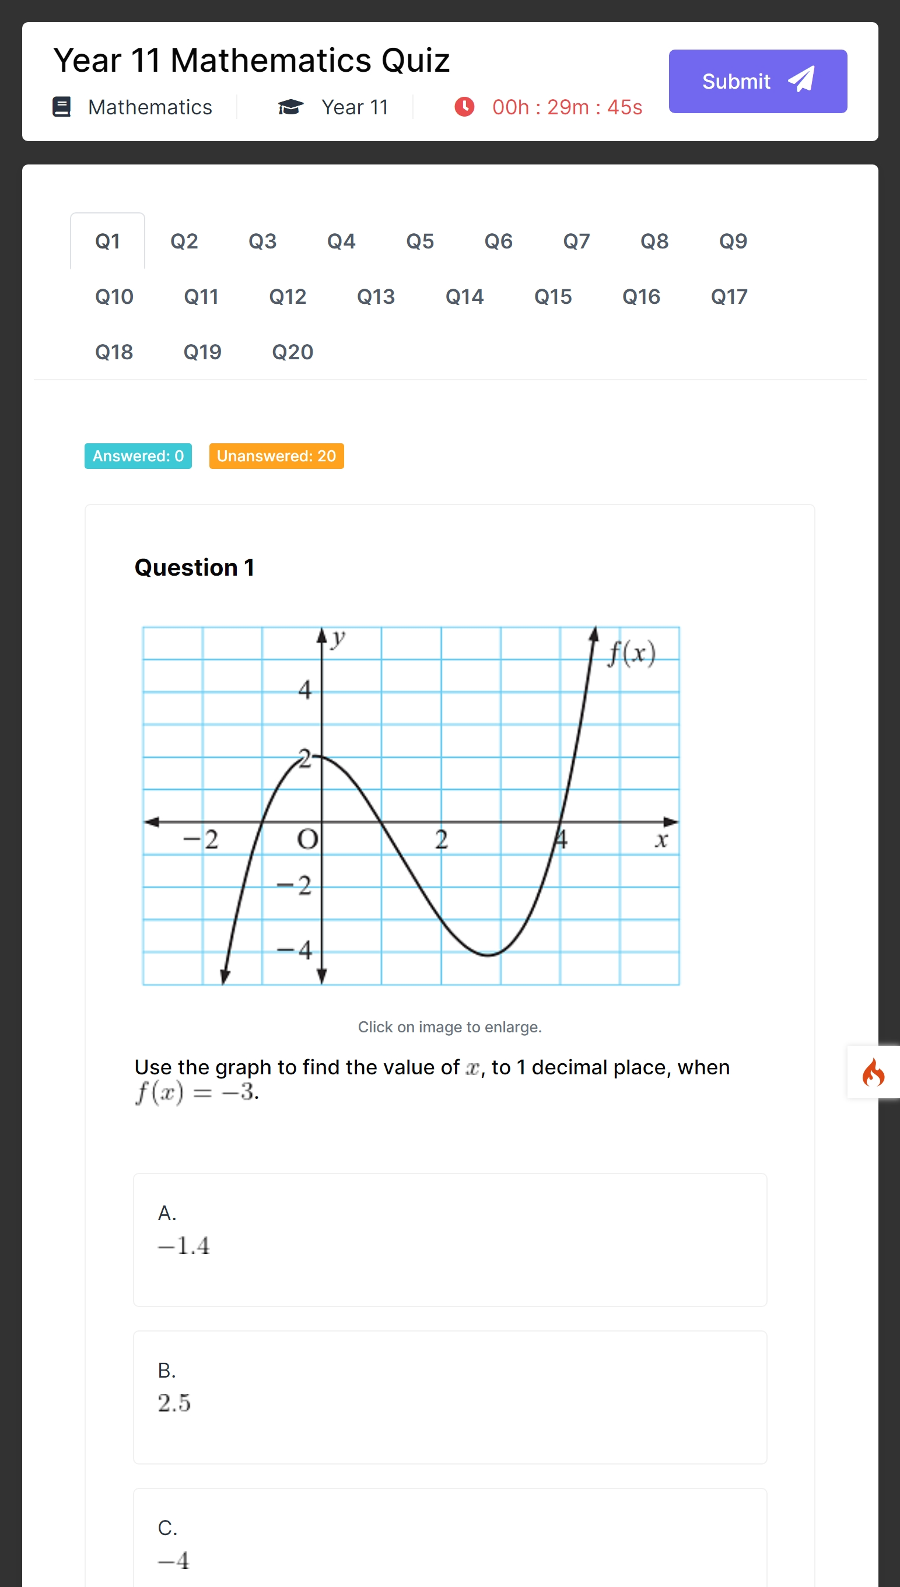
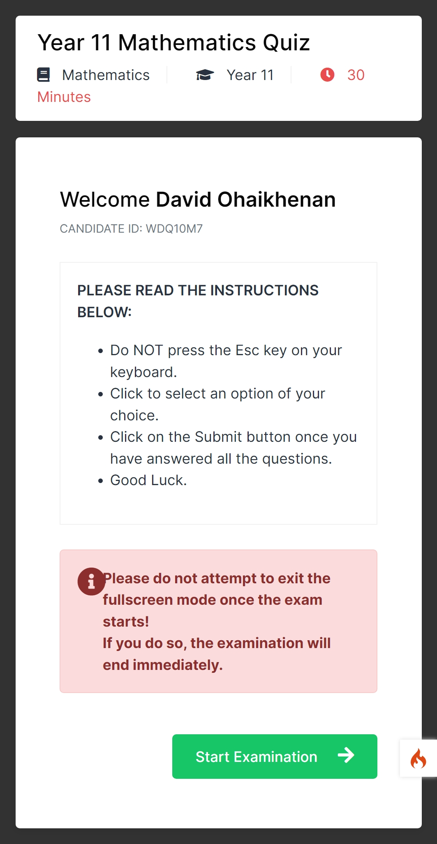

Get equipped with digital tech skills
The world is global and changing.
Computer-Based Testing App
Computer-Based Testing App

Slide 2

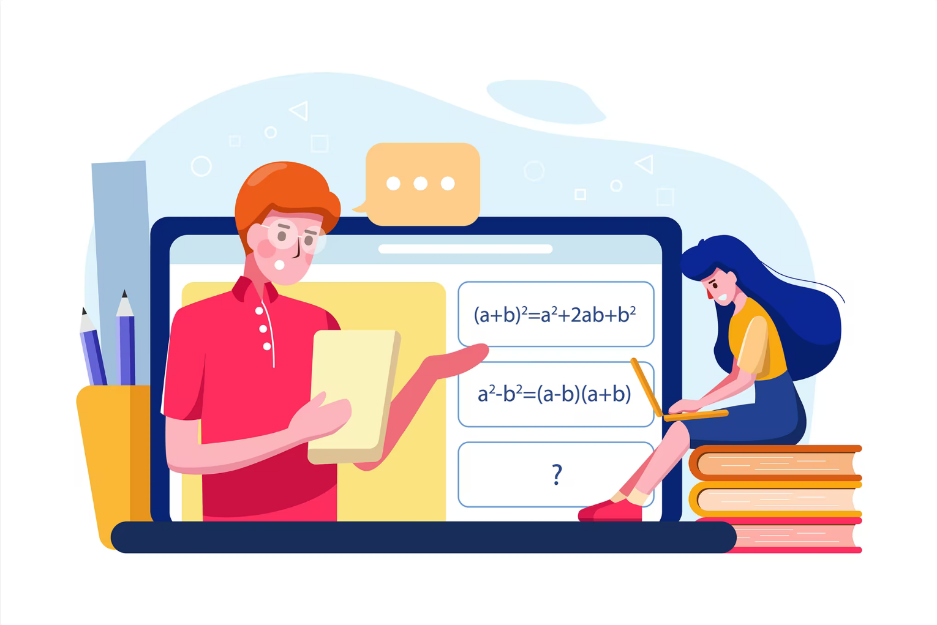
Automated & Online
Computer-Based Testing App
Fullscreen Mode
Automatic Grading
Instant result
Questions shuffle
Smart educators use Questa to set examinations for their students. With Questa, they are able to build assessments on the go and use them instantly!
Students can take the exams using the mobile devices or laptops.
Questa makes it possible to build effective assessments to enhance understanding of students in the topic areas of any subjects they are tested on.
Most reliable Computer-based Testing (CBT) App ever built!

Slide 3




Get trained in
Digital Tech
Bootstrap
JavaScript | React | Next
PHP/Codeigniter
Frontend Web Design
Backend Wed Dev
Mobile Development
qodesquare cultures excellence in training and takes pride in delivering in multiple fronts of tech development.

Slide 4


”
What are they saying about
Questa?
Adebayo Olufemi (Education Consultant)
Concord Schools, Oyo state
Questa has helped us to improve the productivity of our teachers by 150% as they can set examinations on the go and students can answer them instantly.
Mayowa Fateyinse (MPhil.)
Waldorf Knoll Academy, Jabi, FCT
With Questa, paper-work has been replaced by a seamless experience of assessment builder that makes it fun to set examination questions without any hassles.
Rodeeyat Shittu (Student Trainer)
University of Ilorin, Ilorin, Kwara State
I have been using Questa for sometime now. I find the interface very intuitive and friendly. The examination experience is stress-free and engaging.

Slide 5
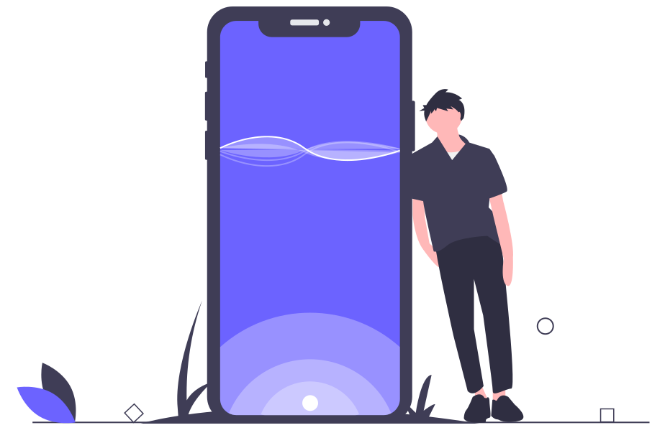
Get in touch to know how you can get
Questa!
Questa knows your educational needs. So it is appropriate to serve you as a productivity tool.
CALL US:
Emmanuel Diogu
(Business Support)
0810 900 0275
@gmail.com

