Slide 1


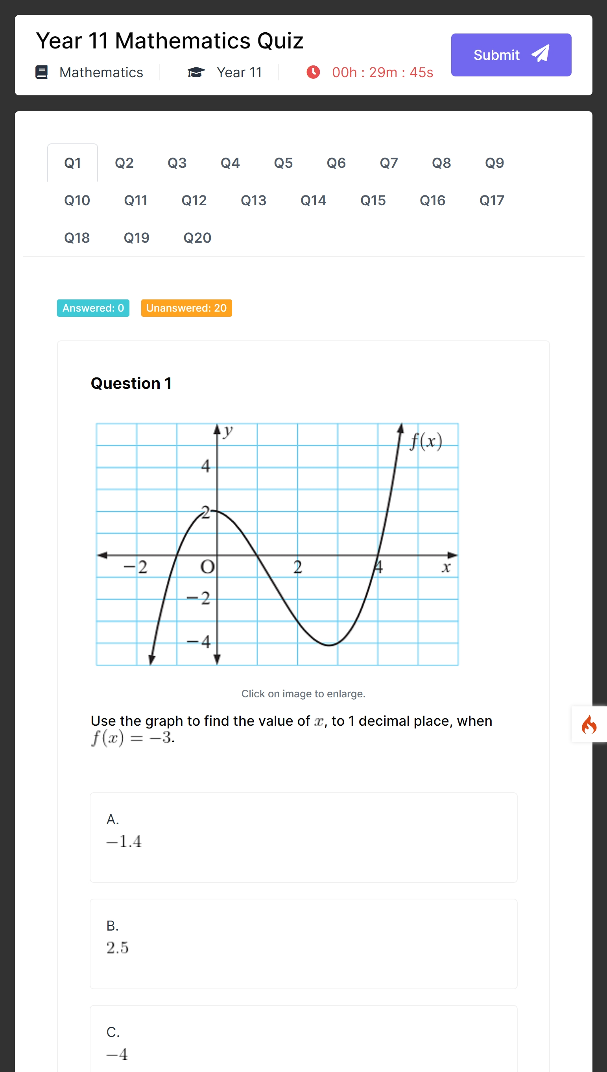
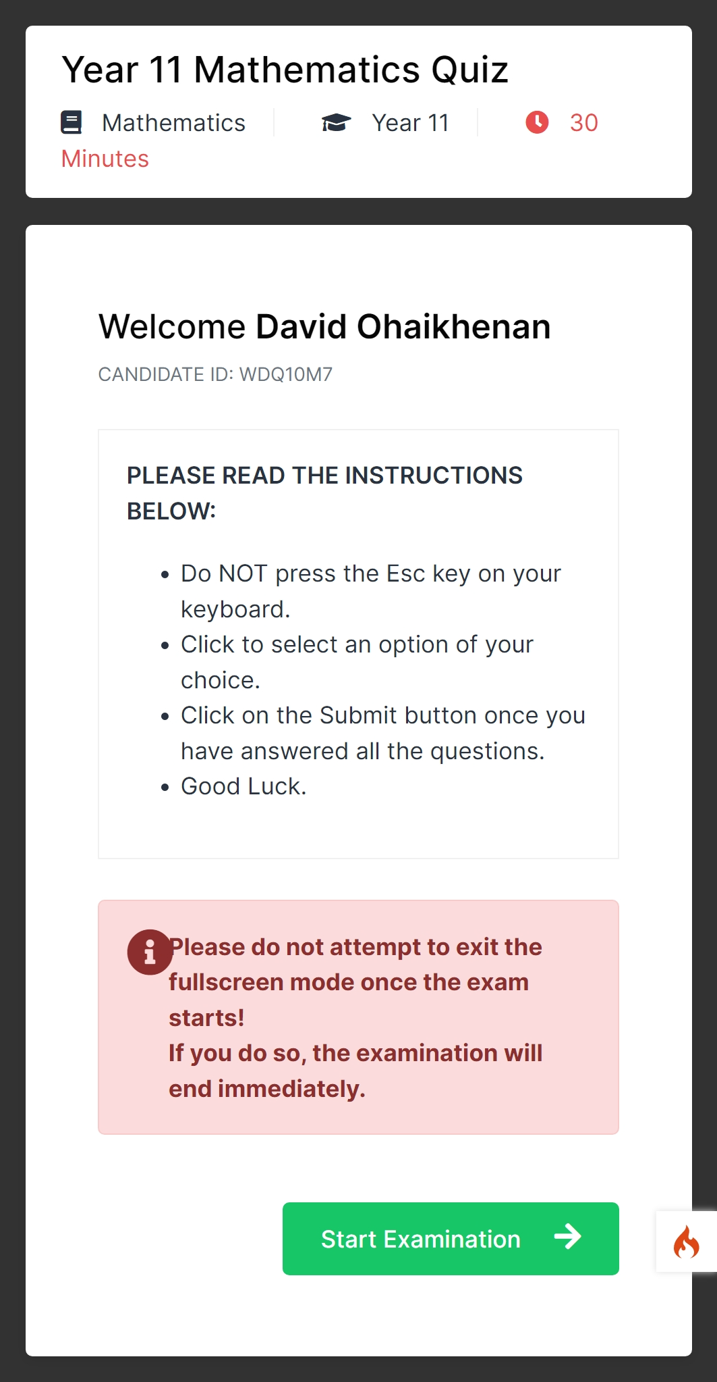

Not all assessments are created equal
Find out how Questa is helping smart educators craft and setup quality and engaging assessments for their students.
Computer-Based Testing App
Computer-Based Testing App

Slide 2

Automated & Online
Computer-Based Testing App
Fullscreen Mode
Automatic Grading
Instant result
Questions shuffle
Smart educators use Questa to set examinations for their students. With Questa, they are able to build assessments on the go and use them instantly!
Students can take the exams using the mobile devices or laptops.
Questa makes it possible to build effective assessments to enhance understanding of students in the topic areas of any subjects they are tested on.
Most reliable Computer-based Testing (CBT) App ever built!

Slide 3

Why use
Questa?
Fullscreen Mode
Automatic Grading
Instant result
Questions shuffle
Automated timing
Fast Search
Ticketing
Mathematics Equation
MsWord Copy & Paste
Multichoice & Essay Types
Questa understands your job. So it makes setting assessments like a breeze, a fun-filled activity with no stress for you as an educator.

Slide 4


”
What are they saying about
Questa?
Adebayo Olufemi (Education Consultant)
Concord Schools, Oyo state
Questa has helped us to improve the productivity of our teachers by 150% as they can set examinations on the go and students can answer them instantly.
Mayowa Fateyinse (MPhil.)
Waldorf Knoll Academy, Jabi, FCT
With Questa, paper-work has been replaced by a seamless experience of assessment builder that makes it fun to set examination questions without any hassles.
Rodeeyat Shittu (Student Trainer)
University of Ilorin, Ilorin, Kwara State
I have been using Questa for sometime now. I find the interface very intuitive and friendly. The examination experience is stress-free and engaging.

Slide 5
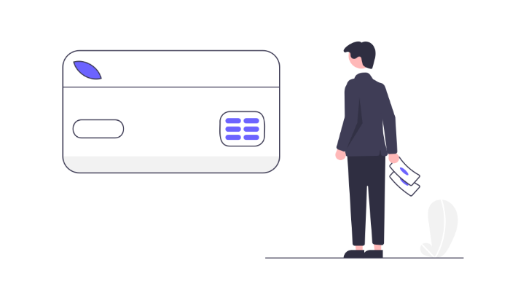
Ready to start with
Questa?!
Choose a plan that suits you.
Free
200k/yr
350k/yr
Exams per month
20
Unlimited
Unlimited
Questions
40
Unlimited
Unlimited
Mathematical equations
×
Yes
Yes
Instructor accounts
×
Yes
Yes
Custom template
×
Yes
Yes
File storage
50mb
1Gb
5Gb
Offline Authoring
×
×
Yes
Email/phone support
50mb
1Gb
5Gb
RECOMMENDED

Slide 6
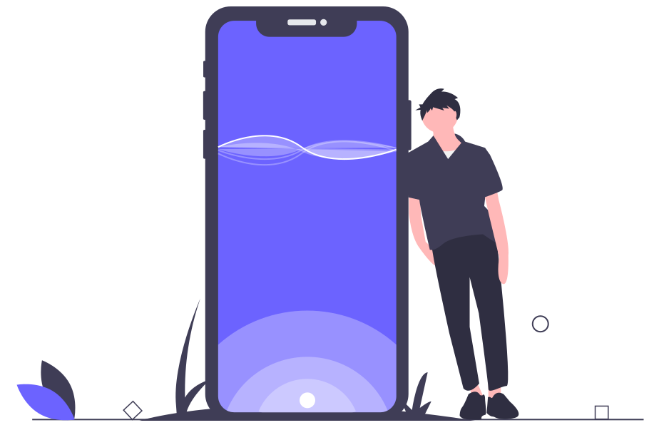
Get in touch to know how you can get
Questa!
Questa knows your educational needs. So it is appropriate to serve you as a productivity tool.
CALL US:
Emmanuel Diogu
(Business Support)
0810 900 0275
@gmail.com

