Slide 1
Moving rules

Slide 2
Run a demo
In one terminal
$ rosrun turtlesim turtlesim_node
This opens a window with a turtle
In another teminal
$ rosrun turtlesim turtle_teleop_key
This runs a tool for controlling a turtle (with arrows)

Slide 3
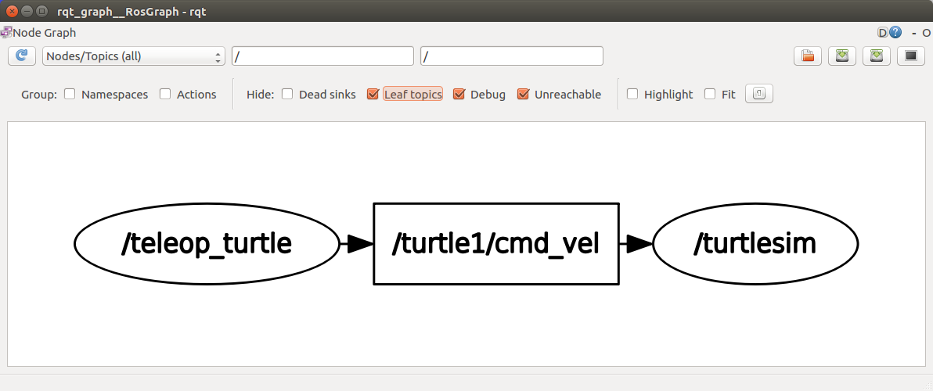
Nodes & Topics
Useful commands
$ rqt_graph
$ rosnode list
$ rosnode info <nodename>
$ rostopic list
$ rostopic info <topicname>

Slide 4
Create, make, set paths & run
$ catkin_create_pkg <package> <depends>
Notes:
Execute from <worksapce>/src
$ catkin_make
Execute from <worksapce>
$ source <workspace>/devel/setup.bash
$ rosrun <package> <type> __name:=<name>

Slide 5
File system structure
workspace_folder ←$ catkin_make
┣bin (auto-generated)
┣devel (auto-generated)
┗src ←$ catkin_create_pkg
┣package#1_folder
┗package#2_folder
┣CmakeLists.txt (auto-generated)
┣package.xml (auto-generated)
┗<other staff>

Slide 6
Publish to topic:
$ rostopic pub /turtle1/color_sensor turtlesim/Color "{r: 0, g: 0, b: 255}"
#! /usr/bin/env python
import rospy
from turtlesim.msg import Color
rospy.init_node("turtle_color_blue")
pub=rospy.Publisher(“/turtle1/color_sensor”,
Color,
queue_size=10)
msg=Color(r=0,g=0,b=255)
pub.publish(msg)

Slide 7
Subscribe to topic:
$ rostopic echo /turtle1/color_sensor
#! /usr/bin/env python
import rospy
from turtlesim.msg import Color
def callback(msg):
print(“turtle color: ” + str(msg))
rospy.init_node("turtle_get_color")
rospy.Subscriber(“/turtle1/color_sensor”,
Color,
callback)
rospy.spin()

Slide 8
Call a service:
$ rosservice call /spawn "{x: 0.0, y: 0.0, theta: 0.0, name: 'victim'}"
#! /usr/bin/env python
import rospy
from turtlesim.srv import Spawn
rospy.init_node("spawn_caller")
rospy.wait_for_service(“/spawn”)
spawn_func=rospy.ServiceProxy(“/spawn”,
Spawn)
res = spawn_func(4.0, 4.0, 0.0, ”victim”)
# isinstance(res, SpawnResponse) == True

Slide 9
Handle a service:
#! /usr/bin/env python
import rospy
from turtlesim.srv import Spawn
from turtlesim.srv import SpawnResponse
def callback(req):
# isinstance(req, SpawnRequest) == True
print(“spawn request: ” + str(req))
return SpawnResponse(req.name)
rospy.init_node("spawn_handler")
rospy.Service(“/spawn”,
Spawn,
callback)
rospy.spin()

Slide 10
Launch file
$ roslaunch <package> <file>.launch
<launch>
<param name=”a” value=”0”/>
<node pkg=”turtlesim”
type=”turtlesim_node”
name=”simulator”
output=”screen”/>
<node pkg=”p” type=”a.py” name=”v”>
<param name=”p_param” value=”p”/>
<remap from=”old_topic_name”
to=”new_topic_name”/>
</node>
</launch>

