Slide 1






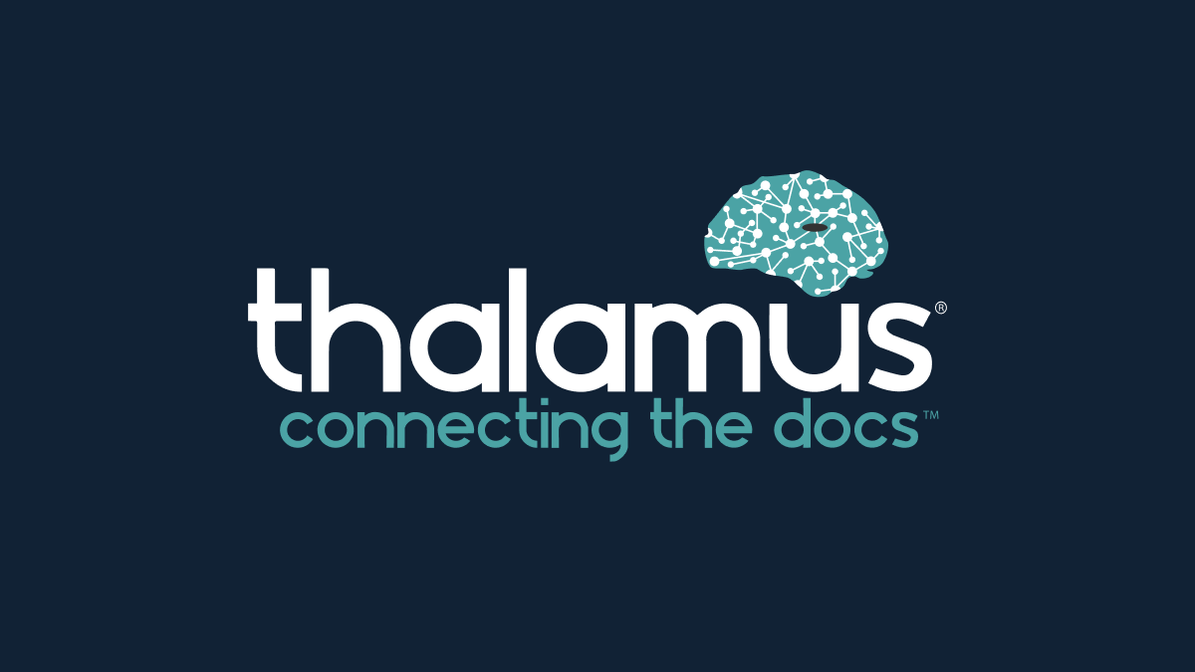


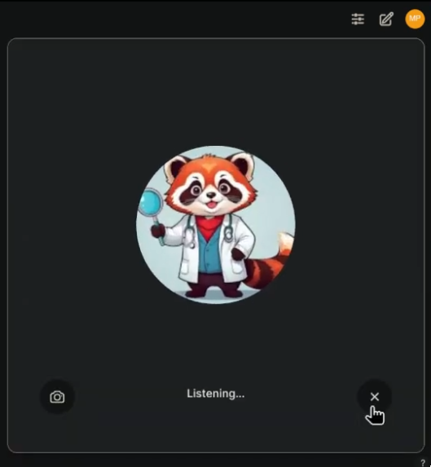


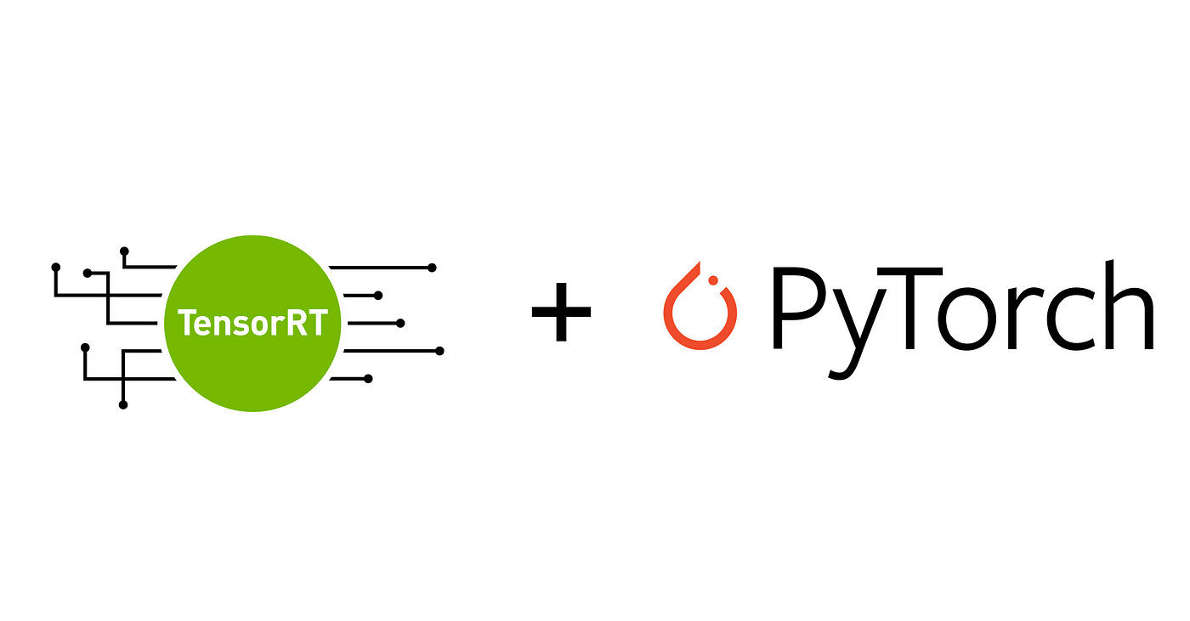
First, Do No Harm:
On Making AI safe, secure and trustworthy
Matt A. Porter, B.S¹, Henry Mroch MD³ ¹Qompass AI, Spokane, WA ²Department of Nephrology, Washington State University Elson S. College of Medicine, Spokane, WA
Intro:
Generative Artificial Intelligence
(Gen AI) now is increasingly used in medicine and education. Acute impacts range from residency selection, clinical documentation, and copilots to learners and educators
Methods
We developed a novel protocol of software tooling to train, host, and deploy small multimodal AI models on-device secured by NIST-endorsed post-quantum cryptography for $0
Results
Current SMM capabilities include multi-language conversation understanding with audio-text generation to address cultural and physical communication barriers. All Post Quantum Cryptography Benchmarks and links to code are accessible via qr-code to our public github.
1,000,000+ Public AI models & datasets
Conclusion
We public-source our code with asynchronous video under Q-CDA/A-GPL3.0 Dual License
How can individuals and institutions adopt quality AI?
We implement CUDA 12.8, Pytorch 2.6, OpenSSL 3.4.1, with oqs-provider 0.80 on Arch Linux

