Slide 1






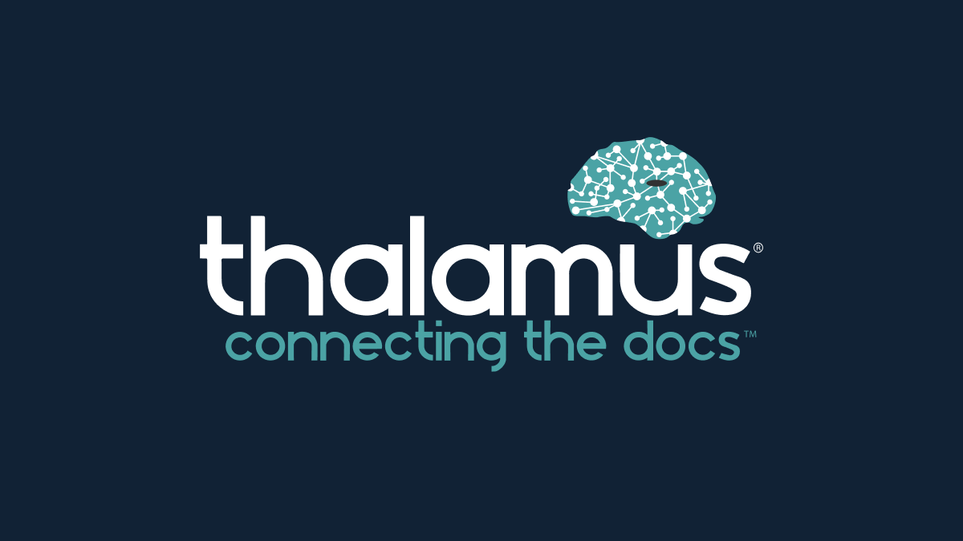


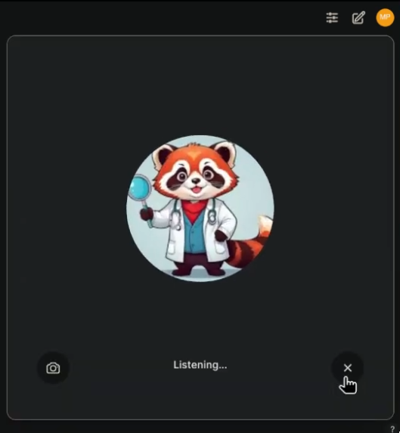


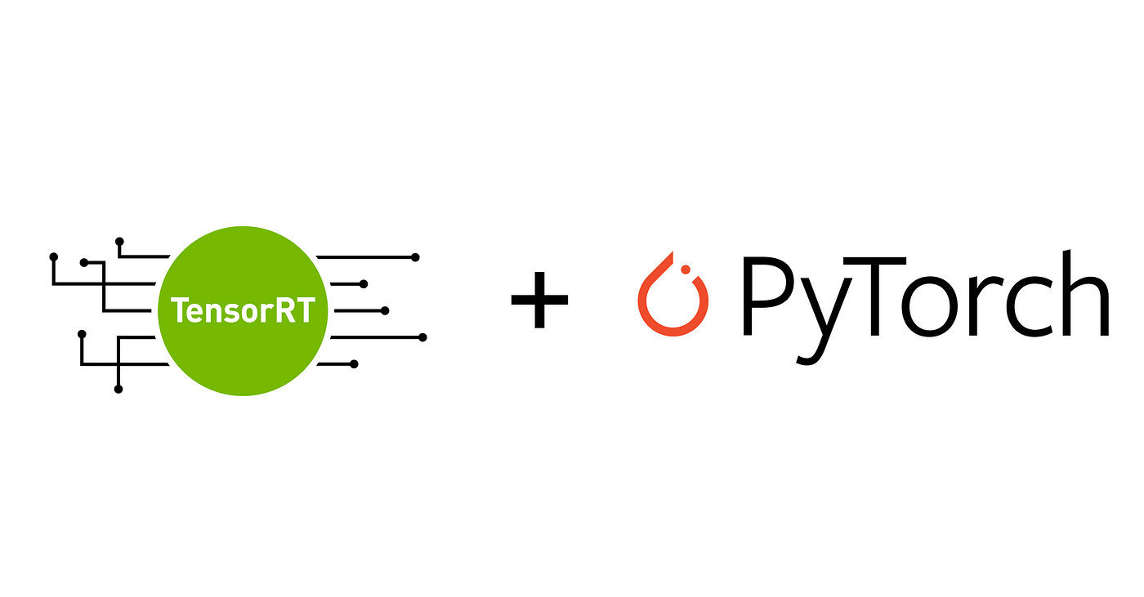

First, Do No Harm:
On Making AI safe, secure and trustworthy
Matt A. Porter, B.S¹, Henry Mroch MD³ ¹Qompass AI, Spokane, WA ²Department of Nephrology, Washington State University Elson S. College of Medicine, Spokane, WA
Generative Artificial Intelligence
(Gen AI) now is increasingly used in medicine and education. Acute impacts range from residency selection, clinical documentation, and copilots to learners and educators
We developed a novel protocol of software tooling to train and host small multimodal AI models on-device.
Current SMM capabilities include multi-language conversation understanding with audio-text generation to address cultural and physical communication barriers.
1,000,000+ Public AI models & datasets
How can individuals and institutions adopt quality AI?

