Slide 1



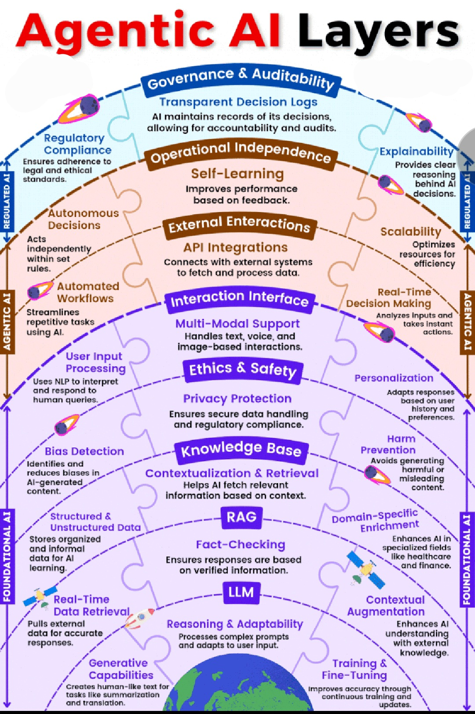
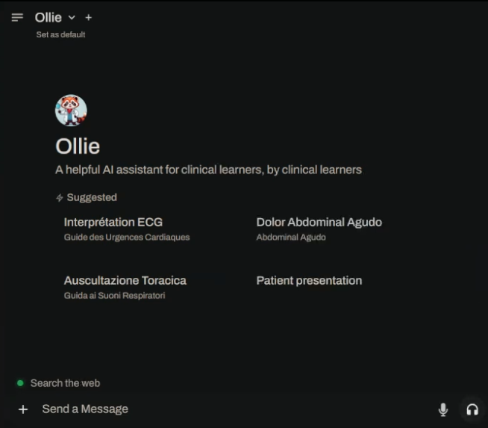


The Responsible Open Science Engine:
Powering Minimally Invasive AI for Mentorship
Matt A. Porter, B.S¹, Ariana Rowshan BA², Marchea J. Hill DO², Dawn L. Laporte, MD² Amiethab A. Aiyer, MD² ¹Qompass AI, Spokane, WA ²The Johns Hopkins University School of Medicine, Department of Orthopaedic Surgery, Baltimore, MD
Generative AI's evolving role in medicine extends beyond traditional medical competency assessment into critical new opportunities and risks.
We evaluate, develop, and deploy small multi-modal models (SMMs) and applications on-device with ethically built tooling to amplify the human intelligence clinical learners at
$0 cost
We public-source the main code-bases behind our year-long endeavor to cultivate equitable quality AI literacy in alignment with the AAMC Principles for the Responsible Use of Artificial Intelligence in and for Medical Education published January 03 2025.
Public code released under Q-CDA/AGPL dual-license

