Slide 1
Lidar automation package
Chenghung Yeh

Slide 2
Source and document
Github location: https://github.platforms.engineering/CYEH1/LiDAR-package
Team folder: https://monsanto365.sharepoint.com/teams/AEHarvestSys/LiDAR/
The sample data and MATLAB code:
Y:\Team\Active\Combine Imaging\Data\Yeh\3rd Data\VELODYNE\09-13-2016 Column_63\Plot 1-36

Slide 3
Workflow
Installment of Lidar and GPS
Manual
LiDAR: VLP-16 User Manual 20170206_newest.pdf
GPS: AGS-372
Hardware
Mount LiDAR
Power
Ethernet cable
Switch
Configure LiDAR using Veloview
Acquisition setting: angle/ RPM/ IP
Mount GPS
Power
Series port
Display data
Read Lidar
Veloview : https://github.com/Kitware/VeloView
Read GPS
SerialPortListener_270410.zip
Aria
Acquisition
Choose LiDAR
STOP
Exporting data to CSV
Modeling using Matlab
Read CSV
Maximum height projection
Segmentation
Manually
GPS
Select Height range
Calculate lodging ratio
Plot R^2

Slide 4
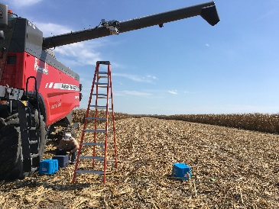
Mount LiDAR
Hardware
Mount LiDAR
Power
Ethernet cable
Switch
Mount it on the combine
Fix the scanning plane

Slide 5
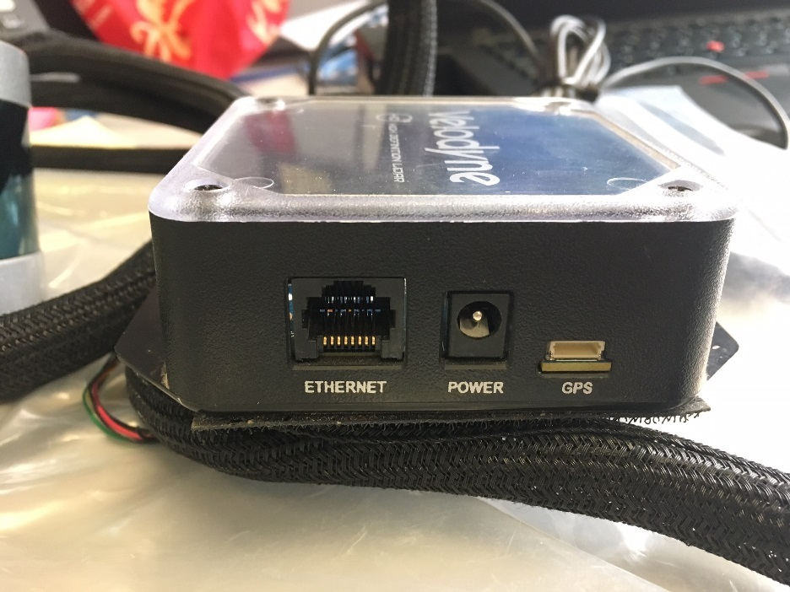
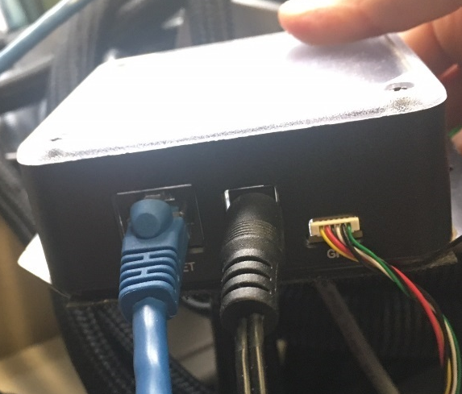
Mount LiDAR
Hardware
Mount LiDAR
Power
Ethernet cable
Switch
Connect the control box with power cable
Connect control box with Ethernet cable
Lidar control box

Slide 6
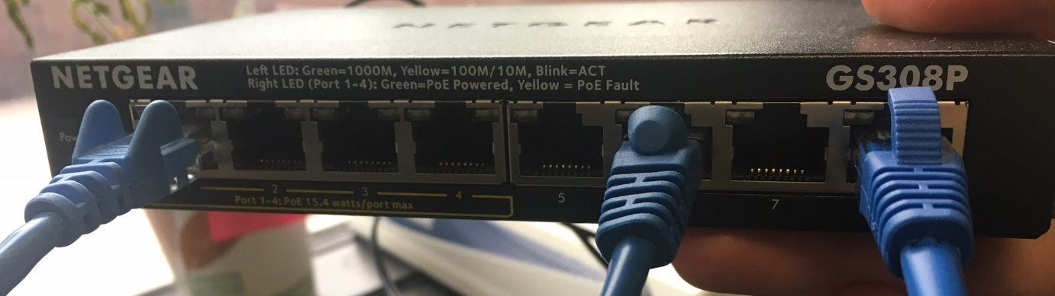
Mount LiDAR
Hardware
Mount LiDAR
Power
Ethernet cable
Switch
Switch
Connect cable from LiDAR control box to the switch
Repeat for the second Lidar

Slide 7
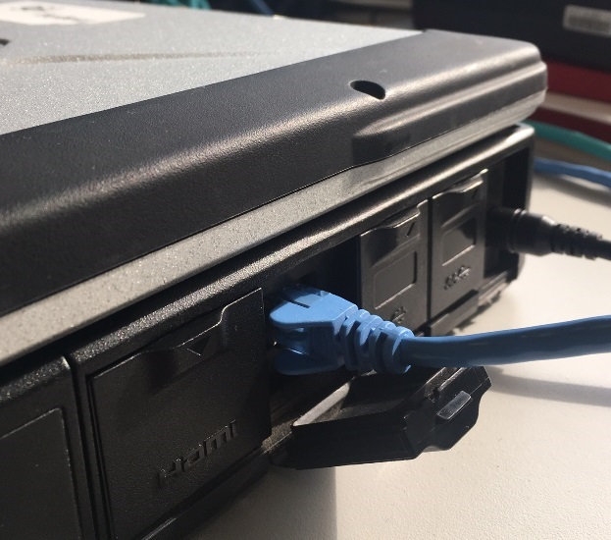
Mount LiDAR
Hardware
Mount LiDAR
Power
Ethernet cable
Switch
Switch
Connect the Ethernet cable between the switch and the laptop

Slide 8
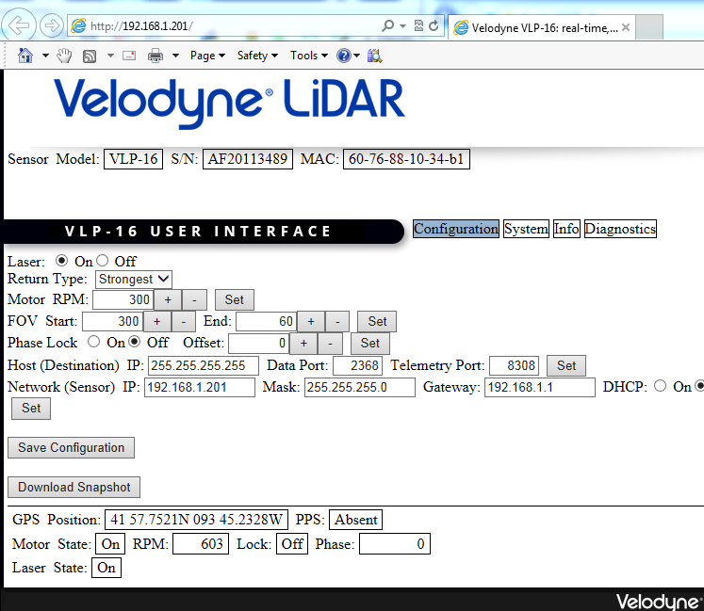
Configure LiDAR using Veloview
Configure LiDAR using Veloview
Acquisition setting: angle/ RPM/ IP
The default setting: 600 Motor RPM, FOV: [359 0]
Open Explore, type LiDAR IP
Left one: 192.168.1.201
Right one: 192.168.1.202
You can save the setting anytime

Slide 9
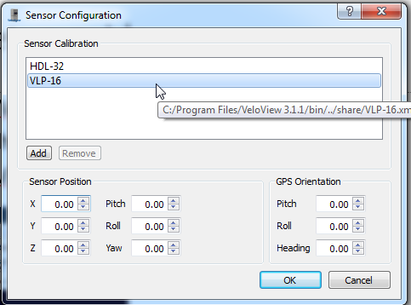
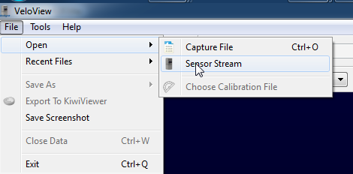
Display
Display data
Read Lidar data
Veloview : https://github.com/Kitware/VeloView
Install VeloView software
Connect Ethernet cable and turn car power on
Open VeloView, File\Open\Sensor Stream, then choose VLP-16

Slide 10
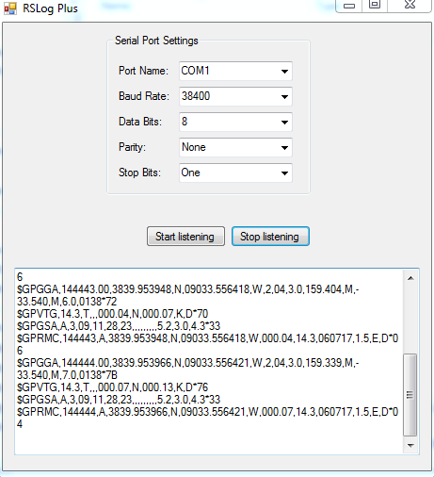
Display GPS
Display data
Read GPS
SerialPortListener_270410.zip

Slide 11
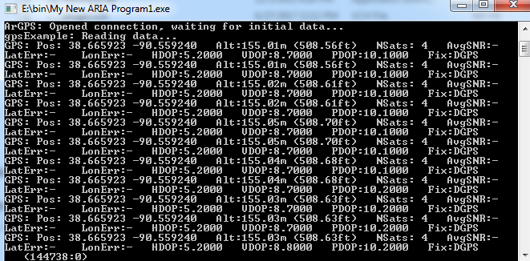
Display GPS
Display data
Read GPS
Aria: Run My New Aria Program1.exe

Slide 12
Acquisition LiDAR
Acquisition LiDAR
MFCA_winpcap.exe or Veloview
Choose LiDAR
STOP
MFCA_winpcap.exe was built by image discovery team
Velvoiew is the official software from Velodyne

Slide 13
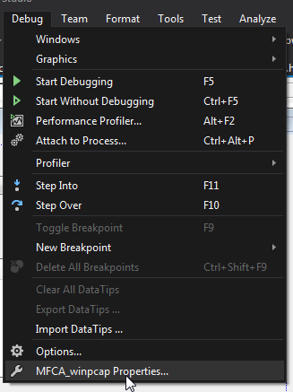
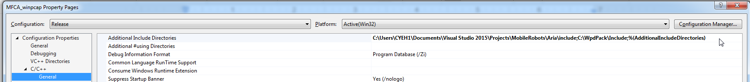
MFCA_winpcap.exe: library installation
Installing and configuring WinPcap
https://www.codeproject.com/Articles/30234/Introduction-to-the-WinPcap-Networking-Libraries
Under the “Configuration Properties -> C/C++ -> General” tab, add the WinPcap include path (“C:\WpdPack_4_0_2\WpdPack\Include”) to Additional Include Directories:
Please follow the rest steps

Slide 14
MFCA_winpcap.exe: library installation
Install Aria and follow this docuemnt
http://robots.mobilerobots.com/ARIA/download/current/README.txt
LiDAR package\Aria
Use template or new project from scratch

Slide 15
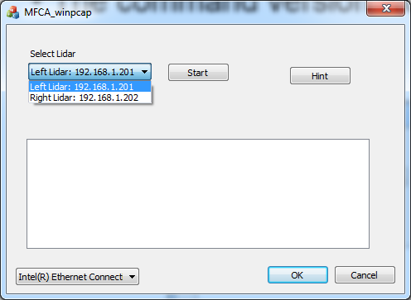
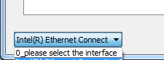
MFCA_winpcap.exe: Choose LiDAR
Acquisition LiDAR
MFCA_winpcap.exe
Choose LiDAR
Start LiDAR and GPS acquisition
STOP

Slide 16
Start LiDAR and GPS acquisition
Acquisition LiDAR
MFCA_winpcap.exe
Choose LiDAR
Start LiDAR and GPS acquisition
STOP

Slide 17
STOP LiDAR
Acquisition LiDAR
MFCA_winpcap.exe
Choose LiDAR
Start LiDAR and GPS acquisition
STOP LiDAR

Slide 18
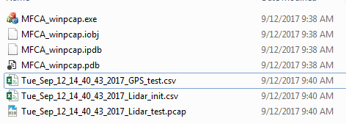
File path
Acquisition LiDAR
File path
Acquisition data was saved at the same folder
Lidar_test.pcap: point cloud data. Use Veloview to convert it to csv
GPS_test.csv: GPS data
Lidar_init.csv: use system time to synchronize Lidar data and GPS data

Slide 19
Synchronization
Init.csv record the system time for the first Lidar data
Acquisition start
GPS
System time
LiDAR
LiDAR time
Init.csv
System time
Program end

Slide 20

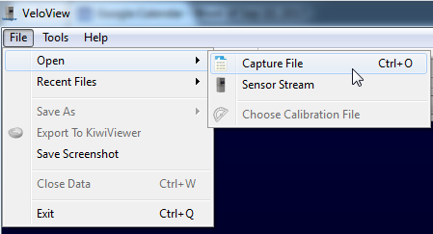
Exporting data to CSV
Lidar data
Open Veloview
File/Open/Capture File
Select *.pcap

Slide 21
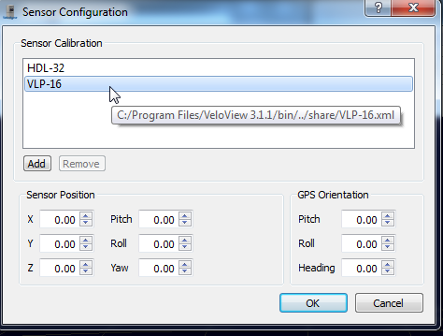
Exporting data to CSV
Lidar data
Select LiDAR model (default: VLP-16)

Slide 22
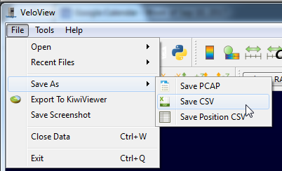
Exporting data to CSV
Lidar data
Save As/ Save CSV
It takes time to convert each frame to zip file

Slide 23
Process data – read CSV
Modeling using Matlab
Read CSV
2D projection
Stack data from each channel
Segmentation
Manually
GPS
Select Height range
Calculate lodging ratio
Plot R^2
Set data path, and check GPS data
C:\Users\CYEH1\OneDrive - Monsanto\software\Lidar\3rd Data\VELODYNE\09-13-2016 Column_63\Plot 1-36\step1_GPS_lidar_set6_v7_lidarGPS_doc.m
Read CSV, 2D projection, visualization
C:\Users\CYEH1\OneDrive - Monsanto\software\Lidar\3rd Data\VELODYNE\09-13-2016 Column_63\Plot 1-36\step2_plotOneChannel_otherChannels8v4_doc.m
Output: plotOneChannel_for_data_channel_digit.mat
digit: channel index

Slide 24
Process data – Stack data from each channel
Stack data from each channel
C:\Users\CYEH1\OneDrive - Monsanto\software\Lidar\3rd Data\VELODYNE\09-13-2016 Column_63\Plot 1-36\step3_calculateChannelsDelta_v4_doc.m
Load selected channel data
laser_id_range = [1 14 3 12 5 10 7 8];
Determinate the offset against channel 1
Repeat to find all offset
shift = -4; [0 -4 4 -6 6 -10 7 -12 6];
Stack channel data based on the estimated offset
shift0 = [0 -4 4 -8 6 -10 6 -12 6];
Visualize height in RGB color
SO2_scale = [1.5 3.6] ;
Outfile:
plotOneChannel_for_data_channel[******].amt

Slide 25
Process data – select height range
Histogram analysis
C:\Users\CYEH1\OneDrive - Monsanto\software\Lidar\3rd Data\VELODYNE\09-13-2016 Column_63\Plot 1-36\step4_histogram_error_save_v9_doc.m
Type in the laser channel range
laser_id_range = [1 14 3 12 5 10 7 8];
Segment manually, decide: yRange and xRange
yRange = [1000 1180 1365 ;
1180 1365 1550];
xRange1234 = [1628 1269 853 478;
1789 1537 1204 851];
set height range
sumRange = [11 15]; %2.5-2.9
Output file:
features.mat
Repeat it for other field data

