Slide 1
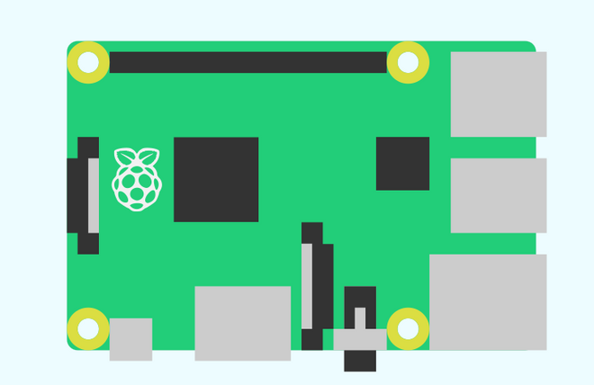
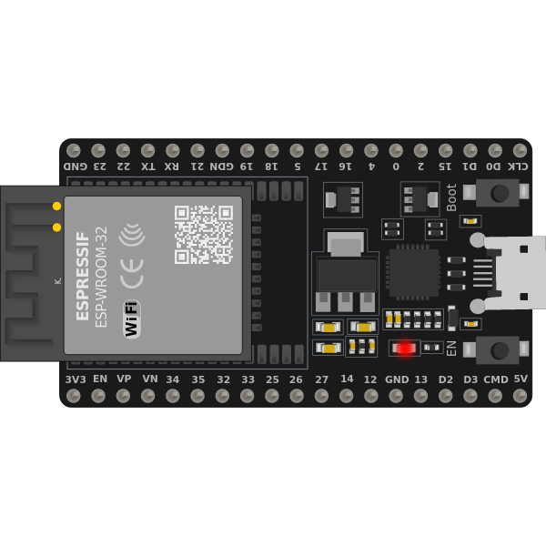

システム構成
Raspberry Pi
Grafana
Elasticsearch
Wi-Fi
Edge1
Edge2
Edge3
Edge devices
Temperature
Humidity
Pressure
Soil Moisture
Plant environment

