Slide 1
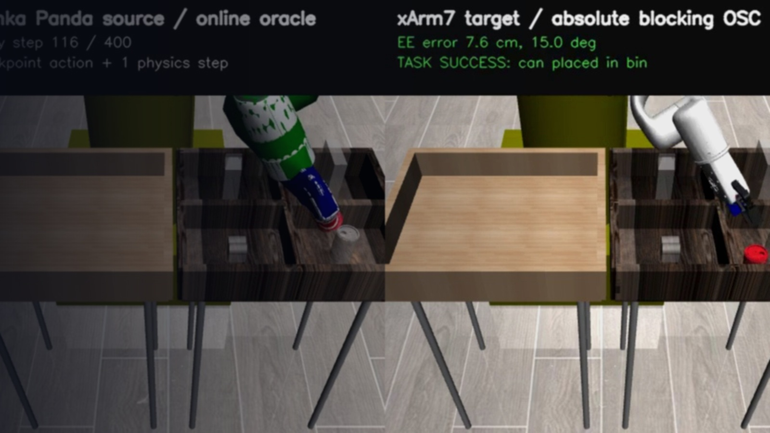
MIRAGE · CROSS-EMBODIMENT
Panda → xArm7
Simulation Policy Transfer
현재 실험 세팅 · 전이 파이프라인 · 정량 검증
PickPlaceCan + Lift | Robosuite 1.4.1 | low-dimensional policy
TARGET SUCCESS PickPlaceCan step 116
2026.08.10 · local working tree

Slide 2
한 줄 결론
02
정책 실행 주체와 성공 판정 주체를 분리해 xArm7 전이를 검증
정책은 Panda에서 실행하고,
성공은 xArm7에서 판정했다.
1 / 1
4 / 4
0
PickPlaceCan
Lift
실패 이벤트
동일한 저차원 체크포인트 출력을 Panda 시뮬레이터에서 1 step 실행한 뒤,
달성 pose를 변환·검증하여 xArm7이 절대 pose로 추종한다.
target step 116
contact-relaxed steps 32
seeds 0, 1, 3, 7
target step 41–57
timeout 0
iteration limit 0
rejection 0
의미 로봇 형태가 달라도 task-space pose contract로 실행 경로를 분리
현재 결과는 실제 로봇이 아닌 시뮬레이션 검증이다.
검증 현재 작업 트리 회귀 테스트 87 passed
Local working tree · 2026-08-10 · SIMULATION ONLY
sources: task-aware rollout reports + pytest

Slide 3
실험 세팅
03
source policy와 target control environment를 완전히 분리
SOURCE
TARGET
Franka Emika Panda
xArm7
Robosuite robot id: Panda
in-process Robosuite target
pose contract
• 저차원 robomimic checkpoint
• action: [Δp(3), Δrotvec(3), gripper]
• OSC_POSE · control_delta=true · 20 Hz
• checkpoint action + 1 physics step
• camera / offscreen rendering disabled
• policy camera를 상속하지 않는 control env
• absolute blocking OSC_POSE
• target task success로만 early stop
• workspace / joint / freshness safety gate
• gripper: −1 open, +1 closed
panda_sim_world
xarm7_sim_world
범위 SIMULATION ONLY · ROS command / xArm SDK / robot IP / real calibration 사용 안 함
Local working tree · 2026-08-10 · SIMULATION ONLY
source: xarm_transfer_sim.example.yaml

Slide 4
End-to-end 실행 파이프라인
04
온라인 oracle과 learned Ridge가 같은 계약·안전 계층을 공유
01
02
03
04
05
06
07
Checkpoint
Panda step
Transform v2
Dynamics
Safety gate
xArm7 OSC
Target success
raw action
+ metadata
one policy step
+ achieved pose
task world ×
tool frame
online oracle
or Ridge
fresh · finite
workspace · joints
absolute blocking
+ outer loop
task event
terminates
Provider만 교체 oracle: Panda achieved next pose | Ridge: autoregressive predicted pose
achieved pose feedback
같은 frame·unit·timestamp contract와 fail-closed validation을 모든 단계에서 유지
Local working tree · 2026-08-10 · SIMULATION ONLY
source: rollout.py · contracts.py · runtime.py

Slide 5
좌표 변환 v2
05
task/world 정합과 tool convention을 분리해 motion direction 왜곡을 방지
TtargetWorld,targetTool = TtargetWorld,sourceWorld @ TsourceWorld,sourceTool @ TsourceTool,targetTool
LEFT-MULTIPLY
RIGHT-MULTIPLY
Task / world transform
Tool-frame correction
Panda와 xArm7이 동일한 task 좌표를 사용
nominal gripper axis 차이만 local-Z에서 보정
현재 값 IDENTITY
현재 값 −90° about local Z
translation = [0, 0, 0] m
rotation = [0, 0, 0, 1] XYZW
quaternion = [0, 0, −0.7071, 0.7071]
핵심 home pose로 변환을 추정하지 않으며, simulation transform을 real calibration으로 표시할 수 없다.
Local working tree · 2026-08-10 · SIMULATION ONLY
source: simulation_transform.py · transform version 2

Slide 6
Target control & safety
06
absolute blocking OSC에 보상 루프와 task-aware 예외를 제한적으로 적용
ADMISSION GATES
BLOCKING OSC
CONTACT EXCEPTION
Frame / type
simulation_only · xarm7_sim_world
Free-space convergence
PickPlaceCan only
simulator가 gripper ↔ Can 접촉을 직접 확인한 동안만
Freshness
age ≤ 0.15 s · future skew ≤ 0.02 s
2.5
7°
Workspace
[−0.65,−0.60,0.40]–[0.35,0.60,1.35] m
6.0 cm / 18°
cm
orientation
position tol.
tolerance
• Kp = [300,300,500,300,300,300]
• position compensation ≤ 10 cm
• Lift에서는 항상 비활성
• workspace/joint/freshness gate는 유지
Joint limits
model limit + 0.01 rad margin
• 5 consecutive in-bound steps
• position correction ≤ 3 cm
• orientation correction ≤ 5°
• timeout 2 s · max 300 iterations
Learned model
held-out position / orientation bounds
Target task-success event가 발생하면 마지막 EE pose가 미수렴이어도 즉시 종료
Local working tree · 2026-08-10 · SIMULATION ONLY
source: profiles.py · control.py

Slide 7
평가 프로토콜
07
task profile이 checkpoint·observation·controller를 정적으로 고정
TASK 01
• object obs [14] · graspable Can
• checkpoint: can / low_dim / epoch 250
• native horizon 400 · full task seed 1
• contact relaxation enabled
TASK 02
• object obs [10] · graspable cube
• checkpoint: lift / low_dim / epoch 1000
• native horizon 400 · seeds 0,1,3,7
• contact relaxation disabled
PickPlaceCan
Lift
PROVIDERS
DATASET
RUNTIME CONTRACT
online_oracle
Panda achieved next pose를 즉시 사용
learned_ridge
recorded action을 autoregressive replay
300 transitions
low_dim만 실행 가능
image modes: classified, fail closed
unregistered task: fail closed
Lift Ridge training: 현재 범위 밖
train: seeds 0,2,4,5 (200)
validation: seeds 1,3 (100)
whole-episode split · seed 11
Local working tree · 2026-08-10 · SIMULATION ONLY
source: profiles.py · dataset/model reports

Slide 8
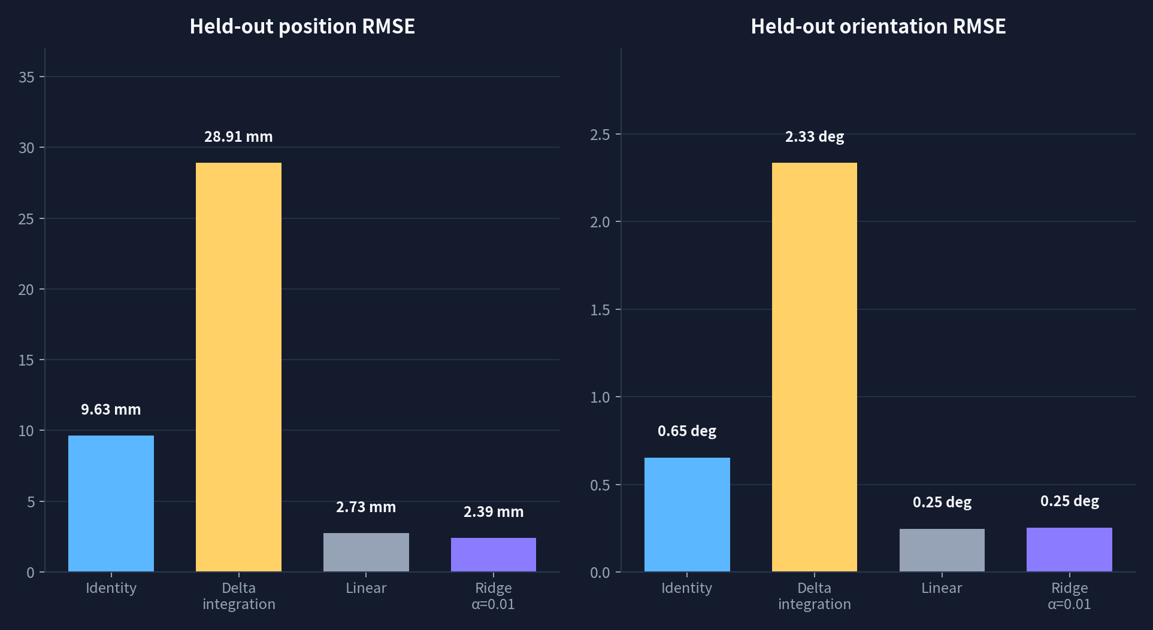
Forward dynamics: held-out one-step prediction
08
episode leakage 없이 100개 validation transition으로 비교
2.39 mm
Ridge position RMSE
α = 0.01 · selected deployable model
0.254°
Ridge orientation RMSE
held-out one-step prediction
≈75%↓ position RMSE
Ridge vs. identity baseline
9.63 mm → 2.39 mm
주의: one-step held-out error는 50-step autoregressive drift의 online safety bound가 아니다.
Local working tree · 2026-08-10 · SIMULATION ONLY
source: forward_dynamics_evaluation.json

Slide 9
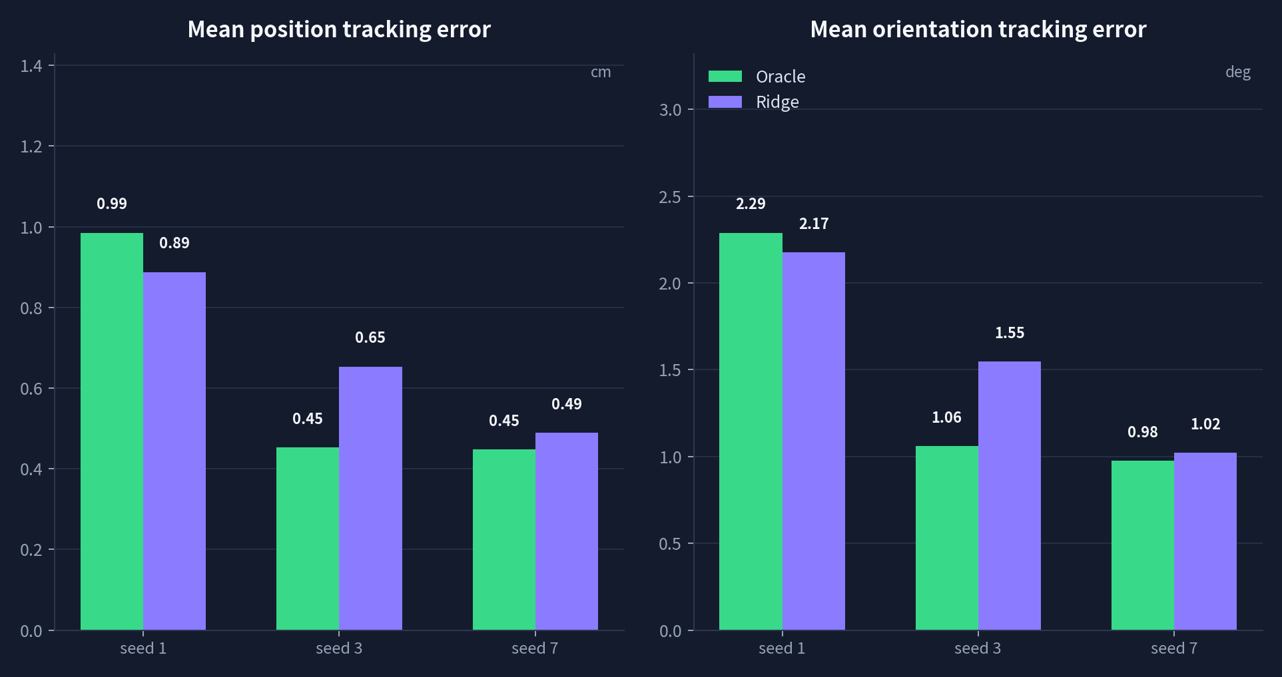
50-step xArm7 tracking: Oracle vs. Ridge
09
동일 held-out seeds 1·3·7, 같은 transform·controller·safety stack
6 / 6
rollouts complete
Oracle 3 + Ridge 3
all 50 / 50 steps
0
control failures
timeout · iteration limit
rejection · contact event
Ridge도 target tracking 유지
mean pos 0.49–0.89 cm
mean ori 1.02–2.17°
그래프는 controller가 달성한 target tracking mean error; learned source-pose drift와 분리해 보고
Local working tree · 2026-08-10 · SIMULATION ONLY
source: task_tool_v2 oracle / learned rollout reports

Slide 10
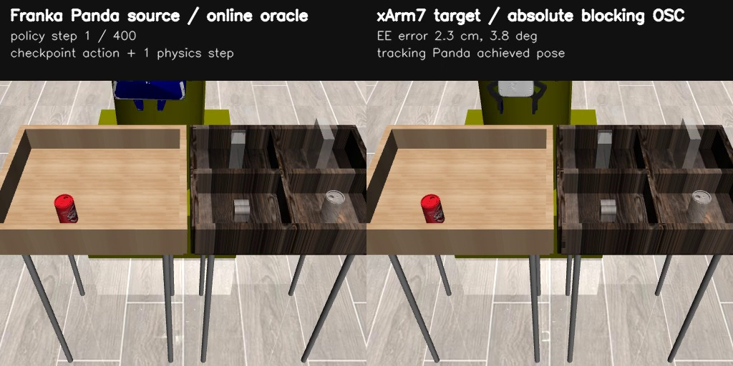
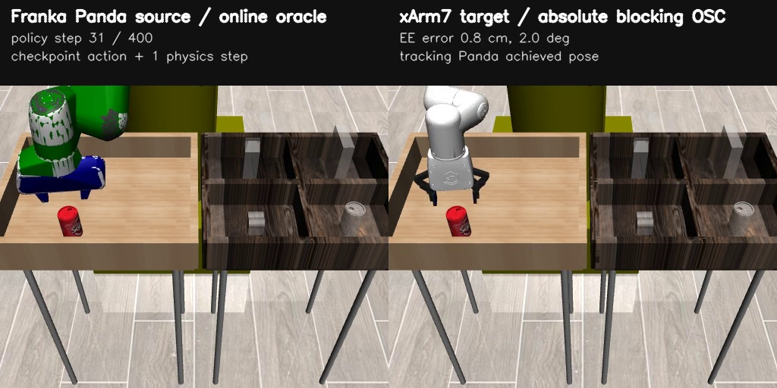
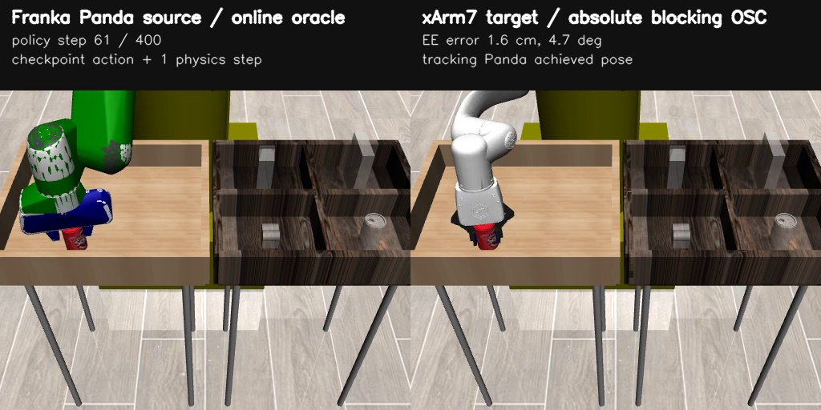
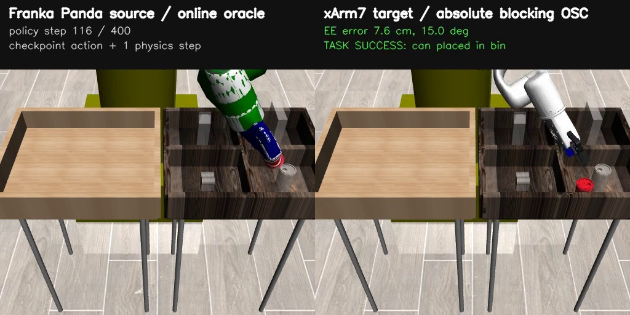
Full-task 결과 ① PickPlaceCan
10
xArm7가 can을 집어 bin에 놓는 실제 task event로 성공 판정
SEED 1
116 / 400
policy steps until target success
STEP 1 · approach
STEP 31 · pre-grasp
• timeout 0 · iteration limit 0
• safety rejection 0
• verified-contact steps 32
• mean command latency 38.6 ms
• target-only early termination
STEP 61 · grasp
STEP 116 · TARGET SUCCESS
final task event > pose convergence
성공 시점의 큰 EE residual은 object contact / immediate task-success 규칙으로 별도 기록됨
Local working tree · 2026-08-10 · SIMULATION ONLY
source: panda_xarm_oracle_seed1_full_task.mp4 + report

Slide 11
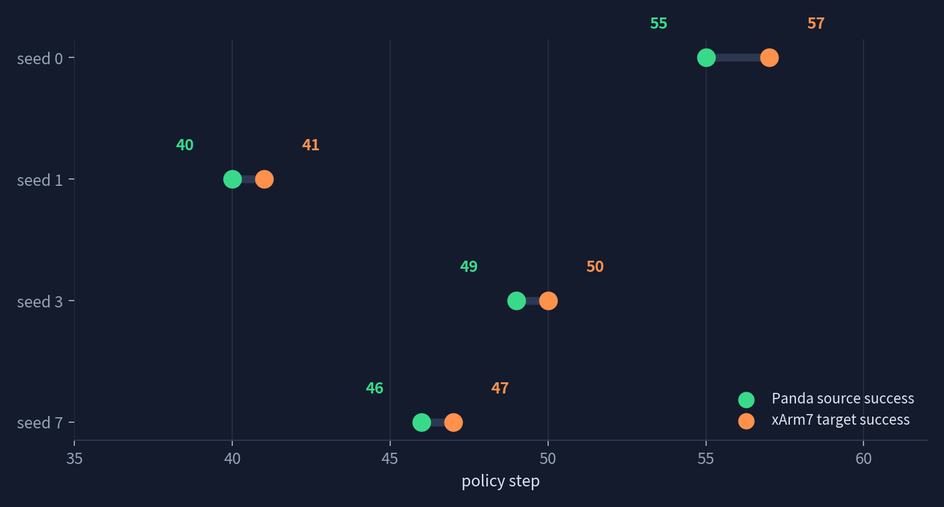
Full-task 결과 ② Lift
11
모든 seed에서 target success까지 계속 실행; contact relaxation은 사용하지 않음
4 / 4
target success
seeds 0 · 1 · 3 · 7
≤ 2.07 cm
maximum position error
all four full-task rollouts
0 failures
timeout · iteration limit
rejection · contact tolerance
seed 1: Panda success step 40 → xArm7 success step 41; source success가 target rollout을 조기 종료하지 않음
Local working tree · 2026-08-10 · SIMULATION ONLY
source: lift/low_dim/xarm_rollout_report.json

Slide 12
재현 방법
12
task-aware CLI가 checkpoint에서 task·mode·native horizon을 해석
RUN
ENVIRONMENT
cd mirage
MUJOCO_GL=egl ../.venv/bin/python -m \
mirage.benchmark.robosuite.xarm_transfer.cli rollout \
--checkpoint mirage/models/can/low_dim/\
model_epoch_250_PickPlaceCan_success_1.0.pth \
--mode oracle --seeds 1 --terminate-on-success
• Ubuntu 22.04.5 · Python 3.10.12
• Robosuite 1.4.1 · MuJoCo 2.3.2
• ROS 2 Humble installed, unused in rollout
• RTX 5060 Laptop GPU · EGL rendering
• branch: agent/xarm7-development
• HEAD: 4e4429e + local working tree
VERIFY
VALIDATION
PYTEST_DISABLE_PLUGIN_AUTOLOAD=1 PYTHONPATH=... \
python -m pytest -q --import-mode=importlib \
test_xarm_transfer_*.py test_canonical_policy_checkpoint.py
87 passed in 70.81 s
current working tree · 2026-08-10
results stay under ignored results/
Local working tree · 2026-08-10 · SIMULATION ONLY
source: CLI README + local validation

Slide 13
결론 및 다음 단계
13
현재 성과와 경계 조건을 함께 제시
현재 확보한 것
아직 주장하지 않는 것
NEXT
• Panda policy → xArm7 control의 명시적 contract
• task/world와 tool-frame을 분리한 transform v2
• PickPlaceCan 1/1, Lift 4/4 target success
• Oracle/Ridge 50-step 6/6 completion
• 87개 회귀·통합 테스트 통과
• 실제 xArm7 hardware 성공
• real-world calibration
• image observation runtime
• Lift learned Ridge model
• Stack/Square/Assembly 지원
1. real calibration 경로를 별도 구현
2. low-speed fake → real safety gate
3. image observation / cross-painting 연결
4. Lift용 dynamics dataset·Ridge 학습
5. multi-seed PickPlaceCan 확대
Takeaway · embodiment 차이는 pose contract로 흡수하고, 안전·성공 판정은 target에서 닫는다.
Local working tree · 2026-08-10 · SIMULATION ONLY
Mirage xArm7 simulation transfer

