Slide 1
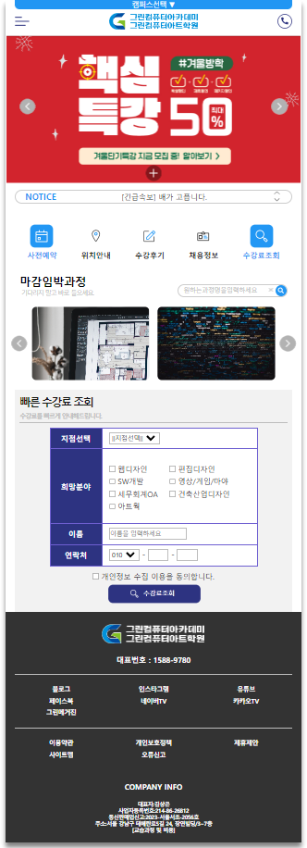
header
contents
footer

Slide 2
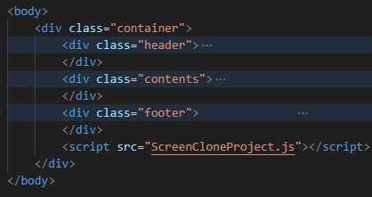
header
contents
container
footer

Slide 3
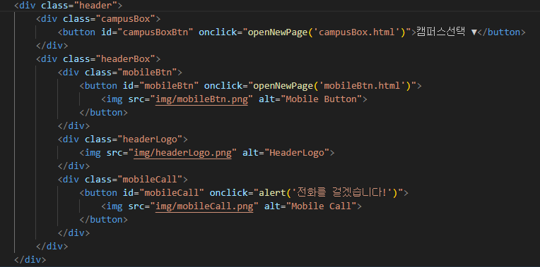

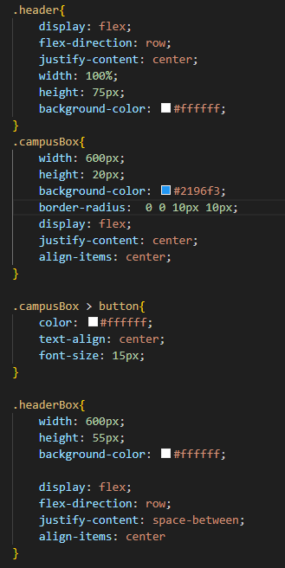

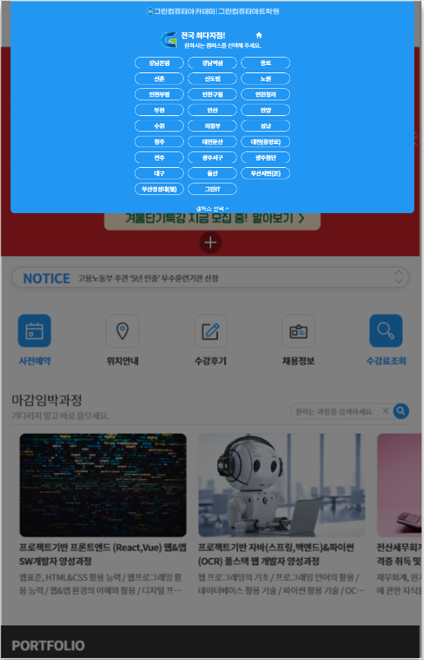
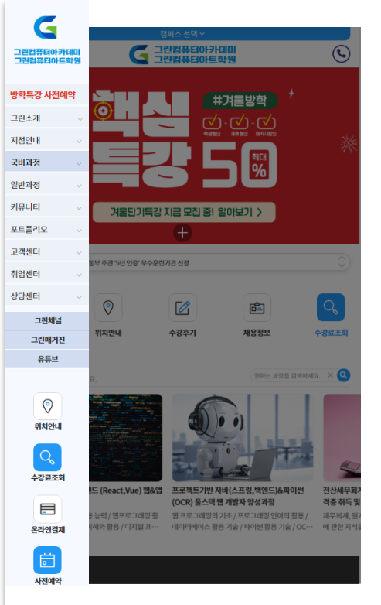
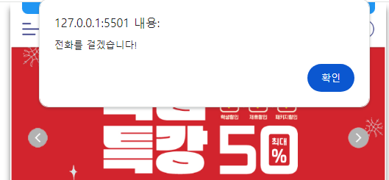

1. campusBox
2. mobileBtn
3. headerLogo
4. mobileCall
header
1.campusBox.html
(버튼-온클릭-파일)
2.moBileBtn.html
(버튼-온클릭-파일)
3. headerLogo
(그냥이미지)
4. mobileCall
(버튼-온클릭-알럿창)

Slide 4
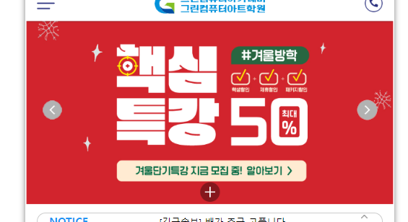
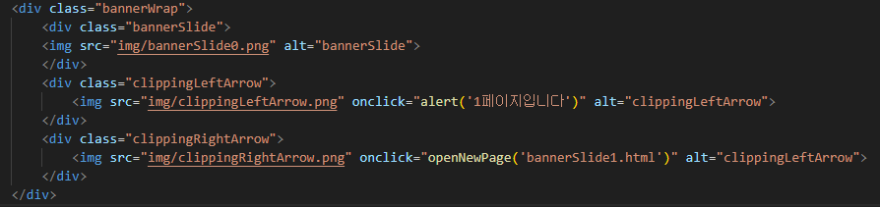
clippingLeftArrow
contents

