Slide 1
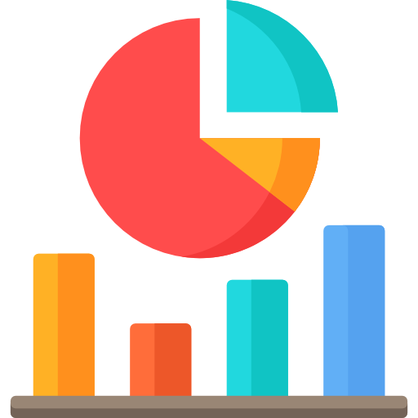
Statistics for Data Science
Lesson 1 — Foundations & Descriptive Statistics
What is Statistics • Population vs Sample • Types of Data • Descriptive Statistics • Visualizations

Slide 2

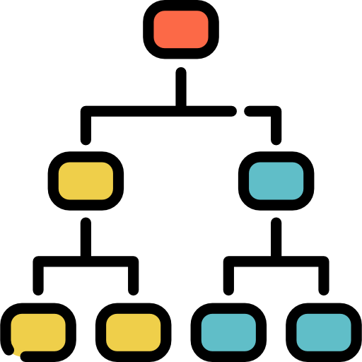



FOUNDATIONS
What is Statistics?
The science of collecting, organizing, analyzing and interpreting data
1. Collect
2. Organize
3. Analyze
4. Interpret
Gather data from surveys, experiments, sensors, databases or observations.
Structure the data into tables, groups and formats that make it usable.
Apply mathematical and statistical methods to find patterns and summaries.
Draw conclusions and make decisions based on the analysis.
In data science, statistics is not optional — it is the theoretical foundation that explains why our models work and when they fail.

Slide 3


FOUNDATIONS
Population vs Sample
We almost never have access to the full picture — we work with samples
Population
Sample
The ENTIRE group you want to study.
Every single member is included.
Example: All 8 billion people on Earth. All 10 million customers of a bank. Every transaction ever made.
In practice, collecting data on an entire population is usually impossible, too expensive, or too slow.
A SUBSET of the population.
Selected to represent the whole.
Example: 1,000 surveyed citizens. 500 randomly chosen customers. Last 3 months of transactions.
A good sample allows us to draw conclusions about the full population without studying every member.

Slide 4
FOUNDATIONS
Parameter vs Statistic
Same concept, different source — one from the population, one from a sample
Parameter (Population)
Statistic (Sample)
Definition
A number that describes the entire population
A number that describes a sample
Source
Calculated from every member of the population
Calculated from the selected sample
Symbol
Greek letters: μ (mean), σ (std dev), N (size)
Latin letters: x̄ (mean), s (std dev), n (size)
Known?
Usually unknown — too large to fully measure
Known — we calculated it from our data
Example
Average salary of ALL employees in a country
Average salary of 500 surveyed employees

Slide 5


FOUNDATIONS
Types of Data
Understanding what kind of data you have determines what you can do with it
Numerical (Quantitative)
Categorical (Qualitative)
Continuous
Nominal
Can take any value within a range. Infinite possible values between any two points.
Examples: height, weight, temperature, salary, time
Categories with NO meaningful order. Labels only. Cannot say one is greater than another.
Examples: gender, country, blood type, product category
Discrete
Ordinal
Countable whole number values. Gaps exist between values. Cannot be measured in fractions.
Examples: number of children, transactions per day, goals scored
Categories WITH a meaningful order, but gaps between them are not equal or known.
Examples: education level, satisfaction rating (1-5), customer tier (Bronze/Silver/Gold)

Slide 6


FOUNDATIONS
Observational Study vs Experiment
How the data was collected determines what conclusions we can draw
Observational Study
Experiment
You observe what is happening without interfering or controlling anything. What you can conclude: Association or correlation between variables — but NOT cause and effect. Example: You notice that people who drink coffee tend to be more productive. You cannot say coffee CAUSES productivity — both could be caused by a third factor (e.g. personality).
You intentionally change one variable (the treatment) and measure the effect on another, while controlling everything else. What you can conclude: Cause and effect — if designed properly. Example: You randomly assign 500 customers to see ad A and 500 to see ad B, then measure which group buys more. This is an A/B test — a controlled experiment.
VS

Slide 7
DESCRIPTIVE STATISTICS
Measures of Central Tendency
Three ways to describe the center of your data
Mean (Average)
Median (Middle)
Mode (Most Common)
x̄ = Σx / n
Middle value when sorted
Most frequent value
Add all values, divide by count.
Sort the data. Take the middle value. If even count, average the two middle values.
The value that appears most often. A dataset can have no mode, one mode, or multiple modes.
Sensitive to outliers. One extreme value can pull the mean far from the center.
Not affected by outliers. A better measure when data is skewed.
The only measure that works for categorical data.
Example:
Example:
Example:
Salaries: 2000, 2500, 3000, 3500, 20000
Mean = 6200 — misleading!
Salaries: 2000, 2500, 3000, 3500, 20000
Median = 3000 — more representative
Sizes sold: S, M, M, L, XL, M, S, M
Mode = M — most popular size

Slide 8
DESCRIPTIVE STATISTICS
Measures of Spread
Central tendency tells you the center — spread tells you how much the data varies around it
Range
The simplest measure. The gap between the largest and smallest values.
Easily distorted by a single outlier.
Scores: 42, 78, 85, 91, 95
Range = 95 − 42 = 53
Max − Min
Variance (σ² or s²)
Average of squared distances from the mean. Squaring penalizes large deviations more. Units are squared — hard to interpret directly.
If scores vary wildly, variance is large. If everyone scored similarly, variance ≈ 0.
Σ(x - x̄)² / n
Standard Deviation (σ or s)
Square root of variance. Same unit as the original data — easy to interpret. The most commonly used measure of spread.
Mean = 5000, SD = 500
→ Typical range:
4500 – 5500
√Variance
Standard deviation is your go-to measure of spread. A small std dev means data is tightly clustered around the mean. A large std dev means it is widely spread.

Slide 9
DESCRIPTIVE STATISTICS
Percentiles, Quartiles & IQR
Understanding where a value sits relative to the rest of the dataset
Percentile
Five Number Summary
The value below which a given percentage of observations fall.
The 70th percentile means 70% of the data is below that value.
The five number summary describes any dataset with just five values:
Q1 (25th percentile)
25% of the data falls below this point. Also called the lower quartile.
Minimum
Q1
Median (Q2)
Q3
Maximum
Q2 (50th percentile)
Box Plot (visual representation):
The median. Half the data is below, half above.
Q3 (75th percentile)
75% of the data falls below this point. Also called the upper quartile.
Min
Q1
Median
Q3
Max
IQR
IQR = Q3 − Q1 (the width of the box)
Interquartile Range = Q3 − Q1. Contains the middle 50% of data. Resistant to outliers.

Slide 10
DESCRIPTIVE STATISTICS
Skewness
The shape of a distribution — symmetric, or pulled in one direction
Left Skewed
Symmetric
Right Skewed
(Negatively Skewed)
(Normal / Bell-Shaped)
(Positively Skewed)
Mean < Median < Mode
Mean = Median = Mode
Mode < Median < Mean
The tail extends to the left. Most values are high, but a few very low values pull the mean down.
Data is evenly distributed around the center. The mean, median, and mode are all equal.
The tail extends to the right. Most values are low, but a few very high values pull the mean up.
Exam where most students scored high but a few scored very low.
Heights in a large population. IQ scores.
Income distribution. House prices. Most people earn less, a few earn a lot.

Slide 11
DATA VISUALIZATION
Visualizing Distributions
Histogram and Box Plot are the two most important charts in descriptive statistics
Histogram
Box Plot (Box-and-Whisker)
Shows the distribution of a single numerical variable. Bars represent ranges (bins) — the height shows how many values fall in each range.
Displays the five number summary visually. Reveals the center, spread, symmetry, and outliers of the data at a glance.
← IQR →
Min
Q1
Median
Q3
Max
Outlier
← Bins (ranges) →
Key: Each bar = a range of values. Width of bar = bin size. Height = frequency.
Key differences: A histogram shows frequency. A box plot summarizes spread and reveals outliers.

Slide 12
DATA VISUALIZATION
Bar Chart vs Histogram
They look similar but they are fundamentally different
Bar Chart
Histogram
Data type
Categorical data
Data type
Numerical (continuous or discrete)
X-axis
Categories (names, labels)
X-axis
Ranges / bins of values
Bars
Separated by gaps
Bars
Touch each other — no gaps
Order
Can be in any order
Order
Must be in numerical order
Purpose
Compare values across categories
Purpose
Show the shape of a distribution
Example
Sales by department, votes per candidate
Example
Distribution of ages, salary ranges
Rule of thumb: if the x-axis has names or labels → Bar Chart. If it has numbers in ranges → Histogram.

Slide 13

Lesson 1 — Key Takeaways
Statistics is the science of collecting, organizing, analyzing and interpreting data
Mean is affected by outliers — median is more robust when data is skewed
A population is the entire group — a sample is a representative subset of it
Std deviation measures spread — large std dev means data is widely spread
A parameter describes the population (often unknown) — a statistic describes a sample (known)
Percentiles and IQR help you understand where values sit in the distribution
Data types: Numerical (continuous / discrete) and Categorical (nominal / ordinal)
Right-skewed: mean > median. Left-skewed: mean < median. Symmetric: mean = median
Observational studies show correlation — experiments can show causation
Histogram shows distribution shape — Box plot reveals center, spread, and outliers

