Slide 1
10 reasons to use logback
Ceki Gülcü & Sébastien Pennec

Slide 2


~
The same basic plumbing only done better.
No revolution, only evolution.
Faster, smaller, higher gas mileage, and generally more bang for the buck.
Notes:
Faster: Certain critical operations, for instance determining whether a log statement should be logged or not, has been significantly improved. This operation takes about 3 nanoseconds in logback versus 30 nanoseconds in log4j. Logback also creates loggers faster : 13 microseconds instead versus 23 microseconds for log4j. More importantly, it fetches an existing logger in 94 nanoseconds versus 2234 nanoseconds for log4j, a 23 fold improvement. The improvement over JUL is also far from insignificant.
Smaller: Each logger instance uses up about 40 bytes of memory version 160 bytes for log4j.
More bang for the buck: Logback does a better job of presenting logs, has much improved filtering and evaluation capability. In short, it does everything that log4j does and more, but better.

Slide 3
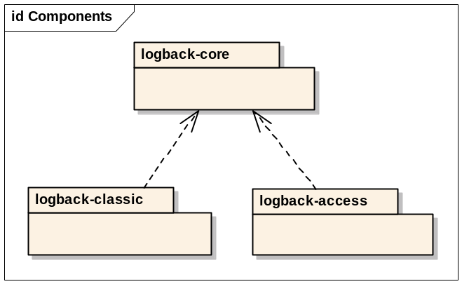
Modular architecture
logback-core
Joran, Status,
Context, pattern parsing
logback-classic
developer logging
logback-access
container (access) logging
Notes:
The logback-core module forms the foundation upon which the other two modules are built. Interestingly enough, logback-core has no notion of "logger." We have recently built a monitoring framework on top of just logback-core (without logback classic or access).
Logback-classic relies on logback-core for basic services. It natively implements the SLF4J API.
Logback-access integrates with servlet containers, in particular Jetty and Tomcat. Thus, the capabilities of a fully-fledged logging system can be leverages in servlet containers.

Slide 4
Access Logging
Definition: Access log
The log generated when a user accesses a web-page on a web server.
Logback-access integrates seamlessly with Jetty and Tomcat
Notes:
Show JMX counter.

Slide 5
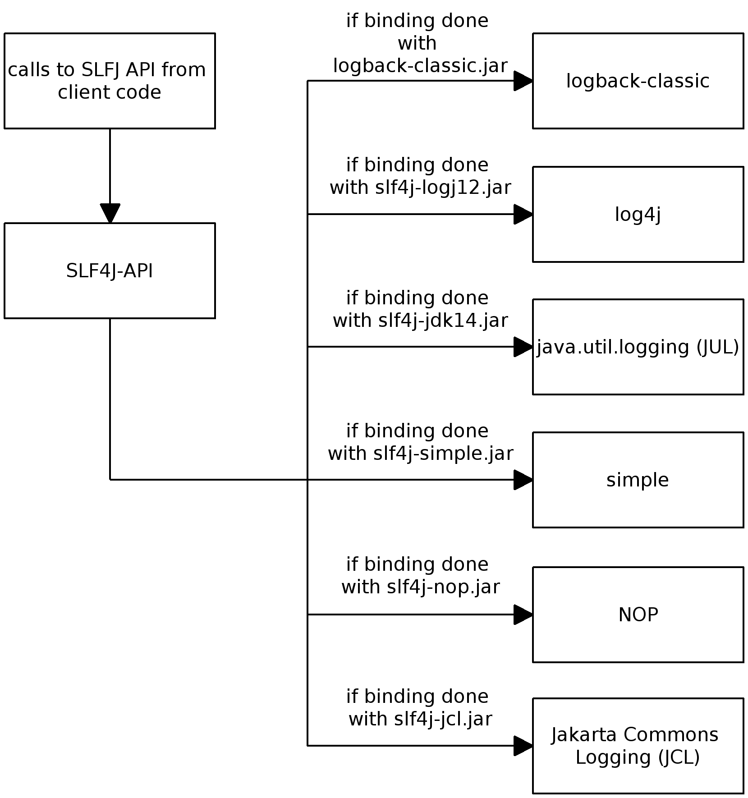
SLF4J in one slide

Slide 6
logback-classic speaks SLF4J
(as mother tongue)
SLF4J can delegate to log4j, logback, java.util.logging or JCL .
SLF4J can bridge jul, log4j and JCL.
Logback-classic offers a native implementation of the SLF4J API.
Logback-classic exposes its logging API through SLF4J.
Notes:
As a logback user, the vast majority of your will depend on SLF4J, not logback. Thus, if you later want to switch to JCL, JUL or log4j, you can do so with relative ease.
SLF4J acts as a universal logging API bridging between the various logging systems. Logback is designed to support SLF4J API from the start. In practice, it is a little less convenient to log directly through logback instead of (indirectly) with SLF4J. For example, logbacks documentation always uses SLF4J. (There are no examples in logback docs that use logback directly.)

Slide 7
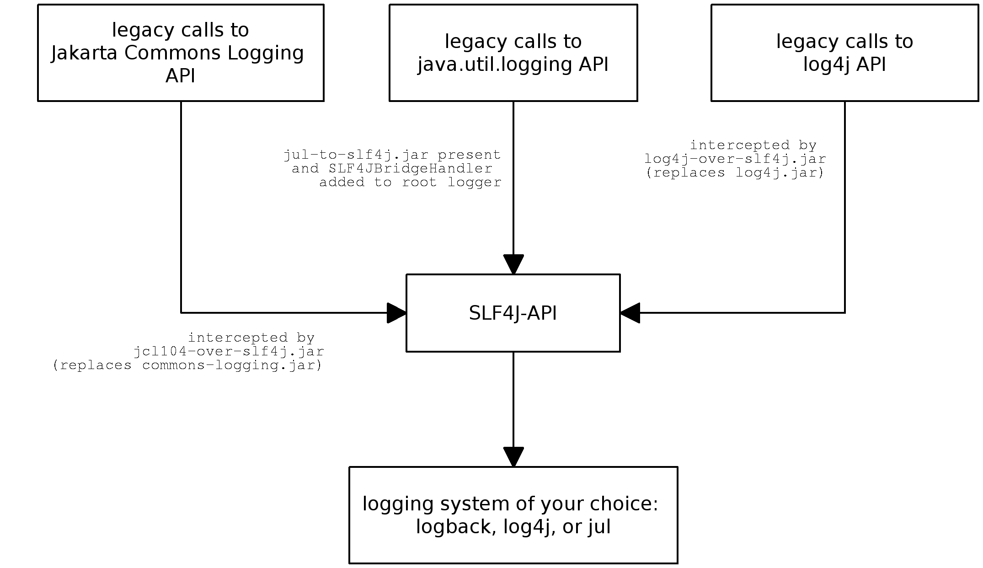
Migrate all jul, log4j and JCL calls (without changing a single line of code)
Notes:
With the help of log4j to logback bridge (log4j-bridge.jar), and the jakarta commons logging (JCL) to SLF4J bridge (jcl104-over-slf4j.jar), users who currently log through the log4j or JCL APIs can keep their existing log statements (without change).

Slide 8
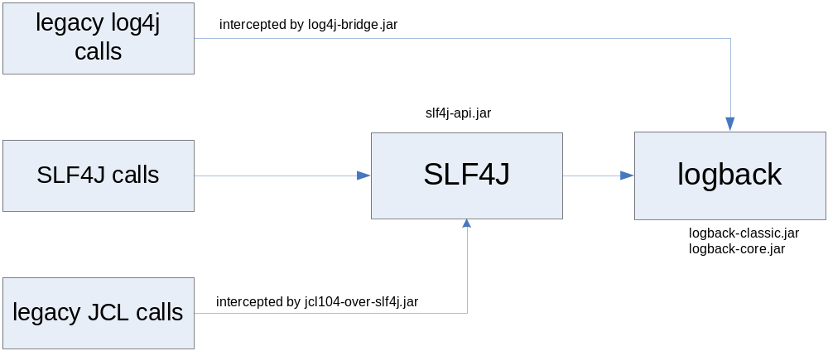
logback: better, faster, smaller.

Slide 9
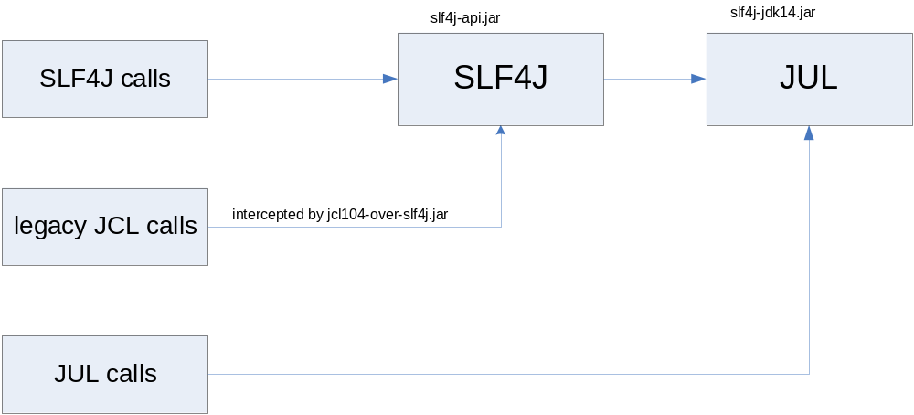
Do you prefer JUL?
Notes:
What if you to delegate all logging to JUL? Peace of cake! Just place slf4j-jdk14.jar in your application’s class path. To bridge JCL call’s to SLF4J, add jcl-over-slf4j.jar in your app’s class path.

Slide 10
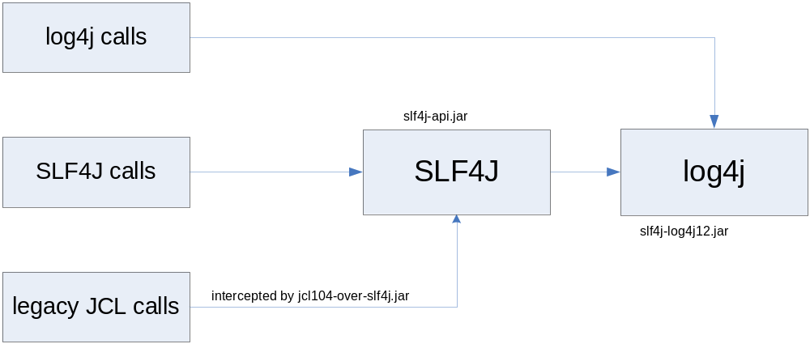
Log4j first, log4j for ever?
Notes:
You prefer to stick with log4j as your underlying logging system? No problem.
Just place slf4j-log4j12.jar in your application’s class path. To bridge JCL call’s to SLF4J, add jcl-over-slf4j.jar in your app’s class path.

Slide 11
Joran: a bowl of fresh air
Given rules (patterns & actions) it can configure any object.
It's generic (can be used in your own projects)
Joran can learn new rules on the fly.
With its implicit rules, you don’t even have to write rules.
It can do partial replay.
Notes:
An example with MultiFileAppender might be interesting.

Slide 12
Configuration example:
<appender name="FILE"
class="ch.qos.logback.core.rolling.RollingFileAppender">
<File>logFile.log</File>
<rollingPolicy
class="ch.qos.logback.core.rolling.TimeBasedRollingPolicy">
<FileNamePattern>
logFile.%d{yyyy-MM-dd_HH-mm}.log.zip
</FileNamePatter>
</rollingPolicy>
<layout class="ch.qos.logback.classic.PatternLayout">
<Pattern>
%d{HH:mm:ss,SSS} [%thread] %-5level %logger{22} - %msg%n
</Pattern>
</layout>
</appender>
Notes:
c.q.l is an abbreviation of ch.qos.logback
c.q.l.c.r stands for ch.qos.logback.core.rolling

Slide 13
Logback-access configuration
<appender name="FILE"
class="c.q.l.c.r.RollingFileAppender">
<File>access.log"</File>
<rollingPolicy
class="c.q.l.c.r.TimeBasedRollingPolicy"> <FileNamePattern>access.%d.log.zip</FileNamePattern>
</rollingPolicy>
<layout class="c.q.l.access.PatternLayout">
<Pattern">combined</Pattern">
</layout>
</appender>

Slide 14
Another example:
<testShell name="test1">
<period>5 minutes</period>
<!-- we need to configure a totally new test
object for each run of the test -->
<test class="com.wombat.myTest">
<DataSource class="c.w.JNDIDS">
<url>jndi://com.wombat/ds"</url>
</DataSource>
</test>
<testShell>
<testShell name="test2">
<period>60 seconds</period>
<test class="com.wombat.myTest2">
<file>c:/wombat/foo.properties</file>
</test>
</testShell>
Notes:
As mentioned previously, we've used Joran (part of logback-core) to implement a monitoring framework.
We needed to recreate sophisticated test object anew each time we needed to perform a verification. Joran's unique capability of selectively replaying parts of a configuration was a perfect match.

Slide 15
Is Joran for me?
Joran is ideal for building frameworks which need to support user-developed plug-ins.
Notes:
Given that
Joran can configure any component via setter/adder methods,
can be easily adjusted to process configuration elements via user-specified actions,
Joran is really ideal for building frameworks which need to support user-developed extensions.

Slide 16
Internal error reporting
Who shall guard the guards?
logback-core module cannot log to report its own state.
Something more generic is needed.
Notes:
logback-core modules cannot log because it has no notion of a "logger".
Loggers are defined in logback-classic.
But, more generally, a logging system which uses itself for its own logging is extremely difficult to design and to maintain. It can be done but a the cost of non-negligible complexity.
Instead logback relies on Status object to report its own state.

Slide 17
Status API
public interface Status {
public final int INFO = 0;
public final int WARN = 1;
public final int ERROR = 2;
int getLevel();
int getEffectiveLevel();
Object getOrigin();
String getMessage();
Throwable getThrowable();
public boolean hasChildren();
public void add(Status child);
public boolean remove(Status child);
public Iterator<Status> iterator();
}
Notes:
In short, a Status object contains a message, an origin, and a level. Moreover, a Status object may have children, which may have children of their own.
The effective level of a Status is equal to highest level of either itself or in any one of its children (at any depth).
Note that the Status API is generic and can be used projects other than logback.

Slide 18
Errors in action
Internal state available via StatusManager
Exceptions and status messages accompanied by references, i.e. URLs, to external documents
Notes:
- ajouter une classe XYAppender, ajouter la config nécessaire dans logback-YY.xml et montrer que la config est faite toute seule, sans modifier quoi que se soit.
- configuration: configurer un fichier xml avec une erreur (pas de TriggeringPolicy dans un RollingFileAppender) et montrer l'effet des status objects et le lien vers la page codes.html. Logback se manifeste lorsqu'il y a une erreur et fourni une piste à suivre pour la résoudre.

Slide 19
Documentation
Major area of effort.
Short Introduction
Complete manual (work in progress)
A short introduction to access logging with logback-access and Jetty
A introduction to Joran
javadoc, FAQ, error codes,…
Notes:
We consider code ready for distribution only after it is properly documented, which is the main reason why logback carries a 0.x version stamp instead of 1.x.

Slide 20
Filters, Filters. Filters everywhere
Filters attachable to any Appender and most contexts
Evaluator filters
Janino filters for evaluation based on java expression
TurboFilters for highly optimized processing

Slide 21
EvaluatorFilter & Janino
<appender name="CYCLIC"
class="c.q.l.core.read.CyclicBufferAppender">
<filter class="c.q.l.core.filter.EvaluatorFilter">
<evaluator name="loggingTaskEval">
<expression>
logger.getName().contains("LoggingTask") &&
message.contains("Howdydy-diddly-ho") &&
(timeStamp - event.getStartTime()) >= 20000
</expression>
</evaluator>
<OnMatch>DENY</OnMatch>
</filter>
<MaxSize>512</MaxSize>
</appender>
Notes:
- Turbo filtering example based on user login

Slide 22
TurboFilters
<turboFilter
class="c.q.l.classic.turbo.MDCFilter">
<MDCKey>username</MDCKey>
<Value>sebastien</Value>
<OnMatch>ACCEPT</OnMatch>
</turboFilter>

Slide 23
Parameterized logging
Integer entry = new Interger(50);
logger.debug("The entry is "+entry+".");
can be optimized as:
if(logger.isDebugEnabled()) {
logger.debug("The entry is "+entry+".");
}
or better yet:
logger.debug("The entry is {}.", entry);

Slide 24
Markers for specialized handling
Coloring for highly-specialized processing of log statements
Notes:
NO_EXCEPTION example

Slide 25
JMX
Logback components can be configured using JMX
Statistical results exposed via JMX

Slide 26
Tested & Ready
Battery of over 200 unit tests
Tests written concomitantly with the code
Logback is here and ready for use in production.
Notes:
Contrary to log4j, where we wrote many regression tests, in logback, we have learned our lesson well. We write many more unit tests and fewer integration tests.

Slide 27
Odds and ends
RollingFileAppender automatic file compression
SMTPAppender subject line
10 fold improvement in the speed of transporting logging events over the wire
logger name abbreviation algorithm

Slide 28
Questions?
read the docs at http://logback.qos.ch/
study the code at http://svn.qos.ch
write to us at logback-user@qos.ch
file a bug report at http://jira.qos.ch/
talk to us at +41 21 312 32 26

