Slide 1
SLF4J project
Ceki Gülcü
ceki@qos.ch

Slide 2
SLF4J
SLF4J: Simple Logging Façade for Java
Problem definition:
  Abstract logging frameworks
Automatically/dynamically adapt to the user’s environment
Manually/statically adapt to the user’s environment

Slide 3
Jakarta Commons Logging (JCL)
  Same problem domain
  Well-established
So why do we re-invent the wheel?
  Because implementation matters.

Slide 4
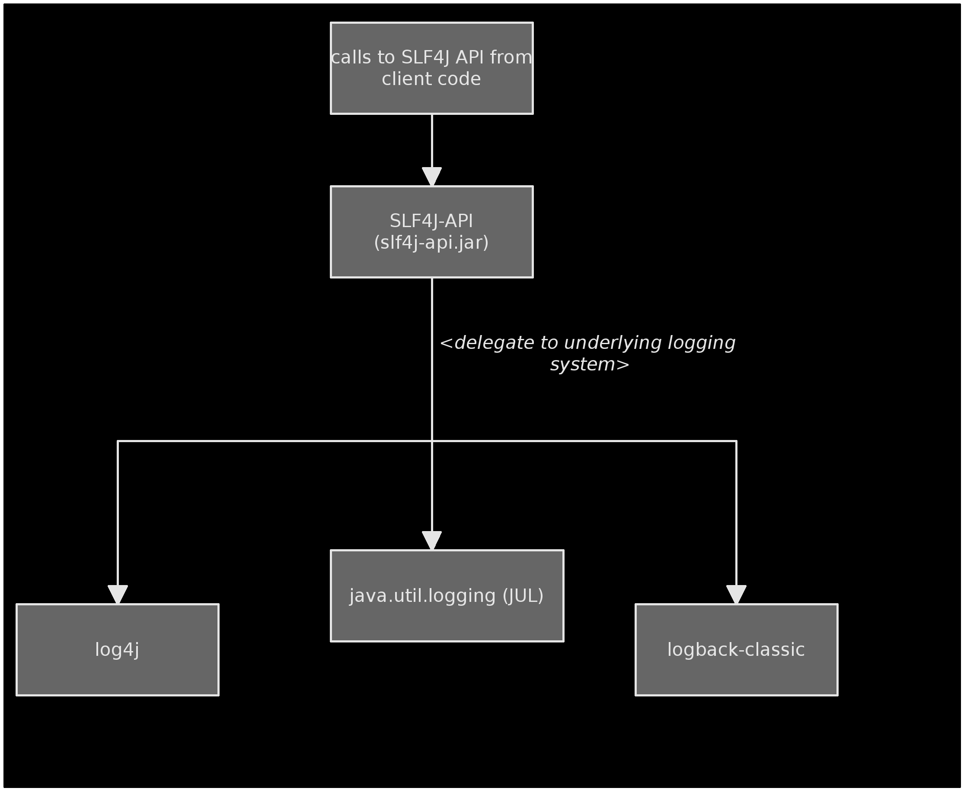
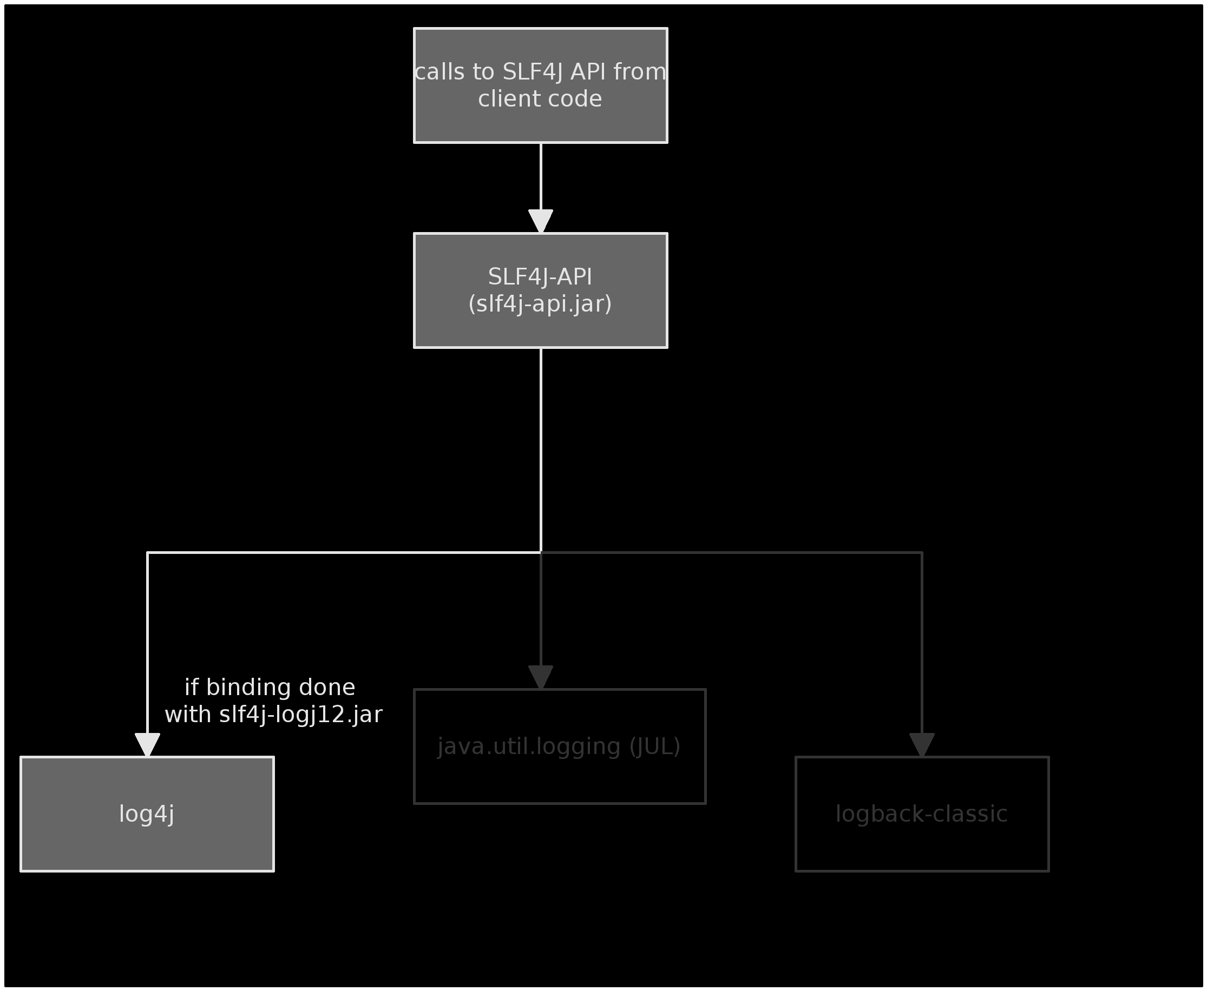
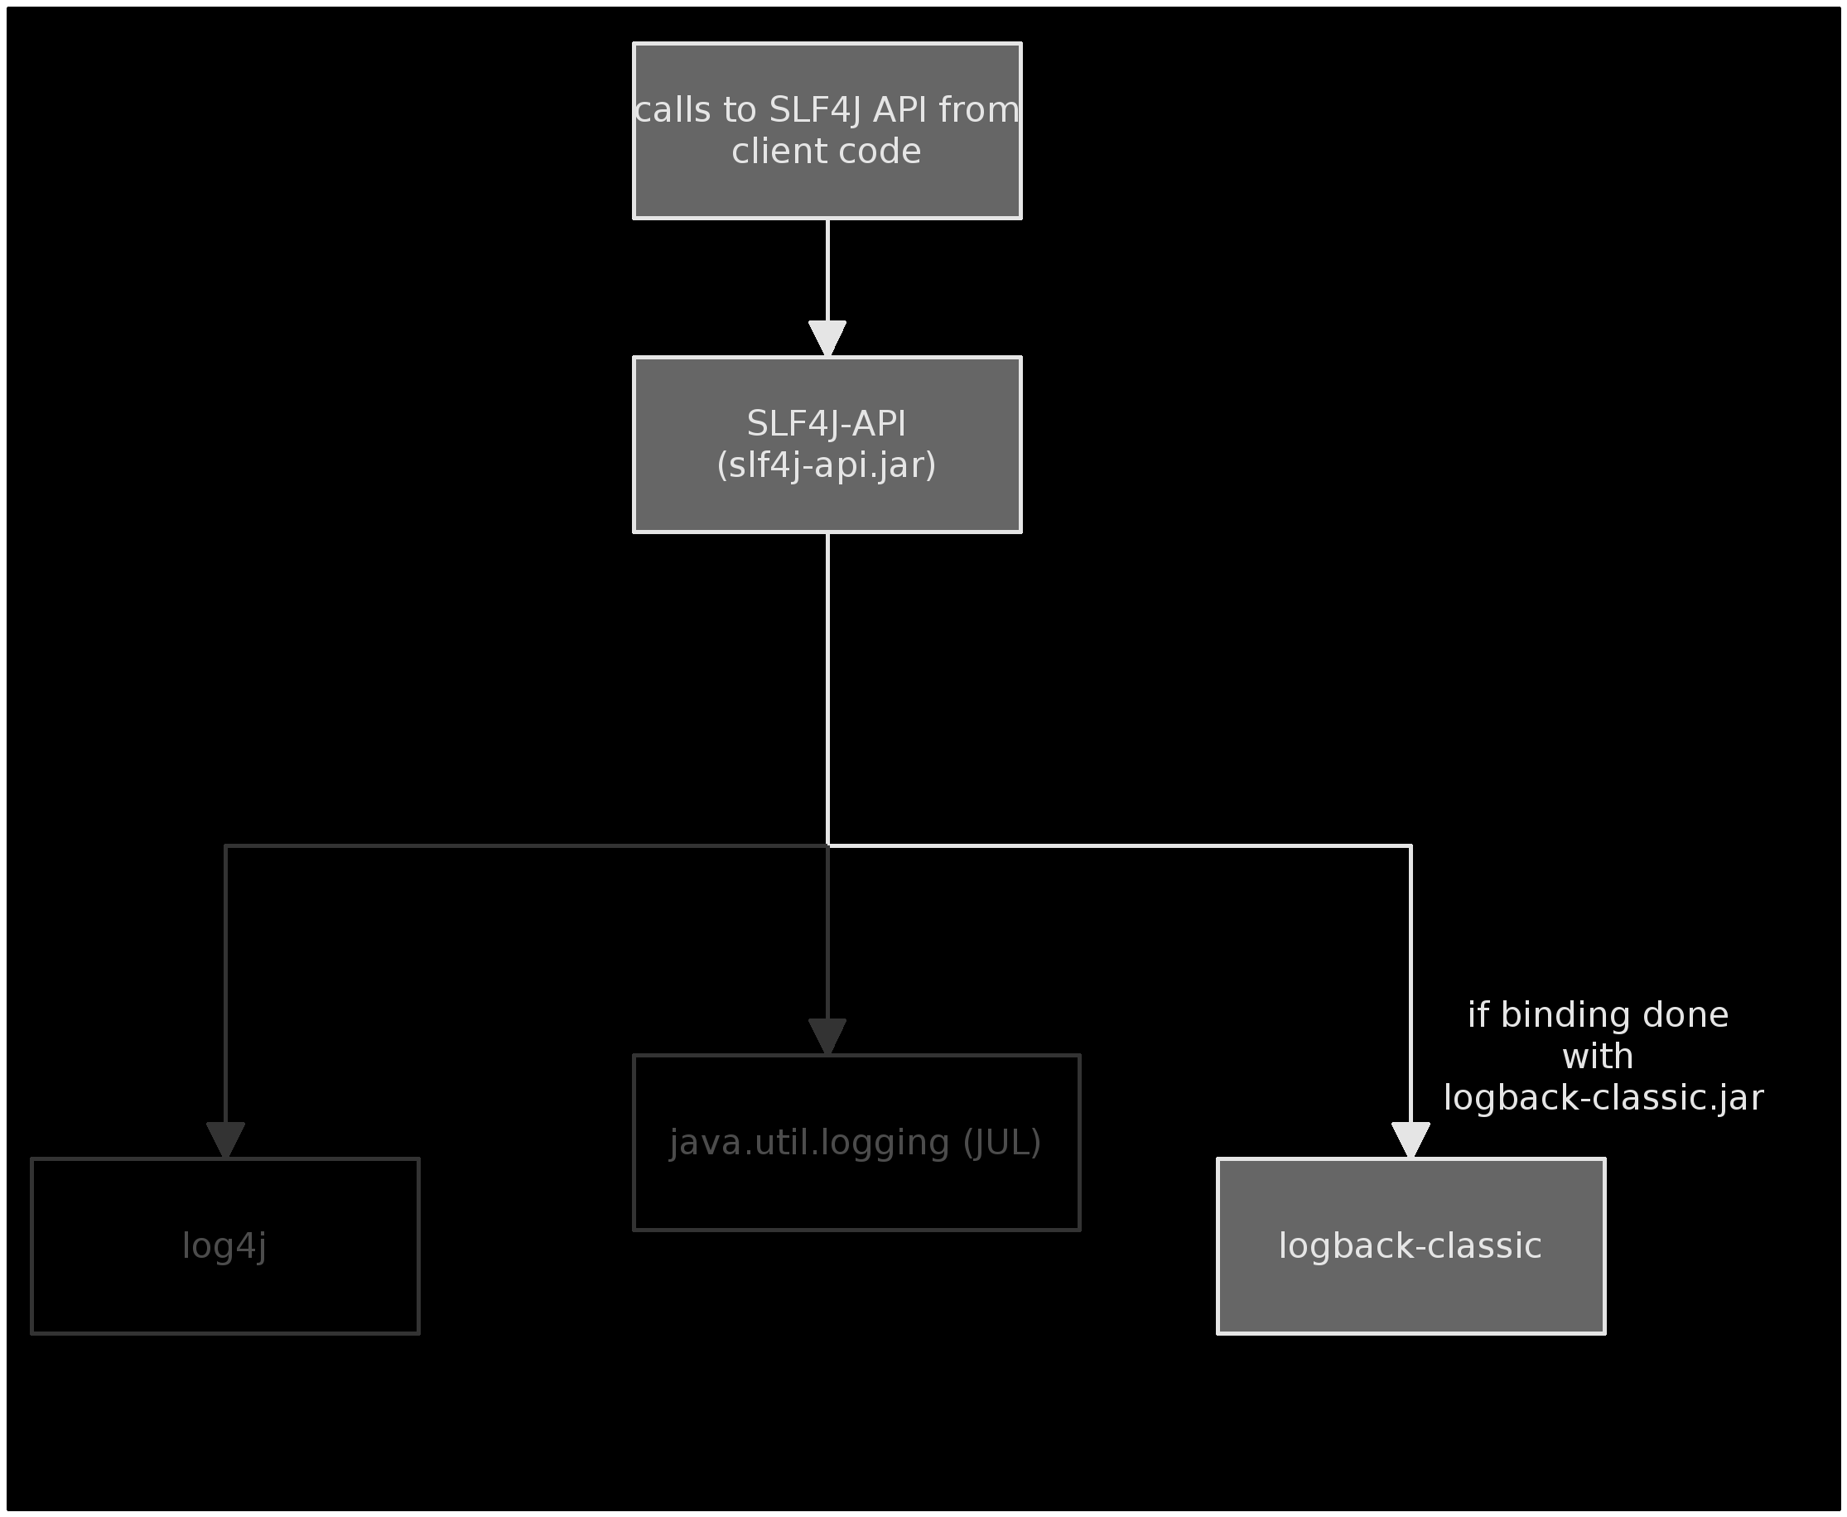
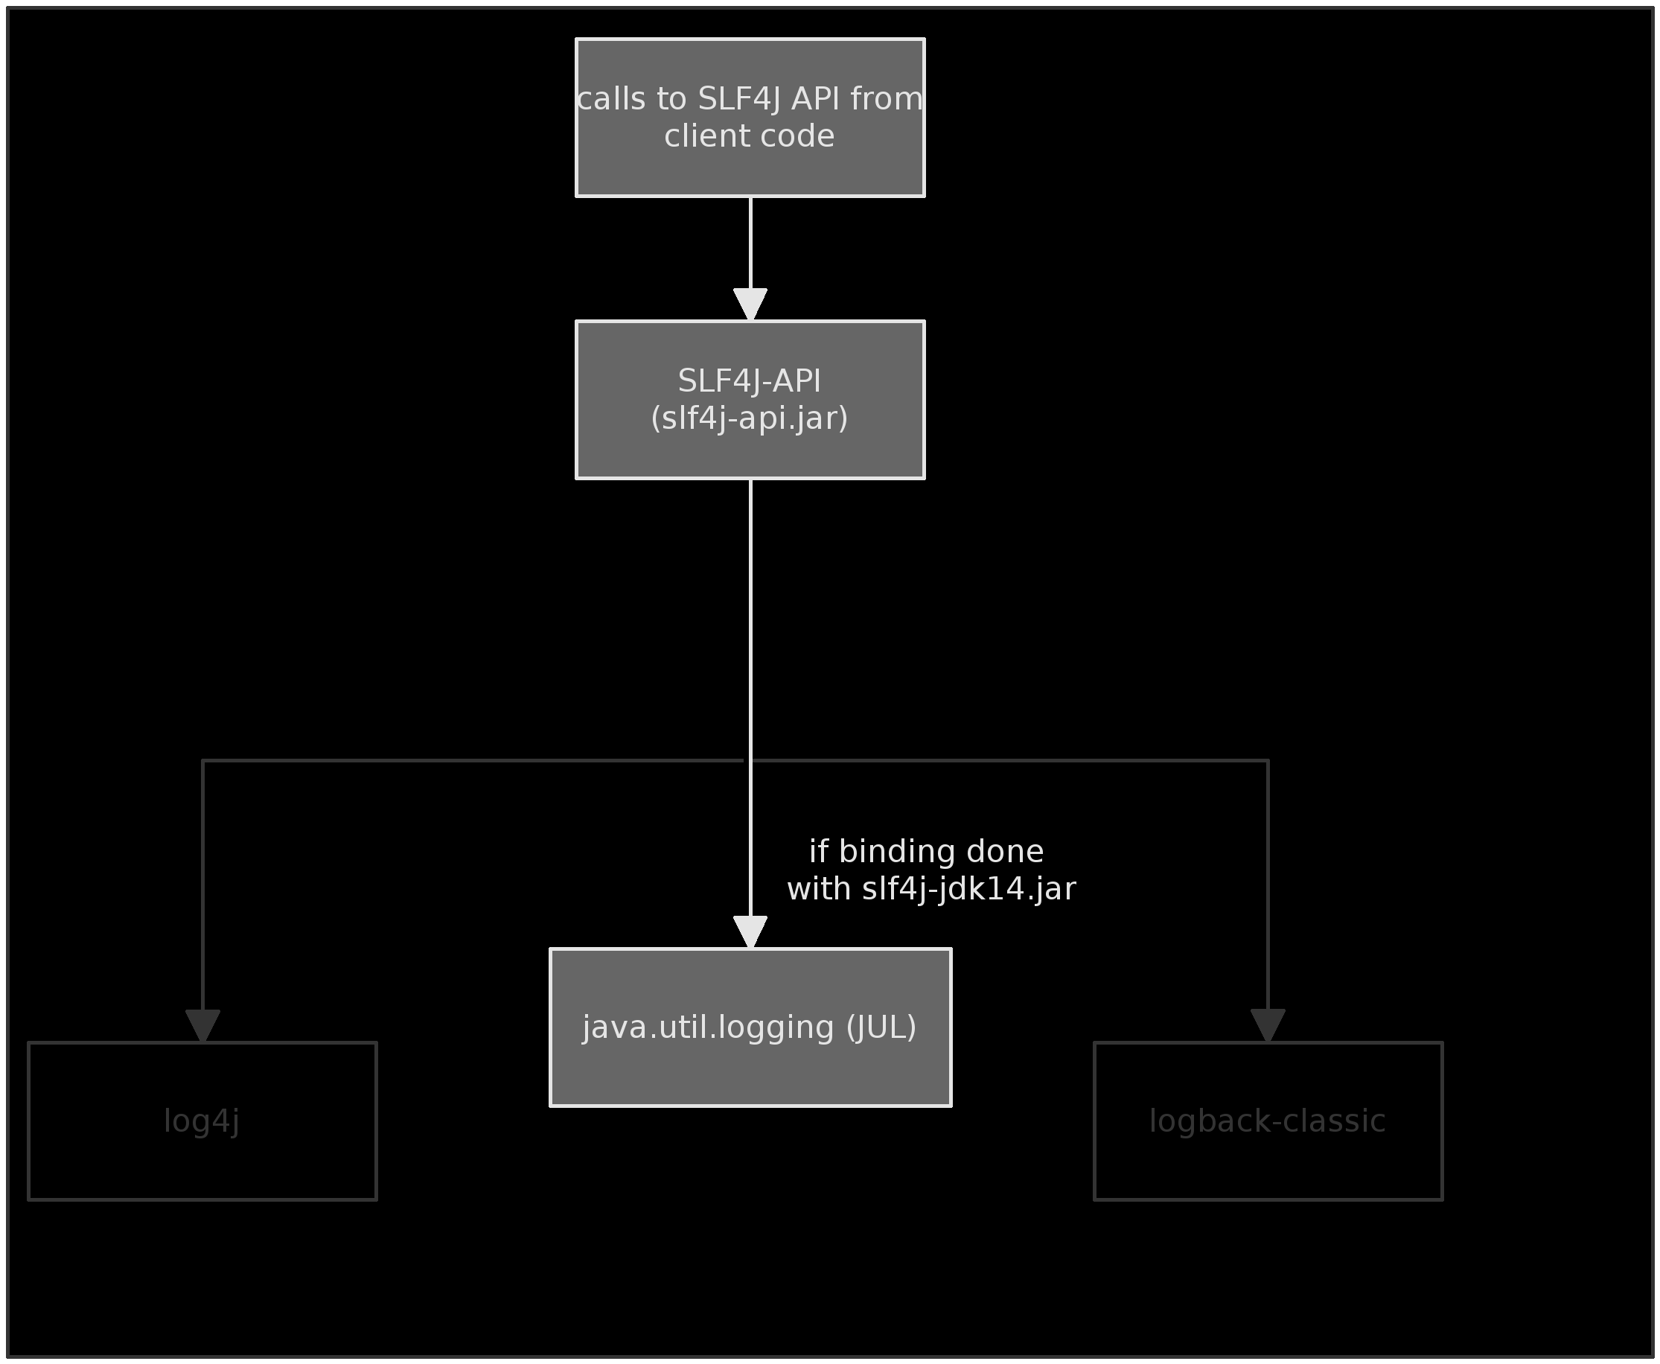

Slide 5
Using SLF4J:
Apache Archiva Apache Directory Apache FTPServer Apache Geronimo Apache Graffito Apache Jackrabbit Apache Mina Apache Qpid Apache Sling Apache Tapestry Apache Wicket Aperture Apogee | Artifactory Bitronix DbUnit Display tag GMaven Gradle GreenMail GumTree H2 Database HA-JDBC Hibernate Igenko Jabsorb | Jetty v6 jLynx JMesa JODConverter JTrac JWebUnit 2.x LIFERAY log4jdbc Magnolia MRCP4J Mindquarry Mugshot Mule | Novocode NetCDF OpenRDF Penrose Proximity PZFileReader QuickFIX/J SMSJ Spring-OSGi StreamBase TimeFinder WTFIGO YASL Xooctory

Slide 6
The API
1: import org.slf4j.Logger;
2: import org.slf4j.LoggerFactory;
3:
4: public class Wombat {
5:
6: final Logger logger = LoggerFactory.getLogger(Wombat.class);
7: Integer t;
8: Integer oldT;
9:
10: public void setTemperature(Integer temperature) {
11:
12: oldT = t;
13: t = temperature;
14:
15: logger.debug("Temperature set to {}. Old temperature was {}.", t, oldT);
16:
17: if(temperature.intValue() > 50) {
18: logger.info("Temperature has risen above 50 degrees.");
19: }
20: }
21: }

Slide 7
Other supported features
MDC (for log4j, logback and jul)
Markers

Slide 8
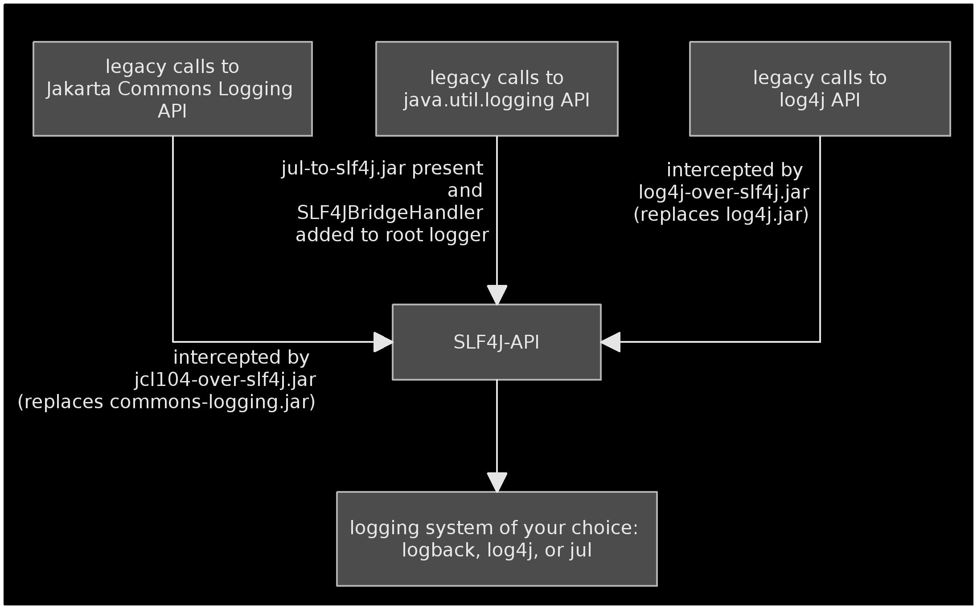
Bridging legacy systems

Slide 9
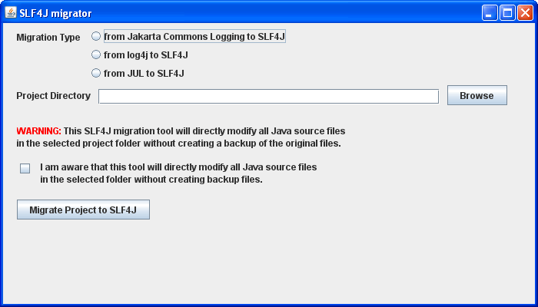
Migrator

Slide 10
Conclusion
Less is more.
Or write just enough code to meet the minimal requirements.
Or, avoid “speculative generality”. page 83 “Refactoring”, by Martin Fowler

