Slide 1
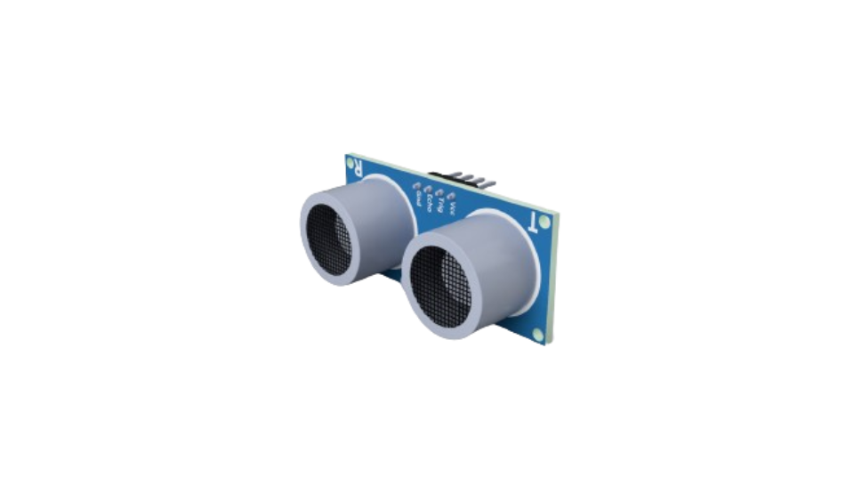

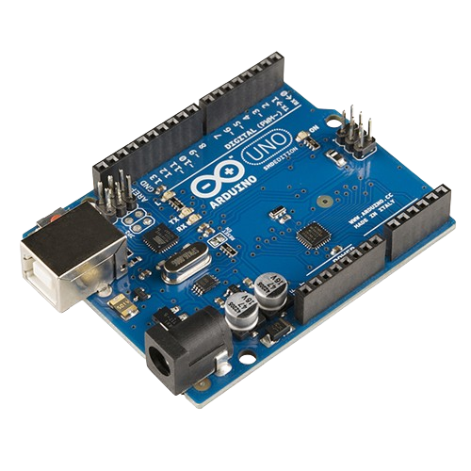
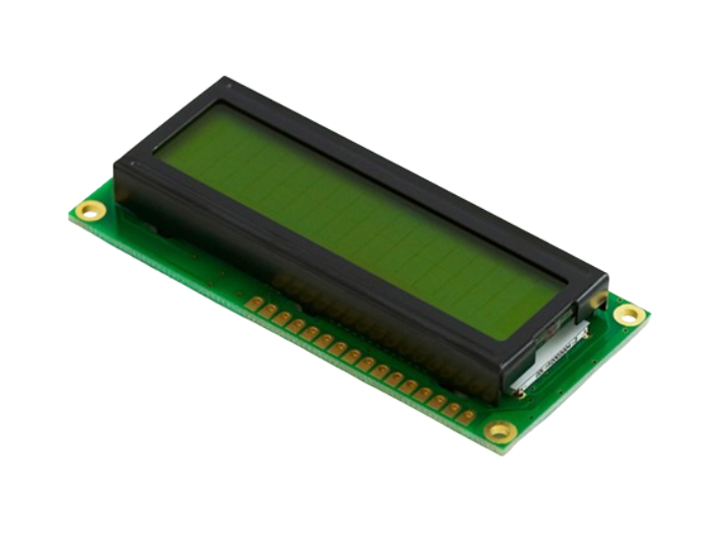

Arduino Course
Prepared by: Qossay Abu Rida

Slide 2
Agenda
Embedded system
Arduino environment
Sensors
Actuators
Communication

Slide 3
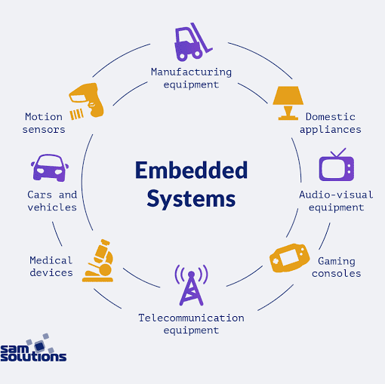
Embedded System

Slide 4
What is an Embedded System?
Definition: An embedded system is a specialized computer system that is designed to perform a specific task. Unlike general-purpose computers, which can run a variety of applications, embedded systems are dedicated to one or a few functions.
Common Use: Embedded systems are found in many everyday devices, from household appliances to automobiles, medical equipment, and industrial machines.

Slide 5
Basic Structure of an Embedded System
1- Microcontroller/Microprocessor:
The brain of the embedded system.
Executes programmed instructions to perform specific tasks.
Example: Arduino uses the ATmega328 microcontroller.
2- Memory:
RAM (Random Access Memory): Temporary storage for data and instructions currently in use.
ROM (Read-Only Memory): Permanent storage for the system's firmware and operating instructions.

Slide 6
3- Input Devices:
Collect data from the external environment.
Examples: Sensors, buttons, keyboards.
4- Output Devices:
Deliver data or actions to the external environment.
Examples: Displays, LEDs, motors.
5- Power Supply:
Provides the necessary power for the system to operate.
Can be battery-operated or connected to a power source.
6- Communication Interfaces:
Allow the system to communicate with other systems or devices.
Examples: Serial ports, USB, Wi-Fi, Bluetooth.

Slide 7
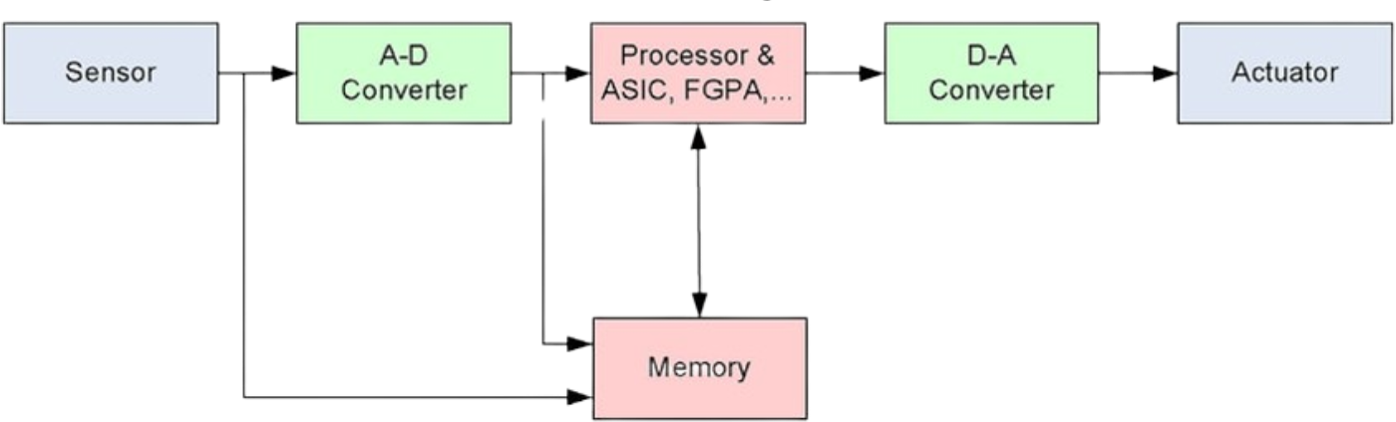
Basic Structure (Symbolic-Based)

Slide 8
Effective delivery techniques
This is a powerful tool in public speaking. It involves varying pitch, tone, and volume to convey emotion, emphasize points, and maintain interest:
Pitch variation
Tone inflection
Volume control
Effective body language enhances your message, making it more impactful and memorable:
Meaningful eye contact
Purposeful gestures
Maintain good posture
Control your expressions

Slide 9
Arduino Environment

Slide 10
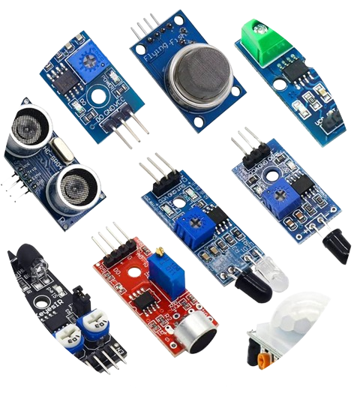
Sensors

Slide 11
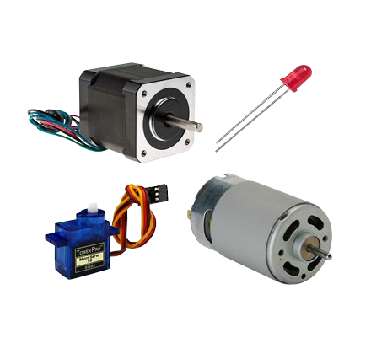
Actuators

Slide 12
Basic Electronic Component

Slide 13
Communication

Slide 14
Speaking impact
Your ability to communicate effectively will leave a lasting impact on your audience
Effectively communicating involves not only delivering a message but also resonating with the experiences, values, and emotions of those listening

Slide 15
Dynamic delivery
Learn to infuse energy into your delivery to leave a lasting impression
One of the goals of effective communication is to motivate your audience

Slide 16
Final tips & takeaways
Seek feedback
Reflect on performance
Explore new techniques
Set personal goals
Iterate and adapt
Consistent rehearsal
Strengthen your familiarity
Refine delivery style
Pacing, tone, and emphasis
Timing and transitions
Aim for seamless, professional delivery
Practice audience
Enlist colleagues to listen & provide feedback

Slide 17
Speaking engagement metrics

Slide 18




Contact us

