Slide 1

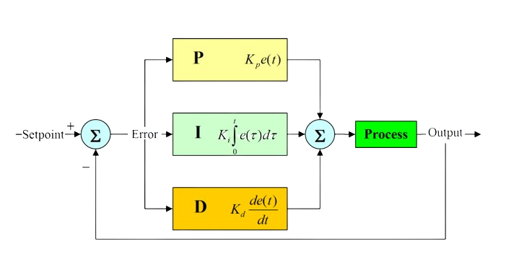

PID Algorithm
Proportional Integral Derivative controller
Prepared by: Qossay Abu Rida

Slide 2
Agenda

Slide 3




Contact us

