Slide 2
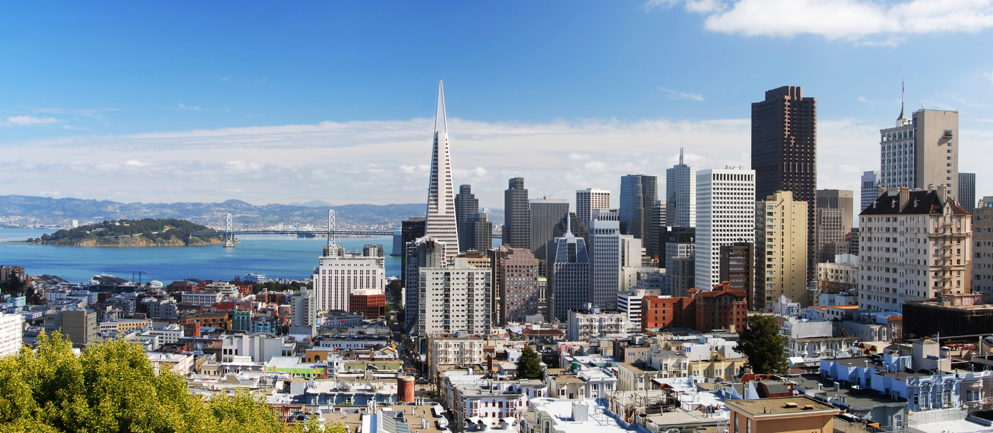
Homelessness in San Francisco

Slide 3
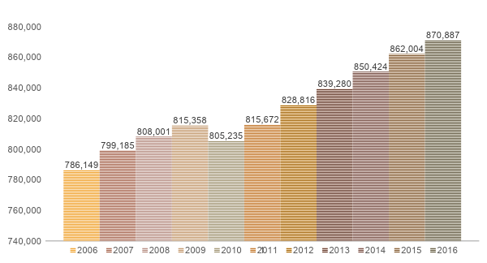
Population growth in San Francisco

Slide 4
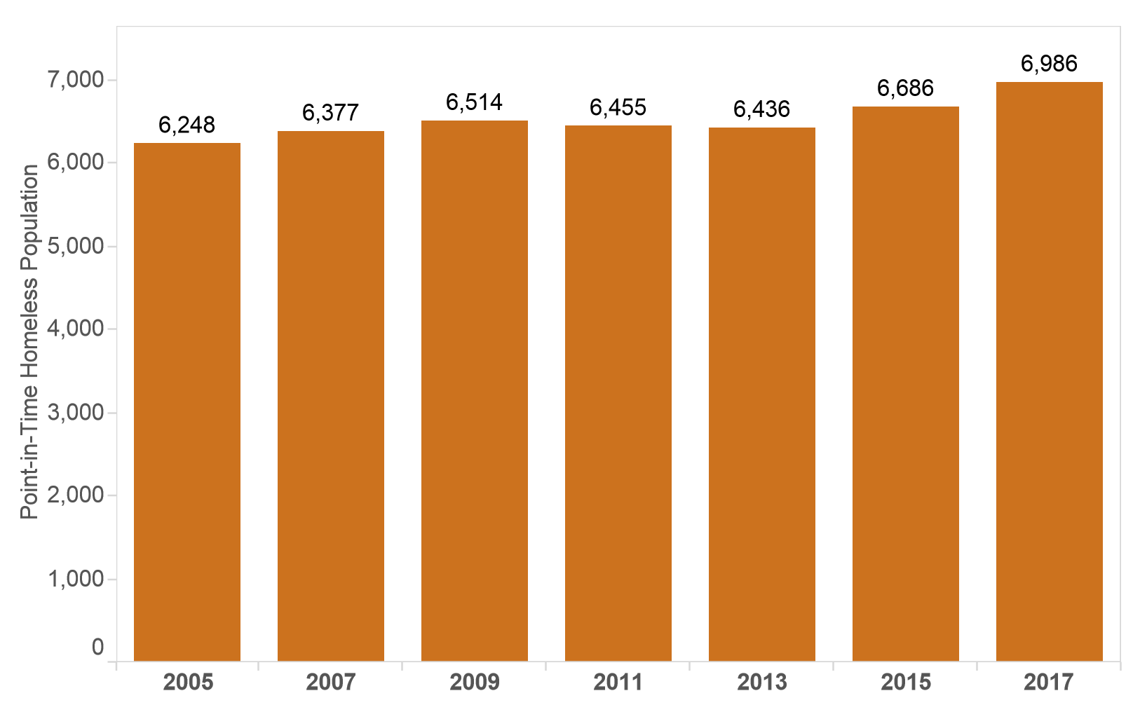
Homeless Population in San Francisco

Slide 5
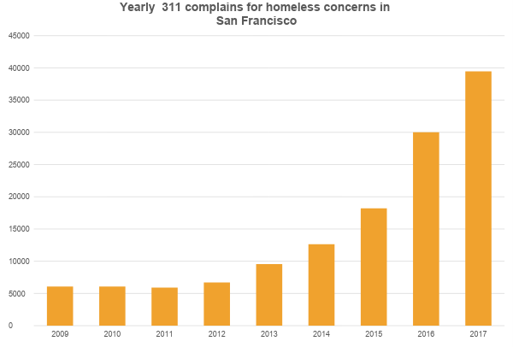
Homeless concerns through 311

Slide 6
*** MOCK UP ***

Slide 7
Genre
Animation
Annotated charts

Slide 8
The Project - *** IMPLEMENTATION PLAN ***

Slide 9
Main dataset
311 cases in San Francisco from 2008 until today
Initially
2.87 million rows, 964,6 MB and 19 columns
After removing irrelevant data
~145.000 rows, 147 MB, 5 columns
Link
https://data.sfgov.org/City-Infrastructure/311-Cases/vw6y-z8j6

Slide 10
Other data
Income from different sections in San Francisco
~600 rows, 32 KB and 4 columns
Link: https://datausa.io/profile/geo/san-francisco-ca/
GeoJSON for San Francisco - edited in Python to suit our needs
Initially ~8000 features (whole of California) and 83,5 MB After editing 1.1 MB
Link: https://github.com/arcee123/GIS_GEOJSON_CENSUS_TRACTS/blob/master/06.geojson

