Slide 1
Administrativetools subsystem
Mohammed Qasabah
Mazen Al-ammari
Mohammed Al-howshbi
Mohanned Shaaf

Slide 2
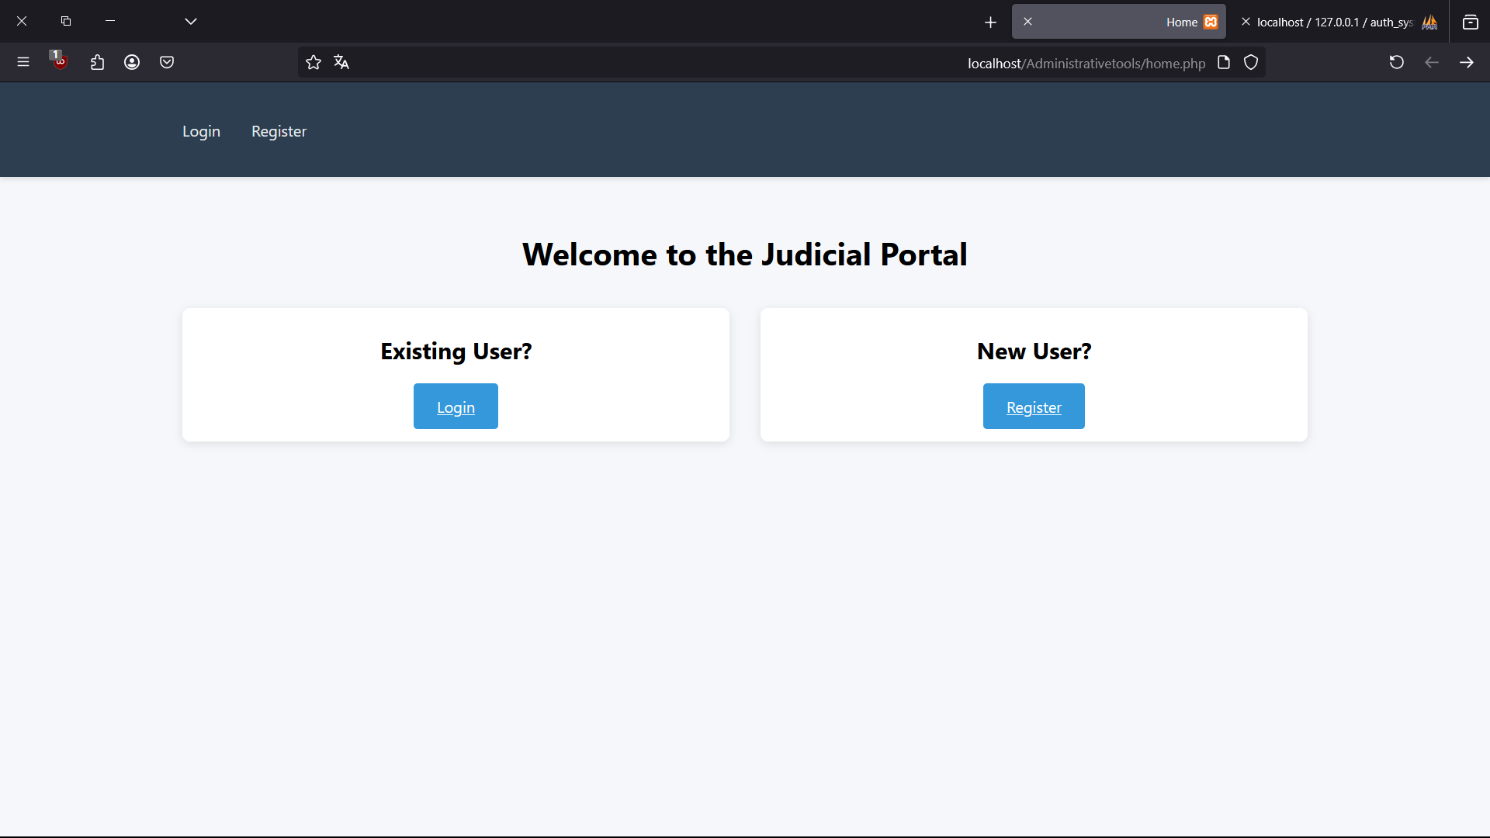
Home page

Slide 3
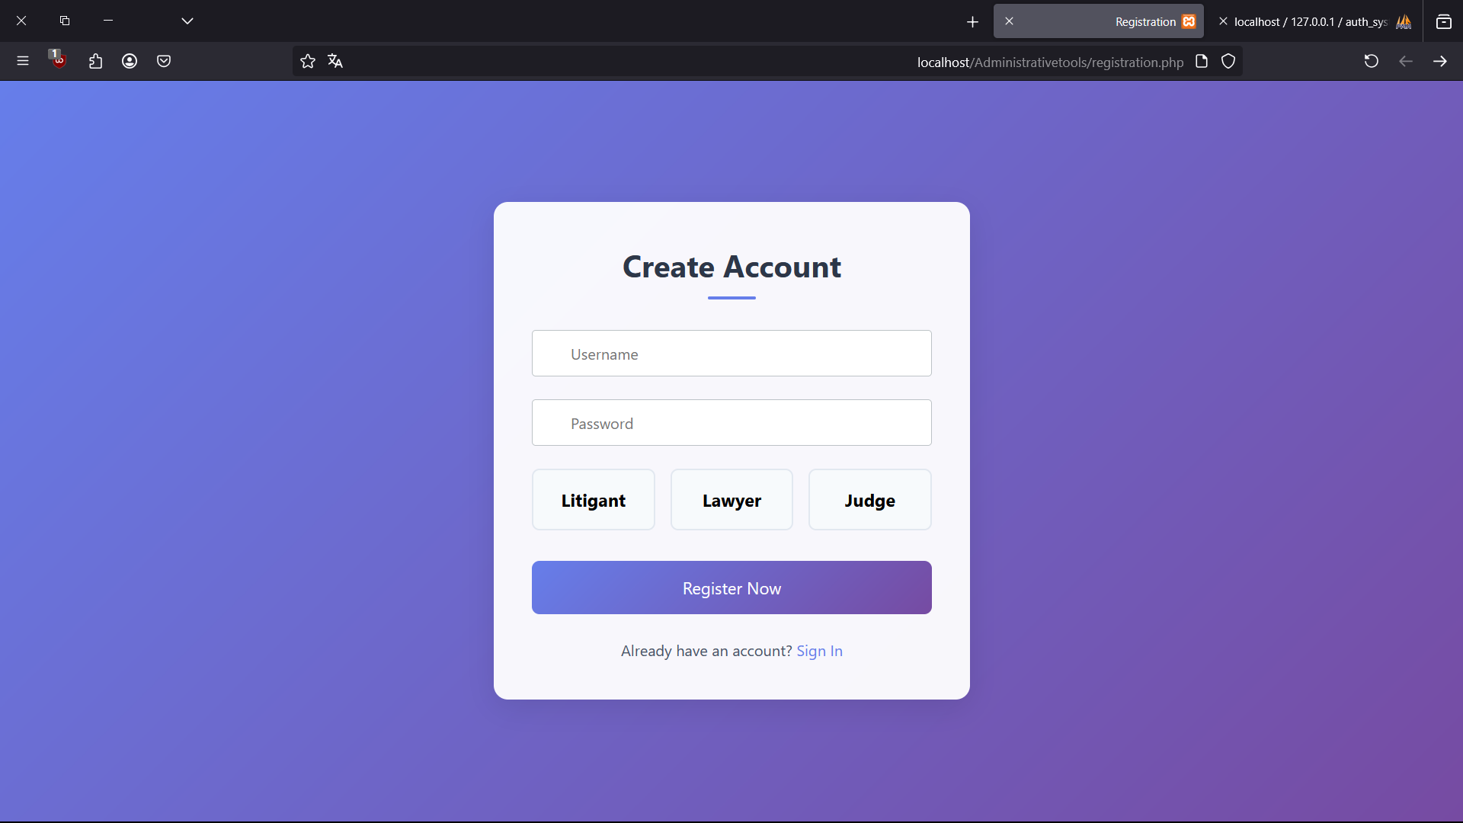
Register page

Slide 4
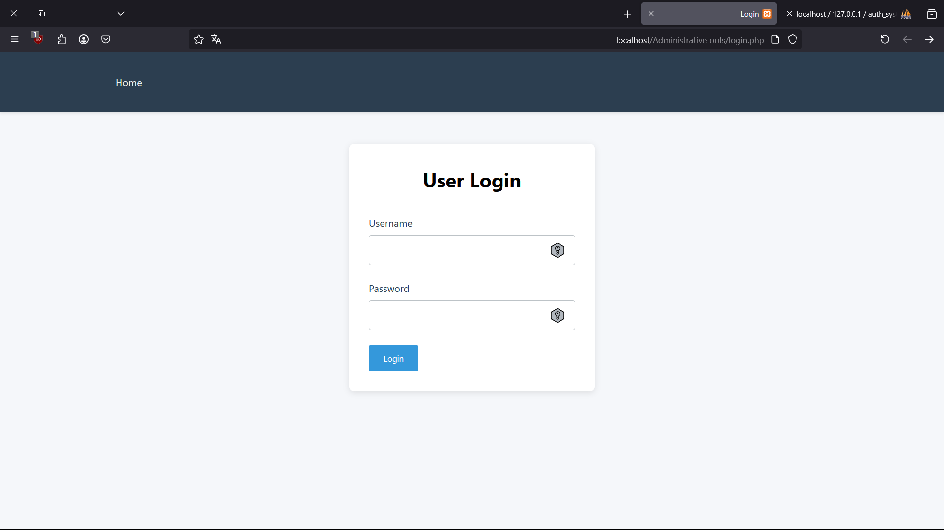
Login page

Slide 5
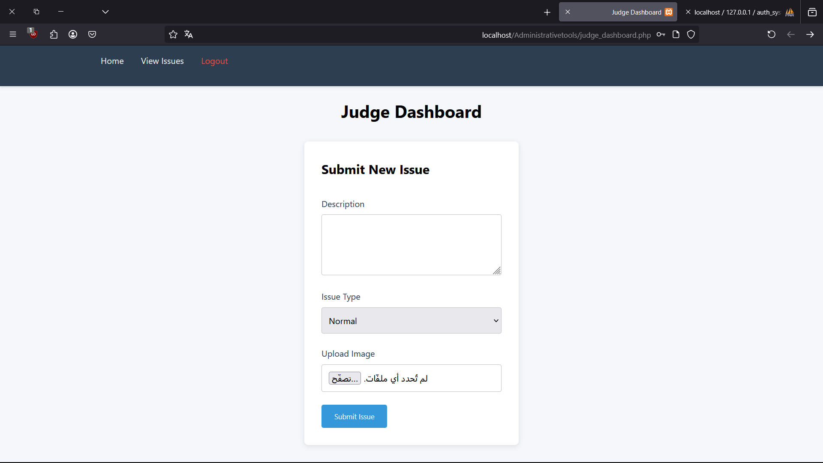
Judge dashboard page

Slide 6
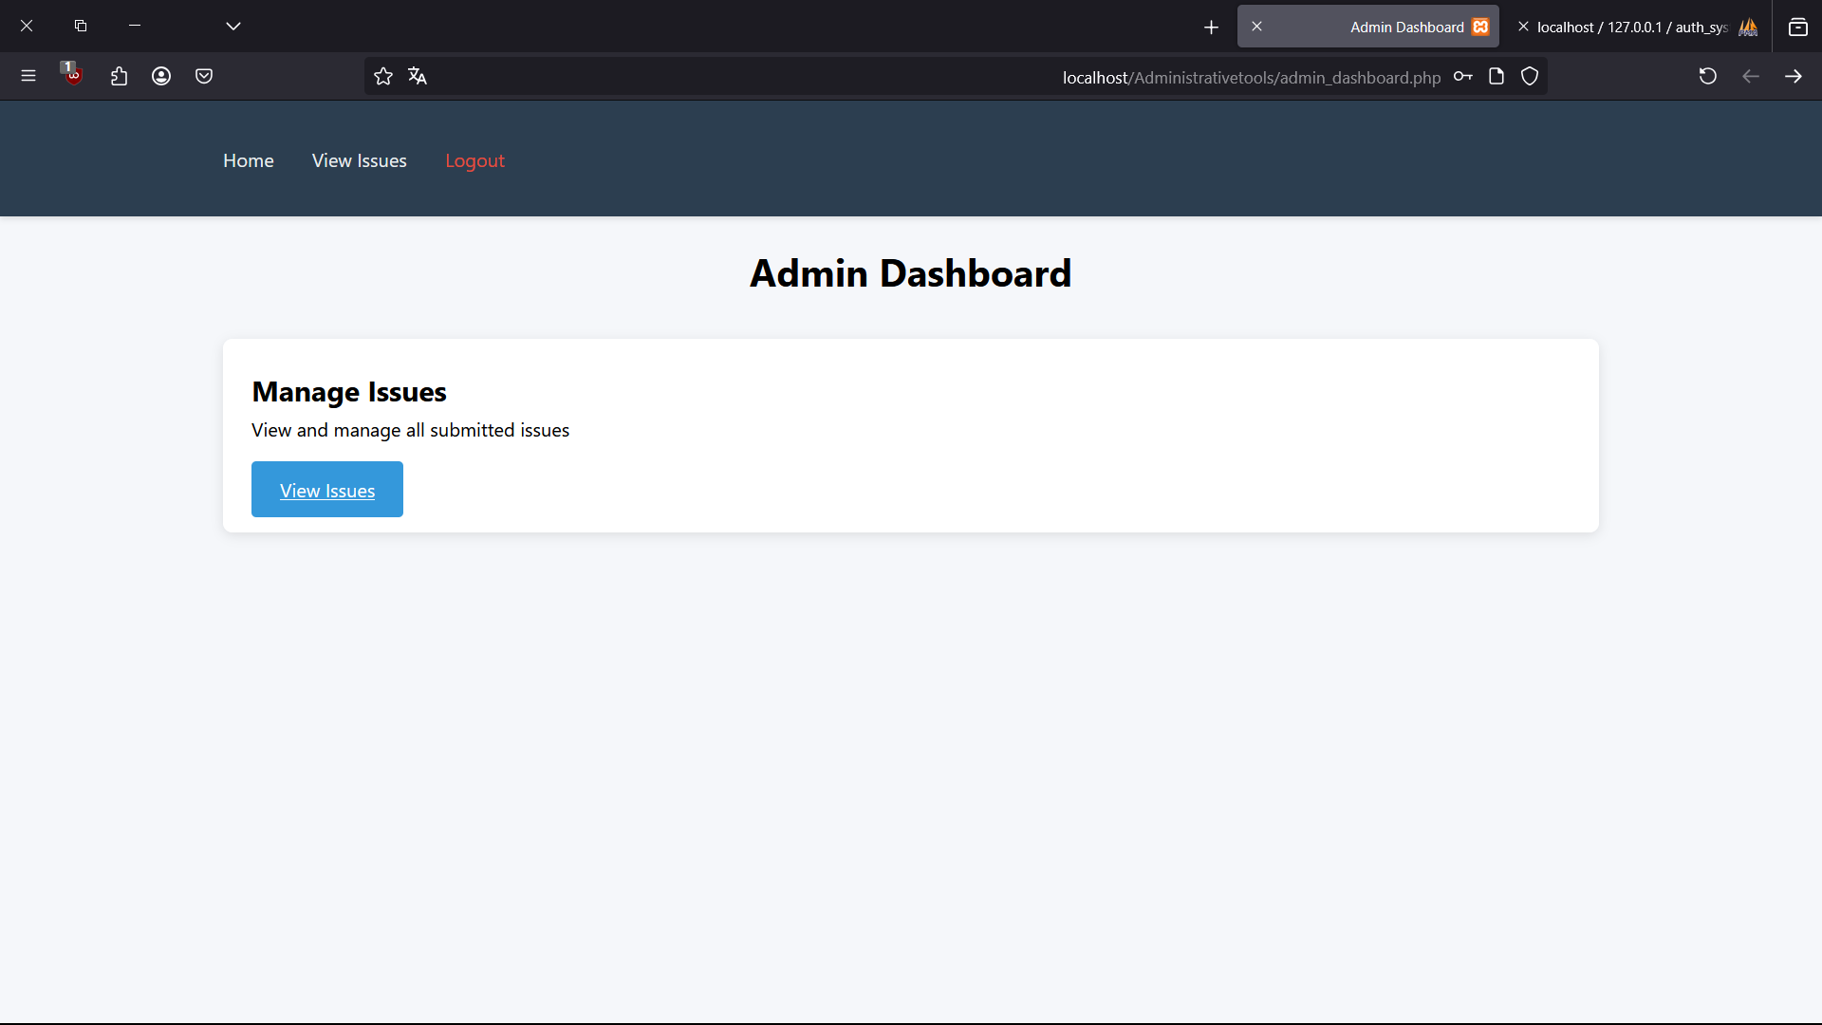
Admin Dashboard page

Slide 7
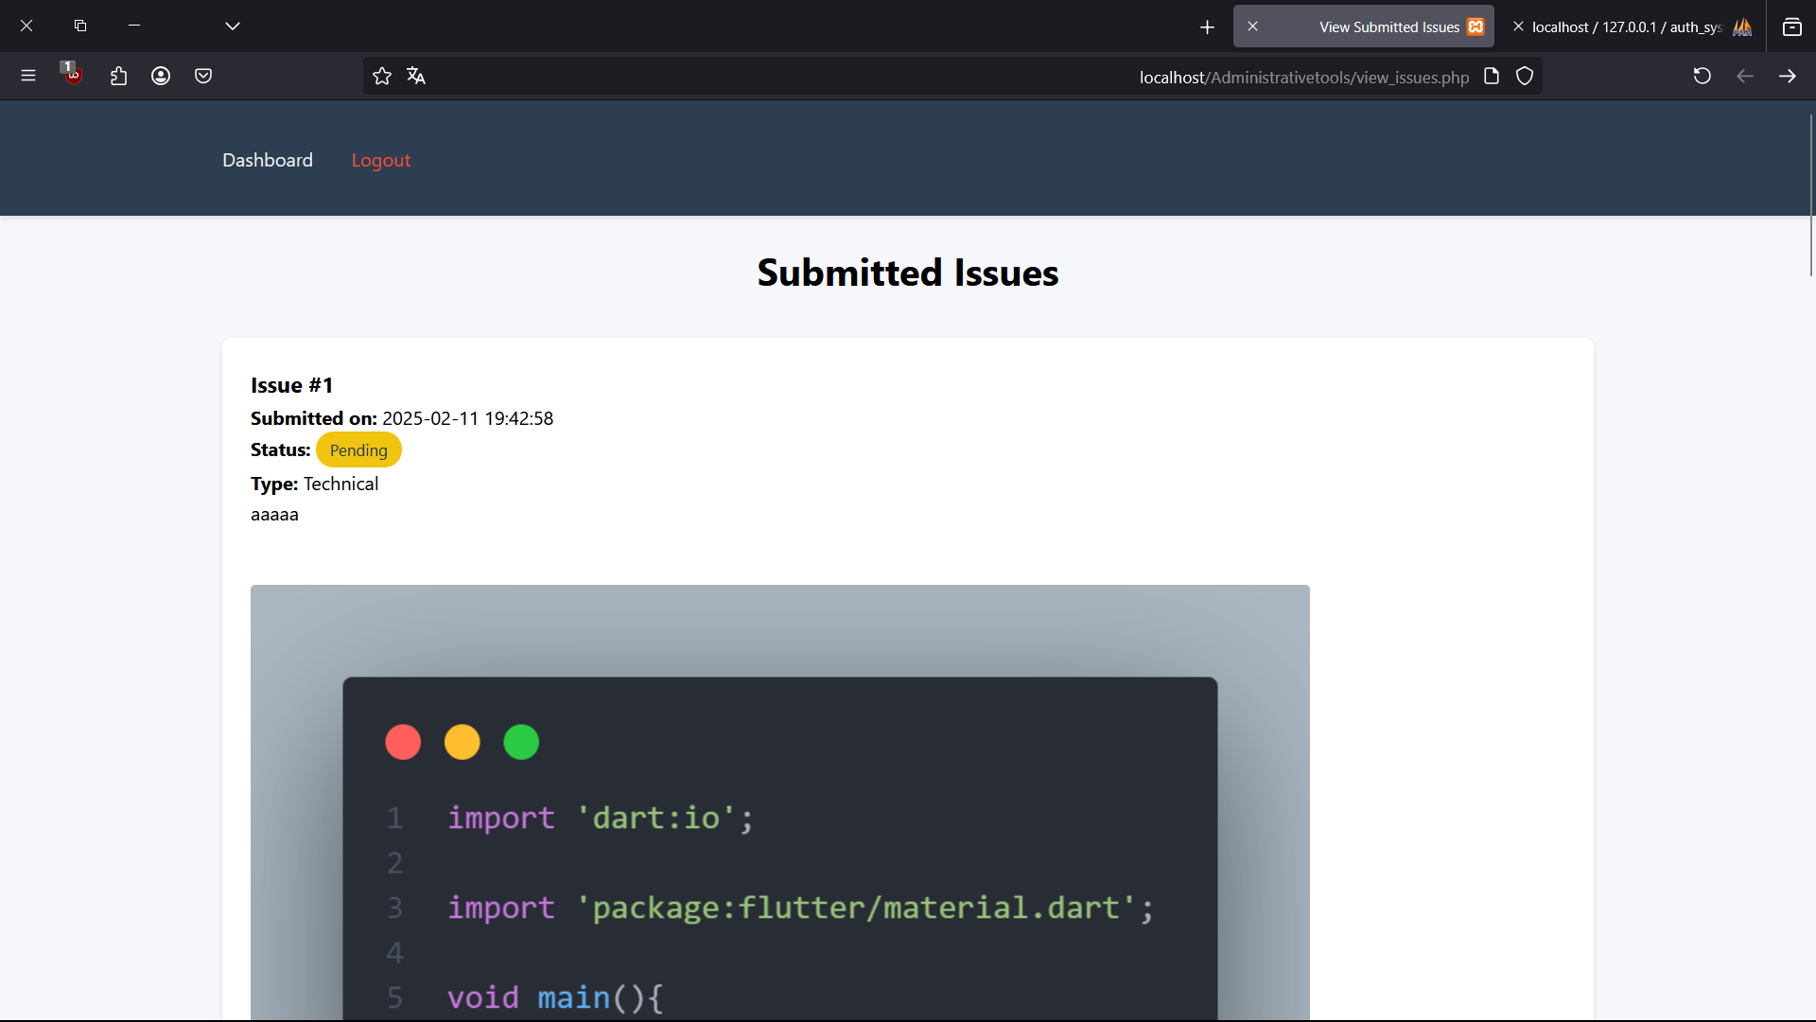
Issues viwer

Slide 8
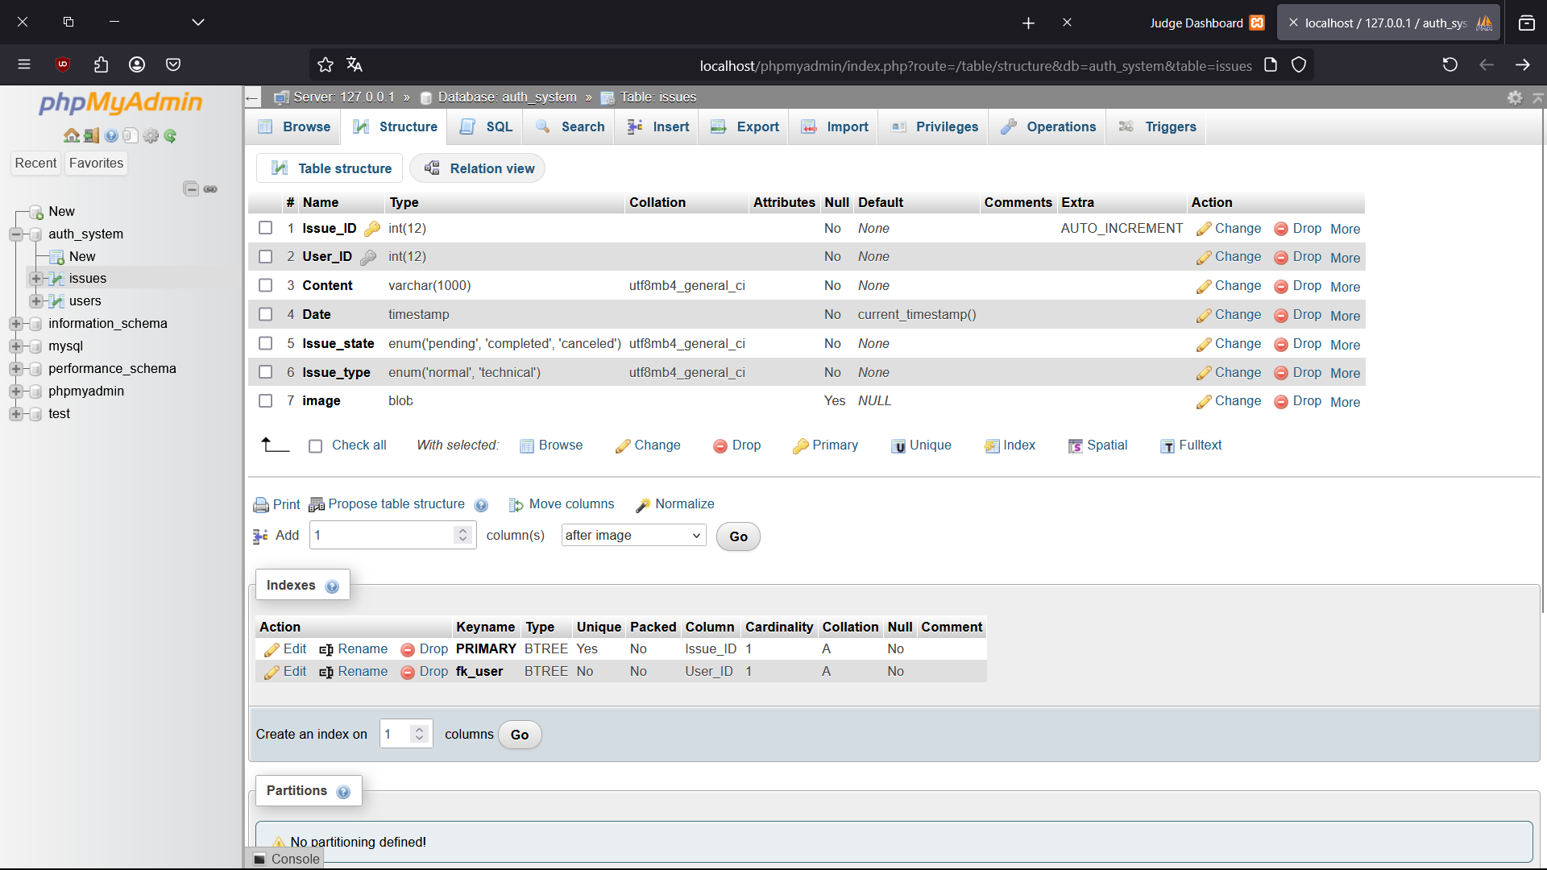
Database

Slide 9
