Slide 1





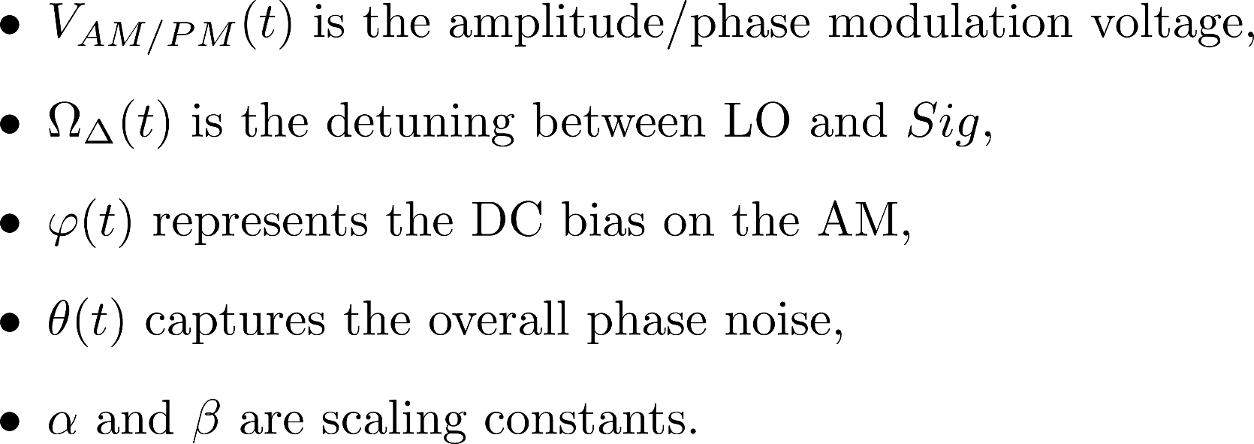
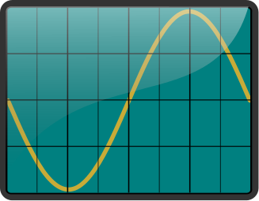
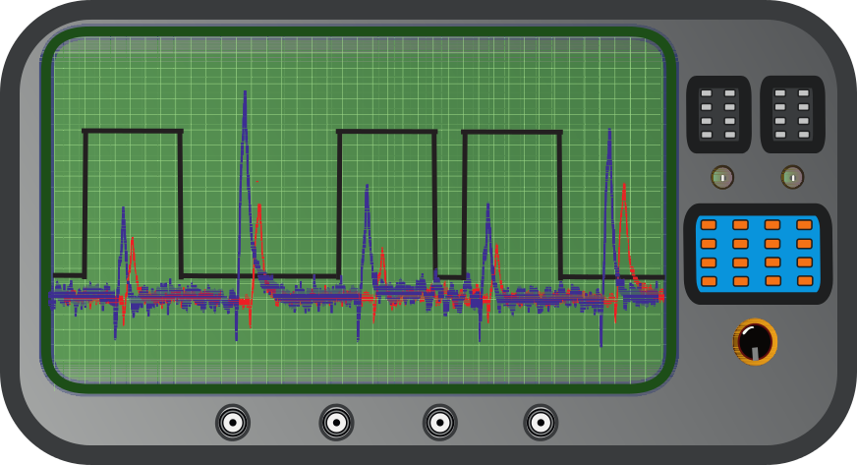
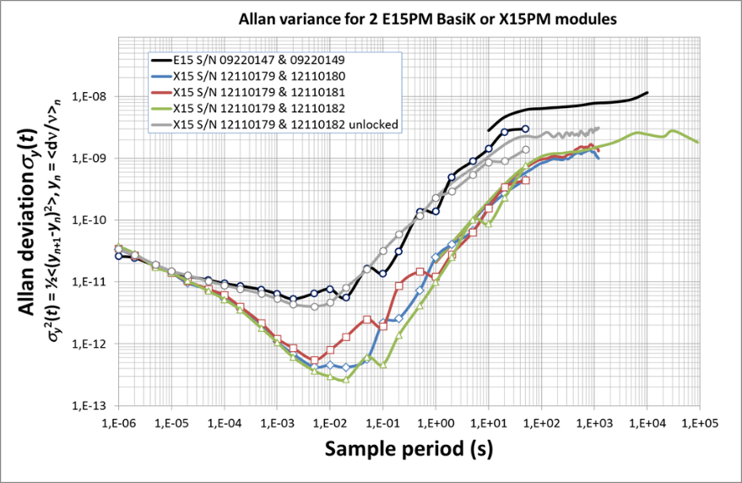
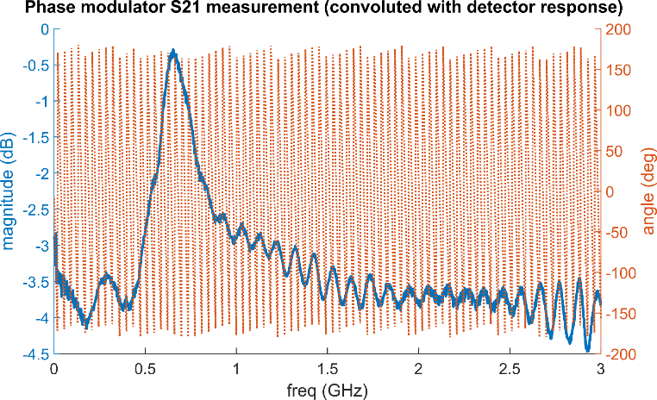
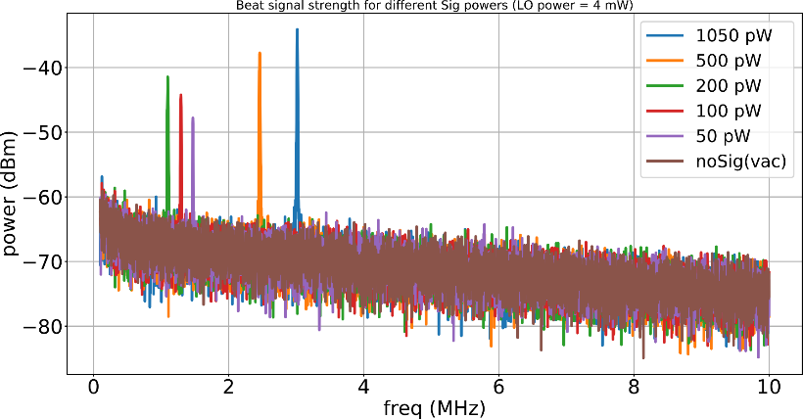
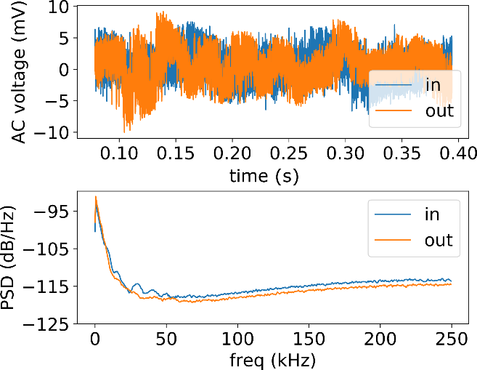
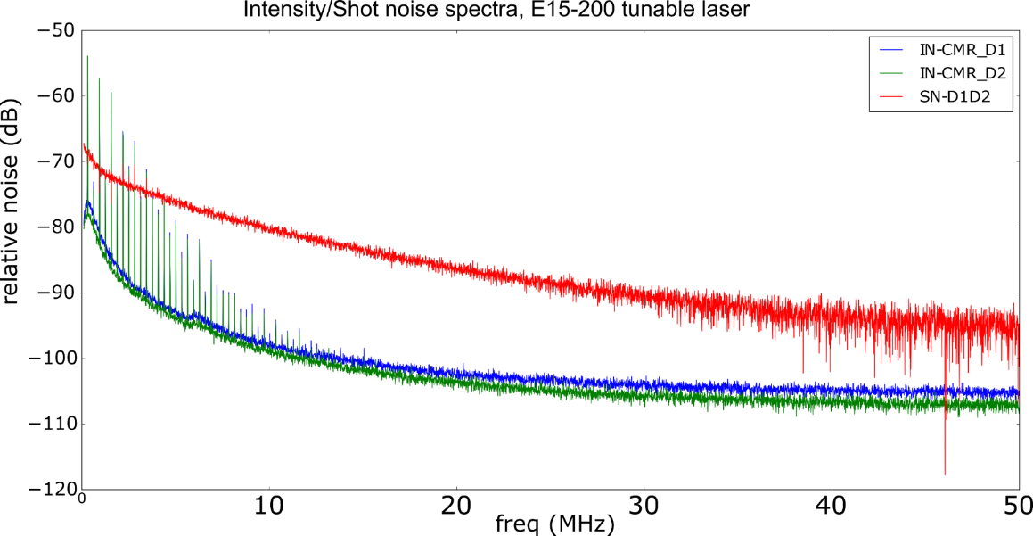
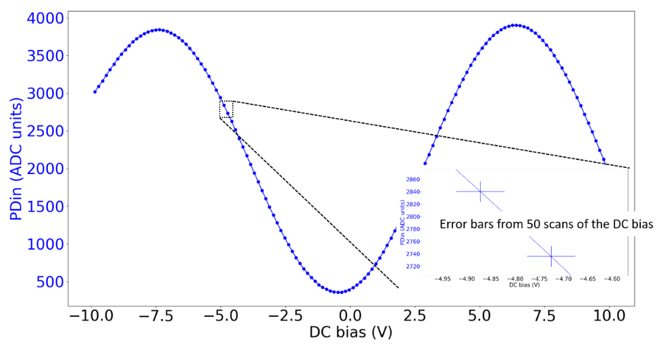
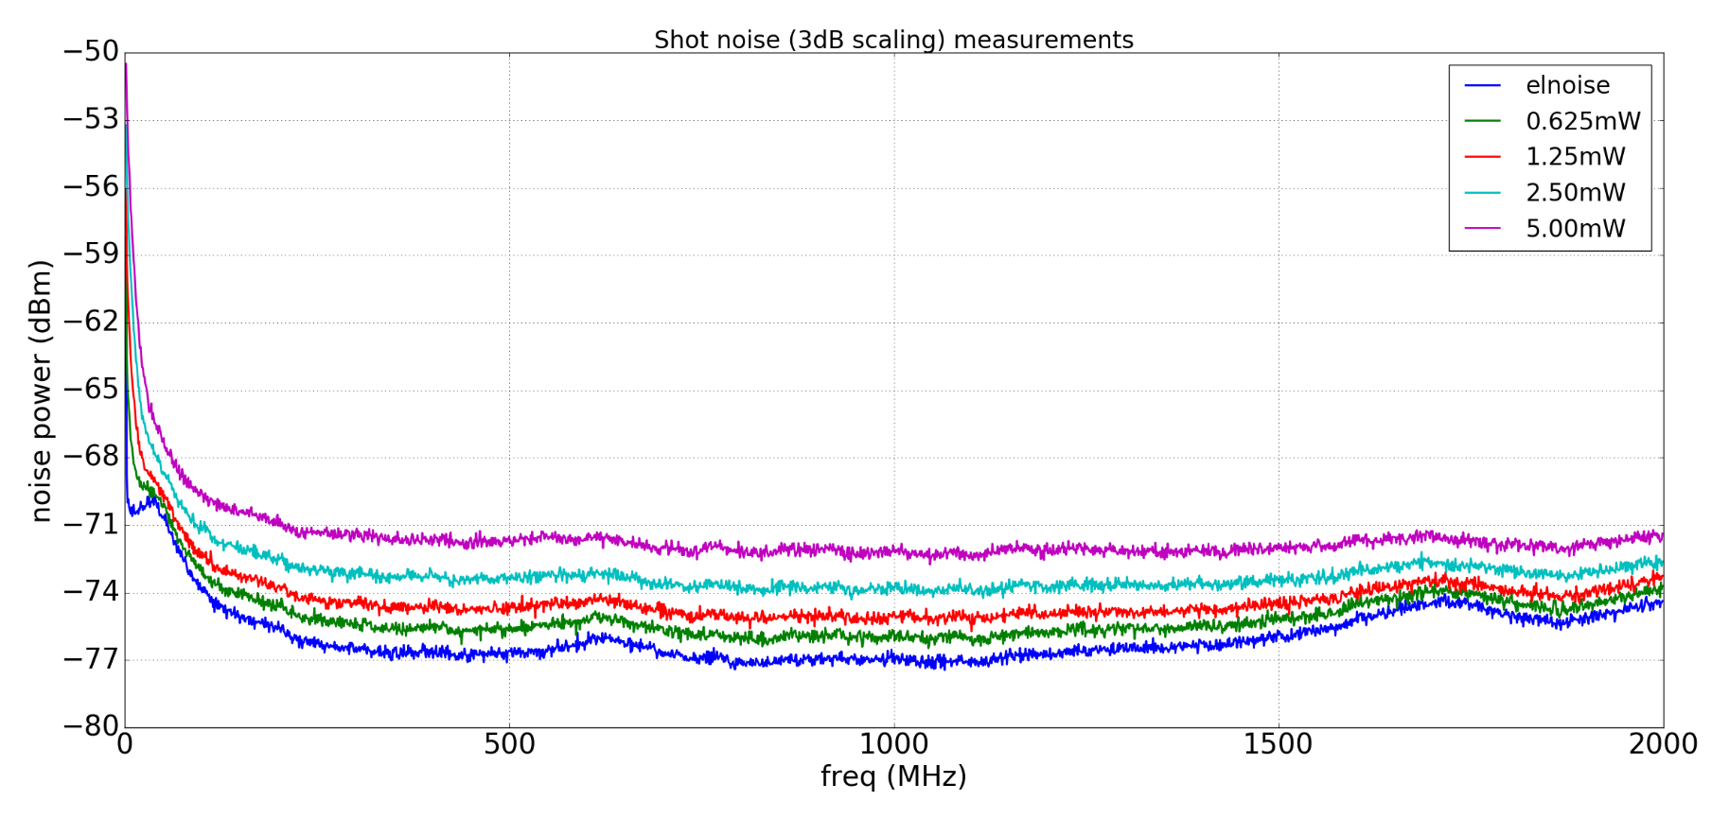
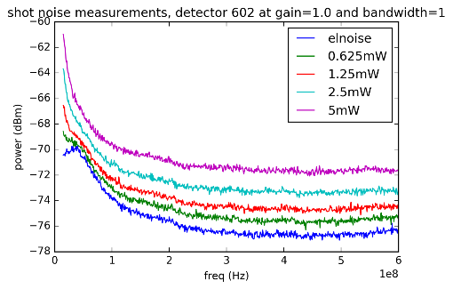
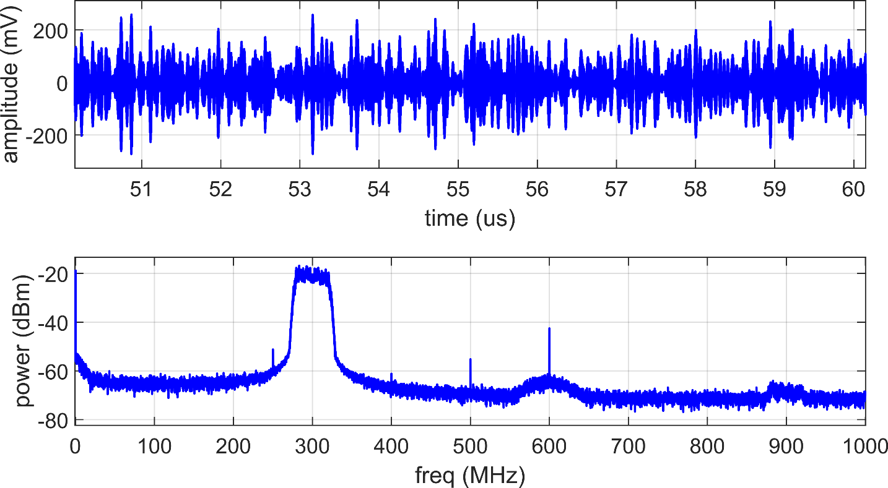
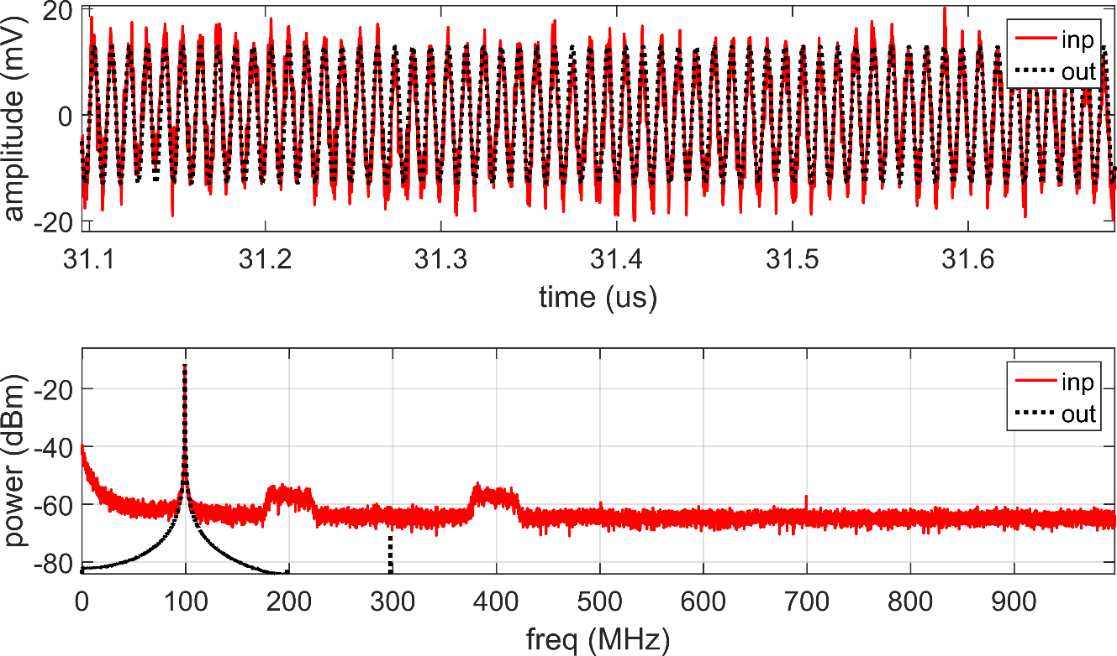
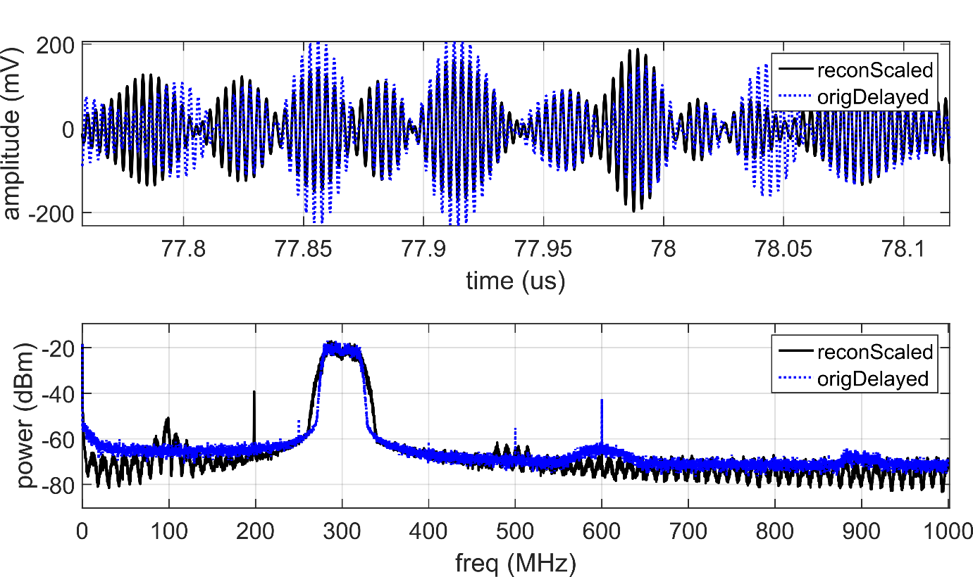
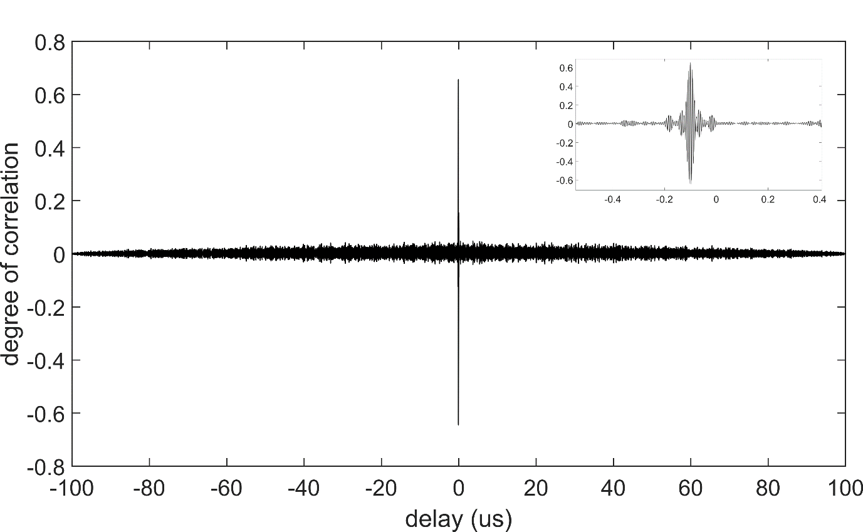
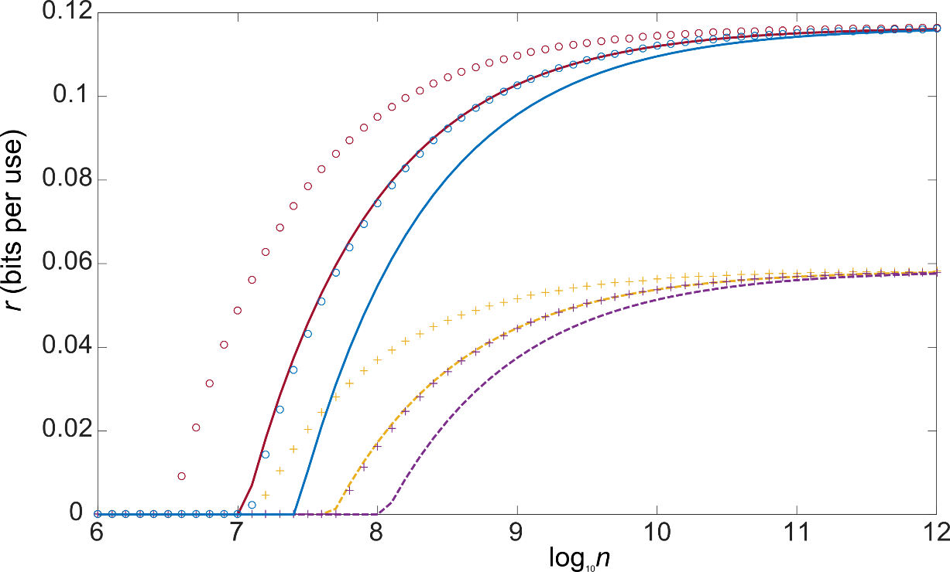

Investigating feasibility of broadband continuous variable quantum key distribution in telecom fibers with local local oscillator
N. Jain,¹ C.S. Jacobsen,¹ D. Solar Nikolic,¹ A. Kordts,¹ C. Lupo,²
R. Grigoryan,¹ T. Pedersen,³ S. Pirandola,^{2,4} T. Gehring,¹ and U.L. Andersen¹
¹Department of Physics, Fysikvej 309, Technical University of Denmark, 2800 Kongens Lyngby, Denmark
²York Centre for Quantum Technologies (YCQT), University of York, York YO10 5GH, United Kingdom
³Cryptomathic A/S, Jaegergardsgale 118, 8000 Aarhus, Denmark
⁴Department of Computer Science, University of York, York YO10 5GH, United Kingdom
Introduction [1-3]
Design dilemma: transmitted LO vs. local LO & homodyne vs. heterodyne [4-7]
Continuous-variable quantum key distribution (CVQKD) implementations have the potential to reach Gbit key rates while staying cost-effective by using standard telecom technology.
One possible realization, for instance, is via encoding quantum states in GHz-wide optical sidebands (at Alice) and decoding them with a broadband coherent detector (at Bob).
Here, we present the progress in realization of such a CV-QKD scheme using coherent states with Gaussian modulation, and the various challenges in adapting the security proof to real-world scenarios.
We use the recently proposed local local oscillator (LO) design and heterodyne detection in Bob to recover the info in the quantum signal (qSig) from Alice.
laser
local oscillator (LO)
Bob
LO
Alice
quantum
channel
laser
LLO
coherent
detection
+ phase
reference
alignment
Transmitted LO design
MUX
DEMUX
coherent
detection
Local LO design
Modulation, addition
of reference signal,
and attenuation to
quantum level
Alice
Modulation &
attenuation to
quantum level
quantum
channel
qSig
laser
qSig + ref Sig
quantum signal (qSig)
Bob
🙂 Stable relative phase between qSig and LO at the receiver
🙁 Vulnerable to LO intensity/wavelength manipulation on quantum channel
🙁 LO intensity limitation at Bob due to propagation losses and nonlinear effects
🙁 High requirments on lasers’ phase noise + complex phase reference alignment
🙂 LO can be fully trusted, security loopholes closed
🙂 No limitation on the local LO intensity
LO
LO
Expression for output current of balanced heterdoyne receiver:
Heterodyne setup
Dual homodyne setup
90 deg
optical
hybrid
Relatively
simple
analog
electronics
processing
Rather complex
digital + analog
electronics
processing
Sig
Sig
🙂 Info of signal directly in baseband, therefore simple electronics.
🙁 Expensive (1 hybrid + 1 extra detector).
🙁 Not so suitable when LO and qSig frequencies are detuned (Ω_{Δ} ≠ 0).
🙁 Complex electronics requiring downconversion etc.
🙂 Less sensitive to deviations of parameters, such as splitting ratio.
🙂 Classically well-studied problem.
Assuming small modulation depths, negligible phase noise and drifts etc:
Current setup and component characterization
Arbitrary waveform generator (AWG)
Oscilloscope
Alice
Ch1
LLO
laser
Bob
Signal
laser
Intensity
modulator
(IM)
Phase
modulator
(PM)
Variable
attenuator
(VATT)
Ch2
heterodyne detection
(Ω_{Δ} ≠ 0)
-
Quantum
channel
polarization maintaining fiber (PMF)
single mode fiber (SMF)
Beat signal strength measurements. The LO and signal lasers are slightly detuned in frequency, and the beat signal is measured via the broadband heterodyne detector. Estimating the strength of this beat signal is necessary to gauge how well the filtering would eventually work, and how can the bits (from the oscilloscope/ADC) be partitioned between the quantum and the beat signal.
Shot noise measurements on the broadband heterodyne detector. Noise traces measured on a spectrum analyzer for different LO powers input at the 50/50 splitter before the detector. The inset shows the same response from near DC to 600 MHz, and it can be observed that it is quite non-uniform. The clearance from the electronic noise floor (blue trace) is also just around 6 dB at the max LO power, above which the detector saturates.
Noise characteristics of the lasers. (Top) Allan deviation of the beat between two E15 or X15 lasers from NKT Photonics. (Bottom) Intensity/shot noise (IN/SN) measurements using the balanced detector with diodes D1 & D2 and assuming 20dB CMR
Characterization of phase & intensity modulators. Broadband coding requires a thorough pre-characterization of the modulators’ response in the frequency band of interest. (Top) Network analyzer measurement results of the S21 parameter for the PM. (Bottom) Transfer function of IM, measured using an Arduino (PDin--ADC, DC bias--DAC), also used for stabilization to quad point
Polarization fluctuation measurements in 20 km fiber spool. Measurements were performed by connecting a detector to the output of the spool via a fiber polarization controller (FPC) and inline polarizer. At t=0, the power was maximized using the FPC, and let evolve. Comparing with the measured trace at the input of spool (blue curve), it can be concluded that the polarization fluctuation in lab conditions is not significant.
Preliminary results (back to back configuration)
Data processing performed offline in MATLAB with digital phase locked loop (PLL) for recovering the modulated data
(Undesired) double sidebands created due to employing intensity and phase modulators
Digitally upconverted signal generated using the AWG and input to
the intensity modulator, shown both in time and frequency domains.
Heterodyne signal (red trace) used as the input to PLL with an
initial DDS frequency of 99.19 MHz, shown with the PLL output
(black trace) in both time and frequency domains.
PLL-compensated and band pass filtered output in comparison with
the original upconverted AM signal,in time domain (top) and frequency
domain (bottom).
Cross correlation of PLL-compensated & filtered signal
with the input to AM. Inset shows a zoom in the vicinity of
the peak cross correlation value
Planned setup
QRNG
FPGA
(RF mod)
Alice
PMF
SMF
Security analysis
Security established for collective attacks and continuous Gaussian modulation
Continuous modulation can be approximated with a discrete one with small error
The proof against coherent attacks requires currently an unfeasible symmetrization procedure during postprocessing
Using single-sideband modulation for spectral efficiency and avoiding security loopholes
Pilot signals for clock recovery, multiplexed in frequency with the quantum signal
Carrier synchronization on receiver side
Replacing AWG and oscilloscope with FPGA DAC/ADC for online signal generation and recovery
Using beat signal for dynamic polarization control
Signal laser
IQmod
VATT
to Bob
from Alice
½
ADC, clock recovery,
demodulation,
reconstruction etc.
dynamic polarization
controller
heterodyne detection
(ω_{b} ≠ 0)
-
Comparison of secret key rates as a function of block size. Key rates
are compared for collective attacks (dashed and lines with (+)) and
individual (solid and lines with (o)) attacks. The discretization introduces
a penalty (solid and dashed lines) compared to the case where the
discretization noise is negligible (lines with (o) and (+)) .
Bob
LLO laser
VATT
References
[3] Rev. Mod. Phys. 81, 1301, (2009)
[4] Phys. Rev. X 5, 041009, (2015)
[5] Phys. Rev. X 5, 041010, (2015)
[6] Opt. Lett. 40 (16), 3695–3698, (2015)
[7] Opt. Lett. 42 (8), 1588-1591 (2017)
[8] Rev. Mod. Phys. 84, 621, (2012)
[9] Phys. Rev. Lett. 114, 070501, (2015)
[10] Phys. Rev. Lett. 118, 200501, (2017)
[1] Entropy 17, 6072-6092, (2015)
[2] Laser Photon. Rev. 4, 337–354 (2010)

