Slide 1
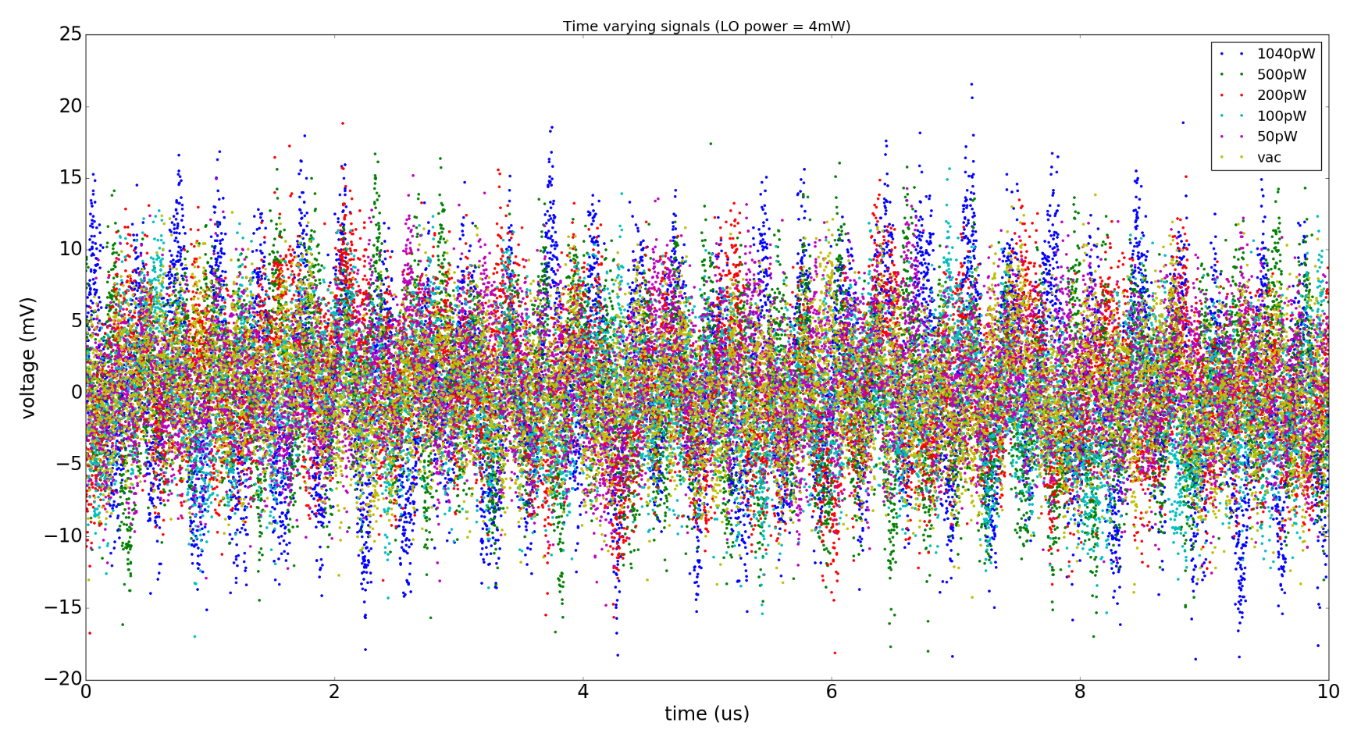
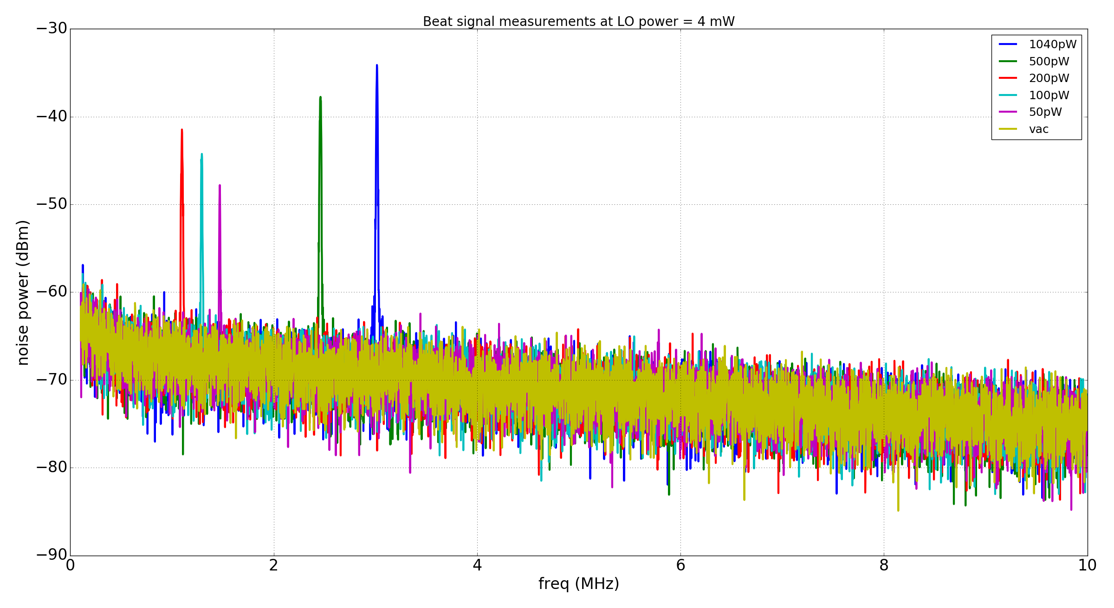
Beat signal measurements (sub nW regime)
Beat freq peak is <20 dB above
SNL for signal power ~50 pW
No harmonics visible too

