Slide 1
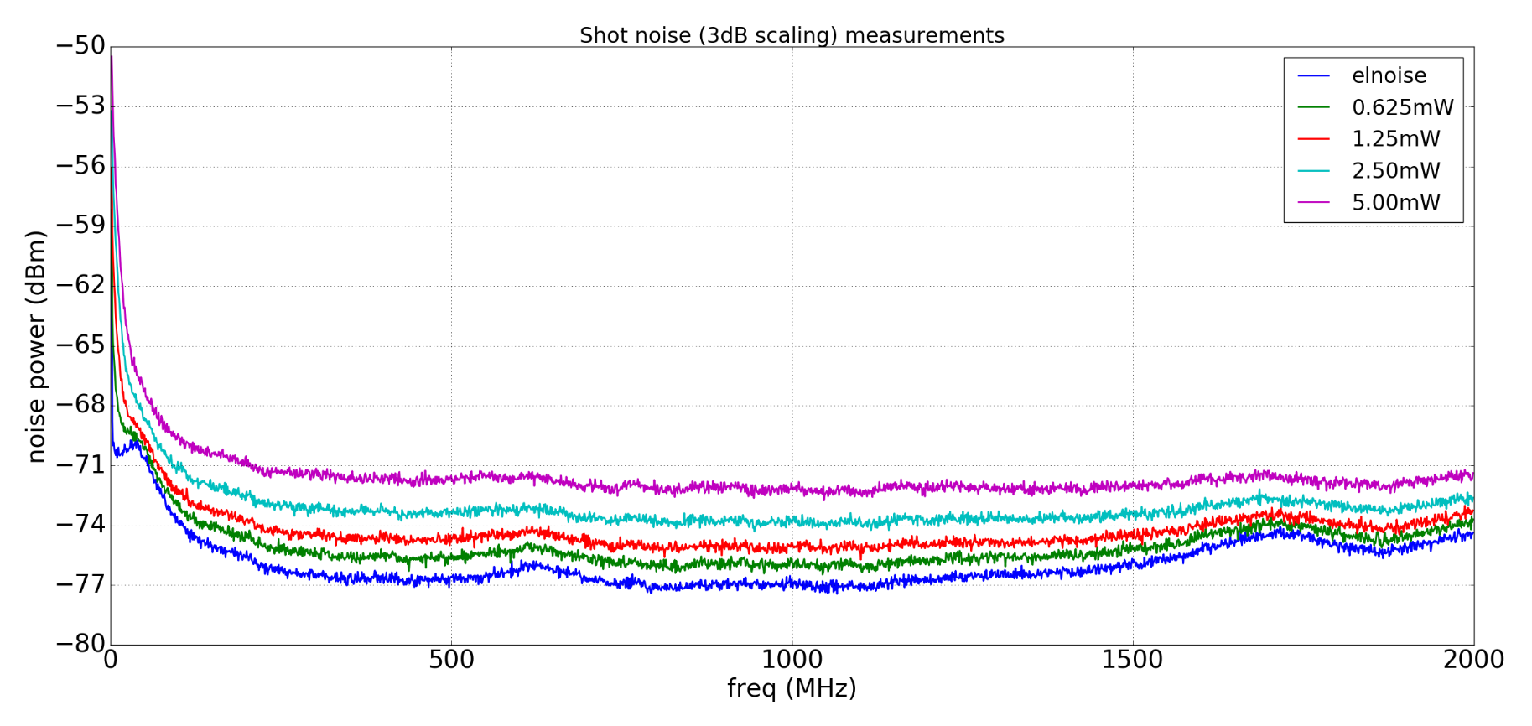
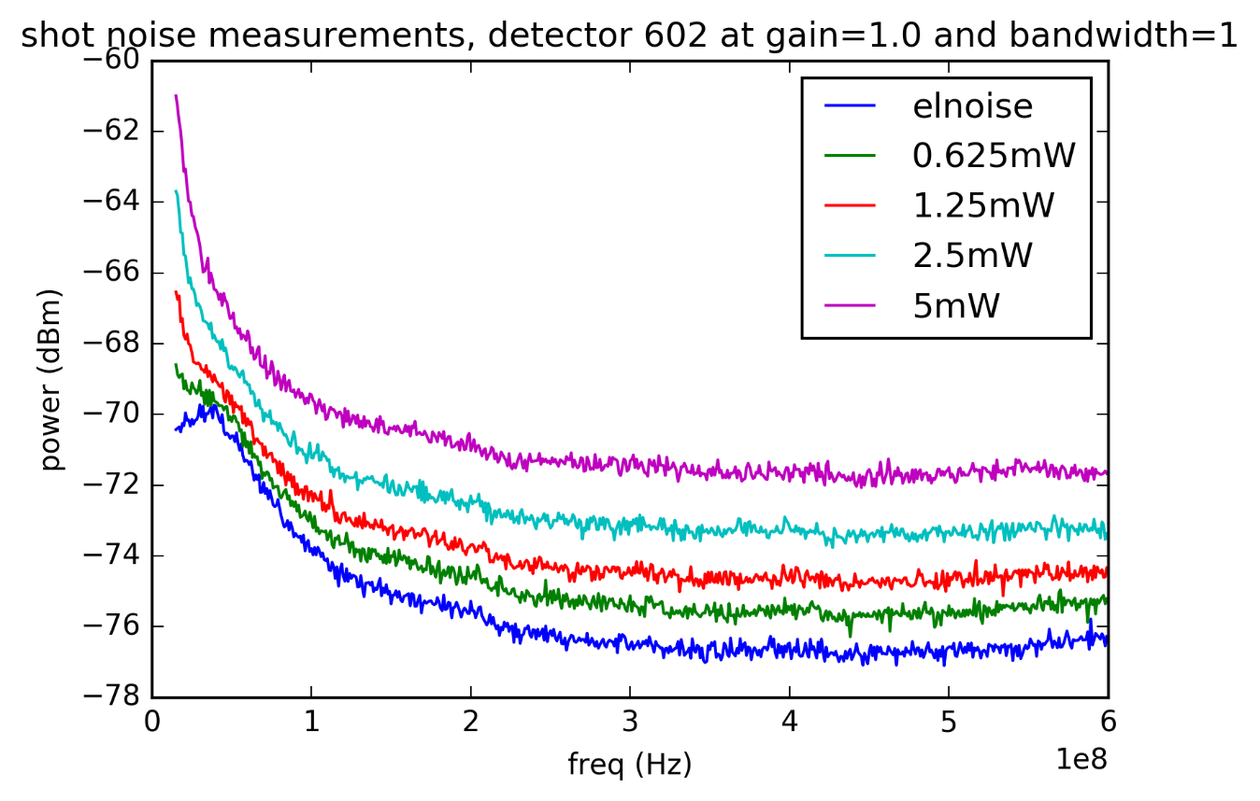
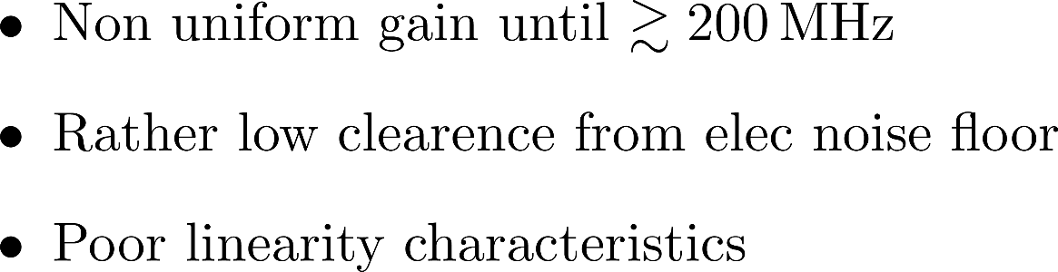
Shot noise performance
~6 dB
Notes:
DC responsivity = 0.7 A/W translating into 56% QE

