Slide 1

Review
For a microbiome with $p$ taxa. We can define the enrichment of set $S$ of size $r$as
$$\sqrt{\frac{r(p−r)}{r+(p −r)}}log⁡\frac{g(T∈S)}{g(T∉S)}$$
Isometric log-ratio transformation
Competitive Gene Set testing

Slide 2
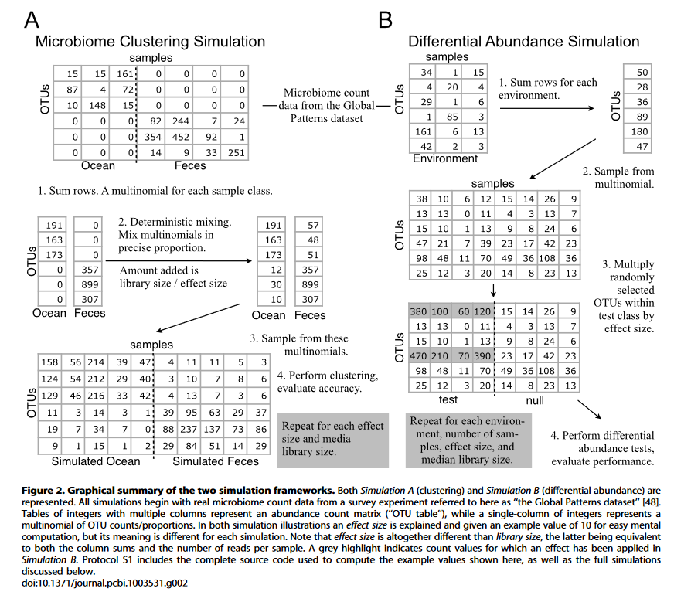
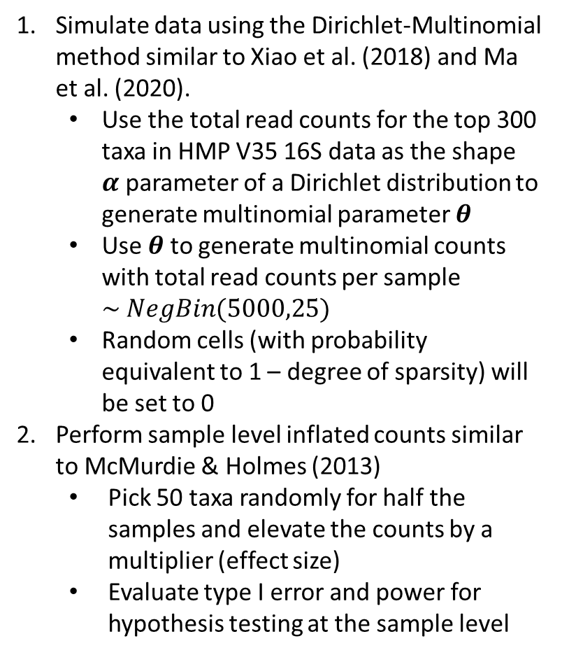
Simulate data using the Dirichlet-Multinomial method similar to Xiao et al. (2018) and Ma et al. (2020).
Use the total read counts for the top 300 taxa in HMP V35 16S data as the shape $α$parameter of a Dirichlet distribution to generate multinomial parameter $θ$
Use $θ$ to generate multinomial counts with total read counts per sample $\sim NegBin(5000,25)$
Random cells (with probability equivalent to 1 – degree of sparsity) will be set to 0
Perform sample level inflated counts similar to McMurdie & Holmes (2013)
Pick 50 taxa randomly for half the samples and elevate the counts by a multiplier (effect size)
Evaluate type I error and power for hypothesis testing at the sample level

Slide 3
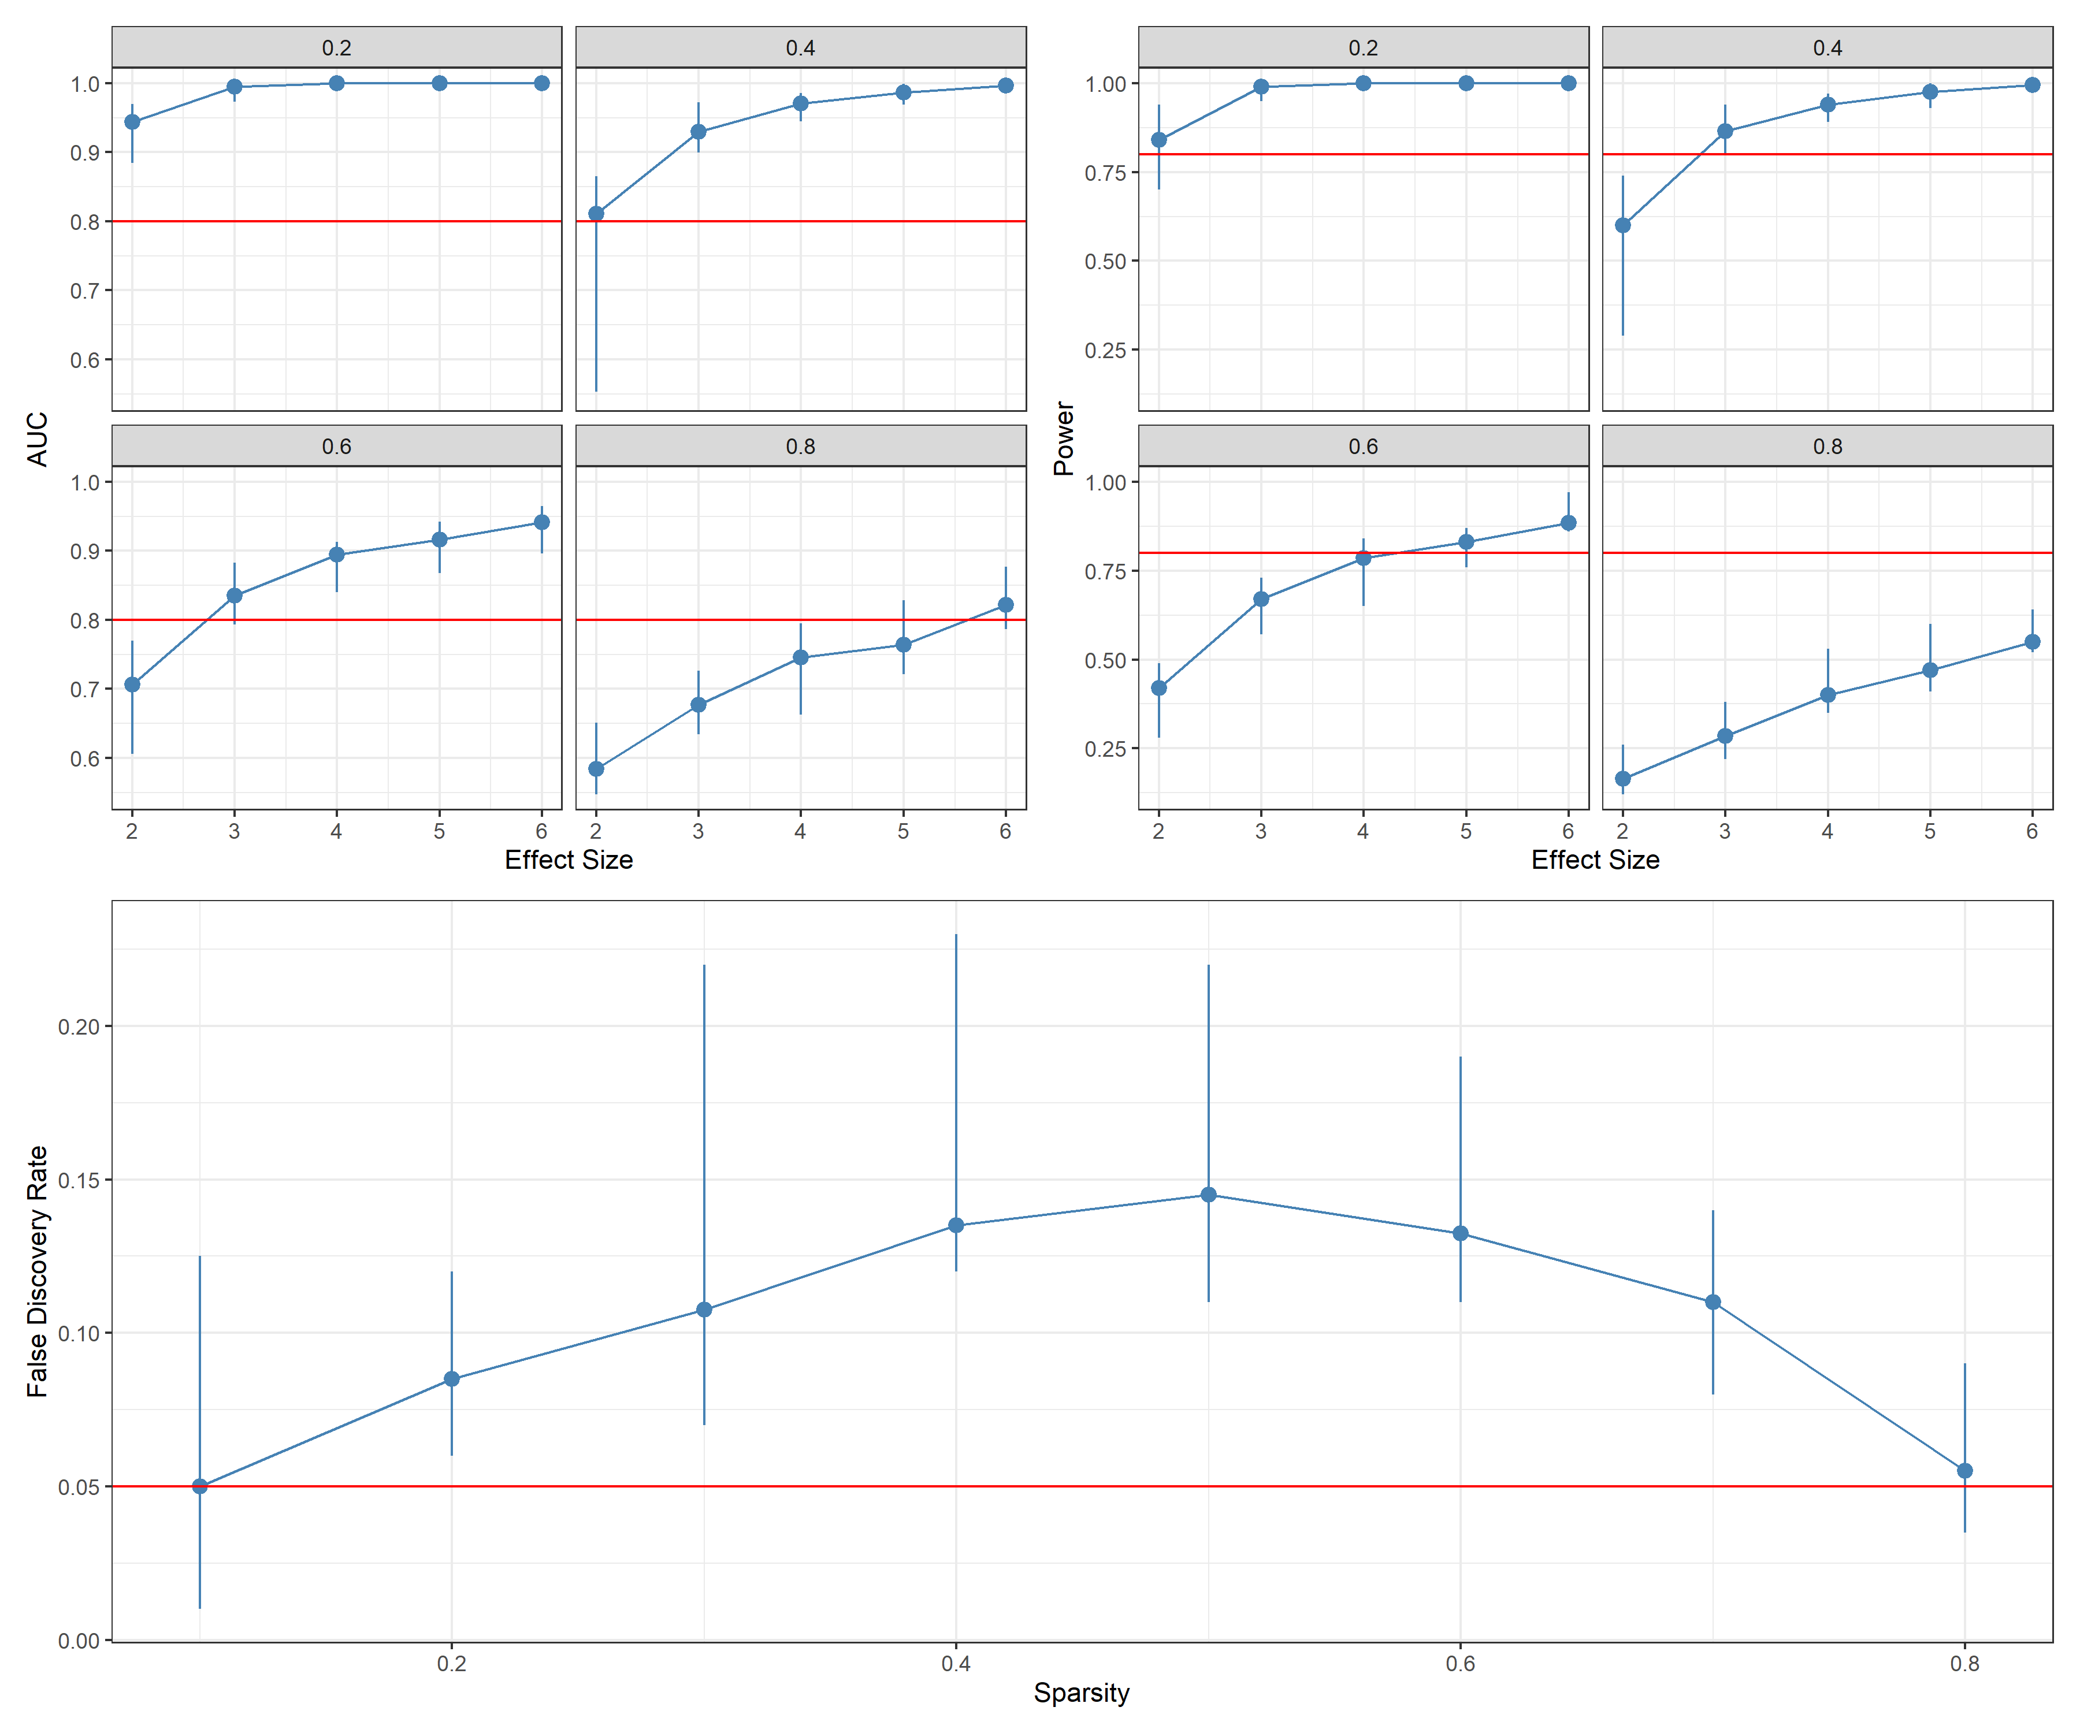
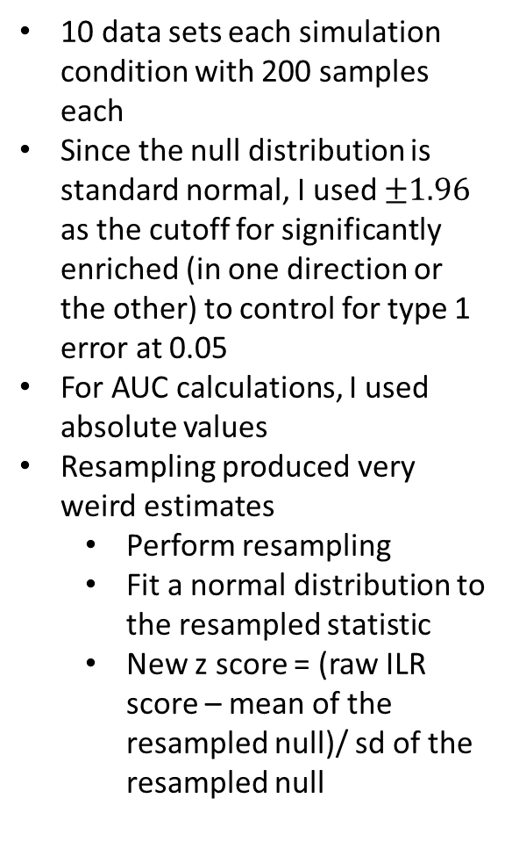
10 data sets each simulation condition with 200 samples each
Since the null distribution is standard normal, I used $±1.96$ as the cutoff for significantly enriched (in one direction or the other) to control for type 1 error at 0.05
For AUC calculations, I used absolute values
Resampling produced very weird estimates
Perform resampling
Fit a normal distribution to the resampled statistic
New z score = (raw ILR score – mean of the resampled null)/ sd of the resampled null

Slide 4
Next steps
Re-do the implementation that is more stable
Simulate differential abundance analysis
Investigate issues with sparsity
Define statistical properties of the statistic and write-up that section

