Slide 1
Taxonomic aggregation using isometric log ratios
Quang Nguyen Work in Progress

Slide 2
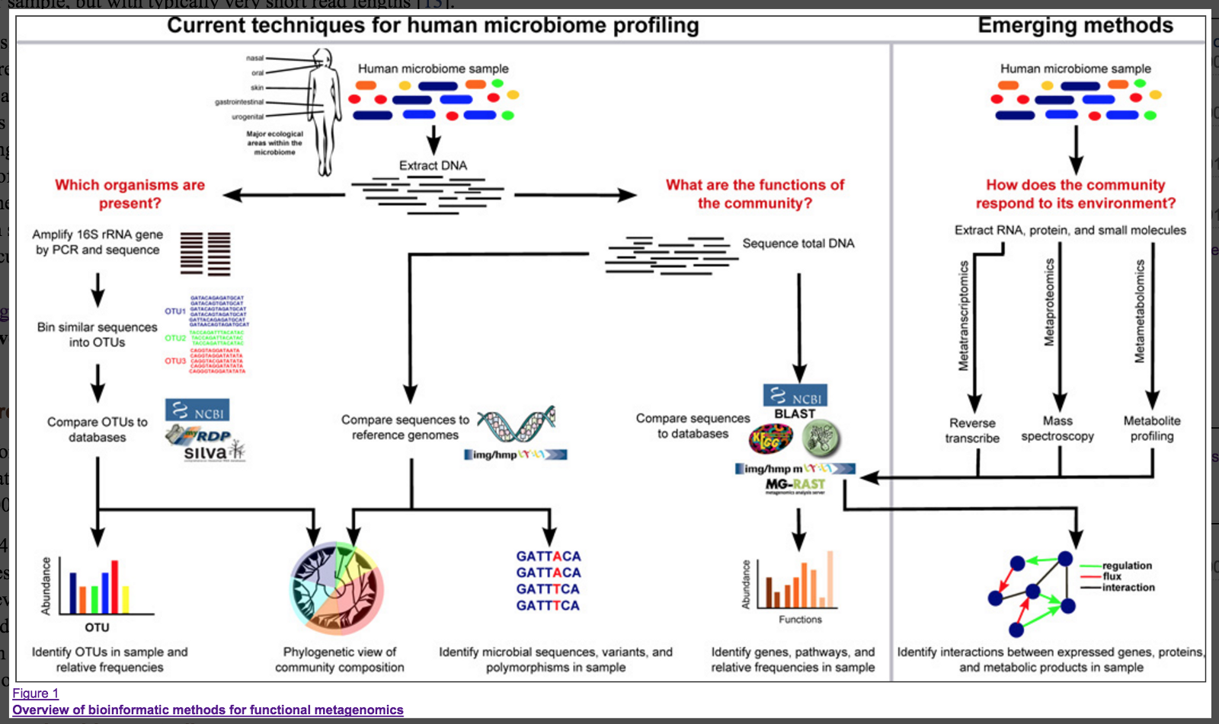
Microbiome data is complicated
Data is high dimensional, compositional and sparse
Dependent on log-ratio analyses

Slide 3
Aggregating variables into sets can help reduce the high dimensionality burden
Specifically for 16S data, since ASVs/OTUs do not have a grounded interpretation and must be aggregated to at least the genus level.
However, microbiome analyses rely on the naïve method by summing up compositional parts
Not particularly appropriate if the goal is to test for differential abundance at multiple taxonomic levels

Slide 4
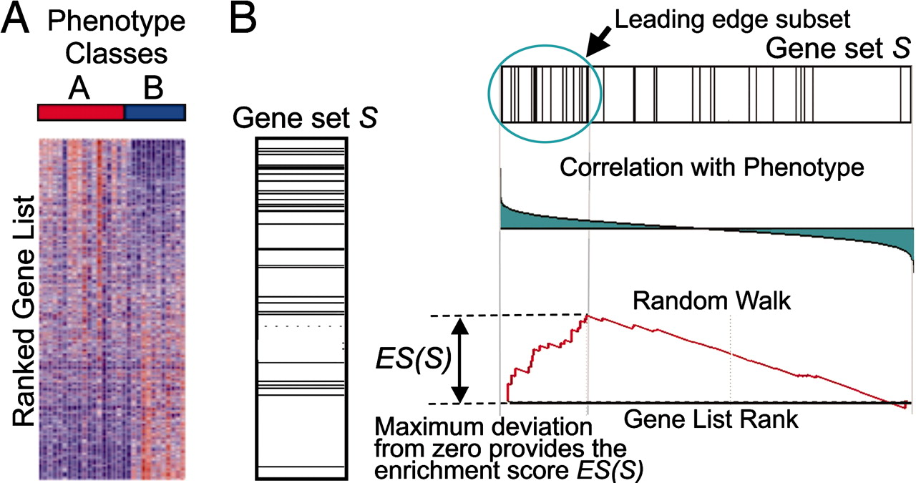
Gene set testing literature provides sophisticated methods to aggregate variables

Slide 5
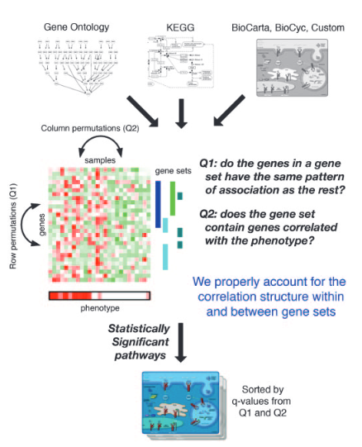
Gene set testing literature provides sophisticated methods to aggregate variables
Competitive gene set testing
Self-contained hypothesis
Tian et al. 2005

Slide 6
Taxonomic enrichment using isometric log ratio transform
Unsupervised competitive taxonomic enrichment method in order to reduce the dimensionality of the data.
Respects the compositional nature of microbiome relative abundance data
Isometric log-ratio is a natural fit (Egozcue et al. 2005)

Slide 7
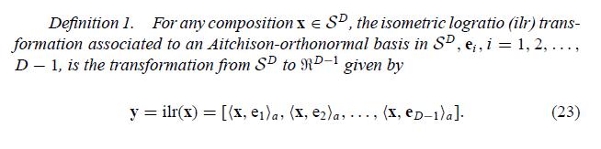
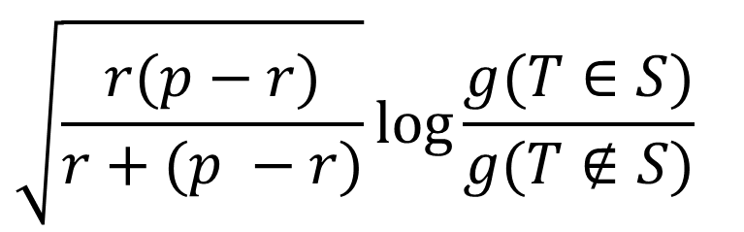
Isometric log-ratio transformation
For a microbiome with $p$ taxa. We can define the enrichment of set $S$ of size $r$as
Geometric mean of proportions of taxa within the set
$$\sqrt{\frac{r(p−r)}{r+(p −r)}}log⁡\frac{g(T∈S)}{g(T∉S)}$$
Geometric mean of proportions of taxa outside the set
Scaling factor
The ILR transformation is essentially the coordinates of a compositional vector when projected onto an orthonormal basis in the compositional space

Slide 8
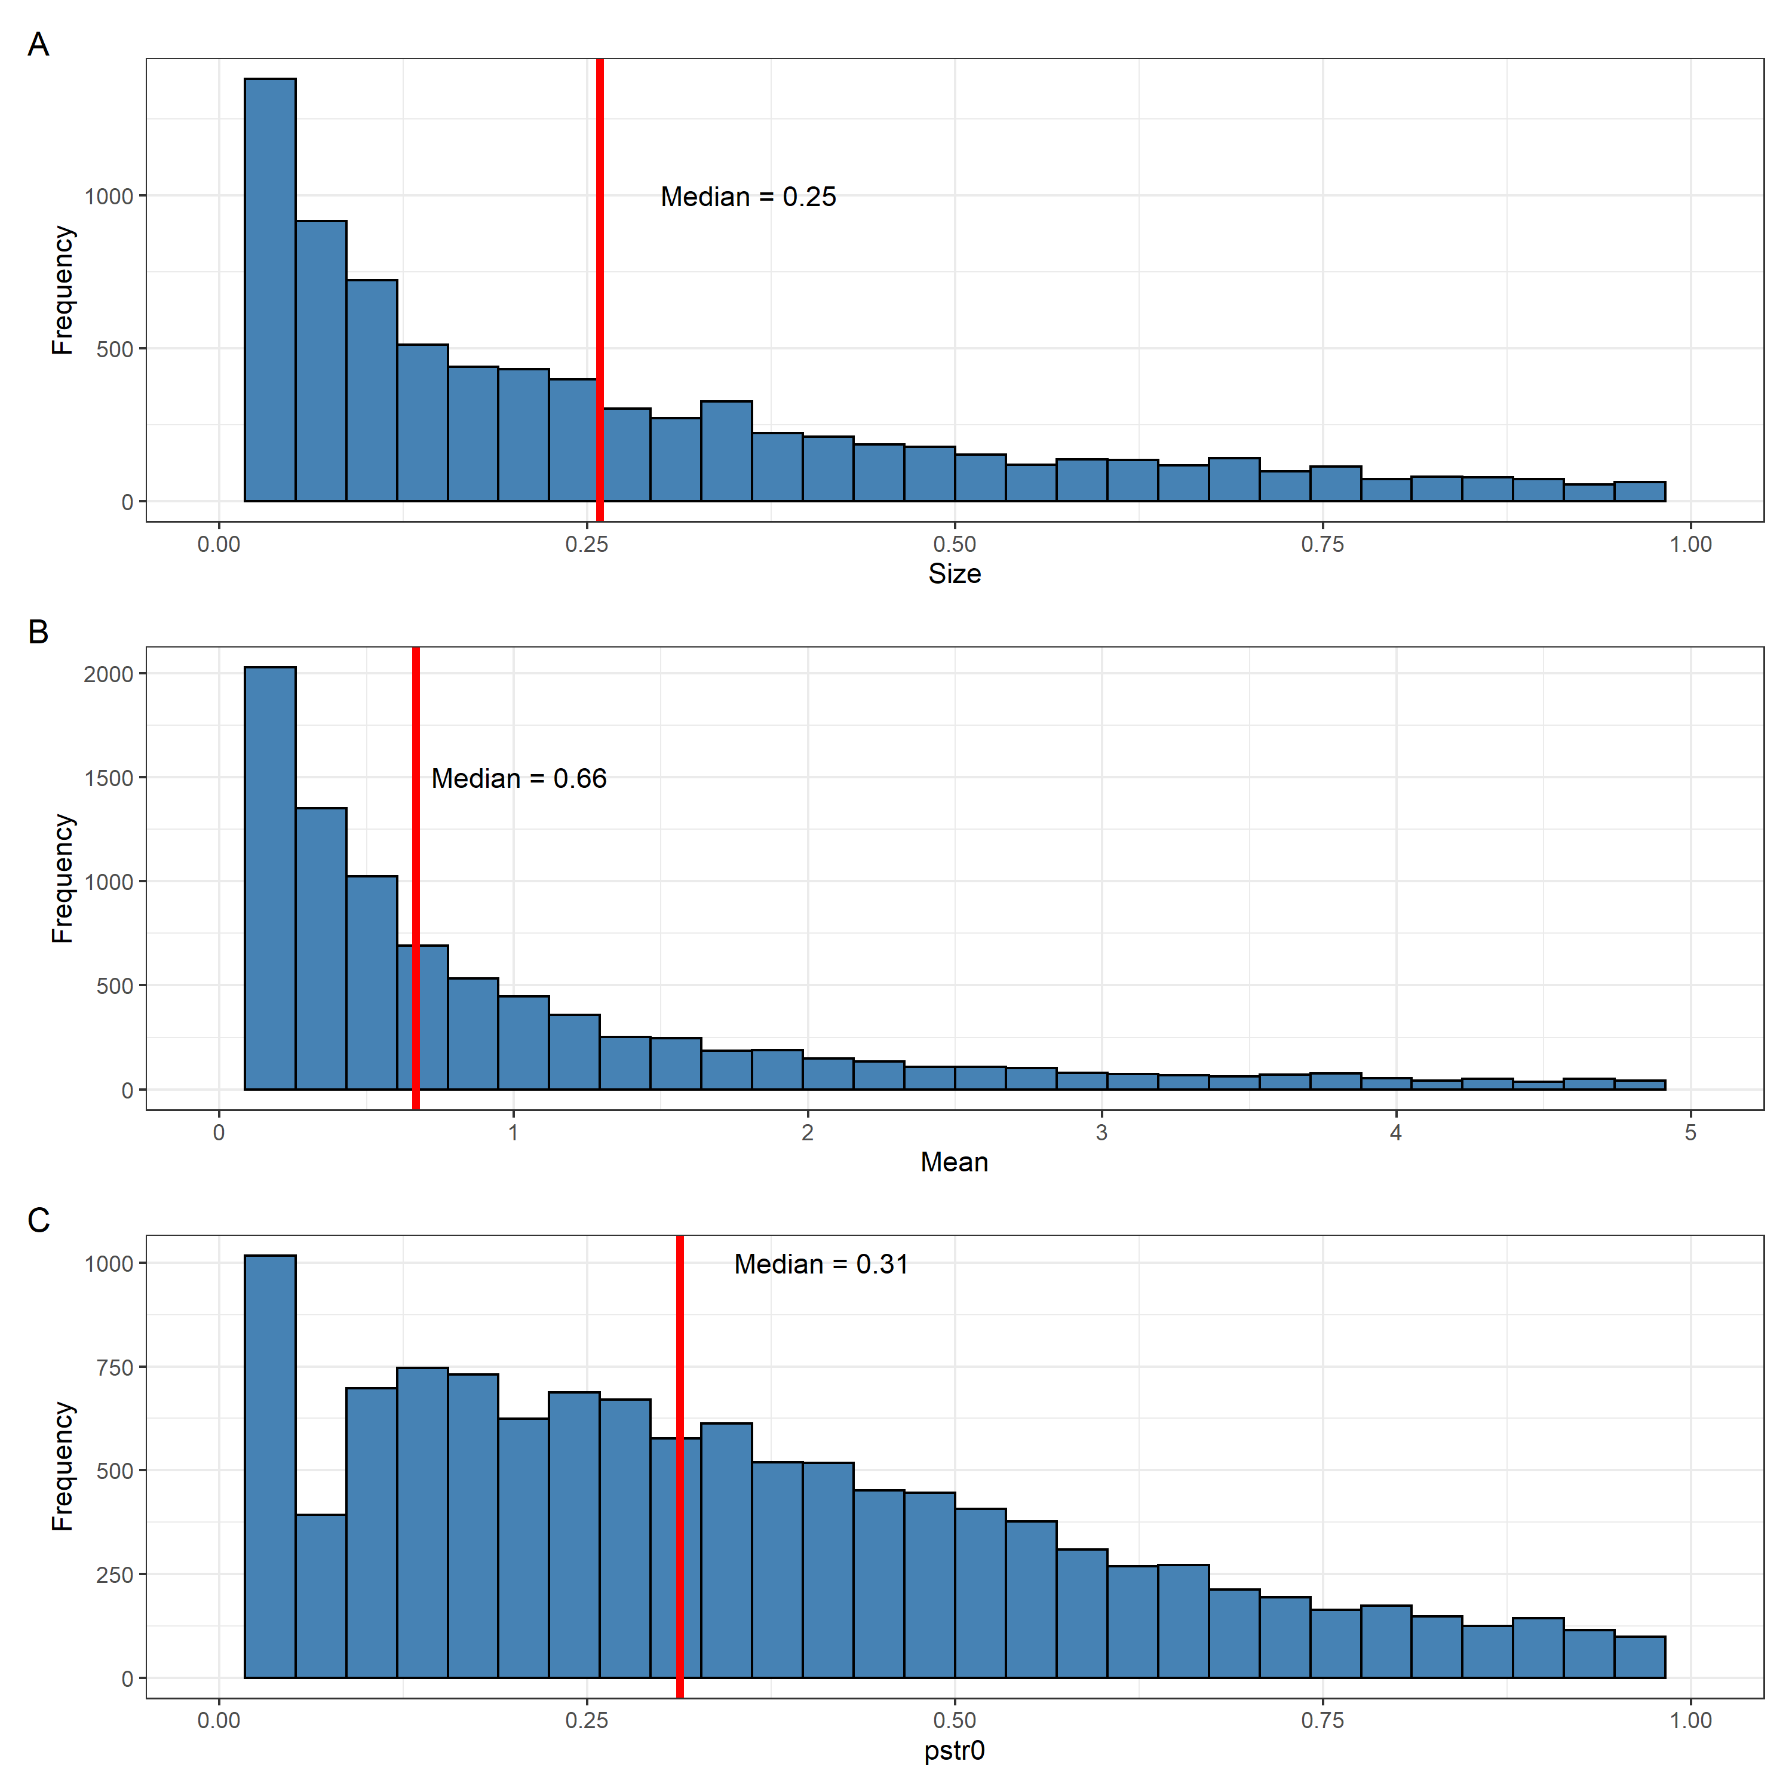
Simulation Design
Generating zero-inflated negative binomial data from normal-copula functions. Parameters of zero-inflated marginals drawn from fitting the distribution to each OTU in the HMP 16S data set. Effect size is calculated as a multiplier to the mean of the distribution
Flexible correlation
Flexible zero-inflation

Slide 9
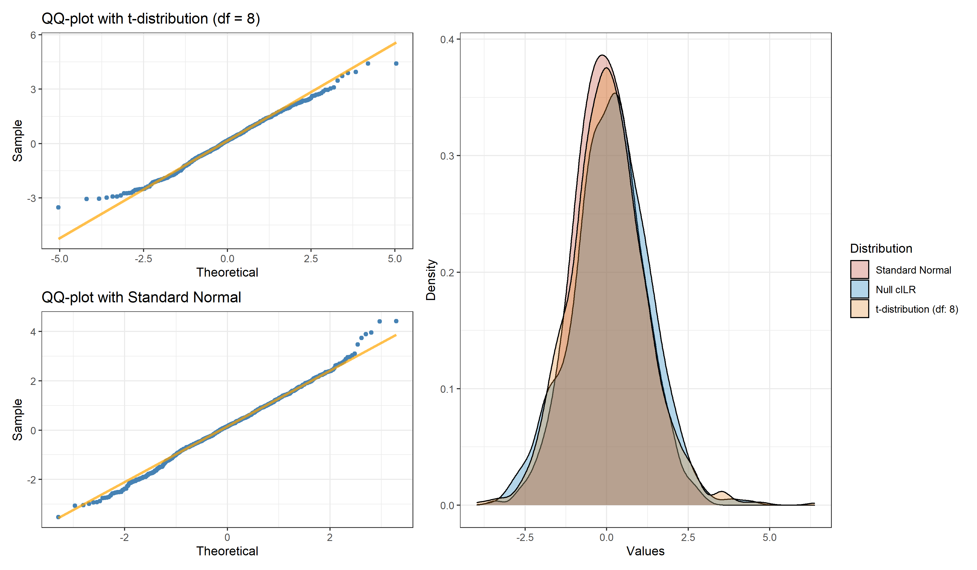

Slide 10
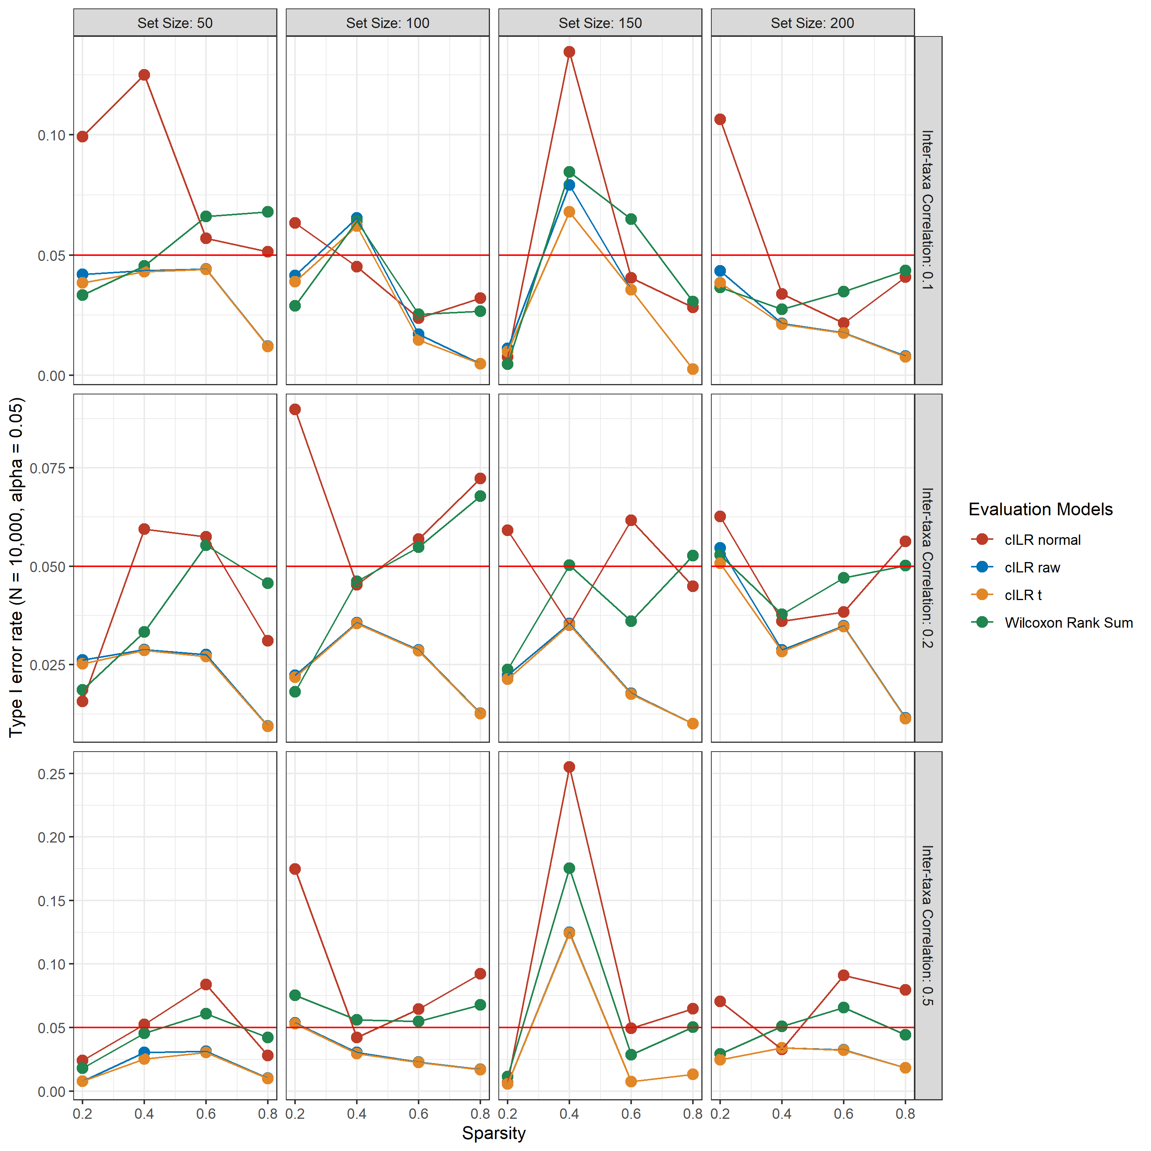
Hypothesis-testing at the single sample level
Type I error rate
Generated a null data set of varying sparsity and inter-taxa correlation with 10,000 samples.
Assign random variables into a set (no differential abundance) of varying sizes

Slide 11
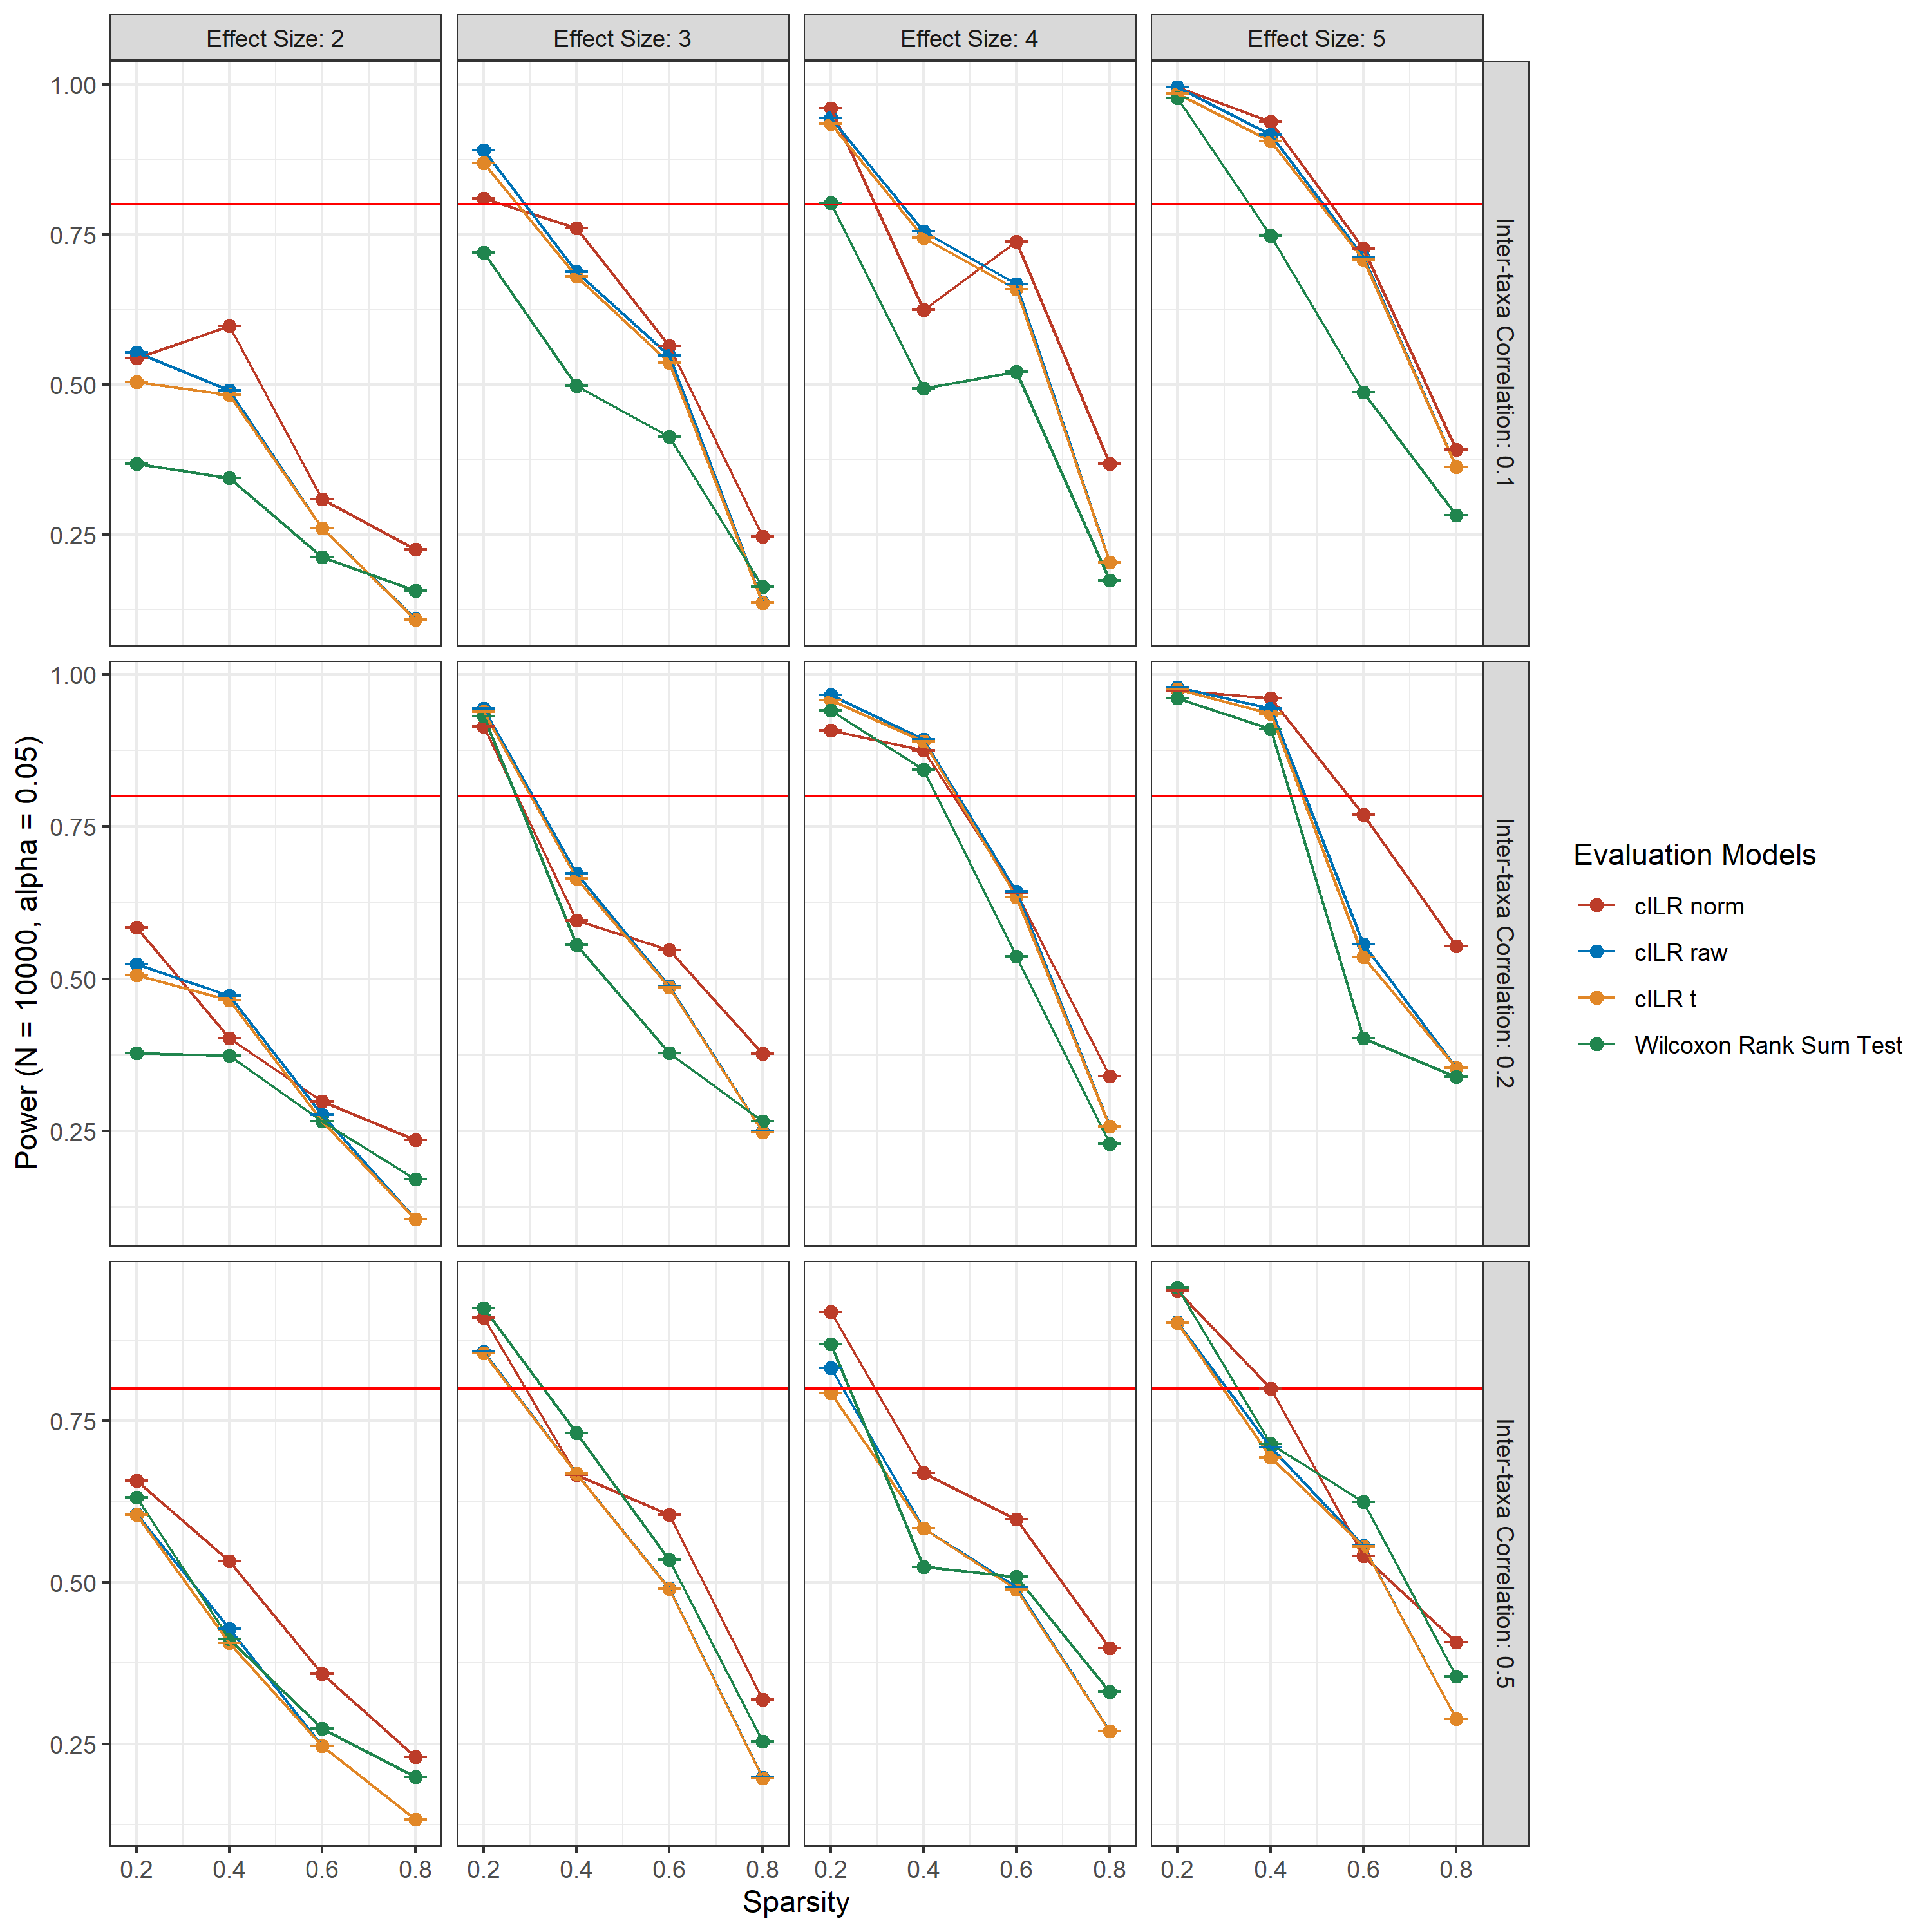
Hypothesis-testing at the single sample level
Power
Generated a data set of varying sparsity and inter-taxa correlation with 10,000 samples.
Have a set of 100 variables to be inflated across all samples with different effect sizes.

Slide 12
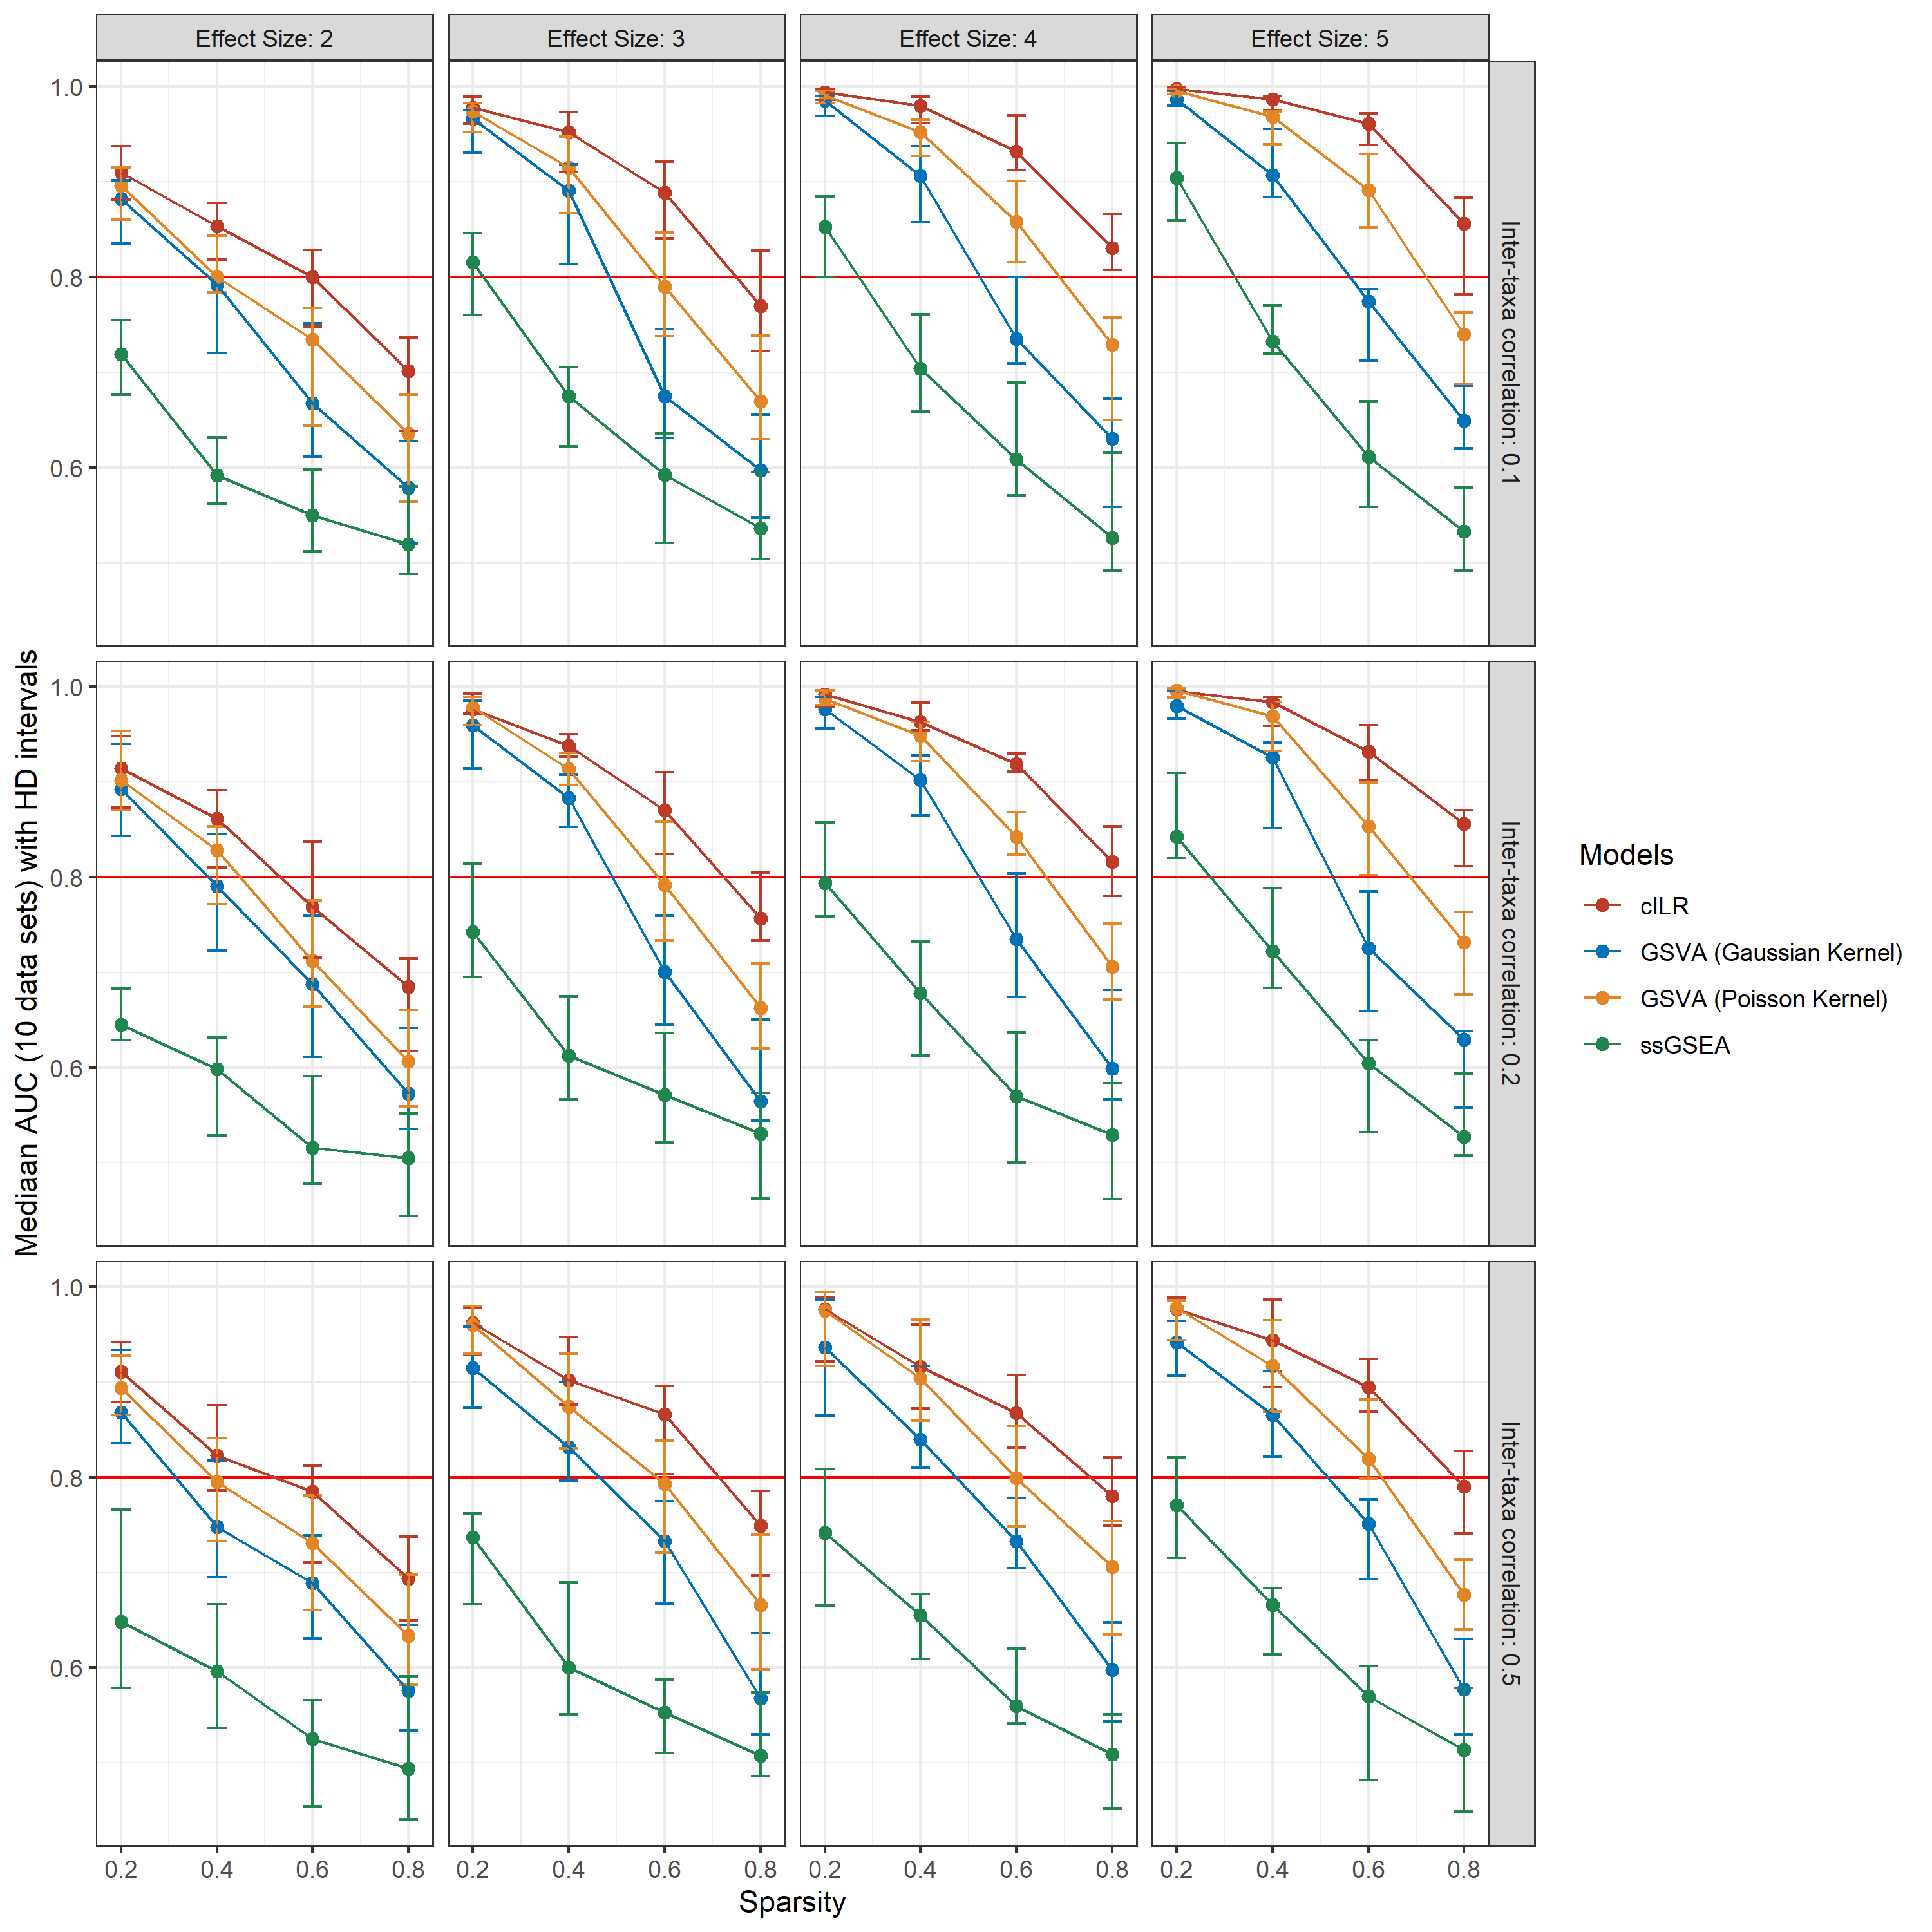
Classification performance at the single sample level
Generated 10 data sets per simulation condition, 300 samples per data set, 50 taxa belonging to 1 set that is DE in half the samples.
AUC values here quantifies the rank-ordering of samples based on enrichment scores in comparison to true labels (where samples have a truly DA set of taxa)
Similar to P(Y = 1|X) in a logistic regression to construct an ROC curve

Slide 13
Next steps
Continue working with simulations for predictive power and differential abundance analysis
Modify the test statistic to improve performance at the sample level
Seeing if different zero-treatments would improve performance.
Account for correlation
Figure out the best approximation of the null distribution

Slide 14
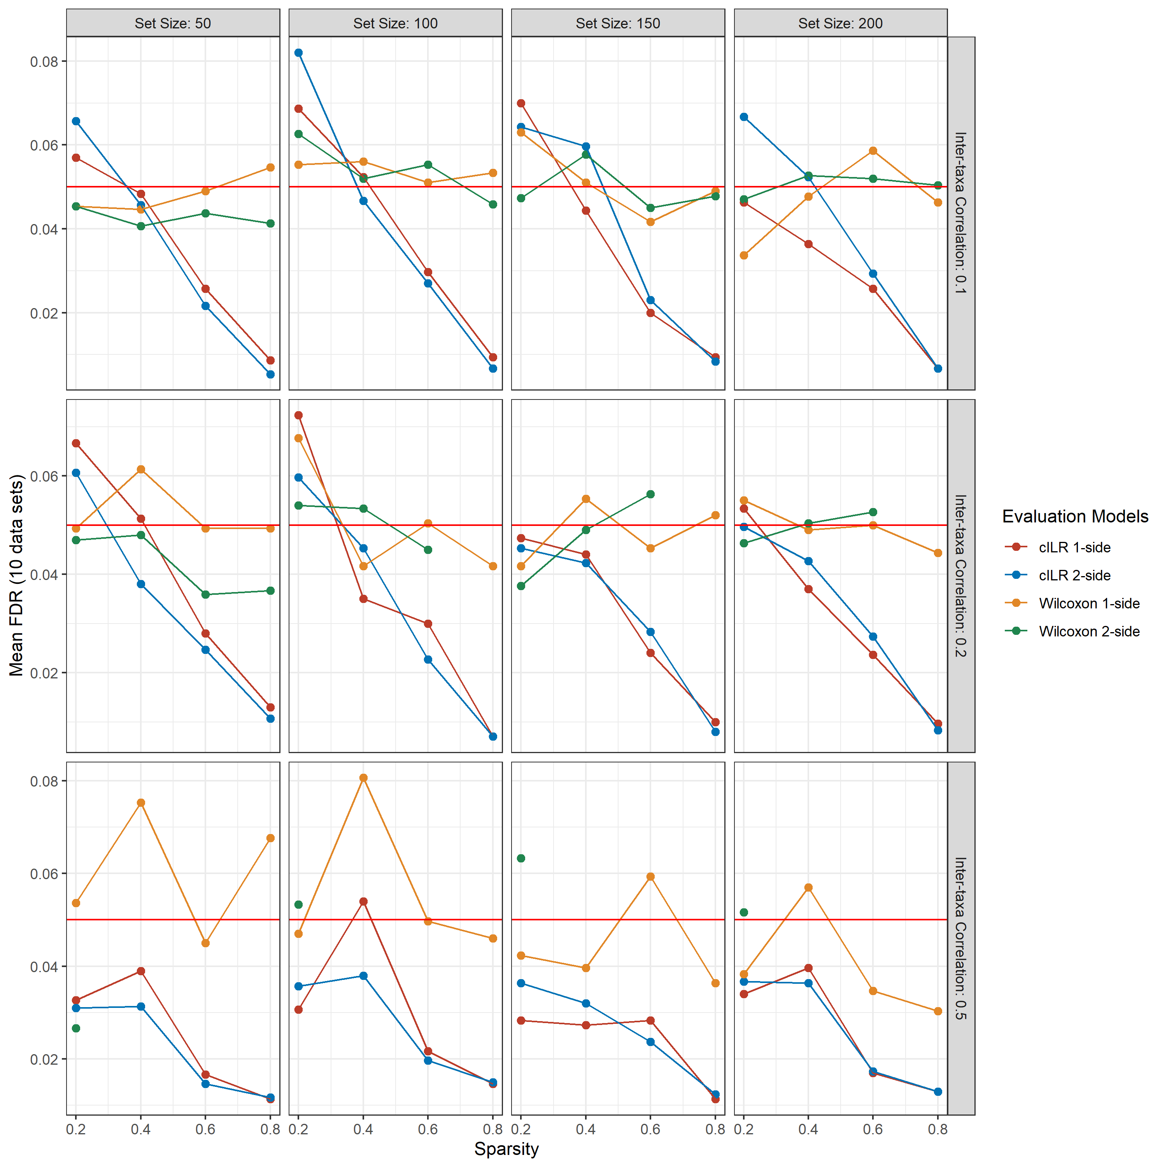
Comparing 1-sided and 2-sided tests between Wilcoxon rank sum test and test based on the CILR method

Slide 15
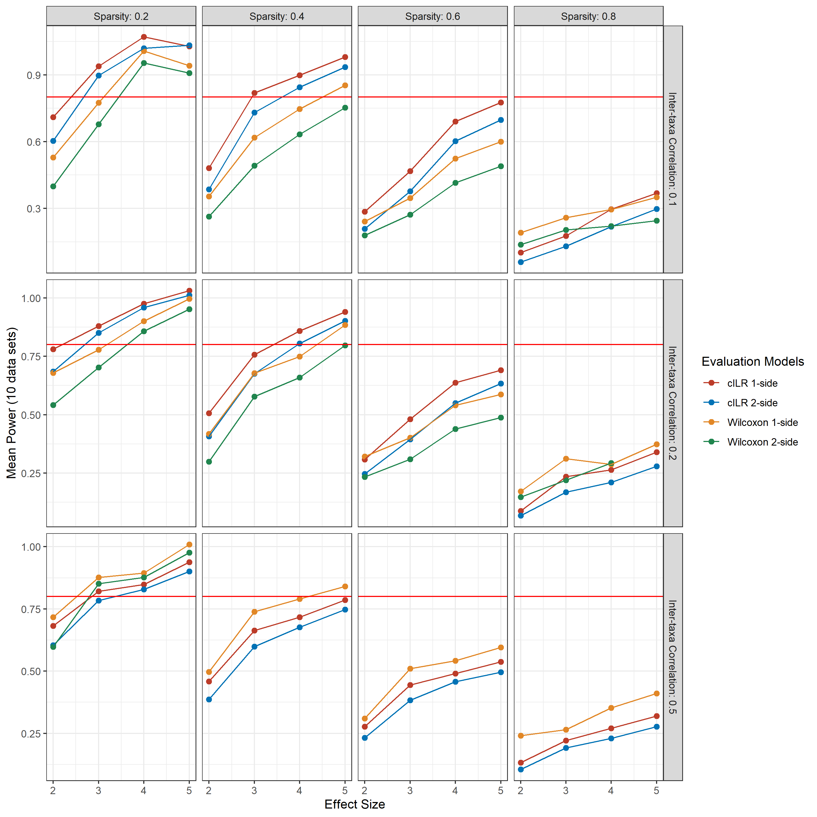
Comparing Power between 1-sided and 2-sided tests for the cILR and Wilcoxon rank sum test

Slide 16
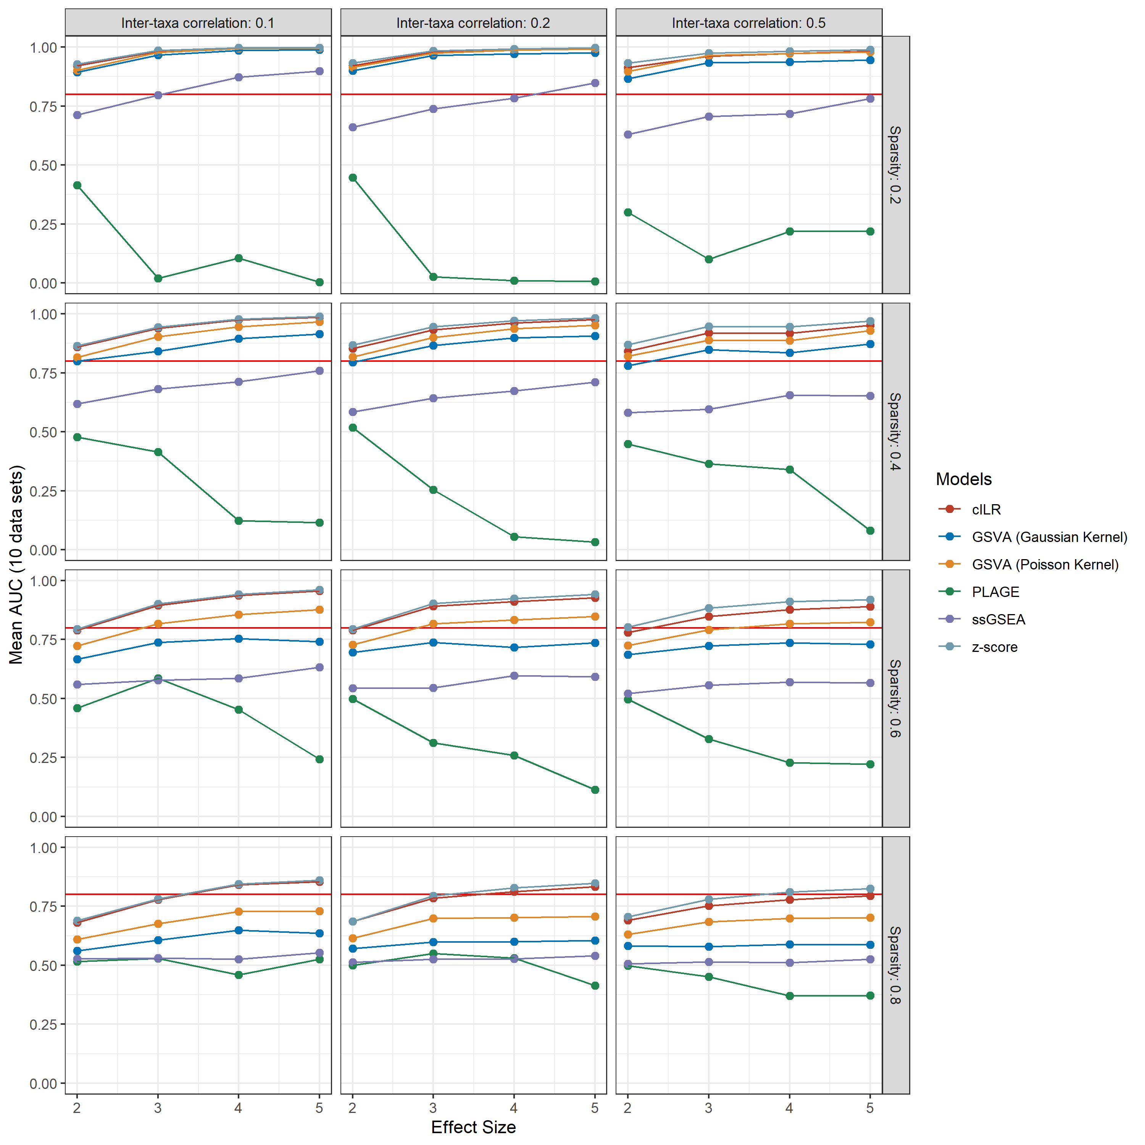
AUC comparison between cILR and other single sample gene set aggregation methods (ssGSEA produced identical results between count and clr transformed data)

