Slide 1
op_send_sq calls the other scripts, but op_send_sq is the only one that is run directly
LAB coordinates
Color Names (Blue,green …)
start
Optimize_pipeline.py
Spectrum_Functions_.py
op_send_sq.py
After Optimize pipeline
Generating spectrum data
data of optimized (center,width,peak,spectrum,LAB cords)
for each dE produced within a threshold
for D1,D2,G1, G2
Spectrum, bandgap
SQlim.py
Power Efficiency data
SQlimit
Sends back to op_send_sq
Then op_send_sq returns max, power efficiency

Slide 2
Data Structures
These are dictionaries
key is dE
For D1,G1
[center, width, peak, spectrum,Lab]
List of dictionaries
For each color
D1
tu_cp
(color parameter tuple)
D2
Color_d
G1
For D2,G2
[center, width, center2, width2, spectrum,Lab]
G2

Slide 3
Data Structures
Dictionary
key is color name
Target color
efficiency
List of dE,eff,LAB produced
Dictionary
Key is d1,d2,g1,g2

Slide 4
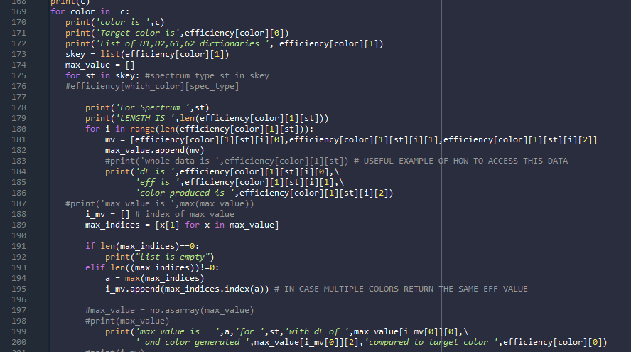
Accessing data in this form is currently a bit confusing. Hopefully this shows how to access these parameters.

