Slide 1
Key
Value
➊
Persistent CPU Caches
➊ Insert to collecting log
➋ Flush to backup log and DRAM table
➌ Flush to PMem table and fingerprints
···
Collecting Log
➋
➋
Directory
Backup Log
Entry 0
…
…
…
…
Entry 1
➌
Entry 2
Entry 3
D-buckets
Directory
DRAM Table
Entry 0
…
…
…
…
Entry 1
➌
Entry 2
Entry 3
P-buckets
Fingerprints
PMem Table
DRAM
PMem

Slide 2
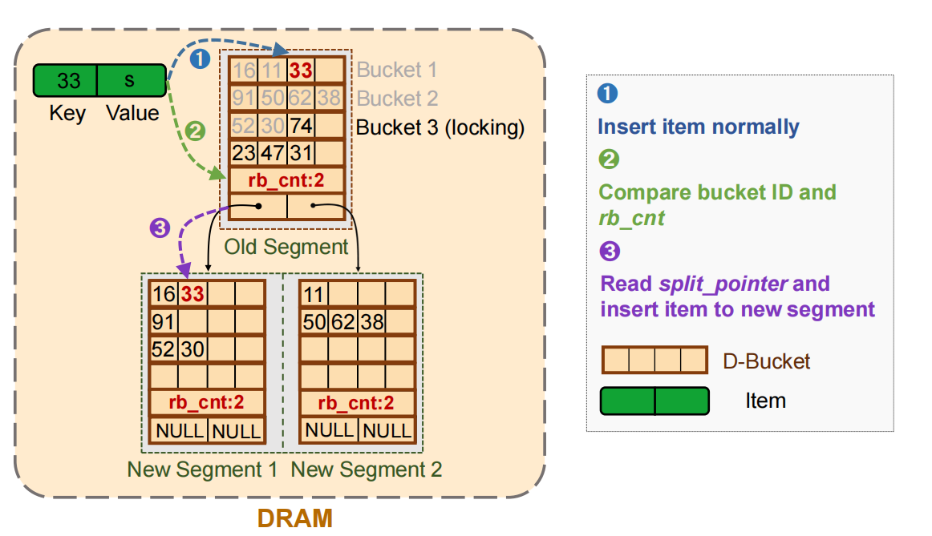
00₂
10₂
01₂
11₂
➊
Flush to Pmem Table
➋
Add fingerprints of the keys
➌
Flip corresponding bits
16
11
61
20
8
9
35
7
➊
00₂
10₂
01₂
11₂
...
...
...
21
51
59
16
23
47
31
10
65
60
41
37
19
1
80
61
85
70
Segment 1
Segment 2
Segment 3
21
13
5
80
51
59
63
72
27
34
42
55
...
DRAM Table
73
81
23
41
7 | 4 | 2 | 5
...
1 | 7 | 9 | 1
➋
...
...
...
11
19
31
65
➌
46
26
...
37
35
7
8
81
70
2
73
4
85
41
37
19
1
60
1
22
98
1110 1011 0111 0111
Segment 1
Segment 2
Segment 3
Backup Log
Fingerprints
Bitmap
PMem Table
DRAM
PMem

