Slide 1
Chapter 5
CPU Scheduling (Algorithms)

Slide 2
Chapter 5: CPU Scheduling
5.1 Basic Concepts
5.2 Scheduling Criteria
5.3 Scheduling Algorithms
5.4 Multiple-Processor Scheduling
5.5 Thread Scheduling (skip)
5.6 Operating System Examples
5.7 Algorithm Evaluation

Slide 3
5.1 Basic Concepts

Slide 4
Basic Concepts
Maximum CPU utilization is obtained with multiprogramming
  Several processes are kept in memory at one time
  Every time a running process has to wait, another process can take over use of the CPU
Scheduling of the CPU is fundamental to operating system design
Process execution consists of a cycle of a CPU time burst and an I/O time burst (i.e. wait) as shown on the next slide
  Processes alternate between these two states (i.e., CPU burst and I/O burst)
  Eventually, the final CPU burst ends with a system request to terminate execution

Slide 5

Alternating Sequence of CPU And I/O Bursts

Slide 6

Histogram of CPU-burst Times
CPU bursts tend to have a frequency curve similar to the exponential curve shown above. It is characterized by a large number of short CPU bursts and a small number of long CPU bursts. An I/O-bound program typically has many short CPU bursts; a CPU-bound program might have a few long CPU bursts.

Slide 7

CPU Scheduler
The CPU scheduler selects from among the processes in memory that are ready to execute and allocates the CPU to one of them
CPU scheduling is affected by the following set of circumstances:
  1. (N) A process switches from running to waiting state
  2. (P) A process switches from running to ready state
  3. (P) A process switches from waiting to ready state
  4. (N) A processes switches from running to terminated state
Circumstances 1 and 4 are non-preemptive; they offer no schedule choice
Circumstances 2 and 3 are pre-emptive; they can be scheduled

Slide 8
Dispatcher
The dispatcher module gives control of the CPU to the process selected by the short-term scheduler; this involves:
  switching context
  switching to user mode
  jumping to the proper location in the user program to restart that program
The dispatcher needs to run as fast as possible, since it is invoked during process context switch
The time it takes for the dispatcher to stop one process and start another process is called dispatch latency

Slide 9
5.2 Scheduling Criteria

Slide 10
Scheduling Criteria
Different CPU scheduling algorithms have different properties
The choice of a particular algorithm may favor one class of processes over another
In choosing which algorithm to use, the properties of the various algorithms should be considered
Criteria for comparing CPU scheduling algorithms may include the following
  CPU utilization – percent of time that the CPU is busy executing a process
  Throughput – number of processes that are completed per time unit
  Response time – amount of time it takes from when a request was submitted until the first response occurs (but not the time it takes to output the entire response)
  Waiting time – the amount of time before a process starts after first entering the ready queue (or the sum of the amount of time a process has spent waiting in the ready queue)
  Turnaround time – amount of time to execute a particular process from the time of submission through the time of completion

Slide 11
Optimization Criteria
It is desirable to
  Maximize CPU utilization
  Maximize throughput
  Minimize turnaround time
  Minimize start time
  Minimize waiting time
  Minimize response time
In most cases, we strive to optimize the average measure of each metric
In other cases, it is more important to optimize the minimum or maximum values rather than the average

Slide 12
5.3a Single Processor Scheduling Algorithms

Slide 13
Single Processor Scheduling Algorithms
First Come, First Served (FCFS)
Shortest Job First (SJF)
Priority
Round Robin (RR)

Slide 14
First Come, First Served (FCFS) Scheduling

Slide 15
First-Come, First-Served (FCFS) Scheduling
Process Burst Time
P₁ 24
P₂ 3
P₃ 3
With FCFS, the process that requests the CPU first is allocated the CPU first
Case #1: Suppose that the processes arrive in the order: P₁ , P₂ , P₃
The Gantt Chart for the schedule is:
Waiting time for P₁ = 0; P₂ = 24; P₃ = 27
Average waiting time: (0 + 24 + 27)/3 = 17
Average turn-around time: (24 + 27 + 30)/3 = 27
P₁
P₂
P₃
0
24
27
30

Slide 16
FCFS Scheduling (Cont.)
Case #2: Suppose that the processes arrive in the order: P₂ , P₃ , P₁
The Gantt chart for the schedule is:
Waiting time for P₁ = 6; P₂ = 0; P₃ = 3
Average waiting time: (6 + 0 + 3)/3 = 3 (Much better than Case #1)
Average turn-around time: (3 + 6 + 30)/3 = 13
Case #1 is an example of the convoy effect; all the other processes wait for one long-running process to finish using the CPU
  This problem results in lower CPU and device utilization; Case #2 shows that higher utilization might be possible if the short processes were allowed to run first
The FCFS scheduling algorithm is non-preemptive
  Once the CPU has been allocated to a process, that process keeps the CPU until it releases it either by terminating or by requesting I/O
  It is a troublesome algorithm for time-sharing systems
P₂
P₃
P₁
0
3
6
30

Slide 17
Shortest Job First (SJF) Scheduling

Slide 18
Shortest-Job-First (SJF) Scheduling
The SJF algorithm associates with each process the length of its next CPU burst
When the CPU becomes available, it is assigned to the process that has the smallest next CPU burst (in the case of matching bursts, FCFS is used)
Two schemes:
  Nonpreemptive – once the CPU is given to the process, it cannot be preempted until it completes its CPU burst
  Preemptive – if a new process arrives with a CPU burst length less than the remaining time of the current executing process, preempt. This scheme is know as the Shortest-Remaining-Time-First (SRTF)

Slide 19
Example #1: Non-Preemptive SJF
(simultaneous arrival)
Process Arrival Time Burst Time
P₁ 0.0 6
P₂ 0.0 4
P₃ 0.0 1
P₄ 0.0 5
SJF (non-preemptive, simultaneous arrival)
Average waiting time = (0 + 1 + 5 + 10)/4 = 4
Average turn-around time = (1 + 5 + 10 + 16)/4 = 8
P₃
P₂
P₄
P₁
0
1
5
10
16

Slide 20
Example #2: Non-Preemptive SJF
(varied arrival times)
Process Arrival Time Burst Time
P₁ 0.0 7
P₂ 2.0 4
P₃ 4.0 1
P₄ 5.0 4
SJF (non-preemptive, varied arrival times)
Average waiting time
= ( (0 – 0) + (8 – 2) + (7 – 4) + (12 – 5) )/4
= (0 + 6 + 3 + 7)/4 = 4
Average turn-around time:
= ( (7 – 0) + (12 – 2) + (8 - 4) + (16 – 5))/4
= ( 7 + 10 + 4 + 11)/4 = 8
P₁
P₃
P₂
P₄
0
3
7
8
12
16
Waiting time : sum of time that a process has spent waiting in the ready queue

Slide 21
Example #3: Preemptive SJF
(Shortest-remaining-time-first)
Process Arrival Time Burst Time
P₁ 0.0 7
P₂ 2.0 4
P₃ 4.0 1
P₄ 5.0 4
SJF (preemptive, varied arrival times)
Average waiting time
= ( [(0 – 0) + (11 - 2)] + [(2 – 2) + (5 – 4)] + (4 - 4) + (7 – 5) )/4
= 9 + 1 + 0 + 2)/4
= 3
Average turn-around time = (16 + 7 + 5 + 11)/4 = 9.75
P₁
P₂
P₃
P₂
P₄
P₁
0
2
4
5
7
11
16
Waiting time : sum of time that a process has spent waiting in the ready queue

Slide 22
Priority Scheduling

Slide 23
Priority Scheduling
The SJF algorithm is a special case of the general priority scheduling algorithm
A priority number (integer) is associated with each process
The CPU is allocated to the process with the highest priority (smallest integer = highest priority)
Priority scheduling can be either preemptive or non-preemptive
  A preemptive approach will preempt the CPU if the priority of the newly-arrived process is higher than the priority of the currently running process
  A non-preemptive approach will simply put the new process (with the highest priority) at the head of the ready queue
SJF is a priority scheduling algorithm where priority is the predicted next CPU burst time
The main problem with priority scheduling is starvation, that is, low priority processes may never execute
A solution is aging; as time progresses, the priority of a process in the ready queue is increased

Slide 24
Round Robin (RR) Scheduling

Slide 25
Round Robin (RR) Scheduling
In the round robin algorithm, each process gets a small unit of CPU time (a time quantum), usually 10-100 milliseconds. After this time has elapsed, the process is preempted and added to the end of the ready queue.
If there are n processes in the ready queue and the time quantum is q, then each process gets 1/n of the CPU time in chunks of at most q time units at once. No process waits more than (n-1)q time units.
Performance of the round robin algorithm
  q large ⇒ FCFS
  q small ⇒ q must be greater than the context switch time; otherwise, the overhead is too high
One rule of thumb is that 80% of the CPU bursts should be shorter than the time quantum

Slide 26
Example of RR with Time Quantum = 20
Process Burst Time
P₁ 53
P₂ 17
P₃ 68
P₄ 24
The Gantt chart is:
Typically, higher average turnaround than SJF, but better response time
Average waiting time
= ( [(0 – 0) + (77 - 20) + (121 – 97)] + (20 – 0) + [(37 – 0) + (97 - 57) + (134 – 117)] + [(57 – 0) + (117 – 77)] ) / 4
= (0 + 57 + 24) + 20 + (37 + 40 + 17) + (57 + 40) ) / 4
= (81 + 20 + 94 + 97)/4
= 292 / 4 = 73
Average turn-around time = 134 + 37 + 162 + 121) / 4 = 113.5
P₁
P₂
P₃
P₄
P₁
P₃
P₄
P₁
P₃
P₃
0
20
37
57
77
97
117
121
134
154
162

Slide 27

Time Quantum and Context Switches

Slide 28

Turnaround Time Varies With The Time Quantum
As can be seen from this graph, the average turnaround time of a set
of processes does not necessarily improve as the time quantum size
increases. In general, the average turnaround time can be improved
if most processes finish their next CPU burst in a single time quantum.

Slide 29
5.3b Multi-level Queue Scheduling

Slide 30
Multi-level Queue Scheduling
Multi-level queue scheduling is used when processes can be classified into groups
For example, foreground (interactive) processes and background (batch) processes
  The two types of processes have different response-time requirements and so may have different scheduling needs
  Also, foreground processes may have priority (externally defined) over background processes
A multi-level queue scheduling algorithm partitions the ready queue into several separate queues
The processes are permanently assigned to one queue, generally based on some property of the process such as memory size, process priority, or process type
Each queue has its own scheduling algorithm
  The foreground queue might be scheduled using an RR algorithm
  The background queue might be scheduled using an FCFS algorithm
In addition, there needs to be scheduling among the queues, which is commonly implemented as fixed-priority pre-emptive scheduling
  The foreground queue may have absolute priority over the background queue

Slide 31

Multi-level Queue Scheduling
One example of a multi-level queue are the five queues shown below
Each queue has absolute priority over lower priority queues
For example, no process in the batch queue can run unless the queues above it are empty
However, this can result in starvation for the processes in the lower priority queues

Slide 32
Multilevel Queue Scheduling
Another possibility is to time slice among the queues
Each queue gets a certain portion of the CPU time, which it can then schedule among its various processes
  The foreground queue can be given 80% of the CPU time for RR scheduling
  The background queue can be given 20% of the CPU time for FCFS scheduling

Slide 33
5.3c Multi-level Feedback Queue Scheduling

Slide 34
Multilevel Feedback Queue Scheduling
In multi-level feedback queue scheduling, a process can move between the various queues; aging can be implemented this way
A multilevel-feedback-queue scheduler is defined by the following parameters:
  Number of queues
  Scheduling algorithms for each queue
  Method used to determine when to promote a process
  Method used to determine when to demote a process
  Method used to determine which queue a process will enter when that process needs service

Slide 35

Example of Multilevel Feedback Queue
Scheduling
  A new job enters queue Q₀ (RR) and is placed at the end. When it gains the CPU, the job receives 8 milliseconds. If it does not finish in 8 milliseconds, the job is moved to the end of queue Q₁.
  A Q₁ (RR) job receives 16 milliseconds. If it still does not complete, it is preempted and moved to queue Q₂ (FCFS).
Q₀
Q₁
Q₂

Slide 36
5.4 Multiple-Processor Scheduling

Slide 37
Multiple-Processor Scheduling
If multiple CPUs are available, load sharing among them becomes possible; the scheduling problem becomes more complex
We concentrate in this discussion on systems in which the processors are identical (homogeneous) in terms of their functionality
  We can use any available processor to run any process in the queue
Two approaches: Asymmetric processing and symmetric processing (see next slide)

Slide 38
Multiple-Processor Scheduling
Asymmetric multiprocessing (ASMP)
  One processor handles all scheduling decisions, I/O processing, and other system activities
  The other processors execute only user code
  Because only one processor accesses the system data structures, the need for data sharing is reduced
Symmetric multiprocessing (SMP)
  Each processor schedules itself
  All processes may be in a common ready queue or each processor may have its own ready queue
  Either way, each processor examines the ready queue and selects a process to execute
  Efficient use of the CPUs requires load balancing to keep the workload evenly distributed
    In a Push migration approach, a specific task regularly checks the processor loads and redistributes the waiting processes as needed
    In a Pull migration approach, an idle processor pulls a waiting job from the queue of a busy processor
  Virtually all modern operating systems support SMP, including Windows XP, Solaris, Linux, and Mac OS X

Slide 39
Symmetric Multithreading
Symmetric multiprocessing systems allow several threads to run concurrently by providing multiple physical processors
An alternative approach is to provide multiple logical rather than physical processors
Such a strategy is known as symmetric multithreading (SMT)
  This is also known as hyperthreading technology
The idea behind SMT is to create multiple logical processors on the same physical processor
  This presents a view of several logical processors to the operating system, even on a system with a single physical processor
  Each logical processor has its own architecture state, which includes general-purpose and machine-state registers
  Each logical processor is responsible for its own interrupt handling
  However, each logical processor shares the resources of its physical processor, such as cache memory and buses
SMT is a feature provided in the hardware, not the software
  The hardware must provide the representation of the architecture state for each logical processor, as well as interrupt handling (see next slide)

Slide 40
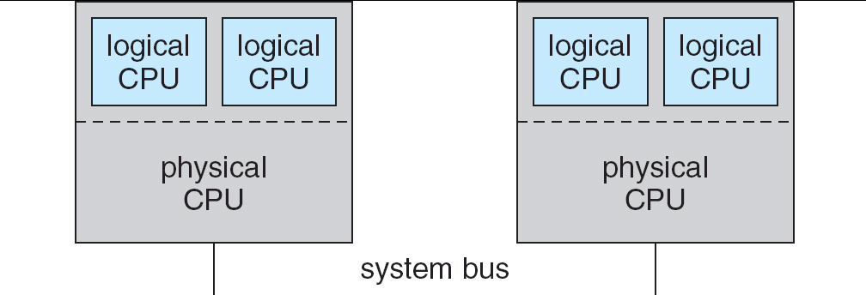
A typical SMT architecture
SMT = Symmetric Multi-threading

Slide 41
5.6 Operating System Examples

Slide 42
Operating System Examples
Solaris scheduling
Windows XP scheduling
Linux scheduling

Slide 43
Solaris

Slide 44
Solaris Scheduling
Solaris uses priority-based thread scheduling
It has defined four classes of scheduling (in order of priority)
  Real time
  System (kernel use only)
  Time sharing (the default class)
  Interactive
Within each class are different priorities and scheduling algorithms

Slide 45
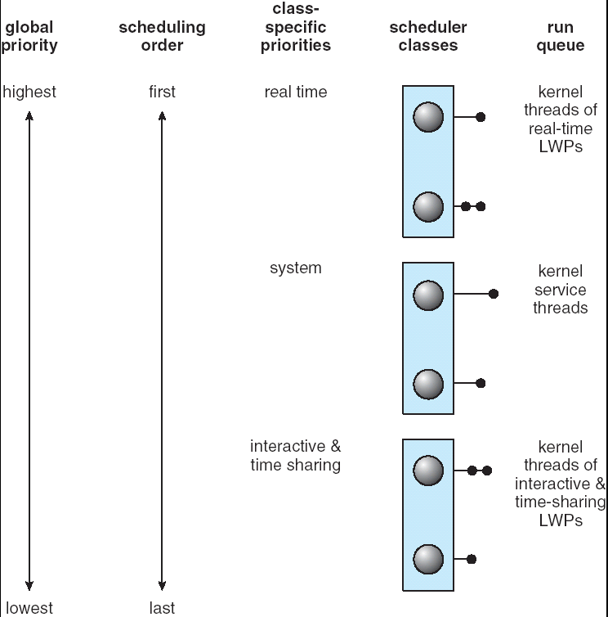
Solaris Scheduling
Solaris uses priority-based thread scheduling and has four
Scheduling classes

Slide 46
Solaris Scheduling
The default scheduling class for a process is time sharing
The scheduling policy for time sharing dynamically alters priorities and assigns time slices of different lengths using a multi-level feedback queue
By default, there is an inverse relationship between priorities and time slices
  The higher the priority, the lower the time slice (and vice versa)
Interactive processes typically have a higher priority
CPU-bound processes have a lower priority
This scheduling policy gives good response time for interactive processes and good throughput for CPU-bound processes
The interactive class uses the same scheduling policy as the time-sharing class, but it gives windowing applications a higher priority for better performance

Slide 47

Solaris Dispatch Table
The figure below shows the dispatch table for scheduling interactive and time-sharing threads
In the priority column, a higher number indicates a higher priority

Slide 48
Windows XP

Slide 49
Windows XP Scheduling
Windows XP schedules threads using a priority-based, preemptive scheduling algorithm
The scheduler ensures that the highest priority thread will always run
The portion of the Windows kernel that handles scheduling is called the dispatcher
A thread selected to run by the dispatcher will run until it is preempted by a higher-priority thread, until it terminates, until its time quantum ends, or until it calls a blocking system call such as I/O
If a higher-priority real-time thread becomes ready while a lower-priority thread is running, lower-priority thread will be preempted
  This preemption gives a real-time thread preferential access to the CPU when the thread needs such access

Slide 50
Windows XP Scheduling
The dispatcher uses a 32-level priority scheme to determine the order of thread execution
Priorities are divided into two classes
  The variable class contains threads having priorities 1 to 15
  The real-time class contains threads with priorities ranging from 16 to 31
  There is also a thread running at priority 0 that is used for memory management
The dispatcher uses a queue for each scheduling priority and traverses the set of queues from highest to lowest until it finds a thread that is ready to run
If no ready thread is found, the dispatcher will execute a special thread called the idle thread

Slide 51
Windows XP Scheduling
There is a relationship between the numeric priorities of the Windows XP kernel and the Win32 API
The Windows Win32 API identifies six priority classes to which a process can belong as shown below
  Real-time priority class
  High priority class
  Above normal priority class
  Normal priority class
  Below normal priority class
  Low priority class
Priorities in all classes except the read-time priority class are variable
  This means that the priority of a thread in one of these classes can change

Slide 52

Windows XP Scheduling
Within each of the priority classes is a relative priority as shown below
The priority of each thread is based on the priority class it belongs to and its relative priority within that class

Slide 53
Windows XP Scheduling
The initial priority of a thread is typically the base priority of the process that the thread belongs to
When a thread’s time quantum runs out, that thread is interrupted
If the thread is in the variable-priority class, its priority is lowered
  However, the priority is never lowered below the base priority
Lowering the thread’s priority tends to limit the CPU consumption of compute-bound threads

Slide 54
Windows XP Scheduling
When a variable-priority thread is released from a wait operation, the dispatcher boosts the priority
  The amount of boost depends on what the thread was waiting for
    A thread that was waiting for keyboard I/O would get a large increase
    A thread that was waiting for a disk operation would get a moderate increase
This strategy tends to give good response time to interactive threads that are using the mouse and windows
It also enables I/O-bound threads to keep the I/O devices busy while permitting compute-bound threads to use spare CPU cycles in the background
This strategy is used by several time-sharing operating systems, including UNIX
In addition, the window with which the user is currently interacting receives a priority boost to enhance its response time

Slide 55
Windows XP Scheduling
When a user is running an interactive program, the system needs to provide especially good performance for that process
Therefore, Windows XP has a special scheduling rule for processes in the normal priority class
Windows XP distinguishes between the foreground process that is currently selected on the screen and the background processes that are not currently selected
When a process moves in the foreground, Windows XP increases the scheduling quantum by some factor – typically by 3
This increase gives the foreground process three times longer to run before a time-sharing preemption occurs

Slide 56
Linux

Slide 57
Linux Scheduling
Linux does not distinguish between processes and threads; thus, we use the term task when discussing the Linux scheduler
The Linux scheduler is a preemptive, priority-based algorithm with two separate priority ranges
  A real-time range from 0 to 99
  A nice value ranging from 100 to 140
These two ranges map into a global priority scheme whereby numerically lower values indicate higher priorities
Unlike Solaris and Windows, Linux assigns higher-priority tasks longer time quanta and lower-priority tasks shorter time quanta
The relationship between priorities and time-slice length is shown on the next slide

Slide 58

Linux Scheduling

Slide 59
Linux Scheduling
A runnable task is considered eligible for execution on the CPU as long as it has time remaining in its time slice
When a task has exhausted its time slice, it is considered expired and is not eligible for execution again until all other tasks have also exhausted their time quanta
The kernel maintains a list of all runnable tasks in a runqueue data structure
Because of its support for SMP, each processor maintains its own runqueue and schedules itself independently
Each runqueue contains two priority arrays
  The active array contains all tasks with time remaining in their time slices
  The expired array contains all expired tasks
Each of these priority arrays contains a list of tasks indexed according to priority
The scheduler selects the task with the highest priority from the active array for execution on the CPU
When all tasks have exhausted their time slices (that is, the active array is empty), then the two priority arrays exchange roles
(See the next slide)

Slide 60

List of Tasks Indexed According to Prorities

Slide 61
Linux Scheduling
Linux implements real-time POSIX scheduling
  Real-time tasks are assigned static priorities
All other tasks have dynamic priorities that are based on their nice values plus or minus the value 5
  The interactivity of a task determines whether the value 5 will be added to or subtracted from the nice value
  A task’s interactivity is determined by how long it has been sleeping while waiting for I/O
  Tasks that are more interactive typically have longer sleep times and are adjusted by –5 as the scheduler favors interactive tasks
  Such adjustments result in higher priorities for these tasks
  Conversely, tasks with shorter sleep times are often more CPU-bound and thus will have priorities lowered
The recalculation of a task’s dynamic priority occurs when the task has exhausted it time quantum and is moved to the expired array
Thus, when the two arrays switch roles, all tasks in the new active array have been assigned new priorities and corresponding time slices

Slide 62
5.7 Algorithm Evaluation

Slide 63
Techniques for Algorithm Evaluation
Deterministic modeling – takes a particular predetermined workload and defines the performance of each algorithm for that workload
Queueing models
Simulation
Implementation

Slide 64

Deterministic Modeling:
Using FCFS scheduling
Process Burst Time
P1 10
P2 29
P3 3
P4 7
P5 12

Slide 65
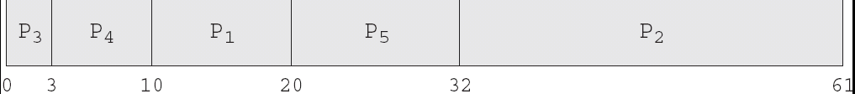
Deterministic Modeling:
Using nonpreemptive SJF scheduling
Process Burst Time
P1 10
P2 29
P3 3
P4 7
P5 12

Slide 66

Deterministic Modeling:
Using round robin scheduling
(Time quantum = 10ms)
Process Burst Time
P1 10
P2 29
P3 3
P4 7
P5 12

Slide 67
Queueing Models
Queueing network analysis
  The computer system is described as a network of servers
  Each server has a queue of waiting processes
  The CPU is a server with its ready queue, as is the I/O system with its device queues
  Knowing the arrival rates and service rates, we can compute utilization, average queue length, average wait time, etc.
  If the system is in a steady state, then the number of processes leaving the queue must be equal to the number of processes that arrive
Little’s formula (n = λ x W)
  # processes in the queue = #processes/time * average waiting time
  Formula is valid for any scheduling algorithm or arrival distribution
  It can be used to compute one of the variables given the other two
  Example
    7 processes arrive on the average of every second
    There are normally 14 processes in the queue
    Therefore, the average waiting time per process is 2 seconds
Queueing models are often only approximations of real systems
  The classes of algorithms and distributions that can be handled are fairly limited
  The mathematics of complicated algorithms and distributions can be difficult to work with
  Arrival and service distributions are often defined in unrealistic, but mathematically tractable ways

Slide 68

Evaluation of CPU schedulers by simulation

Slide 69
Implementation
The only completely accurate way to evaluate a scheduling algorithm is to code it up, put it in the operating system and see how it works
  The algorithm is put to the test in a real system under real operating conditions
The major difficulty with this approach is high cost
  The algorithm has to be coded and the operating system has to be modified to support it
  The users must tolerate a constantly changing operating system that greatly affects job completion time
Another difficulty is that the environment in which the algorithm is used will change
  New programs will be written and new kinds of problems with be handled
  The environment will change as a result of performance of the scheduler
    If short processes are given priority, then users may break larger processes into sets of smaller processes
    If interactive processes are given priority over non-interactive processes, then users may switch to interactive use
The most flexible scheduling algorithms are those that can be altered by the system managers or by the users so that they can be tuned for a specific application or set of applications
  For example, a workstation that performs high-end graphical applications may have scheduling needs different from those of a web server or file server
Another approach is to use APIs (POSIX, WinAPI, Java) that modify the priority of a process or thread
  The downfall of this approach is that performance tuning a specific system or application most often does not result in improved performance in more general situations

Slide 70
End of Chapter 5

