Slide 1
Real-Time Mutli-core Scheduling
Moris Behnam

Slide 2
Introduction
Single processor scheduling
E.g., t₁(P=10,C=5), t₂(10, 6)
U=0.5+0.6>1
Use a faster processor
Thermal and power problems impose limits on the performance of single-core
Multiple processor (multicore)
Problem formulation
Given a set of real time task running on Multicore architecture, find a scheduling algorithm that guarantee the scheduability of the task set.

Slide 3
Task model
Periodic task model t_{i}(T,C,D)
Releases infinite jobs every P period
For all t_{i} if P=D, Implicit‐deadlines
If P>D, Constrained deadline
Otherwise, Arbitrary deadlines
Sporadic task model t_{i}(P,C,D)
P is the minimum inter arrival time between two consecutive jobs
A task is not allowed to be executed on more than one processor/core at the same time.
j_{i1}
j_{i2}
j_{i3}
j_{i1}
j_{i2}
t_{i}
t_{i}
T_{i}
T_{i}
T_{i}
T_{i}
T_{i}
//Monitor task Mc_{i}
t = CurrentTime;
LOOP
S=read_sensor();
Statement1;
.
.
Statement2;
Actuate;
WaitUntil(sensor_signal);
END
//Control task Tc_{i}
t = CurrentTime;
LOOP
S=read_sensor();
Statement1;
.
.
Statement2;
Actuate;
t = t + Tc_{i};
WaitUntil(t);
END

Slide 4


Task model
Task utilization t_{i} , U_{i}=C_{i}/T_{i}
Task density δ_{i}= C_{i}/min(T_{i}, D_{i})
The processor demand bound function h(t) corresponds to the maximum amount of task execution that can be released in a time interval [0, t)
The processor load is the maximum value of the processor demand bound divided by the length of the time interval
A simple necessary condition for task set feasibility

Slide 5
Multicore platefrom
Include several processors on a single chip
Different cores share either on- or off-chip caches
Cores are identical (homogenous)
Processor
Core 1
Processor
Core 2
L1 Cache
L1 Cache
Processor
Core 3
Processor
Core 4
L1 Cache
L1 Cache
L2 Cache

Slide 6
Design space
P₁
P₁
P₁
t₁
t₁
t₁
t₂
t₂
t₂
t₁
t₁
t₁
t₂
Tasks allocation
no migration
task migration
job migration
Priority
fixed task priority
fixed job priority
dynamic priority
Scheduling constraints
non-preemption
fully preemption
limited preemption
P₂
P₂
P₂
t₃
t₃
t₃
t₂
t₃
t₃
t₃
t₂
t₂
time
time
time
t₁
t₁
t₂
t₁
t₁
t₂
time
time
t₂
time
t₂
t₂

Slide 7
Mutliprocessor scheduling
Partitioned scheduling
Global scheduling
P₁
P₂
P₃
Tasks
…
Processors
P₁
P₂
P₃
Tasks
…
Processors

Slide 8
Partitioned scheduling
Advantages
Isolation between cores
No migration overhead
Simple queus managements
Uniprocessor scheduling and analysis
Disadvantage
Task set allocation (NP hard problem)
Bin packing heuristics
First-Fit (FF)
Next-Fit (NF)
Best-Fit (BF)
Worst-Fit (WF)
Task orderings in Decreasing Utilisation (DU) combined with above
U=1
Ci/Ti

Slide 9



Partitioned scheduling
The largest worst-case utilization bound for any partitioning algorithm is
U=(m+1)/2
Implicit deadline task set
Utilization bounds for the RMST (“Small Tasks”)
RM-FFDU has a utilization bound
Utilization bound for any fixed task priority
For EDF-BF and EDF-FF with DU
m +1 tasks with execution time 1+ε and a period of 2, Ui>0.5,
cannot be scheduled on m processors independent on
the scheduling and allocation algorithms.

Slide 10




Partitioned scheduling
Constrained and arbitrary dealine
FFB-FFD algorithm (deadline monotonic with decreasing density) and assuming
constrained-deadlines
arbitrary deadlines
EDF-FFD (decreasing density)
constrained-deadlines
arbitrary deadlines

Slide 11
Global scheduling
Advantages
Fewer context switches / pre-emptions
Unused capacity can be used by all other tasks
More appropriate for open systems
Disadvantages
Job migration overhead

Slide 12
Global scheduling
Implicit deadline and periodic tasks
Global RM, fully preemptive and migration
example: n=m+1, t₁,..,t_{n-1}(C=2ε, T=1), t_{n}(C=1, T=1 + ε)
Increase the priority of t_{n}
P₁
t₁
t_{n}
t₁
P₁
t_{n}
Miss deadline
P_{m}
t_{m}
t_{m}
time
P_{m}
t_{m}
t₁
t_{m}
t₁
Utilization bound ≈0
time

Slide 13
Global scheduling
RM‐US(m/(3m‐2) algorithm
Tasks are categorized based on their utilization
A task t_{i} is considered heavy if C_{i}/T_{i} > m/(3m‐2)
Otherwise it is considered as light
Heavy tasks assigned higher priority than lighter
RM is applied on the light tasks to assign priority
Utilization bound is U_{RM‐US(m/(3m‐2)}=m*m/(3m‐2)
Example: suppose a systems has n=4, m=3 with the following task parameters t₁ (0.4,4), t₂ (0.6,6), t₃ (0.45,9), t₄ (8,10), then the priority assignment according to the algorithm will be, the highest for t₄ as it is a heavy task and then t₁, t₂, t₃ (lowest), based on RM.

Slide 14
Global scheduling
Global EDF, fully preemptive and migration (fixed job priority, dynamic task priority)
Utilization based, U_{EDF} = m − (m −1)u_{max}
Same problem as in global RM
P₁
t₁
t_{n}
t₁
P₁
t_{n}
Miss deadline
P_{m}
t_{m}
t_{m}
time
P_{m}
t_{m}
t₁
t_{m}
t₁
time

Slide 15
Global scheduling
EDF‐US(m/(2m‐1) algorithm
Tasks are categorized based on their utilization
A task t_{i} is considered heavy if C_{i}/T_{i} > m/(2m‐1)
Otherwise it is considered as light
Heavy tasks assigned higher priority than lighter
Relative priority order based on EDF is applied on the light tasks
Utilization bound is U_{EDF‐US(m/(2m‐1)}=m*m/(2m‐1)

Slide 16
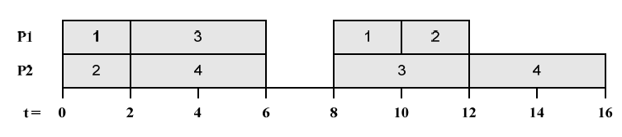
Global scheduling
Constrained and arbitrary deadline
Critical instant
In uniprocessor, when all tasks are released simultaneously
In multiprocessor it is not the case as shown in the following example
Example: suppose a system with n=4, m=2, t₁ (C=2,D=2,T=8), t₂ (2,2,10), t₃ (4,6,8), t₄ (4,7,8)
Deadline miss

Slide 17
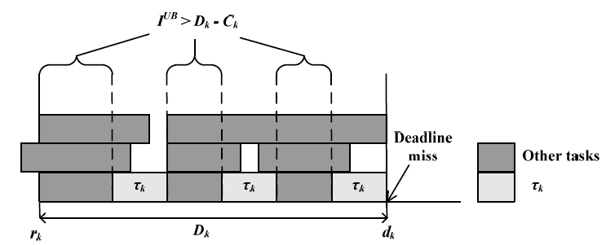
Global scheduling
Determining the schedulability of sporadic task sets
Consider an interval from the release to the deadline of some job of task t_{k}
Establish a condition necessary for the job to miss its deadline, for example each processor executes other tasks more than D_{k} −C_{k}
Derive an upper bound I^{UB} on the maximum interference in the interval from jobs released in the interval and also from jobs that are released before the interval and have remaining execution (carry-in jobs)
Form a necessary un-schedulability test from I^{UB} and necessary condition for deadline miss

Slide 18


Global scheduling
Based on the previous test and assuming global EDF algorithm, the job of τ_{k} misses its deadline if the load in the interval is at least m(1−δ_{k} ) +δ_{k}
A constrained-deadline task set is schedulable under pre-emptive global EDF scheduling if for every task
For fixed task priority, this response time upper bound is

Slide 19
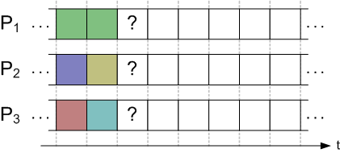
Global scheduling
Pfair algorithm (Proportionate fairness algorithms)
Motivations
All mentioned mutliprocessor scheduling have maximum utilization bound 50%
Ideally, a utilisation bound of 100% is more interesting.
The algorithm is the only known optimal scheduling for periodic implicit deadline task
It is based on dynamic job priority
Timeline is divided into equal length slots
Tasks period and execution time is a multiple of the slot size
Each task receives amount of slots proportional to the task utilization
Disadvantages of Pfair
Computational overheads are relatively high
Too many preemptions (up to 1 per quantum per processor)

Slide 20
Hybrid/semi-partitioned
What if some tasks are allocated to specific processor and other are scheduled globally?
Example:
t₁, t₃ and t₅ are assigned to P₁
t₂ and t₇ are assigned to P₂
t₄ and t₈ can be executed in P₁ and P₂
This kind of scheduling is called hybrid or semi-partitioned multiprocessor scheduling

Slide 21
Hybrid/semi-partitioned
EKG approach
Assuming periodic task model and implicit deadline
Use bin packing algorithm to allocate tasks to processors
Tasks that can not fit into processors are splitted into up to k parts
Split tasks can be executed in up to k processors out of m

Slide 22
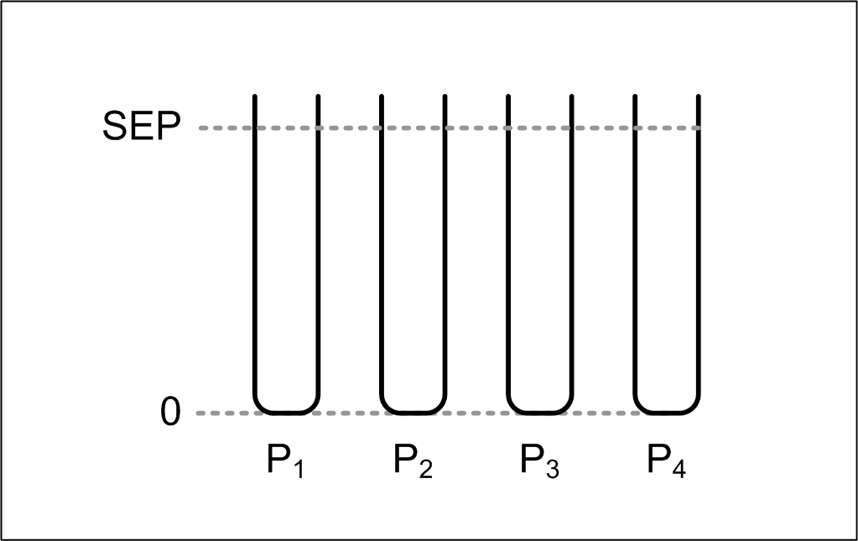
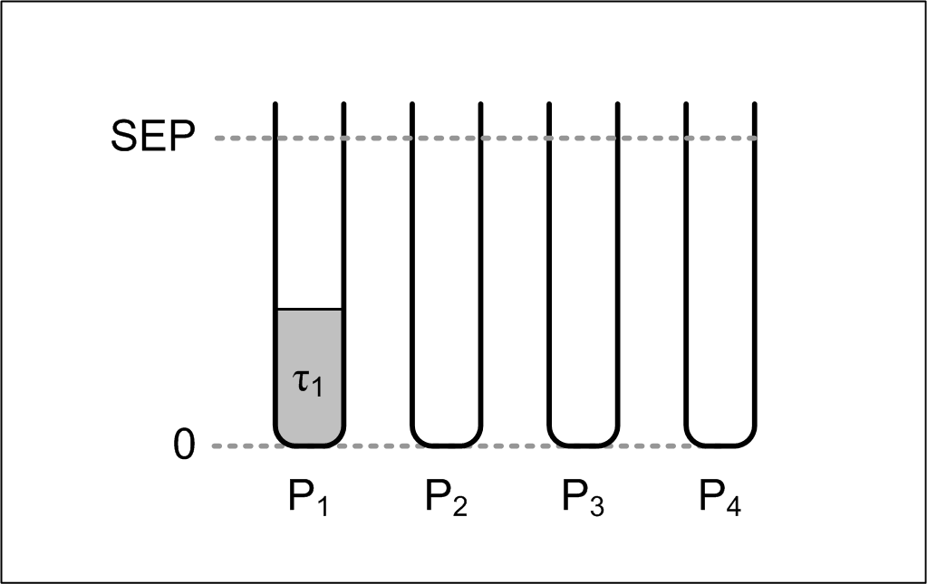
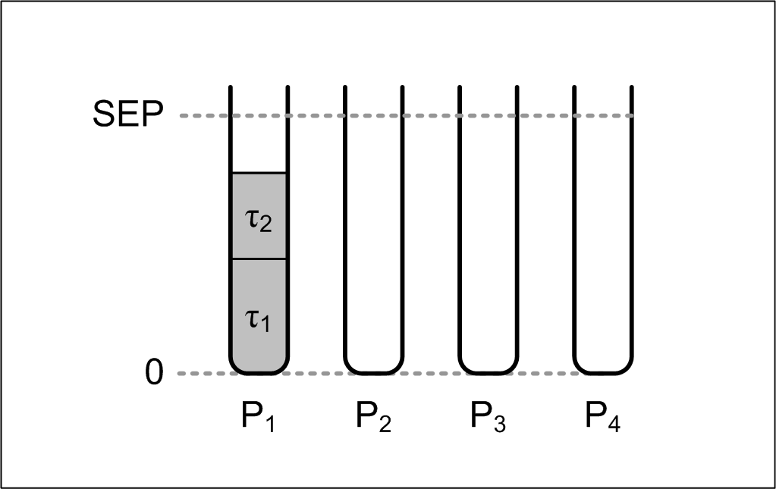
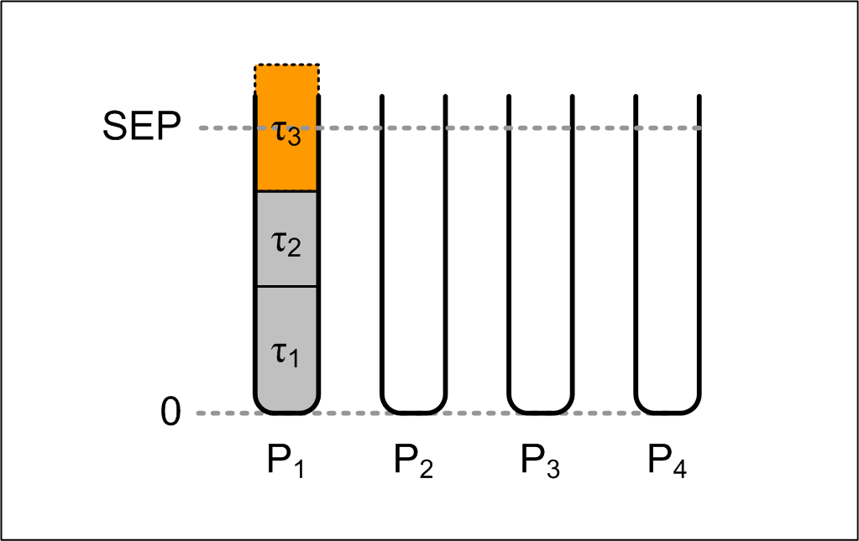
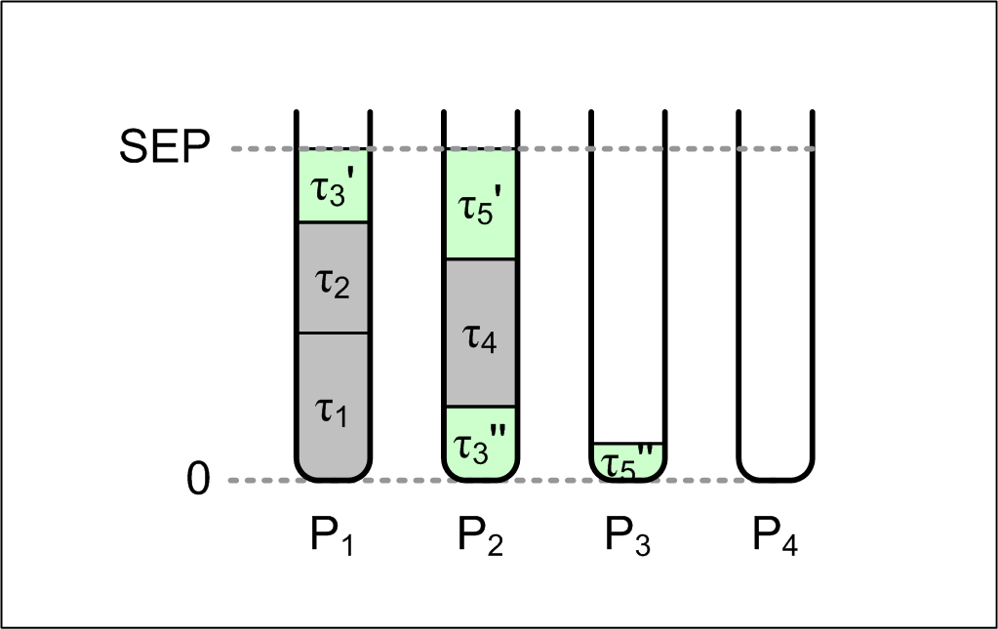
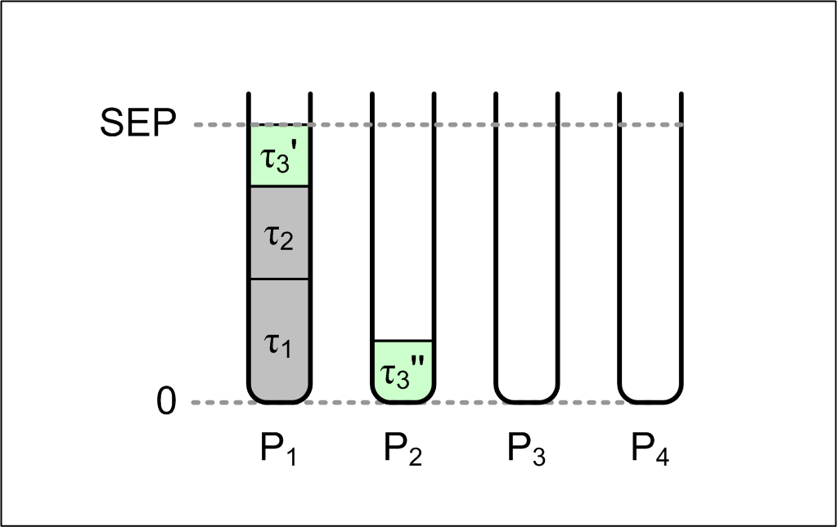
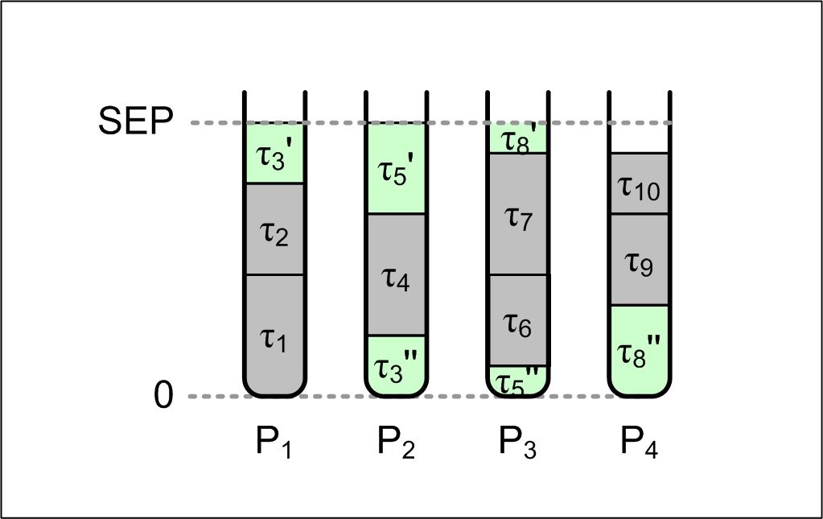
Hybrid/semi-partitioned
If k=m
Tasks are assigned using “next-fit” bin-packing
Processors are filled up to 100%
Example

Slide 23
Hybrid/semi-partitioned
If m < k
Tasks are categorized as heavy or light
Heavy task has U_{i} > SEP=k(k+1), otherwise tasks are considered as light
First, all heavy tasks are assigned to processors, one in each processor
Light tasks are assigned to the processors using the remaining utilization
The utilization bound is equal to m * SEP
Dispatching
Partitioned tasks are scheduled using EDF
Reservations are used in each processor to execute the split tasks and the priority of the reservation is always greater than the other tasks
The reserves of τ_{i} on P_{p} and P_{p+1} can never overlap.
Overhead
For split tasks, each may cause up to k-migration every task period

Slide 24
Cluster scheduling
Combining partition and global scheduling
Tasks are grouped into a set of clusters
Each cluster is allocated to a number of cores m less than or equal to the total number of cores n i.e., m ≤ n. Tasks within a cluster can be migrated between only the processors that are allocated for that cluster
P₁
P₂
P₃
P₄
Tasks
…
Processors

Slide 25
Cluster scheduling
Physical clusters, allocated to m certain cores
Virtual clusters can be allocated to any m available cores (hierarchical scheduling, a scheduler to select clusters and inside each cluster there is a scheduler that selects the tasks to execute )

Slide 26
Mutliprocessor synchronization
All presented algorithms do not support resource sharing
In multiprocessor, there are three general approaches
Lock based
Lock free
Wait free
Lock based: each task locks a mutes before accessing a shared resource, and releases it when it finishes.
Resources can be classified as local resource and global resource
When a task is blocked trying to access a shared resource:
It is suspended until the resource become available
Continue executing in a busy wait

Slide 27
Mutliprocessor synchronization
Partitioned scheduling, suspension
Problems:
Remote blocking: tasks may be blocked by other tasks located in other processors (no direct relation between tasks)
Multiple priority inversions due to suspensions (low priority tasks may execute while the higher priority tasks are suspended and accessing global resources)
Critical
section
Hp task
P 1
Lp task
Remote blocking
P 2

Slide 28
Mutliprocessor synchronization
MPCP (multiprocessor priority ceiling protocol)
Reduces and bounds the remote blocking
applicable to partitioned systems using fixed priorities
Global mutex Is used to protect global resources
Priority ceiling=Max (All executing task priorities) +
Max (priorities of tasks accessing the shared resource)
A task accessing a global shared resource can be preempted by a awakened waiting task on a higher priority ceiling
Each global resource has a priority queue
No nested access to shared resources is allowed
The blocking factor is made up of five different components

Slide 29
Mutliprocessor synchronization
MPCP
P_{i}
Priority queue
Shared
Resource
Priority Queue
P_{j}
Priority queue

Slide 30
Mutliprocessor synchronization
MSRP for partitioned scheduling
Based on SRP protocol for single processor
Can be used with FPS and EDF
when a task is blocked on a global resource under MSRP, it busy waits and is not preemptable
A FIFO queue is used to grant access to tasks waiting on a global resource when it is unlocked
Comparing MPCP and SRP
MSRP removes two of the five contributions to the blocking factor
MSRP Consumes processor time that could be used by other tasks
MSRP is simpler to be implemented

Slide 31
Mutliprocessor synchronization
Lock free approach
Tasks access resources concurrently
A task repeats the access to a shared resource whenever the input data is changes due to a concurrent access by another task
Lock-free approach increases the execution times of tasks
Typically, requires hardware support

Slide 32
Mutliprocessor synchronization
Wait free
Multiple buffers are used
Does not impose blocking on the tasks accessing shared resources nor increasing the execution times of tasks
Requires more memory allocation (buffers)

Slide 33
Other related issues
Parallel task model
Worst-case Execution Time (WCET) analysis
Network / bus scheduling
Memory architectures
Scheduling of uniform and heterogeneous processors
Operating Systems
Power consumption and dissipation
Scheduling tasks with soft real-time constraints
Many cores architecture
Virtualization

