Slide 1
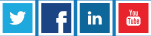
Get More Out of MongoDB
with TokuMX
Presented by Tim Callaghan
VP/Engineering, Tokutek
tim@tokutek.com; @tmcallaghan
Performance Database Company
Tokutek, Inc.
57 Bedford Road, Suite 101
Lexington, MA 02420
www.tokutek.com

Slide 2
Tokutek: Performance Databases
What is Tokutek?
TokuMX: high-performance distribution of MongoDB
TokuDB: high-performance storage engine for MySQL and MariaDB
Open source
Tokutek Removes Limitations
Improve insertion performance by 20X
Reduce HDD and flash storage requirements up to 90%
No need to rewrite code
Tokutek Mission:
Empower your database to handle the Big Data requirements of today’s applications

Slide 3










Tokutek Customers

Slide 4
Webinar Housekeeping
This webinar is being recorded
A link to the recording and to a copy of the slides will be posted on tokutek.com
We welcome questions: enter questions into the chat box and we will respond at the end of the presentation
Think of something later?
Email us at contact@tokutek.com
Visit tokutek.com/contact

Slide 5

Agenda
[Brief] MongoDB overview
What is TokuMX?
Getting started with TokuMX
Maximizing performance
Configuring compression
Transactions
Support
Q+A

Slide 6
MongoDB Overview
From a MySQL perspective
Ease of use
Get started with a 1 binary and 1 folder (storage)
Very few server knobs
Schema-free
No downtime for column changes or index creation
Rapid prototyping and continuous deployment
Better replication
Automatic promotion in failure scenarios
No statement-based vs. row-based choices
No divergence of secondaries
Sharding is “in-the-box”
Horizontal scale-out without 3rd party tools

Slide 7
What is TokuMX?
TokuMX = MongoDB with improved storage
Drop in replacement for MongoDB v2.4 applications
Including replication and sharding
Same data model
Same query language
Drivers just work
But, no Full Text or Geospatial indexing
Open Source
http://github.com/Tokutek/mongo

Slide 8
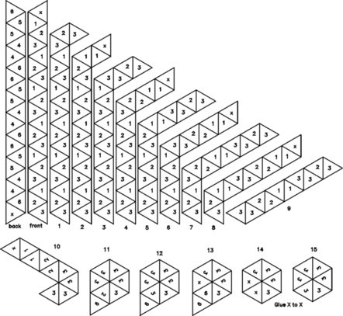
getting started
hexahexaflexagon - http://home.gci.net/~rob/flexagons/

Slide 9
installation
MongoDB
$ tar xzvf mongodb-linux-x86_64-2.4.9.tgz
$ ls */bin
[abbreviated]
mongo
mongod
mongodump
mongoexport
mongoimport
mongorestore
mongos
mongostat
TokuMX
$ tar xzvf mongodb-linux-x86_64-2.4.9.tgz
$ ls */bin
[abbreviated]
mongo
mongo2toku
mongod
mongodump
mongoexport
mongoimport
mongorestore
mongos
mongostat

Slide 10
data conversion
Everything
MongoDB
$ mongodump
TokuMX
$ mongorestore
Specific collections (for each one)
MongoDB
$ mongoexport
TokuMX
$ mongoimport

Slide 11
mongo2toku?
TokuMX
$ tar xzvf tokumx-1.3.3-linux-x86_64.tgz
$ ls */bin
[abbreviated]
mongo
mongo2toku
mongod
mongodump
mongoexport
mongoimport
mongorestore
mongos
mongostat
mongo2toku is a utility that enables a TokuMX server to process replication traffic from a MongoDB master.
The oplog format of MongoDB is incompatible with TokuMX, so they cannot co-exist in a replica set.

Slide 12
advanced data conversion (production)
MongoDB secondary
Take one secondary offline
Note OpLog position
$ mongodump
New TokuMX primary
$ mongorestore
$ mongo2toku <source-mongodb> <dest-tokumx> <oplog-position>
Switchover
Disconnect all clients from MongoDB
Allow mongo2toku to drain
Stop mongo2toku
Connect clients to TokuMX

Slide 13
mongo2toku and evaluations
mongo2toku is an excellent way to try out TokuMX
How much does your data compress?
What is the query performance?
More details in our users guide available at http://www.tokutek.com/resources/product-docs

Slide 14
memory usage
MongoDB uses memory-mapped files
mongod will attempt to use all available RAM
Operating system determines what stays cached
Server performance suffers if running other memory hungry applications running on the server
TokuMX manages a fixed-size cache
mongod constrained to this value
We determine what stays cached
Easily run several TokuMX instances on a single server without memory contention

Slide 15
TokuMX and IO
TokuMX supports two types of IO
Direct IO
Writes go straight to disk
Declare larger cache size, better cache hit ratios
75% of free RAM is a good starting point
Buffered IO
Writes are “buffered” by operating system
Declare smaller cache size, some cache hits will come from OS buffers
OS buffers contain compressed data, more data can fit
I recommend Direct IO

Slide 16
starting the server
MongoDB
bin/mongod --dbpath $MONGO_DATA_DIR --journal
TokuMX
bin/mongod --dbpath $MONGO_DATA_DIR --directio --cacheSize 12G
directio = use Direct IO, default Buffered IO
cacheSize = size of cache, default is 50% RAM
Note that “--journal” isn’t provided
We are based on transactional, and crash-safe, Fractal Tree indexes

Slide 17

maximizing performance

Slide 18
storage and IO - basics
MongoDB
Documents are stored in a heap
Primary key and secondary indexes are stored separately
Both contain pointers to the document (heap)
Document “moves” require index updates
Very expensive for indexed array fields
PowerOf2Sizing and padding
TokuMX
Documents are stored “clustered” in the primary key index (generally _id)
Secondary indexes contain primary key

Slide 19
storage and IO - consequences
Non-cached primary key lookups (general case)
MongoDB
1 IO in primary key index to retrieve heap pointer
1 IO in heap to retrieve document
TokuMX
1 IO in primary key index to retrieve document

Slide 20
clustered secondary index
Feature is exclusive to TokuMX
An additional copy of the document is stored in the secondary index
Think covered index where you only need to define the true key
Saves on IO to lookup the document
Extremely useful when performing range scans on the secondary indexes
Substantial IO reduction
Downsides?
More storage needed (two copies of the document)
TokuMX compression!
Updates to the document require index management
TokuMX indexing performance!

Slide 21
clustered secondary index - syntax
tokumx> db.foo.ensureIndex({bar:1}, {clustering: true})
Keep in mind
Clustered secondary indexes are most helpful for range scans
Insert only collections (or those with few updates) are great candidates for clustering, as long as you have the space
I often see schemas where all indexes are clustered, or none of them.
The optimal schema is usually somewhere in the middle.

Slide 22
concurrency - MongoDB
MongoDB originally implemented a global write lock
1 writer at a time
MongoDB v2.2 moved this lock to the database level
1 writer at a time in each database
This severely limits the write performance of servers
As a work around users sometimes place several shards on a single physical server
High operational complexity
Google “mongodb multiple shards same server”

Slide 23
concurrency - TokuMX
TokuMX performs locking at the document level
Extreme concurrency!
instance
MongoDB v2.0
database
database
MongoDB v2.2
collection
collection
collection
collection
document
document
document
document
TokuMX
document
document
document
document
document
document

Slide 24
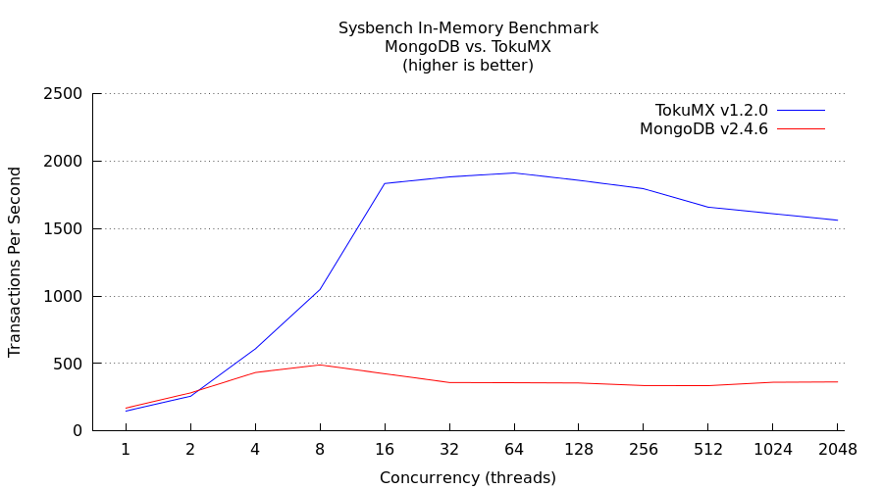
performance : in-memory
Sysbench = point queries, range queries, aggregations, insert, update, delete
From http://docs.mongodb.org/manual/faq/diagnostics
“Your working set should stay in memory to achieve good performance.”
TokuMX proves that concurrency matters, in-memory is not enough!

Slide 25
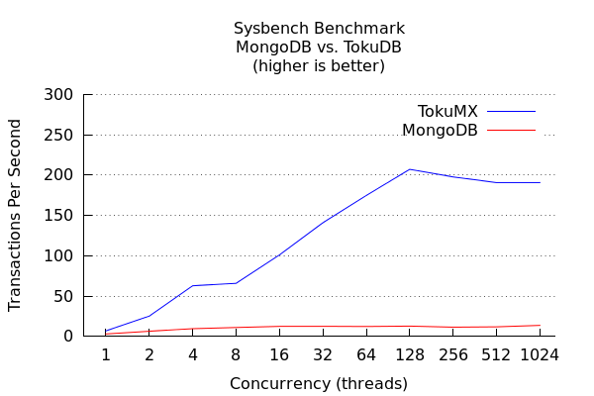
performance : larger-than-memory

Slide 26
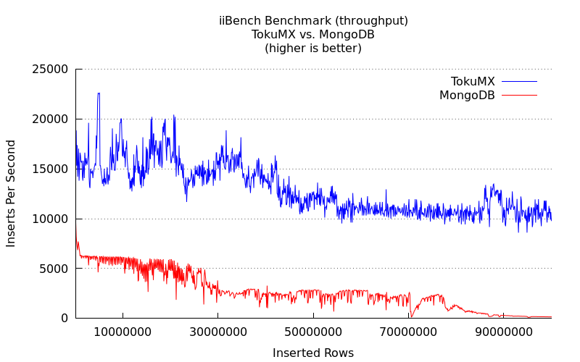
performance : indexed insertion
100mm inserts into a collection with 3 secondary indexes

Slide 27
performance : your application
How fast will your application go?

Slide 28
replication
MongoDB did a great job including support for replication
read scaling to secondary servers
high availability (failover)
add/remove servers without downtime
However, the MongoDB secondary servers do just as much work as the primary with respect to writes (insert, update, delete)
Limits how much of secondary is available for read-scaling
TokuMX replication is nearly effortless on secondaries
Leverages the message based architecture of Fractal Tree indexes
Nearly 100% of secondaries available for read-scaling

Slide 29
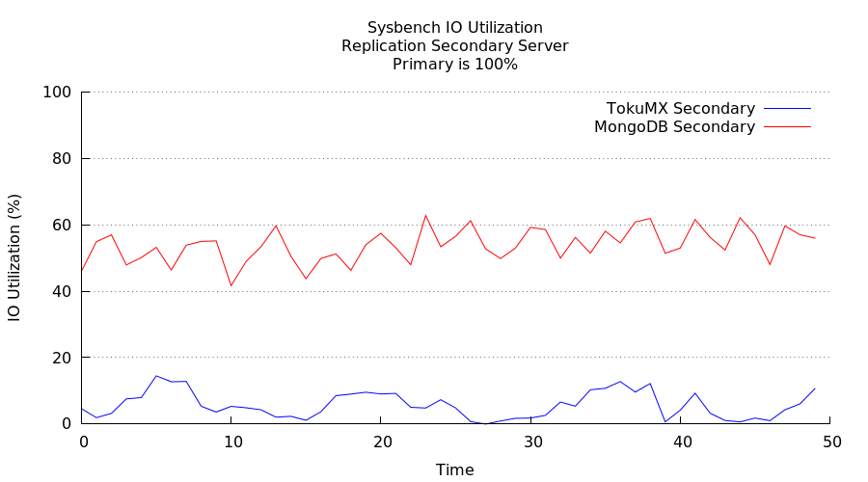
replication – the benchmark

Slide 30
sharding
MongoDB also did a great job including support for horizontal scaling via sharding
many use-cases can go faster with multiple clusters
However...
Shard migration can be painful and disruptive
Lots of querying, deleting, inserting
Each shard is only as performant as MongoDB allows
TokuMX sharding improves this
Clustered index on shard key improves range scans and migration performance
Better per-server performance

Slide 31
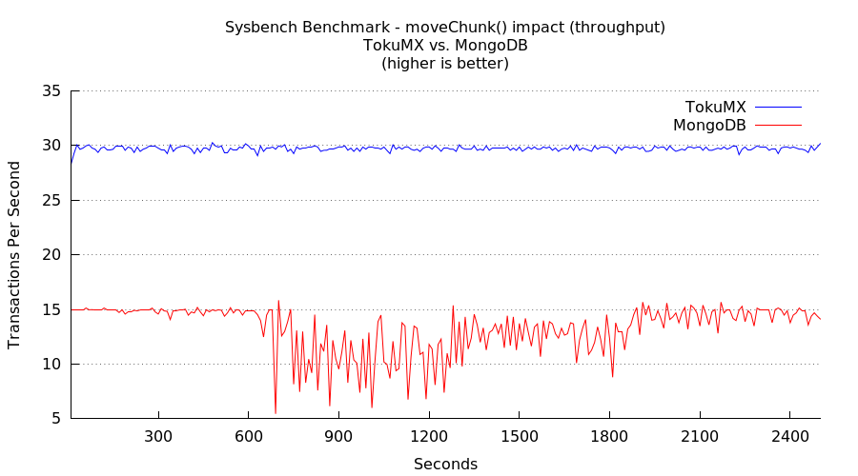
sharding – the benchmark
Issued 6 manual moveChunk() operations over 3 shards, starting at 600 seconds..

Slide 32
“partitioned” collections?
New in TokuMX v1.5.0!
Similar to partitioned tables in MySQL
Allows for a collection to be broken up into smaller collections
Appears to the user as a single collection
Partition is defined on PK
Unsharded environments only (for now)
Queries and insert/update/delete just work
Why?
Lightweight removal of time-series or temporal data
Partition by week, month, other
Great blog at http://bit.ly/1rkEoyk

Slide 33

compression

Slide 34
MongoDB disk space needs
MongoDB databases often grow quite large
it easily allows users to...
store large documents
keep them around for a long time
de-normalized data needs more space
Operational challenges
Big disks are cheap, but not fast
Cloud storage is even slower
Fast disks (flash) are VERY expensive
Backups are large as well
Unfortunately, MongoDB does not offer compression

Slide 35
TokuMX needs less disk space
TokuMX offers built-in compression
More efficient use of space, even without compression
4 compression algorithms
quicklz, zlib, lzma, (none)
Everything is compressed
Field names and values
Secondary indexes too

Slide 36
testing disk space used
BitTorrent Peer Snapshot Data (~31 million documents)
3 Indexes : peer_id + created, torrent_snapshot_id + created, created
{ id: 1,
peer_id: 9222,
torrent_snapshot_id: 4,
upload_speed: 0.0000,
download_speed: 0.0000,
payload_upload_speed: 0.0000,
payload_download_speed: 0.0000,
total_upload: 0,
total_download: 0,
fail_count: 0,
hashfail_count: 0,
progress: 0.0000,
created: "2008-10-28 01:57:35" }
http://cs.brown.edu/~pavlo/torrent/

Slide 37
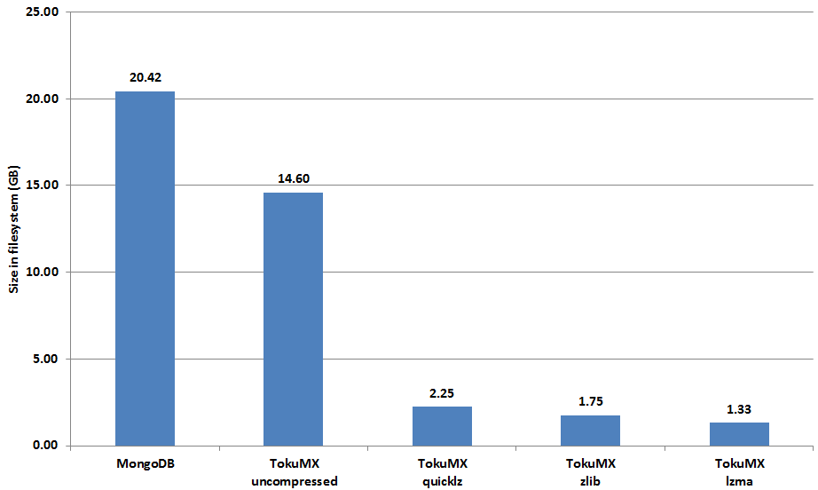
TokuMX compression test
size on disk, ~31 million inserts (lower is better)

Slide 38
TokuMX compression test
size on disk, ~31 million inserts (lower is better)
TokuMX achieved
11.6:1 compression

Slide 39
TokuMX compression test
size on disk, ~31 million inserts (lower is better)
Even uncompressed was significantly smaller

Slide 40
compression comparison
Compression Algorithm | Compression Speed | Compression Achieved
lzma | low | 93.5%
zlib | medium | 91.4%
quicklz | high | 88.9%
none | highest | 28.5%

Slide 41
compression and db.coll.findOne()
On rotating disks, the IO time dominates the overall request time
Decompression won’t measurably increase query time
It’s a huge win if compression can save an IO (16K IO for 16K+ document)
Disk IO millisecs
Time
Decompression
On flash (or SSD) the IO time is near zero
Slower decompression will increase latency
Use zlib for speed, or lzma for size
Flash IO - microsecs
Time
Decompression

Slide 42

transactions

Slide 43
transactions in MongoDB
MongoDB does not support “transactions”
Each operation is visible to everyone
There are work-arounds, Google “mongodb transactions”
http://docs.mongodb.org/manual/tutorial/perform-two-phase-commits/
This document provides a pattern for doing multi-document updates or “transactions” using a two-phase commit approach for writing data to multiple documents. Additionally, you can extend this process to provide a rollback like functionality.
(the document is 8 web pages long)
MongoDB does not support multi-version concurrency control (MVCC)
Readers do not get a consistent view of the data, as they can be interrupted by writers
People try, Google “mongodb mvcc”

Slide 44
transactions in TokuMX
ACID
TokuMX offers multi-statement transactions in unsharded environments
Locking is performed at the document level
No changes are visible to other sessions until commit
Rollback is offered as well
Crash recovery of all committed transactions
MVCC
TokuMX offers true read consistency
Reads are consistent as of the operation start

Slide 45
TokuMX transaction syntax
Example transaction
> db.runCommand({“beginTransaction”})
> db.foo.insert({name : “George”})
> db.foo.insert({name : “Larry”})
> db.foo.insert({name : “Frank”})
> db.runCommand(“commitTransaction”)
None of the above inserts were visible to other connections until the “commitTransaction” was executed.
db.runCommand(“rollbackTransaction”) would have removed the inserts
For more information
http://www.tokutek.com/2013/04/mongodb-transactions-yes/
http://www.tokutek.com/2013/04/mongodb-multi-statement-transactions-yes-we-can/

Slide 46

support

Slide 47
supporting TokuMX
TokuMX is offered in 2 editions
Community
Community support (Google Groups “tokumx-user”)
Enterprise subscription
Commercial support
Wouldn’t you rather be developing another application?
Extra features
Hot backup, more on the way
Access to TokuMX experts
Input to the product roadmap

Slide 48



Any Questions?
Thank you for attending! Enter questions into the chat box
Download TokuDB: www.tokutek.com/downloads
Contact us: contact@tokutek.com
Join the Conversation

