Slide 1
Memory and C++ debugging at Electronic Arts
By Scott Wardle

Slide 2
Introduction
Memory interfaces and debug tools for C++ games
2000 (PS2) embedded C style
2005 (Xbox 360, PS3) Interface programming, EASTL
Now (PS4, Xbox One) 64 bit address spaces
Our Current Tools:
How all of our debugging systems work together

Slide 3
About me
Scott Wardle,
20+ years Game Dev
Solving problems through visualization and drawing pictures
I am also badly dyslexic, so please note spelling mistakes and inform me later after the presentation ☺

Slide 4
Vocabulary
Allocators, Arena, Heaps
Allocators (an object or interface that can alloc and free)
Arena (a set of address ranges controlled by one allocator)
From Arena find an Allocator
From Allocator find an Arena
Heap ~= Allocator + Arena

Slide 5
C style 2000s Overview
Year ~2000: PS2 32M ram
Most people are using C++ compilers
STL is not used
No virtual memory
Nearly no OS
Similar to embedded systems

Slide 6
C style 2000s Interfaces for speed
Macro per class
#define NEW_DELETE_OPERATORS(debug_name)
Good for fixed sized pools or slabs of objects
class CollisionChooser {
public:
NEW_DELETE_OPERATORS(CollisionChooser)
…
};
Notes:
We can’t track everything with these.

Slide 7
C style 2000s Interfaces for debug
Global new
void* operator new(size_t size, const char* debug_name, int flags=MB_LOW)
Debug name and sentinel stored in footer
Header
Allocated Block
footer
Header
Allocated Block
footer
Note debug_name split into “category::alloc” example: “render::player”, “gameplay::physicsmesh”
Header
Allocated Block
footer

Slide 8
C style 2000s Allocation technology
Almost all memory is in one heap
Well we did have a simple small block allocator
We had to work hard at defragmentation
Low Memory
High Memory
Decompress
Small Block
Allocator
Alloc
Mesh
Load compressed
Texture 0
Texture 0
General
Allocator

Slide 9
2005 Overview
2004 - Xbox 360, PS3 (512M ram)
Virtual memory! - NO HDD ☹, No GPU support, 32 bit
All consoles have multiple CPUs
(Not just for Sega Saturn)
The main changes for 2005:
Support for multiple allocators
Better tracking and logging tools
Stomp allocator!!
Memory tracking with EASTL

Slide 10
2005 Support for Multiple Allocator
Polymorphic Allocator
SQLQuery *NewQuery(ICoreAllocator* a) {
return CORE_NEW(a, "sql", MEM_LOW) SQLQuery(a);
}
void DeleteQuery(ICoreAllocator* a, SQLQuery *sql){
CORE_DELETE(a, sql);
}
Calls ~SQLQuery()
not delete!!

Slide 11
2005 Organizing Heaps/Arenas
Static
Global
Level
Sub Level
Temp
Time
Small
Medium
Large
Size
Gameplay
SBA
Gameplay
Heap
Render
SBA
Render
Heap
UI
SBA
UI
Heap
Team
A mix of time and size gives good defragmentation properties.
Organizing by team fragments heaps but easy to set blame.
So for my team we use all of these to varying degrees.

Slide 12
2005 Team Based Heaps/Arenas vs Team Based Categories
Memory Corruption between teams sucks
R 3
Small
S2
Render 0
SIM0
SIM1
Render 2
SIM3
Render 1
Medium
Large
Categories are a way to tags allocations so you can budget them together.
Fragmentation between teams is hard. Who to blame when you are
out of memory?

Slide 13
2005 Better Tracking and Logging
Only sentinel
stored in footer
Tracking live allocations in a separate heap.
Memory
Logging or tracing system
Normal Heap
Debug Heap
H
Allocated Block
F
Address
Size
Category::
Alloc Name
Memory
Logging
To Disk
Alloc
H
Allocated Block
F
Address
Size
Category::
Alloc Name
Alloc
Free
H
Allocated Block
F
Address
Size
Category::
Alloc Name
Alloc
Hash Key

Slide 14
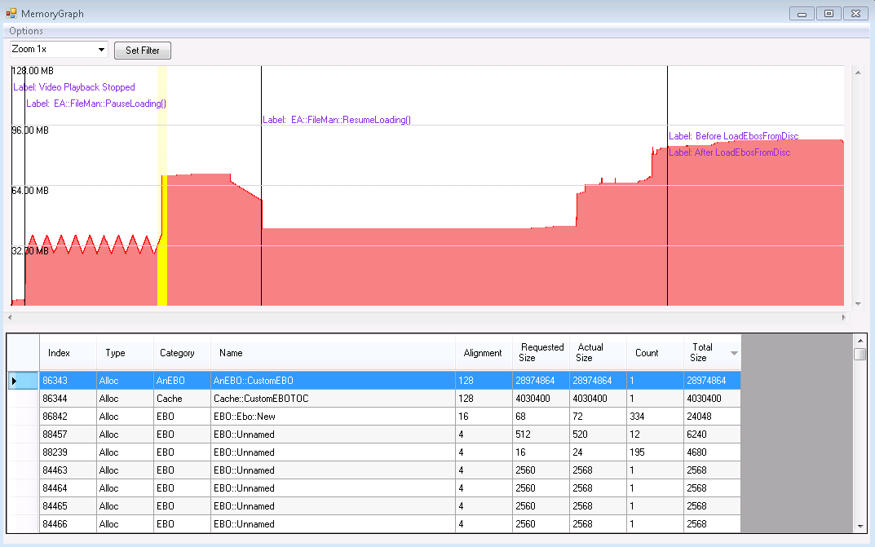
2005 Logging
Start of time
End of time
Select Time
Category/
Heap
Alloc Name
Alloc
Count
Alloc
Size
whole
snapshot
of memory
delta
between 2 times

Slide 15
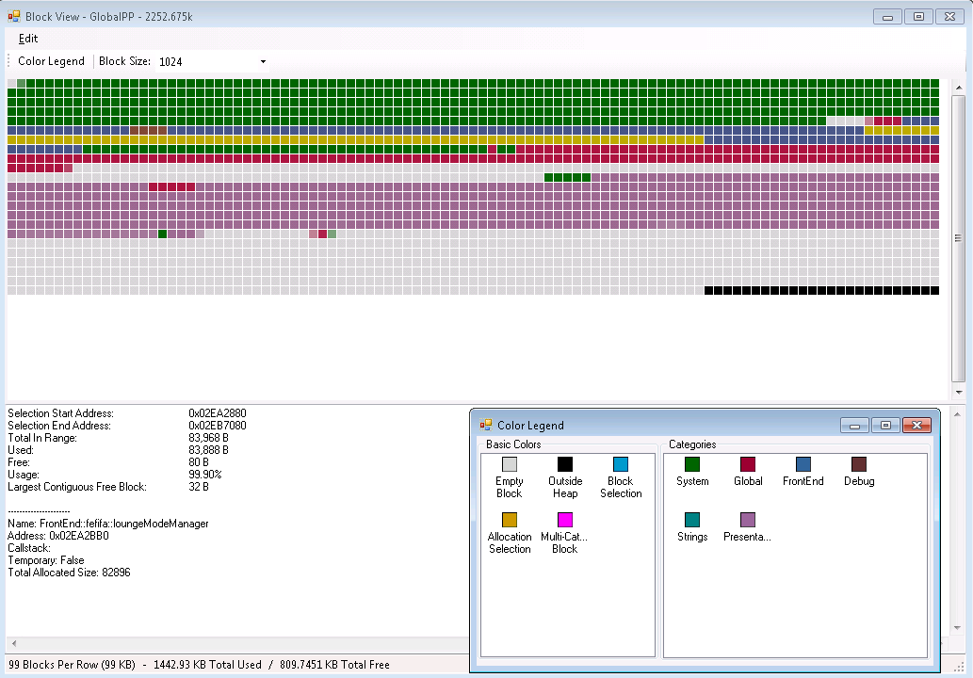
2005 Arena Block View
Green Systems
Yellow selected block
Purple Presentation
Grey Free
Info about selected block

Slide 16
2005 Stomp Allocator!!
Stomp Allocator – so good it is worth it’s own slide
Lots of memory, 4k per alloc
Crash!
Page 4KiB
Read/Write
Alloc
512 bytes
Page 4KiB
Read Only
(Or not mapped)
No Crash but bad
Use sentinel? Or Flip

Slide 17
2005 Ref Counted Pointers
Add a debug system for ref counts is hard:
A Tracking system would be like garbage collector…
A Logging system would generate even more data…
shared_ptr
are useful !!
but use
unique_ptr
or bare pointers
for easy life times
Sim
Player
Render
Player
Oh No
memory leak!
Collision
Mesh
particle
system

Slide 18
2005 EASTL
A 2010 version of EASTL is available now from webkit.
Why EASTL
STL allocators are painful to work with
Intrusive containers, Ring Buffers, etc…
Superior readability and performance
Memory is Allocated in empty versions of some STL objects
Etc…
http://www.open-std.org/jtc1/sc22/wg21/docs/papers/2007/n2271.html
http://www.open-std.org/jtc1/sc22/wg21/docs/papers/2015/n4526.pdf
Notes:
(STL has Deep function calls, cryptic variable names)

Slide 19
EASTL faster for optimized code
EASTL is often a little faster. In 71 out of 188 tests.
Faster means 1.3x or better.
Slower means 0.8x as quick or slower
EASTL
Faster
71
Even 107
EASTL
Slower
10

Slide 20
EASTL MUCH faster for debug code
The same 188 tests complied in debug
EASTL
Faster
164
EASTL
Slower
2
Even
19

Slide 21
Open sourcing EASTL
EA is looking to open source EASTL
Roberto Parolin will be taking pull requests
Coming soon to:
https://github.com/electronicarts
Technical details announce later to SG14 group
Notes:
We had to open source EASTL for WebKit and other projects

Slide 22
2005 EASTL Memory tracking problems
EASTL’s allocator were painful to track every object
You need to make a new type
typedef eastl::vector<int,EASTLICoreAllocator> MyVec;
Then pass in a defaulted parameter
ICoreAllocator* alloc = GetGameplayAllocator();
MyVec vec(alloc);
Notes:
Slow and bad hash look up for each alloc (and arena look up on free)

Slide 23
2005 EASTL Memory tracking problems
Default parameters at the end so hard to enforce use.
unordered_map ( size_type n = 1000
const hasher& hf = hasher(),
const key_equal& eql = key_equal(),
const allocator_type& alloc = allocator_type() );
Worked on all EASTL types but clumsy
EA::ICoreAllocator* alloc = GetRendAllocator();
vec.get_allocator().set_allocator(alloc);

Slide 24
2005 EASTL Memory tracking problems
At first we hacked EASTL to make it easier
vector v(eastl::allocator( "AI::Piano::Input" ))
But this meant our team couldn’t share code... with other teams
(Accessing allocator by name was a bad idea anyways)

Slide 25
2005 EASTL Memory tracking problems
We also ran into type erasure problems
typedef vector<int, EASTLICoreAllocator> MyVec;
typedef vector<int> YourVec;
MyVec myVec;
YourVec yourVec;
myVec = yourVec; // what should happen here…
ERROR: no operator found which takes a right-hand operand of type 'YourVec' (or there is no acceptable conversion)

Slide 26
2005 “Good?” EASTL usage with EASTLICA
Wrap EASTL with EASTLICA to force usage of polymorphic allocator
template <typename T>
class String : public base_string<T, EASTLICoreAllocator>{
String(ICoreAllocator *alloc, const char*name=“Str")
: basic_string<char, EASTLICoreAllocator>(
EASTLICoreAllocator( name, alloc ))
…
};
ICoreAllocator* alloc = GetStringAllocator();
EASTLICA::String str(alloc);

Slide 27
2005 “Good?” EASTL usage with EASTLICA
Macro used to implement STL like types for each large system.
#define EASTLICA_VECTOR( EASTLICA_TYPE, GET_DEFAULT_ALLOC, ALLOC_NAME )\
template< typename T> class EASTLICA_TYPE : public EASTLICA::Vector<T>
Using Macro to create a STL-like types for a large system
EASTLICA_STRING( CareerModeString,
CareerMode::GetStringDefaultAllocator(), ”CareerStr" );
Notes:
Add more to this macro from impl

Slide 28
2005 “Good?” EASTL usage with EASTLICA
This fixed our type type erasure problems.
CareerModeString str;
LocalizedString lstr = getStrId(42);
str = lstr; // woot no compile error! Both use same allocator.
This also fixed the ownership issues.
CareerMode owns its strings and localization does not own all strings in the game.
Allocators are copied sometimes but not always.

Slide 29
Today’s Memory System
PS4, Xbox One – Today 8GB (5GB for the game)
GPU memory does not have to be linearly mapped. (GPU assets are still special case however.)
64 bit virtual address space and a HDD to swap to.
The big changes these days:
Debug Memory System
EASTL Memory Tracking
New debug tools

Slide 30
Today’s Debug Memory System
Alloc debug names slowly die
void* operator new(size_t size, EA::ICoreAllocator* alloc)
The old interface exists. But uses scopes.
Scopes are everywhere
Resource and Asset Names
Alloc Name, Allocator, Category, and Call stacks
FB_MEMORYTRACKER_SCOPE(data->debugNames[i]);
FB_ALLOC_RES_SCOPE(data->debugNames[i]);
*(This does mean more thread local storage use)

Slide 31
Today’s EASTL Memory Tracking
Everyone is still doing this:
class Team
{
int teamid;
eastl::vector<player> players;
}
Team*home = new (allocator) Team;
However EASTL is still a problem

Slide 32
EASTL use parent arena by default tracking
Gameplay Arena
Don’t have to use the same arena for child
IE: use gameplay’s
small block allocator
not general allocator
Team Home
(One Allocation)
Check What
Arena parent is in
int teamId;
vector<player> players;
allocator (0 bytes maybe)
first
last
end
Allocate Child using parent arena
as parameter
Player 1
Player 2
Player 3

Slide 33
EASTL use parent arena by default tracking
Problems
It does take some CPU time.
What about objects on the stack?
What about move operators?
Object in gameplay arena and move it to rendering. Only the parent object will move.
“You made it you own it” logic works 80% of the time.
For other cases use EASTLICA patterns.
(Systems that are factory for other systems.)

Slide 34
Today’s Debugging Tool DeltaViewer
History lesson over! Let’s look at today’s tools!
DeltaViewer displays a session of data.
A session is one run of the game
This data is sent from console to a http server on the SE’s or QA’s computer
The data is stored in tables
These tables can be joined into views

Slide 35
DeltaViewer
Some popular views are:
TTY events debugging (Trace Log)
IO Load profiler (Turbo Tuner)
Frame rate and Job thread profiler (Performance Timer)
Memory Investigator, reviews memory leaks and changes over time
Memory Categorization groups allocations at a given time

Slide 36
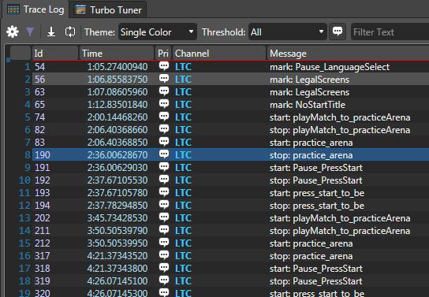
TTY events debugging (Trace Log)
Level 1
Level 2

Slide 37
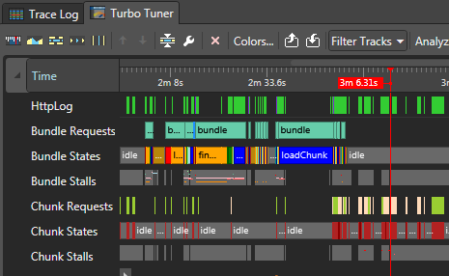
IO Load profiler (Turbo Tuner)
Bundle is a group of files that have to be loaded to move the game to the next level or sub level.
Chunks are blocks of data that are steamed in. Like movies or music or terrain in open world games.
Timeline
Bundles
Chunks

Slide 38
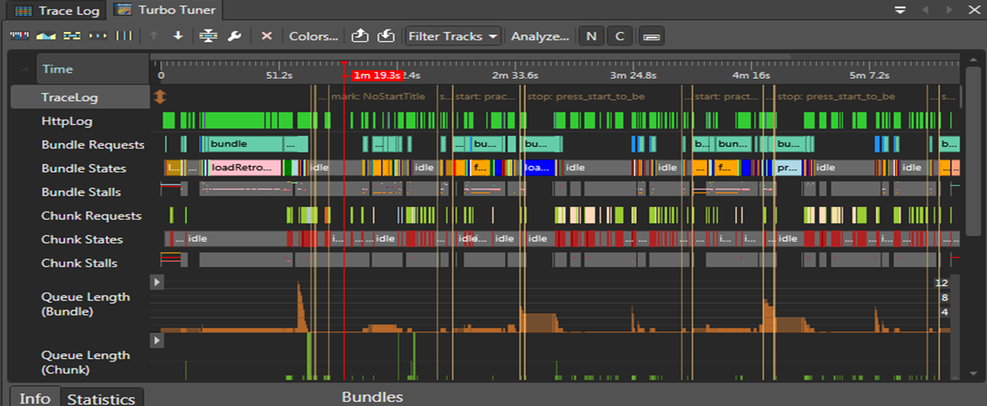
IO Load profiler (Turbo Tuner)
Each Printf on the selected channel
gets an event line so you can undersand
when it happened

Slide 39
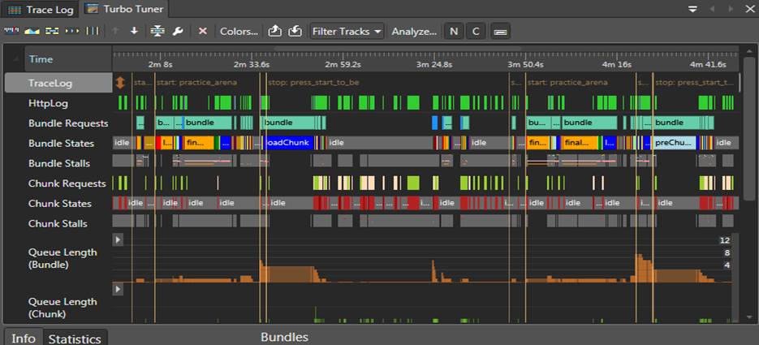
IO Load profiler (Turbo Tuner)
Loading Level 1
Playing Level 1
Loading Level 2
Playing Level 2
Why do I continue
to load bundle
while playing

Slide 40
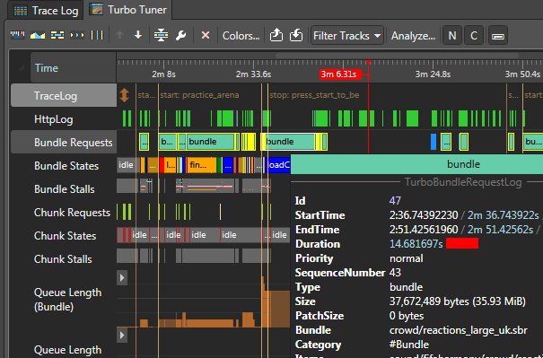
IO Load profiler (Turbo Tuner)
Hover
Name of
the Bundle

Slide 41
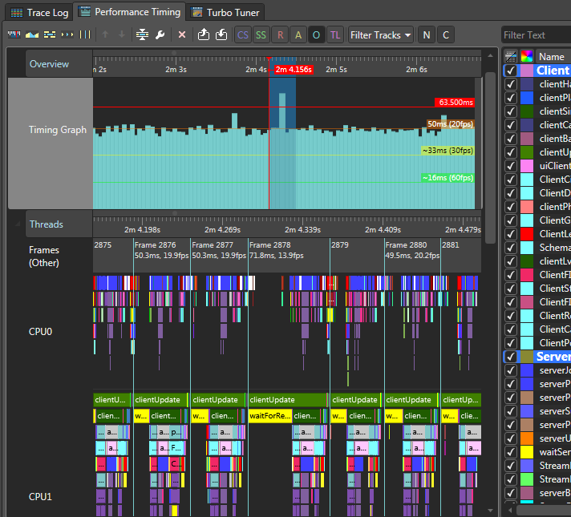
Frame rate and Job thread profiler (Performance Timer)
Each Rectangle is a Frame
The height is the time in ms of this frame
Frames
Expensive frame
Selected Frames in blue
Job
Selected Frames
Show Up here
Functions Calls
From Job
Expensive Frame
Why wait for rendering
Start Frame
End Frame

Slide 42
Loading profiler + Frame rate profiler
We can combine views
Why?
Loading is about more then disk performance
Decompression
Stamping one texture on with a font
Recompressing and loading into VRAM
Loading is often limited by CPU

Slide 43
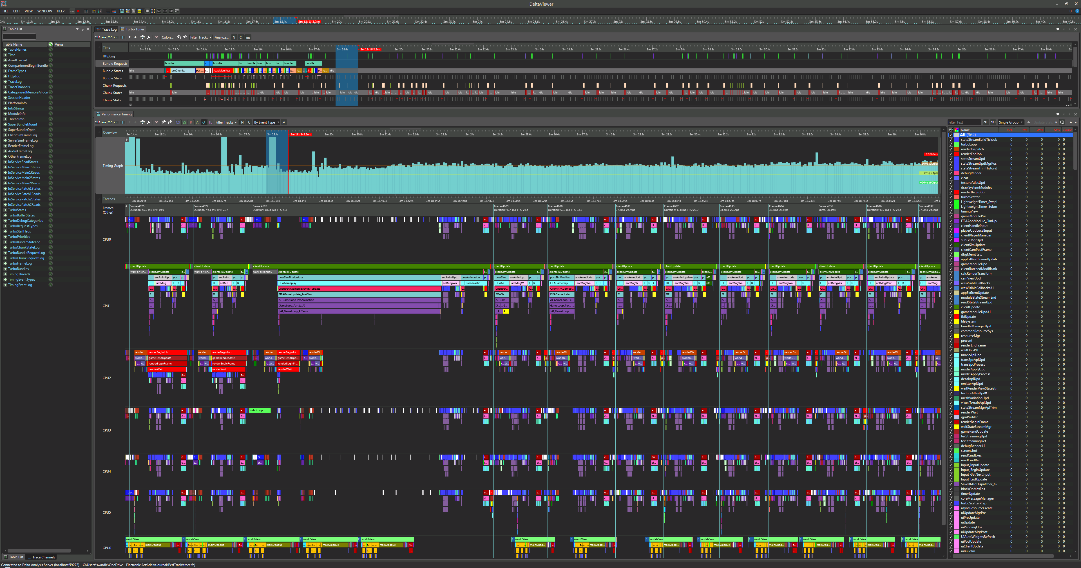
Add noisy screen from 4k screen
Turbo
Tuner
Selected time/frames
Frame
Rates
View of CPUs and Jobs
One BIG Frame
Selected time/rames
CPU0
CPU1
CPU2
CPU3
CPU4
CPU5
GPU

Slide 44

Use Memory Investigator for leaks
Finding memory leaks
How to find memory leaks in most games. Find:
Start of loading 1st level
End of loading 1st level
End of Loading 2nd level
(Growing objects look like leaks but often after a few levels this goes away, wish we had realloc)
By C it should be free
Capture allocs
between A and B
Alloc at T1
Not Free at T2 LEAK!

Slide 45
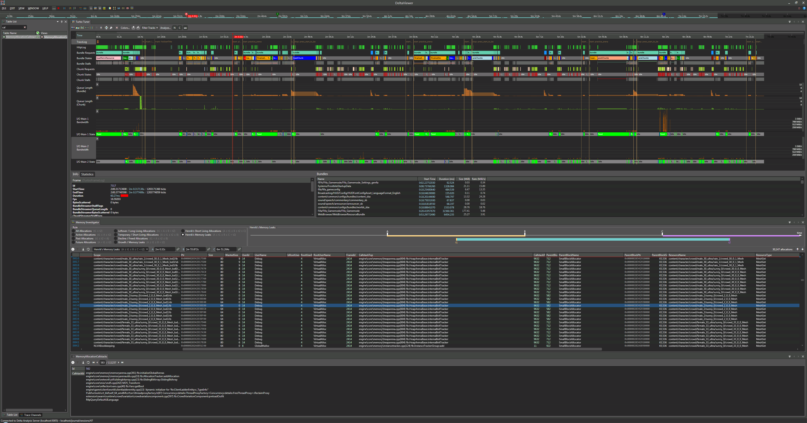
A
B
C
Turbo
Tuner
Capture
Allocs
Here
Should
Be Free
Before
Here
Different mode like growth or memory leaks
Diagram of the mode
List of leaks!
BAD!
Scope
Ptr
&
Size
Call Stack
ID
Asset Name
Full Call stack of
Selected item

Slide 46
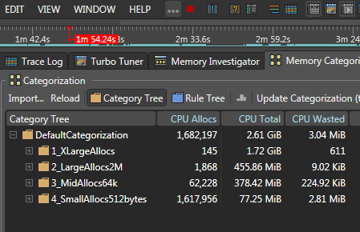
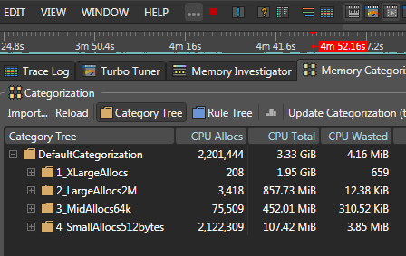
Memory Categorization
These times are often found
using turbo tuner
Scrub to another time
Before
After

Slide 47
Memory Categorization
big allocs 2M or greater take the space
Lots of small allocs 512 bytes or smaller

Slide 48
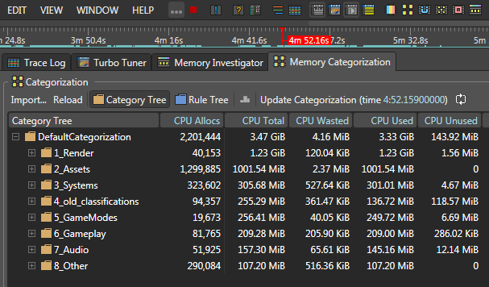
Memory Categorization
the code is 50MiB small on this scale
Rendering (procedural textures and other buffers used to draw the scene)
Content, meshes, textures and entities that tie these together

Slide 49
Summary
DeltaViewer
Has many views:
TTY Event Timing
IO and Load times
Jobs and threads
Memory changes
We have a lot of work to do to ship the game I am on ☺
(Good thing I have one year left)

Slide 50
Summary
EASTL and STL allocators
Hard to track
Use the “if you made it you own it rule”
Use the “this” pointer of allocator as a parameter for your allocators
EASTLICA
Good at enforcing allocator use for a large group of SEs
Helped with type erasure problems in stl::string and other classes. MyString does not work with YourString

Slide 51
Summary
Games in general
Most memory is used by large allocation
Most memory is mostly content (meshes and textures) or rendering
There are a large number of small allocations.
Small block allocators, pool systems, slab allocators are a good idea
Stomp Allocator are great (Use memory map to find who stomped you…)

Slide 52
Questions?

