Slide 1
open source in netease
网易杭州研究院
谢骋超
@圈圈套圈圈
@xiecc

Slide 2
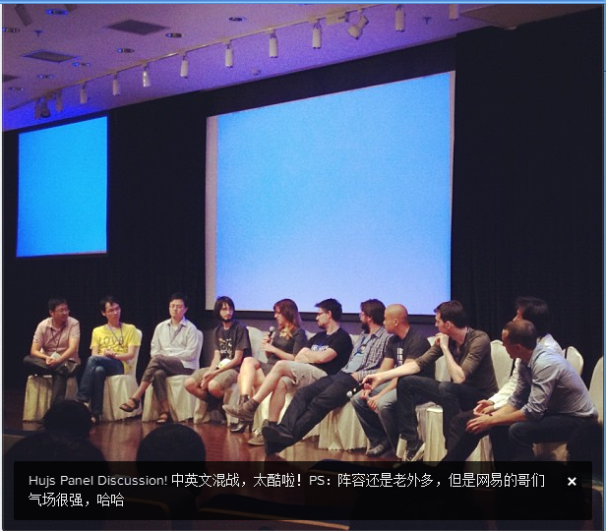
About me---hujs(jsconf in china)

Slide 3
Category
Overview
Pomelo framework
InnoSQL
Site

Slide 4

Overview
How many corps support employees for full time open source？
We are, a long, along … time ago

Slide 5

Netease and open source
Now is the time, for exposure

Slide 6

A game server development framework

Slide 7

Pomelo framework
Web
Tomcat/Jetty
Struts/Spring
ruby on rails
django
express
Game
Reddwarf
SmartfoxServer
Bigworld

Slide 8
Fast, scalable architecture single process does not scale

Slide 9
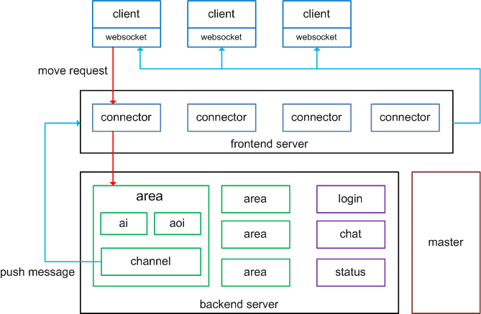
Runtime architecture

Slide 10
Game VS Web
Long connection VS Short connection
Partition: area based VS Load balanced cluster
State VS Stateless
Broadcast VS Request/response

Slide 11
almost zero code achieving this architecture easy to extend servers

Slide 12
Server abstraction
master
backend
forward message
frontend
push message
by channel
backend
rpc
backend
frontend
backend

Slide 13
Server abstraction
Duck type
connector
area
chat
frontend
backend
status

Slide 14
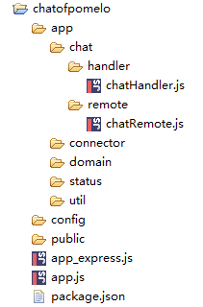
Server abstraction
server type

Slide 15
Easy request/response, channel, rpc

Slide 16
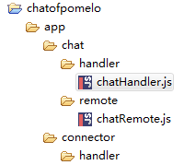
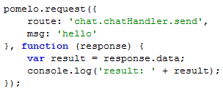

Request/response
Zero config
Client, like ajax
Server, like web mvc framework

Slide 17
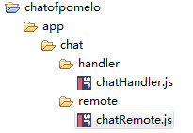

rpc framework
Zero config
Auto route
app.rpc.chat.chatRemote.kick

Slide 18
Focus on performance, and honest

Slide 19
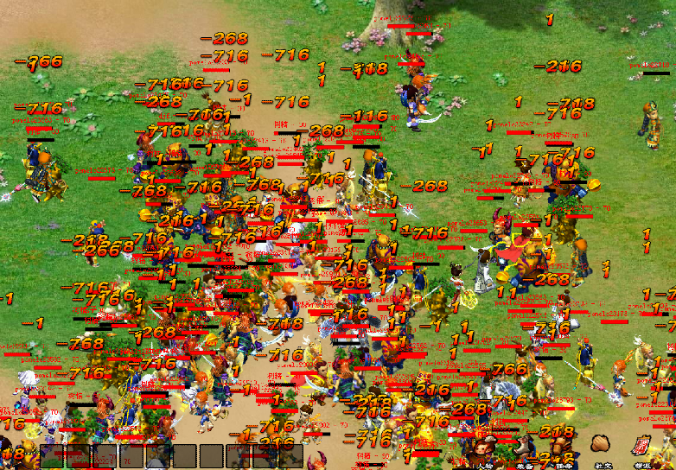
Full stress testing

Slide 20
A lot of optimization
Online users per area: 100 to 800
Response time: 200ms
Problems solved:
Html 5, client side memory leak
Path finding and aoi optimization
Data too… fat, reduce weight
Unclean connection data, make socket.io crazy
Some api implementation: dataApi
Divide process: path finding
And… broadcast

Slide 21
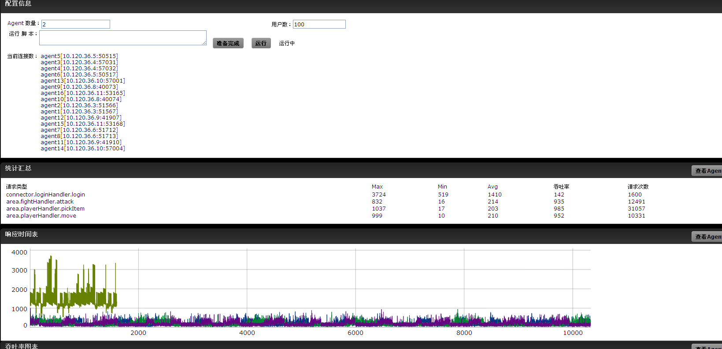
1600 onlines per area

Slide 22
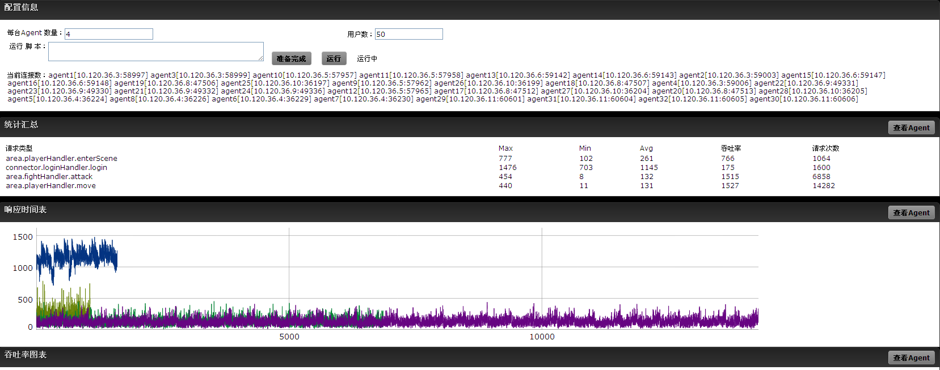
800 onlines per area

Slide 23
A lot of tools and library

Slide 24
Pomelo---architecture
ai
aoi
schedule
robot
. . .
pathfind
seq-queue
data-sync
Admin console
Library
tools
framework

Slide 25
Full MMO demos in HTML5

Slide 26
Written in node.js

Slide 27
Coming soon… 2012.11月底

Slide 28
InnoSQL
http://www.innomysql.org/
Mysql 分支版本
更好的MySQL数据库性能
将一些富有创意的想法用于数据库的生产环境。

Slide 29
InnoDB Flash Cache
SSD as L2 Cache
Persistent cache – Write back
Read cache – Read page from flash cache
Write cache – Merge write – Improve write intensive workload

Slide 30
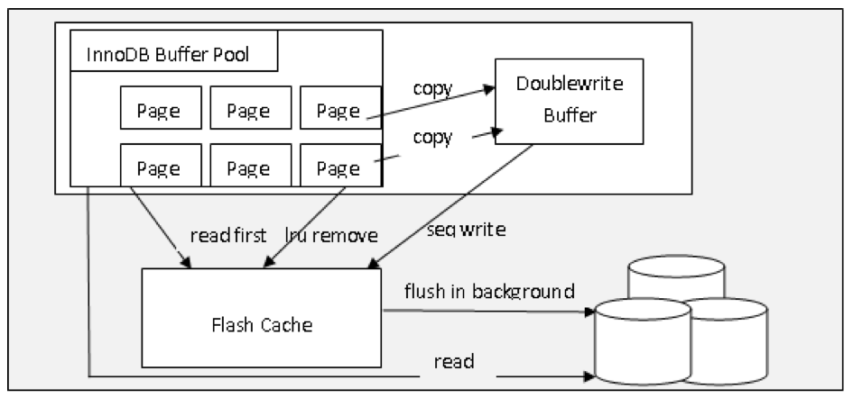
InnoSql’s flash cache architecture

Slide 31
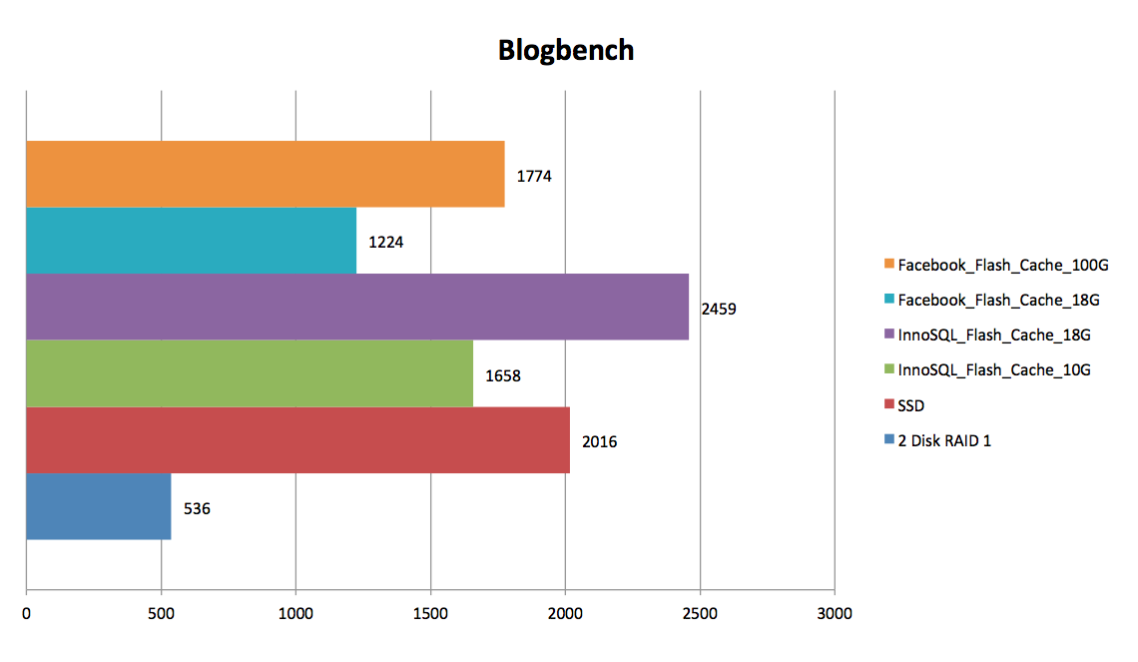
InnoDb FlashCache

Slide 32
InnoDb warm up
MySQL/Percona/Twider
– Dump/Load LRU
InnoSQL
– Share Memory + Dump/Load LRU

Slide 33
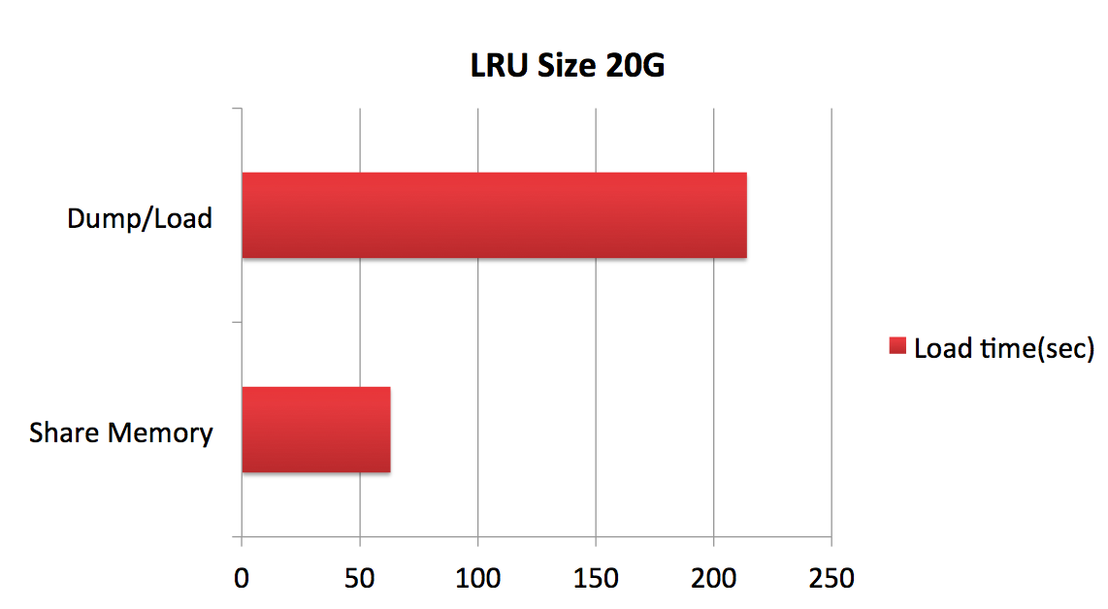
InnoSql warm up

Slide 34
IO Statistics
Vanilla MySQL SQL Profiler
– Record IO statstics based on global
InnoSQL SQL Profiler – Integrate IO statistics with SQL Profiler
– IO statistics with each SQL
– Excellent help for DBA & developer

Slide 35
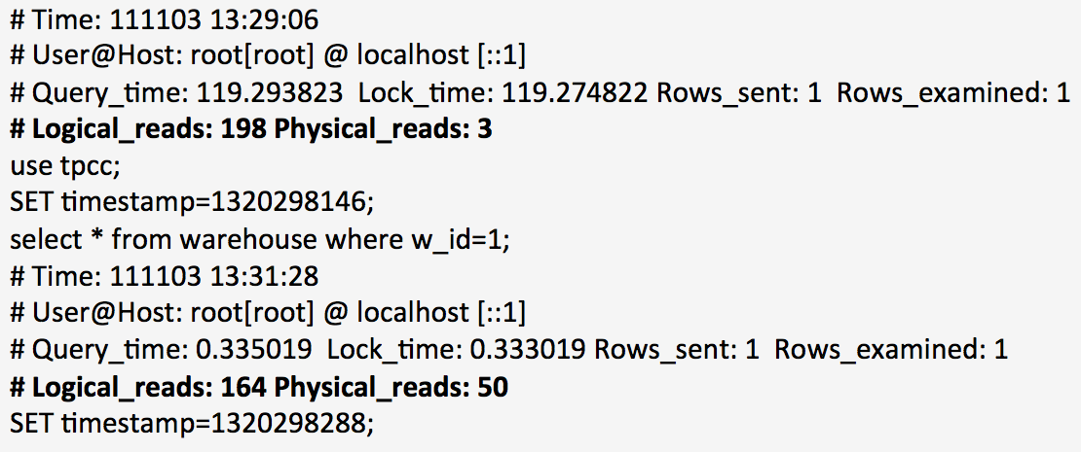
IO Statistics
Slow log

Slide 36
And more
死锁检测优化
--stack方式模拟递归
UNDO informatin_schema
--每个事务的undo信息
Virtual sync Replication with group commit
MySQL Profiler

Slide 37
Open source site
http://code.netease.com
https://github.com/NetEase/
Follow us
@圈圈套圈圈
@insidemysql
@网易汪源
@-CE-

Slide 38
Q&A

