Slide 1
Dynamic Android Application Repackaging Detection
汇报人：岳胜涛 MG1533079
指导老师：陶先平 马骏

Slide 2

Application Repackaging
Crack software’s payloads
Embed advertisements
Insert malware
Notes:
破解软件，是的有些付费软件可以免费使用
插入广告
恶意软件
说明其带来的影响
1、修改软件的作者署名等信息
2、插入广告
3、插入可以付费程序或者恶意软件
4、占用市场空间，浪费

Slide 3
Application Repackaging
The installation package (i.e. the .apk file) is easy to obtain
Reverse engineering tools are readily available
Apktool, dex2jar, Baksmali/Smali and so on
There is no certificate authorization
Too many unofficial and third-party app markets exist
5% to 13% of apps are plagiarisms in the oﬃcial Android market [1].
1083 of the analyzed 1260 malware samples (86.0%) are repackaged versions of legitimate apps with malicious payloads. [2]
Notes:
说明Repackaging易于实现
1、apk很容易得到
2、反编译很容易搞定
3、app不进行认证
4、其他市场的检查力度不够
Plagiarism 抄袭
Legitimate 合法的
1 使用了fuzzy hash
About 5% to 13% of apps in the third party Android markets are the plagiarism of apps in the oﬃcial Android market with no consideration of code obfuscation [1].
According to a recent study[2], it shows that 1083 of the analyzed 1260 malware samples (86.0%) are repackaged versions of legitimate apps with malicious payloads, indicating that repackaging is a favorable channel for mobile malware propagation.
【1】 Zhou, W., Zhou, Y., Jiang, X., Ning, P.: Detecting repackaged smartphone applications in third-party android marketplaces. In: Proceedings of the 2nd ACM Conference on Data and Application Security and Privacy, pp. 317–326. ACM (2012)
【2】Symantec Inc. Android threats getting steamy (May 7 (2011), http://www.symantec.com/connect/blogs/android-threats-getting-steamy

Slide 4
Related Work
Static |  | Dynamic
Code-level | UI-level | API-level | UI-level
Fuzzy Hashing[3] | View Graph[9] ResDroid[12] | API birthmarks[10] | Our works
Program Dependence Graph(PDG)[4,5]
Feature Hashing[6]
Module Decouple[7]
Notes:
已有工作
Fuzzy hashing：模糊hash 分块hash比较
Program Dependence Graph：data dependencies and control dependencies
Feature Hashing： feature as data hased
Module decouple：通过分析代码之间的调用与依赖关系，将app分割成多个module，生成图进行分析
Normal Compression Distance: how difficult it is to transform them into each other
View Graph : 上面的都是code-level viewdroid第一个使用ui level方式检测
[3] W. Zhou, Y. Zhou, X. Jiang, and P. Ning. Detecting repackaged smartphone applications in third-party Android marketplaces. In Proceedings of the second ACM conference on Data and Application Security and Privacy, 2012.
[4] J. Crussell, C. Gibler, and H. Chen. Attack of the clones: Detecting cloned applications on android markets. In ESORICS, pages 37–54, 2012.
[5] J. Crussell, C. Gibler, and H. Chen. Scalable semantics-based detection of similar android applications. In ESORICS, 2013.
[6] S. Hanna, L. Huang, E. Wu, S. Li, C. Chen, and D. Song. Juxtapp: A scalable system for detecting code reuse among android applications. In Proceedings of the 9th Conference on Detection of Intrusions and Malware & Vulnerability Assessment, 2012.
[7] W. Zhou, Y. Zhou, M. Grace, X. Jiang, and S. Zou. Fast, scalable detection of piggybacked mobile applications. In Proceedings of the third ACM conference on Data and application security and privacy, pages 185–196. ACM, 2013.
[8] A. Desnos and G. Gueguen. Android: From reversing to decompilation. In Black hat 2011, Abu Dhabi.
[9] Zhang F, Huang H, Zhu S, et al. ViewDroid: Towards obfuscation-resilient mobile application repackaging detection[C]//Proceedings of the 2014 ACM conference on Security and privacy in wireless & mobile networks. ACM, 2014: 25-36.

Slide 5

Our works
Apk Similarity
Similarity Calculator
Window transaction graph
Window transaction graph
AutoDroid
AutoDroid
apk1
apk2

Slide 6
Our works
Implement an automatic testing tool, AutoDroid, to generate the runtime Android application’s window transaction graph.
Propose a method to measure the similarity between two Android applications based on their window transaction graphs.

Slide 7
AutoDroid Structure
Device Emulator
Android Agent
Strategy Runner
Uiautomator command
UiAutomatorClient
Socket Stream
Invoke function
Function call
Shell command
Do an action
ADB
ADB Host
Graph
Generator
Send device raw data
Raw data parser
(Layout, Window)
Structured data
Strategy step

Slide 8
UiAutomator
Phone
PC
Command cmd = Socket.ObjectInputStream.readObject();
Socket.ObjectOutputStream.writeObject(backCmd);
Command backData = CommandHandler.Handle(cmd);
Command backData = Socket.ObjectInputStream.readObject();
Socket.ObjectOutputStream.writeObject(backData);
Handle backData

Slide 9
AndroidAgent
IAndroidAgent | IAndroidAgent
boolean init()//初始化 | void pressBack()
void terminate()//终止操作 | String getLayout()
IDevice getDevice()//当前设备 | String getRuntimePackage()
boolean installApk(String apkFilePath) | boolean doClick(LayoutNode btn)
String getFocusedActivity() | boolean doSetText(LayoutNode node, String content)
boolean startActivity(String activityName) | boolean doLongClick(LayoutNode node)
boolean stopApplication(String packageName) | boolean doClickAndWaitForWindow(LayoutNode node)
List<String> getRunningActivities() | boolean doScrollBackward(LayoutNode node, int steps)
List<AndroidWindow> getAndroidWindows() | boolean doScrollForward(LayoutNode node, int steps)
int getFocusedTaskId() | boolean doScrollToEnd(LayoutNode node, int maxSwipes, int steps)
void pressHome() | boolean doScrollToBeginning(LayoutNode node, int maxSwipes, int steps)

Slide 10
Strategy Runner
Window Transaction Graph(WTG) [11]
A window transaction Graph of an Apk is a directed graph G(V,E), where V is a set of nodes, each of which represents a window. E is a set of edges < a,b > such that a ∈ V , b ∈ V and the smartphone display can switch from window a to window b by user actions.
Window
A window is a logical data structure which contains the information about the screen.
Layout
A Layout is dumped from a certain hierarchy view, which is in the form of XML.
LayoutTree is a logical tree created by the Layout XML.

Slide 11
Strategy Runner
Depth(board) First Search strategy
Trying to traversal the whole application
However, almost impossible for most applications because the former states are hardly restored.
Random strategy with exact action
Knowing the layout of the window, we can do the exact action on each layout node. As a result, it performs more efficiently than Monkey does.
Bias weighted Random selection strategy
Random selection with bias weight.

Slide 12
Challenges
According to the methods above, there are several challenges during our work and experiments.

Slide 13
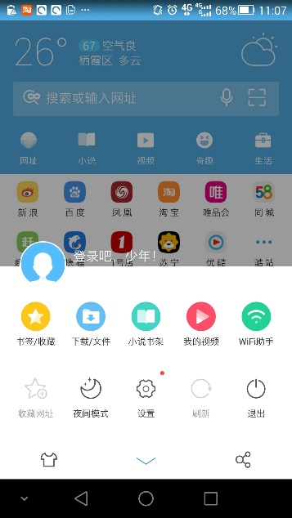
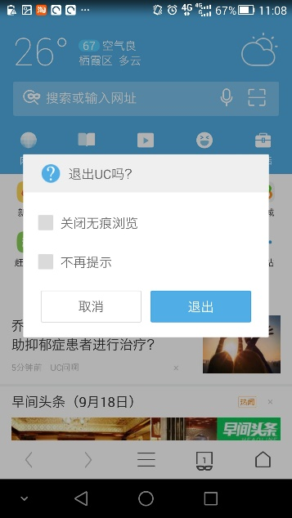
Challenges 1
WTG节点Window的确定
以前的工作都是以Activity直接作为window的Identification，如果当前界面存在AlertDialog, PopupWindow或者Menu，那么本不应该相同的界面则被认为是同一个界面。因此我们决定使用当前界面的layout和windowID结合作为window的关键信息。

Slide 14
Challenges 2
Algorithm 2: similarityWith(layoutTree1, layoutTree2)
editDis = EditDistance(layoutTree1.getTreeBFSHashes(),
layoutTree2.getTreeBFSHashes());
return 1.0-editDis/getTotalChildrenCount();
//EditDistance is a generics function, where the array element is in type of T.
//所有节点(即使是自定义控件)的className都是该节点的基类名(Button, TextView等)
Window相似度判断
WindowID为系统为Window实例分配的一个id，id相同的Window必定为同一个window，id不同的Window可能是相同的Activity创建的，也可能不是。因此，id不同时，要通过比对layout是否相似来确定是否为同一个Window。
Algorithm 1: getTreeBFSHashes
i=0; hash=Int[];
foreach(n : root.getChildren)
nodeQueue.push(n);
while(!nodeQueue.isEmpty())
topNode = nodeQueue.pop();
if(!topNode.className is TreeView)
foreach(n : topNode.getChildren)
nodeQueue.push(n)
hash[i++] = topNode.className.hashCode();
return hash;

Slide 15
Challenges 3
遍历策略
Algorithm 3: SelectionStrategy
currentWindow = getCurrentWindow()
while(currentWIndow != null)
action = getNextAction(currentWindow, lastAction);
switch(action)
case NoMoreAction:
return true;
case NoAction:
break;
default:
DoAction();LogAction();
currentWindow = getCurrentWindow();
WTG.addTransaction(fromWindow, toWindow, action);
endswitch
endwhile

Slide 16
Challenges 3
初始状态时，所有节点权重为1
遍历策略
Algorithm 4: WindowWeightSelectionStrategy : SelectionStrategy
@Override getNextAction(currentWindow, lastAction)
if WTG doesn’t change any edge or vertex aftar doing lastAction
lastAction.weight -=1;
if(lastAction.weight < 1) lastAction.weight=1;
nochangeCount++;
else
lastAction.weight += 2+averageWeight(currentWindow.layout);
endif
nodeList = layout.nodes && node can be interacted
if nochangeCount >=threshold return NoMoreAction;
action.node = randomSelectBasedOnWeight(actionList);
action.type = randomSelect(actionList);
return action;
lastAction操作之后，WTG的没有发生变化，则该Action对应的节点权重将被减少
否则，权重增加，如果跳至了新的窗口，会把新窗口中所有节点的平均权重也加到这个节点上
带权重的随机选择
特殊处理：会将返回、菜单按钮一并加入计算

Slide 17
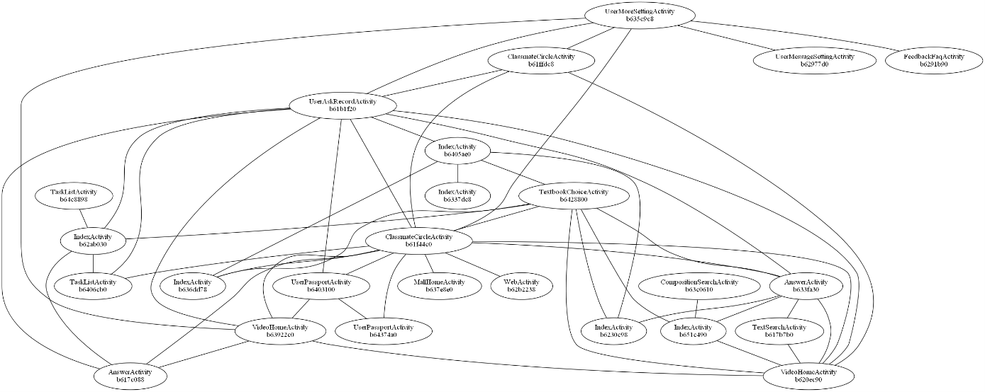
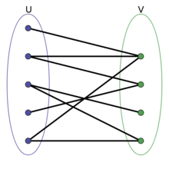
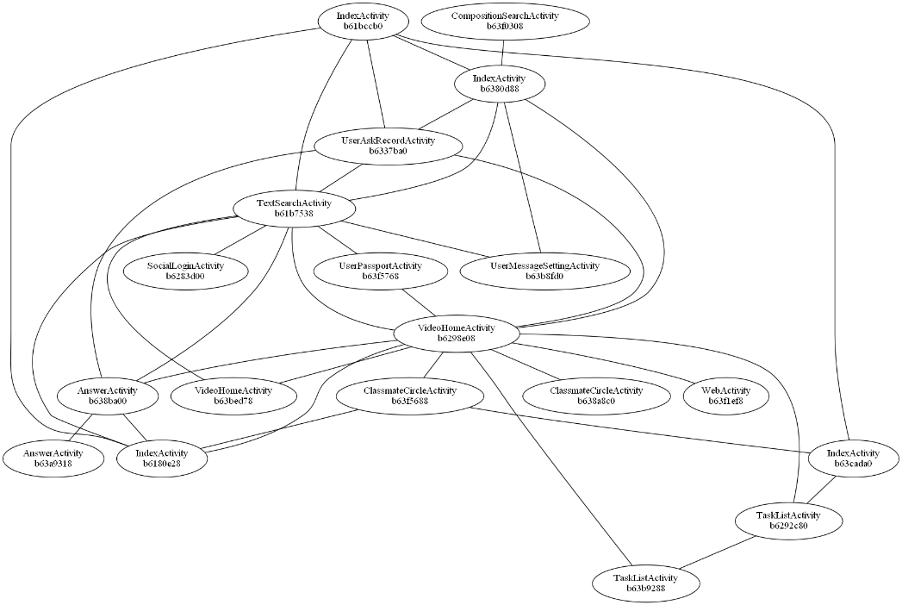
Challenges 4
Graph相似度计算:带权值的二分图匹配(KM算法)
二分图由2个WTG的节点两两配对组成
权值为两个节点相似度，同样利用之前的Window相似度算法作为节点的相似度，相似度小于一个阈值时，权值设为0
计算得到最大的匹配权值W, sim = W/min(G1.vetexCount,G2.vetexCount)

Slide 18
Experiments
Resistance
一个应用与其一个（通过程序转换技术获得的）副本应该被检测出相似
利用爱加密来进行实验
APK中的classes.dex被加密，无法被反编译
APK被优化，API函数调用被修改
共计15个APK被加密，被检测出15组相似，FN_Rate = 0%, FP_Rate = 0%
Discrimination
实现同一规约的独立开发的不同应用的应该认为是不同的应用.
挑选了应用市场中的5个分类，每个分类挑选若干个应用进行实验
共计5个分类87个APK，被检测出5组相似，经过人为判断，其中4组为确实为同一款应用（版本、部分外观不同），1组为误判，FP_Rate = 1.1%。该误判是由于该组Window个数过少，导致最后的相似度值过高。

Slide 19
Experiments
apk1 | apk2 | Graph similarity | Vertex count 1 | Vertex count 2 | Vetex sim | Final sim
0f549bf753685d02049f0f87750fbdbc | 0f549bf753685d02049f0f87750fbdbc | 4 | 6 | 4 | 4 | 1
0f549bf753685d02049f0f87750fbdbc_new0 | 0f549bf753685d02049f0f87750fbdbc_new0 | 4 | 5 | 4 | 4 | 1
0f7eabb88512189109d1cfad6ba44951 | 0f7eabb88512189109d1cfad6ba44951 | 3.923809524 | 9 | 5 | 5 | 0.784762
1b483ad34282a0822db64d3821dfa738 | 1b483ad34282a0822db64d3821dfa738 | 7.5 | 9 | 8 | 8 | 0.9375
1e3793bc428c823d883f2bec95289144 | 1e3793bc428c823d883f2bec95289144 | 5 | 7 | 5 | 5 | 1
38dd5a548134514aa281a64a3349acff | 38dd5a548134514aa281a64a3349acff | 3 | 8 | 3 | 3 | 1
47914f8549fbc29eadddc79f36892020 | 47914f8549fbc29eadddc79f36892020 | 7.385336743 | 12 | 8 | 8 | 0.923167
49ac5a364159a7de007d501f97987912 | 49ac5a364159a7de007d501f97987912 | 4 | 5 | 4 | 4 | 1
5933a8cf7d55991921c04be51327f532 | 5933a8cf7d55991921c04be51327f532 | 2 | 2 | 2 | 2 | 1
618e186bf447356128e70f1b21a206c0 | 618e186bf447356128e70f1b21a206c0 | 6.256493506 | 9 | 8 | 7 | 0.782062
69f2319c6a9606fe30fcecb2a1b531db | 69f2319c6a9606fe30fcecb2a1b531db | 4 | 7 | 4 | 4 | 1
7463372e633e7905c1a40c6ac7604374 | 7463372e633e7905c1a40c6ac7604374 | 3 | 3 | 3 | 3 | 1
756809df9f533cae5476b5825c6d9ccb | 756809df9f533cae5476b5825c6d9ccb | 4 | 4 | 4 | 4 | 1
92cc1d557f7cd56a7e5c4643c1590fce | 92cc1d557f7cd56a7e5c4643c1590fce | 3 | 3 | 3 | 3 | 1
ahsan.my.lytish.1409802619785 | ahsan.my.lytish.1409802619785 | 1 | 5 | 1 | 1 | 1
b14339f142c3b846becb983400f8707b | b14339f142c3b846becb983400f8707b | 3 | 5 | 3 | 3 | 1

Slide 20
Experiments
Category | Count
EDUCATION | 25
COMMUNICATION | 17
WALLPAPER | 12
BOOKS_AND_REFERENCE | 12
LIFESTYLE | 21

Slide 21
Experiments

Slide 22
Experiments

Slide 23
Experiments

Slide 24
Limitations
无法处理需要特定输入或者行为的情况
本工作以UI为核心，当应用UI数量较少时，在相似度判别上会出现错误。
本工作无法处理混合应用，这类应用采用HTML+JavaScript+CSS等Web技术快速架构应用的界面，因此利用我们的方法无法解析当前界面的Layout信息。

Slide 25
Reference
[1]Zhou, W., Zhou, Y., Jiang, X., Ning, P.: Detecting repackaged smartphone applications in third-party android marketplaces. In: Proceedings of the 2nd ACM Conference on Data and Application Security and Privacy, pp. 317–326. ACM (2012)
[2]Symantec Inc. Android threats getting steamy (May 7 (2011), http://www.symantec.com/connect/blogs/android-threats-getting-steamy
[3] W. Zhou, Y. Zhou, X. Jiang, and P. Ning. Detecting repackaged smartphone applications in third-party Android marketplaces. In Proceedings of the second ACM conference on Data and Application Security and Privacy, 2012.
[4] J. Crussell, C. Gibler, and H. Chen. Attack of the clones: Detecting cloned applications on android markets. In ESORICS, pages 37–54, 2012.
[5] J. Crussell, C. Gibler, and H. Chen. Scalable semantics-based detection of similar android applications. In ESORICS, 2013.
[6] S. Hanna, L. Huang, E. Wu, S. Li, C. Chen, and D. Song. Juxtapp: A scalable system for detecting code reuse among android applications. In Proceedings of the 9th Conference on Detection of Intrusions and Malware & Vulnerability Assessment, 2012.

Slide 26
Reference
[7] W. Zhou, Y. Zhou, M. Grace, X. Jiang, and S. Zou. Fast, scalable detection of piggybacked mobile applications. In Proceedings of the third ACM conference on Data and application security and privacy, pages 185–196. ACM, 2013.
[8] A. Desnos and G. Gueguen. Android: From reversing to decompilation. In Black hat 2011, Abu Dhabi.
[9] Zhang F, Huang H, Zhu S, et al. ViewDroid: Towards obfuscation-resilient mobile application repackaging detection[C]//Proceedings of the 2014 ACM conference on Security and privacy in wireless & mobile networks. ACM, 2014: 25-36.
[10] Kim D, Gokhale A, Ganapathy V, et al. Detecting plagiarized mobile apps using API birthmarks[J]. Automated Software Engineering, 2015: 1-28.
[11] Yang S, Zhang H, Wu H, et al. Static Window Transition Graphs for Android (T)[C]//Automated Software Engineering (ASE), 2015 30th IEEE/ACM International Conference on. IEEE, 2015: 658-668.
[12] Shao Y, Luo X, Qian C, et al. Towards a scalable resource-driven approach for detecting repackaged android applications[C]//Proceedings of the 30th Annual Computer Security Applications Conference. ACM, 2014: 56-65.

Slide 27
Thanks for watching!

