Slide 1
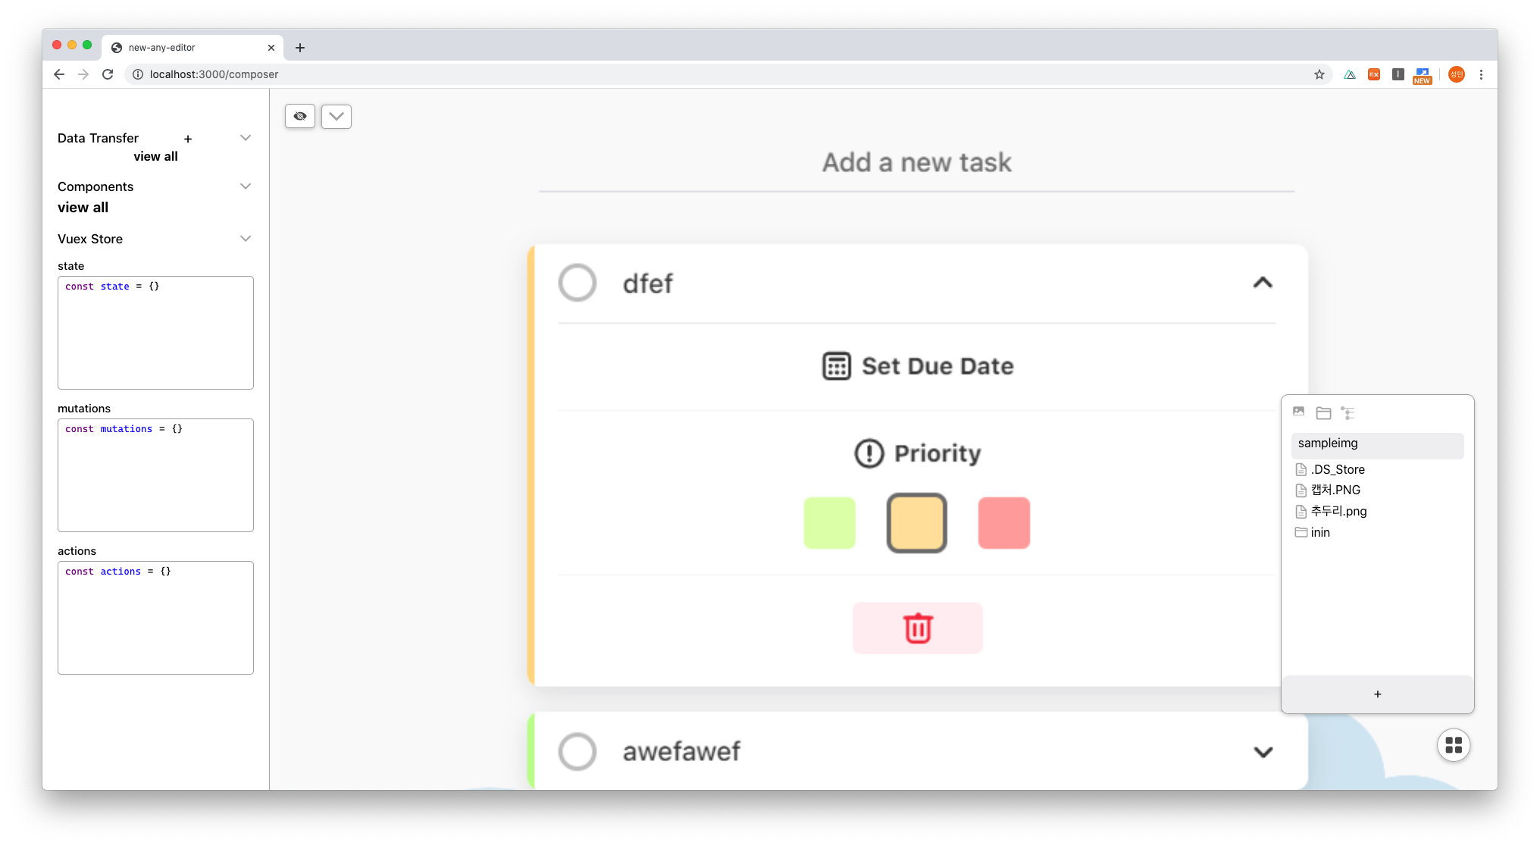
ImgLoad
ExpandPanel
VuexStore
Directory
Side Panel

Slide 2
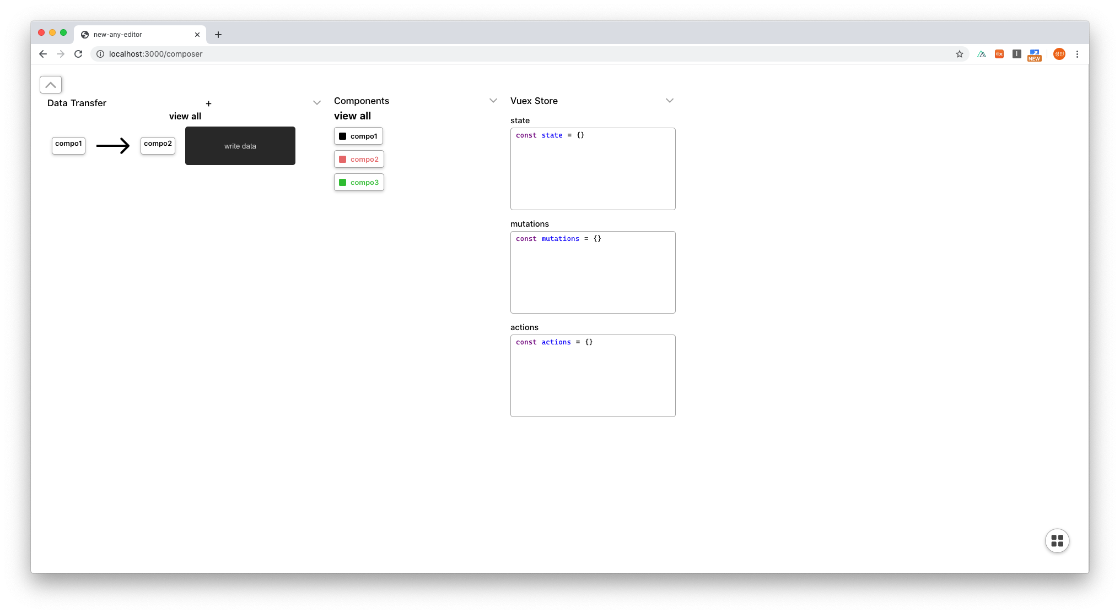
DataValue
DataTransfer
Components

Slide 3
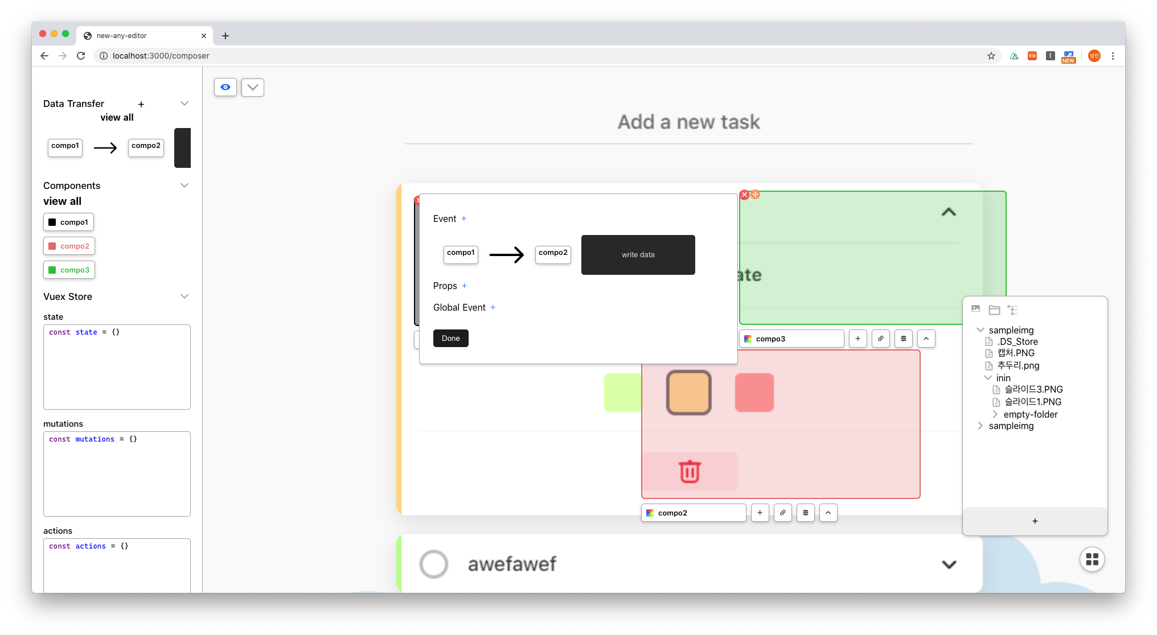
ViewHide
FileTree
DataTransferAdd

Slide 4
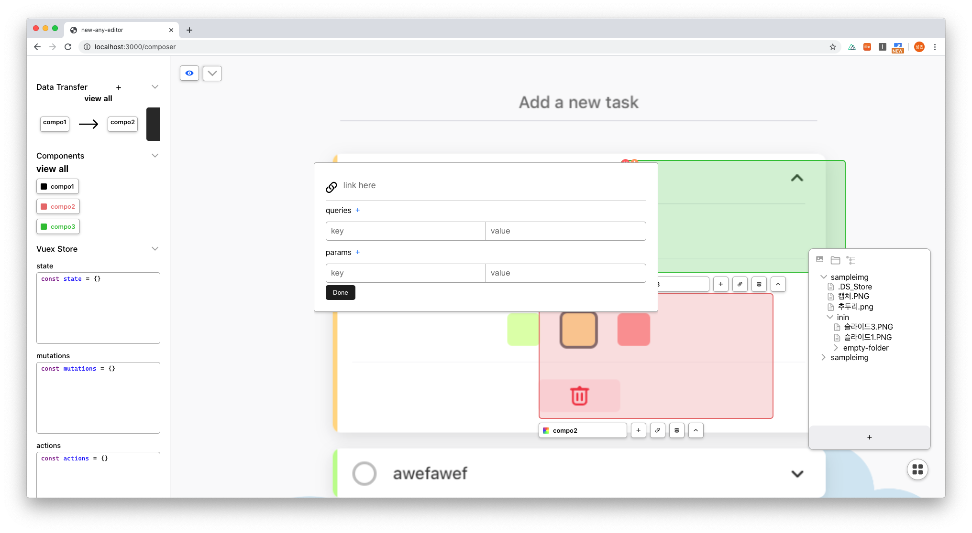
CompoLink

Slide 5
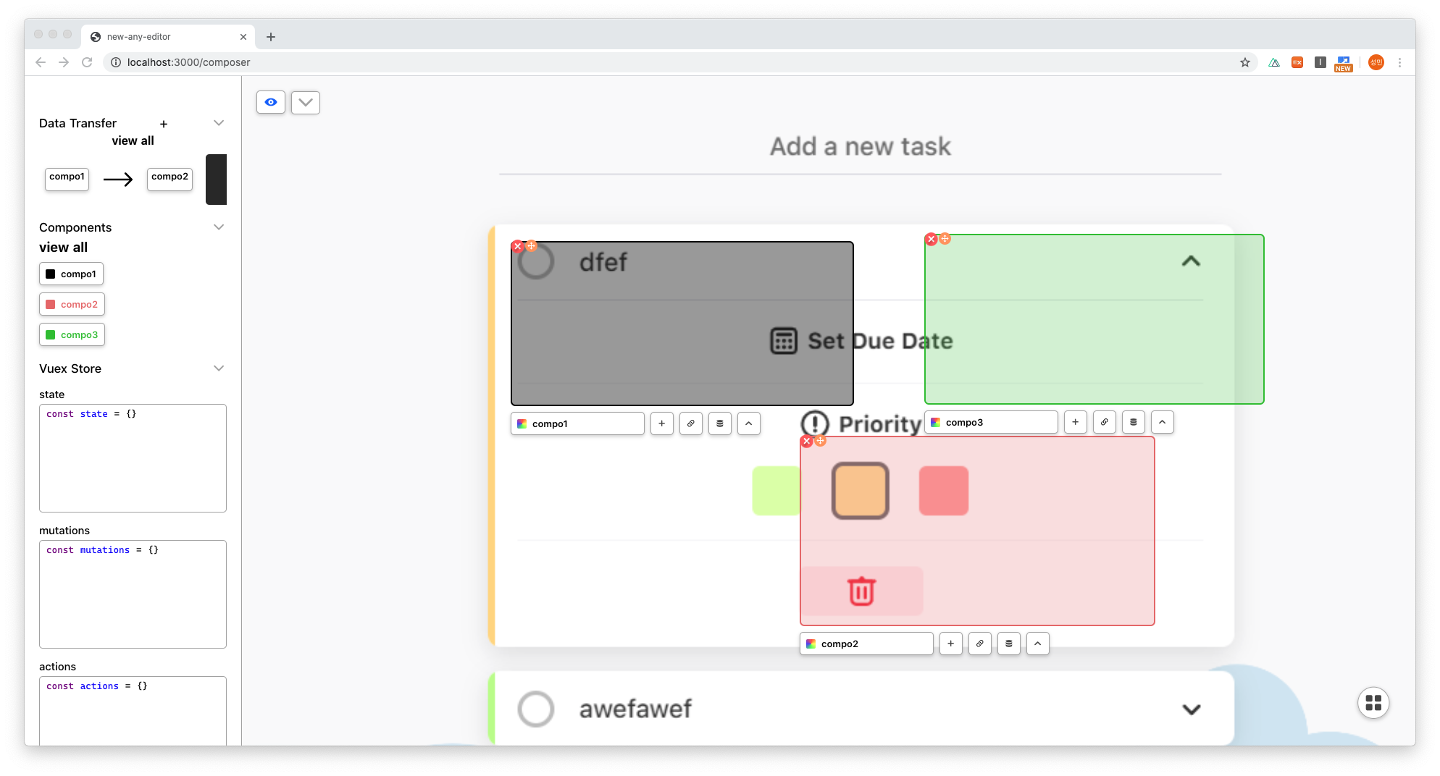
Identifier

