Slide 1
SlideAnywhere
Puzzle Game Based on iOS
Dan Chunchun 440473116
Zhao Qian 430564266

Slide 2
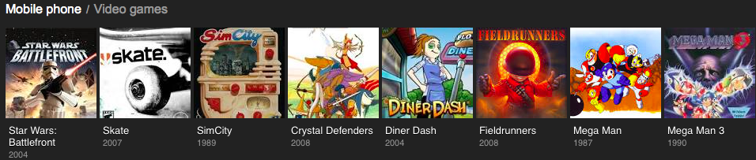
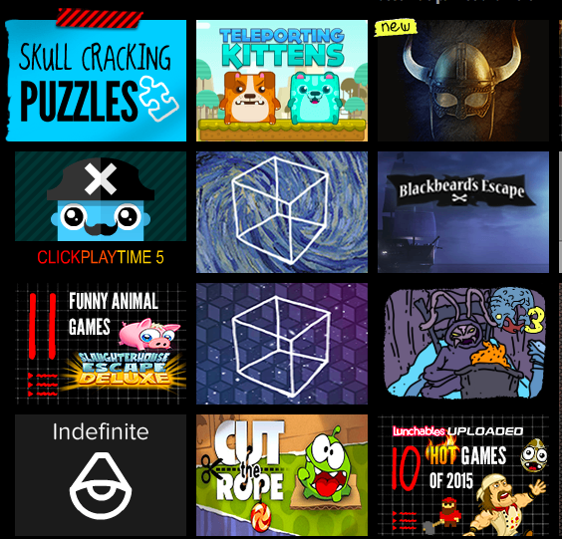
Introduction
Mobile Games are Popular
Puzzle Game has More Fun

Slide 3

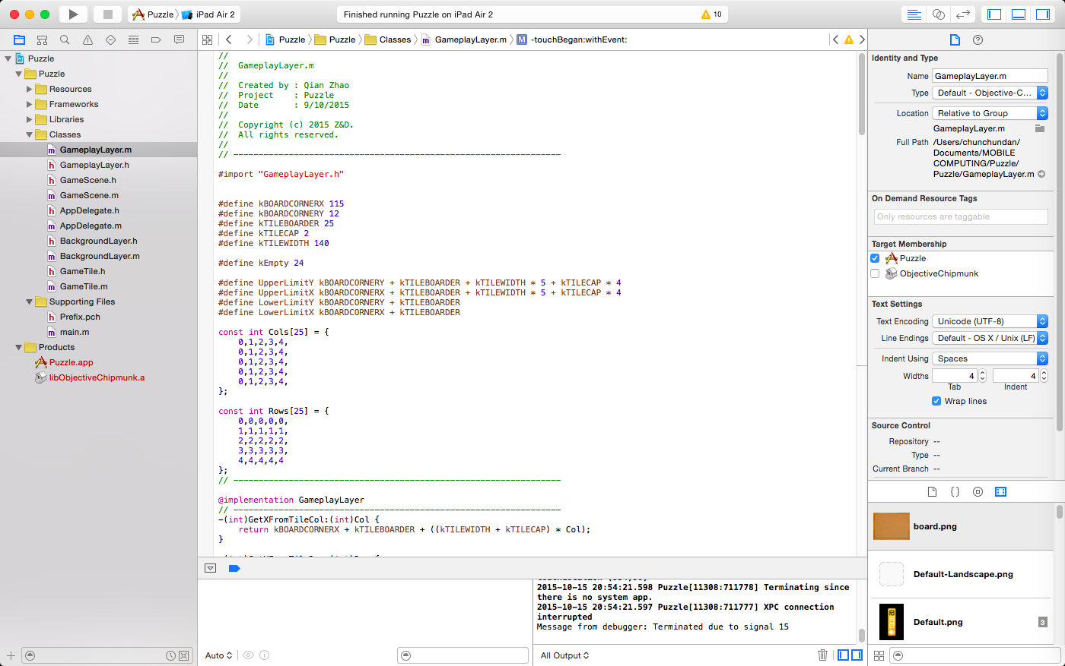


Development
Development Platform

Slide 4
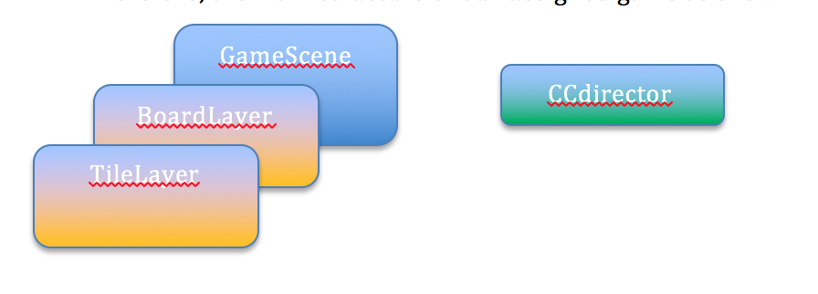
Algorithm

Slide 5
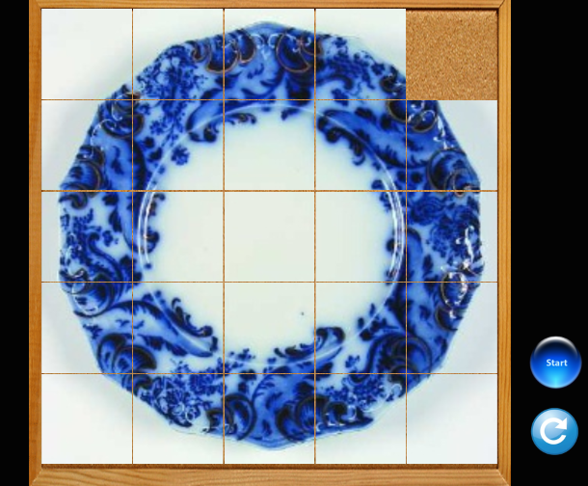
App Test
Interface
Play Game

Slide 6
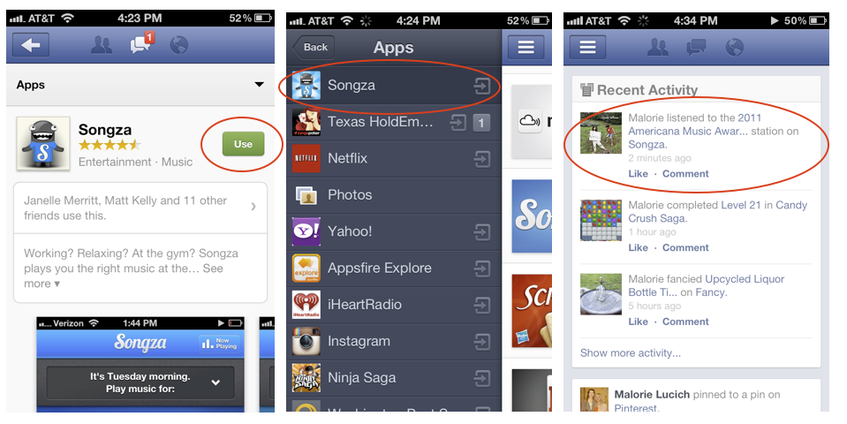
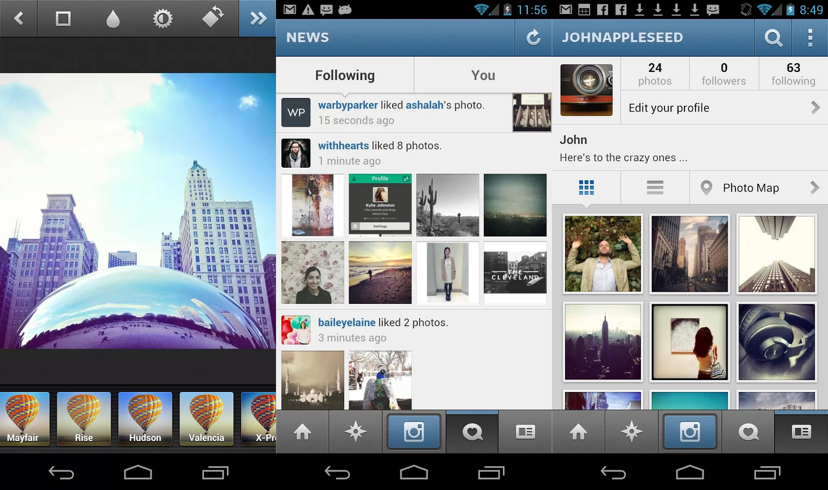
Future Development
Log in Facebook
Log in Instagram

