Slide 1
Machine Learning #NN

Slide 2
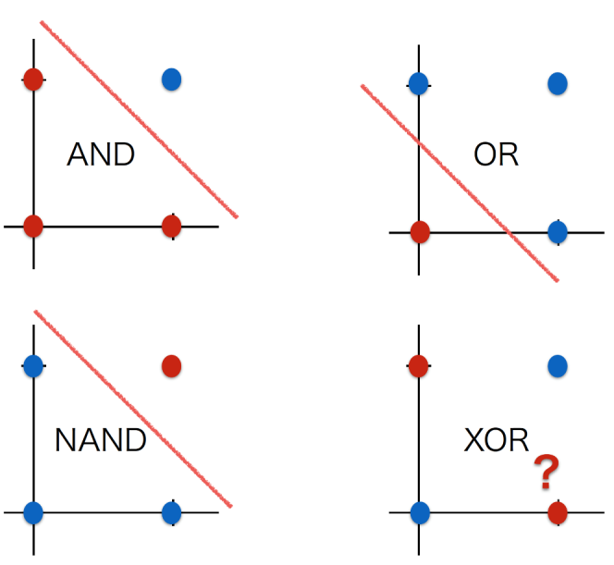
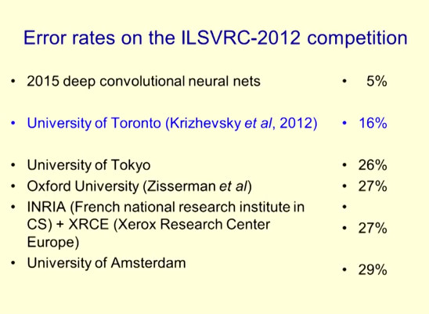
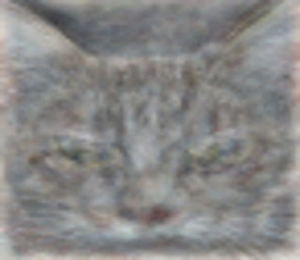
おさらい：boom#3 : 2010年〜現在
1958年 Rosenblatt, Frank “The Perceptron: A Probabilistic Model for Information Storage and Organization in the Brain”.
1969年 XOR問題。パーセプトロンはXORできないことを証明。➡1980年代隠れ層を入れれば理論上は問題解決できた。
1986年 バックプロパゲーション：Rumelhart, etc. “Learning representations by back-propagating errors”. Nature 323
2006年 ディープネットワーク：Geoffrey Hinton “Reducing the Dimensionality of Data with Neural Networks”
※ Geoffrey Hinton ：2013年Google Brainへ。2018年Turing Award http://www.cs.toronto.edu/~hinton/
2012年 ILSVRC(大規模画像認識の競技会)で圧倒的に勝利 by Geoffrey Hinton。誤り率25.7%から16%へ。現在：4.9%
2012年 YouTubeの動画を学習し猫認識 by Google（※論文がここ
2016年 AlphaGo （※論文がここ from Nature
論理演算とは、
AND、OR、NAND、XORの4つが基本
ILSVRCで圧倒的に勝利
http://www.image-net.org/challenges/LSVRC/2012/
https://googleblog.blogspot.com/2012/06/using-large-scale-brain-simulations-for.html
・200×200px画像：1000万枚
・ニューラルネットワーク：９つの階層
・1000台×3日間
・コンピュータが「もっとも猫らしい猫」と判断する画像が ➡

Slide 3
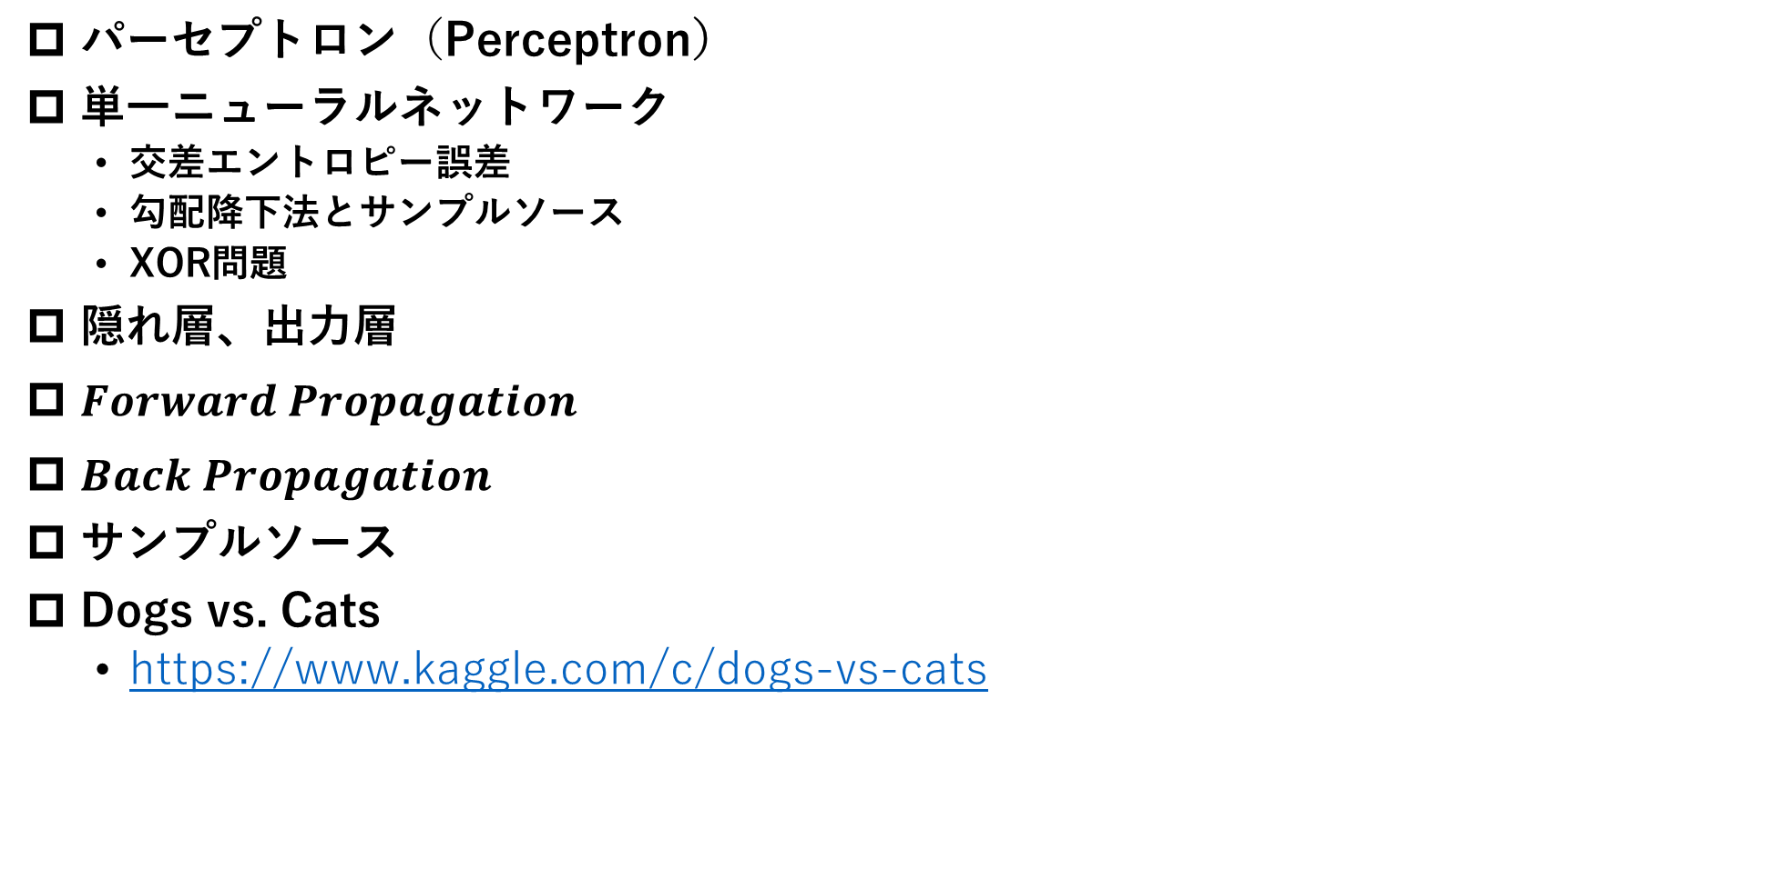
Agenda：NN
パーセプトロン（Perceptron）
単一ニューラルネットワーク
交差エントロピー誤差
勾配降下法とサンプルソース
XOR問題
隠れ層、出力層
$Forward Propagation$
$Back Propagation$
サンプルソース
Dogs vs. Cats
https://www.kaggle.com/c/dogs-vs-cats

Slide 4
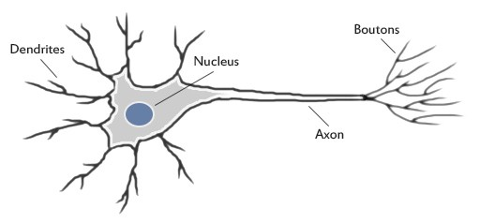
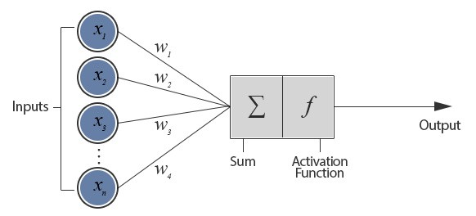

パーセプトロン（Perceptron）
1958年 Rosenblatt, Frank “The Perceptron: A Probabilistic Model for Information Storage and Organization in the Brain”.
人間の脳の中の神経（ニューロン）
$$教師あり学習 \left\{\left({input}^{1},{output}^{1}\right),\left({input}^{2},{output}^{2}\right),…,\left({input}^{m},{output}^{m}\right)\right\}$$
Note: $output∈(0,1)$

Slide 5
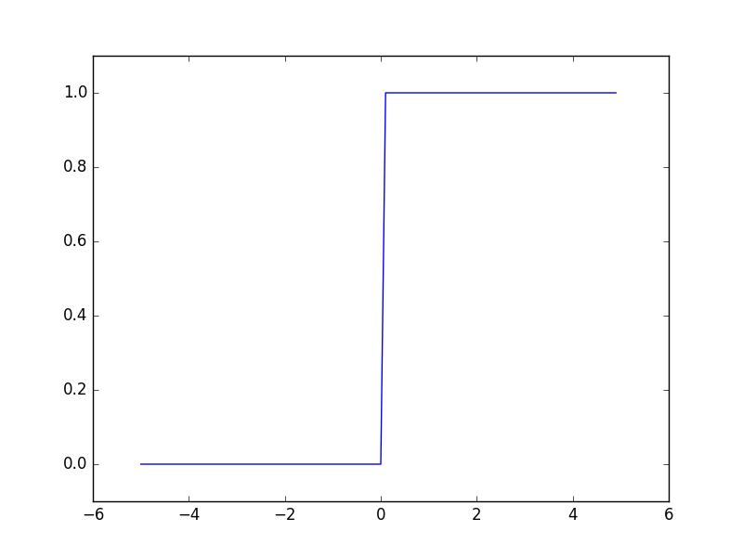
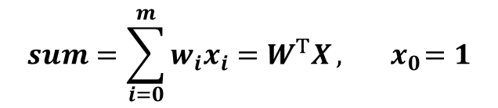




パーセプトロン（Perceptron）
1958年 Rosenblatt, Frank “The Perceptron: A Probabilistic Model for Information Storage and Organization in the Brain”.
$$sum=\sum_{i=0}^{m}{w_{i}x_{i}=W^{T}X}, { x}_{0}=1$$
線形回帰 linear regression
$$h_{w}\left(x\right)=f\left(sum\right)=f(W^{T}X)$$
$h:\text{h}\text{ypothesis}, f:$ activation function
ステップ関数（step function）
$$output=1 if{ W}^{T}X≥0$$
$$output=0 if{ W}^{T}X<0$$

Slide 6




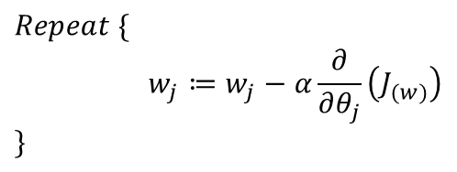
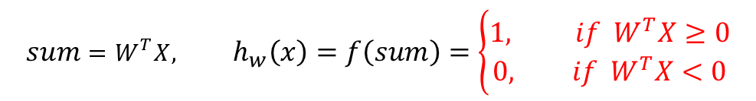
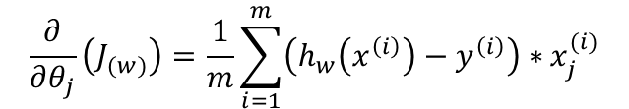
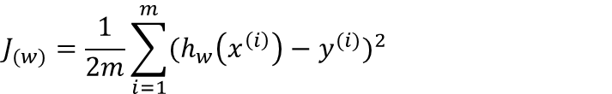
パーセプトロン（Perceptron）
Training set:
Note: $y∈(0,1)$
$${sum=W^{T}X, h}_{w}\left(x\right)=f\left(sum\right)=\left\{\begin{aligned}1, if{ W}^{T}X≥0 \\ 0, if{ W}^{T}X<0\end{aligned}\right.$$
Hypothesis:
Parameters:
$$\left[\begin{matrix}w_{0} & w_{1} & w_{2} & … & w_{m}\end{matrix}\right]$$
$$Cost(h_{w}\left(x\right), y)={\frac{1}{2}(h_{w}\left(x\right)−y)}^{2}$$
Cost function:
$$J_{(w)}=\frac{1}{2m}\sum_{i=1}^{m}{{(h_{w}\left(x^{\left(i\right)}\right)−y^{(i)})}^{2}}$$
Objective function:
Goal:
${minimize J}_{(w)}$
Gradient descent:
$$Repeat \{$$
$$w_{j}≔w_{j}−α\frac{∂}{∂θ_{j}}\left(J_{(w)}\right)$$
$$\}$$
$$\frac{∂}{∂θ_{j}}\left(J_{(w)}\right)=\frac{1}{m}\sum_{i=1}^{m}{\left(h_{w}\left(x^{\left(i\right)}\right)−y^{\left(i\right)}\right)∗}x_{j}^{(i)}$$

Slide 7
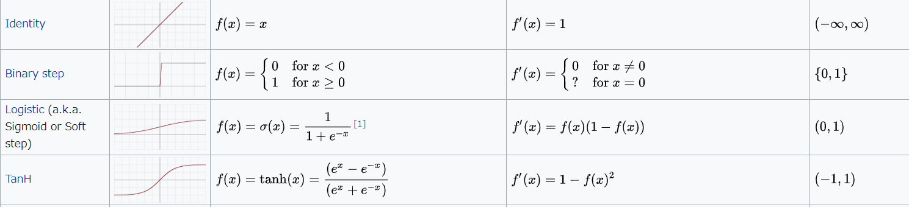
活性化関数（Activation Function）
https://en.wikipedia.org/wiki/Activation_function

Slide 8
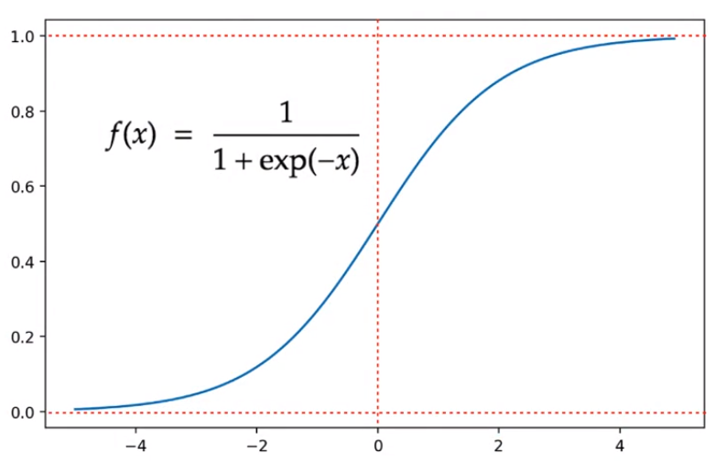
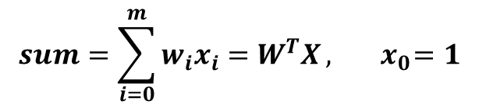


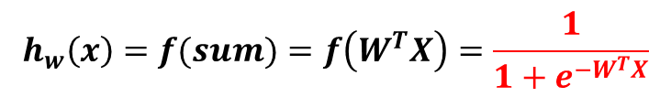


単層ニューラルネットワーク（neural network）
$$sum=\sum_{i=0}^{m}{w_{i}x_{i}=W^{T}X}, { x}_{0}=1$$
線形回帰 linear regression
$$h_{w}\left(x\right)=f(sum)=f\left(W^{T}X\right)=\frac{1}{1+e^{−W^{T}X}}$$
$h:\text{h}\text{ypothesis}, f:$ activation function
Note: $output∈(0,1)$
シグモイド関数（sigmoid function）
$$0<h\left(x\right)<1$$
$$h\left(x\right)=P(output=1|x,θ)$$
単層ニューラルネットワーク（neural network）
= ロジスティック回帰 Logistic regression

Slide 9
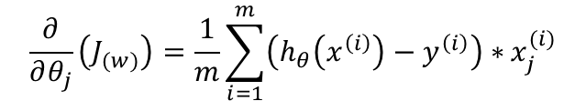
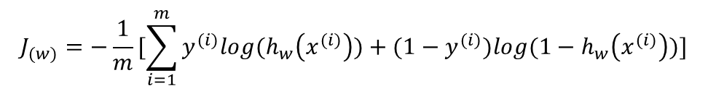
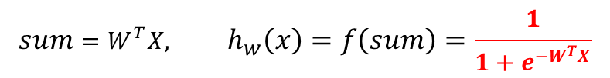
単層ニューラルネットワーク（neural network）
Training set:
Note: $y∈(0,1)$
$${sum=W^{T}X, h}_{w}\left(x\right)=f\left(sum\right)=\frac{1}{1+e^{−W^{T}X}}$$
Hypothesis:
Parameters:
$$\left[\begin{matrix}w_{0} & w_{1} & w_{2} & … & w_{m}\end{matrix}\right]$$
交差エントロピー誤差
$Cost\left(h_{w}\left(x\right), y\right)=\left\{\begin{aligned}−\log\left(h_{w}\left(x\right)\right), if y=1 \\ &−log⁡(1−h_{w}\left(x\right)), if y=0\end{aligned}\right.$ = $−(y∗\log\left(h_{w}\left(x\right)\right)+\left(1−y\right)∗log⁡(1−h_{w}\left(x\right)))$
Cost function:
$$J_{(w)}=−\frac{1}{m}[\sum_{i=1}^{m}{y^{(i)}log{(h}_{w}\left(x^{(i)}\right))+{(1−y}^{(i)})log{(1−h}_{w}\left(x^{(i)}\right))}]$$
Objective function:
Goal:
${minimize J}_{(w)}$
Gradient descent:
$$Repeat \{$$
$$w_{j}≔w_{j}−α\frac{∂}{∂θ_{j}}\left(J_{(w)}\right)$$
$$\}$$
$$\frac{∂}{∂θ_{j}}\left(J_{(w)}\right)=\frac{1}{m}\sum_{i=1}^{m}{\left(h_{θ}\left(x^{\left(i\right)}\right)−y^{\left(i\right)}\right)∗}x_{j}^{(i)}$$

Slide 10
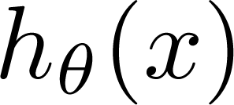
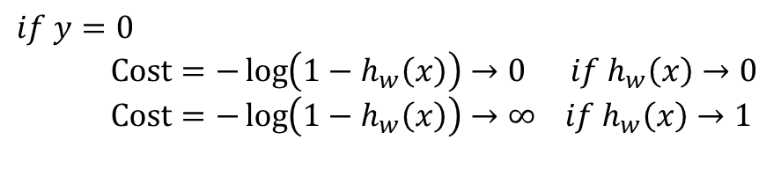
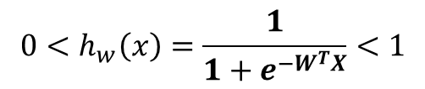
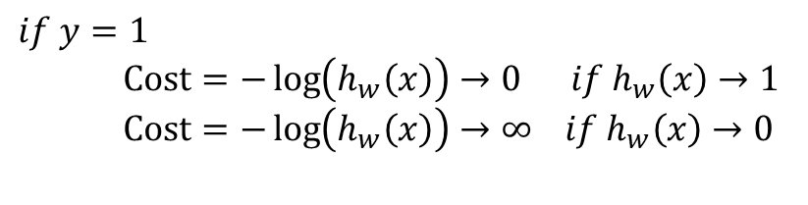
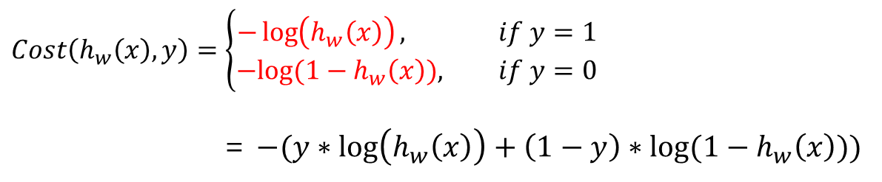
補足：交差エントロピー誤差の理解
$$0<h_{w}\left(x\right)=\frac{1}{1+e^{−W^{T}X}}<1$$
$$Cost\left(h_{w}\left(x\right), y\right)=\left\{\begin{aligned}−\log\left(h_{w}\left(x\right)\right), if y=1 \\ &−log⁡(1−h_{w}\left(x\right)), if y=0\end{aligned}\right.$$
= $−(y∗\log\left(h_{w}\left(x\right)\right)+\left(1−y\right)∗log⁡(1−h_{w}\left(x\right)))$
$$if y=1$$
$Cost=−\log\left(h_{w}\left(x\right)\right)→0 if h_{w}\left(x\right)→1$
$Cost=−\log\left(h_{w}\left(x\right)\right)→∞ if h_{w}\left(x\right)$ $→0$
$$if y=0$$
$Cost=−\log\left(1−h_{w}\left(x\right)\right)→0 if h_{w}\left(x\right)→0$
$Cost=−\log\left({1−h}_{w}\left(x\right)\right)→∞ if h_{w}\left(x\right)$ $→1$
If y = 0
If y = 1
0
1
0
1

Slide 11
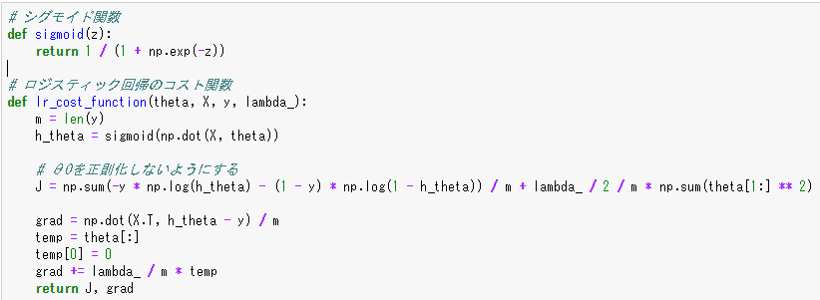
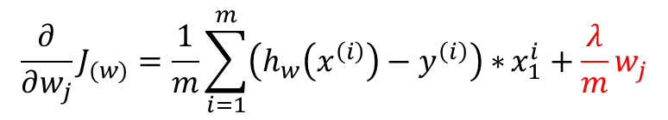
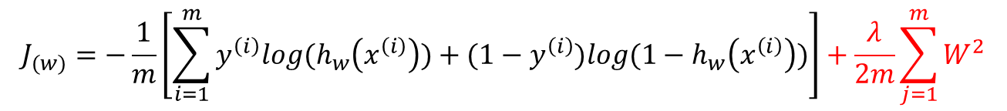
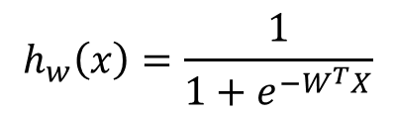
補足：サンプルソース
$$h_{w}\left(x\right)=\frac{1}{1+e^{−W^{T}X}}$$
Hypothesis:
$$J_{(w)}=−\frac{1}{m}\left[\sum_{i=1}^{m}{y^{\left(i\right)}log{(h}_{w}\left(x^{\left(i\right)}\right))+{(1−y}^{\left(i\right)})log{(1−h}_{w}\left(x^{\left(i\right)}\right))}\right]+\frac{λ}{2m}\sum_{j=1}^{m}{W^{2}}$$
Objective function:
L2正則化
$$\frac{∂}{∂w_{j}}J_{(w)}=\frac{1}{m}\sum_{i=1}^{m}{\left(h_{w}\left(x^{\left(i\right)}\right)−y^{\left(i\right)}\right)∗}x_{1}^{i}+\frac{λ}{m}w_{j}$$
Gradient Descent:
L2正則化

Slide 12
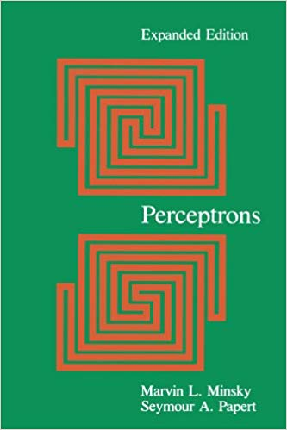
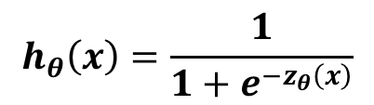
XOR問題
Minsky, M. Papert, S. (1969). Perceptron: an introduction to computational geometry.
$$h_{θ}\left(x\right)=\frac{1}{1+e^{−z_{θ}\left(x\right)}}$$

Slide 13
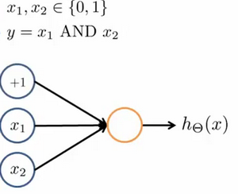

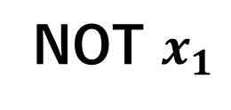

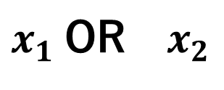




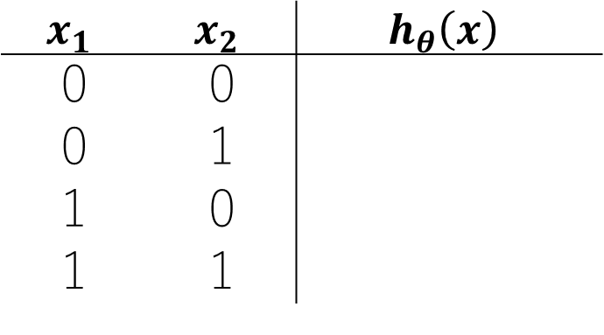

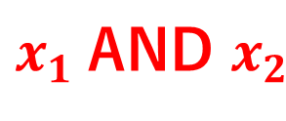


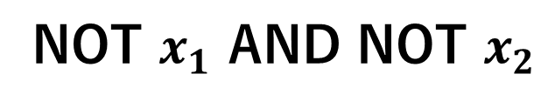
XOR問題
Minsky, M. Papert, S. (1969). Perceptron: an introduction to computational geometry.
$x_{1}$AND $x_{2}$
$$x_{1},x_{2}∈\{0,1\}$$
-30
$$x_{1}$$ | $$x_{2}$$ | $$h_{θ}\left(x\right)$$
0 | 0
0 | 1
1 | 0
1 | 1
$$W^{T}X=−30,h= \frac{1}{1+e^{30}}≈0$$
20
0
0
$$W^{T}X=−10,h=\frac{1}{1+e^{10}}≈0$$
20
0
$$W^{T}X=−10,h= \frac{1}{1+e^{10}}≈0$$
$$W^{T}X= 10,h= \frac{1}{1+e^{−10}}≈1$$
$$h_{w}\left(x\right)=\frac{1}{1+e^{−W^{T}X}}=\frac{1}{1+e^{−(−30+20x_{1}+20x_{2})}}$$
1
$x_{1}$OR ${ x}_{2}$
$$h_{w}\left(x\right)=\frac{1}{1+e^{−W^{T}X}}=\frac{1}{1+e^{−(−10+20x_{1}+20x_{2})}}$$
NOT $x_{1}$
$$h_{w}\left(x\right)=\frac{1}{1+e^{−W^{T}X}}=\frac{1}{1+e^{−(10−20x_{1})}}$$
NOT $x_{1}$ AND NOT $x_{2}$
$$h_{w}\left(x\right)=\frac{1}{1+e^{−W^{T}X}}=\frac{1}{1+e^{−(10−20x_{1}−20x_{2})}}$$
$$h_{θ}\left(x\right)=\frac{1}{1+e^{−z_{θ}\left(x\right)}}$$

Slide 14
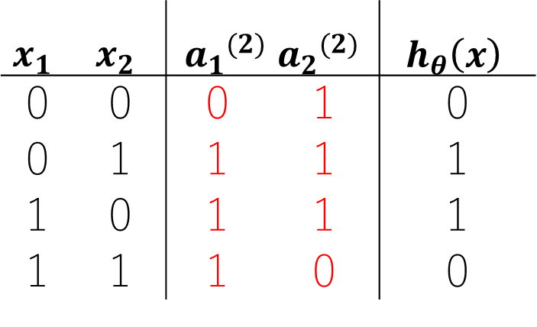


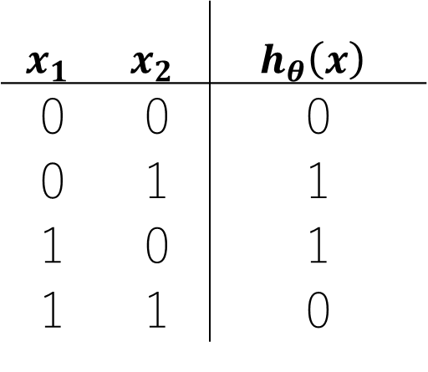

XOR問題
Minsky, M. Papert, S. (1969). Perceptron: an introduction to computational geometry.
XOR(排他的論理和)
$x_{1}$ XOR $x_{2}={(x}_{1} \text{OR} x_{2}) AND (\text{NOT} x_{1} \text{AND} \text{NOT} x_{2})$
$$x_{1}$$ | $$x_{2}$$ | $$h_{θ}\left(x\right)$$
0 | 0 | 0
0 | 1 | 1
1 | 0 | 1
1 | 1 | 0
$$x_{1}$$ | $$x_{2}$$ | $${a_{1}}^{(2)}$$ | $${a_{2}}^{(2)}$$ | $$h_{θ}\left(x\right)$$
0 | 0 | 0 | 1 | 0
0 | 1 | 1 | 1 | 1
1 | 0 | 1 | 1 | 1
1 | 1 | 1 | 0 | 0
➔
-30
-10
$x_{1} OR$ $x_{2}$
a₁
$x_{1} AND$ $x_{2}$
20
20
10
20
20
-20
a₂
-20
NOT $x_{1}$ AND NOT $x_{2}$

Slide 15


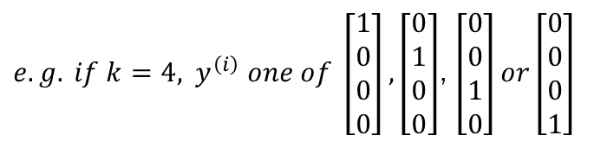


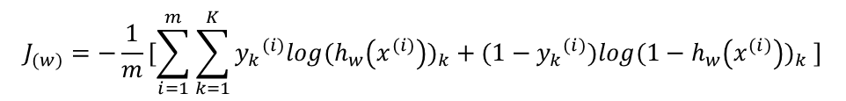


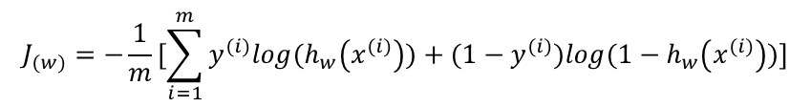




隠れ層、出力層、損失関数
$${a_{i}}^{(j)}$$
$${w_{mn}}^{(j)}$$
$$w^{(1)}∈ℝ^{5×4}$$
$$w^{(2)}∈ℝ^{5×6}$$
$$w^{(3)}∈ℝ^{1×6}$$
入力層
隠れ層
出力層
入力層
隠れ層
出力層
$a^{(1)}=x$ $∈ℝ^{4×1}$
$$a^{(2)}{,a}^{(3)}∈ℝ^{6×1}$$
$$a^{(4)}=h_{w}(x)∈ℝ^{1}$$
Binary classification
Multi-class classification (K classes)
${e.g. if k=4, y}^{\left(i\right)} one of \left[\begin{aligned}1 \\ 0 \\ 0 \\ 0\end{aligned}\right],\left[\begin{aligned}0 \\ 1 \\ 0 \\ 0\end{aligned}\right]$, $\left[\begin{aligned}0 \\ 0 \\ 1 \\ 0\end{aligned}\right]or\left[\begin{aligned}0 \\ 0 \\ 0 \\ 1\end{aligned}\right]$
1 output unit
$$y∈(0,1)$$
K output units
$$y∈ℝ^{K}$$
$$J_{(w)}=−\frac{1}{m}[\sum_{i=1}^{m}{y^{(i)}log{(h}_{w}\left(x^{(i)}\right))+{(1−y}^{(i)})log{(1−h}_{w}\left(x^{(i)}\right))}]$$
$$J_{(w)}=−\frac{1}{m}[\sum_{i=1}^{m}{\sum_{k=1}^{K}{{y_{k}}^{(i)}{log{(h}_{w}\left(x^{(i)}\right))}_{k}+(1−{y_{k}}^{(i)}){log{(1−h}_{w}\left(x^{(i)}\right))}_{k} }}]$$

Slide 16

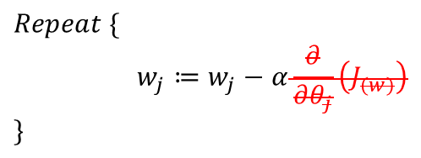
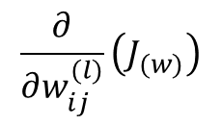
隠れ層、出力層、損失関数
Gradient descent:
$$Repeat \{$$
$$w_{j}≔w_{j}−α\frac{∂}{∂θ_{j}}\left(J_{(w)}\right)$$
$$\}$$
Need code to compute:
$$J_{(w)}$$
入力層
隠れ層
出力層
$$\frac{∂}{∂w_{ij}^{(l)}}\left(J_{(w)}\right)$$
Multi-class classification (K classes)
${e.g. if k=4, y}^{\left(i\right)} one of \left[\begin{aligned}1 \\ 0 \\ 0 \\ 0\end{aligned}\right],\left[\begin{aligned}0 \\ 1 \\ 0 \\ 0\end{aligned}\right]$, $\left[\begin{aligned}0 \\ 0 \\ 1 \\ 0\end{aligned}\right]or\left[\begin{aligned}0 \\ 0 \\ 0 \\ 1\end{aligned}\right]$
K output units
$$y∈ℝ^{K}$$
$$J_{(w)}=−\frac{1}{m}[\sum_{i=1}^{m}{\sum_{k=1}^{K}{{y_{k}}^{(i)}{log{(h}_{w}\left(x^{(i)}\right))}_{k}+(1−{y_{k}}^{(i)}){log{(1−h}_{w}\left(x^{(i)}\right))}_{k} }}]$$

Slide 17



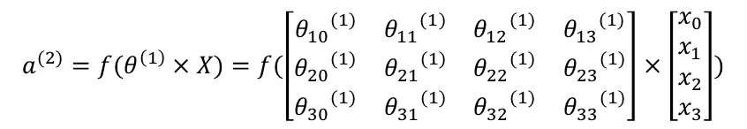






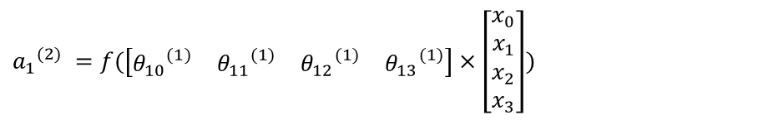
$$Forward Propagation$$
$${a_{1}}^{(2)} =f(\left[\begin{matrix}{θ_{10}}^{(1)} & {θ_{11}}^{(1)} & {θ_{12}}^{(1)} & {θ_{13}}^{(1)}\end{matrix}\right]×\left[\begin{aligned}x_{0} \\ x_{1} \\ x_{2} \\ x_{3}\end{aligned}\right])$$
$${a_{1}}^{(2)}$$
$$a^{(2)}=f(θ^{\left(1\right)}×X)=f(\left[\begin{matrix}{θ_{10}}^{(1)} & {θ_{11}}^{(1)} & {θ_{12}}^{(1)} & {θ_{13}}^{(1)} \\ {θ_{20}}^{(1)} & {θ_{21}}^{(1)} & {θ_{22}}^{(1)} & {θ_{23}}^{(1)} \\ {θ_{30}}^{(1)} & {θ_{31}}^{(1)} & {θ_{32}}^{(1)} & {θ_{33}}^{(1)}\end{matrix}\right]×\left[\begin{aligned}x_{0} \\ x_{1} \\ x_{2} \\ x_{3}\end{aligned}\right])$$
$$w^{(1)}$$
$$w^{(2)}$$
$$w^{(3)}$$
入力層
隠れ層
出力層
$$a^{(1)}=x$$
➔
$$a^{(2)}=f(w^{\left(1\right)}a^{(1)})$$
➔
$$a^{(3)}=f(w^{\left(2\right)}a^{(2)})$$
➔
$$a^{(4)}=σ(θ^{\left(3\right)}a^{(3)})$$
f$,σ:$ activation function

Slide 18








$$Back Propagation$$
$${a_{1}}^{(2)}$$
$$δ^{(3)}$$
$$δ^{(4)}$$
$$δ_{j}^{(l)}=error of node j in layer l$$
$$δ^{(1)}$$
$$w^{(1)}$$
$$δ^{(2)}$$
$$w^{(2)}$$
$$w^{(3)}$$
入力層
隠れ層
出力層
$$a^{(1)}=x$$
➔
$$a^{(2)}=f(w^{\left(1\right)}a^{(1)})$$
➔
$$a^{(3)}=f(w^{\left(2\right)}a^{(2)})$$
➔
$$a^{(4)}=σ(θ^{\left(3\right)}a^{(3)})$$
➔
f$,σ:$ activation function
$$δ^{(2)}={(w^{(2)})}^{T}δ^{(3)}∗g^{′}(w^{\left(1\right)}a^{(1)})$$
➔
$$δ^{(3)}={(w^{(3)})}^{T}δ^{(4)}∗g^{′}(w^{\left(2\right)}a^{(2)})$$
➔
$$δ^{(4)}=a^{(4)}−y$$

Slide 19

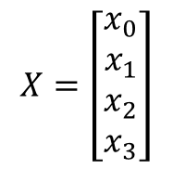
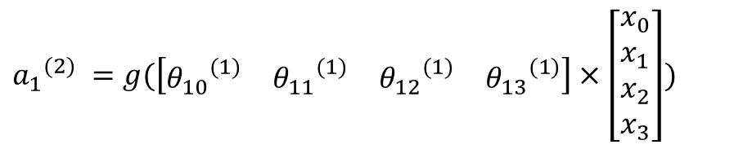

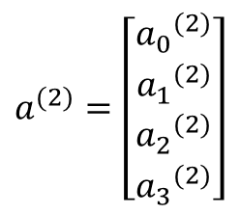



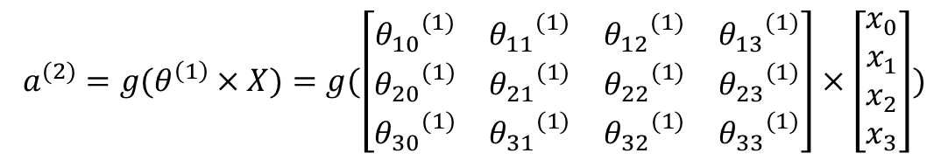

$$Forward Propagation$$
$$x_{0}=1$$
$${a_{0}}^{(2)}=1$$
$${a_{1}}^{(2)} =g(\left[\begin{matrix}{θ_{10}}^{(1)} & {θ_{11}}^{(1)} & {θ_{12}}^{(1)} & {θ_{13}}^{(1)}\end{matrix}\right]×\left[\begin{aligned}x_{0} \\ x_{1} \\ x_{2} \\ x_{3}\end{aligned}\right])$$
$${a_{1}}^{(2)}$$
?
$$θ^{(1)}$$
入力層
隠れ層
$a^{(2)}=$ $\left[\begin{aligned}{a_{0}}^{(2)} \\ {a_{1}}^{(2)} \\ {a_{2}}^{(2)} \\ {a_{3}}^{(2)}\end{aligned}\right]$
$$a^{(2)}=g(θ^{\left(1\right)}×X)=g(\left[\begin{matrix}{θ_{10}}^{(1)} & {θ_{11}}^{(1)} & {θ_{12}}^{(1)} & {θ_{13}}^{(1)} \\ {θ_{20}}^{(1)} & {θ_{21}}^{(1)} & {θ_{22}}^{(1)} & {θ_{23}}^{(1)} \\ {θ_{30}}^{(1)} & {θ_{31}}^{(1)} & {θ_{32}}^{(1)} & {θ_{33}}^{(1)}\end{matrix}\right]×\left[\begin{aligned}x_{0} \\ x_{1} \\ x_{2} \\ x_{3}\end{aligned}\right])$$
$$X=\left[\begin{aligned}x_{0} \\ x_{1} \\ x_{2} \\ x_{3}\end{aligned}\right]$$
$g:$ activation function

Slide 20






$$Forward Propagation$$
$$x_{0}=1$$
$${a_{0}}^{(2)}=1$$
$$a^{(3)}$$
$$θ^{(1)}$$
$$θ^{(2)}$$
入力層
隠れ層
出力層
$$X=\left[\begin{aligned}x_{0} \\ x_{1} \\ x_{2} \\ x_{3}\end{aligned}\right]$$
➔
$$a^{(2)}=g(θ^{\left(1\right)}X)$$
➔
$${a^{(3)}=h}_{θ}(x)=σ(θ^{\left(2\right)}a^{(2)}))$$
$g,σ:$ activation function

Slide 21
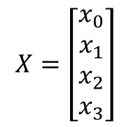

$$Back Propagation$$
$$x_{0}=1$$
$${a_{0}}^{(2)}=1$$
$$a^{(3)}$$
$$θ^{(1)}$$
$$θ^{(2)}$$
入力層
隠れ層
出力層
$$X=\left[\begin{aligned}x_{0} \\ x_{1} \\ x_{2} \\ x_{3}\end{aligned}\right]$$
➔
$$a^{(2)}=g(θ^{\left(1\right)}X)$$
➔
$${a^{(3)}=h}_{θ}(x)=σ(θ^{\left(2\right)}a^{(2)}))$$
$$δ_{j}^{(l)}$$

Slide 22






補足：活性化関数（activation function）
ステップ関数
シグモイド関数
ReLU関数
出力層
隠れ層

Slide 23



損失関数（Cost function）
Logistic regression:
$$J_{(w)}=−\frac{1}{m}[\sum_{i=1}^{m}{y^{(i)}log{(h}_{w}\left(x^{(i)}\right))+{(1−y}^{(i)})log{(1−h}_{w}\left(x^{(i)}\right))}]$$
Neural network:

Slide 24




過学習（over-fit）へ対策：Regularization（正規化）
線形回帰
$$J(θ)=\frac{1}{2m}\sum_{i=1}^{m}{{(h_{θ}\left(x^{\left(i\right)}\right)−y^{(i)})}^{2}}$$
Lasso回帰
$$J(θ)=\frac{1}{2m}\sum_{i=1}^{m}{{(h_{θ}\left(x^{\left(i\right)}\right)−y^{(i)})}^{2}+\frac{λ}{2m}\sum_{j=1}^{m}{{|θ}_{j}|}}$$
Ridge回帰
$$J(θ)=\frac{1}{2m}\sum_{i=1}^{m}{{(h_{θ}\left(x^{\left(i\right)}\right)−y^{(i)})}^{2}+\frac{λ}{2m}\sum_{j=1}^{m}{θ_{j}^{2}}}$$

Slide 25





パーセプトロン（Perceptron）
(Yes) 1
悪性?
(No) 0
腫瘍サイズ
$$threshold$$
$$threshold$$
$$g_{w}(x)=\sum_{j=0}^{m}{w_{j}x_{j}}$$
線形回帰 linear regression
$y=\left\{\begin{aligned}0, if{ g}_{w}(x)≤threshold \\ &1, if{ g}_{w}\left(x\right)>threshold\end{aligned}\right.$

