Slide 1
Machine Learning #NN

Slide 2
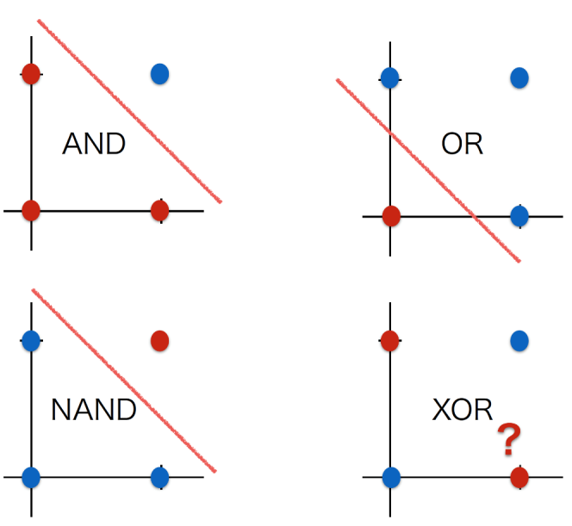
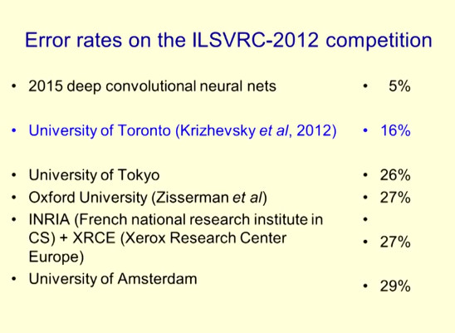
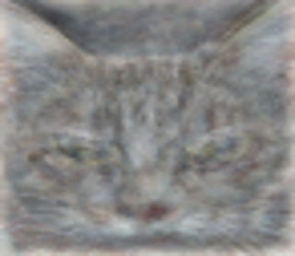
おさらい：boom#3 : 2010年〜現在
1958年 Rosenblatt, Frank “The Perceptron: A Probabilistic Model for Information Storage and Organization in the Brain”.
1969年 XOR問題。パーセプトロンはXORできないことを証明。➡1980年代隠れ層を入れれば理論上は問題解決できた。
1986年 バックプロパゲーション：Rumelhart, etc. “Learning representations by back-propagating errors”. Nature 323
2006年 ディープネットワーク：Geoffrey Hinton “Reducing the Dimensionality of Data with Neural Networks”
※ Geoffrey Hinton ：2013年Google Brainへ。2018年Turing Award http://www.cs.toronto.edu/~hinton/
2012年 ILSVRC(大規模画像認識の競技会)で圧倒的に勝利 by Geoffrey Hinton。誤り率25.7%から16%へ。現在：4.9%
2012年 YouTubeの動画を学習し猫認識 by Google（※論文がここ
2016年 AlphaGo （※論文がここ from Nature
論理演算とは、
AND、OR、NAND、XORの4つが基本
ILSVRCで圧倒的に勝利
http://www.image-net.org/challenges/LSVRC/2012/
https://googleblog.blogspot.com/2012/06/using-large-scale-brain-simulations-for.html
・200×200px画像：1000万枚
・ニューラルネットワーク：９つの階層
・1000台×3日間
・コンピュータが「もっとも猫らしい猫」と判断する画像が ➡

Slide 3
Agenda：NN
パーセプトロン（Perceptron）
単一ニューラルネットワーク
勾配降下法
XOR問題
ニューラルネットワーク機械学習（neural network ）
隠れ層
バックプロパゲーション（ back-propagating ）
サンプルソース
Dogs vs. Cats
https://www.kaggle.com/c/dogs-vs-cats

Slide 4
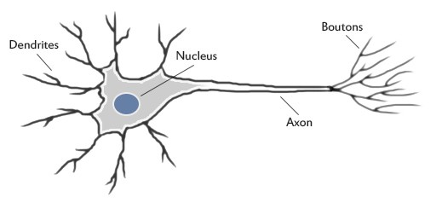
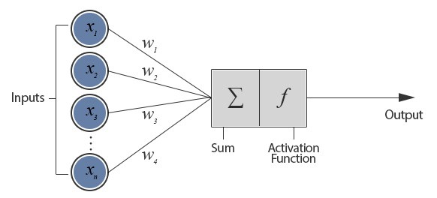
パーセプトロン（Perceptron）
1958年 Rosenblatt, Frank “The Perceptron: A Probabilistic Model for Information Storage and Organization in the Brain”.
人間の脳の中の神経（ニューロン）

Slide 5
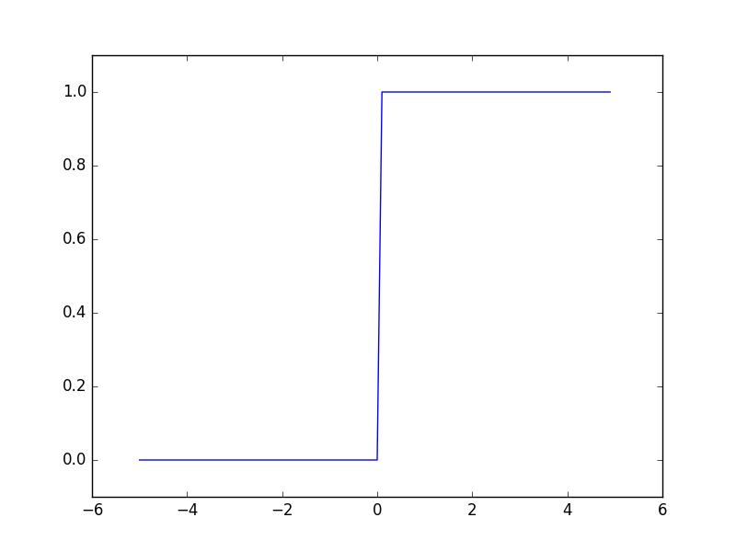
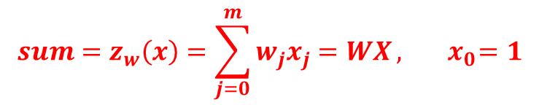



パーセプトロン（Perceptron）
1958年 Rosenblatt, Frank “The Perceptron: A Probabilistic Model for Information Storage and Organization in the Brain”.
$${sum=z}_{w}\left(x\right)=\sum_{j=0}^{m}{w_{j}x_{j}=WX}, { x}_{0}=1$$
線形回帰 linear regression
$${output= h}_{w}\left(x\right)=g\left(sum\right)=g({ z}_{w}(x))$$
$h:\text{h}\text{ypothesis}, g:$ activation function
ステップ関数（stepfunction）
$$output=1 if{ z}_{w}\left(x\right)≥0$$
$$output=0 if{ z}_{w}\left(x\right)<0$$

Slide 6
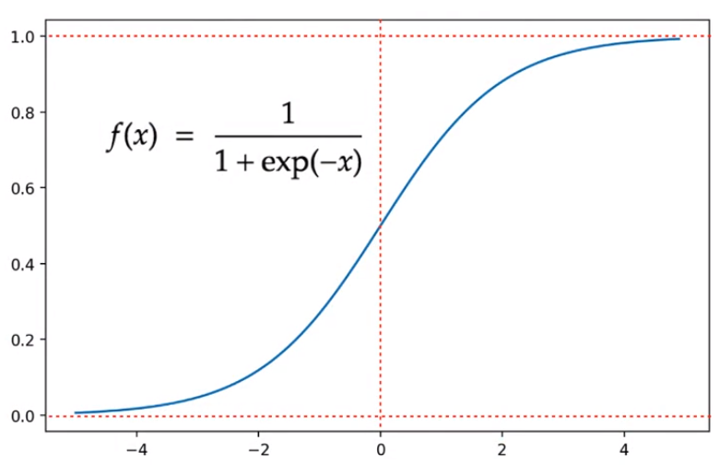


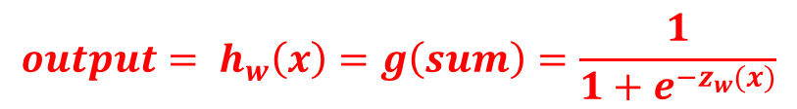

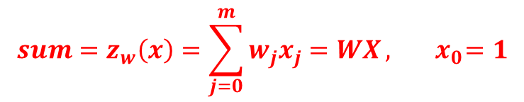
単一層ニューラルネットワーク（neural network）
= ロジスティック回帰
Logistic regression
$${sum=z}_{w}\left(x\right)=\sum_{j=0}^{m}{w_{j}x_{j}=WX}, { x}_{0}=1$$
線形回帰 linear regression
$${output= h}_{w}\left(x\right)=g\left(sum\right)=\frac{1}{1+e^{−z_{w}(x)}}$$
$${output= h}_{w}\left(x\right)=g\left(sum\right)$$
$h:\text{h}\text{ypothesis}, g:$ activation function
シグモイド関数（sigmoid function）
$$0<h\left(sum\right)<1$$
$$h\left(sum\right)=P(y=1|x,w)$$

Slide 7
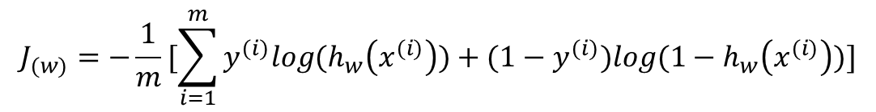

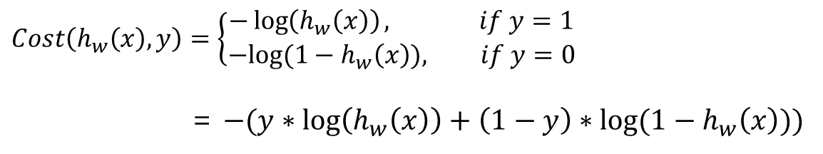

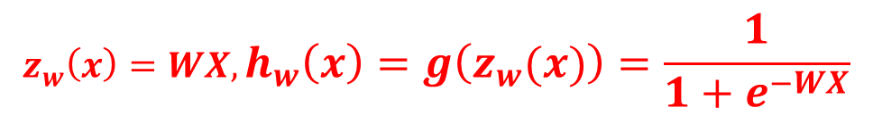
単一層ニューラルネットワーク（neural network）
Training set:
$${z_{w}\left(x\right)=WX, h}_{w}\left(x\right)=g\left(z_{w}(x)\right)=\frac{1}{1+e^{−WX}}$$
Hypothesis:
Parameters:
$$\left[\begin{matrix}w_{0} & w_{1} & w_{2} & … & w_{m}\end{matrix}\right]$$
Cost function:
$$Cost\left(h_{w}\left(x\right), y\right)=\left\{\begin{aligned}−\log\left(h_{w}\left(x\right)\right), if y=1 \\ &−log⁡(1−h_{w}\left(x\right)), if y=0\end{aligned}\right.$$
= $−(y∗\log\left(h_{w}\left(x\right)\right)+\left(1−y\right)∗log⁡(1−h_{w}\left(x\right)))$
交差エントロピー誤差
$$J_{(w)}=−\frac{1}{m}[\sum_{i=1}^{m}{y^{(i)}log{(h}_{w}\left(x^{(i)}\right))+{(1−y}^{(i)})log{(1−h}_{w}\left(x^{(i)}\right))}]$$
Objective function:
Goal:
${minimize J}_{(w)}$

Slide 8
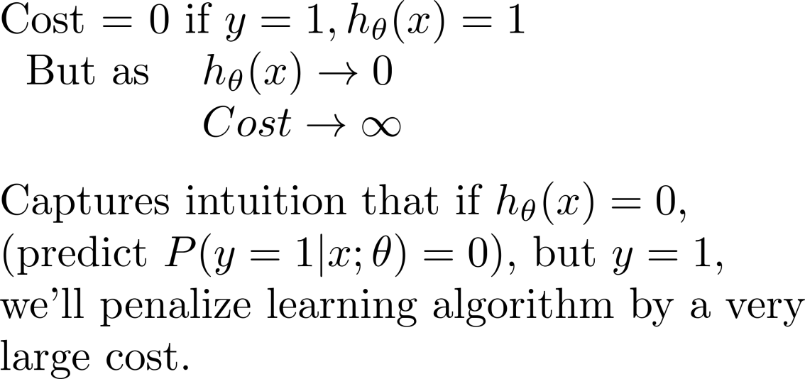
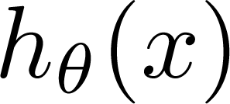
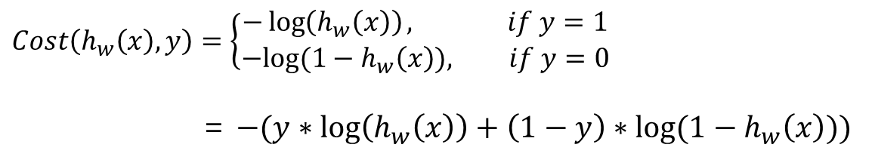
補足：交差エントロピー誤差の理解
$$Cost\left(h_{w}\left(x\right), y\right)=\left\{\begin{aligned}−\log\left(h_{w}\left(x\right)\right), if y=1 \\ &−log⁡(1−h_{w}\left(x\right)), if y=0\end{aligned}\right.$$
= $−(y∗\log\left(h_{w}\left(x\right)\right)+\left(1−y\right)∗log⁡(1−h_{w}\left(x\right)))$
If y = 1
0
1
If y = 0
0
1

Slide 9
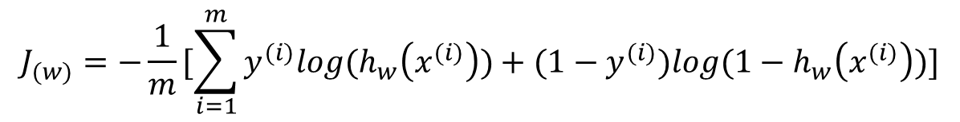
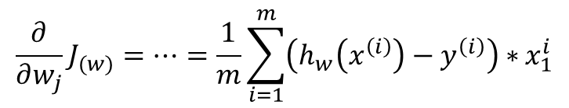
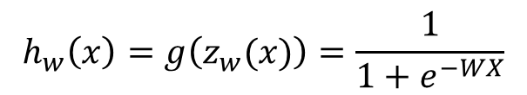
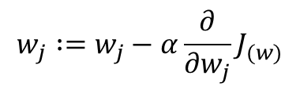
単一層ニューラルネットワーク+ 勾配降下法（Gradient descent）
Hypothesis:
$$h_{w}\left(x\right)=g\left(z_{w}(x)\right)=\frac{1}{1+e^{−WX}}$$
Objective function:
$$J_{(w)}=−\frac{1}{m}[\sum_{i=1}^{m}{y^{(i)}log{(h}_{w}\left(x^{(i)}\right))+{(1−y}^{(i)})log{(1−h}_{w}\left(x^{(i)}\right))}]$$
Gradient Descent:
Repeat
$$w_{j} :=w_{j}−α\frac{∂}{∂w_{j}}J_{(w)}$$
$$\frac{∂}{∂w_{j}}J_{(w)}=…=\frac{1}{m}\sum_{i=1}^{m}{\left(h_{w}\left(x^{\left(i\right)}\right)−y^{\left(i\right)}\right)∗}x_{1}^{i}$$

Slide 10
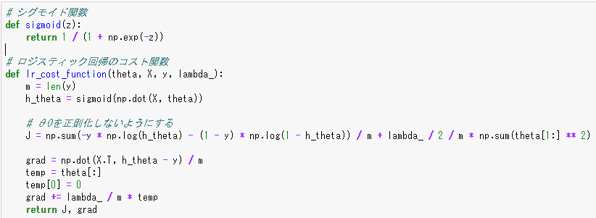
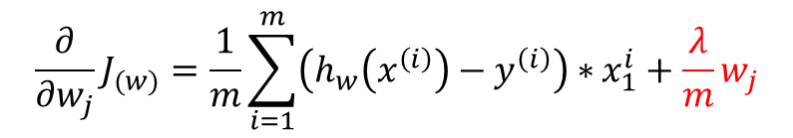
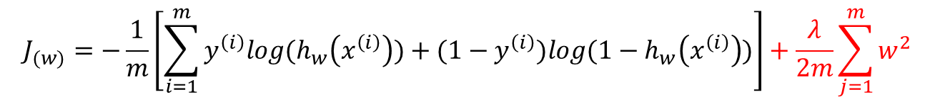
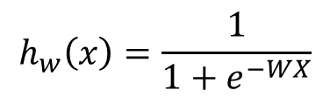
補足：サンプルソース
$$h_{w}\left(x\right)=\frac{1}{1+e^{−WX}}$$
Hypothesis:
$$J_{(w)}=−\frac{1}{m}\left[\sum_{i=1}^{m}{y^{\left(i\right)}log{(h}_{w}\left(x^{\left(i\right)}\right))+{(1−y}^{\left(i\right)})log{(1−h}_{w}\left(x^{\left(i\right)}\right))}\right]+\frac{λ}{2m}\sum_{j=1}^{m}{w^{2}}$$
Objective function:
L2正則化
$$\frac{∂}{∂w_{j}}J_{(w)}=\frac{1}{m}\sum_{i=1}^{m}{\left(h_{w}\left(x^{\left(i\right)}\right)−y^{\left(i\right)}\right)∗}x_{1}^{i}+\frac{λ}{m}w_{j}$$
Gradient Descent:
L2正則化

Slide 11
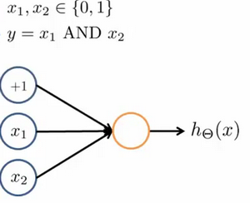





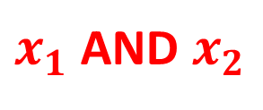

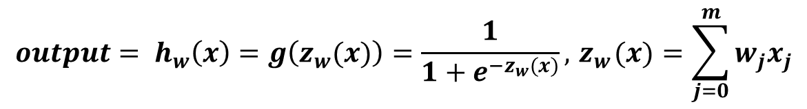



XOR問題
Minsky, M. Papert, S. (1969). Perceptron: an introduction to computational geometry. The MIT Press, Cambridge, expanded edition
$${output= h}_{w}\left(x\right)=g\left(z_{w}(x)\right)=\frac{1}{1+e^{−z_{w}(x)}},{ z}_{w}(x)=\sum_{j=0}^{m}{w_{j}x_{j}}$$
$x_{1}$AND $x_{2}$
-30
$$z_{w}\left(x\right)=−30+20x_{1}+20x_{2}$$
20
0 | 0
0 | 1
1 | 0
1 | 1
0
$$z_{w}\left(x\right)=−30, output= \frac{1}{1+e^{30}}≈0$$
20
$$z_{w}\left(x\right)=−10, output= \frac{1}{1+e^{10}}≈0$$
0
0
$$z_{w}\left(x\right)=−10, output= \frac{1}{1+e^{10}}≈0$$
$$x_{1},x_{2}∈\{0,1\}$$
$$z_{w}\left(x\right)= 10, output= \frac{1}{1+e^{−10}}≈1$$
1

Slide 12
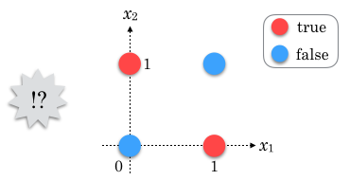
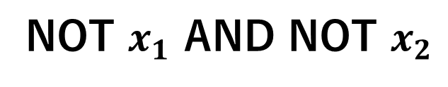


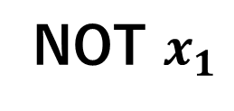
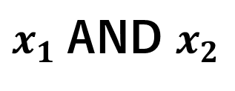


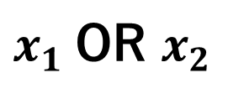
XOR問題
Minsky, M. Papert, S. (1969). Perceptron: an introduction to computational geometry. The MIT Press, Cambridge, expanded edition
$${output= h}_{w}\left(x\right)=g\left(z_{w}(x)\right)=\frac{1}{1+e^{−z_{w}(x)}},{ z}_{w}(x)=\sum_{j=0}^{m}{w_{j}x_{j}}$$
$x_{1}$AND $x_{2}$
$$z_{w}\left(x\right)=−30+20x_{1}+20x_{2}$$
-30
$x_{1}$OR $x_{2}$
$$z_{w}\left(x\right)=−10+20x_{1}+20x_{2}$$
20
NOT $x_{1}$
$$z_{w}\left(x\right)= 10−20x_{1}$$
20
NOT $x_{1}$ AND NOT $x_{2}$
$$z_{w}\left(x\right)=10−20x_{1}−20x_{2}$$
$$x_{1},x_{2}∈\{0,1\}$$
XOR(排他的論理和)
0 | 0 | 0
0 | 1 | 1
1 | 0 | 1
1 | 1 | 0

Slide 13





XOR問題
Minsky, M. Papert, S. (1969). Perceptron: an introduction to computational geometry. The MIT Press, Cambridge, expanded edition
$${output= h}_{w}\left(x\right)=g\left(z_{w}(x)\right)=\frac{1}{1+e^{−z_{w}(x)}},{ z}_{w}(x)=\sum_{j=0}^{m}{w_{j}x_{j}}$$
XOR(排他的論理和)
$x_{1}$ XOR $x_{2}={(x}_{1} \text{OR} x_{2}) AND (\text{NOT} x_{1} \text{AND} \text{NOT} x_{2})$
0 | 0 | 0 | 1 | 0
0 | 1 | 1 | 1 | 1
1 | 0 | 1 | 1 | 1
1 | 1 | 1 | 0 | 0

Slide 14

XOR問題
Minsky, M. Papert, S. (1969). Perceptron: an introduction to computational geometry. The MIT Press, Cambridge, expanded edition
$${output= h}_{w}\left(x\right)=g\left(z_{w}(x)\right)=\frac{1}{1+e^{−z_{w}(x)}},{ z}_{w}(x)=\sum_{j=0}^{m}{w_{j}x_{j}}$$
XOR(排他的論理和)
$x_{1}$ XOR $x_{2}={(x}_{1} \text{OR} x_{2}) AND (\text{NOT} x_{1} \text{AND} \text{NOT} x_{2})$
-10
$x_{1} OR$ $x_{2}$
a₁
20
20

Slide 15


XOR問題
Minsky, M. Papert, S. (1969). Perceptron: an introduction to computational geometry. The MIT Press, Cambridge, expanded edition
$${output= h}_{w}\left(x\right)=g\left(z_{w}(x)\right)=\frac{1}{1+e^{−z_{w}(x)}},{ z}_{w}(x)=\sum_{j=0}^{m}{w_{j}x_{j}}$$
XOR(排他的論理和)
$x_{1}$ XOR $x_{2}={(x}_{1} \text{OR} x_{2}) AND (\text{NOT} x_{1} \text{AND} \text{NOT} x_{2})$
-10
$x_{1} OR$ $x_{2}$
a₁
20
10
20
-20
a₂
-20
NOT $x_{1}$ AND NOT $x_{2}$

Slide 16


XOR問題
Minsky, M. Papert, S. (1969). Perceptron: an introduction to computational geometry. The MIT Press, Cambridge, expanded edition
$${output= h}_{w}\left(x\right)=g\left(z_{w}(x)\right)=\frac{1}{1+e^{−z_{w}(x)}},{ z}_{w}(x)=\sum_{j=0}^{m}{w_{j}x_{j}}$$
XOR(排他的論理和)
$x_{1}$ XOR $x_{2}={(x}_{1} \text{OR} x_{2}) AND (\text{NOT} x_{1} \text{AND} \text{NOT} x_{2})$
+1
-30
-10
$x_{1} OR$ $x_{2}$
0 | 0 | 0 | 1 | 0
0 | 1 | 1 | 1 | 1
1 | 0 | 1 | 1 | 1
1 | 1 | 1 | 0 | 0
a₁
$x_{1} AND$ $x_{2}$
20
20
10
20
20
-20
a₂
-20
NOT $x_{1}$ AND NOT $x_{2}$

Slide 17






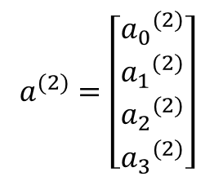
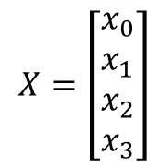
中間層、隠れ層
$$x_{0}=1$$
$${a_{0}}^{(2)}=1$$
入力層
隠れ層
出力層
$$X=\left[\begin{aligned}x_{0} \\ x_{1} \\ x_{2} \\ x_{3}\end{aligned}\right]$$
$$x_{0}=1$$
$$a^{(2)}=\left[\begin{aligned}{a_{0}}^{(2)} \\ {a_{1}}^{(2)} \\ {a_{2}}^{(2)} \\ {a_{3}}^{(2)}\end{aligned}\right]$$
$${a_{0}}^{(2)}=1$$
$$a^{(3)}=h_{θ}(x)$$

Slide 18
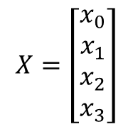
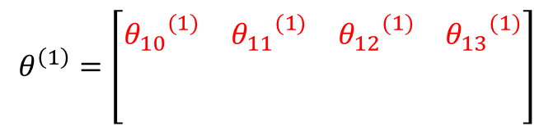
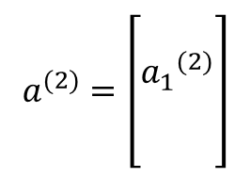


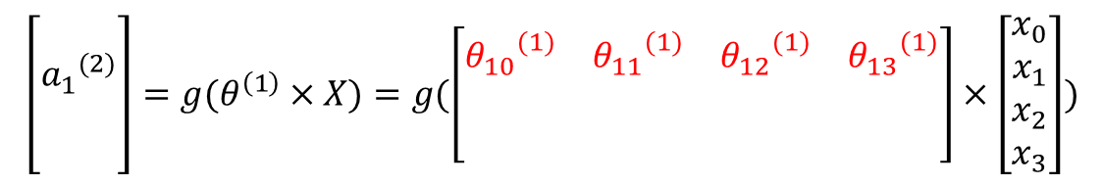
中間層、隠れ層
$$x_{0}=1$$
$${a_{0}}^{(2)}=1$$
$$θ^{\left(1\right)}=\left[\begin{matrix}{θ_{10}}^{(1)} & {θ_{11}}^{(1)} & {θ_{12}}^{(1)} & {θ_{13}}^{(1)} \\ & & & \\ & & & \end{matrix}\right]$$
$$\left[\begin{aligned} \\ {a_{1}}^{(2)} \\ \\ \end{aligned}\right]=g(θ^{\left(1\right)}×X)=g(\left[\begin{matrix}{θ_{10}}^{(1)} & {θ_{11}}^{(1)} & {θ_{12}}^{(1)} & {θ_{13}}^{(1)} \\ & & & \\ & & & \end{matrix}\right]×\left[\begin{aligned}x_{0} \\ x_{1} \\ x_{2} \\ x_{3}\end{aligned}\right])$$
$$θ^{(1)}$$
入力層
隠れ層
$$X=\left[\begin{aligned}x_{0} \\ x_{1} \\ x_{2} \\ x_{3}\end{aligned}\right]$$
$$a^{(2)}=\left[\begin{aligned} \\ {a_{1}}^{(2)} \\ \\ \end{aligned}\right]$$
$g:$ activation function

Slide 19
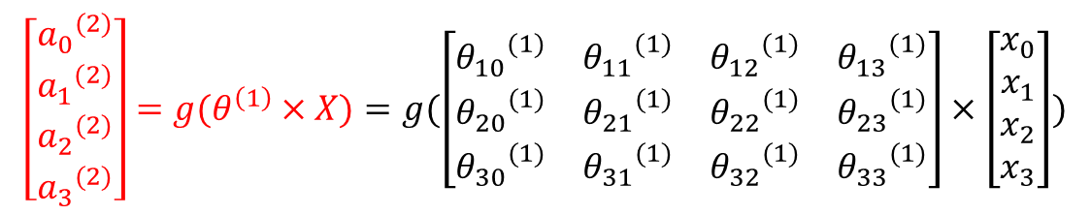
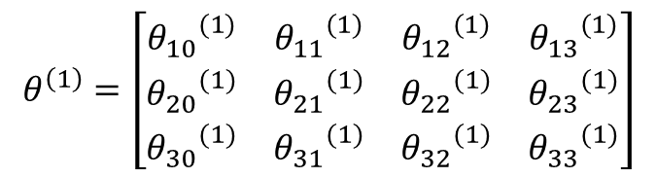

中間層、隠れ層
$${a_{0}}^{(2)}=1$$
$$x_{0}=1$$
$${a_{0}}^{(2)}=1$$
$$x_{0}=1$$
$$θ^{\left(1\right)}=\left[\begin{matrix}{θ_{10}}^{(1)} & {θ_{11}}^{(1)} & {θ_{12}}^{(1)} & {θ_{13}}^{(1)} \\ {θ_{20}}^{(1)} & {θ_{21}}^{(1)} & {θ_{22}}^{(1)} & {θ_{23}}^{(1)} \\ {θ_{30}}^{(1)} & {θ_{31}}^{(1)} & {θ_{32}}^{(1)} & {θ_{33}}^{(1)}\end{matrix}\right]$$
$$\left[\begin{aligned}{a_{0}}^{(2)} \\ {a_{1}}^{(2)} \\ {a_{2}}^{(2)} \\ {a_{3}}^{(2)}\end{aligned}\right]=g(θ^{\left(1\right)}×X)=g(\left[\begin{matrix}{θ_{10}}^{(1)} & {θ_{11}}^{(1)} & {θ_{12}}^{(1)} & {θ_{13}}^{(1)} \\ {θ_{20}}^{(1)} & {θ_{21}}^{(1)} & {θ_{22}}^{(1)} & {θ_{23}}^{(1)} \\ {θ_{30}}^{(1)} & {θ_{31}}^{(1)} & {θ_{32}}^{(1)} & {θ_{33}}^{(1)}\end{matrix}\right]×\left[\begin{aligned}x_{0} \\ x_{1} \\ x_{2} \\ x_{3}\end{aligned}\right])$$
$$θ^{(1)}$$
入力層
隠れ層
$$X=\left[\begin{aligned}x_{0} \\ x_{1} \\ x_{2} \\ x_{3}\end{aligned}\right]$$
$$a^{(2)}=\left[\begin{aligned}{a_{0}}^{(2)} \\ {a_{1}}^{(2)} \\ {a_{2}}^{(2)} \\ {a_{3}}^{(2)}\end{aligned}\right]$$
$g:$ activation function

Slide 20
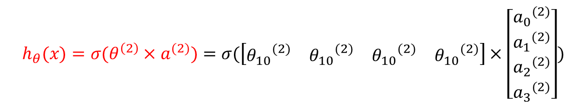



中間層、隠れ層
$$x_{0}=1$$
$${a_{0}}^{(2)}=1$$
$$θ^{(1)}$$
$$θ^{(2)}$$
入力層
隠れ層
出力層
$$X=\left[\begin{aligned}x_{0} \\ x_{1} \\ x_{2} \\ x_{3}\end{aligned}\right]$$
$$a^{(2)}=\left[\begin{aligned}{a_{0}}^{(2)} \\ {a_{1}}^{(2)} \\ {a_{2}}^{(2)} \\ {a_{3}}^{(2)}\end{aligned}\right]$$
$$h_{θ}(x)=σ(θ^{\left(2\right)}×a^{(2)})=σ(\left[\begin{matrix}{θ_{10}}^{(2)} & {θ_{10}}^{(2)} & {θ_{10}}^{(2)} & {θ_{10}}^{(2)}\end{matrix}\right]×\left[\begin{aligned}{a_{0}}^{(2)} \\ {a_{1}}^{(2)} \\ {a_{2}}^{(2)} \\ {a_{3}}^{(2)}\end{aligned}\right])$$
$σ:$ activation function

Slide 21




中間層、隠れ層
$$x_{0}=1$$
$${a_{0}}^{(2)}=1$$
$$θ^{(1)}$$
$$θ^{(2)}$$
入力層
隠れ層
出力層
$$X=\left[\begin{aligned}x_{0} \\ x_{1} \\ x_{2} \\ x_{3}\end{aligned}\right]$$
$$a^{(2)}=g(θ^{\left(1\right)}×X)$$
$$h_{θ}(x)=σ(θ^{\left(2\right)}×a^{(2)}))$$
$g,σ:$ activation function
$$Forward Propagation$$

Slide 22
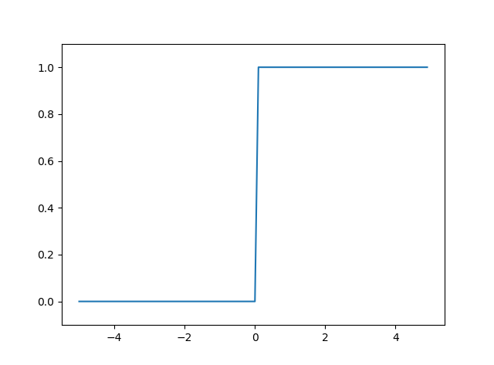
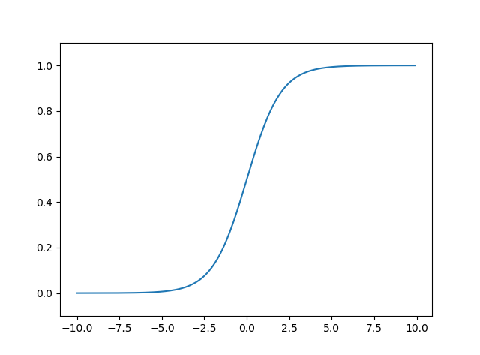
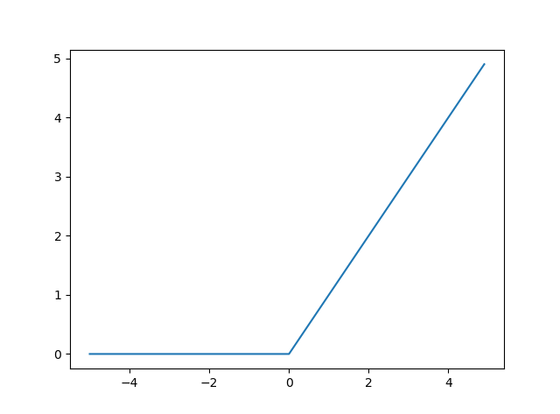



補足：活性化関数（activation function）
ステップ関数
シグモイド関数
ReLU関数
出力層
隠れ層

Slide 23








Multiple output units: One-vs-all
total no. of layers in network
no. of units (not counting bias unit) in layer
Layer 1
Layer 2
Layer 3
Layer 4
Binary classification
1 output unit
Multi-class classification (K classes)
K output units
E.g. , , ,
pedestrian car motorcycle truck

Slide 24

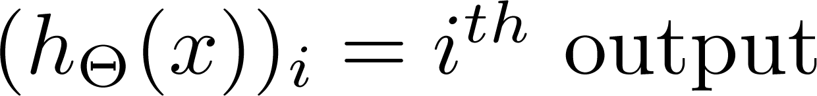
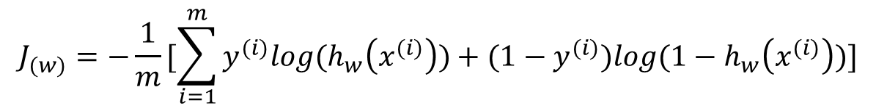
損失関数（Cost function）
Logistic regression:
$$J_{(w)}=−\frac{1}{m}[\sum_{i=1}^{m}{y^{(i)}log{(h}_{w}\left(x^{(i)}\right))+{(1−y}^{(i)})log{(1−h}_{w}\left(x^{(i)}\right))}]$$
Neural network:

Slide 25

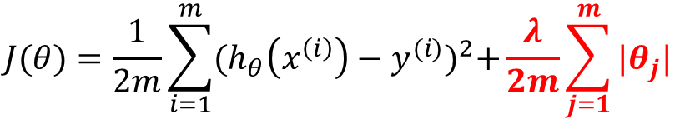
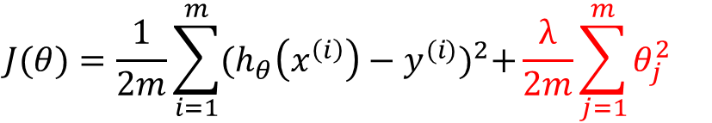
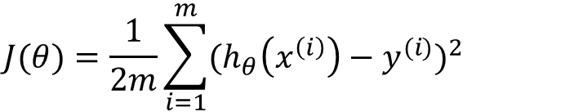
過学習（over-fit）へ対策：Regularization（正規化）
線形回帰
$$J(θ)=\frac{1}{2m}\sum_{i=1}^{m}{{(h_{θ}\left(x^{\left(i\right)}\right)−y^{(i)})}^{2}}$$
Lasso回帰
$$J(θ)=\frac{1}{2m}\sum_{i=1}^{m}{{(h_{θ}\left(x^{\left(i\right)}\right)−y^{(i)})}^{2}+\frac{λ}{2m}\sum_{j=1}^{m}{{|θ}_{j}|}}$$
Ridge回帰
$$J(θ)=\frac{1}{2m}\sum_{i=1}^{m}{{(h_{θ}\left(x^{\left(i\right)}\right)−y^{(i)})}^{2}+\frac{λ}{2m}\sum_{j=1}^{m}{θ_{j}^{2}}}$$

Slide 26
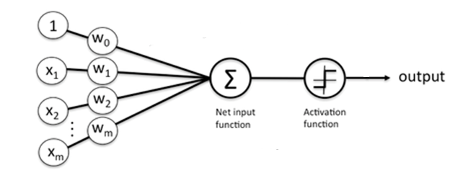




パーセプトロン（Perceptron）
(Yes) 1
悪性?
(No) 0
腫瘍サイズ
$$threshold$$
$$threshold$$
$$g_{w}(x)=\sum_{j=0}^{m}{w_{j}x_{j}}$$
線形回帰 linear regression
$y=\left\{\begin{aligned}0, if{ g}_{w}(x)≤threshold \\ &1, if{ g}_{w}\left(x\right)>threshold\end{aligned}\right.$

