Slide 1
Machine Learning #NN

Slide 2
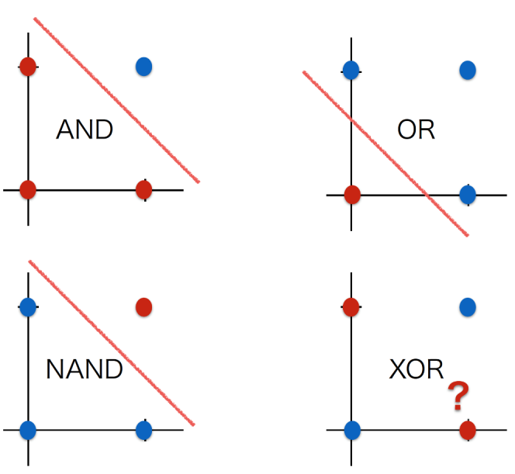
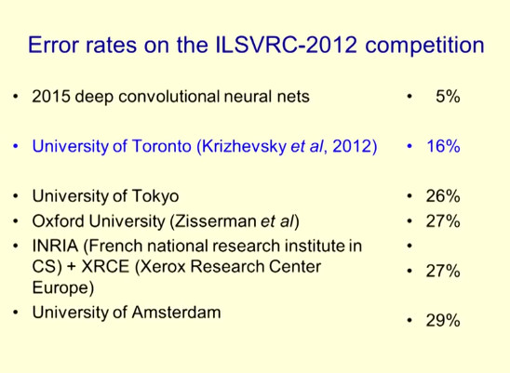
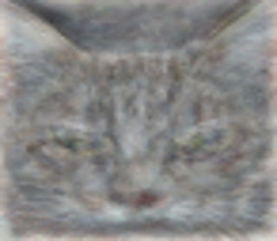
おさらい：boom#3 : 2010年〜現在
1958年 Rosenblatt, Frank “The Perceptron: A Probabilistic Model for Information Storage and Organization in the Brain”.
1969年 XOR問題。パーセプトロンはXORできないことを証明。➡1980年代隠れ層を入れれば理論上は問題解決できた。
1986年 バックプロパゲーション：Rumelhart, etc. “Learning representations by back-propagating errors”. Nature 323
2006年 ディープネットワーク：Geoffrey Hinton “Reducing the Dimensionality of Data with Neural Networks”
※ Geoffrey Hinton ：2013年Google Brainへ。2018年Turing Award http://www.cs.toronto.edu/~hinton/
2012年 ILSVRC(大規模画像認識の競技会)で圧倒的に勝利 by Geoffrey Hinton。誤り率25.7%から16%へ。現在：4.9%
2012年 YouTubeの動画を学習し猫認識 by Google（※論文がここ
2016年 AlphaGo （※論文がここ from Nature
論理演算とは、
AND、OR、NAND、XORの4つが基本
ILSVRCで圧倒的に勝利
http://www.image-net.org/challenges/LSVRC/2012/
https://googleblog.blogspot.com/2012/06/using-large-scale-brain-simulations-for.html
・200×200px画像：1000万枚
・ニューラルネットワーク：９つの階層
・1000台×3日間
・コンピュータが「もっとも猫らしい猫」と判断する画像が ➡

Slide 3
Agenda：NN
パーセプトロン（Perceptron）
XOR問題
ニューラルネットワーク機械学習（neural network ）
隠れ層
バックプロパゲーション（ back-propagating ）
サンプルソース
Dogs vs. Cats
https://www.kaggle.com/c/dogs-vs-cats

Slide 4
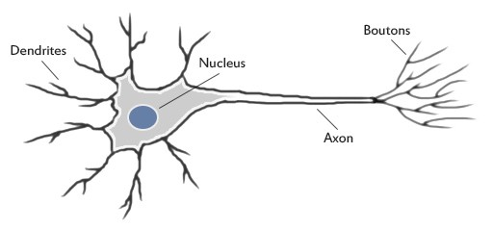
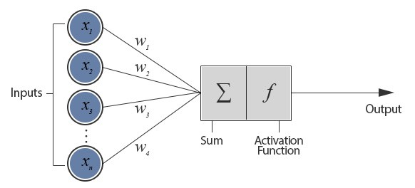
パーセプトロン（Perceptron）
1958年 Rosenblatt, Frank “The Perceptron: A Probabilistic Model for Information Storage and Organization in the Brain”.
人間の脳の中の神経（ニューロン）

Slide 5
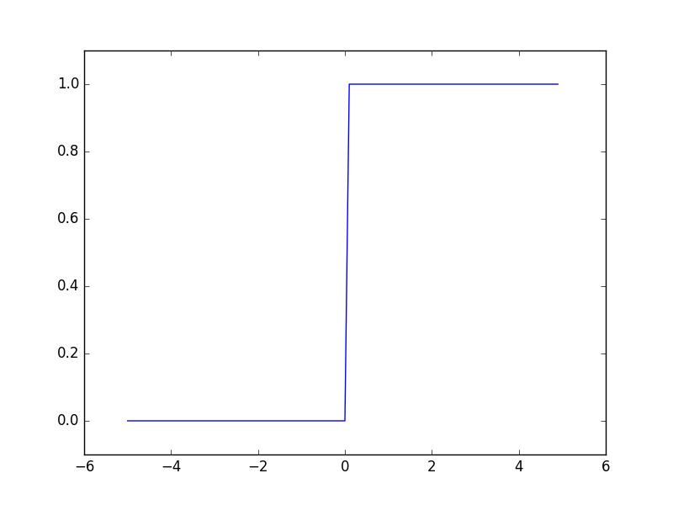



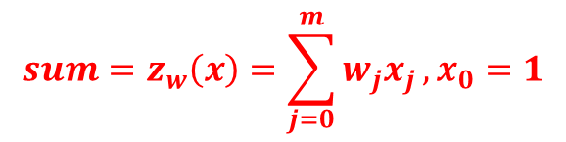

パーセプトロン（Perceptron）
$${sum=z}_{w}\left(x\right)=\sum_{j=0}^{m}{w_{j}x_{j}}, x_{0}=1$$
線形回帰 linear regression
$${output= h}_{w}\left(x\right)=g\left(z_{w}(x)\right)$$
$g:$ activation function
ステップ関数（stepfunction）
$$g\left(z_{w}(x)\right)=1 if{ z}_{w}\left(x\right)≥0$$
$$g\left(z_{w}(x)\right)=0 if{ z}_{w}\left(x\right)<0$$

Slide 6
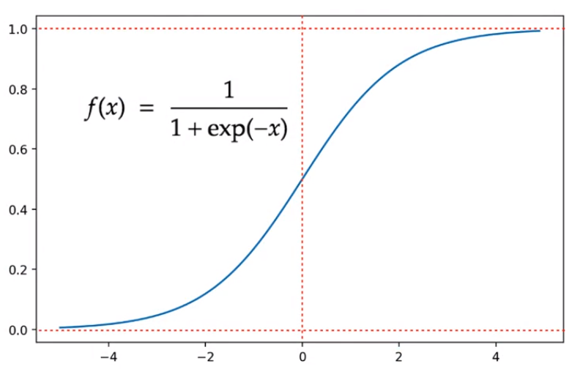
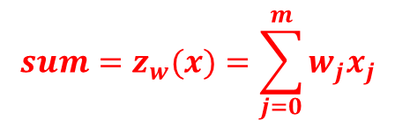
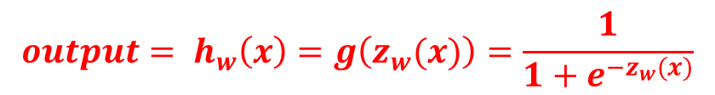

パーセプトロン（Perceptron）
$${sum=z}_{w}(x)=\sum_{j=0}^{m}{w_{j}x_{j}}$$
線形回帰 linear regression
$${output= h}_{w}\left(x\right)=g\left(z_{w}(x)\right)=\frac{1}{1+e^{−z_{w}(x)}}$$
$${output= h}_{w}\left(x\right)=g\left(z_{w}(x)\right)$$
$g:$ activation function
（入力、出力）＝（n、１）、隠れ層0のニューラルネットワーク
シグモイド関数（sigmoid function）
= ロジスティック回帰
Logistic regression
$$0<g\left(z_{w}(x)\right)<1$$

Slide 7
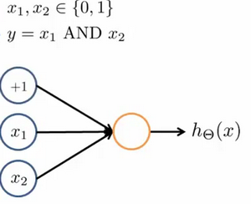





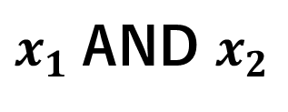

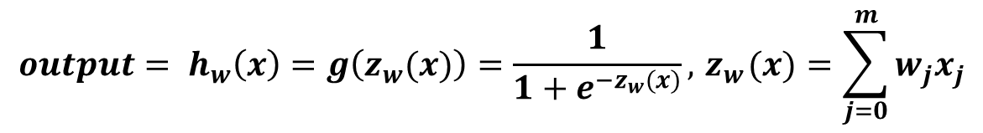



XOR問題
$${output= h}_{w}\left(x\right)=g\left(z_{w}(x)\right)=\frac{1}{1+e^{−z_{w}(x)}},{ z}_{w}(x)=\sum_{j=0}^{m}{w_{j}x_{j}}$$
$x_{1}$AND $x_{2}$
-30
$$z_{w}\left(x\right)=−30+20x_{1}+20x_{2}$$
20
0 | 0
0 | 1
1 | 0
1 | 1
0
$$z_{w}\left(x\right)=−30, output= \frac{1}{1+e^{30}}≈0$$
20
$$z_{w}\left(x\right)=−10, output= \frac{1}{1+e^{10}}≈0$$
0
0
$$z_{w}\left(x\right)=−10, output= \frac{1}{1+e^{10}}≈0$$
$$x_{1},x_{2}∈\{0,1\}$$
$$z_{w}\left(x\right)= 10, output= \frac{1}{1+e^{−10}}≈1$$
1

Slide 8
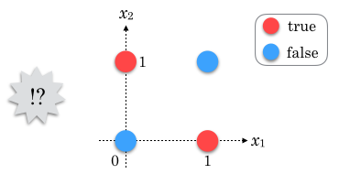
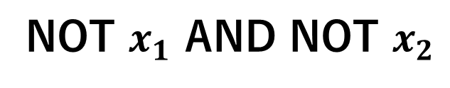


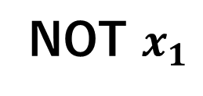


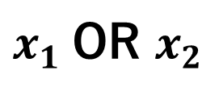
XOR問題
$${output= h}_{w}\left(x\right)=g\left(z_{w}(x)\right)=\frac{1}{1+e^{−z_{w}(x)}},{ z}_{w}(x)=\sum_{j=0}^{m}{w_{j}x_{j}}$$
$x_{1}$AND $x_{2}$
$$z_{w}\left(x\right)=−30+20x_{1}+20x_{2}$$
-30
$x_{1}$OR $x_{2}$
$$z_{w}\left(x\right)=−10+20x_{1}+20x_{2}$$
20
NOT $x_{1}$
$$z_{w}\left(x\right)= 10−20x_{1}$$
20
NOT $x_{1}$ AND NOT $x_{2}$
$$z_{w}\left(x\right)=10−20x_{1}−20x_{2}$$
$$x_{1},x_{2}∈\{0,1\}$$
XOR(排他的論理和)
0 | 0 | 0
0 | 1 | 1
1 | 0 | 1
1 | 1 | 0

Slide 9





XOR問題
$${output= h}_{w}\left(x\right)=g\left(z_{w}(x)\right)=\frac{1}{1+e^{−z_{w}(x)}},{ z}_{w}(x)=\sum_{j=0}^{m}{w_{j}x_{j}}$$
XOR(排他的論理和)
$x_{1}$ XOR $x_{2}={(x}_{1} \text{OR} x_{2}) AND (\text{NOT} x_{1} \text{AND} \text{NOT} x_{2})$
0 | 0 | 0 | 1 | 0
0 | 1 | 1 | 1 | 1
1 | 0 | 1 | 1 | 1
1 | 1 | 1 | 0 | 0

Slide 10

XOR問題
$${output= h}_{w}\left(x\right)=g\left(z_{w}(x)\right)=\frac{1}{1+e^{−z_{w}(x)}},{ z}_{w}(x)=\sum_{j=0}^{m}{w_{j}x_{j}}$$
XOR(排他的論理和)
$x_{1}$ XOR $x_{2}={(x}_{1} \text{OR} x_{2}) AND (\text{NOT} x_{1} \text{AND} \text{NOT} x_{2})$
-10
$x_{1} OR$ $x_{2}$
a₁
20
20

Slide 11


XOR問題
$${output= h}_{w}\left(x\right)=g\left(z_{w}(x)\right)=\frac{1}{1+e^{−z_{w}(x)}},{ z}_{w}(x)=\sum_{j=0}^{m}{w_{j}x_{j}}$$
XOR(排他的論理和)
$x_{1}$ XOR $x_{2}={(x}_{1} \text{OR} x_{2}) AND (\text{NOT} x_{1} \text{AND} \text{NOT} x_{2})$
-10
$x_{1} OR$ $x_{2}$
a₁
20
10
20
-20
a₂
-20
NOT $x_{1}$ AND NOT $x_{2}$

Slide 12


XOR問題
$${output= h}_{w}\left(x\right)=g\left(z_{w}(x)\right)=\frac{1}{1+e^{−z_{w}(x)}},{ z}_{w}(x)=\sum_{j=0}^{m}{w_{j}x_{j}}$$
XOR(排他的論理和)
$x_{1}$ XOR $x_{2}={(x}_{1} \text{OR} x_{2}) AND (\text{NOT} x_{1} \text{AND} \text{NOT} x_{2})$
+1
-30
-10
$x_{1} OR$ $x_{2}$
0 | 0 | 0 | 1 | 0
0 | 1 | 1 | 1 | 1
1 | 0 | 1 | 1 | 1
1 | 1 | 1 | 0 | 0
a₁
$x_{1} AND$ $x_{2}$
20
20
10
20
20
-20
a₂
-20
NOT $x_{1}$ AND NOT $x_{2}$

Slide 13





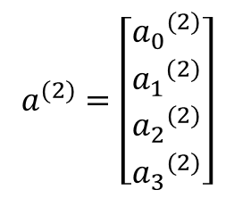
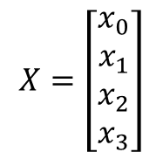
中間層、隠れ層
$$x_{0}=1$$
$${a_{0}}^{(2)}=1$$
入力層
隠れ層
出力層
$$X=\left[\begin{aligned}x_{0} \\ x_{1} \\ x_{2} \\ x_{3}\end{aligned}\right]$$
$$a^{(2)}=\left[\begin{aligned}{a_{0}}^{(2)} \\ {a_{1}}^{(2)} \\ {a_{2}}^{(2)} \\ {a_{3}}^{(2)}\end{aligned}\right]$$
$$a^{(3)}=h_{θ}(x)$$

Slide 14
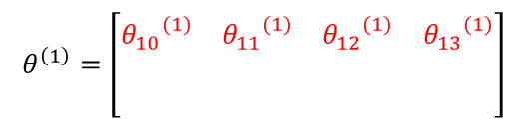
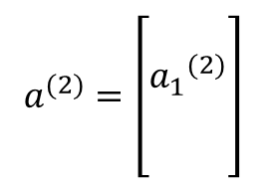


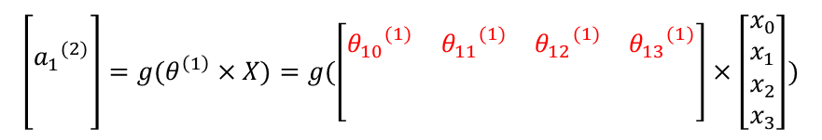
中間層、隠れ層
$$x_{0}=1$$
$${a_{0}}^{(2)}=1$$
$$θ^{\left(1\right)}=\left[\begin{matrix}{θ_{10}}^{(1)} & {θ_{11}}^{(1)} & {θ_{12}}^{(1)} & {θ_{13}}^{(1)} \\ & & & \\ & & & \end{matrix}\right]$$
$$\left[\begin{aligned} \\ {a_{1}}^{(2)} \\ \\ \end{aligned}\right]=g(θ^{\left(1\right)}×X)=g(\left[\begin{matrix}{θ_{10}}^{(1)} & {θ_{11}}^{(1)} & {θ_{12}}^{(1)} & {θ_{13}}^{(1)} \\ & & & \\ & & & \end{matrix}\right]×\left[\begin{aligned}x_{0} \\ x_{1} \\ x_{2} \\ x_{3}\end{aligned}\right])$$
$$θ^{(1)}$$
入力層
隠れ層
$g:$ activation function
$$X=\left[\begin{aligned}x_{0} \\ x_{1} \\ x_{2} \\ x_{3}\end{aligned}\right]$$
$$a^{(2)}=\left[\begin{aligned} \\ {a_{1}}^{(2)} \\ \\ \end{aligned}\right]$$

Slide 15
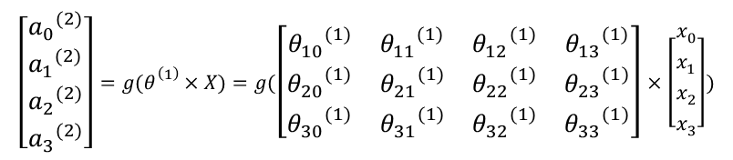
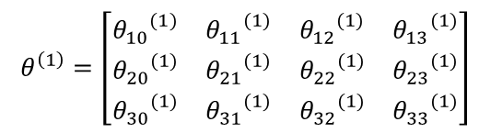

中間層、隠れ層
$${a_{0}}^{(2)}=1$$
$$x_{0}=1$$
$${a_{0}}^{(2)}=1$$
$$x_{0}=1$$
$$θ^{\left(1\right)}=\left[\begin{matrix}{θ_{10}}^{(1)} & {θ_{11}}^{(1)} & {θ_{12}}^{(1)} & {θ_{13}}^{(1)} \\ {θ_{20}}^{(1)} & {θ_{21}}^{(1)} & {θ_{22}}^{(1)} & {θ_{23}}^{(1)} \\ {θ_{30}}^{(1)} & {θ_{31}}^{(1)} & {θ_{32}}^{(1)} & {θ_{33}}^{(1)}\end{matrix}\right]$$
$$\left[\begin{aligned}{a_{0}}^{(2)} \\ {a_{1}}^{(2)} \\ {a_{2}}^{(2)} \\ {a_{3}}^{(2)}\end{aligned}\right]=g(θ^{\left(1\right)}×X)=g(\left[\begin{matrix}{θ_{10}}^{(1)} & {θ_{11}}^{(1)} & {θ_{12}}^{(1)} & {θ_{13}}^{(1)} \\ {θ_{20}}^{(1)} & {θ_{21}}^{(1)} & {θ_{22}}^{(1)} & {θ_{23}}^{(1)} \\ {θ_{30}}^{(1)} & {θ_{31}}^{(1)} & {θ_{32}}^{(1)} & {θ_{33}}^{(1)}\end{matrix}\right]×\left[\begin{aligned}x_{0} \\ x_{1} \\ x_{2} \\ x_{3}\end{aligned}\right])$$
$$θ^{(1)}$$
入力層
隠れ層
$g:$ activation function
$$X=\left[\begin{aligned}x_{0} \\ x_{1} \\ x_{2} \\ x_{3}\end{aligned}\right]$$
$$a^{(2)}=\left[\begin{aligned}{a_{0}}^{(2)} \\ {a_{1}}^{(2)} \\ {a_{2}}^{(2)} \\ {a_{3}}^{(2)}\end{aligned}\right]$$

Slide 16
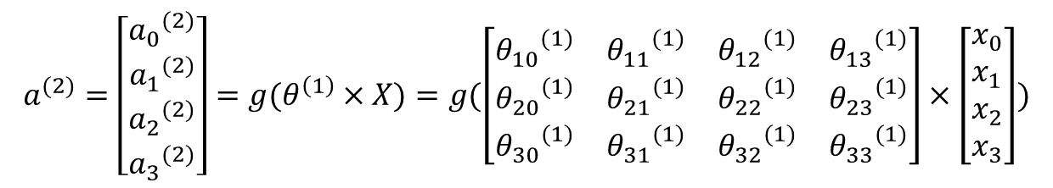


中間層、隠れ層
$$x_{0}=1$$
$${a_{0}}^{(2)}=1$$
$$θ^{(1)}$$
$$θ^{(2)}$$
入力層
隠れ層
出力層
$$X=\left[\begin{aligned}x_{0} \\ x_{1} \\ x_{2} \\ x_{3}\end{aligned}\right]$$
$$a^{(2)}=\left[\begin{aligned}{a_{0}}^{(2)} \\ {a_{1}}^{(2)} \\ {a_{2}}^{(2)} \\ {a_{3}}^{(2)}\end{aligned}\right]=g(θ^{\left(1\right)}×X)=g(\left[\begin{matrix}{θ_{10}}^{(1)} & {θ_{11}}^{(1)} & {θ_{12}}^{(1)} & {θ_{13}}^{(1)} \\ {θ_{20}}^{(1)} & {θ_{21}}^{(1)} & {θ_{22}}^{(1)} & {θ_{23}}^{(1)} \\ {θ_{30}}^{(1)} & {θ_{31}}^{(1)} & {θ_{32}}^{(1)} & {θ_{33}}^{(1)}\end{matrix}\right]×\left[\begin{aligned}x_{0} \\ x_{1} \\ x_{2} \\ x_{3}\end{aligned}\right])$$
$$a^{(3)}=h_{θ}(x)$$

Slide 17



中間層、隠れ層
$$x_{0}=1$$
$${a_{0}}^{(2)}=1$$
入力層
隠れ層
出力層
$$X=\left[\begin{aligned}x_{0} \\ x_{1} \\ x_{2} \\ x_{3}\end{aligned}\right]$$
$$Forward Propagation$$

Slide 18
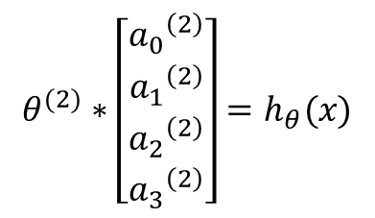
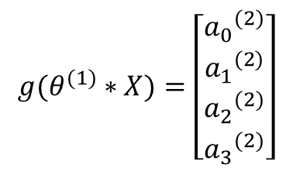


$$Forward Propagation、Back Propagation$$
$$x_{0}=1$$
$${a_{0}}^{(2)}=1$$
$$θ^{(1)}$$
$$θ^{(2)}$$
入力層
隠れ層
出力層
$$X=\left[\begin{aligned}x_{0} \\ x_{1} \\ x_{2} \\ x_{3}\end{aligned}\right]$$
$${g(θ}^{(1)}∗X)=\left[\begin{aligned}{a_{0}}^{(2)} \\ {a_{1}}^{(2)} \\ {a_{2}}^{(2)} \\ {a_{3}}^{(2)}\end{aligned}\right]$$
$$θ^{(2)}∗\left[\begin{aligned}{a_{0}}^{\left(2\right)} \\ {a_{1}}^{\left(2\right)} \\ {a_{2}}^{\left(2\right)} \\ {a_{3}}^{\left(2\right)}\end{aligned}\right]=h_{θ}(x)$$

Slide 19
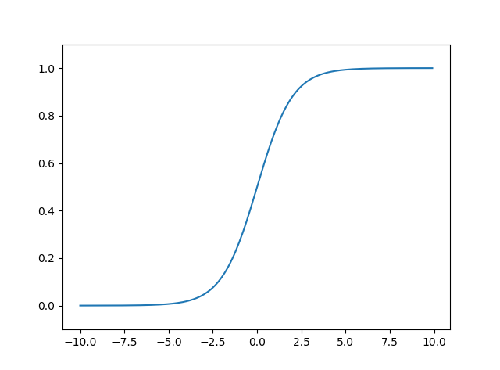
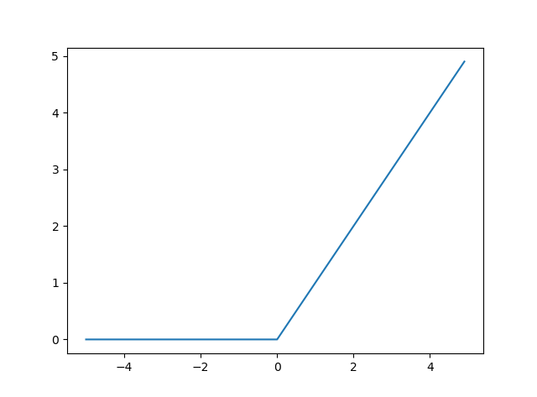
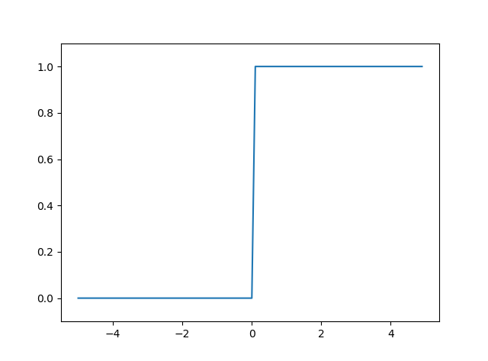



活性化関数（activation function）
シグモイド関数
ReLU関数
ステップ関数
出力層
隠れ層

Slide 20

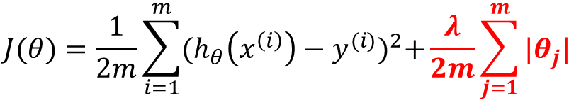
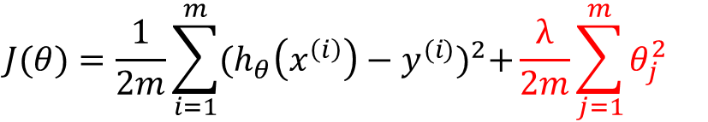
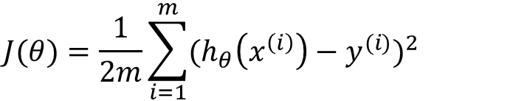
過学習（over-fit）へ対策：Regularization（正規化）
線形回帰
$$J(θ)=\frac{1}{2m}\sum_{i=1}^{m}{{(h_{θ}\left(x^{\left(i\right)}\right)−y^{(i)})}^{2}}$$
Lasso回帰
$$J(θ)=\frac{1}{2m}\sum_{i=1}^{m}{{(h_{θ}\left(x^{\left(i\right)}\right)−y^{(i)})}^{2}+\frac{λ}{2m}\sum_{j=1}^{m}{{|θ}_{j}|}}$$
Ridge回帰
$$J(θ)=\frac{1}{2m}\sum_{i=1}^{m}{{(h_{θ}\left(x^{\left(i\right)}\right)−y^{(i)})}^{2}+\frac{λ}{2m}\sum_{j=1}^{m}{θ_{j}^{2}}}$$

Slide 21
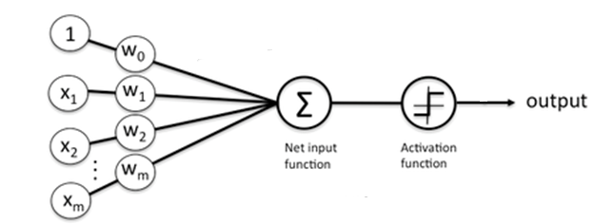


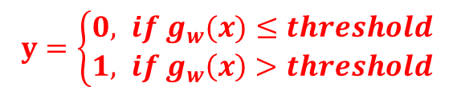

パーセプトロン（Perceptron）
(Yes) 1
悪性?
(No) 0
腫瘍サイズ
$$threshold$$
$$threshold$$
$$g_{w}(x)=\sum_{j=0}^{m}{w_{j}x_{j}}$$
線形回帰 linear regression
$y=\left\{\begin{aligned}0, if{ g}_{w}(x)≤threshold \\ &1, if{ g}_{w}\left(x\right)>threshold\end{aligned}\right.$

