Slide 1
Final Project
Image caption generation
106403054 洪睿甫
106403528 王佩晨

Slide 2
Review
Multi-label classification
Result
Evaluation Metrics- BLEU
Analysis
Contents

Slide 3
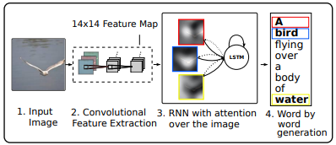
Show, Attend and tell
Note: 利用attention提取圖片中的特徵，將影像特徵和之前預測出的單詞資訊輸入LSTM中。attention 中分成soft和hard。結果發現hard的表現較佳。
Soft: 全部都引入attention
Hard: 對特定某一個visual concept引入attention
Xu, Kelvin, et al. "Show, attend and tell: Neural image caption generation with visual attention." International conference on machine learning. PMLR, 2015.
Notes:
Xu, Kelvin, et al. "Show, attend and tell: Neural image caption generation with visual attention." International conference on machine learning. PMLR, 2015.

Slide 4
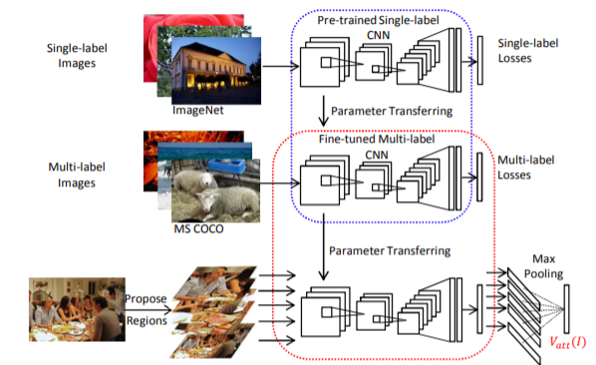
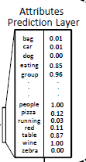
What Value Do Explicit High Level Concepts Have in Vision to Language Problems?
以往方法只用圖片特徵向量當作decoder的Input，沒辦法明確表達圖片中的語意概念
將圖片特徵向量轉為類別分布
attribute vector
Notes:
attribute vector 告訴你這張圖出現甚麼東西間接告訴這張圖的語意概念

Slide 5
Final Model
attention
attention
attention
This
cat
h0
h1
h2
Encoder
image
feature
h0
decoder
h1
decoder
h2
transform
multi-label
classification
<start>
This
embedding後和dec_input做加總
+
+

Slide 6
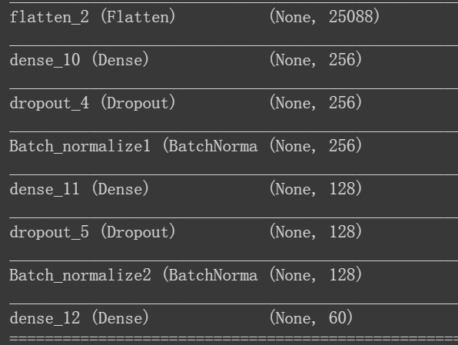
Multi-label Classifation
Transfer learning - VGG19
最後五層trainable設為True
optimizer = SGD (lr=2e-4)
loss function = categorical crossentropy

Slide 7
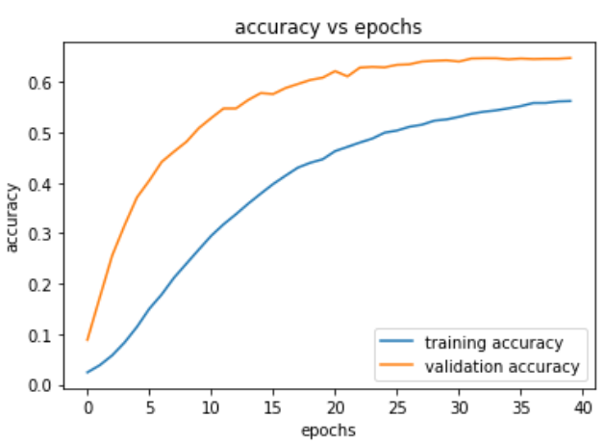
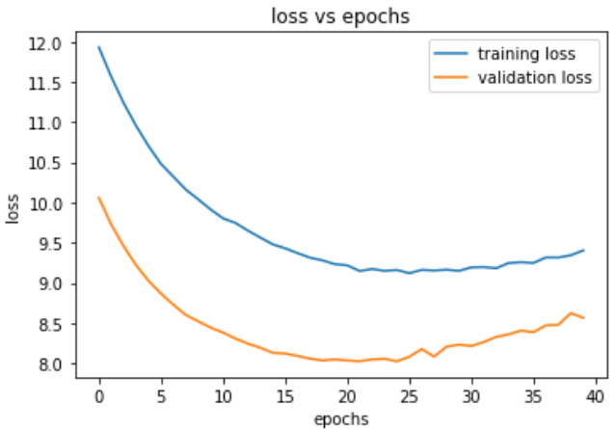
Multi-label Classifation

Slide 8
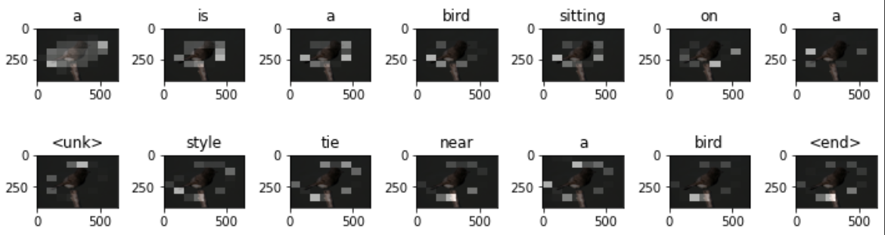
RESULT - image captioning
Actual : the bird is sitting on a thin broken branch
Predict : a is a bird sitting on o a <unk> style tie near a bird

Slide 9
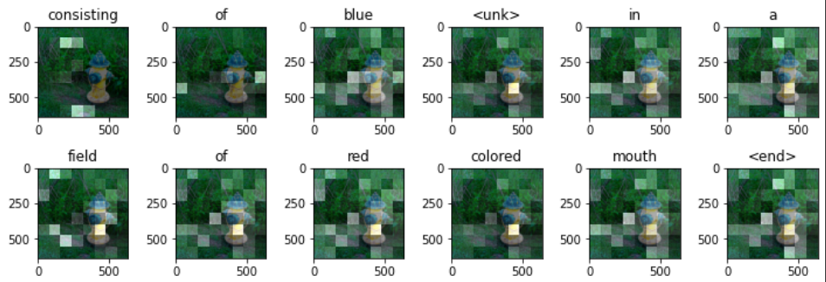
RESULT - image captioning (Our model)
Actual : a tellow and green fire hydrant sits near a grassy area
Predict : consisting of blue <unk> in a field of red colored mouth

Slide 10
Evaluation Metric
BLEU
 | B-1 | B-2 | B-3 | B-4
Baseline - Show attend and tell(VGG) | 0.88 | 0.79 | 0.66 | 0.45
CNN+LSTM with multi-label | 0.74 | 0.52 | 0.46 | 0.31
Our Proposal 10 Epoch | 0.77 | 0.62 | 0.489 | 0.30
Our Proposal 20 Epoch | 0.83 | 0.69 | 0.55 | 0.35

Slide 11
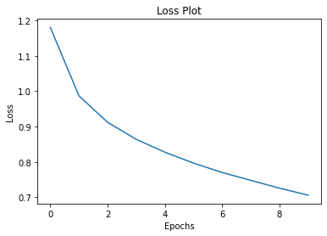
Analysis
multi-label classification 準確率不佳
輸入到decoder的label相似度太高
epoch 跑不夠多次
trainging data和validation data太少 (4800+1200)

