Slide 1
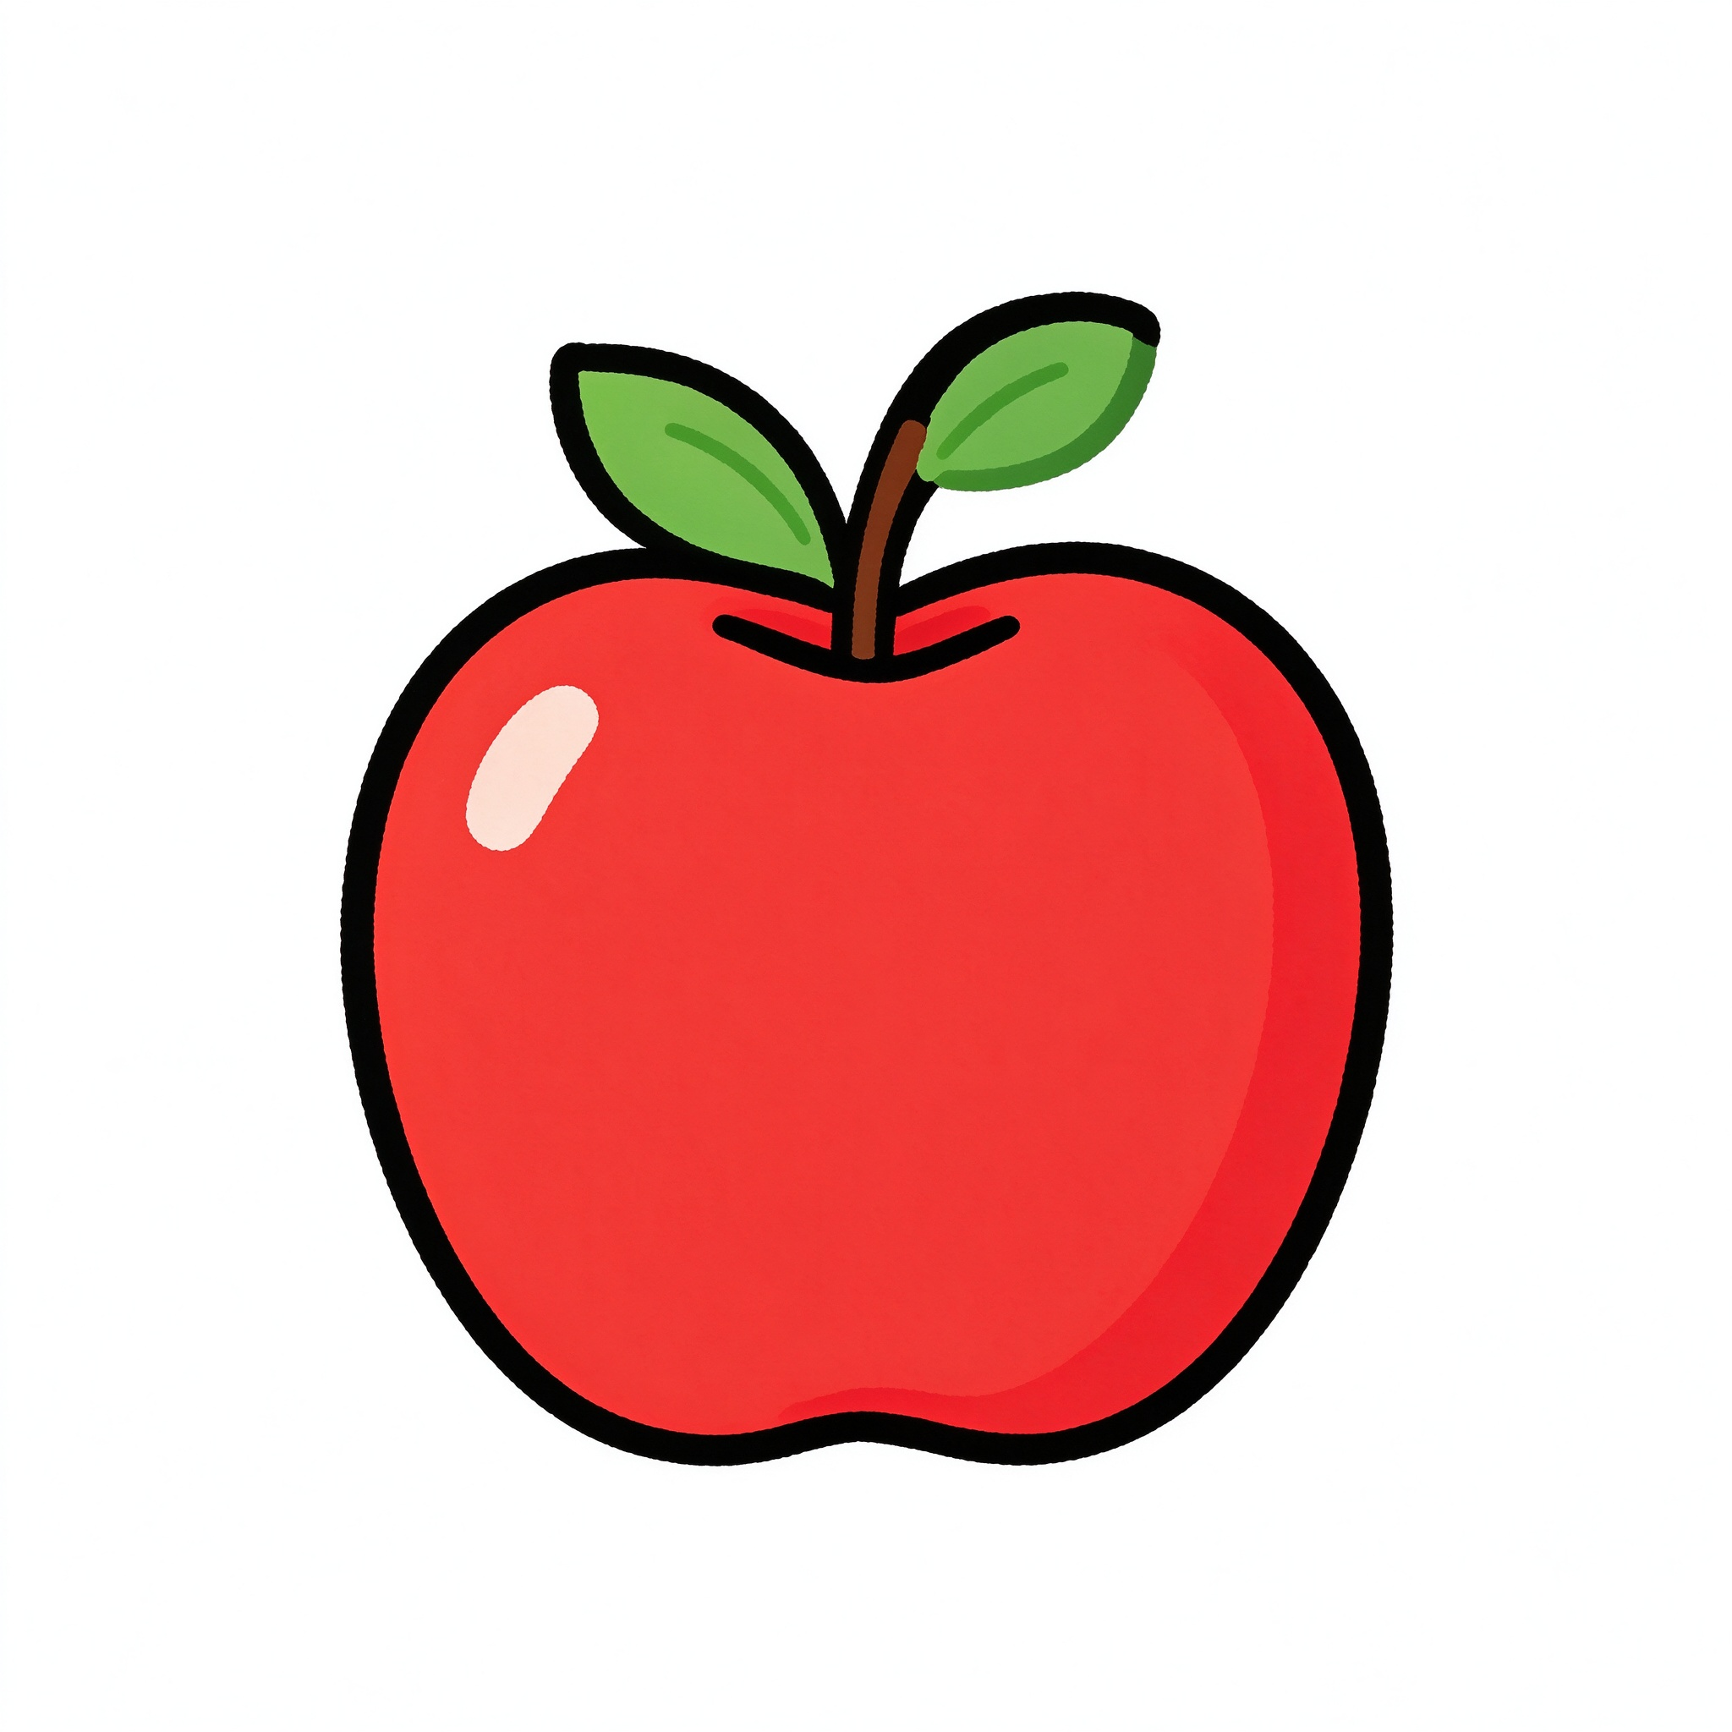
I like apples!
我喜欢苹果！
Food and Drinks · 5-minute micro-teaching
Notes:
Hello everyone! Today we're going to learn about food and drinks in Chinese. By the end of this short lesson, you'll be able to say what food you like. Let's start!

Slide 2
Today we will learn...
今天我们要学……
1
Say 4 food words in Chinese correctly
2
Use "我喜欢..." to say what food you like
3
Ask a friend: "你喜欢苹果吗？"
Can you do all three by the end of the lesson?
Notes:
Let's look at what we'll achieve today. First, you'll learn four food words. Then you'll be able to say what you like using the sentence pattern. Finally, you'll be able to ask your friend what they like. Three goals for five minutes - let's go!

Slide 3
PART 1 · WARM-UP
Last time we talked about colours
上节课我们学了颜色
红色 hóngsè
Remember this pattern:
蓝色 lánsè
我喜欢红色。
我不喜欢蓝色。
黄色 huángsè
Quick check: ask your neighbour "你喜欢红色吗？"
Notes:
Alright, let's warm up. Last lesson we learned colours - red, blue, yellow. And we learned how to say what we like or don't like: "我喜欢红色" means "I like red". Now turn to your partner and ask "你喜欢红色吗？" - yes or no? Great, now we're ready for today's new words!

Slide 4

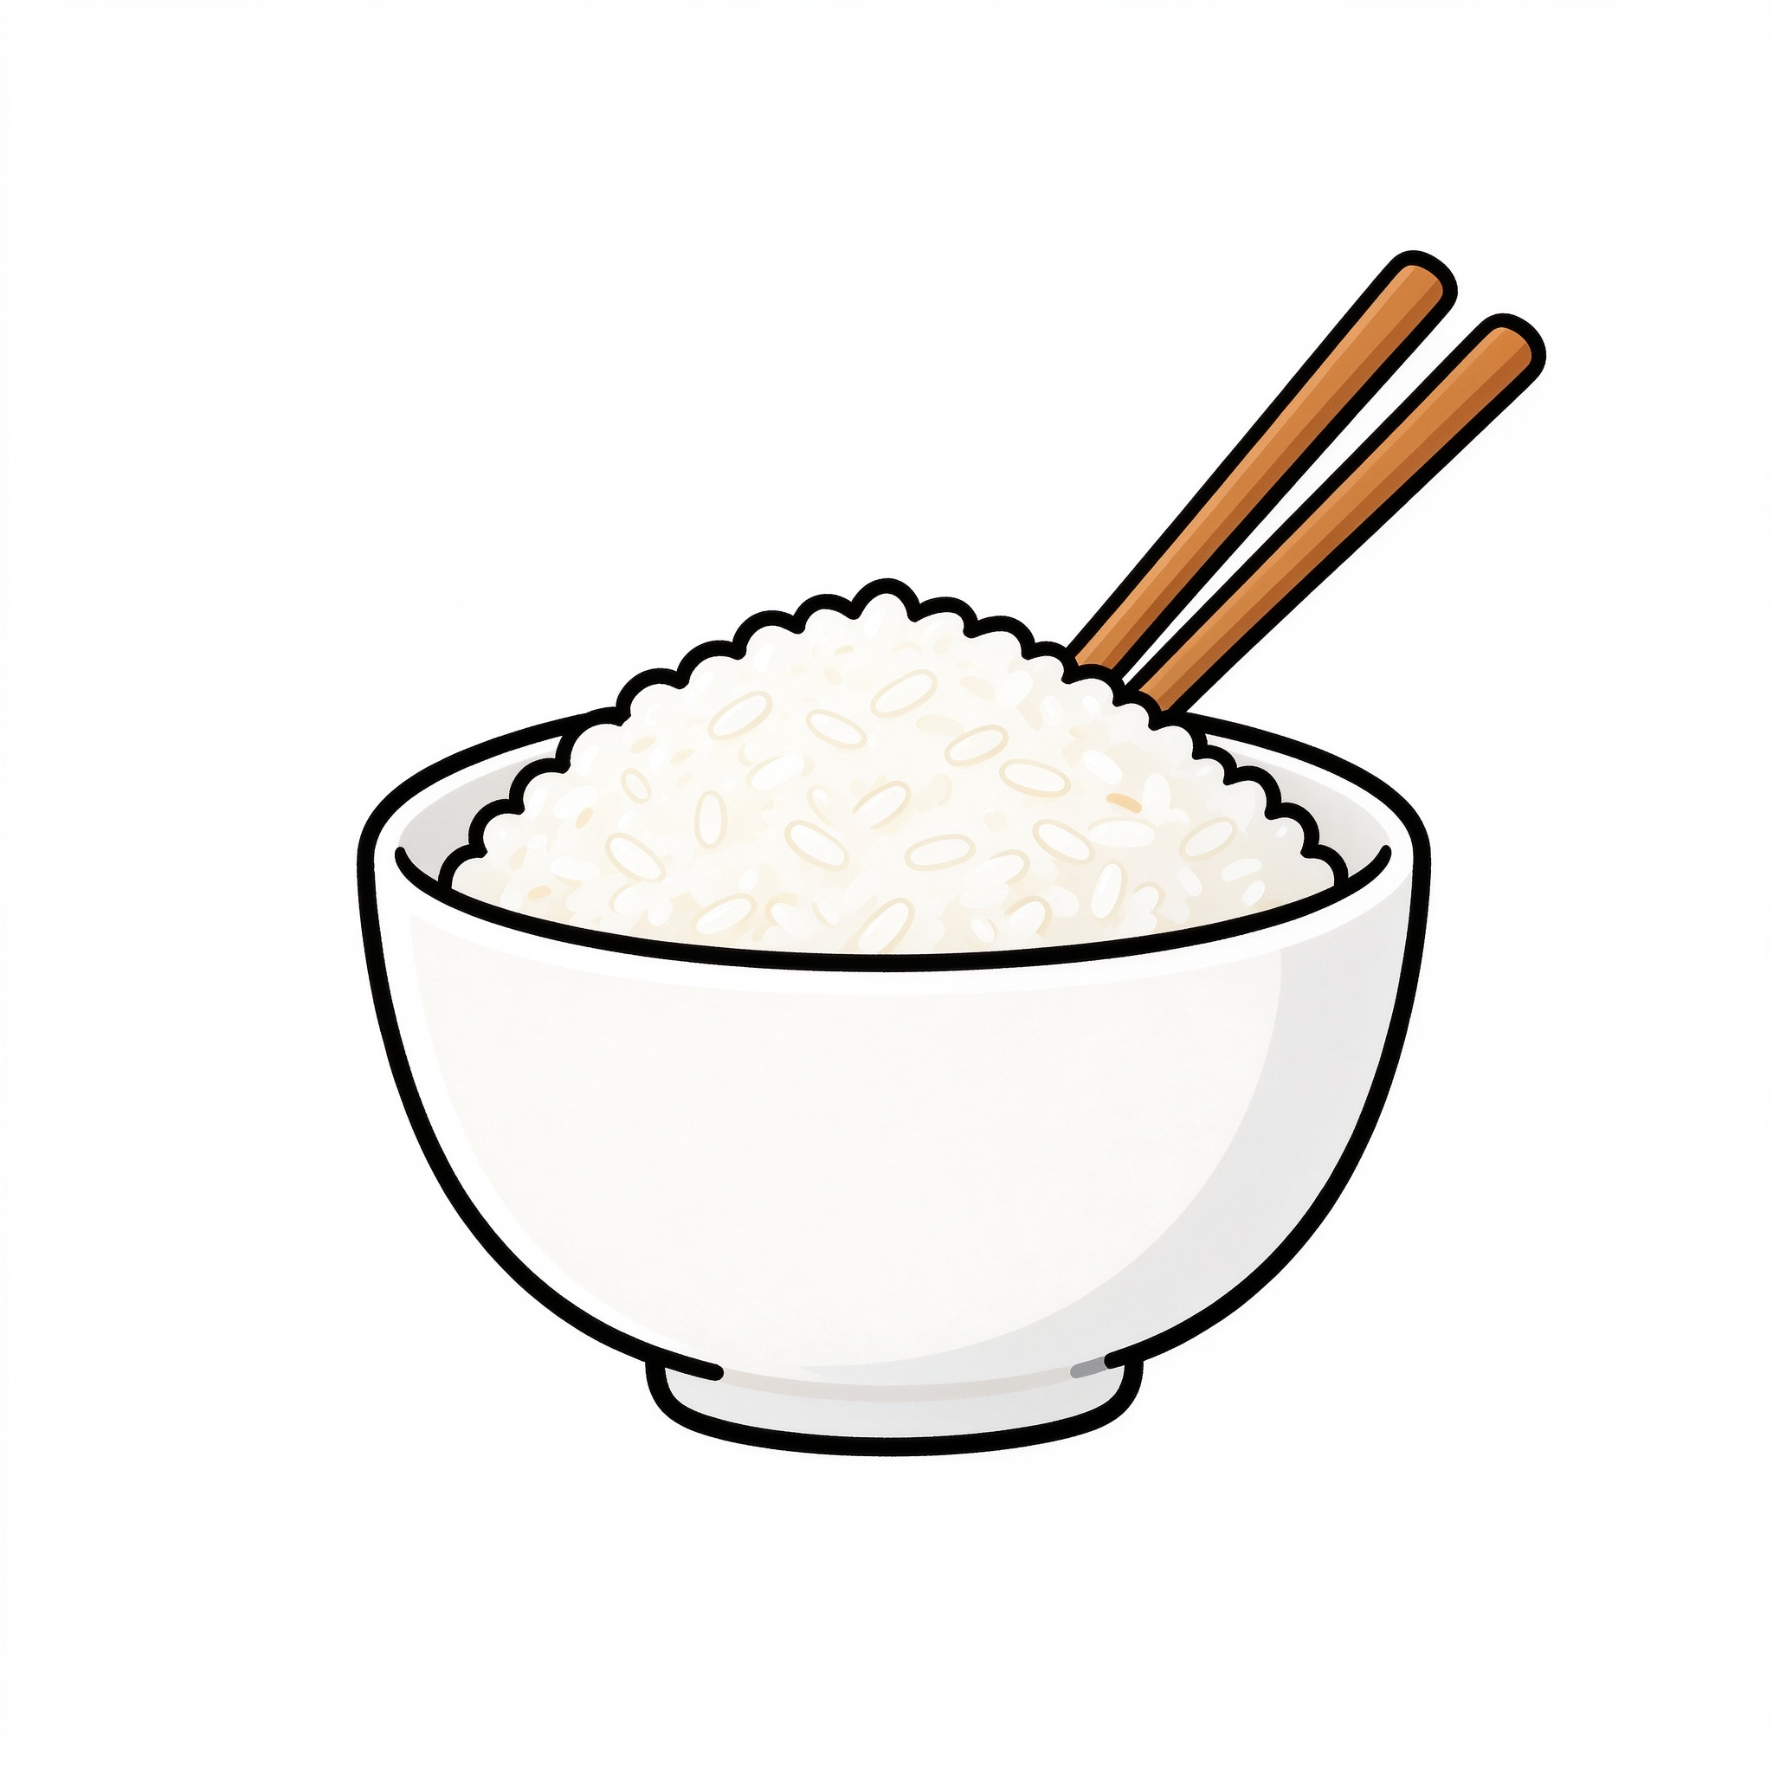
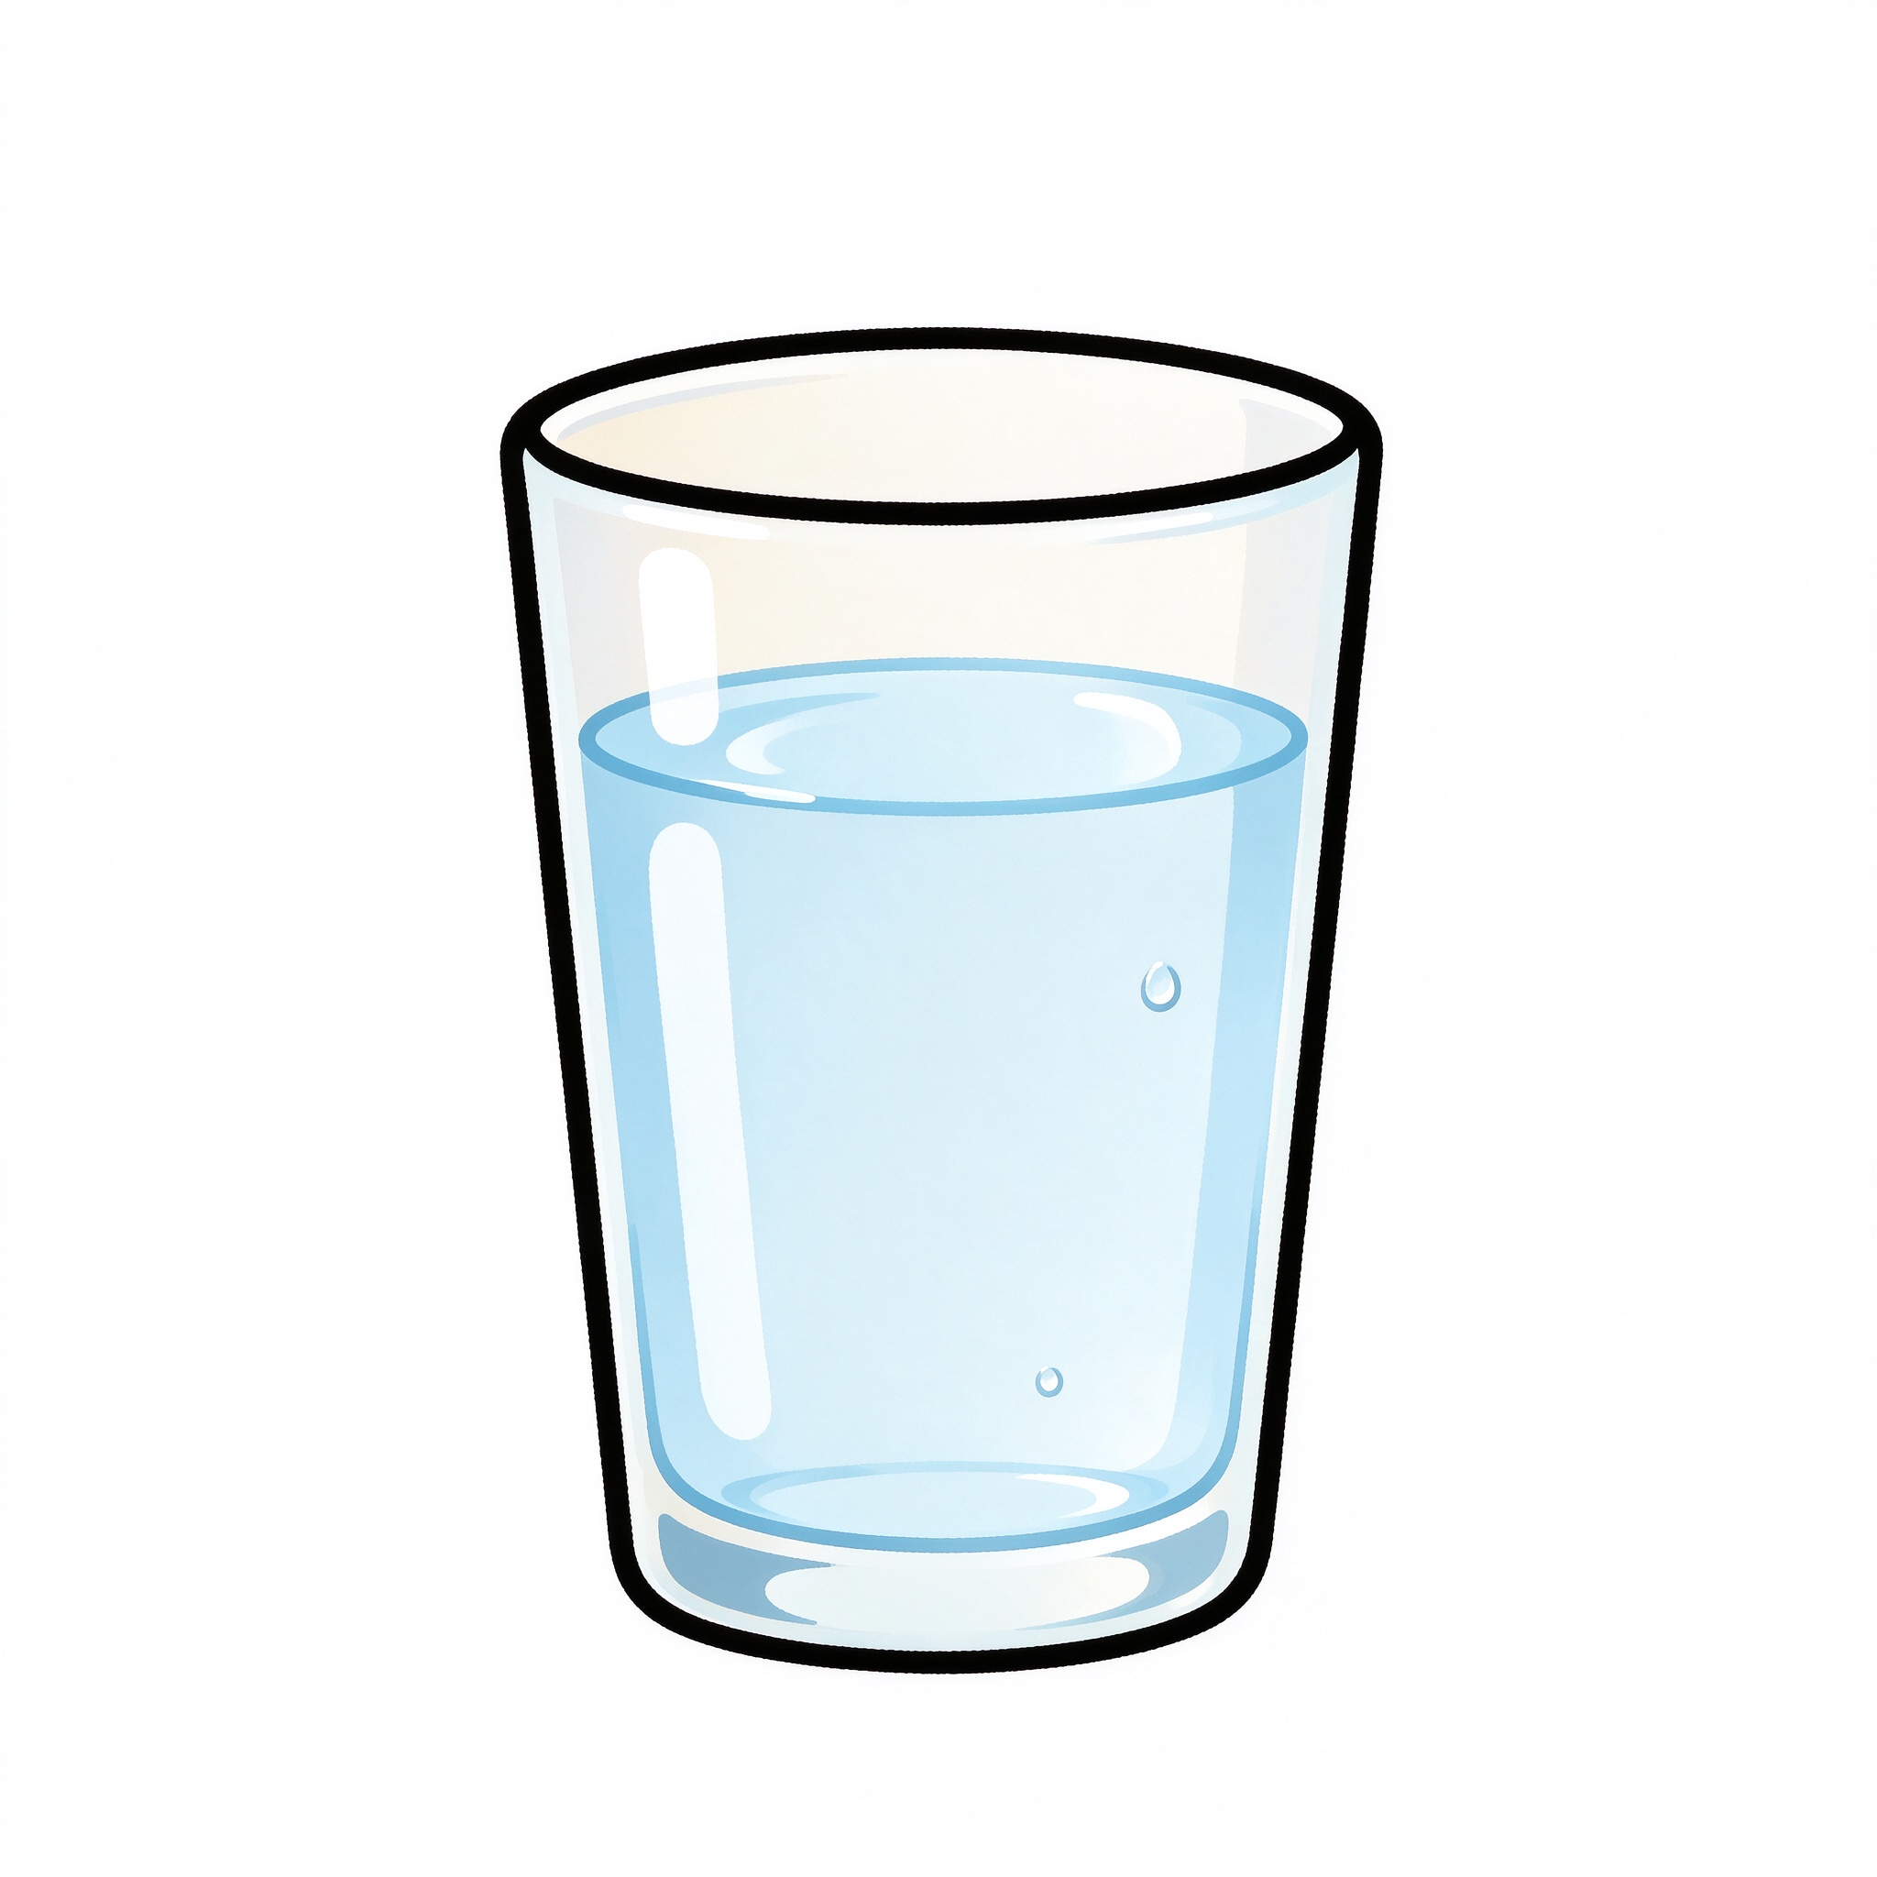
PART 2 · NEW WORDS
Let's learn food words!
我们来学食物的说法
苹果
香蕉
米饭
水
píngguǒ · apple
xiāngjiāo · banana
mǐfàn · rice
shuǐ · water
Listen and repeat after me: píngguǒ, xiāngjiāo, mǐfàn, shuǐ
Notes:
Great! Now let's meet our new food words. Look at the screen - we have four words today. First, 苹果 - that's apple. Repeat after me: píngguǒ. Good! Next, 香蕉 - banana. xiāngjiāo. Then 米饭 - rice. mǐfàn. And finally 水 - water. shuǐ. Now everyone repeat all four after me, ready? píngguǒ, xiāngjiāo, mǐfàn, shuǐ. Excellent!

Slide 5
PART 3 · ACTIVITY
Game time: What's missing?
游戏时间：哪个不见了？
How to play:
1
Look at all four words on the screen
?
2
Close your eyes!
3
I take one away. Open your eyes!
4
Tell me: "苹果！" - what's missing?
Notes:
Now it's game time! We're going to play "What's missing?". Here's how it works: look at all four food words on the screen. Now close your eyes... ready? I've taken one away! Open your eyes! Which one is missing? Shout it out in Chinese! Great, that was 香蕉! Let's play again...

Slide 6
PART 3 · PRACTISE
Now ask your friend!
现在来问问你的朋友
ASK:
ANSWER (yes):
你喜欢苹果吗？
我喜欢苹果。
ANSWER (no):
我不喜欢苹果。
Now turn to your partner and ask! Try all four foods.
Notes:
Great! Now let's use our new words in a sentence. If you want to ask someone if they like apples, you say: "你喜欢苹果吗？" And if you like apples, you answer: "我喜欢苹果。" If you don't like them, you say: "我不喜欢苹果。" Now turn to your partner - ask them about apples, bananas, rice and water. Go!

Slide 7
PART 4 · WRAP-UP
Well done! What did we learn?
太棒了！今天我们学了什么？
苹果
香蕉
米饭
水
我喜欢苹果。你喜欢香蕉吗？
Next time we'll learn more food words! 下次见！
Notes:
Great work everyone! Let's quickly recap what we learned today. We can say four food words in Chinese: 苹果, 香蕉, 米饭, 水. And we can ask and answer: "你喜欢苹果吗？" "我喜欢苹果。" Well done! Next lesson we'll learn even more food words. See you then!

