Slide 1

Apache Spark – Overview
CS 143 Spring 2017
Shubham Mittal
Notes:
1
1
1

Slide 2
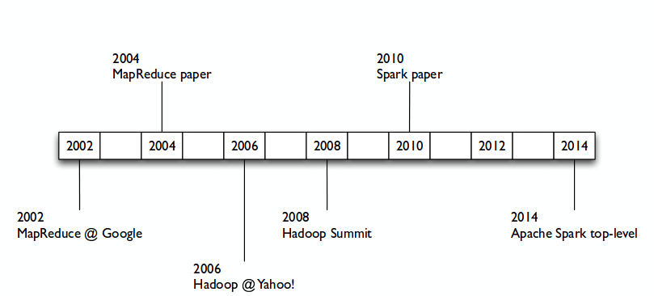
A Brief History
Shubham Mittal
2
Notes:
2
2002 – Doug Cutting started work on Apache Nutch
2003 – GFS
2005 – GFS and map reduce support added to Nutch
2008 – Yahoo releases a ton of statistics showing how Hadoop made search almost 33 times faster and how hadoop could be used for a lot more than search
2009 – First Commercial Version of Hadoop released (hortonworks)
2010 – started by Matei Zaharia at UC Berkeley's AMPLab in 2009, and open sourced in 2010
2012 – Hadoop 2.2 released
2014 – Matei founds DataBricks

Slide 3
Spark Basics
Spark helps us tackle problems too big for a single machine!
Traditional distributed computing platforms scale well but have limited APIs (map/reduce)
On the other hand, Spark has an expressive data focused API that makes writing large scale programs easy.
Supports built-in APIs in multiple languages:
Spark originally written in Scala.
Java API added for standalone applications.
Python API added recently along with interactive shell.
Shubham Mittal
3
Notes:
3

Slide 4
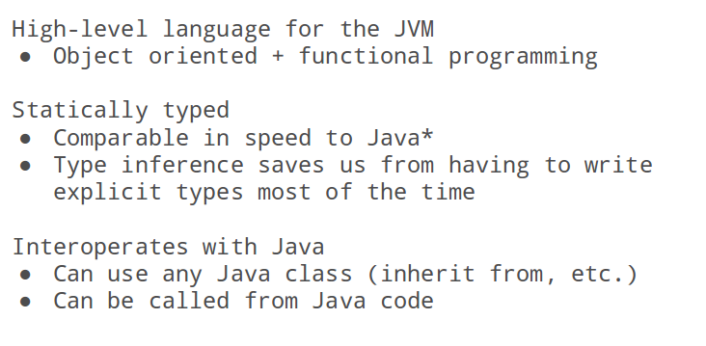
About Scala
Shubham Mittal
4
Notes:
4

Slide 5
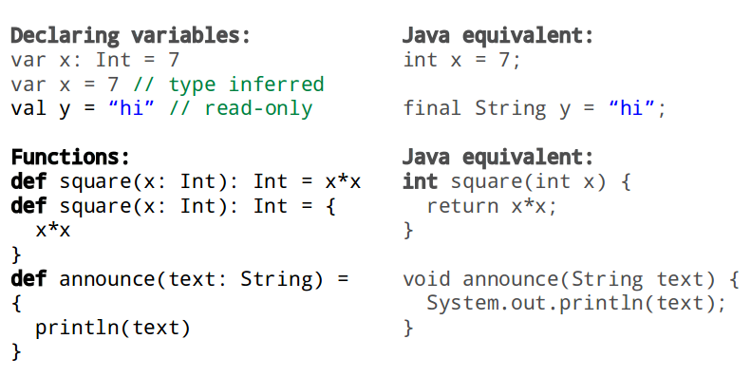
Scala Programming
Shubham Mittal
5
Notes:
5

Slide 6
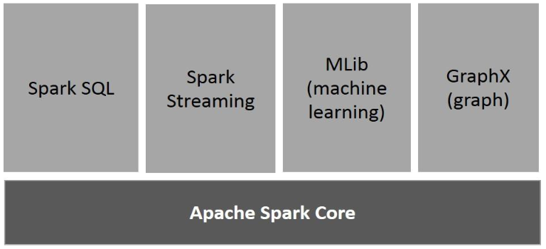
Spark Advanced Analytics
Not only supports “Map” and “Reduce”. But also supports SQL queries, Streaming data, Machine learning (ML) and Graph algorithms.
Shubham Mittal
6
Notes:
6
Like Google MapReduce, Hadoop “maps” tasks across a cluster of machines, splitting them into tiny sub-tasks, before “reducing” the results into one master calculation. If a system fails, another node can pick up the slack. It’s an old “grid computing” technique given new life in the age of “cloud computing.”

Slide 7
Our Focus
Apache Spark Core: Underlying general execution engine for Spark platform. Provides in-memory computing and referring datasets in external storage systems.
Spark SQL: A component on top of Spark Core that introduces new data abstraction called SchemaRDD, which provides support for structured and semi-structured data.
Shubham Mittal
7
Notes:
7

Slide 8
Spark Deep Dive - RDDs
Resilient Distributed Datasets (RDD) is a fundamental data structure of Spark.
They are read-only, partitioned collection of records (on different nodes of cluster)
They can be created through deterministic operations on either data on stable storage or other RDDs.
They can be operated in parallel and provides fault tolerance.
Spark uses RDD to achieve faster and efficient MapReduce operations as shown next.
Shubham Mittal
8
Notes:
8
Key Idea - Work with distributed collections as you would with local ones
Immutable collections of objects spread across a cluster
Built through parallel transformations (map, filter, etc)
Automatically rebuilt on failure
Controllable persistence (e.g. caching in RAM)

Slide 9
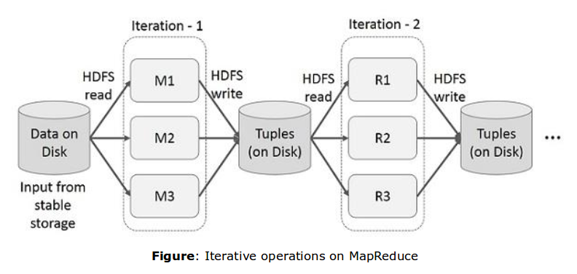
Why MapReduce is Slow?
Only way to reuse data between two MapReduce jobs is to write it to an external stable storage system (eg. HDFS)
This makes both iterative and interactive applications slow as they spend 90% of the time doing HDFS (disk) read-write operations.
Shubham Mittal
9
Notes:
9
List.map(x => x.age>23).map(x => x.gender==‘female’).map(x => x.major==‘CS’)
Data sharing is slow in MapReduce due to replication, serialization, and disk IO

Slide 10
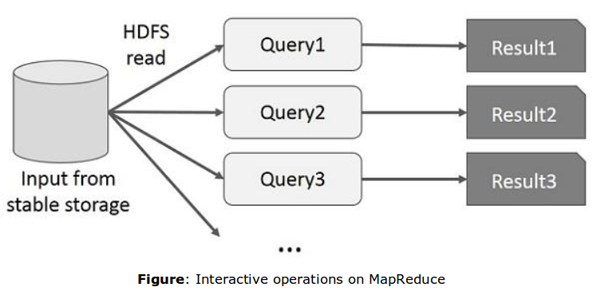
MapReduce is Slow!
Only way to reuse data between two MapReduce jobs is to write it to an external stable storage system (eg. HDFS)
This makes both iterative and interactive applications slow as they spend 90% of the time doing HDFS (disk) read-write operations.
Shubham Mittal
10
Notes:
10
User runs ad-hoc queries on the same subset of data. Each query will do the disk I/O on the stable storage, which can dominates application execution time

Slide 11
Speed-up in Spark!
Support in-memory processing i.e. store the state of memory as an object across jobs and the object is sharable beween those jobs.
In other words, persist an RDD in memory, in which case Spark keeps elements around on the cluster for much faster access for the next time you query.
Data sharing is 10 to 100 times faster than network and disk.
Shubham Mittal
11
Notes:
11

Slide 12
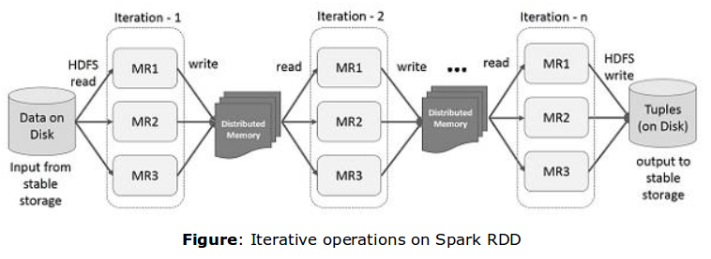
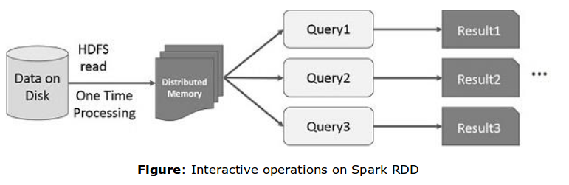
Speed-up in Spark!
Shubham Mittal
12
Notes:
12

Slide 13
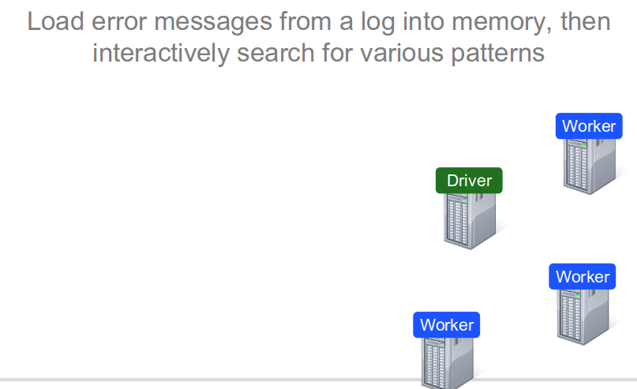
Example: Log-Mining
Shubham Mittal
13
Notes:
13

Slide 14
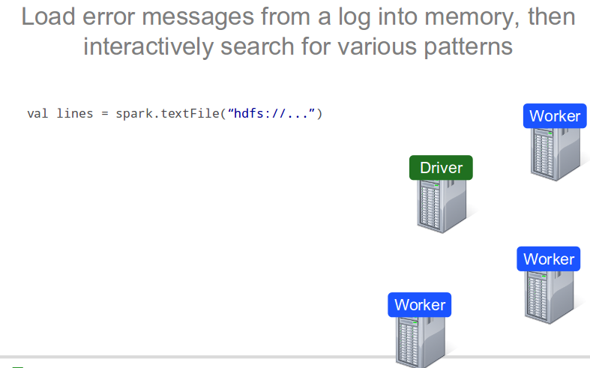
Example: Log-Mining
Shubham Mittal
14
Notes:
14

Slide 15
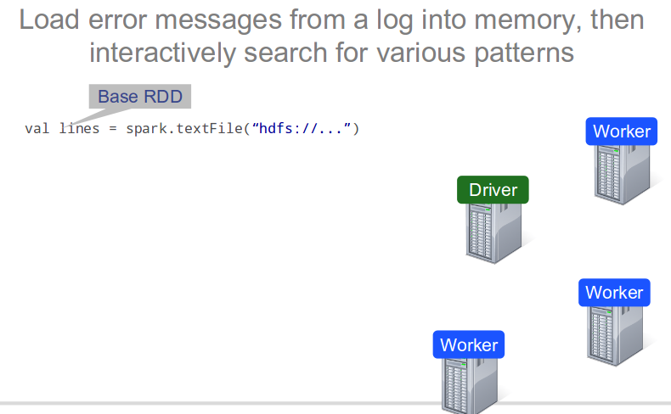
Example: Log-Mining
Shubham Mittal
15
Notes:
15

Slide 16
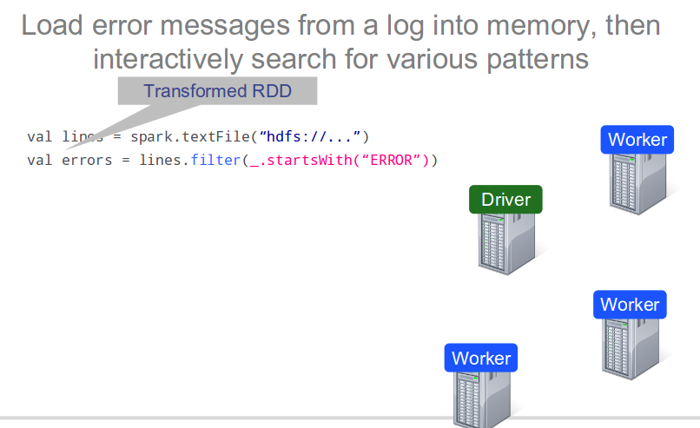
Example: Log-Mining
Shubham Mittal
16
Notes:
16

Slide 17
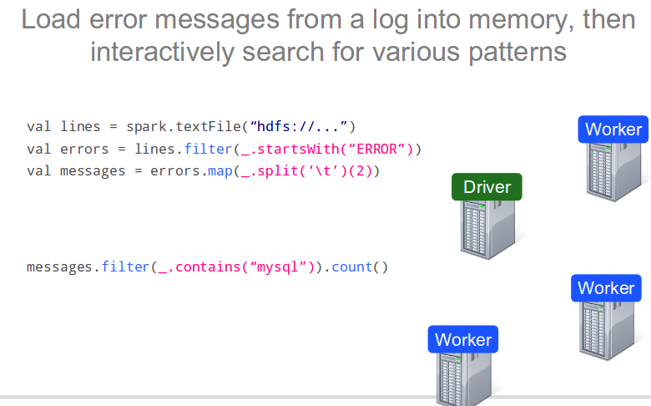
Example: Log-Mining
Shubham Mittal
17
Notes:
17

Slide 18
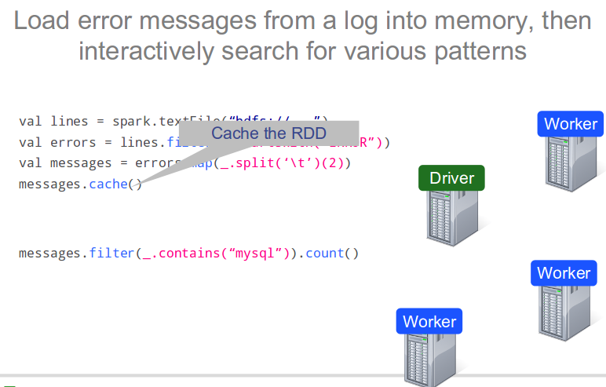
Example: Log-Mining
Shubham Mittal
18
Notes:
18

Slide 19
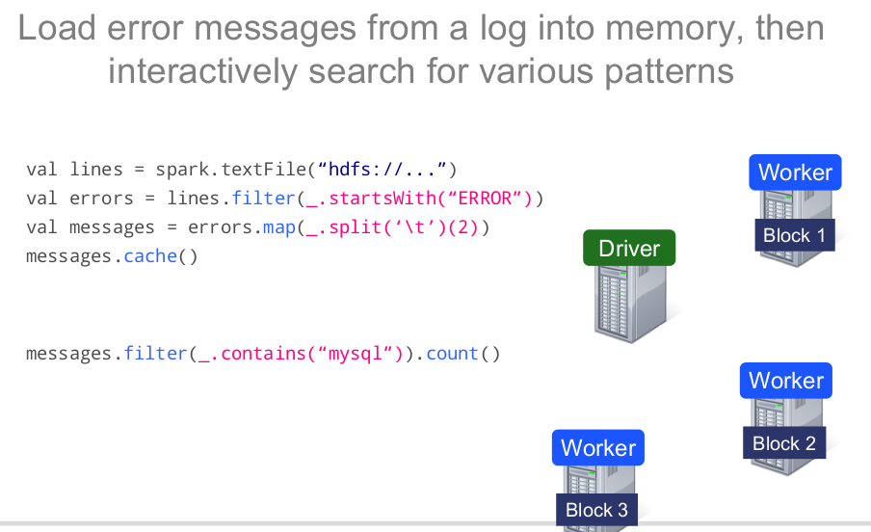
Example: Log-Mining
Shubham Mittal
19
Notes:
19

Slide 20
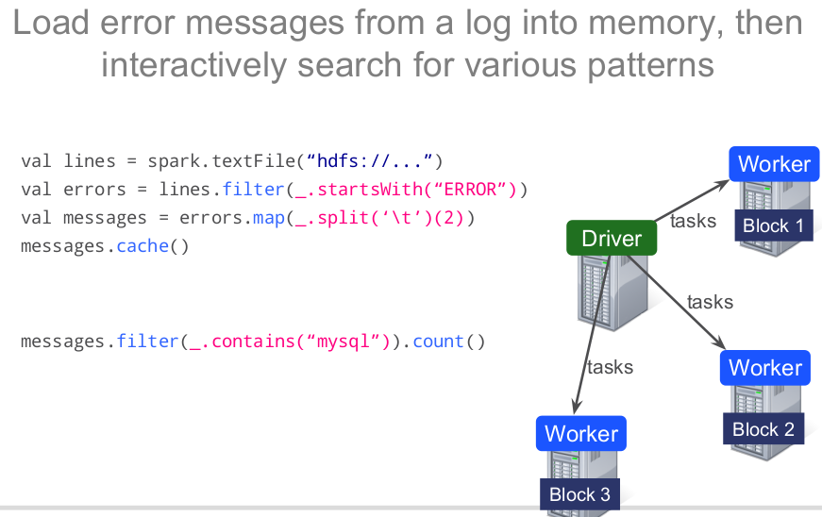
Example: Log-Mining
Shubham Mittal
20
Notes:
20

Slide 21
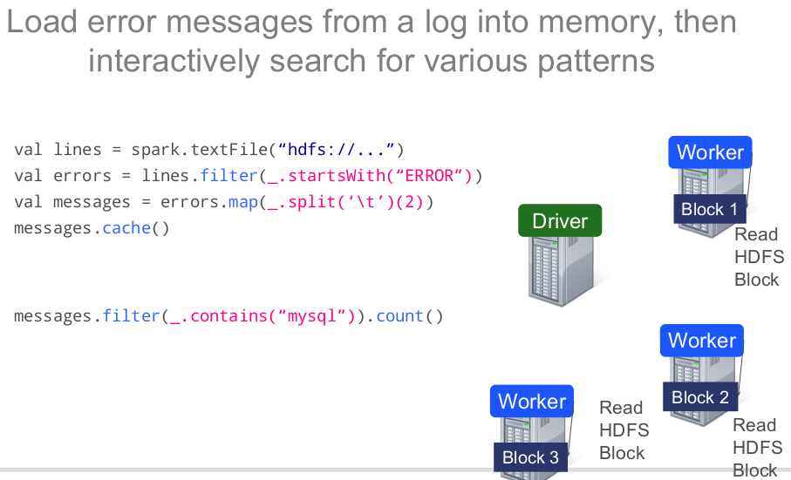
Example: Log-Mining
Shubham Mittal
21
Notes:
21

Slide 22
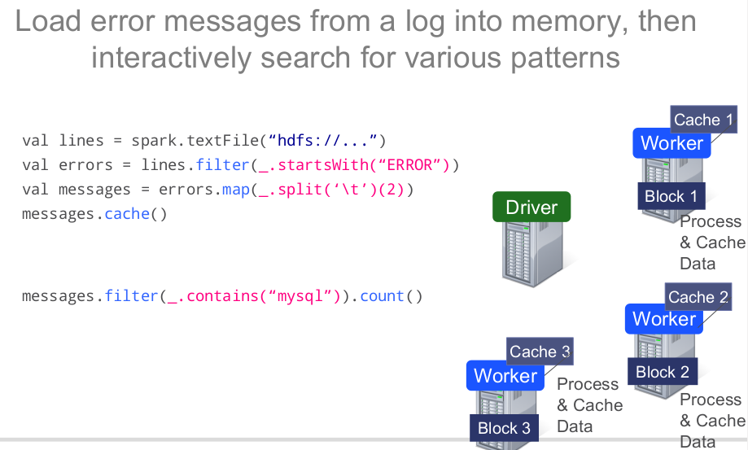
Example: Log-Mining
Shubham Mittal
22
Notes:
22

Slide 23
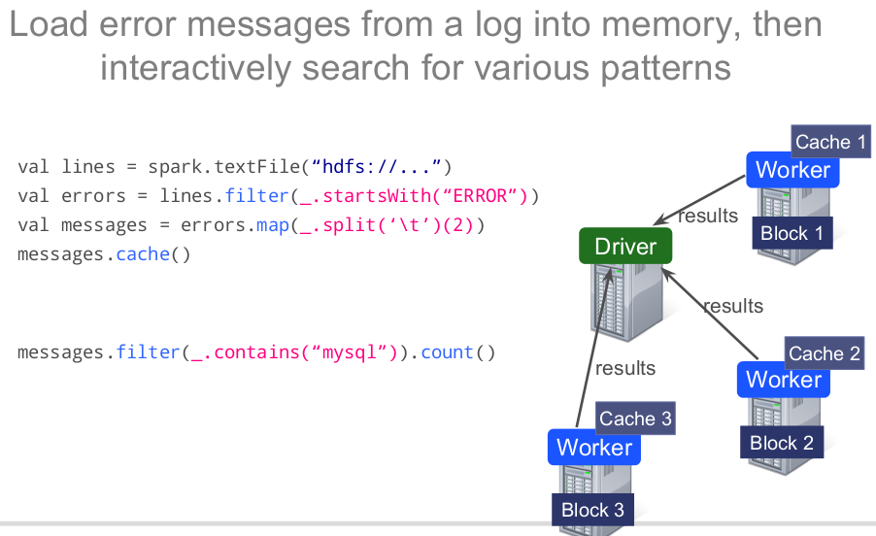
Example: Log-Mining
Shubham Mittal
23
Notes:
23

Slide 24
Example: Log-Mining
For subsequent queries, the workers will process the data from cache.
Gives much faster results (typically 5-7s from cache vs 170s for on-disk).
Shubham Mittal
24
Notes:
24

Slide 25
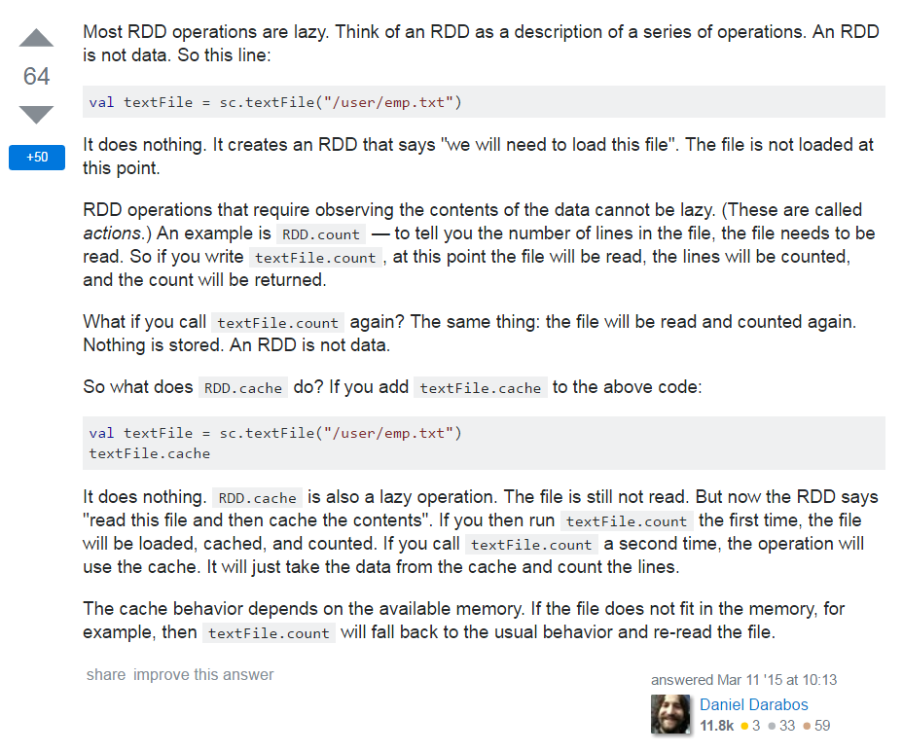
Shubham Mittal
25

Slide 26
References
http://www.tutorialspoint.com/apache_spark/
http://hortonworks.com/hadoop-tutorial/hands-on-tour-of-apache-spark-in-5-minutes/
http://stanford.edu/~rezab/sparkclass/slides/itas_workshop.pdf
http://stanford.edu/~rezab/sparkworkshop/slides/holden.pdf
Shubham Mittal
26
Notes:
26

