Slide 1
NHẬN DẠNG
April 22nd, 2021
VNU- HCMUS

Slide 2
Topic: FACE-MASK DETECTION

Slide 3
Instructors
Lê Hoàng Thái
Võ Hoàng Việt

Slide 4
List Members
Lê Thành Nam-18127158
Lê Hồng Quang-18127190

Slide 5
Outline
Introduction Face Detection
Face-mask Detection
Evaluation
Demo
References

Slide 6
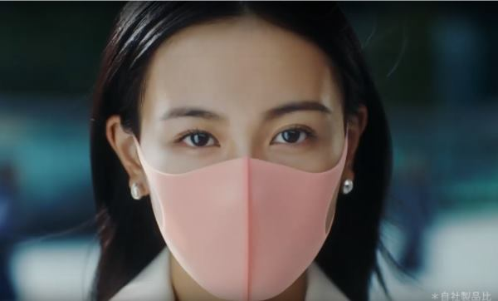
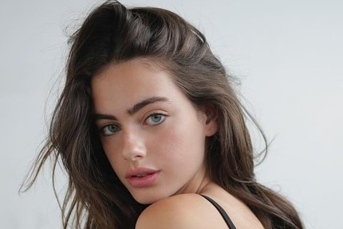
I. Giới thiệu
- Face masks are important in reducing the spread of Covid-19, and are highly recommended or even mandatory in many situations. In this project, the team explores a process to detect faces that do not wear masks in the image. This can be used to warn people not to wear masks when entering supermarkets, offices or public buildings.

Slide 7
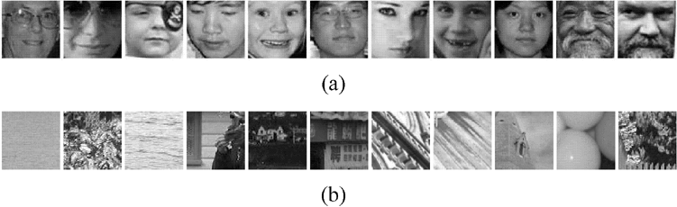
II.Face detection
GIỚI THIỆU:
Face detection is the first step in automatic face recognition With an image or a video, an ideal face detector is capable of identifying and positioning all current faces regardless of their position, proportions, orientation, age, and expression. Ref:[III]
Notes:
Its reliability has a great influence on the performance and usability of the entire facial recognition system Moreover, detection must be carried out not depending on the lighting conditions, image content and video. Processing is carried out as follows: An input image is scanned in all possible locations and scaled with a secondary window (sub/subwindow). Face recognition is set as a sample classification in subwindows such as face or nonface. Face/nonface classification is learned from train examples of face and nonface using statistical learning methods.

Slide 8
II.Face detection
b) FACE DETECTION METHODS:
- AdaBoost-based methods => the most successful ones in terms of detection accuracy and speed.
AdaBoost-based methods:
+ Local Features + Asymmetric Learning Methods
+ Learning Weak Classifiers + Cascade of Strong Classifiers
+ Learning Strong Classifiers Using AdaBoost
+ Alternative Feature Selection Methods

Slide 9
II.Face detection
c) Violas & john face detection method:
This method is said to be simple and the detection result is relatively high, up to 98%, camera manufacturers such as Canon, Samsung ... has also integrated it into its products.
Haar-Like features are rectangles that are divided into different regions as follows:

Slide 10
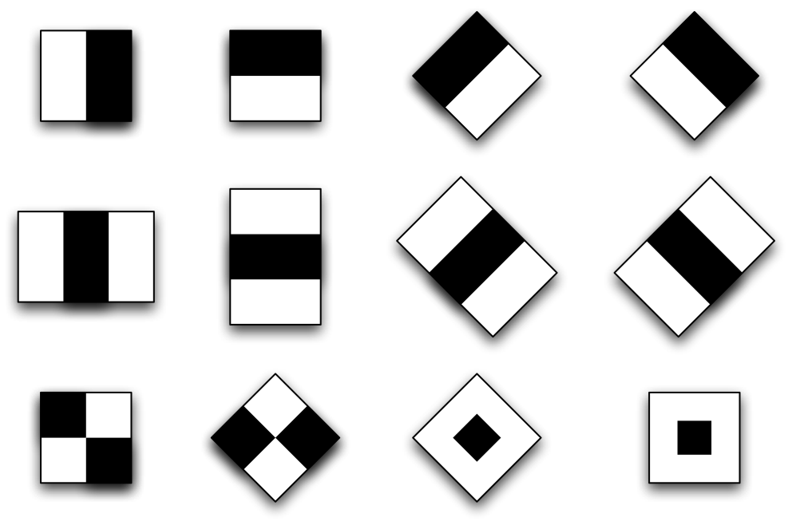
II.Face detection
Ref:[III]

Slide 11

II.Face detection
c) Violas & john ’s face detection method :
Features published by Viola and Jones include four basic features for identifying human faces. Each Haar-Like feature is a combination of two or three white or black rectangles as in the following image:
Ref:[III]
Notes:
To use these features in identifying human faces, the 4 basic Haar-Like features are expanded and divided into 3 characteristic episodes as follows: + Edge feature + Line feature + Characteristics around the center-surround features

Slide 12
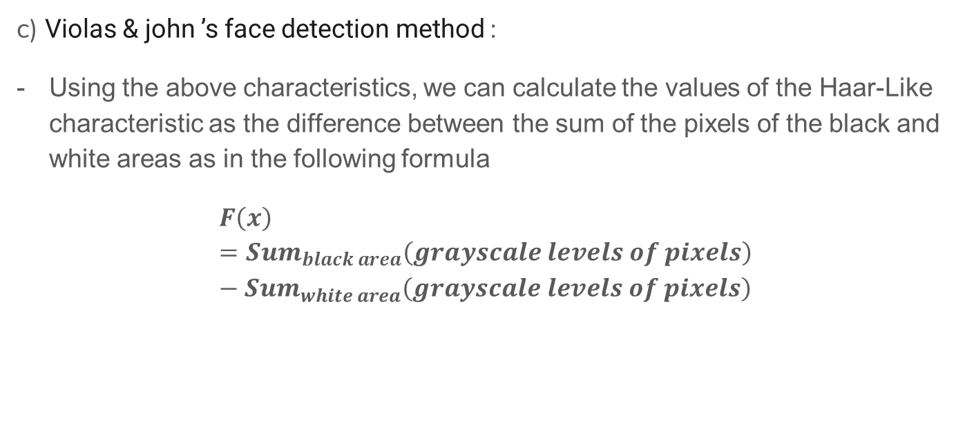
II.Face detection
c) Violas & john ’s face detection method :
Using the above characteristics, we can calculate the values of the Haar-Like characteristic as the difference between the sum of the pixels of the black and white areas as in the following formula
$F\left(x\right)={Sum}_{black area}\left(grayscale levels of pixels\right)−{Sum}_{white area}\left(grayscale levels of pixels\right)$

Slide 13
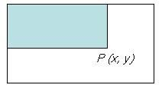

II.Face detection
c) Violas & john ’s face detection method :
Viola and John introduced a concept called Integral Image, which is a 2-dimensional array the size of a haar-Like-like image, with each of its components calculated by summing up the upper (line-1) and left (column-1) images
Ref:[II]
$$P\left(x,y\right)=\sum_{x^{′}≤x, y^{′}≤y}{i\left(x^{′} , y^{′}\right)}$$

Slide 14

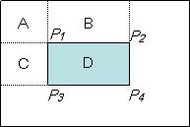
II.Face detection
c) Violas & john ’s face detection method :
Total grayscale values of any region:
D = A + B + C + D – (A+B) – (A+C) + A
-
Ref:[II]
Notes:
With A + B + C + D is the value at point P4 on Integral Image, similarly A+B is the value at point P2, A+C is the value at point P3, and A is the value at point P1. So we can rewriting the D-calculated expression above as follows:

Slide 15
II.Face detection
c) Violas & john ’s face detection method :
Adaboost also works on the principle of linearly combining weak classifiers to form one of the classifiers. - Viola and Jones use AdaBoost to combine weak classifications using Haar-like features according to the cascade model as follows:

Slide 16
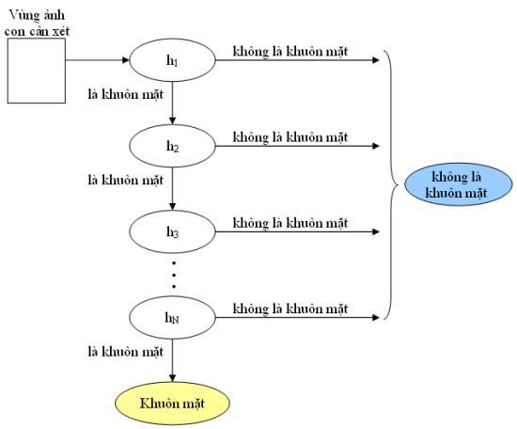
II.Face detection
Ref:[II]

Slide 17
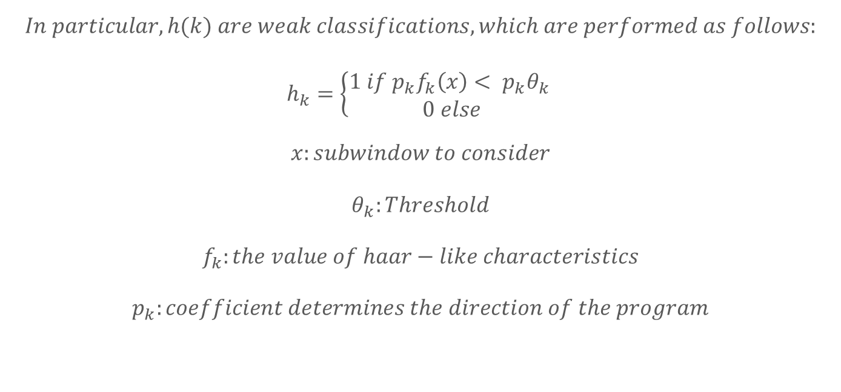
II.Face detection
$$In particular, h(k) are weak classifications, which are performed as follows: \\ h_{k}=\left\{\begin{aligned}1 if p_{k}f_{k}\left(x\right)< p_{k}θ_{k} \\ 0 else\end{aligned} \right.$$
$$x:subwindow to consider \\ θ_{k}:Threshold \\ f_{k}:the value of haar−like characteristics \\ p_{k}:coefficient determines the direction of the program$$

Slide 18
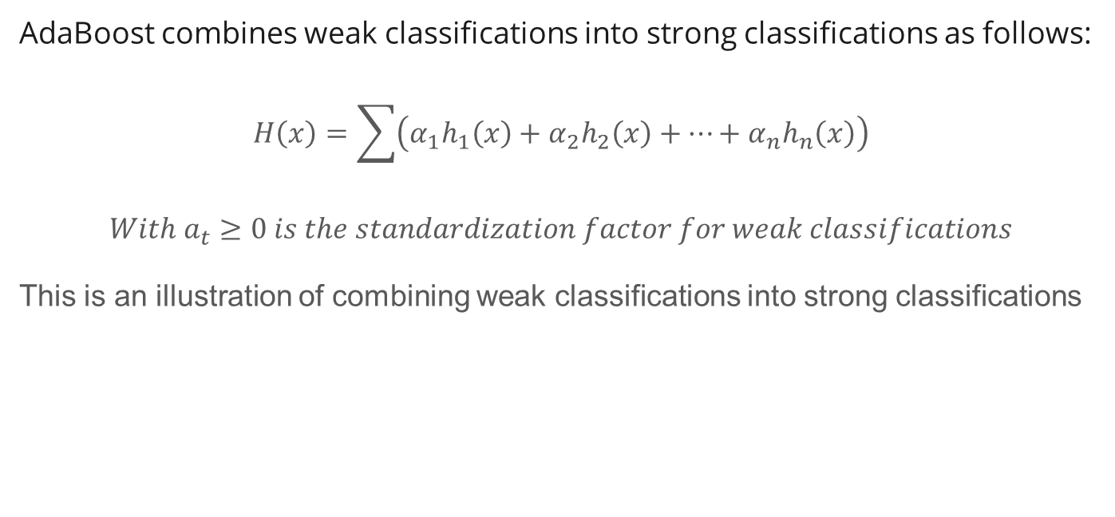
II.Face detection
AdaBoost combines weak classifications into strong classifications as follows:
$$H\left(x\right)=\sum{\left(α_{1}h_{1}\left(x\right)+α_{2}h_{2}\left(x\right)+…+α_{n}h_{n}\left(x\right)\right)}$$
$$With a_{t}≥0 is the standardization factor for weak classifications$$
This is an illustration of combining weak classifications into strong classifications

Slide 19
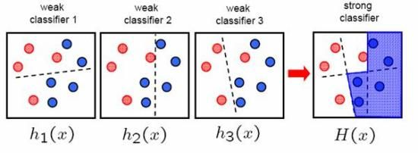
II.Face detection
This is an illustration of combining weak classifications into strong classifications Ref:[II]

Slide 20
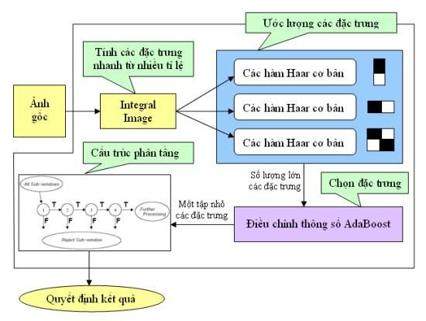
II.Face detection
Ref:[II]

Slide 21
II.Face detection
Model used: RetinaNetMobileNetV1 for face extraction, much faster than RetinaNetResNet50 and DSFDDetector.

Slide 22
II.Face detection
Powerful algorithm that can detect even masked faces.
Needs to detect almost real time
State of the art face localization algorithm run in the wild and works in real-time on a single CPU core.
RETINAFACE MODEL

Slide 23
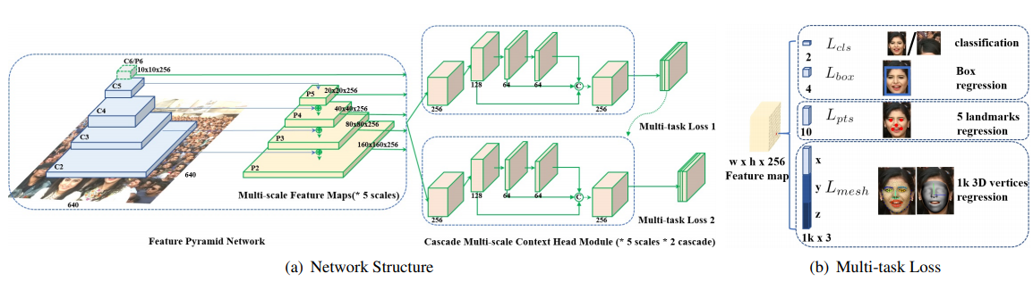
II.Face detection
RETINAFACE MODEL

Slide 24
II.Face detection
The feature pyramid network gets the input face images and outputs five feature maps of different scale
With a coarser-resolution feature map, we upsample the spatial resolution by a factor of 2 (using nearest neighbor upsampling for simplicity).
The upsampled map is then merged with the corresponding bottom-up map (which undergoes a 1×1 convolutional layer to reduce channel dimensions) by element-wise addition.
RETINAFACE MODEL

Slide 25
II.Face detection
This process is iterated until the finest resolution map is generated.
To start the iteration, we simply attach a 1×1 convolutional layer on C5 to produce the coarsest resolution map.
Finally, we append a 3×3 convolution on each merged map to generate the final feature map, which is to reduce the aliasing effect of upsampling. This final set of feature maps is called {P2, P3, P4, P5}, corresponding to {C2, C3, C4, C5} that are respectively of the same spatial sizes.
RETINAFACE MODEL

Slide 26
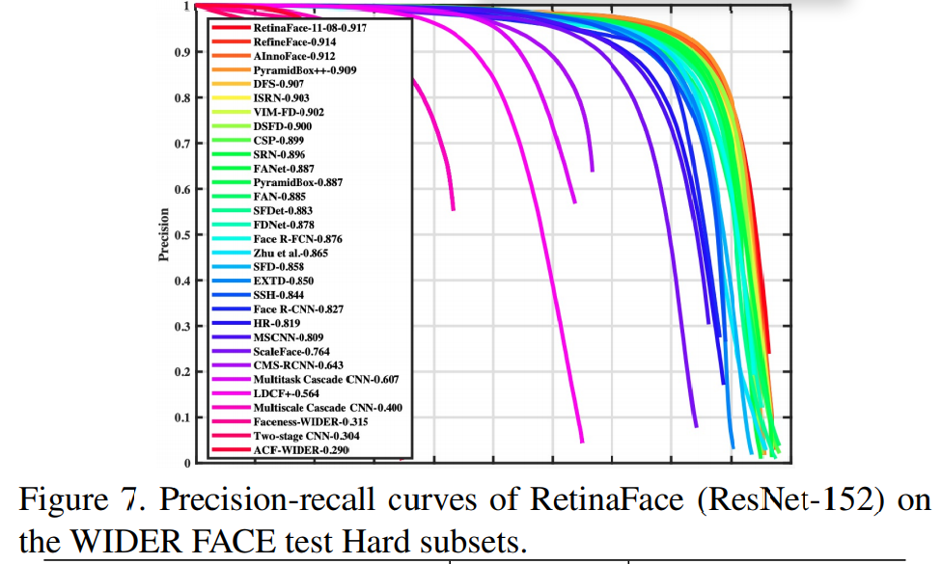
II.Face detection
Comparison

Slide 27
II.Face detection
Efficiency
Paul Viola and Michael Jones presented a fast and robust method for face detection which is 15 times quicker than any technique at the time of release with 95% accuracy at around 17 fps.
RetinaFace produces the best AP in all subsets of both validation and test sets, 96.9% (Easy), 96.1% (Medium) and 91.8% (Hard) for validation set, and 96.3% (Easy), 95.6% (Medium) and 91.4% (Hard) for test set. Compared to the recent best performed method , RetinaFace sets up a new impressive record (91.4% v.s. 90.3%) on the Hard subset which contains a large number of tiny faces.Ref:[V]

Slide 28
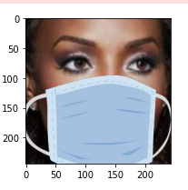
III.Face Mask Detection
1. Create training data
Create a wearable and mask-free photo train data set from the Vggface2 data set. Use the face detection library to identify each part of your face Assign a label worn without a mask to a data set Use the MobileNetV1 model
Label the wearable label without a mask to the data set.
artificial mask image

Slide 29
III.Face Mask Detection
2. Model
Using MobileNetV1 model MobileNetV1:
Neutral network architecture
Efficient on mobile/embedded devices
Trained on 1000 different objects
4.2M parameters.

Slide 30
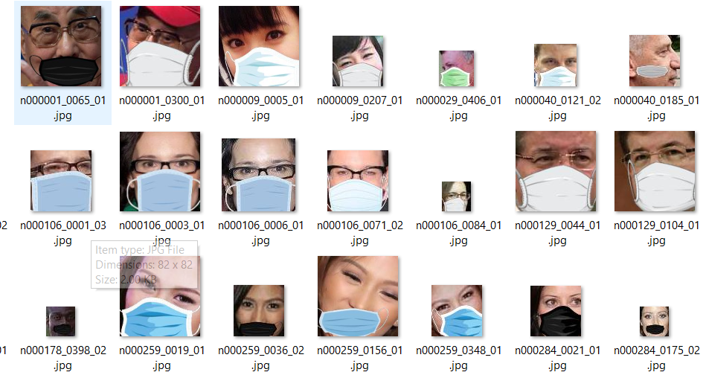
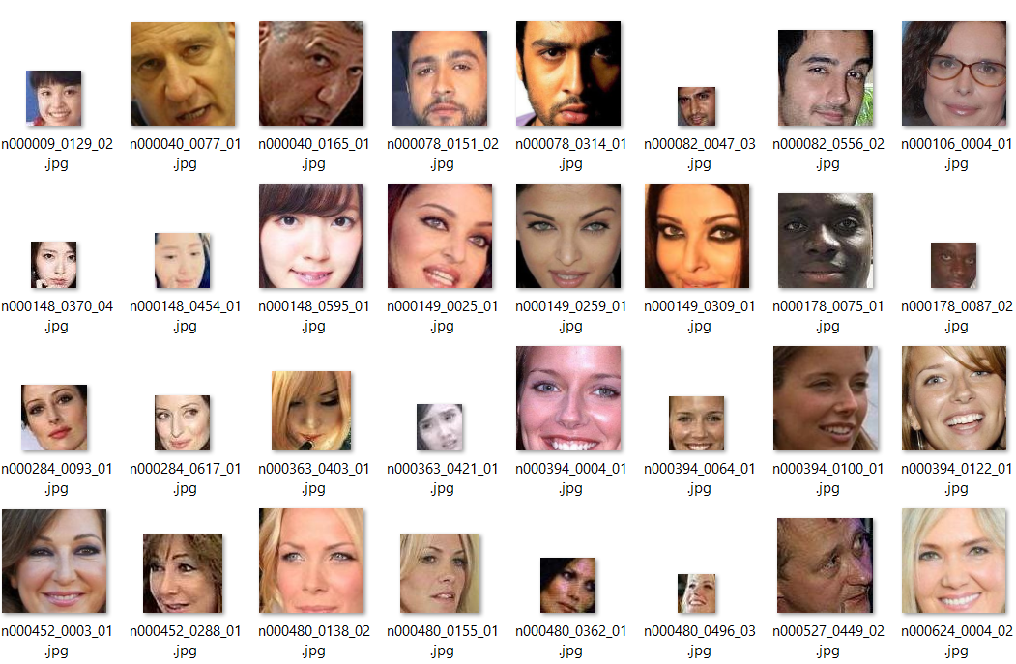
III.Face Mask Detection
2. Model
MobileNetV1 is followed by a fully connected layer and a final output layer with sigmoid activation Use ImageNet's saved pre-trained model weight to distinguish between two layers worn and not wearing a mask.

Slide 31
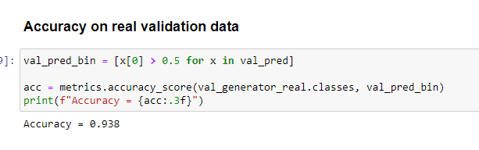
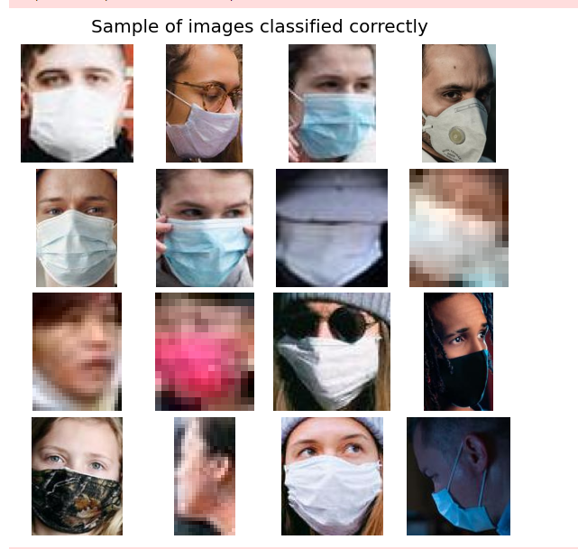
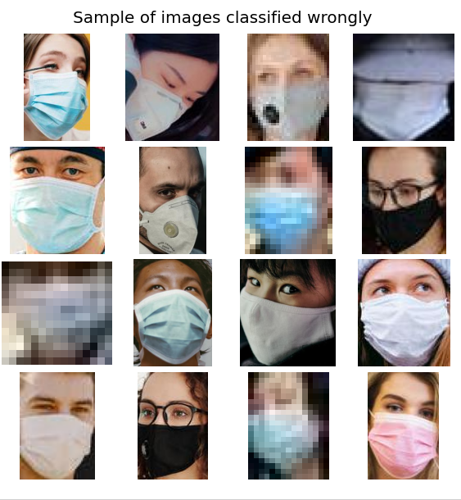
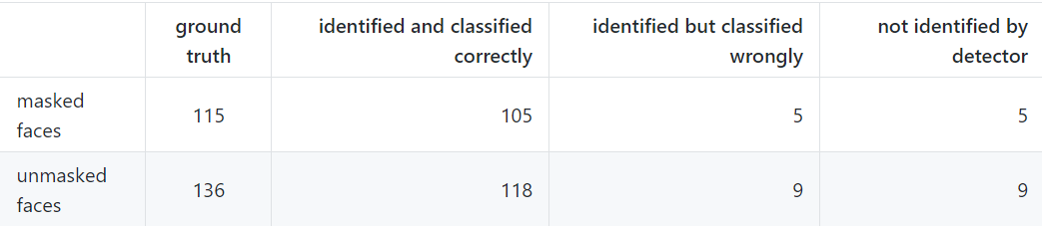
IV.Evaluation
Data from dataset Vggface2 has been fitted with masks and no masks separated into train and validation exercises.
test set consists of 135 photos of 251 faces, of which 136 are not wearing masks

Slide 32
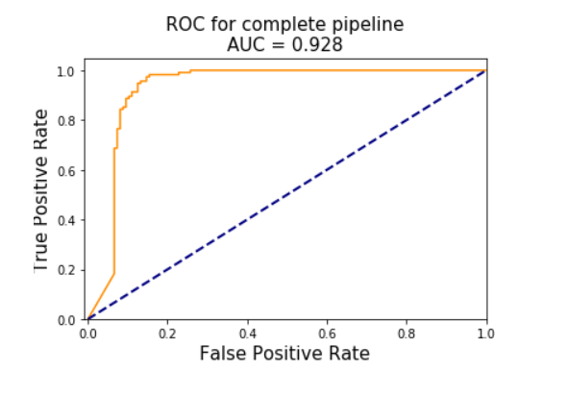
IV.Evaluation
True negative rate (TNR): 87%
(118 of the 136 photos without a mask were correctly identified)
False negative rate (FNR) of 4%
(118 of 136 photos without a mis-identified mask)

Slide 33
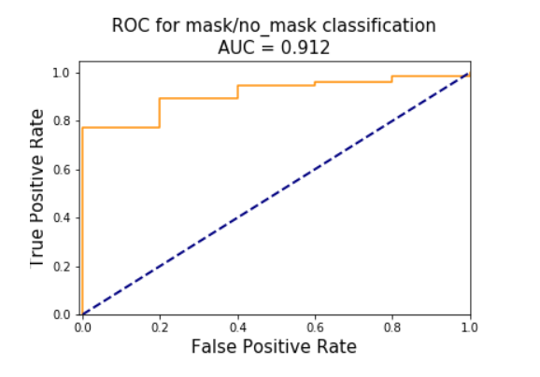
IV. Evaluation
Classification model
Face detector model
the mask/no mask classifier
With threshold 0.5, the model gives 90% accuracy
Correctly identified 94%(237 out of 251) test sets (in 14 unknown samples,5 models wearing masks and 9 models without masks) The face detector model also released 13 models that did not identify the face but were incorrectly labeled as not wearing a mask.

Slide 34
References
Dataroots,2021, https://github.com/datarootsio/face-mask-detection HaiHa, 2019, https://viblo.asia/p/tim-hieu-ve-phuong-phap-nhan-dien-khuon-mat-cua-violas-john-ByEZkNVyKQ0
Stan Z. Li ! Anil K. Jain,2011, Handbook of Face Recognition Second Edition
Groups of Authors , 2019, RetinaFace: Single-stage Dense Face Localisation in the Wild
Groups of Authors , 2019, RetinaFace: Single-shot Multi-level Face Localisation in the Wild

Slide 35
Thanks for watching

