Slide 1
BÁO CÁO QUÁ TRÌNH HOẠT ĐỘNG CỦA NHÓM
Nhập môn công nghệ phần mêm

Slide 2
Danh sách thành viên của nhóm
18127241 – Nguyễn Đăng Triều
18127274 – Nguyễn Lê Đức Hoàng
18127086 – Lê Thị Thùy Dương
18127230 – Nguyễn Bá Tín
18127190 – Lê Hồng Quang

Slide 3
Work assigned
Triều
Propose main features for system (PA0)
Tín
Target user and choose environment for system (PA0)
Hoàng
Review Main Features(PA0)
Dương
Quang
Write Vision document (PA1) - Stakeholder and User Descriptions
Write specification for use case import products, search product, manage product (admin role)
Draw use case diagram (PA2)
Write document for PA3 - Architectural Goals and Constraints
Revise PA2 error
Write Weekly report for PA3, PA4, PA6
Write document for PA6
Write test case and report bug
Implement function add product to cart, login as customer
Write Plan document (PA1) - Management Process
Write specification for use case add to cart, view items, buy items(PA2)
Write document for PA3 - Logical View : BackEnd Controller and Component BackEnd Controller (class diagram + explain key classes)
Write PA4 document - Deployment
Revise PA1 error
Write test case and report bug
Create tables in database
Add data into tables
Coding constraint between tables
Product Features, Non-Functional Requirements and write Weekly report(PA1).
Write specification for use case Register, forgot password, profile management(PA2).
Write document for PA3 - Logical View : BackEnd Route, Component: BackEnd Route(class diagram + explain key classes)(PA3).
Write PA4 document - Implementation View(PA4).
Revise PA3 error
Implement function Import product, manage product(role admin)
Write test case for function Import items(PA6).
Presentation for project (PA0)
Write Plan document - Introduction, Project Overview and Project Organization (PA1)
Draw use case diagram (PA2)
Write specification for use case Login, payment, rating
Write document for PA3 - Component : FrontEnd Controller ( class diagram + explain key classes ) and Logical View : FrontEnd Controller
Revise PA4 error
Write test case for manage item in cart, login as customer
Implement function manage product in cart, order product
Propose Ideas of Project(PA0)
Write Vision document - Introduction, Positioning and Product Overview (PA1)
Revise project plan, write detail for vision document (PA2)
Write document for PA3 - Component : FrontEnd GUI ( class diagram + explain key classes ) and Logical View : FrontEnd Controller
Design prototype for interface using Figma
Revision history and submit, upload all PA into github
Write test case for add item into cart, order product
Design interface for system
Gathering image for every product Fix bug reported

Slide 4

Problem statement
The problem of
Because of Covid-19 epidemic, everyone can not go shopping directly at stores and have to limit direct touching.
Affects
Residents,salespeople, businessmen
The impact of which is
Limit the need of shopping of many people and cause economic damage to shopping stores as well as businessmans
A successful solution would be
Supply a convenient and safe way for many people to purchase and create profits for businessmen as well as reduce economic damage. Moreover, people now have a variety of shopping stores to choose and purchase.

Slide 5

Product position statement
For
The
That
Who
Buyers, salesmen,fashion stores or fashion companies, enterprises
Buy, sell, or review products
is a website
Enables to register an account for shopping online, open an online stores and access to product and salesman information

Slide 6

Team structure and responsibilities
Đăng Triều – Project Manager
Assign work, monitor project progress
Hồng Quang - Tester
Check and find errors, Write Document
Đức Hoàng - Developer
Coding main
Thùy Dương – Designer
Design web page interface
Bá Tín – Business Analyst
Taking demand, analyzing profession, choosing options for project development

Slide 7
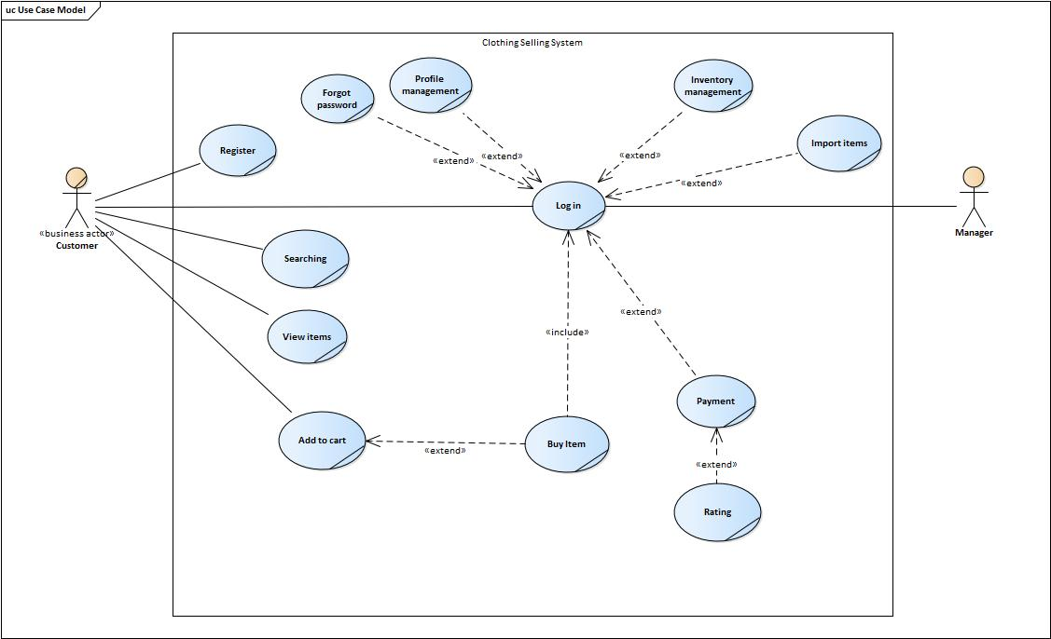
Usecase Model

Slide 8

Security
When a user forgets his password, the link to create a new password must be sent to only the first registered email address
Performance
All data input and output screens need to be ready to be displayed to users quickly and accurately
Usability
Easy to use, effective, for example, to buy an item we only need to perform 3 simple steps: select the item, purchase and finally pay.
Integrity
Availability
Audit
Information for each product is accurate and reliable enough
The system must ensure 24/7 operation
Accessibility
The audit data will be stored separately in a separate database, different from the main database of the system.
The audit data must be in Read Only mode and not edited from the user interface.
Support chat and exchange with users

Slide 9
Architecture
FrontEnd – GUI
FrontEnd – Controller
BackEnd Route – Controller

Slide 10
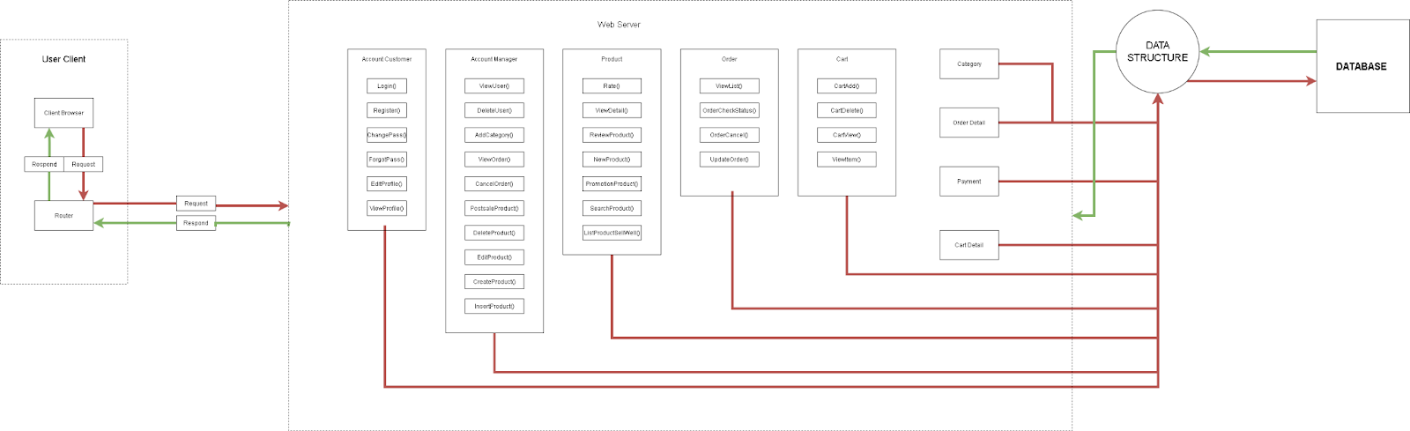

Slide 11
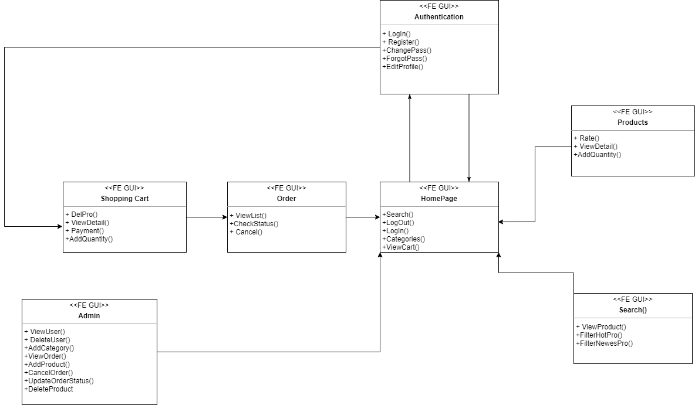
Frontend – GUI

Slide 12
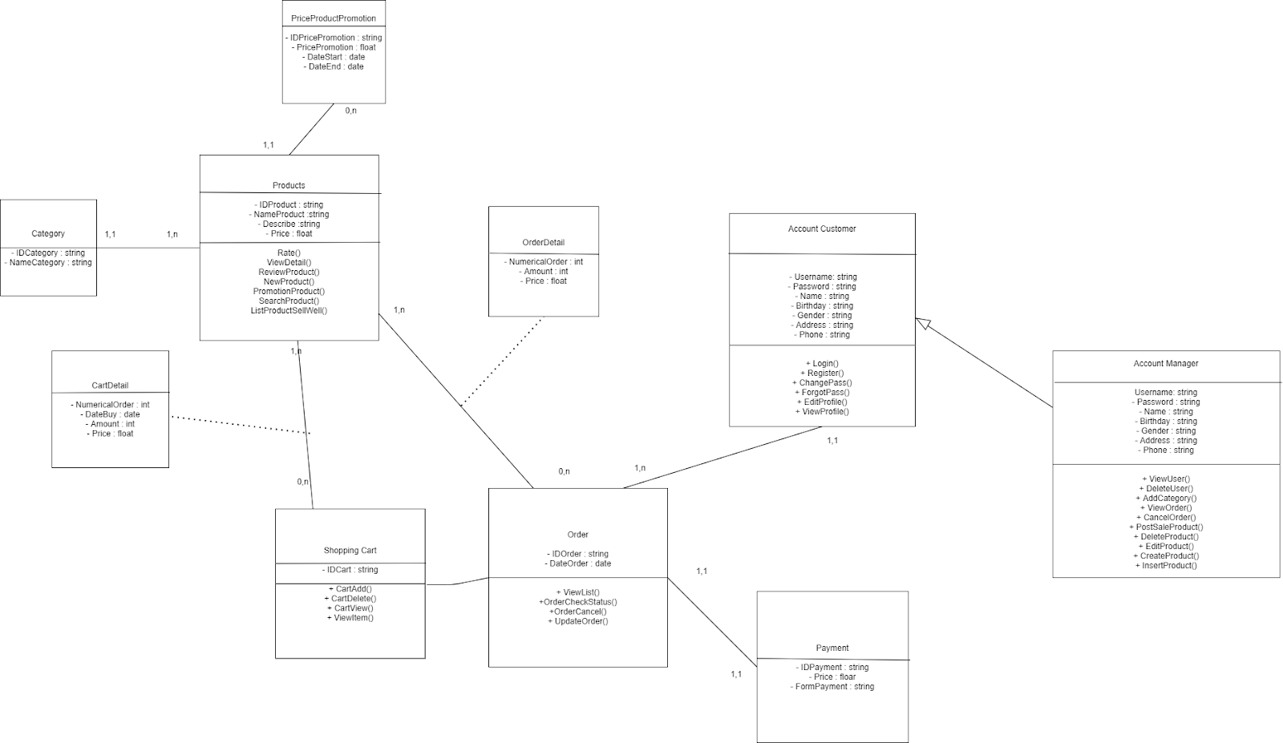
Frontend – Controller

Slide 13
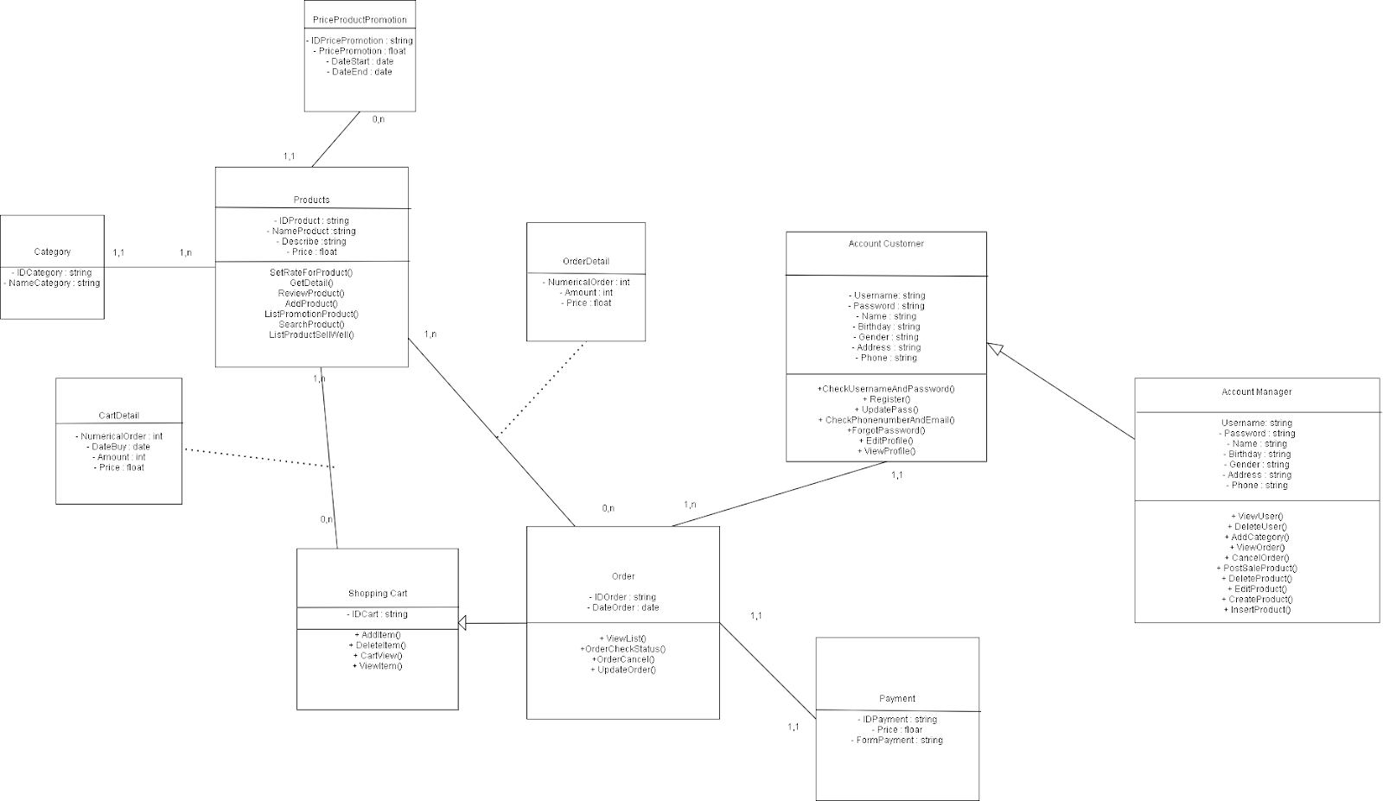
Backend -Router

Slide 14

Technologies
HTML
Frontend – GUI
PHP
Backend – Router
SQL
Construct Database
Save and Impo
CSS
Frontend – GUI
JavaScript
Frontend – Controller

Slide 15

Test Plan
It is a brief summary of the product that is being tested.
Identify existing project information and the software that should be tested.
Provide visibility to stakeholders in the testing effort that adequate consideration has been given to various aspects of governing the testing effort, and where appropriate to have those stakeholders approve the plan.

Slide 16

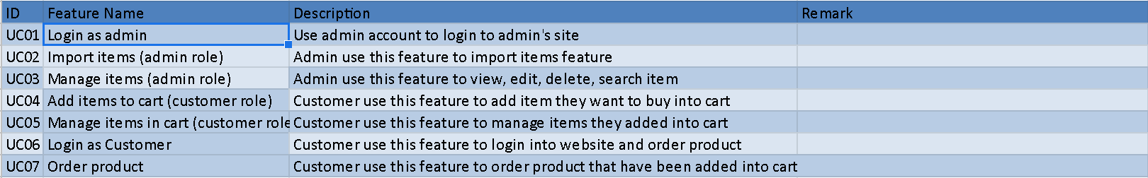
Test case

Slide 17

Test environment
Software Name
Chrome/Microsoft Edge
Windows 10, 32bit
Purpose
Use to access to website in order to test function
Operating system use to run browser and other software.
Version
Latest version
Type and Other Notes
Windows 7, 64 bit
Mac OS X 10.10
XAMPP
Sublime text
Operating system use to run browser and other software.
Operating system use to run browser and other software.
Create a localhost website
View source code, structure folder.
Latest version
Latest version
Latest version
Latest version
Latest version
Internet Browser
Operating System
Operating System
Operating System
Website
Text editor
The following base software elements are required in the test environment for this Test Plan

Slide 18

Test Result
Number features:
7
Non fixed bugs:
5
Number test cases:
Pass:
Fail:
Total Bugs:
Fixed Bugs:
28
22
6
6
1
Result about testing our website

