Slide 1
Dependency Injection à la Carte
Paolo Picci

Slide 2
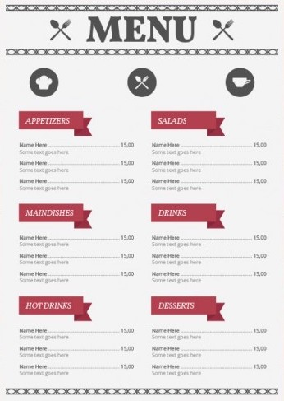
Dependency Injection Motivation…. £
Constructor Injection…………………… £
Cake Pattern………………………….………. £
Monad Reader……………………………… £
Notes:
Dependency Injection Motivation
Constructor Injection
Cake Pattern
Monad Reader

Slide 3

Appetizers: Dependency Injection

Slide 4
Dependency Injection
Decouple system components.
Separate concerns.
Hide implementations details.
Write testable software.
Organize and structure code.
Notes:
Concerns (Create a component is a different concern from Using the component)

Slide 5
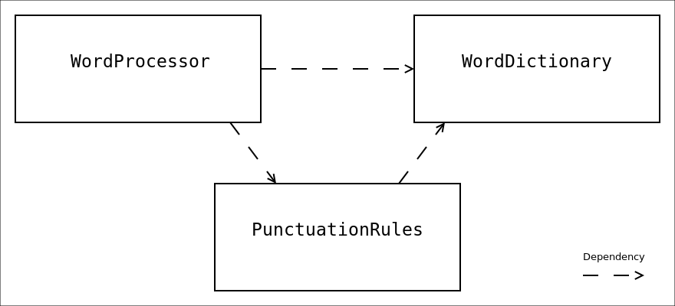

Slide 6

Plain and tasty Constructor Injection

Slide 7
Constructor Injection: WordDictionary
trait WordDictionary { def lang: Lang def hasWord(word: Word): Boolean def definition(word: Word): Option[Definition] def intoSyllables(word: Word): List[Syllable] }
class DefaultWordDictionary(
val lang: Lang,
private val definitions: Map[Word, Definition]
) extends WordDictionary { def hasWord(word: Word): Boolean = ??? def definition(word: Word): Option[Definition] = ??? def intoSyllables(word: Word): List[Syllable] = ??? }
Notes:
mention default clear in constructor injection example

Slide 8
Constructor Injection: PunctuationRules
trait PunctuationRules {
def lang: Lang def dictionary: WordDictionary def checkHyphenation(word1: Word, word2: Word): Boolean } class DefaultPunctuationRules(
val lang: Lang,
val dictionary: WordDictionary
) extends PunctuationRules {
// uses dictionary and lang def checkHyphenation(word1: Word, word2: Word): Boolean = ???
}
Notes:
mention default clear in constructor injection example

Slide 9
Constructor Injection: WordProcessor
class WordProcessor(dictionary: WordDictionary, punctuationRules: PunctuationRules) { def highlightNonWords = ??? // uses dictionary and lang def composeNewDocument = ??? //uses dictionary and punctuationRules … }

Slide 10
Constructor Injection: Wiring dependencies
object MaybeSoftWord2020 extends App { import Config._ wordProcessor.composeNewDocument }
object Config { val Definitions = Map("Foo" -> ”Bar")
val wordDictionary =
DefaultWordDictionary("English", Definitions)
val punctuationRules =
DefaultPunctuationRules("English", wordDictionary)
val wordProcessor =
WordProcessor(wordDictionary, punctuationRules) }

Slide 11
Pros and Cons
The good: - Very easy to understand - Dependencies are clear between components, and are easy to follow.
The bad: - Can get very verbose.

Slide 12

Cake Pattern
Oh, and there will be cake..
Notes:
Slices vs Layers
Ml and ocaml module system

Slide 13
Cake Pattern
”For me a cake is simply a mixin composition of traits that refer to
members of other traits in the cake using their self types.”
Martin Odersky
trait PunctuationRulesComponent { self: WordDictionaryComponent => type PunctuationRules <: PunctuationRulesInterface def punctuationRules: PunctuationRules trait PunctuationRulesInterface {
def lang: Lang def checkHyphenation(word1: Word, word2: Word): Boolean } }
Notes:
External Abstract Component
that encloses the Abstract trait
Self type
Abstract types
Abstract member that generates the Abstract type instances

Slide 14
trait PunctuationRulesComponent { self: WordDictionaryComponent => type PunctuationRules <: PunctuationRulesInterface def punctuationRules: PunctuationRules trait PunctuationRulesInterface {
def lang: Lang def checkHyphenation(word1: Word, word2: Word): Boolean } }
trait DefaultPunctuationRulesComponent extends PunctuationRulesComponent { self: WordDictionaryComponent => type PunctuationRules = DefaultPunctuationRules class DefaultPunctuationRules(lang: Lang)
extends PunctuationRulesInterface { def checkHyphenation(word1: Word, word2: Word): Boolean = wordDictionary.intoSyllables(word1 + word2).nonEmpty } }
Notes:
wordDictionary is not in scope and will be provided through wordDictionaryComponent
Our component is not totally concrete, still we need to implement the metodh to generate PunctuationRules
There are no rules on what to keep concrete or what to implement. You can implement many abstract layers extending the trait and refining it.

Slide 15
trait Config extends WordProcessorComponent with DefaultWordDictionaryComponent with DefaultPunctuationRulesComponent { val Definitions = Map("Foo" -> ”Bar") val wordDictionary = new DefaultWordDictionary("English", Definitions) val punctuationRules = new DefaultPunctuationRules("English") val wordProcessor = new WordProcessor }
object MaybeSoftWord2020 extends App with Config { val wp: MaybeSoftWord2020.WordProcessor = wordProcessor wp.composeNewDocument }

Slide 16
Would you test some cake?
trait WordDictionaryComponentMock extends WordDictionaryComponent { val wordDictionary = new WordDictionaryMock type WordDictionary = WordDictionaryMock class WordDictionaryMock extends WordDictionaryInterface { override def lang: Lang = "Test" override def hasWord(word: Word): Boolean = word == "foo" override def definition(word: Word): Option[Definition] = ??? override def intoSyllables(word: Word): List[Syllable] = ??? } }
"The checkHyphenation" should "not fail for foo" in { val prc =
new DefaultPunctuationRulesComponent with WordDictionaryComponentMock { def punctuationRules: DefaultPunctuationRules = new DefaultPunctuationRules("Test") }
dependantTypeTestCheckHyphenation(prc)(prc.punctuationRules)
}
def dependantTypeTestCheckHyphenation(
prc: DefaultPunctuationRulesComponent)(pr: prc.PunctuationRules) = pr.checkHyphenation("fo", "o") shouldEqual true

Slide 17
Pros and Cons
The good: - No parameters and no imports needed, just mix slices together. - Allows for mutual dependencies between slices. - Works well with tight coupled components (eg. Graphs, Nodes, Arcs)
The bad: - Dependencies are hard to track for big cakes. - Dependent types must be used to access types declared in the slices.
Martin Odersky view:
https://groups.google.com/forum/#!topic/scala-language/WcnHXjAJaKg

Slide 18

Is this like a Reader Monad?

Slide 19
Higher Order Function
type Host = String
type Gateway = String
def ping(hostname: Host)(gateway: Gateway) =
s"connecting to $gateway and ping $hostname" val myProgram = ping("www.sky.com") _ myProgram("testing gateway 127.0.0.1") // connecting to testing gateway 127.0.0.1 and ping www.sky.com myProgram("production bastion 10.0.0.2") // connecting to production bastion 10.0.0.2 and ping www.sky.com
Notes:
Start with a simple ping program, Gatway is a dependency

Slide 20
Towards the Reader Monad
case class Reader[C, T](run: C => T)
def ping(hostname: Host) = Reader[Gateway, String] ( (gateway: Gateway) => s"connecting to $gateway and ping $hostname” ) val myProgram = ping("www.sky.com") myProgram.run("testing gateway 127.0.0.1") // connecting to testing gateway 127.0.0.1 and ping www.sky.com myProgram.run("production bastion 10.0.0.2") // connecting to production bastion 10.0.0.2 and ping www.sky.com

Slide 21
Composing Readers
def ping(hostname: Host) = Reader[Gateway, String] { (gateway: Gateway) => s"connecting to $gateway and ping $hostname” }
def grantAccess(gateway: Gateway, password: String) =
gateway.startsWith("testing") def checkSecurity(password: String) = Reader[Gateway,Boolean] { (gateway: Gateway) => grantAccess(gateway, password) } val myProgram = ???

Slide 22
Composing Readers
case class Reader[C, T](run: C => T) { def map[T2](f: T => T2): Reader[C, T2] = Reader( (e: C) => f(run(e)) )
def flatMap[T2](f: T => Reader[C, T2]): Reader[C, T2] = Reader( (e: C) => f(run(e)).run(e) )
}
def unit[C, T]: T => Reader[C, T] =
(x: T) => Reader( _ => x )
https://github.com/qqupp/di-experiments/blob/reader-proof/src/main/scala/ReaderIsAMonad.scala

Slide 23
Composing Readers
case class Reader[C, T](run: C => T) { def map[T2](f: T => T2): Reader[C, T2] = Reader( (e: C) => f(run(e)) )
def flatMap[T2](f: T => Reader[C, T2]): Reader[C, T2] = Reader( (e: C) => f(run(e)).run(e) )
}
def ping(hostname: Host) = Reader[Gateway, String] { (gateway: Gateway) => s"connecting to $gateway and ping $hostname"}
def grantAccess(gateway: Gateway, password: String) =
gateway.startsWith("testing") def checkSecurity(password: String) = Reader[Gateway,Boolean] { (gateway: Gateway) => grantAccess(gateway, password)} val myProgram = for { allowed <- checkSecurity("password_1234") pingResult <- if (allowed) ping("www.sky.com") else ping("localhost") } yield pingResult

Slide 24
Composing Readers
val myProgram = for { allowed <- checkSecurity("password_1234") pingResult <- if (allowed) ping("www.sky.com") else ping("localhost") } yield pingResult
myProgram.run("testing gateway 127.0.0.1") // connecting to testing gateway 127.0.0.1 and ping www.sky.com myProgram.run("production bastion 10.0.0.2") // connecting to production bastion 10.0.0.2 and ping localhost

Slide 25
Reader monad in a OO World
def configureWordDictionary: Reader[Env, WordDictionary] = ??? def configurePunctuationRules(wDict: WordDictionary): Reader[Env,PunctuationRules] = ???
object MaybeSoftWord2020 extends App { wordProcessor.run(productionConfiguration).composeNewDocument } object DependencyGraphConfig { case class Env(lang: Lang, definitions: Map[Word, Definition]) val wordProcessor = for { wordDictionary <- configureWordDictionary punctuationRules <- configurePunctuationRules(wordDictionary) } yield WordProcessor(wordDictionary, punctuationRules)
} object Config { val productionConfiguration = Env(”English", Map("foo"-> "bar")) }

Slide 26
Pros and Cons
The good: - Simple and powerful - Dependency resolution is done inside the Monad - Declarative style
The bad: - Composing with other monads can get verbose - Combining different dependencies requires a common Environment

Slide 27

Effects vs Side Effects
Notes:
Why Should we care about monads?
Composition and effects

Slide 28
Effects vs Side Effects: Pure functions
val l = List(2,3) val pureFun = (x: Int) => x * x val p1 = l.map( pureFun ).map( pureFun ) // p1: List[Int] = List(16, 81) val p2 = l.map( pureFun andThen pureFun ) // p2: List[Int] = List(16, 81)

Slide 29
Effects vs Side Effects: Impure functions
val l = List(2,3) val impureFun = (x: Int) => {println(x); x * x} val i1 = l.map( impureFun ).map( impureFun ) // 2 // 3 // 4 // 9 // i1: List[Int] = List(16, 81) val i2 = l.map( impureFun andThen impureFun ) // 2 // 4 // 3 // 9 // i2: List[Int] = List(16, 81)

Slide 30
Effects vs Side Effects: Monadic functions
val l = List(2,3) val monadicFun = (x: Int) => Writer[String,Int](s"$x\n",x * x) val m1 = l.map(monadicFun).map( _.flatMap(monadicFun)) m1.foreach( x => print(x.written)) val mr1 = m1.map( _.value) // 2
// 4
// 3
// 9 // mr1: List[cats.Id[Int]] = List(16, 81) val m2 = l.map(monadicFun andThen( _.flatMap(monadicFun))) m2.foreach( x => print(x.written)) val mr2 = m2.map( _.value) // 2 // 4 // 3 // 9 // mr2: List[cats.Id[Int]] = List(16, 81)

Slide 31
References
Code: https://github.com/qqupp/di-experiments/
Cake Pattern: http://lampwww.epfl.ch/~odersky/papers/ScalableComponent.pdf https://www.youtube.com/watch?v=yLbdw06tKPQ https://stackoverflow.com/questions/7860163/what-are-some-compelling-use-cases-for-dependent-method-types http://www.scala-archive.org/The-cake-s-problem-dotty-design-and-the-approach-to-modularity-td4640697.html
FP and Monads: https://wiki.haskell.org/All_About_Monads https://typelevel.org/cats/datatypes/kleisli.html http://eed3si9n.com/herding-cats/Reader.html https://underscore.io/books/scala-with-cats

Slide 32

Thank You!

