Slide 1

Data Collection from Reddit's DataScience Subreddit: Case Study
An Exploration of Top Reddit Posts and Comments in 2024
Sylvester Krampah

Slide 2
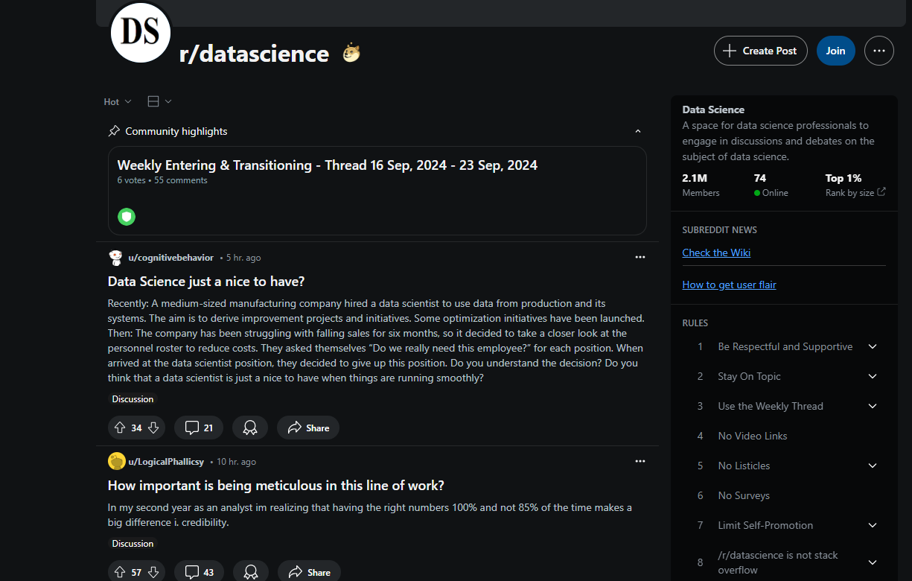
Problem Overview
Goal: To gather insights on what data science practitioners and enthusiasts are discussing anonymously on Reddit.
Context: Reddit allows users to share opinions more freely compared to public social platforms like X (formerly Twitter).
Key Task: Collect the top 100 posts from the 'DataScience' subreddit for the year 2024 and their top 3 comments.

Slide 3
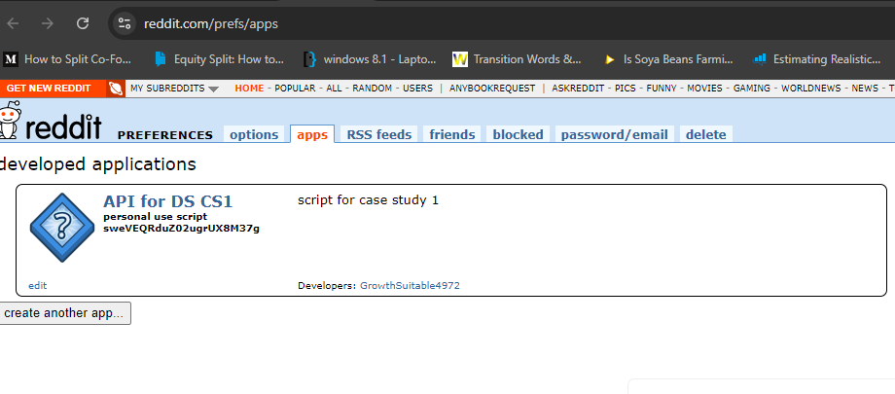
Methods
Tools Used:
- PRAW (Python Reddit API Wrapper) to collect Reddit posts and comments.
- Pandas for data storage and manipulation.
Filtering Criteria:
- Posts from 2024 only.
- Post score greater than 50.
- Post titles with more than 5 words.

Slide 4
Data Gathering Process
Step 1: Collected top 100 posts for 2024, filtering by post score and title length.
Step 2: Gathered top 3 comments for each post.
Step 3: Saved the final dataset with the following columns:
1. Date
2. Post Score
3. Post Title
4. Body of the Post
5. Top Comment 1
6. Top Comment 2
7. Top Comment 3

Slide 5

Example Post and Comments
Example:
- Post Title: 'Data Scientist Quits Her Job at Spotify'
- Post Body: 'In summary, it discusses how she worked with machine learning models.'
Top Comments:
1. 'I wonder how her skills will transfer to her new role.'
2. 'Spotify's data science team has been a leader in innovation.'
3. 'Do you think she'll move to another FAANG company?'
Insight: Most top posts discuss career paths, industry challenges, and data science methodologies.

Slide 6
Insights
Common Themes:
- Career challenges and transitions in data science.
- Discussions on the value of different data science tools and models.
- Real-world challenges in implementing machine learning models.
Engagement: Posts with detailed, personal experiences received more interaction (comments and upvotes).

Slide 7
Conclusion
Takeaways:
- Reddit offers a wealth of insight into current discussions in data science.
- The anonymity of Reddit allows for more candid discussions compared to other platforms.
- The most discussed topics tend to be related to career transitions, methodologies, and industry insights.

