Slide 1
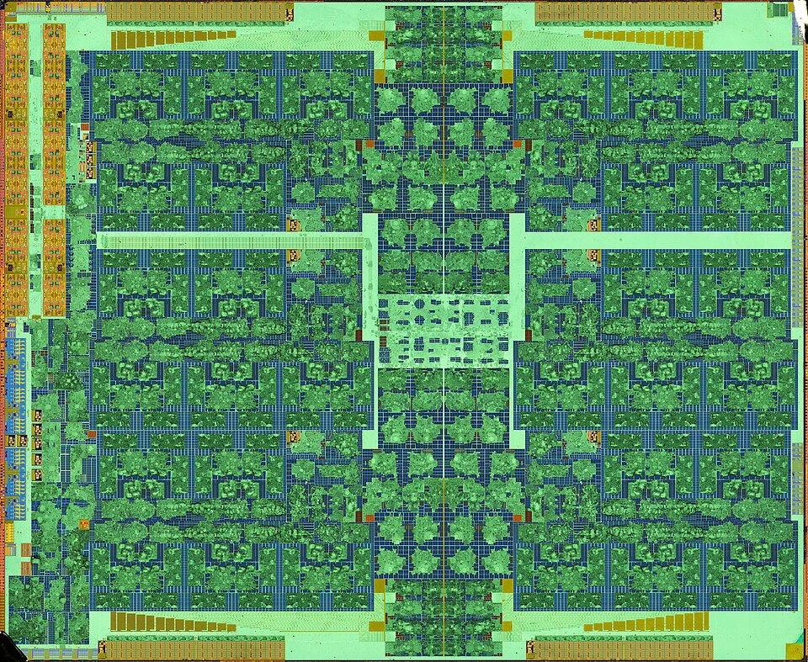

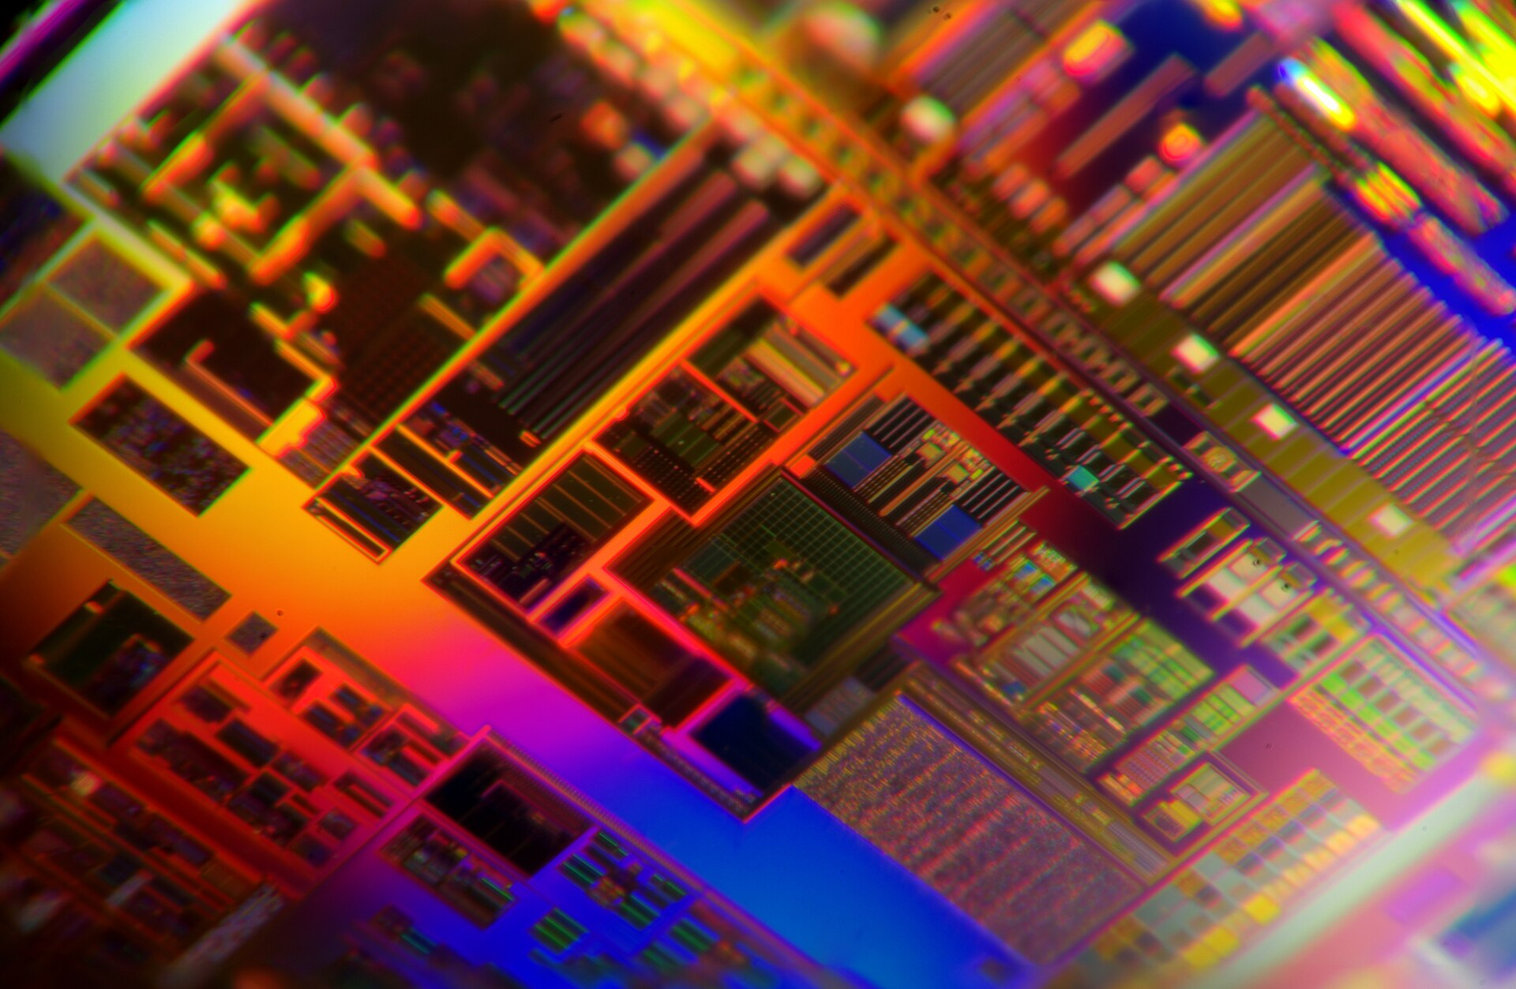
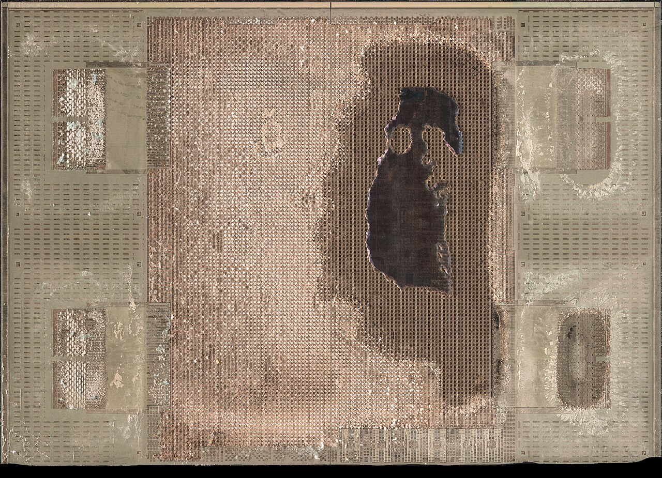
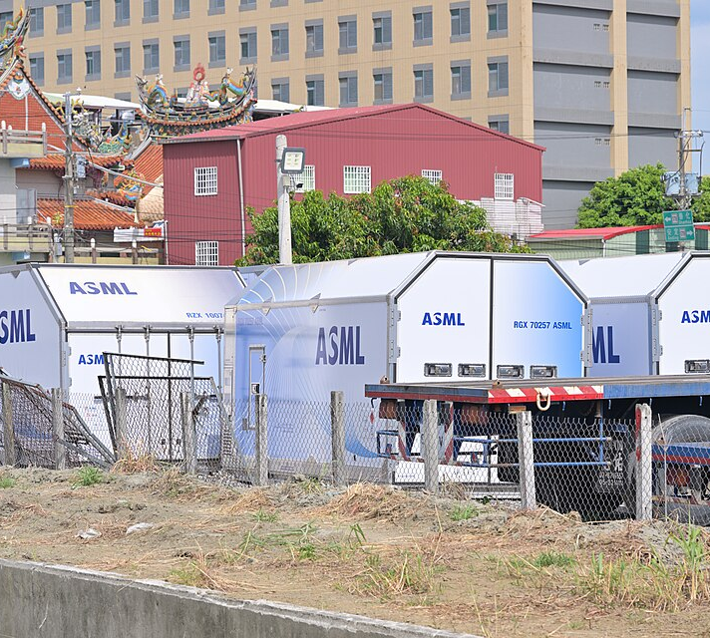
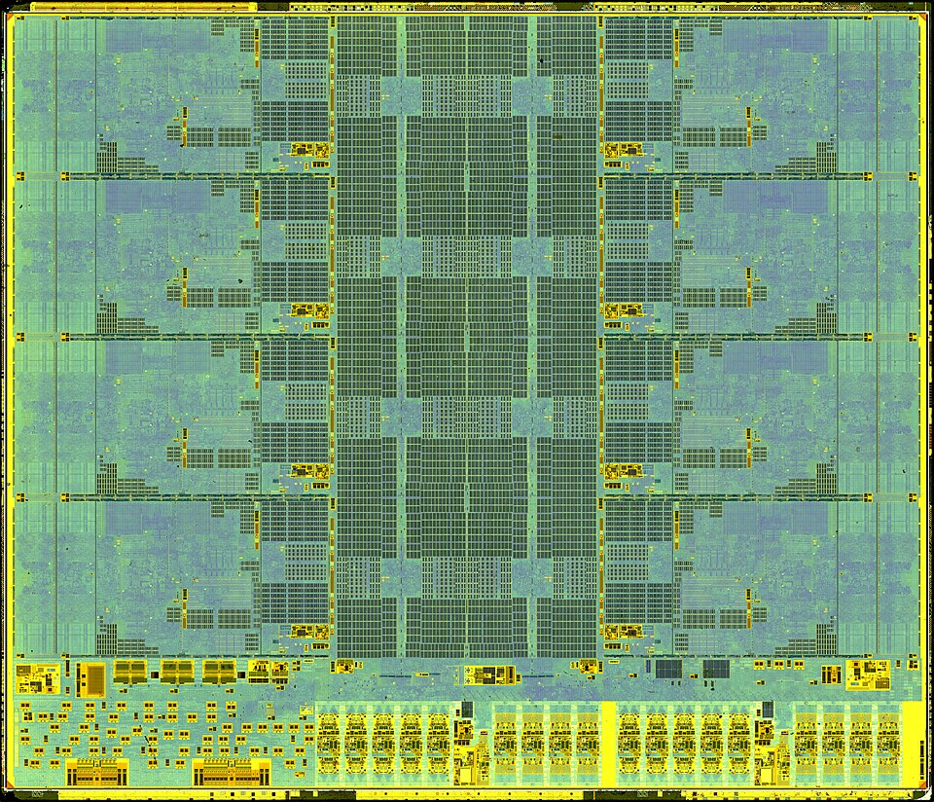
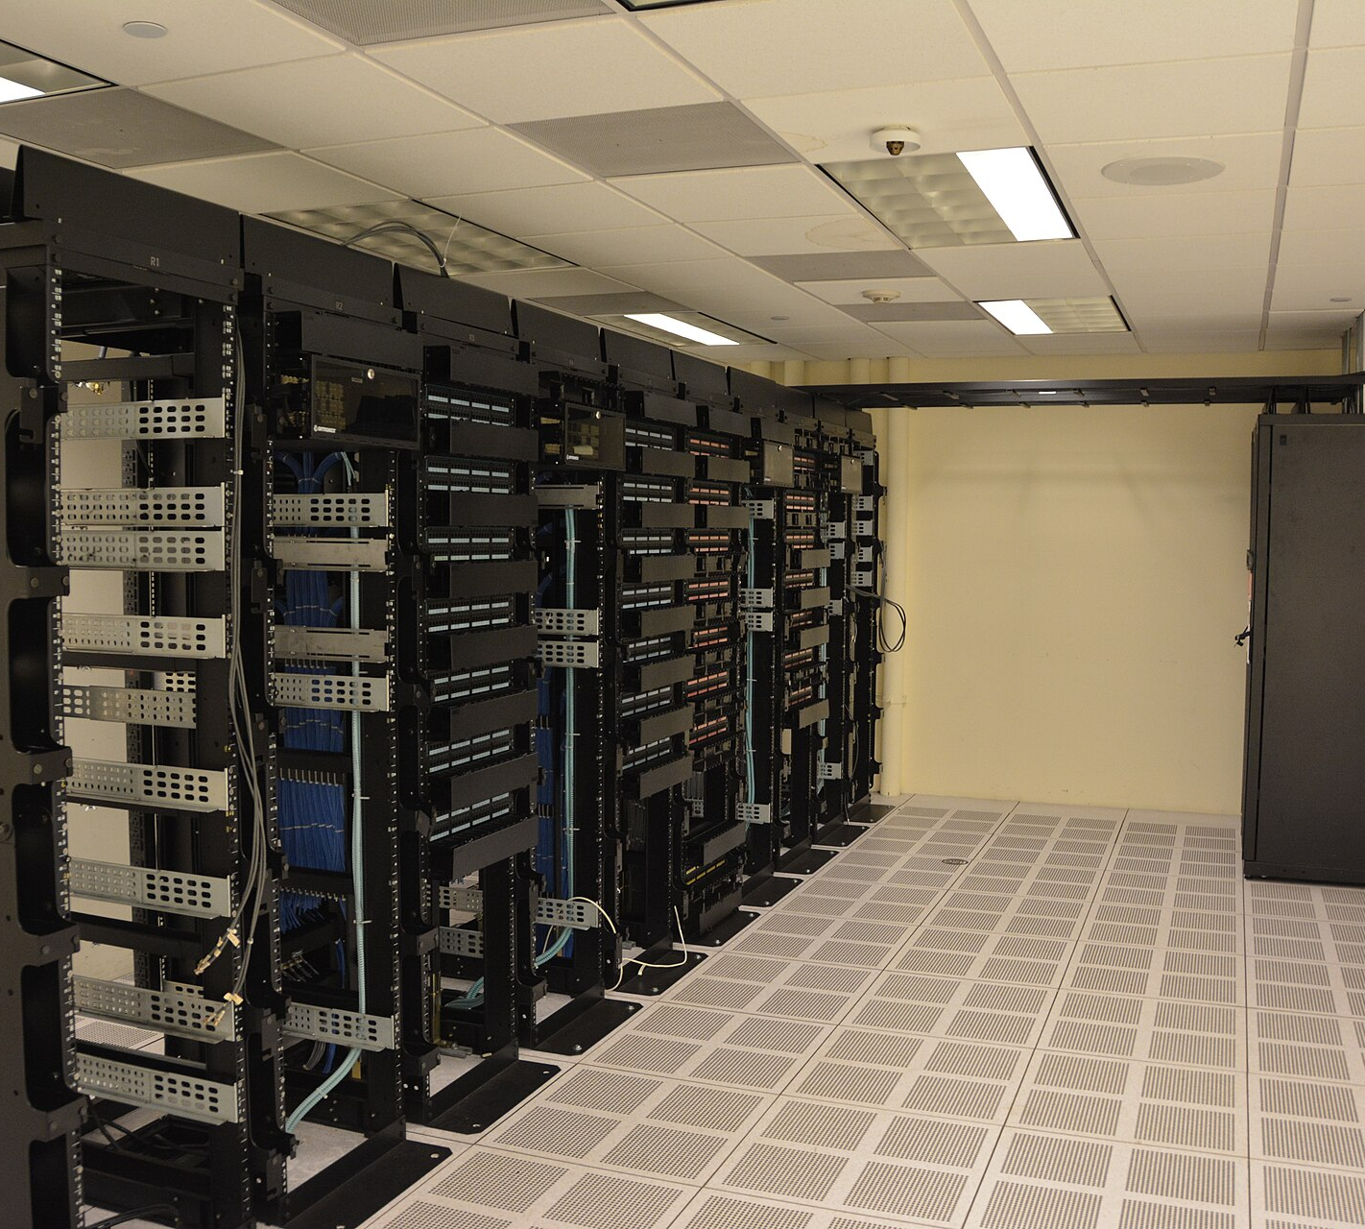
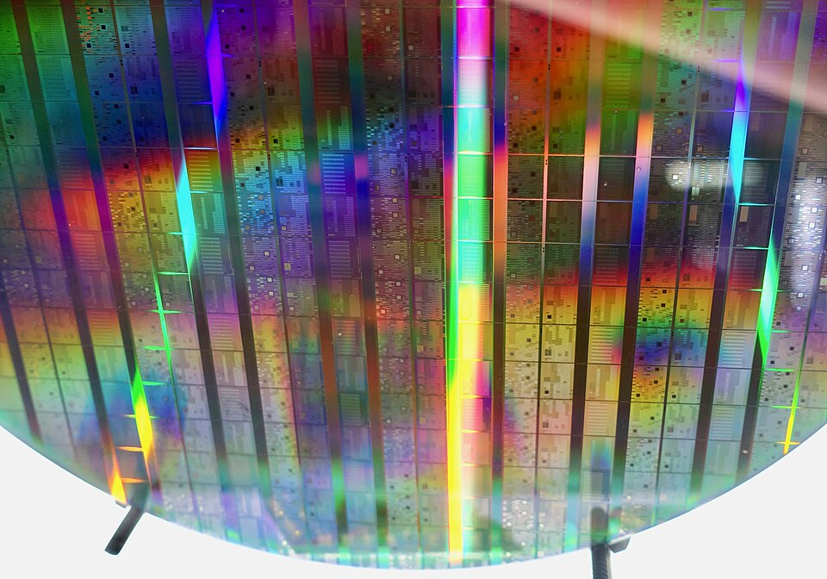
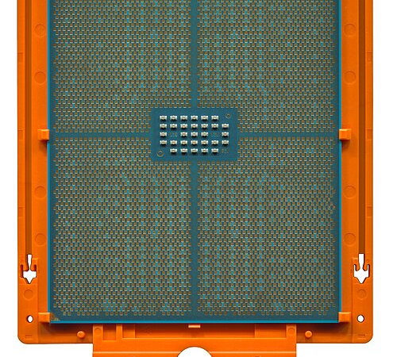
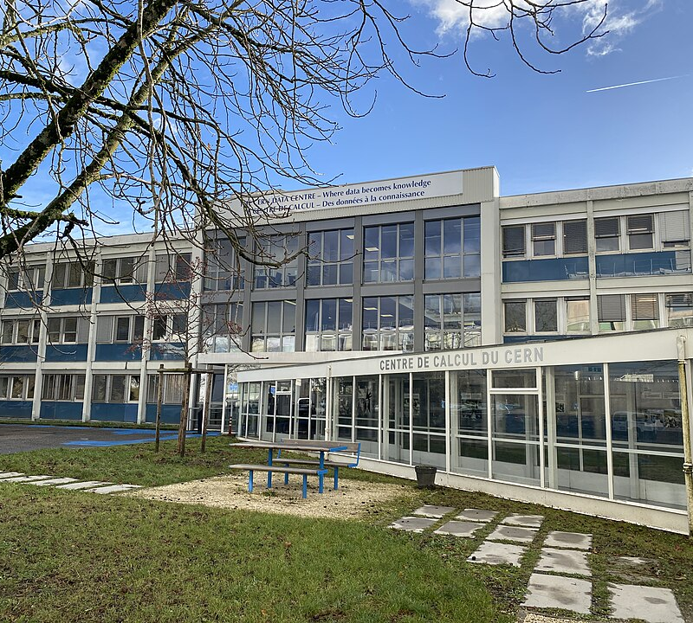
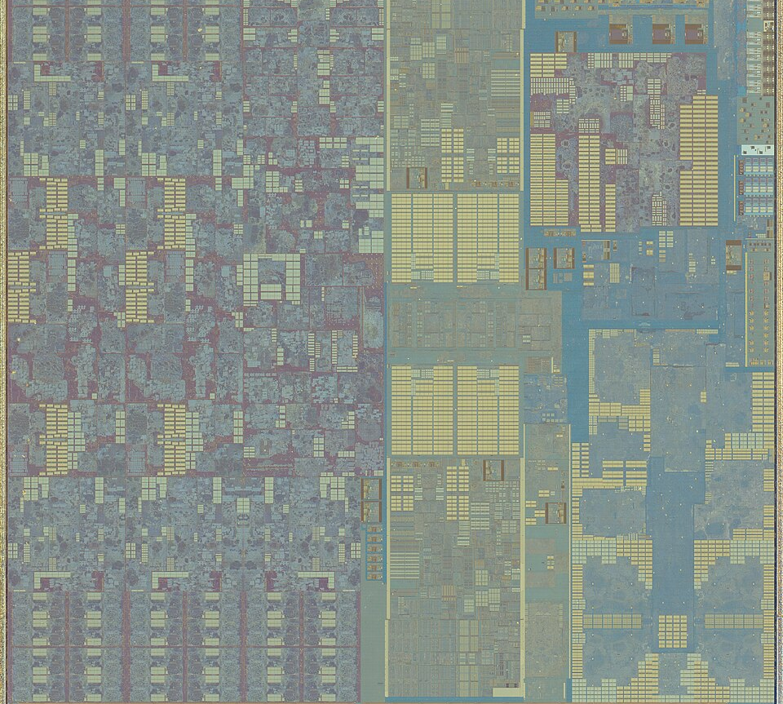
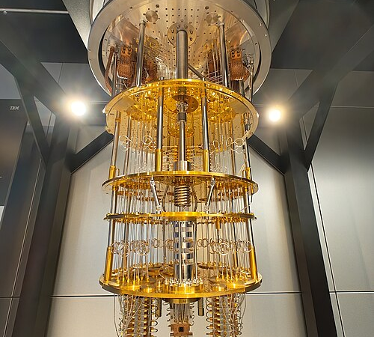
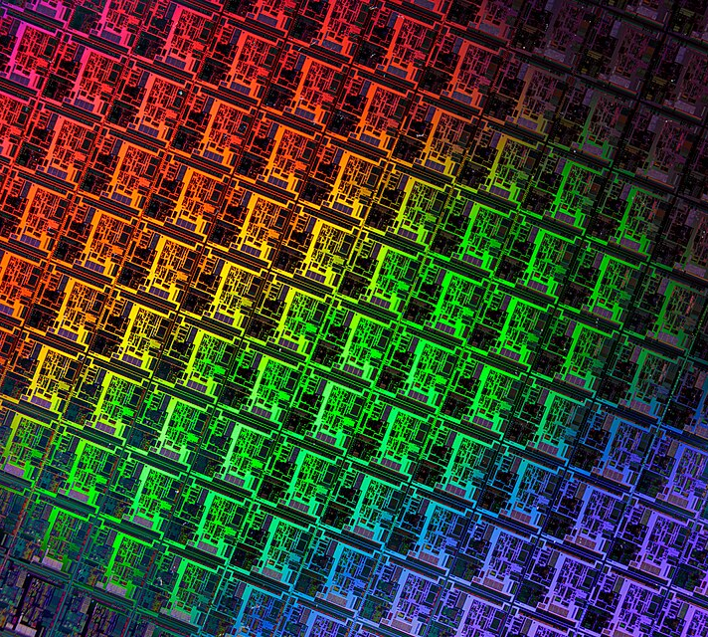
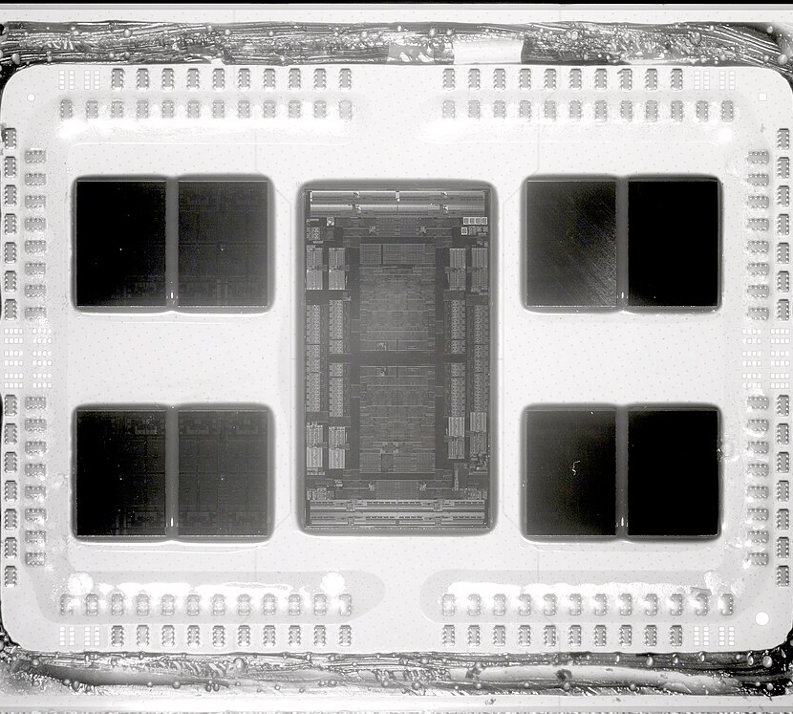
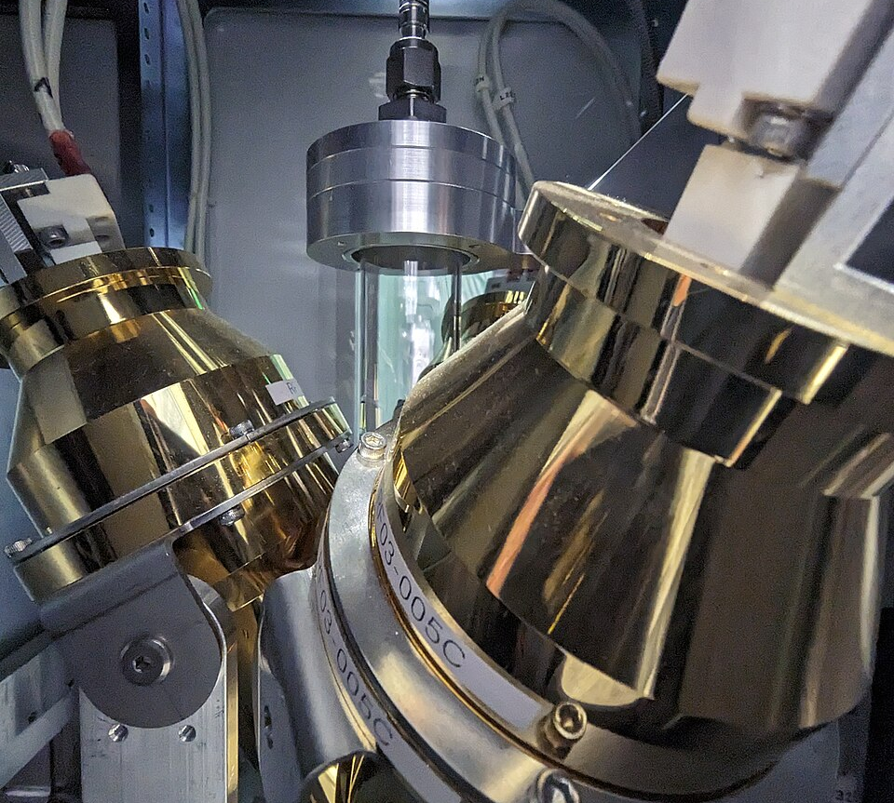
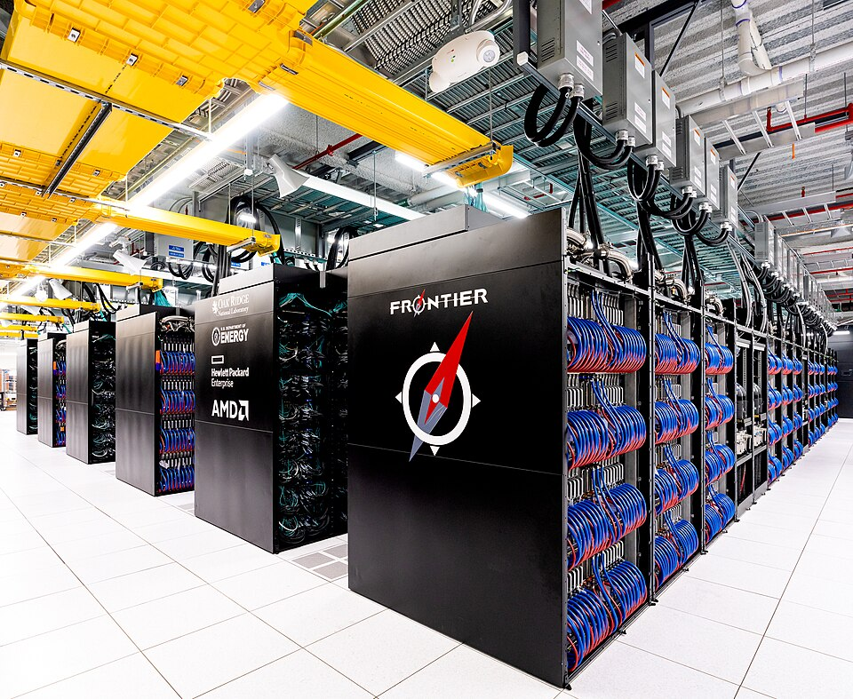
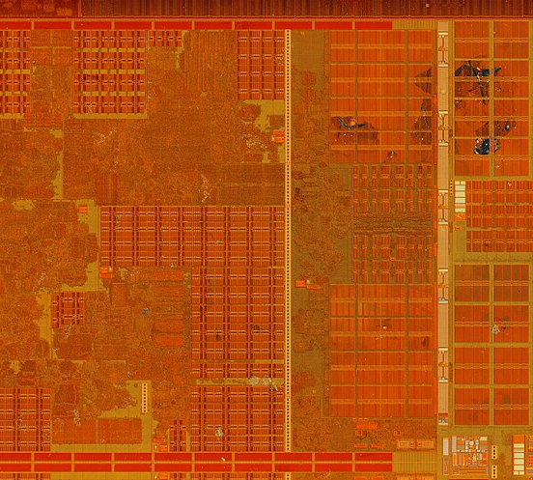
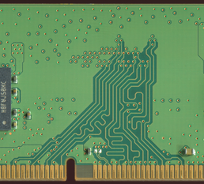
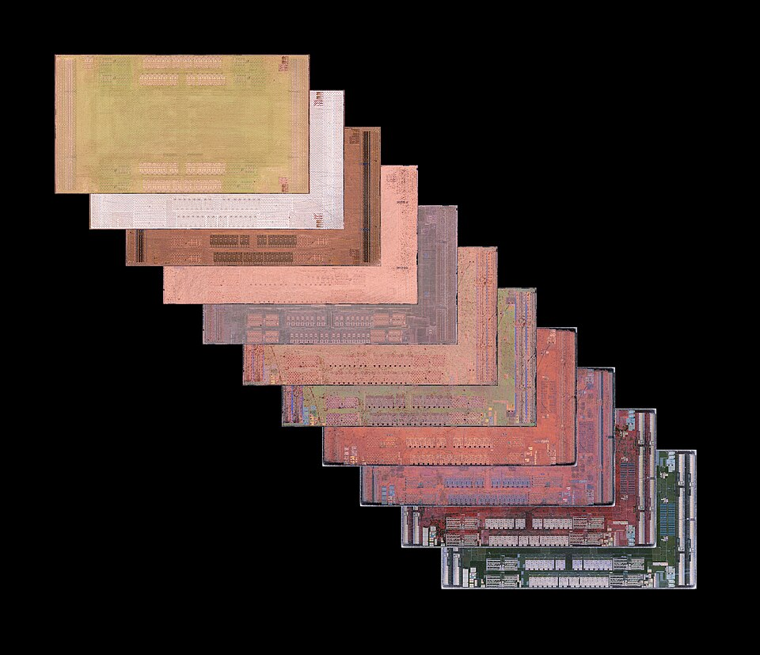
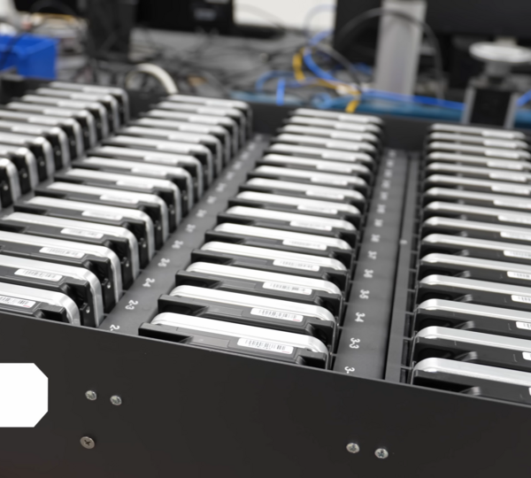
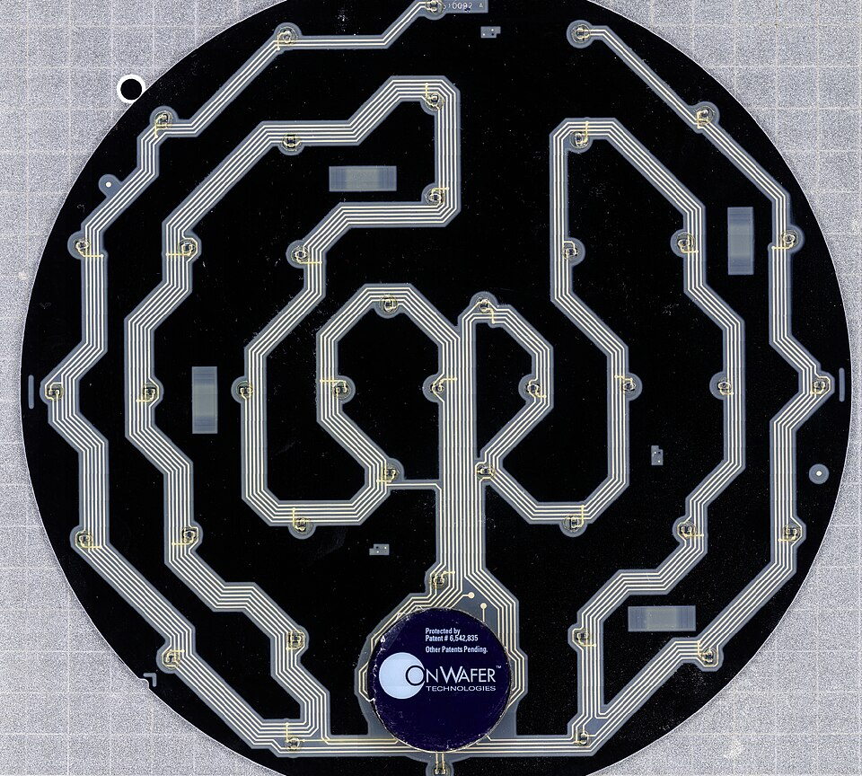
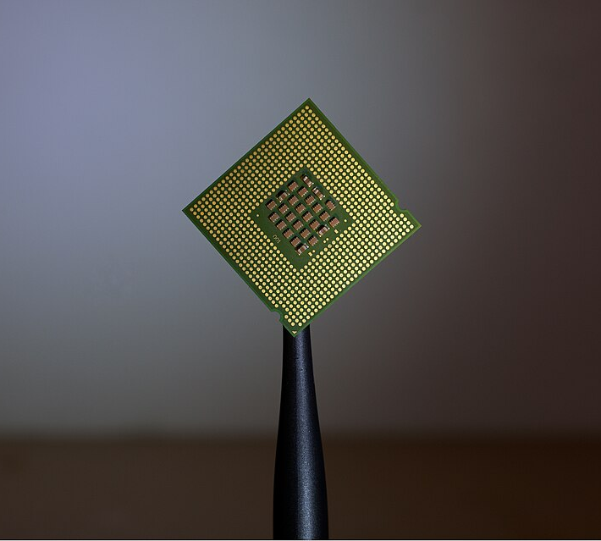
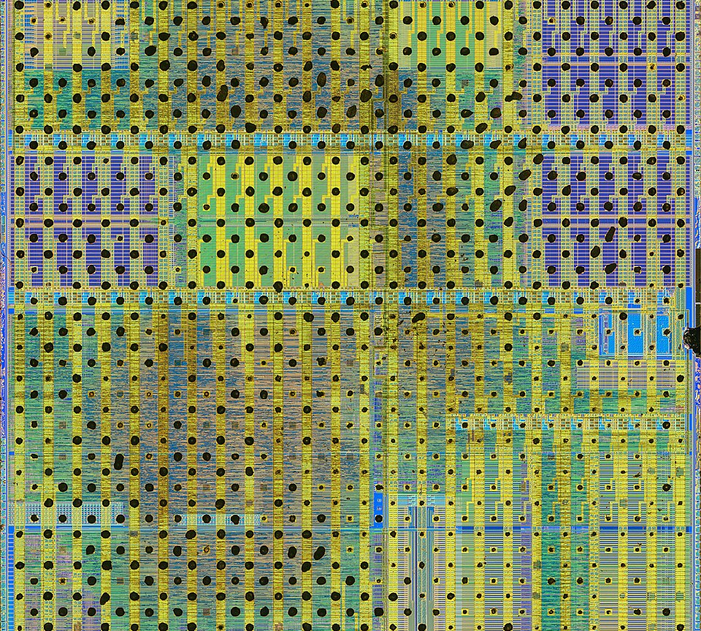
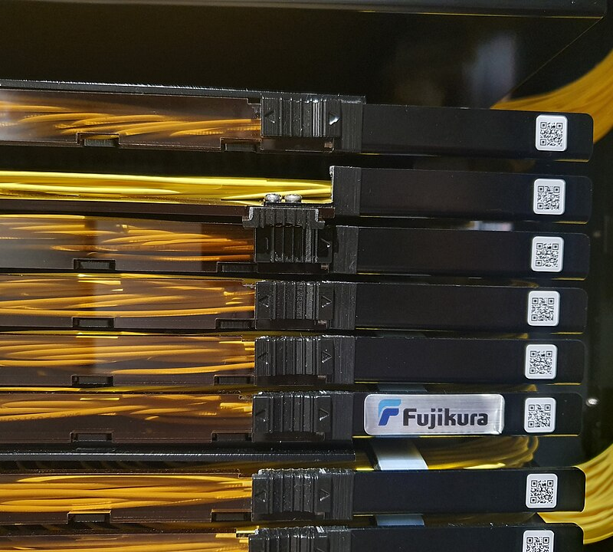
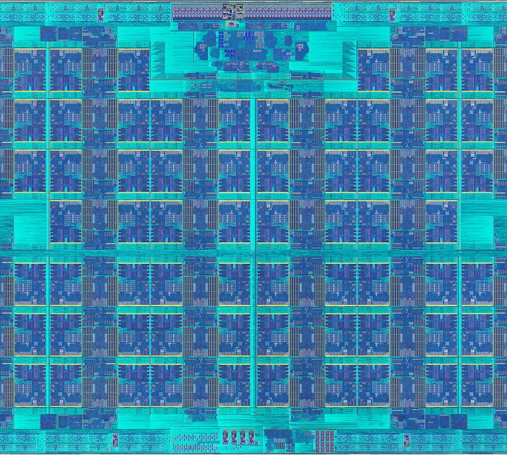
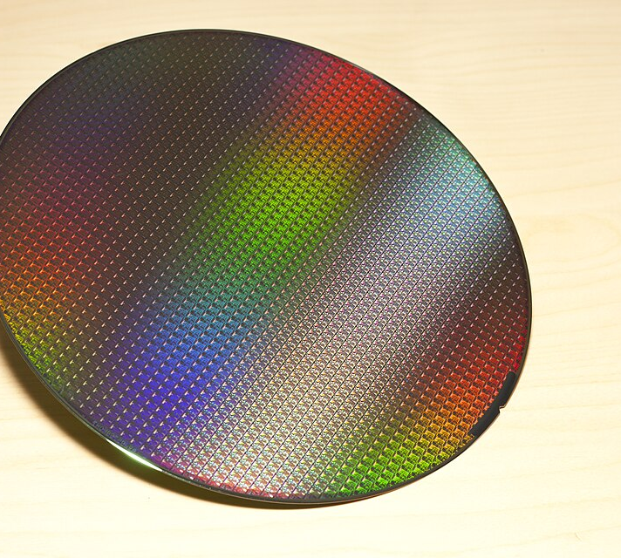
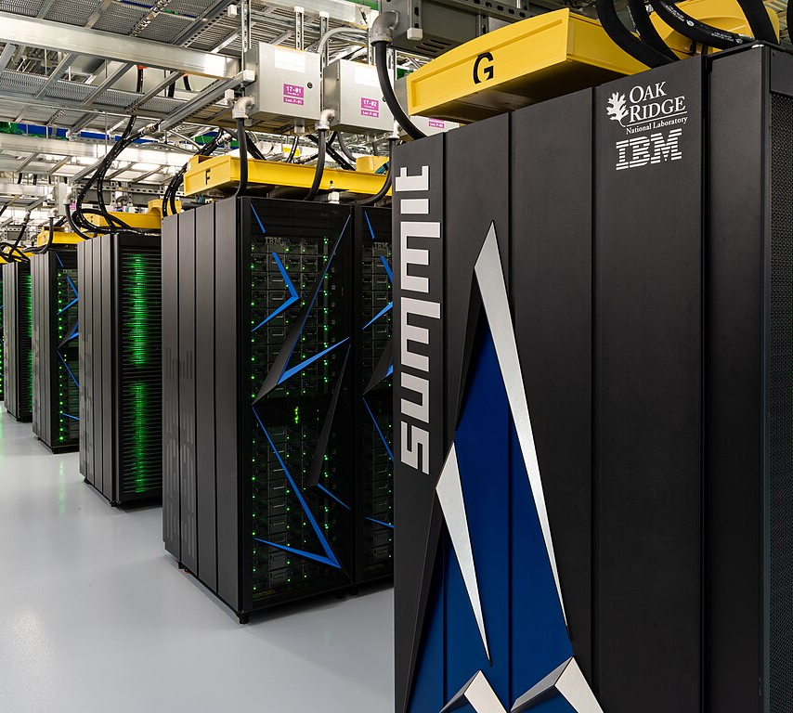
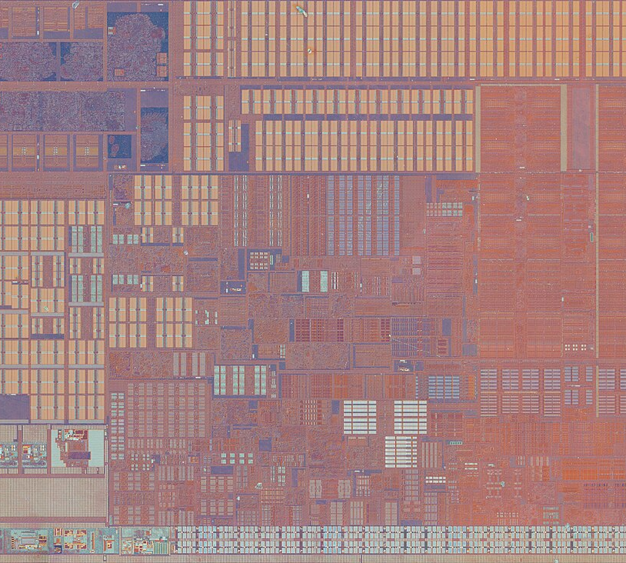
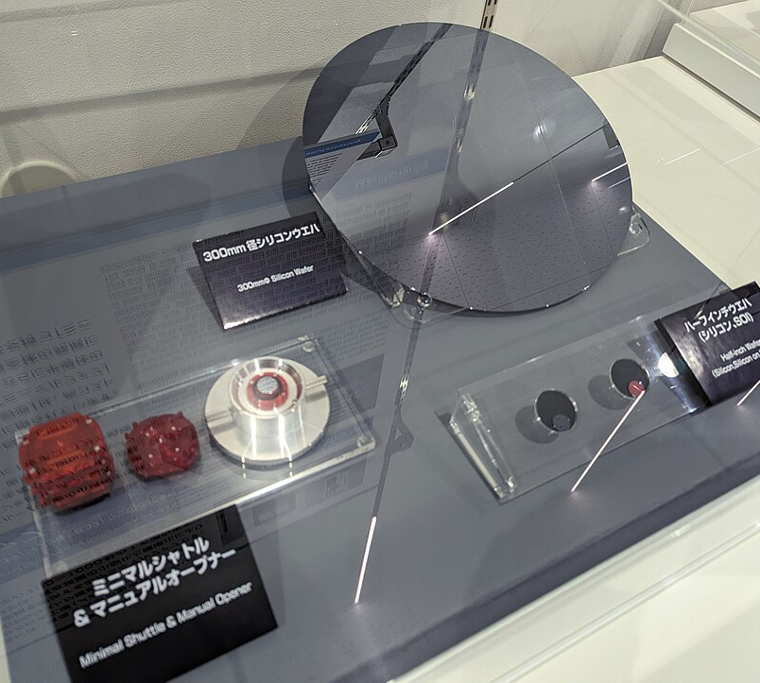
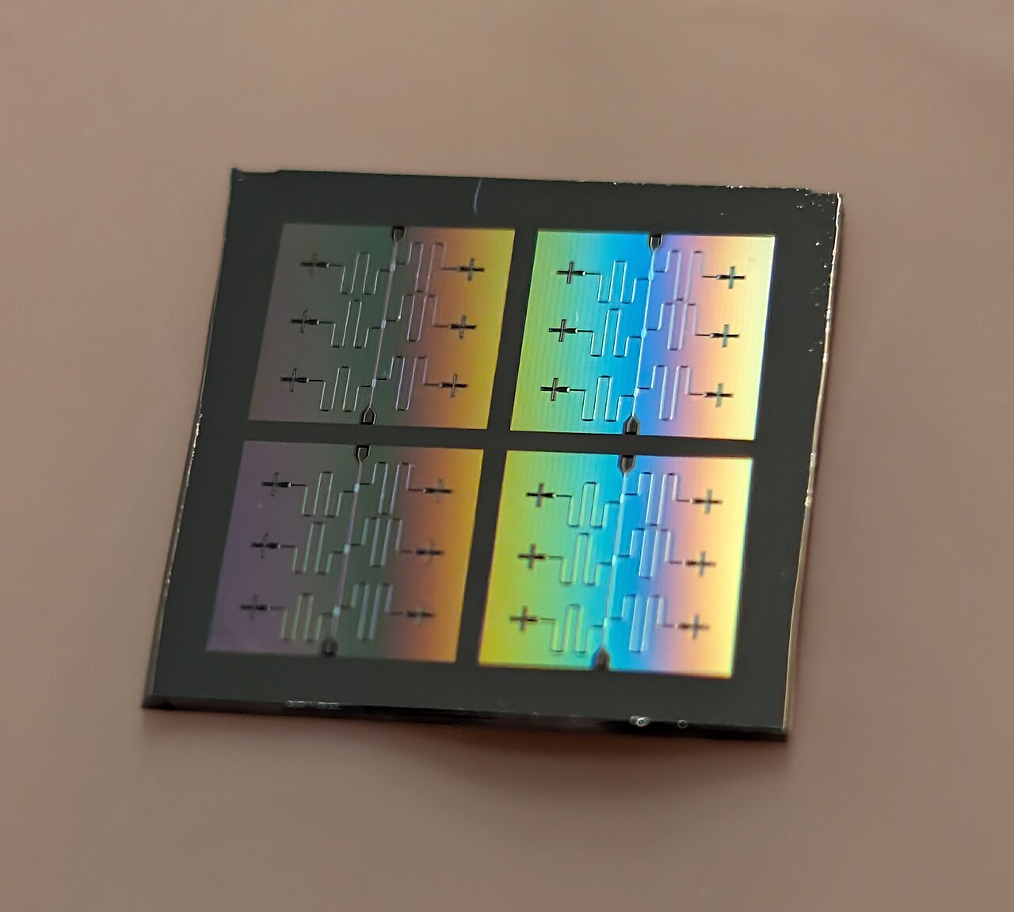
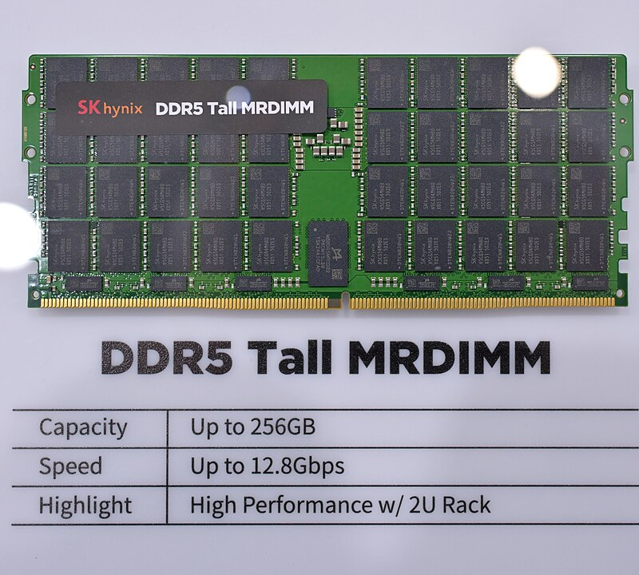
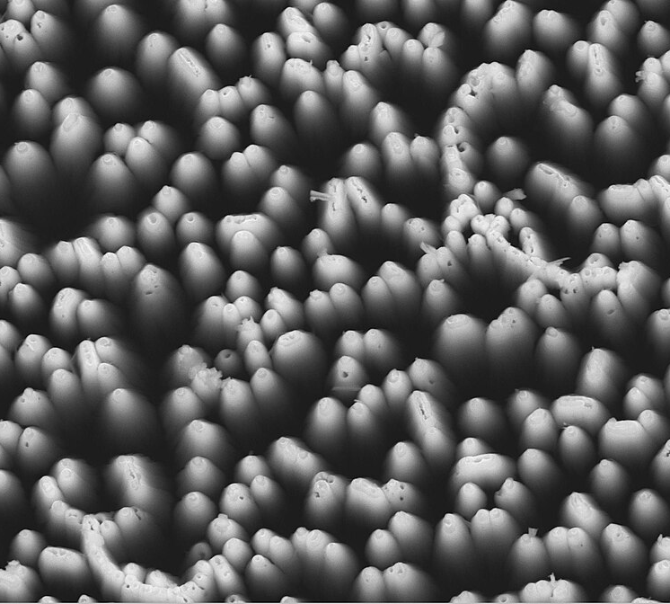
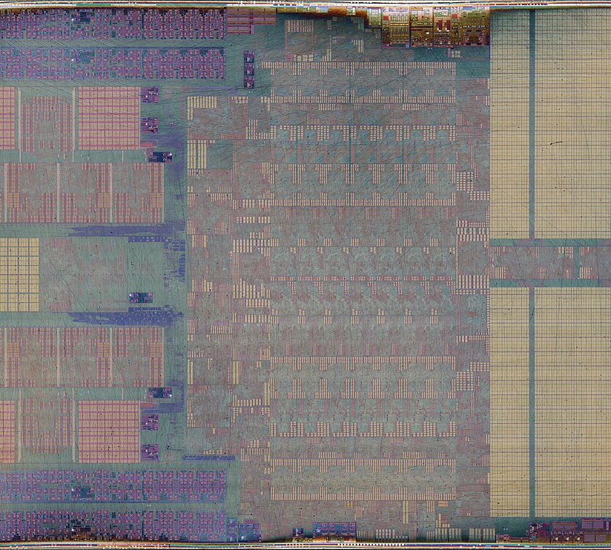
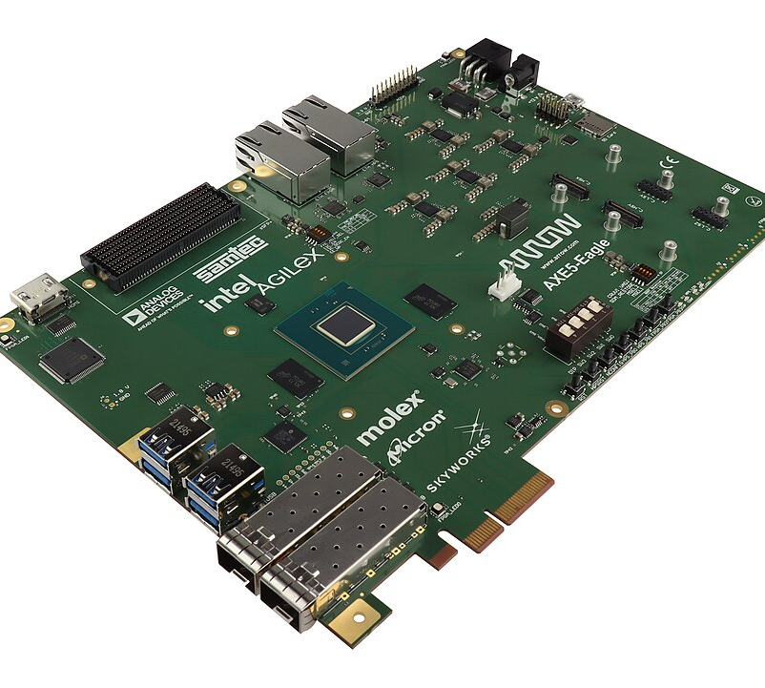
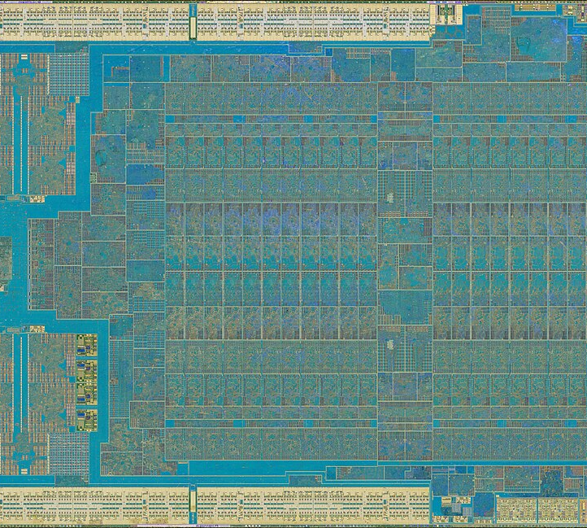
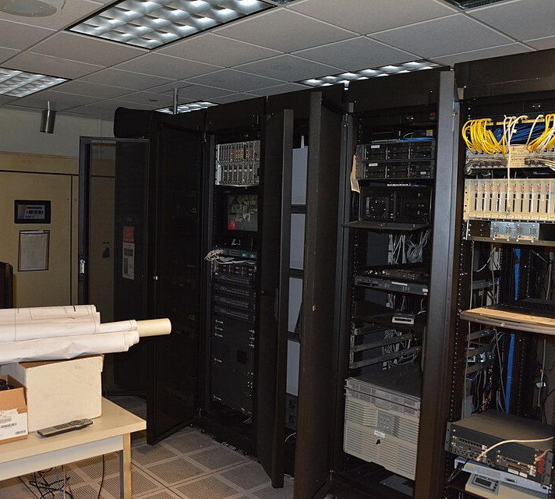
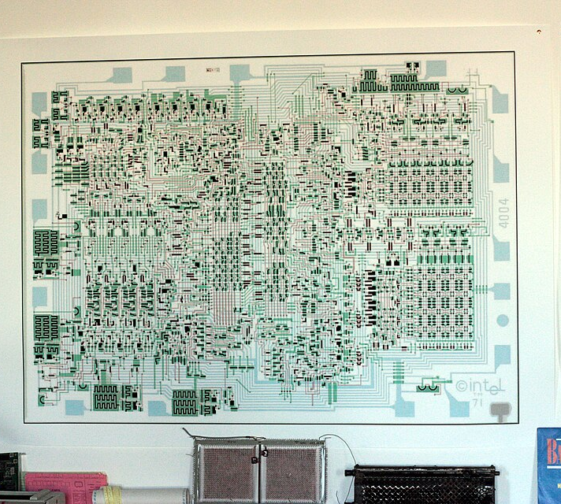
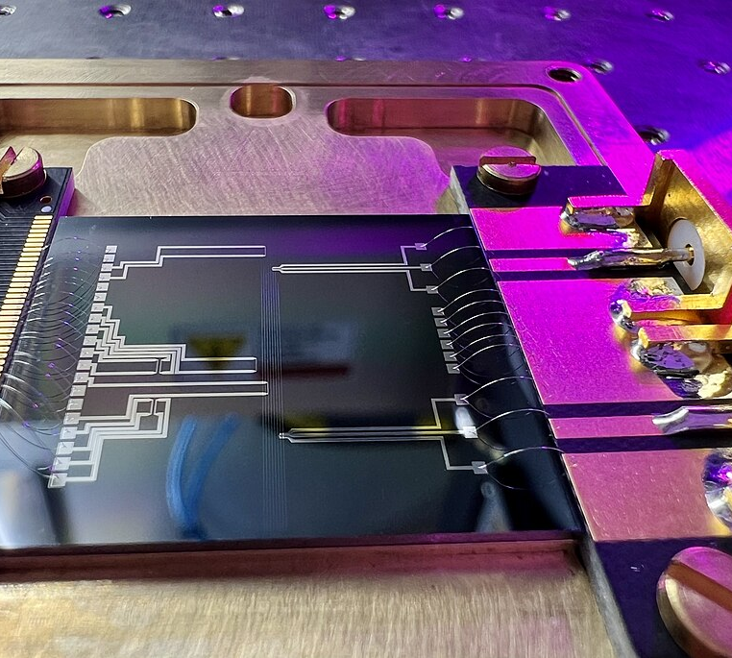
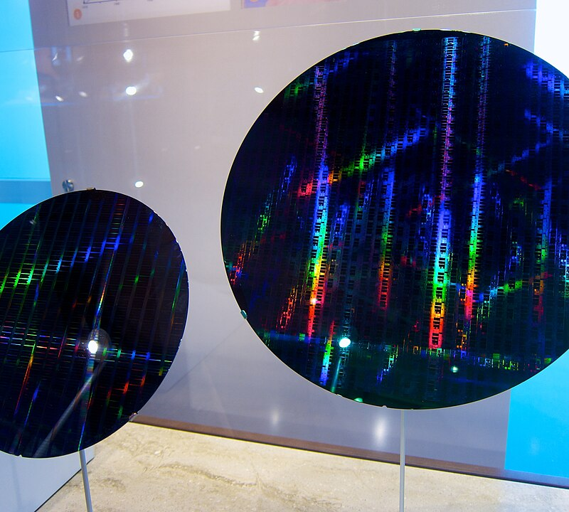
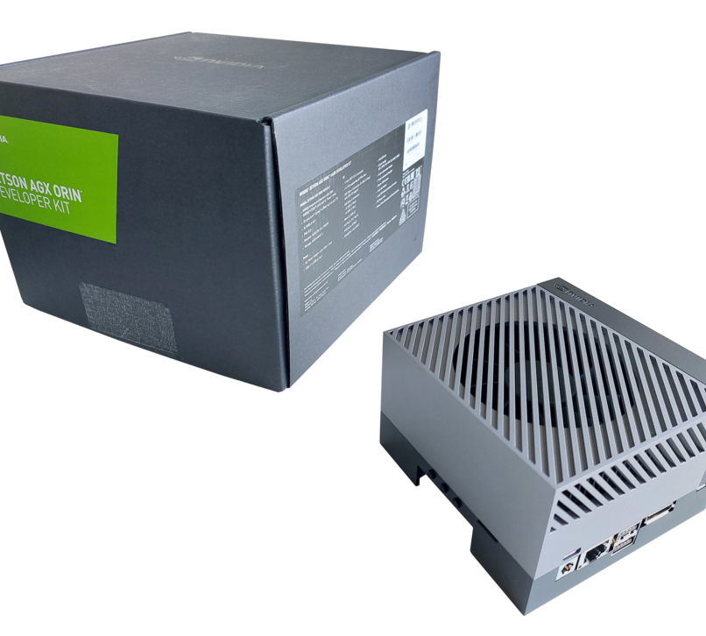
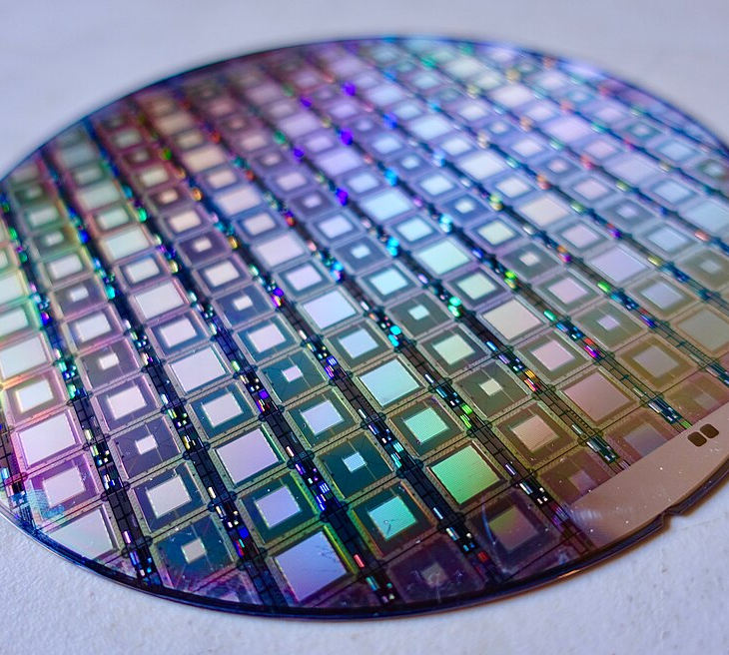
SEMICONDUCTORS 2026 → 2036
After the Shrink
Raveh Neeman · October 21, 2026
The roadmap of the semiconductor industry
2026
2031
2036
IRDS/ISRDS 2026 workshops, Granada — sinano.eu/irds-isrds-presentations · Images: Wikimedia Commons (PD, CC0, CC BY) — credits at the end
2026–28
2029–31
2031–36
Notes:
Good evening. From first chips in 1971, the next process node was the default answer to almost every problem. Timing does not close? The shrink will fix it. Power budget blown? The shrink. Die too big? Shrink. We ported the RTL — the register-transfer-level description of the design — re-ran synthesis, and the new node handed us a faster, cooler, cheaper chip almost for free.
That free lunch is over. Not because engineers stopped being clever, but because physics and economics changed the menu. The industry is at an inflection point: shrinking is giving way to stacking — transistors on top of transistors, dies on top of dies — and to packaging and whole systems as the real unit of design. A rack in a data centre now behaves the way a transistor used to behave in a chip. And at the very same moment, the money in this industry has never been bigger.
My compass is the IRDS, the International Roadmap for Devices and Systems, published by the IEEE, the Institute of Electrical and Electronics Engineers. It continues the ITRS, the International Technology Roadmap for Semiconductors, and its US predecessor, the NTRS, the National Technology Roadmap for Semiconductors — together published without a break from 1992 to 2015; the roadmap moved to the IEEE in May 2016. Engineers from chipmakers, toolmakers, universities and research institutes agree on where devices, lithography, packaging and systems will be in five, ten and fifteen years. It is not a prophecy. It is the consensus of people who have to place real bets.
The freshest version of that consensus was presented in Granada, Spain, on the 18th and 19th of May 2026, at the IRDS workshop and the ISRDS, the International Symposium on Roadmapping Devices and Systems. Since then the industry has kept moving: its figures here run to the end of September 2026.
Whether you write RTL, close timing, verify, or write the software that runs on these chips, the decisions that will matter over the next ten years are moving — away from "which node?" and towards "which package, which memory, how much energy per operation, and what system is my chip part of?"
[click] Cyan is the near term, 2026 to 2028 — things already shipping or funded. Violet is about five years out, around 2029 to 2031. Amber is five to ten years out, 2031 to 2036, where the roadmap is a projection, not a promise.
Sources:
Ref: 2024IRDS_ES.txt p.7 (IRDS continues NTRS/ITRS, publications 1992–2015, move to IEEE May 2016)
https://sinano.eu/irds-isrds-presentations/
Ref: L2a_gargini.md finding 8 — TE p.45–47 ("Racks in data centers have become like transistors in ICs")
Ref: L2a_gargini.md finding 1 — Intro p.14 (3D power scaling era; shrinking → stacking)
Ref: register.tsv (collage ids; attribution lines for class-B tiles)

Slide 2
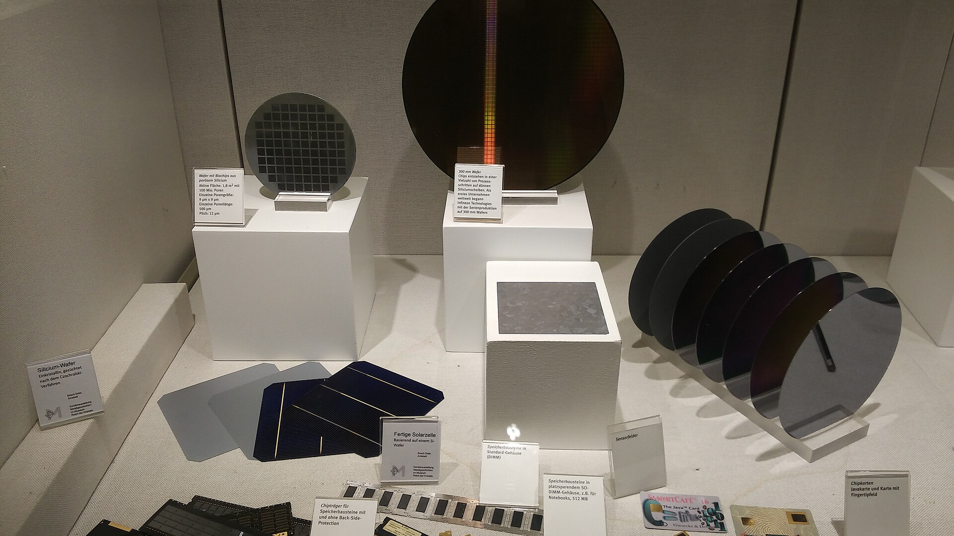




THE MARKET · 2026
2026: the market doubles — on memory prices
$1T
four years early
$1.9T
Memory
Non-memory
$1.6T
< $0.9T
54%
of the money (2026F)
718
McKinsey 2022: '$1T by 2030'
$809B
SIA: $791.7B
$630.5B
24%
of the silicon area
589
837
> $1T
465
165
220
Bits bought: +20% a year. Price per bit 2026: ×3.
share of dollars
26%
→
28%
→
54%
share of silicon
24%
→
24%
→
≈ ¼
SEMI: no step change
The difference is price — and memory booms revert: 2019, 2023
2026
2031
2036
SIA Feb 2025 · SIA/WSTS Feb & Sep 2026 · Gartner 24 Aug 2026 (forecast) · SEMI World Fab Forecast Jan 2024 · Jan 2025 · SEMI 300mm Fab Outlook Jun 2026 · Micron calls 2022–25 · McKinsey 2022
Notes:
Money moved first — and most of the money is memory price.
[click] This is the world chip market. In 2024 it was 630 and a half billion dollars, by the SIA, the US Semiconductor Industry Association, which publishes the WSTS figures, World Semiconductor Trade Statistics. Memory was 165 billion of that — 26 percent of the dollars. In 2025 the market grew by about a quarter: 791.7 billion by SIA's count, 809 by Gartner's, which splits memory from everything else; memory at 28 percent. Now the second line: memory's share of the world's silicon area. SEMI, the equipment makers' association, counts installed fab capacity in 200-millimetre-equivalent wafers, which is area: DRAM plus 3D NAND flash were 7.7 of 31.5 million wafers a month in 2024 and 8.2 of 33.6 million in 2025 — 24 percent, twice. A quarter of the silicon, a quarter of the money.
[click] Then 2026. Gartner's forecast from August: 1.6 trillion dollars, up 92 percent — the market nearly doubles in a single year, and the first seven months of 2026 already beat any previous full year. In April 2022 McKinsey set the famous target, a trillion-dollar industry by 2030: we cross it four years early. But look at the colours. Memory — DRAM, flash and above all HBM, the high-bandwidth memory stacked beside every AI accelerator — goes from 220 to 837 billion dollars and doubles its share to 54 percent of all chip revenue, while its share of the silicon stays about a quarter: in June, mid-boom, SEMI wrote that memory capacity growth "remains moderated". For 2027 Gartner projects 1.9 trillion with memory above a trillion; that last bar is a projection and the split is my subtraction.
[click] So what doubled? Not the silicon, and not the bits. The world buys about 20 percent more memory bits every year — Micron's year-end estimates: DRAM plus 4 and 5 percent in the bust years 2022 and 2023, then 18, 22 and about 20 percent this year. Revenue times 3.75 over 2025, bits times 1.2, price per bit about times three; TrendForce's contract prices for ordinary DRAM nearly doubled in the first quarter alone. The difference is price — and price has a habit: the last two memory booms ended in busts, in 2019 and in 2023. Take memory out, and 2026 growth is 21.9 percent: strong, healthy, ordinary.
At your desk: when memory is the expensive line on the bill of materials, every byte you save — a smarter cache, compression, leaner embedded software — is money; and if you plan a career move or a startup budget, plan for the cycle. A memory correction in 2027 or 2028 hits hiring and budgets first.
Sources:
https://www.semiconductors.org/global-semiconductor-sales-increase-19-1-in-2024/
https://www.semiconductors.org/global-annual-semiconductor-sales-increase-25-6-to-791-7-billion-in-2025/
https://www.gartner.com/en/newsroom/press-releases/2026-08-24-gartner-forecasts-worldwide-semiconductor-revenue-to-reach-1-trillion-dollars-in-2026
https://www.semiconductors.org/global-semiconductor-sales-increase-6-4-month-to-month-in-july/
https://www.mckinsey.com/industries/semiconductors/our-insights/the-semiconductor-decade-a-trillion-dollar-industry
https://www.techinsights.com/blog/semiconductor-industrys-trillion-dollar-milestone-four-years-ahead-schedule
https://www.semi.org/en/news-media-press-releases/semi-press-releases/global-semiconductor-capacity-projected-to-reach-record-high-30-million-wafers-per-month-in-2024-semi-reports
https://www.semi.org/en/semi-press-release/eighteen-new-semiconductor-fabs-to-start-construction-in-2025-semi-reports
https://www.semi.org/en/semi-press-release/semi-projects-300mm-memory-equipment-investment-to-surpass-50-billion-dollars-in-2026
https://www.roic.ai/quote/MU/transcripts/2022-year/4-quarter
https://www.roic.ai/quote/MU/transcripts/2023-year/4-quarter
https://www.roic.ai/quote/MU/transcripts/2024-year/4-quarter
https://futurumgroup.com/insights/micron-technology-q1-fy-2026-sets-records-strong-q2-outlook/
https://www.trendforce.com/presscenter/news/20260601-13070.html
https://www.semi.org/en/semi-press-release/global-semiconductor-equipment-sales-forecast-to-reach-a-record-229-billion-dollars-in-2028-semi-reports
https://www.globenewswire.com/news-release/2026/08/26/3351702/0/en/nvidia-announces-financial-results-for-second-quarter-fiscal-2027.html
https://news.skhynix.com/en/q2-2026-business-results/

Slide 3

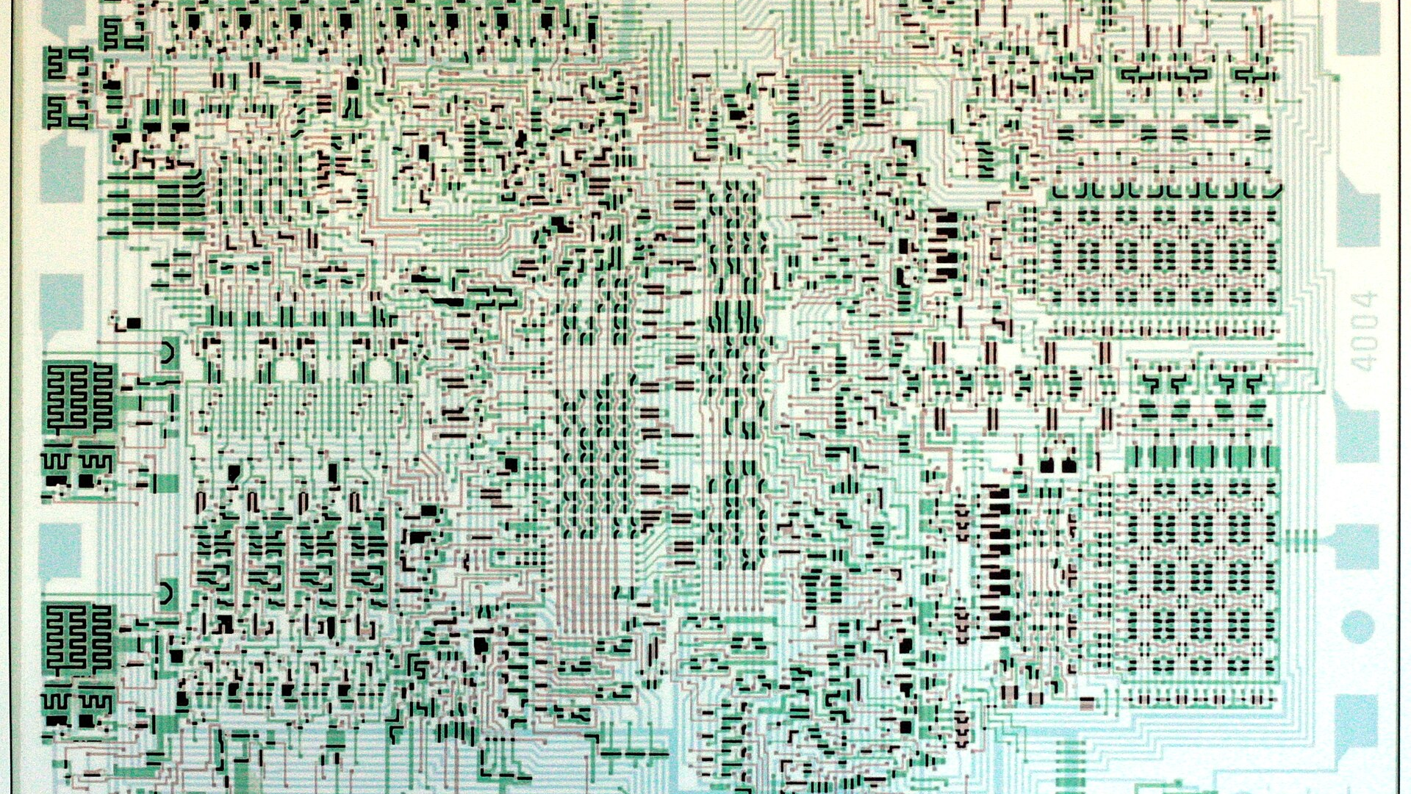
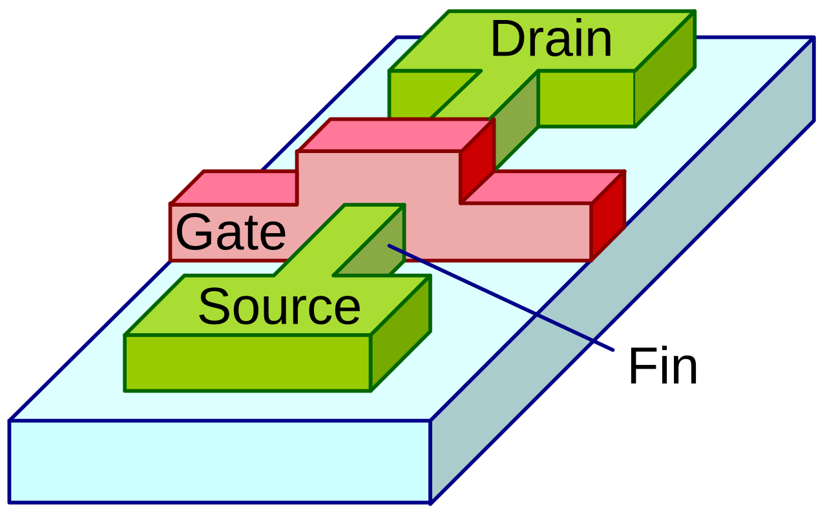
THREE ERAS OF SCALING
Scaling changed its goal: from speed to energy
~2005: clock stops rising
P ≈ N · C · V² · f · A
3D power scaling → 2040
2003
2007
2011
memory 2015 (3D NAND)
Geometrical scaling
~1975–2003 · shrink every dimension
Equivalent scaling ~2003–2024
strain 2003 · high-k/metal gate 2007 · FinFET 2011
logic 2025 (GAA nanosheets)
1970
1980
1990
2000
2010
2020
2030
2040
“Minimizing switch energy was the new rule.”
— IRDS 2024 Prologue
2026
2031
2036
2040
Gargini, IRDS Granada 2026 (Intro p.14, p.16) · IRDS 2024 Prologue & Exec. Summary p.7 · Gargini, ConFab 2015
Notes:
Why did the rules change? Paolo Gargini, the chairman of the IRDS, tells the history of our industry as three eras of scaling.
[click] The first, roughly 1975 to 2003, he calls geometrical scaling. You shrink every dimension of the transistor and lower the supply voltage with it, and each new node gives you a transistor that is smaller, faster, cheaper and no hotter per unit area. Textbooks call it Dennard scaling. For a designer it meant the node did the work.
Then, around 2005, the clock stopped rising. Gargini shows why with one formula every one of you knows: dynamic power is roughly N times C times V-squared times f times A — the number of transistors, their capacitance, the supply voltage squared, the clock frequency, and the activity factor, the fraction of nodes that toggle each cycle. Once the voltage can no longer drop, every extra megahertz and every extra transistor turns straight into heat. That is the power wall.
[click] The second era, 2003 to 2024, is equivalent scaling: density kept coming from new materials and shapes rather than from smaller dimensions alone. Strained silicon in 2003 — stretching the crystal so electrons move faster. High-k metal gate in 2007 — a gate insulator that holds more charge, so it can be thicker and leak less. FinFET in 2011 — the channel stands up as a fin and the gate wraps it on three sides. The roadmap had called all three back in 1998.
The third era is what Gargini calls 3D power scaling. It began in memory in 2015 with 3D NAND flash, where memory cells are stacked in vertical strings, and in logic in 2025 with gate-all-around (GAA) nanosheets: the channel becomes a stack of thin horizontal sheets, each completely surrounded by the gate. His electron-microscope picture shows eight sheets, each about nine nanometres thick. The roadmap runs this era to 2040. The era dates are approximate — they shift slightly between his 2015 and 2026 presentations.
My own story here: in my first projects, C-V-squared-f was an exam formula. Over the years every letter became a line in the power specification. A — clock gating. f — dynamic voltage and frequency scaling. V — voltage islands. N — the architecture itself. Today the power intent of a chip, written in formats like UPF, the Unified Power Format, matters as much as its RTL.
[click] Gargini put the whole shift into one sentence in the 2024 roadmap prologue: over-shrinking the channel to make power-hungry transistors switch faster was no longer desirable; minimizing switch energy was the new rule. The goal flipped — from the fastest switch to the most frugal one.
Sources:
Ref: L2a_gargini.md finding 1 — Gargini, Granada Intro deck p.14 ("3D Power Scaling 2015 → 2025–2040"; memory 2015, logic 2025; TEM of 8-sheet GAA stack, channel height ≈9 nm) — hin-014.png
https://sst.semiconductor-digest.com/wp-content/uploads/2015/05/1505_21_Paolo-Overview_Out_pptx.pdf
Ref: Gargini, Granada Intro deck p.16–17 (power wall, P_dyn ≈ N·C·V²·f·A; frequency and power flatten ~2005 in the Karl Rupp microprocessor data) — L2a_gargini.md finding 2 and §3
Ref: 2024IRDS_ES.txt p.7 (strained Si 2003, high-κ/metal gate 2007, FinFET 2011, foreseen in 1998)
Ref: 2024IRDS_Prologue.txt p.1 (quote: "'Over shrunk' channel length … minimizing switch energy was the new rule")
Ref: register.tsv MR-0085 (FinFET icon, PD), MR-0444 (optional texture, CC BY 3.0, Our World in Data)

Slide 4
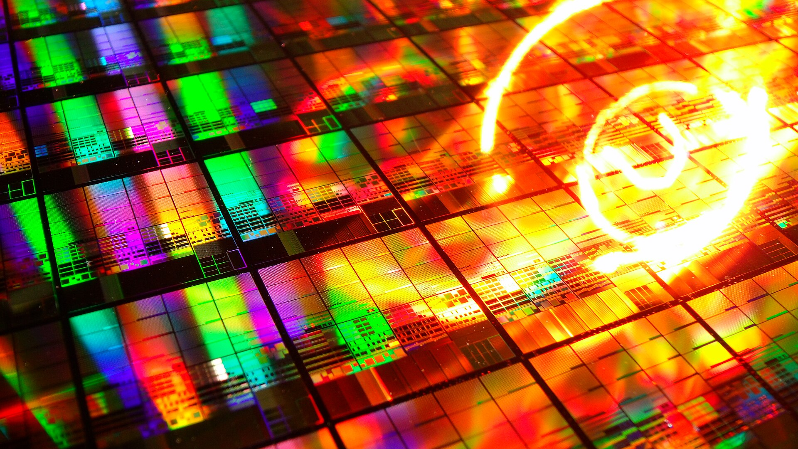


LOGIC ROADMAP 2025–2039
Density now grows up, not across
Logic density, million NAND2 gates per mm² (IRDS)
all tiers
per tier
17× by 2039 — stacking
“1.4 nm” node = 48 nm gate pitch
2.4× in 8 years — shrinking
T2
T4
T6
Gate pitch floors at 42 nm
…–2025
FinFET
GAA nanosheet
CFET ~2031–33
3D tiers
Backside power:
Intel 18A 2025 ✓
· TSMC A16 2027 · direct backside contact 2027
2026
2031
2036
IRDS More Moore, Granada 2026 (Badaroglu p.6, 7, 16) & 2024 Table MM01 · IRDS Litho 2025 · imec 2026 roadmap · TSMC, Intel
Notes:
Here is where the third era takes us, in one number the roadmap tracks: how many NAND2-equivalent gates — the standard unit, one two-input NAND — fit on a square millimetre of logic.
[click] 27 million in 2025. 34 in 2027, then 43, 57, and 64 million in 2033. That is 2.4 times in eight years.
Underneath, the transistor keeps changing shape. The FinFET era ends in 2025. Gate-all-around nanosheets carry us to about 2031, and they are already here: Intel's 18A and TSMC's N2 are both nanosheet processes. Next comes the CFET, the complementary FET: the n-type transistor built directly on top of the p-type, so an inverter folds onto itself. The IRDS More Moore team says 2031; imec's roadmap and the IRDS's own lithography chapter say 2033 — so read it as 2031 to 2033. In parallel comes backside power: the power grid moves to the back of the wafer, like moving the plumbing under the floor so that the corridors above are free for signals. Intel shipped it first, with PowerVia on 18A in 2025. TSMC's version, the Super Power Rail on A16, reaches volume in 2027, and the roadmap expects direct backside contacts the same year.
[click] Now the flattening. Gate pitch — the distance from one gate to the next — stops shrinking at 42 nanometres; imec holds it there from about 2030 to 2036 before a last step to 39 nanometres in 2038; the IRDS holds it from 2035 to the end of its table, 2039. And a reminder that node names are marketing: the node sold as "1.4 nanometre" has a 48-nanometre gate pitch and a 22-nanometre tightest metal pitch. Nothing on it measures 1.4 nanometres.
[click] So where does density come from after 2033? From the third dimension. 3D VLSI — two, four, then six tiers of logic built on top of each other: 153, 306, 459 million gates per square millimetre by 2039 — seventeen times 2025. But look at the dashed line: per tier, density goes flat at about 76 million — the IRDS table lists that per-tier figure too. Shrinking stops. Stacking takes over.
Think of Tel Aviv running out of land: the city keeps growing, but upward, and the elevators become the scarce resource. For us the elevators are vias between tiers, power delivery and heat. The roadmap's own model is sobering: mask count grows from 81 in 2025 to 365 in 2039, it plans for 20 percent of logic to be repairable — spare units, like memory redundancy — by 2033, and at constant power density a CPU clock falls from 3.1 to 0.8 gigahertz by 2039. Everything after 2033 is model projection. But the direction is clear: your floorplan gets a z-axis, IR-drop sign-off moves to the back of the wafer, and partitioning across tiers becomes an architecture decision.
Sources:
Ref: IRDS 2024 More Moore Table MM01 (2024IRDS_MM_Tables.xlsx) and Badaroglu, Granada 2026 (9-MM-20260516_ISRDS_2026_More_Moore_Badaroglu_v1-1.pdf p.16 — NAND2 27→459 Mgates/mm², "17x"; p.6 device evolution FinFET 2011–2025 → LGAA 2025–2031 → 3D VLSI 2031–2039; p.7 tiers T2/T4/T6) — via L1_moremoore_litho.md table and finding 2; image L1mm_p16-16.png
Ref: L1_moremoore_litho.md finding 1 — gate pitch floors at 42 nm from 2035 (2024IRDS_MM.pdf p.8, p.13); "1.4nm" = G48M22 (xlsx)
Ref: L1_moremoore_litho.md §4 — CFET 2031 (More Moore) vs "now projected in 2033" (2025IRDS_LITHO.pdf p.7)
https://www.tomshardware.com/tech-industry/semiconductors/imecs-2026-roadmap-details-0-3nm-nodes-by-2038-cfet-transistors-become-viable-at-0-7nm-company-redefines-moores-law-as-cell-sizes-gain-importance-for-density
https://www.tomshardware.com/tech-industry/semiconductors/intel-chip-roadmap-2026-2028
https://pr.tsmc.com/english/news/3302
https://www.tomshardware.com/tech-industry/semiconductors/tsmc-unveils-process-technology-roadmap-through-2029-a12-a13-n2u-announced-a16-slips-to-2027
Ref: IRDS backside roadmap — direct backside contact 2027 (9-MM…pdf p.12, p.17) via L1_moremoore_litho.md finding 3
Ref: IRDS Table MM01 — mask count 81→365, repairable logic 20% (2033), CPU 3.1→0.8 GHz at constant power density (T3 model projection) via L1_moremoore_litho.md findings 10–11
Ref: Per-tier density 76.5 = 153/2 = 306/4 = 459/6 — also listed in IRDS 2024 Table MM01 as "NAND2-eq gate density (Mgates/mm2) - HD" = 76.49 for 2035–2039 (2024IRDS_MM_Tables.xlsx)

Slide 5

COST OF THE LEADING EDGE
The shrink got expensive, and gives back less
$380–400M
High-NA EUV scanner
≈$30k
2 nm wafer (reported)
≈$725M
2 nm design (estimate)
Intel: in production
TSMC: not through 2029
Density gain per node: 1.9× (2017) → 1.23× (2028)
Cost per transistor: flat since 28 nm
2017
+0.9
2028
+0.23
28 nm
today
Node migration no longer pays for itself.
2026
2031
2036
ASML Q2 2026 call; Tom’s HW (Jul 2026) · TSMC Symposium Apr 2026 · EE Times · IBS via CSIS (Sep 2026) · Google/IEDM via Tom’s HW · IRDS Litho 2026
Notes:
So the shrink continues — but look at its price.
[click] Start with the tool. The finest layers of a modern chip are printed with EUV, extreme-ultraviolet light at 13.5 nanometres. ASML's next generation is High-NA EUV — NA is the numerical aperture, the size of the optics' opening, 0.55 instead of 0.33. By press reports it costs 380 to 400 million dollars per scanner, against about 180 million for today's EUV tool; ASML publishes no list price. ASML expects to recognise revenue on four or five this year, against about 65 standard EUV machines shipped.
And the industry is split on it. In July 2026 Intel became the first company to use High-NA in high-volume production, on selected layers of its 18A Panther Lake chips. TSMC, the most successful foundry on earth, published its roadmap through 2029 — A14, A13, A12 — without High-NA. Their words: "very, very expensive". The best foundry declines the best tool — because, as ASML's own chief executive conceded in July, High-NA must first mature before it beats the cost of standard EUV plus multiple exposures.
[click] The wafer: a TSMC 2-nanometre wafer reportedly costs about 30,000 dollars, against 18 to 20 thousand at 3 nanometres. TSMC does not publish prices, so these are estimates. And the design: the consultancy IBS, International Business Strategies, estimates about 725 million dollars to design a leading-edge system-on-chip at 2 nanometres, against 48 million at 28 — fifteen times. That is a model that includes software and IP — treat it as an order of magnitude.
And what does a node give back? When TSMC announced 10 nanometres against 16 in 2015: half the area — about 1.9 times the density — and 40 percent less power. A14 against N2, for 2028: 1.23 times the density and 25 to 30 percent less power. The density gain per node has shrunk to about a quarter of what it was. Meanwhile Google told IEDM, the International Electron Devices Meeting, that the cost per transistor stopped falling at 28 nanometres and has stayed flat since — one company's data, but everything else points the same way.
Why is it so hard? Not resolution — randomness. At these sizes a few photons more or less decide whether a contact prints. The IRDS lithography team shows the probability of a missing contact changing by five orders of magnitude over just three nanometres of feature size. By 2033 the roadmap asks for line edges straight to within 0.8 nanometres — three or four silicon-silicon bonds — printed with 13.5-nanometre light.
[click] So: node migration no longer pays for itself. The gains now come from architecture, specialisation, chiplets — and from choosing a mature node where that is the rational choice. For those of us who tape out, one more consequence: at these prices, verification and FPGA prototyping are worth more than ever.
Sources:
https://www.fool.com/earnings/call-transcripts/2026/07/15/asml-asml-q2-2026-earnings-call-transcript/
https://www.trendforce.com/news/2026/03/19/news-imec-secures-asmls-most-advanced-exe5200-high-na-euv-for-sub-2nm-4q26-qualification-target/
https://www.tomshardware.com/tech-industry/semiconductors/intel-becomes-the-first-company-to-ship-high-volume-logic-chips-made-with-asmls-high-na-euv-select-panther-lake-layers-on-18a-are-now-dual-qualified-for-0-55-na-scanners
https://www.tomshardware.com/tech-industry/semiconductors/tsmc-unveils-process-technology-roadmap-through-2029-a12-a13-n2u-announced-a16-slips-to-2027
https://pr.tsmc.com/english/news/3302
https://www.trendforce.com/news/2026/04/23/news-tsmc-unveils-latest-roadmap-a12-a13-set-for-2029-without-high-na-euv-a16-volume-production-delayed-to-2027/
https://www.eetimes.com/tsmc-price-hikes-end-the-era-of-cheap-transistors/
https://www.tomshardware.com/tech-industry/tsmcs-wafer-pricing-now-usd18-000-for-a-3nm-wafer-increased-by-over-3x-in-10-years-analyst
https://www.csis.org/analysis/billion-dollar-chip-who-can-afford-design-future
https://www.eetimes.com/tsmc-preps-10nm-tunes-16nm/
https://pr.tsmc.com/english/news/3228
https://www.tomshardware.com/tech-industry/manufacturing/chips-arent-getting-cheaper-the-cost-per-transistor-stopped-dropping-a-decade-ago-at-28nm
Ref: Stochastic missing-contact probability ~1e-3 → ~1e-8 over 21.5 → 24.5 nm CD: 7-Lithography-2026-ISRDS-Lithography-presentation.pdf p.26 (/home/claude/src/img/L1litho_p26-26.png); LER 0.8 nm in 2033: 2025IRDS_LITHO.pdf p.8–9 — via L1_moremoore_litho.md finding 8; "3–4 Si–Si bonds" (0.235 nm each) is L1_moremoore_litho.md §3 analogy
Ref: MR-0021 bg photo: "IMaGe 30949R+ HDR Stacked – Silicon Wafer 20120926" — CC BY 2.0, via Wikimedia Commons

Slide 6

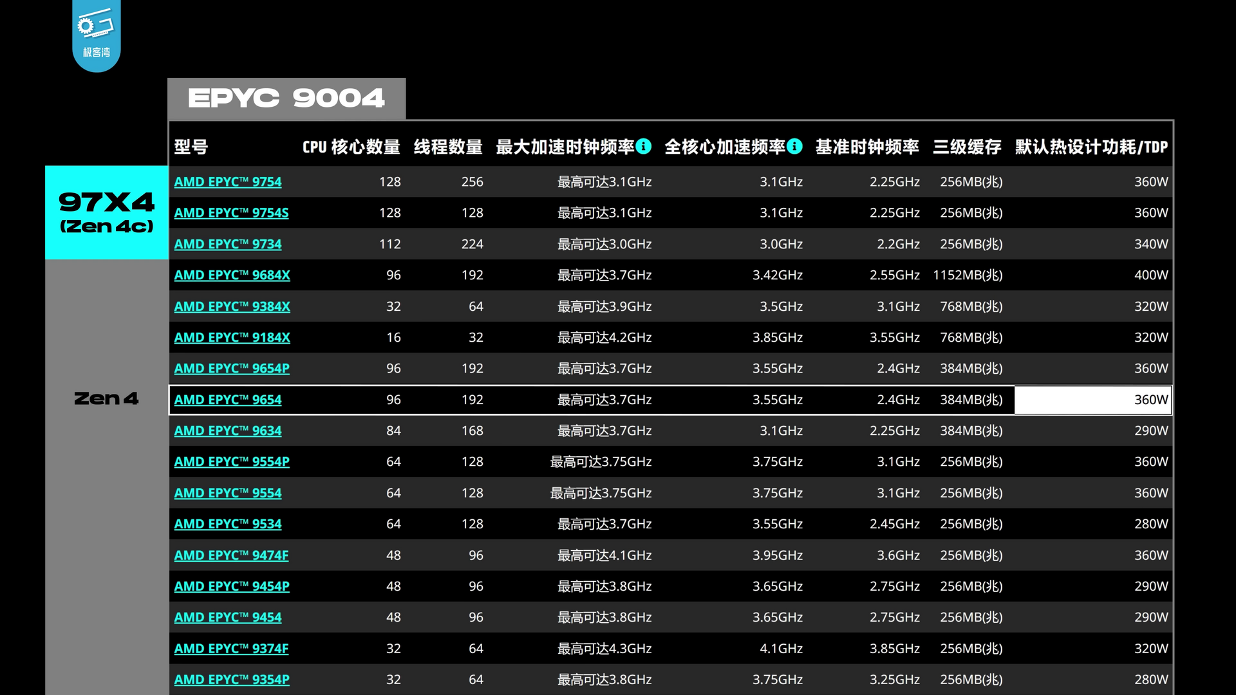
PACKAGING · 2026 → 2031
The package is the new chip
300 mm wafer
GPU dies per package
Hopper 1
SoW-X 40× · 2029
Blackwell 2
GPU + HBM on a silicon interposer
Rubin Ultra · 2027 4
14× · 2028
Feynman 8?
forecast
9.5× · 2027
5.5× · now
Die-to-die energy:
SerDes 5–10 pJ/bit → 3D bond 0.01–0.05 pJ/bit
3.3×
1 reticle = 858 mm²
Hybrid-bond pitch 9 → 6 → 4.5 µm
Open chiplet market: not yet
Gargini’s law: bits per package double every 2 years
2026
2031
2036
TSMC Technology Symposium 2026 · Gargini, IRDS/ISRDS Granada 2026 · UCIe 2.0 · IRDS 2024 SA · Photo: Fritzchens Fritz, CC0
Notes:
For most of our careers the die was the product: we floorplanned it, closed timing on it, taped it out. That has quietly changed, because a die cannot grow past the reticle, the largest field a lithography scanner prints in one exposure: 26 by 33 millimetres, about 858 square millimetres. [click] NVIDIA's Hopper, at 814 square millimetres, already fills it. So growth moved into the package.
The enabler is the silicon interposer, a passive slab of silicon under the dies that carries thousands of fine wires between them. TSMC calls its version CoWoS, Chip-on-Wafer-on-Substrate. Its April 2025 roadmap started at 3.3 reticles of interposer; today it builds 5.5, at over 98% yield, which is TSMC's own claim. Blackwell puts two reticle-sized GPU dies in one package, next to stacks of HBM, High-Bandwidth Memory: DRAM (dynamic RAM) dies stacked and wired vertically through the silicon.
Next come 9.5 reticles in 2027 and 14 in 2028: about 12,000 square millimetres, roughly the size of a CD, carrying some twenty HBM stacks. Rubin Ultra, due in 2027, carries four GPU dies.
[click] For 2029 TSMC shows SoW-X, System-on-Wafer: about 40 reticles as one package. Take the date with some salt: 2025 press reports said 2027, and TSMC now says 2029. The eight dies for Feynman are a question mark from Paolo Gargini, chairman of the IRDS, the International Roadmap for Devices and Systems. NVIDIA itself says only "die stacking" for Feynman in 2028.
Why does this work? Wires. Hybrid bonding fuses copper pads face to face, with no solder, at 9 microns pitch, 6 today, and 4.5 by 2029. Halve the pitch and you get four times the connections per square millimetre. Then energy: a SerDes, the serialiser-deserialiser behind PCIe (PCI Express) or Ethernet, spends 5 to 10 picojoules per bit. The 3D mode of UCIe, the Universal Chiplet Interconnect Express standard, specifies 0.01 to 0.05. That is at least a hundredfold. One warning: the IRDS writes that a fab-independent chiplet marketplace has not emerged. Today's multi-die products are captive, with one company designing every die. Don't plan on buying chiplets like soft IP yet.
[click] Gargini frames it as a law. Moore, 1975: the number of transistors per integrated circuit can cost-effectively double every two years. Gargini, 2020: the number of bits per integrated package. For us it is the jump from one board to a backplane of cards, except that the backplane is silicon and the traces are microns long. Partitioning, die-to-die links, known-good-die test and thermal sign-off across the stack are now everyday RTL decisions.
Sources:
https://pr.tsmc.com/english/news/3302
https://semiengineering.com/tsmc-tech-symposium-2026-by-the-numbers/
https://www.tomshardware.com/tech-industry/semiconductors/tsmcs-details-next-gen-cowos-roadmap-over-14-reticle-packages-and-48x-leap-in-compute-power-expected-by-2029-massive-size-enables-24-hbm5e-stacks-and-additional-memory-bandwidth-jump
https://www.trendforce.com/news/2025/04/24/news-tsmc-tech-symposium-highlights-a14-set-for-2028-launch-9-5-reticle-cowos-arriving-in-2027/
https://www.tomshardware.com/tech-industry/semiconductors/tsmc-soic-3d-stacking-roadmap-outlines-path-from-6-micron-pitches-today-to-4-5-micron-in-2029-fujitsus-monaka-cpu-to-benefit-from-face-to-face-chiplet-stacking
https://www.hpcwire.com/2024/08/16/ucie-2-0-for-3d-chip-structures-offers-up-to-75-times-more-bandwidth-than-predecessor-spec/
https://semiengineering.com/chiplets-still-a-challenge-with-ucie-2-0/
Ref: 26_05_19_Tech-Eco_Out.pdf p.37 (Blackwell 2 → Rubin Ultra 4 → Feynman "8?"), p.38–40 (Feynman 2028 "Die Stacking, Custom HBM"), p.56 (TSMC roadmap 23 Apr 2025: 3.3 → 5.5 → 9.5 reticles → SoW-X)
Ref: 1-Intro-26_05_18_Granada_Paolo.pdf p.23 (Moore 1975 / Gargini 2020 wording, checked on the rendered page)
Ref: 2024IRDS_ES.pdf PDF p.79 Fig. ES-48 and p.81 (Hopper 80 B transistors on 814 mm²; reticle limit 858 mm²)
Ref: 2024IRDS_SA.pdf p.13 ("What has not yet emerged is a fab independent chiplet marketplace")
Ref: SoW-X date conflict (2025 press "2027" vs TSMC 2026 "2029"): research/W2_packaging_memory.md §6
https://commons.wikimedia.org/wiki/File:Nvidia%4016nm%40Pascal%40GP100%40Tesla_P100%40T_Taiwan_1912A1_PN9G70.S6W_GP100-897-A1_DSCx10_topmetal%40Interposer_5x.jpg

Slide 7
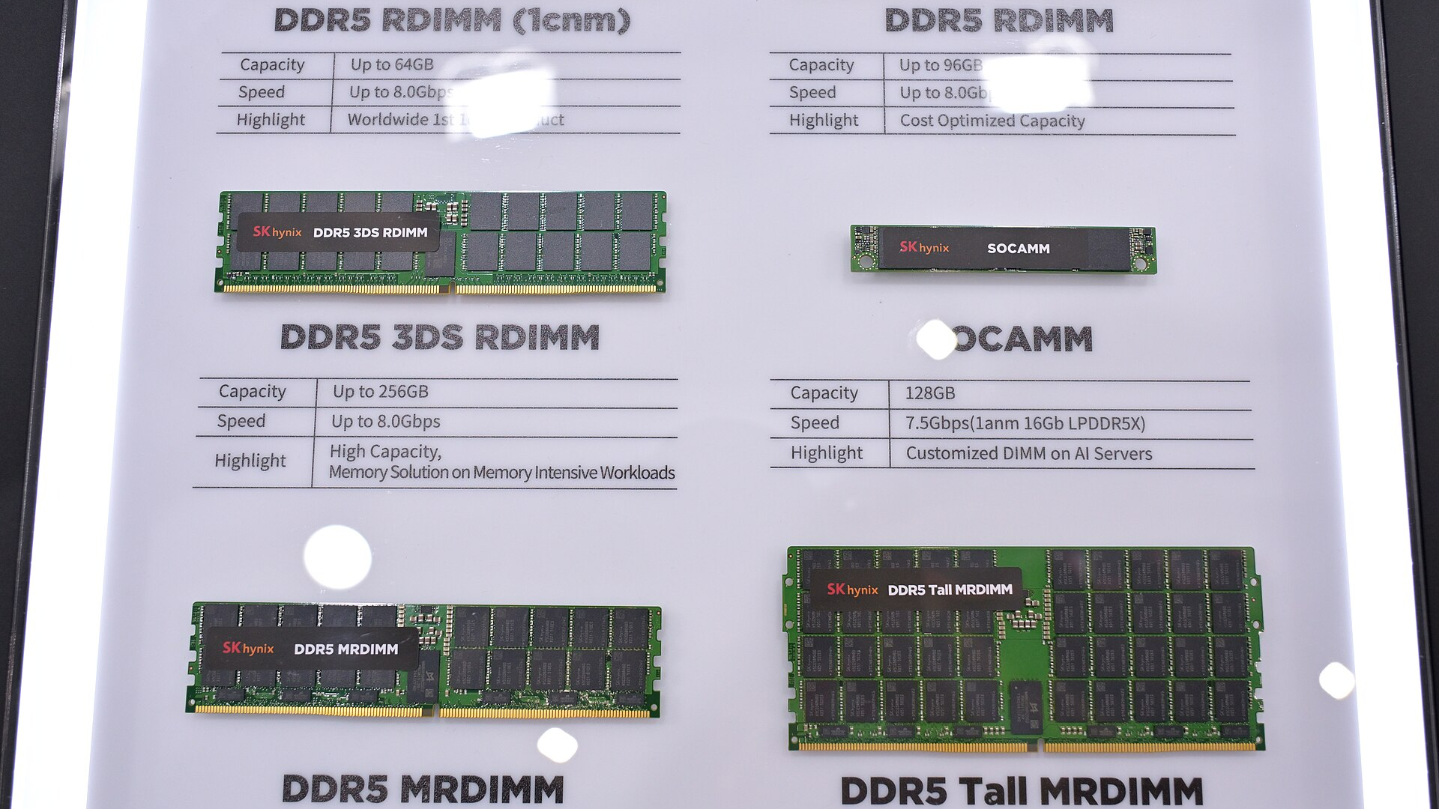
MEMORY · 2026 → 2036
DRAM access 2–3 pJ/bit · compute ~10 fJ/bit
Throughput: the memory and interconnect wall
Growth over ~20 years (index, log scale)
200–300×
energy: fetch a DRAM bit vs compute on it
×59,000
Peak compute ×3.0 / 2 yr
DRAM bandwidth ×1.6 / 2 yr
Interconnect ×1.4 / 2 yr
2048-bit HBM4 bus
2.8–3.3 TB/s per stack, shipping 2026
memory wall
HBM base die → foundry logic (2027)
×110
×29
+93–98%
DRAM contract price, one quarter (1Q26)
idealised lines from the paper’s fitted rates
Design for bytes moved, not FLOPs
years (≈20-year span, Gholami et al. 2024)
2026
2031
2036
Gholami et al., IEEE Micro 2024 · IRDS More Moore 2026 · JEDEC · Samsung · Micron · TrendForce
Notes:
If packaging is where the growth went, memory is where it gets stuck. [click] Amir Gholami and colleagues, writing in IEEE Micro in 2024, looked at twenty years of server hardware. Peak compute grew three times every two years. DRAM bandwidth grew only 1.6 times, and the bandwidth between chips 1.4 times. Compound that over twenty years, which is my arithmetic from their fitted rates, so read these as idealised lines, and compute is up about 59,000-fold while memory bandwidth is up about a hundredfold. That gap is the memory wall: the arithmetic units sit idle, waiting for data. A rough check: an H100 does about 590 operations for every byte it can fetch from memory, and a Rubin about 2,270. The precisions differ, 8-bit against 4-bit, so treat that as a trend, not a benchmark. A large language model generating text reads all its weights for every token, so it lives on the bandwidth side of this chart.
[click] Energy tells the same story. The IRDS More Moore team puts on-die computation at about 10 femtojoules per bit and a DRAM access at 2 to 3 picojoules: 200 to 300 times more energy to fetch a bit than to use it. Picture a brilliant chef whose fridge is in another building. Cooking speed stops mattering; the walking is everything.
The industry's answer is HBM, and 2026 is the year of HBM4. The JEDEC standard (JEDEC is the memory standards body) gives each stack a 2048-bit bus; at the nominal 8 gigabits per second per pin, that is 2 terabytes per second. The parts shipping this year run 40 to 60 percent faster: Samsung quotes 3.3 terabytes per second per stack, Micron over 2.8. And look at the bottom of the stack: the base die is becoming a logic chip made in a foundry. In TSMC's custom HBM4E, planned for 2027 on its N3P process, the memory controller moves into the stack. Your controller RTL may soon ship inside someone else's memory.
Scarcity has a price. TrendForce, the market-research firm, reports conventional DRAM contract prices, the prices large buyers negotiate, up 93 to 98 percent in the first quarter of 2026 over the previous quarter. SK hynix reported a 76 percent operating margin in the second quarter. If you build embedded boards, you have seen this in your bill of materials.
[click] So design for bytes moved, not for FLOPs, floating-point operations. Keep data close: SRAM reuse and near-memory compute. Make it smaller: FP8 and FP4, 8-bit and 4-bit floating-point formats. And judge an architecture with a roofline, a plot of achievable performance against operations per byte, not with the peak-FLOPs line on the datasheet.
Sources:
https://arxiv.org/abs/2403.14123
Ref: 9-MM-20260516_ISRDS_2026_More_Moore_Badaroglu_v1-1.pdf p.4 (on-die compute ~10 fJ/bit; DRAM access ~2–3 pJ/bit; ~1 DRAM byte per MAC for LLMs)
https://www.jedec.org/news/pressreleases/jedec%C2%AE-and-industry-leaders-collaborate-release-jesd270-4-hbm4-standard-advancing
https://news.samsung.com/global/samsung-ships-industry-first-commercial-hbm4-with-ultimate-performance-for-ai-computing
https://investors.micron.com/news/press-release/2026/Micron-in-High-Volume-Production-of-HBM4-Designed-for-NVIDIA-Vera-Rubin-PCIe-Gen6-SSD-and-SOCAMM2-03-16-2026/default.aspx
https://www.tomshardware.com/pc-components/dram/hbm-undergoes-major-architectural-shakeup-as-tsmc-and-guc-detail-hbm4-hbm4e-and-c-hbm4e-3nm-base-dies-to-enable-2-5x-performance-boost-with-speeds-of-up-to-12-8gt-s-by-2027
https://www.trendforce.com/presscenter/news/20260601-13070.html
https://www.trendforce.com/presscenter/news/20260709-13140.html
https://www.prnewswire.com/news-releases/sk-hynix-announces-2q26-financial-results-302837085.html
https://nvidianews.nvidia.com/news/rubin-platform-ai-supercomputer

Slide 8
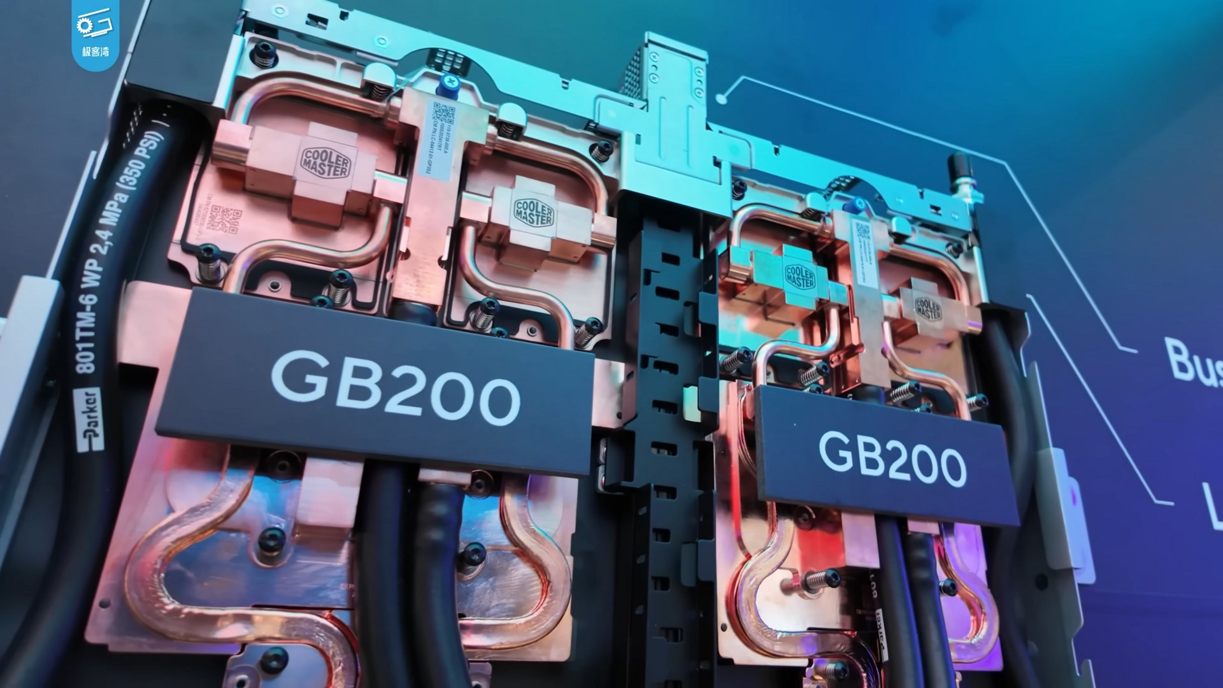
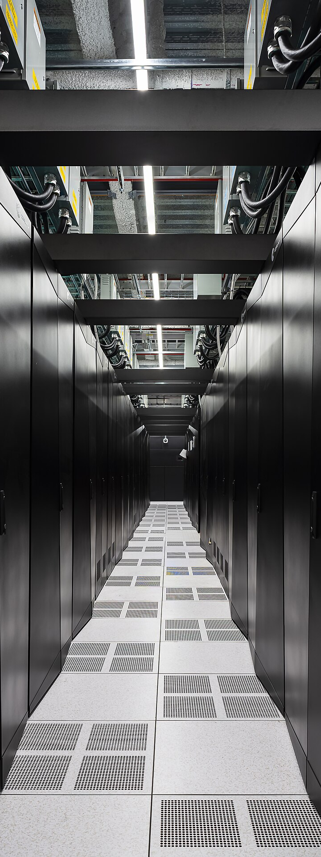
SYSTEMS · 2026 → 2028
The rack is the new computer
Power per rack (kW, log scale)
45 °C
water, no chillers
800 V DC designed for >1 MW
×11 (2020→25)
×4 more by 2027
~200
(est.)
300–600
(unconfirmed)
130 kW
At 54 V, 1 MW = 18.5 kA
and up to 200 kg copper
20–30
30 W → 9 W
per optical port (co-packaged optics, vendor)
5–15
485 → ~950 TWh
data-centre electricity, 2025→2030
Frontier, ORNL · water-cooled · 21 MW
Racks in data centers have become like transistors in ICs.
Gargini, IRDS/ISRDS Granada 2026 · IEA Energy & AI · NVIDIA (800 V DC, CPO) · DCD · Photos: Geekerwan, CC BY 3.0 · Oak Ridge National Laboratory, CC BY 2.0
2026
2031
2036
Notes:
Now step back one more level. [click] A typical enterprise rack, a standard cabinet of servers, draws 5 to 15 kilowatts; the A100 generation pushed that to 20 or 30. These are industry estimates, not specs. Then came the GB200 NVL72: 72 Blackwell GPUs and 36 Grace CPUs in one rack, joined by NVLink, NVIDIA's chip-to-chip fabric, so that software sees them almost as one giant GPU. It draws about 130 kilowatts, and it is water-cooled: two litres per second, in at 25 degrees and out at 45. Gargini quotes a price of about three million dollars per rack; treat that as an estimate. The International Energy Agency counts an eleven-fold rise in AI-server power density from 2020 to 2025, and expects four times more by 2027.
Vera Rubin, ramping in the second half of this year, is estimated at around 200 kilowatts, and Jensen Huang said at CES, the Consumer Electronics Show in Las Vegas, in January, that its racks run on 45-degree supply water, with no chillers. Water you could bathe in is cooling the most expensive computers on Earth.
[click] Kyber, NVIDIA's 2027 rack for Rubin Ultra, is where the numbers get soft. At GTC 2025, NVIDIA's developer conference, it said 600 kilowatts; after this year's redesign one well-known HPC blogger, Glenn Lockwood, guesses it is now closer to 300. Nobody outside NVIDIA knows. Either way, power delivery breaks. Today's racks distribute 54 volts. At 54 volts, one megawatt means about 18,500 amps (current is power over voltage, my arithmetic), and NVIDIA says up to 200 kilograms of copper busbar per rack. Hence 800 volts DC inside the rack, planned for production with Kyber. That puts power electronics, gallium-nitride and silicon-carbide converters, on the critical path of AI.
Even the optics move. A pluggable optical transceiver, the module you plug into a switch port, burns about 30 watts; NVIDIA claims about 9 with co-packaged optics, where the optical engine sits inside the switch package. That ratio is vendor marketing, and other vendors quote different baselines. Zoom all the way out: the IEA estimates that data centres used 485 terawatt-hours in 2025 and projects about 950 by 2030. That is a scenario, not a measurement, but it is a doubling.
[click] Gargini's line sums it up: racks in data centers have become like transistors in ICs. The rack is the unit that gets designed, bought and replicated by the thousand. For a chip architect, the spec now starts from the rack's power, cooling and link budget, and works backwards to the die.
Sources:
Ref: 26_05_19_Tech-Eco_Out.pdf p.45, p.47 (1.3 kW accelerator; NVL72 72 GPUs + 36 CPUs, 130 kW, 2 L/s, 25→45 °C), p.96 (NVL72 ≈$3 M, T3), p.98 ("Racks in Data Centers have become like Transistors in ICs", checked in the extracted text)
https://www.iea.org/reports/key-questions-on-energy-and-ai/executive-summary
https://michaelbommarito.com/wiki/datacenters/technology/rack-density/
https://developer.nvidia.com/blog/nvidia-800-v-hvdc-architecture-will-power-the-next-generation-of-ai-factories/
https://www.datacenterdynamics.com/en/news/vera-rubin-hot-water-cooling-reveal-triggers-hvac-share-drop/
https://www.datacenterdynamics.com/en/news/nvidia-updates-data-center-product-roadmap-following-lpu-launch-at-gtc-2026/
https://blog.glennklockwood.com/2026/03/gtc-2026-recap.html
https://developer.nvidia.com/blog/scaling-ai-factories-with-co-packaged-optics-for-better-power-efficiency/
https://commons.wikimedia.org/wiki/File:Eindr%C3%BCcke_von_der_COMPUTEX_2024_(_%E6%9E%81%E5%AE%A2%E6%B9%BEGeekerwan
https://commons.wikimedia.org/wiki/File:Frontier_supercomputer_(25

Slide 9
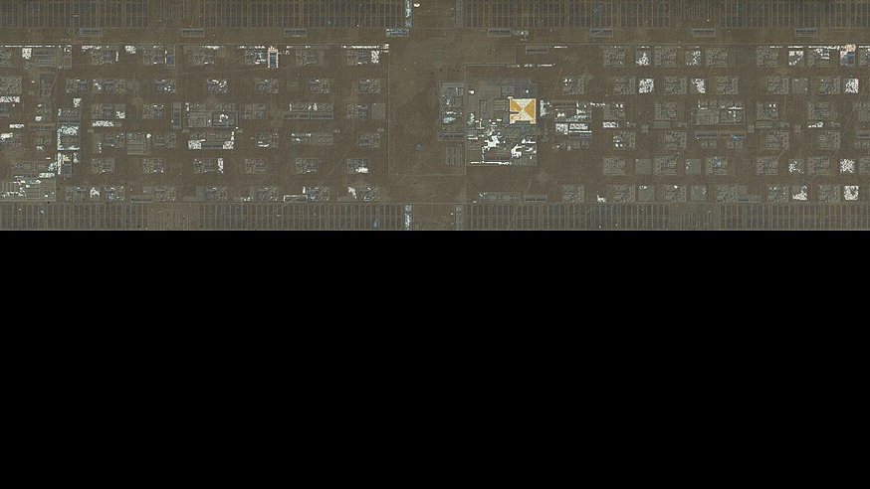
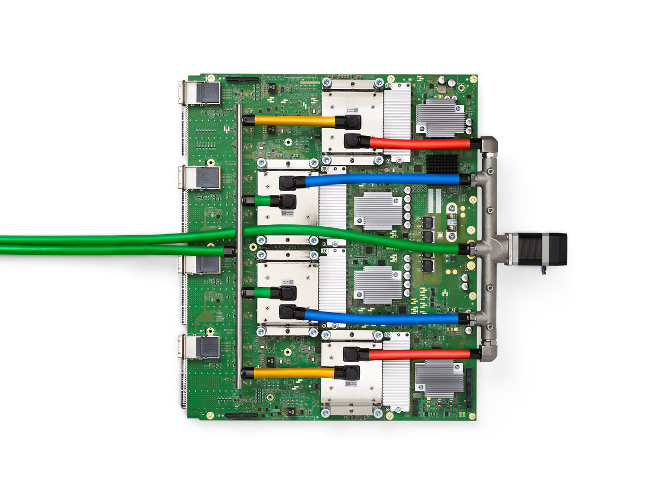
CUSTOM SILICON · 2026 → 2031
Every AI giant now designs its own silicon
TPU v4: ASIC + 4 HBM
Google
Ironwood TPU v7
4.6 PF FP8
27.8%
ASIC-based
AWS
Trainium3
3 nm
Microsoft
Maia 200
>10 PF FP4
Anthropic
own chip team (Aug 2026)
buys TPU · Trainium · NVIDIA · AMD
10+ GW
announced
AI servers shipped, 2026
9 months
to tape-out
OpenAI + Broadcom
Jalapeño · ~840 mm²
+44.6%
+16.1%
FPGA: Lattice +42% YoY, AI servers
RISC-V: ~32% of SoCs by 2031 (forecast)
Emulation & prototyping: record demand
Demand shifts to architects, verification and prototyping engineers
TrendForce via Tom’s Hardware · Google, AWS, Microsoft, Broadcom · Anthropic via DCD · Lattice · SHD Group · IRDS 2024 SA · Photo: Jouppi et al., CC BY 4.0
2026
2031
2036
Notes:
Who designs the chips in those racks? More and more, not the chip companies. [click] TrendForce, a market-research firm, estimates that 27.8 percent of the AI servers shipped in 2026 are built around ASICs, application-specific integrated circuits designed by or for the buyer, rather than around merchant GPUs. And that slice grows faster: ASIC shipments up 44.6 percent this year, GPUs up 16.1. A caveat: that is servers shipped, not dollars. NVIDIA still takes most of the revenue.
Look at the roster. Google's seventh-generation TPU, Tensor Processing Unit, called Ironwood: 4.6 petaFLOPS at 8-bit precision, announced for general availability in November 2025 and generally available on Google Cloud by April. AWS's Trainium3 on 3 nanometres. Microsoft's Maia 200; Meta, off the slide, has its MTIA, Meta Training and Inference Accelerator, in two new generations. Then Anthropic, the maker of the Claude models and the late entrant: only in August 2026 did it confirm an in-house silicon team. Its hires include Amir Salek, who founded Google's TPU programme, and Clive Chan, OpenAI's former custom-chip lead; no chip has been announced. Until now it has been the anchor tenant of everyone else's silicon: up to a million Google TPUs, Trainium co-optimised with Amazon's Annapurna Labs down to the kernels, NVIDIA GPUs through Microsoft Azure, and up to 2 gigawatts of AMD Instinct MI450 from 2027, more than 10 gigawatts announced in all. Its stated aim is modest, that Claude run "faster and more efficiently"; but a chip team of its own is also a lever on that buying power. [click] And the one that should make every design manager sit up: OpenAI with Broadcom, "Jalapeño", an inference chip whose compute die is about 840 square millimetres by Tom's Hardware's estimate, a full reticle, reportedly taken to tape-out in nine months, with OpenAI's own models used in the design. Broadcom and Marvell together do about 95 percent of this custom co-design work. Why inference? McKinsey projects that by 2030 inference, running trained models, will draw about 93 gigawatts of data-centre power against 62 for training. That is a projection, but inference is a stable, known workload, and stable workloads reward custom silicon.
Around the accelerator, the picture is good for the people in this room. The IRDS says plainly that FPGAs no longer drive process-node scaling; GPUs do. Yet FPGAs are all over the AI server. Lattice grew 42 percent year on year in the first quarter, led by AI-server demand. AMD's Versal AI Edge Gen 2 adaptive SoCs, systems-on-chip mixing FPGA fabric, AI engines and Arm cores, are all in production. Cadence reported a record hardware quarter for its emulation and FPGA-prototyping systems. And RISC-V, the open instruction-set architecture, is moving up: the RVA23 profile, the standard feature set for RISC-V application processors, gives it a server-class baseline, and NVIDIA is porting CUDA, its GPU programming platform, to RISC-V host processors. The SHD Group forecasts about 32 percent of all SoC units by 2031. Note that it counts any chip containing even one RISC-V core.
[click] So this is a design-services boom. Every one of these chips needs architects, verification engineers and prototyping engineers. And when a reticle-sized chip goes to tape-out in nine months, the bottleneck is not writing the RTL. It is proving that it works.
Sources:
https://www.tomshardware.com/tech-industry/semiconductors/custom-ai-asics-examined-from-broadcom-to-mtia
https://thenextweb.com/news/google-ironwood-tpu-inference-cloud-next
https://cloud.google.com/blog/products/compute/ironwood-tpus-and-new-axion-based-vms-for-your-ai-workloads
https://www.datacenterdynamics.com/en/news/aws-makes-trainium3-ultraservers-generally-available/
https://www.tomshardware.com/tech-industry/artificial-intelligence/broadcom-and-openai-unveil-custom-built-jalapeno-inference-processor-openais-first-chip-is-a-massive-reticle-sized-asic-built-in-an-ultra-fast-nine-month-development-cycle
https://www.mckinsey.com/featured-insights/week-in-charts/the-future-of-ai-workloads
Ref: 2024IRDS_SA.pdf p.24–25 (FPGAs "losing their appeal as the primary driver for process node scaling")
https://ir.latticesemi.com/news-releases/news-release-details/lattice-semiconductor-reports-42-yoy-first-quarter-2026-revenue
https://www.amd.com/en/blogs/2026/from-sensor-to-insight-production-ready-single-chip.html
https://investor.cadence.com/news/news-details/2026/Cadence-Reports-Second-Quarter-2026-Financial-Results/default.aspx
https://theshdgroup.com/wp-content/uploads/2026/04/RISC-V-Market-Analysis-2026-Final-abridged.pdf
https://chipsandcheese.com/p/hot-chips-2026-cuda-targets-risc
https://www.servethehome.com/update-on-risc-v-standards-and-adoption-at-hot-chips-2026/
https://www.datacenterdynamics.com/en/news/anthropic-publicly-confirms-its-putting-together-an-in-house-chip-design-team/
https://www.bloomberg.com/news/articles/2026-08-21/anthropic-taps-google-chip-veteran-as-part-of-push-into-hardware
https://www.anthropic.com/news/expanding-our-use-of-google-cloud-tpus-and-services
https://www.anthropic.com/news/google-broadcom-partnership-compute
https://www.anthropic.com/news/anthropic-amazon-compute
https://www.anthropic.com/news/anthropic-amazon-trainium
https://blogs.nvidia.com/blog/microsoft-nvidia-anthropic-announce-partnership
https://www.anthropic.com/news/higher-limits-spacex
https://newsroom.amd.com/news/amd-anthropic-strategic-partnership/
Ref: "10+ GW announced": floor of the headline "up to" figures in 13–16 (they sum to ≈13 GW with Broadcom's 3.5 GW filing figure; Anthropic gives no official total)
https://commons.wikimedia.org/wiki/File:TPU_v4.png

Slide 10

9-month tape-outs
VERIFICATION · 2026 → 2028
Reported first-silicon success has fallen to 1 in 20
IC/ASIC survey respondents · any spin before production counts, planned or not
First-silicon success (IC/ASIC projects)
Marketing vs measured
1 in 20
Vendor “up to” speed-ups
≈30%
10×
24%
40×
50×
14.4%
FPGA: no bug escape 16%
Measured pass@1
13%
5%
63%
33.6%
Survey sample changed, 2024
23.6%
2%
6%
n = 320 · 95% range 3–8%
0%
75% of projects late (2024)
49% of project time in verification (2026)
Agents write stimulus. Humans own intent, spec, (reference model and checkers ?).
2026
2031
2036
Siemens EDA / Wilson Research Group 2026 & 2024 · survey method · Cadence · Synopsys · CVDP (NVIDIA) · ChipVerilog
Notes:
Which brings me to my own trade. [click] Every two years Siemens EDA and the Wilson Research Group survey verification teams. First-silicon success means the first tape-out goes to production: no respin, no new masks. For twenty years it sat around 30 percent; in 2022, 24. Then Siemens switched from industry lists to a sample provider, and says itself the two periods are not the same measurement. So the fall to 14.4 in 2024 is partly real, partly a different crowd. The next step uses the same method: 5 percent in 2026, about 16 of 320 chip respondents, between 3 and 8 percent. One in twenty. Two caveats: every spin before production counts, including an A0 always meant as test silicon, and this year's respondents lean toward CPU, GPU and AI accelerators, where that is normal. But FPGA teams, with no masks at all, collapsed too: 2 percent shipped without a bug escape. This is not just mask economics.
In 2024, 75 percent of projects finished late, and Siemens puts verification at about half of project time, 49 percent in 2026.
[click] Into this walk the agents, AI systems that run tools in a loop on their own. Cadence, in February: "up to" ten times faster at writing designs and testbenches. Cadence with NVIDIA, in June: forty times, as Forbes reports it. Synopsys, in July: "up to" fifty times faster to validated RTL. No named customers, no named designs. Now the measured side, in pass@1, the share of problems where the model's first answer passes the tests. VerilogEval, short single-module problems: about 63 percent for GPT-4o, and that benchmark is close to saturated. NVIDIA's CVDP, the Comprehensive Verilog Design Problems benchmark, 783 realistic design and verification problems: the best model scores 33.6 percent, and 6 percent on writing testbench checkers. ChipVerilog, real open-source designs, a few of them over a thousand lines: 23.6 percent at best, and zero on any design with two or more submodules.
[click] Here is how I read it. Think of an agent as a tireless junior engineer who writes a thousand tests overnight but has never read the spec. Stimulus generation and coverage closure: agents will take that work. The intent, the specification, the reference model and the checker stay ours, and that is exactly where the models score 6 percent. The lever is the executable specification, a spec that a machine can run and check against. If your spec is a Word document, the agent is guessing. If your spec is a model, the agent is testing. That is where I would place a career bet in verification.
Sources:
https://blogs.sw.siemens.com/verificationhorizons/2026/09/08/the-2026-functional-verification-study/
https://verificationacademy.com/topics/planning-measurement-and-analysis/wrg-industry-data-and-trends/2026-functional-verification-study-executive-findings-paper/
https://verificationacademy.com/topics/planning-measurement-and-analysis/wrg-industry-data-and-trends/functional-verification-study-survey-methodology-evolution-reference/
https://verificationacademy.com/topics/planning-measurement-and-analysis/2026-siemens-eda-and-wilson-research-group-functional-verification-study/
https://semiengineering.com/first-time-silicon-success-plummets/
https://blogs.sw.siemens.com/verificationhorizons/2022/10/24/part-2-the-2022-wilson-research-group-functional-verification-study/
https://www.sigasi.com/news/verification-blog/
https://www.forbes.com/sites/karlfreund/2026/06/01/cadence-and-nvidia-team-to-develop-first--fully-autonomous-eda-agent/
https://news.synopsys.com/2026-07-26-Synopsys-Showcases-Comprehensive-Autonomous-Engineering-Workflows-from-Silicon-to-Systems,-Developed-with-NVIDIA-Technology
https://arxiv.org/html/2506.14074v1
https://arxiv.org/html/2607.13079v2

Slide 11

THE 3D ERA
After 2031, chips stack up and clock down
Logic density, Mgates/mm² (all tiers)
CPU clock at constant power density, GHz
CFET 2031–33
ARRIVES
eMRAM · eRRAM
6 tiers
Analog in-memory (2.5–20 TOPS/W)
Optical I/O chiplets
3.1 GHz
4 tiers
STAYS IN THE LAB · to 2036
81 → 365 masks
Steep-slope switches
60% of logic repairable (2037)
Spin logic
2 tiers
2D-channel logic
0.8 GHz
No beyond-CMOS switch beats CMOS. A rival needs ~10×.
2026
2031
2036
IRDS 2024 More Moore Table MM01 · IRDS Beyond-CMOS 2024 · imec 2026 roadmap
→ 2039
Notes:
So what do the roadmap people themselves expect after 2031? This comes from IRDS, the International Roadmap for Devices and Systems, the IEEE successor to the old ITRS (International Technology Roadmap for Semiconductors). It is their logic-scaling table.
[click] From 2025 to 2033, logic density rises from 27 to 64 million NAND2 gates per square millimetre, the standard yardstick cell. That is 2.4× in eight years; one node used to give us about 2×. Around 2031 pitch scaling slows and saturates. IRDS writes that after 2035 "there is no room for 2D geometry scaling". The transistor changes shape: CFET, the complementary FET, stacks the n-transistor on top of the p-transistor. IRDS says 2031 and imec's 2026 roadmap says about 2033, so think 2031–33.
Then comes the hockey stick: 153, 306, 459. That growth is not shrinking. It comes from stacking two, four and then six tiers of logic, which the roadmap calls 3D VLSI (very-large-scale integration). Density per tier is flat. These are model outputs, not anyone's commitment.
Now the red line. If you hold power density constant, the IRDS model's CPU clock falls from 3.1 gigahertz in 2025 to 0.8 in 2039. Picture a six-storey building with one air-conditioner on the roof. You can add floors, but everyone upstairs works slower. The architecture of the 3D era is wide, slow and parallel.
[click] Manufacturing gets harder too. The mask count grows from 81 to 365. With that many steps, IRDS plans for repairable logic: spare multiply-accumulate units, the way we have repaired memories with built-in self-repair for decades. It projects 20% of logic repairable in 2033 and 60% by 2037. That is design-for-test work, and it is coming to your team.
Now the reality check. Here is what actually reaches your hands. Embedded MRAM (magnetoresistive RAM) already replaces flash in NXP's 16-nanometre automotive microcontrollers. Embedded resistive RAM is licensed to onsemi and Texas Instruments. Analog in-memory compute chips measure 2.5 to 20 tera-operations per second per watt in the IRDS tables. In optical I/O, Marvell agreed to pay $3.25 billion upfront for Celestial AI.
[click] Other things stay in the lab through 2036: steep-slope switches such as tunnel FETs, spin logic, and 2D-channel logic. The IRDS Beyond-CMOS chapter says plainly that no device competitive with the CMOS transistor has been identified. It adds that a newcomer would need about ten times better performance to be adopted. Physics leaves room: IRDS puts a typical system at 10⁻¹⁴ joules per bit, the target at 10⁻¹⁷, and the Landauer limit at 3×10⁻²¹. The room is real. The switch to use it is not here yet.
Sources:
Ref: Density, CPU GHz at constant power density, mask count, repairable-logic share, tier count (2025–2039 columns): 2024IRDS_MM_Tables.xlsx, sheet MM01 (via L1_moremoore_litho.md, table and findings 2, 10, 11)
Ref: "Saturate around 2031", "after 2035 there is no room for 2D geometry scaling": 2024IRDS_MM.pdf p.8, p.13
https://www.tomshardware.com/tech-industry/semiconductors/imecs-2026-roadmap-details-0-3nm-nodes-by-2038-cfet-transistors-become-viable-at-0-7nm-company-redefines-moores-law-as-cell-sizes-gain-importance-for-density
https://spectrum.ieee.org/semiconductor-technology-roadmap
Ref: Beyond-CMOS verdict and the ~10× adoption bar: 2024IRDS_BC.pdf p.89–91, p.94 (via L4a_beyondcmos.md F1)
Ref: Analog in-memory compute 2.5–20.5 TOPS/W measured: 2024IRDS_BC_Tables-2.xlsx Table BC4.2 (via L4a_beyondcmos.md F8)
https://www.nxp.com/company/about-nxp/newsroom/NW-NXP-AND-TSMC-DELIVER-FIRST16NM-FINFET-MRAM
https://www.embedded.com/nxp-introduces-s32k5-mcu-family-pioneering-16nm-finfet-with-mram-for-automotive-innovation/
https://www.weebit-nano.com/news/press-releases/weebit-nano-secures-a-license-agreement-with-texas-instruments/
https://investor.marvell.com/news-events/press-releases/detail/1000/marvell-to-acquire-celestial-ai-accelerating-scale-up-connectivity-for-next-generation-data-centers
Ref: TFET interest diminished: 2024IRDS_BC.pdf p.31
Ref: Energy per bit 10⁻¹⁴ / 10⁻¹⁷ / Landauer 3×10⁻²¹: IRDS 2024 Executive Summary p.54, Fig. ES-36 (via L2b_systems.md F4)

Slide 12

ISRAEL · THE PLANS
Israel after the shrink: design nation
NVIDIA · Kiryat Tivon
Intel · Kiryat Gat
Tower · Migdal HaEmek
Innovation Authority + MAFAT
National AI Directorate
>10,000
$25 B
$1 B
NIS 150 M
100,000
people in a new R&D campus, 160,000 m²; occupancy 2031. About 5,000 in Israel today
Fab 38 expansion plan, $3 B of it state aid — frozen since July 2025; Fab 28 keeps running
silicon-photonics revenue run rate by Q4 2026; record $460 M quarter; 2028 target $3.6 B
national photonic-chip R&D facility, operating within 18 months
GPUs in a cluster within five years, and a leading-edge fab — reported talks with TSMC, Samsung, Intel
land bought Dec 2025
no restart announced
new 300 mm fab: Japan
call opened Jun 2026
reported, not signed
45,000 people in 250+ chip companies — and a senior hardware hire takes 5–7 months. The constraint is people, not money.
2026
2031
2036
Globes 10 Jul 2025 · CTech 18 Dec 2025 · Tower Q2 2026 · IIA/MAFAT Jun 2026 · Startup Nation Central 2025 · Globes 10 Jun 2026
Notes:
Geopolitics was going to be this slide. For this room the geopolitics that matters is the plan for Israel, so here are the plans — five of them, with their numbers and their dates.
[click] Two anchors. NVIDIA chose Kiryat Tivon in November 2025 and bought the land in December: a campus of 160,000 square metres built for more than ten thousand people — it employs about five thousand in Israel today, three thousand of them in Yokneam — with occupancy expected in 2031. Intel's Fab 38 in Kiryat Gat, the 25-billion-dollar plan with 3 billion of government aid, has been frozen since July 2025: the shell of the second phase is finished and no fit-out contracts were signed. Intel has said nothing official since; one blog claims renewed activity, nothing more. Fab 28 keeps running.
[click] Three smaller moves. Tower in Migdal HaEmek is growing on silicon photonics — the optical transceiver chips that connect AI data centres: a record 460-million-dollar quarter, a billion-dollar annual run rate of photonics revenue expected by the fourth quarter of this year, and a 2028 target of 3.6 billion. Its new 300-millimetre capacity goes to Japan, after Intel walked away in February from the New Mexico capacity deal. The Innovation Authority and MAFAT, the defence ministry's research directorate, opened in June a call for a national photonic-chip R&D facility: up to 150 million shekels, operating within eighteen months. And the National AI Directorate, with a billion-dollar budget rising to one and a half, is reported — reported, not signed — to be courting TSMC, Samsung and Intel for a leading-edge fab and a cluster of a hundred thousand GPUs, the graphics processors that train AI, within five years.
[click] What this means at your desk. Israel is a design nation: over 250 chip companies, 45,000 people, about nine percent of the tech workforce; private investment steady at four to five hundred million dollars a year since the 2021 peak; forty billion dollars of acquisitions since 1996, Hailo to Microchip the latest, in July. The constraint is people, not money: a senior hardware hire takes five to seven months, NVIDIA alone had over four hundred open positions in June, and the placement firms expect 2027 to be worse. If you can design — and verify — the chips of after the shrink, the plan for Israel is your plan.
Sources:
https://en.globes.co.il/en/article-1001515435
https://www.calcalistech.com/ctechnews/article/hwov8cyuf
https://www.calcalistech.com/ctechnews/article/sjcwdmxxzg
https://en.globes.co.il/en/article-1001526333
https://towersemi.com/2026/08/04/08042026/
https://techtime.news/tag/semiconductors
https://thequantuminsider.com/2026/06/14/israel-innovation-authority-and-israeli-ddrd-mafat-launch-nis-150-million-initiative-to-advance-israels-next-generation-of-photonic-chips
https://cryptobriefing.com/israel-chipmaking-ai-infrastructure-expansion/
https://ground.news/article/israels-ai-czar-seeks-chip-fab-new-data-centers-to-keep-edge
https://www.calcalistech.com/ctechnews/article/sj411cxdkwe
https://en.globes.co.il/en/article-1001545491
https://ir.microchip.com/news-events/press-releases/detail/1406/microchip-technology-signs-definitive-agreement-to-acquire-hailo
Ref: 30_working/research/Q12_israel-semiconductors.md (all of the above, with gaps: the IIA national semiconductor programme and the 2026 export-control status were not found in the session)

Slide 13

COLD COMPUTING
Quantum's bottleneck is classical electronics
300 K
4 K CMOS ~2030
Superconducting ~2038
Qubits one 4 K stage can control (IRDS model: 1.5 W, 620 cm²)
2026: 464 qubits
2038: 29,700
2030: 1,860
Room-temperature control (300 K)
~1,700
Cryo-CMOS (4 K)
~9,800
SFQ logic, ERSFQ (4 K)
~59,000
< 480 ns
mean time to decode 12 cycles on FPGAs (IBM, simulated data)
Carnot: ≥ 74 W
at 300 K to remove 1 W at 4 K
2026
2031
2036
IRDS 2026 CEQIP (Cryogenic Electronics & Quantum Information Processing) · IBM Quantum, Nov 2025
→ 2038
Notes:
This is my own research territory, so forgive a little passion. A superconducting quantum computer sits in a dilution refrigerator, the gold chandelier you see. It cools the chip in stages to about ten millikelvin. Every qubit needs microwave control and readout lines, and every wire from room temperature leaks heat into stages that can remove very little.
[click] IRDS 2026 now has a chapter for this: CEQIP, Cryogenic Electronics and Quantum Information Processing. Its model allows 1.5 watts over 620 square centimetres at 4 kelvin. With the control electronics at room temperature, wiring heat caps a machine at about 1,700 qubits. The chapter's roadmap for superconducting qubits goes from 464 this year to about 1,860 in 2030, straight through that wall.
The next step moves control into the fridge as cryo-CMOS, ordinary CMOS designed to work at 4 kelvin. That raises the ceiling to about 9,800 qubits, where latency becomes the limit. IBM has demonstrated a cryo-CMOS controller: its 14-nanometre FinFET chip at 4 kelvin drove two qubits at 23 milliwatts per qubit.
[click] By 2038 the roadmap reaches about 29,700 qubits, and only superconducting logic gets there. That means ERSFQ, energy-efficient single-flux-quantum logic, where a bit is a picosecond voltage pulse carrying one quantum of magnetic flux. The model gives about 59,000 qubits. So control migrates: 4 K CMOS around 2030, superconducting logic around 2038. The same chapter draws these walls somewhat higher in another figure, so treat them as orders of magnitude. The largest superconducting circuit shown so far has about a million switching devices, and some seventeen logic families still compete, like semiconductor logic in the 1960s.
A hype flag. You will read that cold electronics saves energy. Jülich reports chip power falling to 0.22× at 4 kelvin, but that is chip power only. The Carnot limit says removing one watt at 4 kelvin costs at least 74 watts at room temperature, and real cryocoolers do worse. Always ask for the wall-plug numbers.
[click] Now the part that belongs to you. Quantum error correction means measuring check qubits continuously and deciding the corrections in real time, faster than errors pile up. IBM's decoder on AMD FPGAs handles a window of twelve such cycles in under 480 nanoseconds on average, about 40 nanoseconds per cycle, on simulated check-qubit data, not a live chip. That is on the road to Starling, its fault-tolerant target for 2029: 200 logical qubits and 100 million gates, as a vendor roadmap. NVIDIA's NVQLink couples quantum processors to GPUs; its launch named nineteen quantum companies. Stay sceptical. Microsoft's Majorana claim is disputed in Nature. The quantum computer of the next decade is a co-processor, and its hardest real-time problem is an FPGA and ASIC problem.
Sources:
Ref: Control wall ~1,700 / ~9,800 / ~59,000 qubits, 1.5 W / 620 cm² budget at 4 K (XQsim model): IRDS/13-CEQIP…pdf p.18 (via L4b_newcomputing.md F8). The chart on p.19 draws the room-temperature limit at ~2,000–3,500 and the 4 K CMOS limit at ~10⁴–2×10⁴; p.18 values used, range mentioned in notes.
Ref: Qubit roadmap 464 (2026) → 1,860 (2030) → 29,700 (2038); control migration 300 K → 4 K CMOS ~2030 → superconducting ~2038: 13-CEQIP…pdf p.20, Table CEQIP-24 (T3 trend extrapolation)
Ref: IBM 14 nm FinFET cryo-CMOS controller demonstration, 2 transmons, 23 mW per qubit: 13-CEQIP…pdf p.14 (PRX Quantum 2024)
Ref: Largest superconducting circuit ≈1 M devices; ~17 logic families, "1960s" comparison: 13-CEQIP…pdf p.5–7
https://www.fz-juelich.de/en/news/archive/press-release/2025/cool-computing-2013-why-the-future-of-electronics-could-lie-in-the-cold
Ref: Carnot minimum ≈74 W per W removed at 4 K, computed (300 − 4)/4: L4b_newcomputing.md §5 (own arithmetic in the research file)
https://newsroom.ibm.com/2025-11-12-ibm-delivers-new-quantum-processors,-software,-and-algorithm-breakthroughs-on-path-to-advantage-and-fault-tolerance
https://www.ibm.com/quantum/blog/large-scale-ftqc
https://nvidianews.nvidia.com/news/nvidia-nvqlink-quantum-gpu-computing
https://www.networkworld.com/article/4189610/researchers-cast-new-doubt-on-microsofts-quantum-computing-advance.html

Slide 14

THE MAP · 2026 → 2036
Every layer of the stack moves by 2036
H1 · 2026–28
H2 · 2029–31
H3 · 2031–36
Transistor & litho
N2 nanosheets in volume
2029 A13/A12 · 14A · SF1.4
2031–33 CFET: nMOS on pMOS
High-NA EUV: Intel only
2030–31 gate pitch stops at 42 nm
2035 3D logic, 2 tiers
2027 backside power (A16)
Package
5.5 reticles now → 14 in 2028
2029 wafer-scale SoW-X, 64 HBM
2031+ hybrid bonds at 3 µm
Co-packaged optics ships
2029 hybrid bonds at 4.5 µm
Chiplets on functional interposers
Memory
HBM4 in volume, ≤ 3.3 TB/s
2029–31 HBM5 and 3D DRAM
2034+ 3D memory on accelerators
2027 HBM base die on N3P
Embedded RRAM broad in MCUs
FeFET · SOT-MRAM cache
Systems & power
130 kW racks, 45 °C water
2030 data centres ~950 TWh
2036 2.5 kW accelerator socket
2027 800 V DC racks
2030 inference > training
✕
Energy/bit must fall ~1,000×
Design work
Agentic EDA ships
2029 backside I/O, on-die regulators
Repairable logic 20% → 60%
✕
First-silicon success 5%
✕
>1 M more workers needed by 2030
3D floorplans: tiers, heat, test
New computing
eMRAM replaces eFlash
2029 fault-tolerant QC targets
✕
No beyond-CMOS switch
QEC decoding < 480 ns on FPGAs
~2030 cryo-CMOS qubit control
→ 2038 superconducting control
Common thread: stack it, package it, move fewer bits.
2026
2031
2036
IRDS 2024–26 · imec 2026 · TSMC · Intel · JEDEC · IEA · Siemens · IBM (full list in notes)
Notes:
By 2036 every layer of the stack moves, from the transistor to the design flow.
[click] The next three years are largely decided: the fabs are built and the tools are ordered. TSMC's 2-nanometre nanosheet process is in volume. High-NA EUV, the new scanners with 0.55 numerical aperture, reported at roughly 380 to 400 million dollars each, runs in production only at Intel. Backside power, which feeds the transistors from underneath the wafer, reaches TSMC in 2027. Packages grow from 5.5 reticles to 14 by 2028, a reticle being the largest area a scanner can expose in one shot. HBM4, high-bandwidth stacked DRAM, is shipping. A rack already draws 130 kilowatts, is cooled with 45-degree water, and moves to 800-volt DC in 2027. In our own work, all three big EDA (electronic design automation) vendors have announced agentic flows, shipping from the second half of 2026, yet first-silicon success in Siemens' latest survey fell to 5%. Embedded MRAM is replacing flash, and quantum error decoding already runs in under 480 nanoseconds on FPGAs.
Between 2029 and 2031 the roadmaps start to bend. Imec expects gate pitch to stop at 42 nanometres around 2030–31. TSMC, Intel and Samsung each place a new node in 2029. Packages go wafer-scale, with 64 HBM stacks and hybrid bonds at 4.5 micrometres. HBM5 and the first 3D DRAM arrive. The International Energy Agency expects data centres to use about 950 terawatt-hours in 2030, and McKinsey expects inference to use more power than training by then. Backside I/O and on-die voltage regulators enter the design flow. Fault-tolerant quantum computers are targeted for 2029; those are targets, not deliveries. Qubit control moves into the fridge around 2030. And the industry says it needs more than a million additional workers by 2030.
[click] From 2031 to 2036 we enter the 3D era: CFET, then tiers of logic, hybrid bonds at 3 micrometres, and memory stacked on accelerators. IRDS projects a 2.5-kilowatt accelerator socket in 2036 and a growing share of repairable logic. Two red marks will not yield to money quickly. Energy per bit must fall roughly a thousandfold to keep data-centre electricity in bounds, and no new switch is coming to replace CMOS.
[click] Across transistors, packages, memory, power, design and new computing, the same three verbs keep coming back: stack it, package it, move fewer bits. That is the job description for the next decade.
Sources:
https://pr.tsmc.com/english/news/3302
https://www.tomshardware.com/tech-industry/semiconductors/tsmc-unveils-process-technology-roadmap-through-2029-a12-a13-n2u-announced-a16-slips-to-2027
https://www.tomshardware.com/tech-industry/semiconductors/intel-becomes-the-first-company-to-ship-high-volume-logic-chips-made-with-asmls-high-na-euv-select-panther-lake-layers-on-18a-are-now-dual-qualified-for-0-55-na-scanners
https://www.tomshardware.com/tech-industry/semiconductors/asml-lithograpy-roadmap-examined-from-duv-to-hyper-na
https://anysilicon.com/news/intel-begins-work-on-10a-and-7a-process-nodes-as-14a-roadmap-moves-toward-key-pdk-release/
https://www.tomshardware.com/tech-industry/samsung-foundry-updates-process-roadmap-to-move-1-4nm-node-to-2029-high-na-euv-will-enable-1nm-class-and-smaller-nodes-in-2030-and-beyond
https://www.tomshardware.com/tech-industry/semiconductors/imecs-2026-roadmap-details-0-3nm-nodes-by-2038-cfet-transistors-become-viable-at-0-7nm-company-redefines-moores-law-as-cell-sizes-gain-importance-for-density
Ref: IRDS CFET 2031, 3D VLSI 2 tiers 2035, repairable logic 20% (2033) → 60% (2037), hybrid bond 3 µm (2031+): 2024IRDS_MM_Tables.xlsx MM01; 9-MM-…Badaroglu_v1-1.pdf p.6 (via L1_moremoore_litho.md, L3_packaging_fab.md F2)
Ref: Domain-specific chiplets on functional interposer 2031+: 9-MM-…Badaroglu_v1-1.pdf p.5 (via W6_horizon.md F11)
https://semiengineering.com/tsmc-tech-symposium-2026-by-the-numbers/
https://www.tomshardware.com/tech-industry/semiconductors/tsmcs-details-next-gen-cowos-roadmap-over-14-reticle-packages-and-48x-leap-in-compute-power-expected-by-2029-massive-size-enables-24-hbm5e-stacks-and-additional-memory-bandwidth-jump
https://nvidianews.nvidia.com/news/nvidia-spectrum-x-co-packaged-optics-networking-switches-ai-factories
https://www.globenewswire.com/news-release/2025/10/08/3163429/19933/en/Broadcom-Announces-Tomahawk-6-Davisson-the-Industry-s-First-102-4-Tbps-Ethernet-Switch-with-Co-Packaged-Optics.html
https://news.samsung.com/global/samsung-ships-industry-first-commercial-hbm4-with-ultimate-performance-for-ai-computing
https://investors.micron.com/news/press-release/2026/Micron-in-High-Volume-Production-of-HBM4-Designed-for-NVIDIA-Vera-Rubin-PCIe-Gen6-SSD-and-SOCAMM2-03-16-2026/default.aspx
https://www.tomshardware.com/pc-components/dram/hbm-undergoes-major-architectural-shakeup-as-tsmc-and-guc-detail-hbm4-hbm4e-and-c-hbm4e-3nm-base-dies-to-enable-2-5x-performance-boost-with-speeds-of-up-to-12-8gt-s-by-2027
https://wccftech.com/sk-hynixs-roadmap-hbm5-hbm5e-gddr7-next-ddr6-400-layer-4d-nand-2029-2031/
https://www.weebit-nano.com/news/press-releases/weebit-nano-secures-a-license-agreement-with-texas-instruments/
Ref: 3D-stacked memory 2034+, 2.5 kW socket 2036, energy per bit ≥1,000× cut: IRDS 2024 SA chapter p.24, Table SA-4 (via L2b_systems.md F1, F4)
Ref: FeFET and SOT-MRAM as H3: L4a_beyondcmos.md §0, F7; 2024IRDS_BC.pdf p.19
https://www.datacenterdynamics.com/en/news/vera-rubin-hot-water-cooling-reveal-triggers-hvac-share-drop/
https://developer.nvidia.com/blog/nvidia-800-v-hvdc-architecture-will-power-the-next-generation-of-ai-factories/
https://www.iea.org/reports/key-questions-on-energy-and-ai/executive-summary
https://www.mckinsey.com/featured-insights/week-in-charts/the-future-of-ai-workloads
https://news.synopsys.com/2026-07-26-Synopsys-Showcases-Comprehensive-Autonomous-Engineering-Workflows-from-Silicon-to-Systems,-Developed-with-NVIDIA-Technology
https://news.siemens.com/en-us/siemens-fuse-eda-ai-agent/
https://www.forbes.com/sites/karlfreund/2026/06/01/cadence-and-nvidia-team-to-develop-first--fully-autonomous-eda-agent/
https://blogs.sw.siemens.com/verificationhorizons/2026/09/08/the-2026-functional-verification-study/
Ref: Backside I/O and integrated voltage regulators by 2029: IRDS 2024 SA p.25 (via L2b_systems.md F7)
https://www.deloitte.com/us/en/industries/tmt/articles/global-semiconductor-talent-shortage.html
https://www.embedded.com/nxp-introduces-s32k5-mcu-family-pioneering-16nm-finfet-with-mram-for-automotive-innovation/
https://newsroom.ibm.com/2025-11-12-ibm-delivers-new-quantum-processors,-software,-and-algorithm-breakthroughs-on-path-to-advantage-and-fault-tolerance
https://www.ibm.com/quantum/blog/large-scale-ftqc
Ref: Cryo-CMOS control ~2030, superconducting control ~2038: 13-CEQIP…pdf p.20 (via L4b_newcomputing.md F8)
Ref: No beyond-CMOS switch: 2024IRDS_BC.pdf p.89–91
Ref: "3D floorplans: tiers, heat, test" is a synthesis of W6_horizon.md §2 and L1_moremoore_litho.md §2 (research teams' "so what", not a single sourced number)

Slide 15

FIVE BETS
Five bets that pay after the shrink
1
2
3
4
5
Joules per bit
Own the intent
Memory first
Design for defects
Learn the next layer
200–300×
6%
3.0×
vs 1.6×
60%
< 480 ns
DRAM access vs on-die compute
best LLM score writing testbench checkers
compute vs DRAM bandwidth, per 2 years
of logic repairable by 2037
QEC decoding on FPGAs
PQC: FIPS 203/204/205
photonics · power · cryo
After the shrink, the gains are ours to design.
2026
2031
2036
IRDS More Moore 2026 · NVIDIA CVDP · Gholami et al., IEEE Micro 2024 · IRDS MM01 · IBM
Notes:
These are bets, not predictions: things I would put my own career on.
[click] One: think in joules per bit. On a modern die, computing on a bit costs about 10 femtojoules. Fetching it from DRAM costs 2 to 3 picojoules, 200 to 300 times more, according to the IRDS More Moore team. Learn die-to-die links such as UCIe, the Universal Chiplet Interconnect Express, along with thermal sign-off and known-good-die test. If your architecture review has no energy-per-bit budget, add one.
Two: own the intent and let agents write the stimulus. Agents will write testbenches, assertions and coverage closure. Vendors claim speed-ups of up to 50×, but those are marketing figures. On NVIDIA's CVDP (Comprehensive Verilog Design Problems) benchmark the best model scored 6% at generating testbench checkers. On a 2026 benchmark of real designs, models scored zero on anything with two or more submodules. The specification, the reference model and the checker remain yours.
Three: design memory first. Over twenty years, peak server compute grew 3× every two years and DRAM bandwidth only 1.6×. Gartner forecasts that memory will be 54% of all chip revenue this year. So design for bytes moved per operation, and get fluent with 8- and 4-bit number formats and with verifying them.
[click] Four: design for defects and for attackers. With up to 365 masks and stacked tiers, IRDS projects 20% of logic to be repairable in 2033 and 60% by 2037. Built-in self-repair, which we have used on memories for decades, is coming to logic. Security is moving into silicon too. That means PUFs (physically unclonable functions, a chip's manufacturing fingerprint used as a key), hardware attestation, and post-quantum cryptography, which NIST, the US National Institute of Standards and Technology, finalised as FIPS (Federal Information Processing Standards) 203, 204 and 205 in August 2024. Those are accelerators that someone in this room will write.
Five: learn the adjacent layer. Learn photonics: NVIDIA says co-packaged optics cuts a switch port from about 30 watts to about 9. Learn power delivery, because racks are moving to 800-volt DC. And learn cryogenic and quantum control, where IBM decodes errors in under 480 nanoseconds on FPGAs. That is our craft, in a colder room.
[click] For fifty years the process node did part of our homework. Every shrink gave us faster, cheaper, cooler transistors for free, and that free lunch is over. After the shrink, the gains are ours to design. Thank you.
Sources:
Ref: On-die compute ~10 fJ/bit vs DRAM access 2–3 pJ/bit (200–300×): ISRDS-2026-Granada/9-MM-20260516_ISRDS_2026_More_Moore_Badaroglu_v1-1.pdf p.4 (via W2_packaging_memory.md F13, L3_packaging_fab.md F4)
https://arxiv.org/html/2506.14074v1
https://arxiv.org/html/2607.13079v2
https://news.synopsys.com/2026-07-26-Synopsys-Showcases-Comprehensive-Autonomous-Engineering-Workflows-from-Silicon-to-Systems,-Developed-with-NVIDIA-Technology
https://arxiv.org/abs/2403.14123
https://www.gartner.com/en/newsroom/press-releases/2026-08-24-gartner-forecasts-worldwide-semiconductor-revenue-to-reach-1-trillion-dollars-in-2026
Ref: 365 masks (2039), repairable logic 20% (2033) → 60% (2037): 2024IRDS_MM_Tables.xlsx MM01 (via L1_moremoore_litho.md finding 10)
https://csrc.nist.gov/pubs/fips/203/final
https://developer.nvidia.com/blog/scaling-ai-factories-with-co-packaged-optics-for-better-power-efficiency/
https://developer.nvidia.com/blog/nvidia-800-v-hvdc-architecture-will-power-the-next-generation-of-ai-factories/
https://newsroom.ibm.com/2025-11-12-ibm-delivers-new-quantum-processors,-software,-and-algorithm-breakthroughs-on-path-to-advantage-and-fault-tolerance

Slide 16



































PART 2
Quantum computers update
2026
2031
2036
Images: credits at the end
Notes:
Part one ended inside a dilution refrigerator. We saw that the hardest problem of a quantum computer today is classical electronics: wiring, control and real-time decoding. And I closed with a claim: the quantum computer of the next decade is a co-processor.
[click] So let me treat it the way you would treat any accelerator a customer asks you to integrate. You would not start from the physics. You would ask for the datasheet, and then you would ask which numbers on it were measured and which were promised. The grey dashed tail on the ribbon is new: it means beyond 2036, past the horizon of part one, and quantum computing lives there more than anything else in this talk.
Many of you heard me on quantum last year, and the field has moved since. When a headline announces a thousand qubits or a trillion-dollar market, I want you to be able to tell the measurement from the roadmap, and the roadmap from the hope.
Sources:
Ref: Hand-over line "the quantum computer of the next decade is a co-processor": S3.md slide 13 notes (part 1).
Ref: Mosaic construction: S1.md slide 1. Image ids: assigned by the builder from the part-2 image register (in preparation).

Slide 17
THE REASON
Why quantum computers? Because only they can…
1
Simulate quantum matter and fields
Feynman 1982
Lloyd 1996
drug metabolism (cytochrome P450), CO₂ catalysts, cuprate superconductors, battery cathodes, nuclei
2
Quantum networks and quantum sensors — one ecosystem
Kimble 2008
Degen et al. 2017
entanglement distribution and quantum key distribution; sensors and clocks whose quantum data a processor learns from exponentially faster (Science 2022)
3
Quantum neural networks — a speculation
speculation
R. Neeman 2026
networks whose weights and activations are quantum states; no proven edge on ordinary data yet, barren plateaus in the way — my own bet, not a theorem
4
Break today's public-key cryptography
Shor 1994
US deadline 2030
RSA and elliptic curves; the US orders post-quantum key exchange for high-value systems by 2030
Missing on purpose: search (only quadratic), optimisation, AI on ordinary data (dequantised); sampling and structured algebra — no buyer yet.
2026
2031
2036
Feynman 1982 · Lloyd 1996 · Kimble 2008 · Degen, Reinhard, Cappellaro 2017 · Huang et al., Science 2022 · Larocca et al. 2025 (barren plateaus) · Shor 1994 · US EO 14412 (2026)
Notes:
Nobody adds a DSP block to run the operating system; you add it because a few kernels map onto it far better. A quantum computer is that kind of block, and its kernel list is short. One caveat covers everything here: nobody has proven that BQP, the problems a quantum computer solves efficiently, is larger than BPP, its classical counterpart.
[click] First, simulating quantum matter and fields. Feynman argued in 1982 that a classical computer needs exponentially more resources as the quantum system grows; Lloyd showed in 1996 that a quantum computer simulates such systems efficiently. The problem is BQP-complete: if quantum computers have an advantage at all, simulation has it. The named problems are those with published resource estimates: cytochrome P450, the liver enzyme that metabolises most drugs; ruthenium catalysts that fix CO₂; the cuprate and pnictide models of high-temperature superconductors; lithium-rich battery cathodes; nuclei. Off the list: FeMoco, the nitrogen-fixing enzyme — a classical calculation solved the model in January 2026.
[click] Second, an ecosystem rather than a kernel: quantum networks and quantum sensors. Networks distribute entanglement between machines — Kimble's quantum internet of 2008 — and carry quantum key distribution, keys whose interception shows up as physics. Sensors — atomic clocks, magnetometers, gravimeters — measure with quantum states; Degen, Reinhard and Cappellaro's 2017 review is the map. The two meet in the one exponential advantage proven without any conjecture: a quantum processor that reads a sensor's quantum state directly learns from exponentially fewer experiments than any classical analysis of its readouts — Huang and colleagues, Science 2022, shown on 40 qubits. Processors, networks and sensors share one hardware stack — cryogenics, control electronics, photonics — which is why the Israeli roster later mixes them freely.
[click] Third, my own speculation, marked as such: quantum neural networks — networks whose weights and activations are quantum states, trained like today's models. Nothing is proven here for ordinary data: the exponential claims were mostly dequantised after Ewin Tang's 2018 result, and variational circuits run into barren plateaus, flat landscapes where training stalls. My bet is that the first useful programs for these machines will be learnt, not written — but it is a bet, not a theorem.
[click] Fourth, breaking today's public-key cryptography, RSA and elliptic curves. Shor's 1994 algorithm factors in polynomial time; the best classical method, the number field sieve, grows almost exponentially with the key length. Never run on a real key: a 2025 paper matched the published quantum factoring records with a VIC-20 home computer, an abacus and a dog. Yet the US executive order of 22 June 2026 wants key exchange in the federal government's high-value systems moved to post-quantum cryptography by the end of 2030.
Missing on purpose: search is provably only quadratically faster; optimisation and AI on ordinary data have no proven edge; and two things only they can do — certified random sampling, and the structured algebra behind Pell's equation — have no buyer yet.
Sources:
https://link.springer.com/article/10.1007/BF02650179
https://arxiv.org/abs/quant-ph/9701001
https://doi.org/10.1126/science.273.5278.1073
https://arxiv.org/abs/quant-ph/9508027
https://www.whitehouse.gov/wp-content/uploads/2026/06/eo-14412.pdf
https://eprint.iacr.org/2025/1237
https://arxiv.org/abs/1011.3245
https://arxiv.org/abs/1005.1407
https://www.nature.com/articles/s41586-025-08737-1
https://doi.org/10.1145/509907.510001
https://arxiv.org/abs/2408.08292
https://arxiv.org/abs/2112.00778
Ref: BQP vs BPP unproven: Q3 §2
https://arxiv.org/abs/1807.06209
https://arxiv.org/abs/1807.04271
https://arxiv.org/abs/2601.04621
https://doi.org/10.1038/nature07127
https://arxiv.org/abs/1611.02427
https://arxiv.org/abs/2405.00781
https://arxiv.org/html/2307.00523v1
https://arxiv.org/abs/2403.07059

Slide 18


THE GAP
Today: dozens of logical qubits. Needed: thousands
Largest system and best logical-qubit record, by platform (log scale)
≈1,600×
more physical qubits than the largest 2026 array
100M
■ Physical qubits, largest system
■ Logical qubits, best record
≈10⁷ physical, surface code
10M
≈10⁶ physical, qLDPC codes (derived)
1M
100k
10k
6,100
Threshold machine: ≈3,000 logical
≈60×
more logical qubits, and far better ones
1k
1,121
no gates yet · 448 with error correction
98
48
100
30*
18
12
BELOW THRESHOLD
10
2*
Google Λ 2.14 · Dec 2024
1
1
Harvard–MIT–QuEra 2.14× · Nov 2025
none
none · contested
Superconducting qubits
Trapped ions
Neutral atoms
Photonic qubits
Silicon spin qubits
Topological qubits
USTC Λ 1.40 · Dec 2025, reported
* error detection only
2026
2031
2036
Platform records: IBM (Dec 2023) · Quantinuum (Nov 2025) · Caltech (Sep 2025) · Harvard/MIT/QuEra, Nature (Nov 2025) · Infleqtion (Sep 2026, vendor claim) · Xanadu, Nature (Jan 2025) · HRL, Nature (Jul 2026) · Google Willow, Nature (Dec 2024) · threshold machine: Qodeh model, Oct 2026
→ 2040s
Notes:
Last year I showed you qubit counts. This year I want two numbers side by side.
[click] Physical qubits first. A physical qubit is one piece of hardware, a superconducting circuit, a trapped ion or a neutral atom, and it fails roughly once in a thousand operations. IBM's Condor had 1,121 superconducting qubits in December 2023 but was never offered to users. Quantinuum's Helios has 98 trapped ions. Caltech holds 6,100 neutral atoms, without entangling gates so far; the largest machine that has run error correction has 448 atoms, at Harvard, MIT and QuEra.
Now logical qubits. A logical qubit is one reliable qubit spread over many physical ones by an error-correcting code: repeated parity checks that expose errors without reading the data. Error detection only flags errors and discards the flagged runs, which is called post-selection; error correction repairs them. Helios runs 48 error-corrected logical qubits; Quantinuum claims better-than-bare performance only for 50 error-detected ones. Infleqtion announced 30, error-detected, with no paper yet. Harvard's Nature paper says "dozens" in its summary, and one figure shows up to 96 small logical qubits active at once. Google's Willow has exactly one, but a good one.
[click] Why I am optimistic anyway. Code distance is the number of physical errors it takes to corrupt a logical qubit. Lambda is how many times the logical error falls when the distance grows by two. Above one, a bigger code gives fewer errors: the hardware is below threshold. Willow reached 2.14 in December 2024, the Harvard team 2.14 in November 2025, and USTC reported 1.40 last December, which I have only from a secondary source.
The target is a threshold machine of about 3,000 logical qubits. With the surface code, the standard grid-shaped code, that is of order ten million physical qubits, derived from a 2025 estimate of 4.5 million for a 1,459-logical-qubit chemistry run. qLDPC codes, quantum low-density parity-check codes that link distant qubits, aim to cut that up to tenfold.
[click] So, roughly 1,600 times more physical qubits than the largest array; 160 times with qLDPC codes; 22,000 times against the largest machine that has corrected errors. And 60 times more logical qubits, each far more reliable.
Here is where you come in. Every round of checks yields a syndrome, the pattern of results. A decoder, a classical processor beside the machine, must turn each syndrome into a correction before the next round, about every microsecond on superconducting qubits. Think of ECC memory whose scrubber must finish every microsecond, forever. If it falls behind, errors pile up faster than it removes them.
Sources:
https://thequantuminsider.com/2023/12/04/ibm-says-new-1000-plus-processors-to-advance-toward-quantum-utility/
https://www.quantinuum.com/blog/introducing-helios-the-most-accurate-quantum-computer-in-the-world
https://www.caltech.edu/about/news/caltech-team-sets-record-with-6100-qubit-array
https://www.nature.com/articles/s41586-025-09848-5
https://postquantum.com/industry-news/infleqtion-30-logical-qubits/
https://www.nature.com/articles/s41586-024-08406-9
https://www.nature.com/articles/s41586-026-10754-7
https://www.hrl.com/uncategorized/2026/07/29/hrl-demonstrates-a-silicon-quantum-processing-unit-that-runs-error-correction-with-all-its-control-electronics-housed-inside-the-cryostat
https://www.nature.com/articles/s41586-024-08445-2
https://arxiv.org/abs/2408.13687
https://www.nature.com/articles/s41586-024-08449-y
https://link.aps.org/doi/10.1103/rqkg-dw31
https://postquantum.com/quantum-research/zuchongzhi-3-2-belowthreshold/
https://arxiv.org/abs/2502.15882
https://arxiv.org/abs/2308.07915
Ref: Ratios ≈1,600×, ≈160×, ≈22,000×, ≈60×: Q4 §3 (arithmetic)
Ref: Physical/logical qubit, syndrome and decoder paragraph: Q4 §4

Slide 19
WHEN
Roadmaps say 2029; the evidence says about 2040
PsiQuantum 2027–28 · IonQ 2028 / 2029
IBM Starling 2029 · Google 2029 · Quantinuum 2029–30
2029
vendor roadmaps
IBM Blue Jay 2033+
Vendor fault-tolerance targets
beyond the talk's horizon
Expert surveys
Vendor roadmaps + slip
≈2040
median · Qodeh model, Oct 2026
Engineering extrapolation
First machine able to break RSA-2048
Threshold machine: ≈3,000 logical
Vendor targets, by year stated
2023–26 → 2029
2025
2030
2035
2040
2045
2050
2055
2060
✕
2030
2031
2035
✕
post-quantum migration deadlines
bar: 10–90% range · tick: median
2015–19 → 2023
2020–22 → 2025
always about 5 years away
2026
2031
2036
Qodeh model, Oct 2026 (QT-Map SP10, draft v2) · GRI Quantum Threat Timeline 2025 · IBM · IonQ, Quantinuum, Google, PsiQuantum roadmaps · US EO 14412 · NSM-10, UK NCSC, EU NIS CG
→ 2040s
Notes:
Every vendor has a date, and most of them say 2029.
[click] IBM's Starling: 200 logical qubits and a hundred million operations in 2029, then 2,000 qubits and a billion gates in 2033 or later. IonQ: 1,600 logical qubits in 2028 and 8,000 in 2029, with no operation rate stated. Quantinuum: 2029 to 2030. Google said in 2021: a useful, error-corrected computer by 2029. PsiQuantum: a site in Brisbane operational by the end of 2027. These are vendor roadmaps, not measurements.
Governments do not wait. The US executive order of June 2026 wants the federal government's high-value and high-impact systems on post-quantum cryptography, for key exchange by the end of 2030 and for signatures by the end of 2031; the 2022 national security memorandum, the UK's National Cyber Security Centre and the European Union aim at 2035. Deadlines are revealed beliefs about risk, not forecasts.
Some history. Vendor targets stated between 2015 and 2019 had a median year of 2023; those stated in 2020 to 2022, 2025; those stated since 2023, 2029. Both targets that came due, Microsoft's and PsiQuantum's, were missed. The horizon stays at four to five years while the calendar moves. Anyone who has watched a tape-out date slide one week per week knows this curve.
[click] So we built a model, a Monte Carlo simulation of 20,000 random futures with three evidence lines of equal weight. The Global Risk Institute's 2025 survey of 26 experts, which gives a 28 to 49 percent chance of a code-breaking machine within ten years. Vendor roadmaps with a slip added: a median of three years and a 90th percentile of seven, our judgment, on a thin and partly recalled record. And an engineering extrapolation, physical-qubit counts doubling every 1.3 to 2.8 years from about a thousand good qubits today.
Combined, a machine able to run Shor's algorithm against RSA-2048 (the register row shor-rsa2048) arrives at a median of 2039, with a one-in-ten chance before mid-2033 and one-in-ten after 2048. The 3,000-logical-qubit threshold machine follows at a median of about 2042, with only an eight percent chance by 2035. These are estimates from our own model.
[click] About 2040, not 2029. Part of the gap is definition, because the 2029 machines are smaller than this class, and part is slip. The counterweight: the expert surveys have moved earlier in every edition, and Scott Aaronson takes the 2028–29 roadmaps more seriously than we do. Either way, migrate your cryptography on the governments' schedule, not ours.
Sources:
https://qodeh.com/publications/quantum-technology-map/
https://globalriskinstitute.org/publication/quantum-threat-timeline-report-2025b/
Ref: Slip median 3 y, P90 7 y (judgment; slip record thin, partly unverified): Q1 §2.2, §B.1.2
Ref: Doubling every 1.3–2.8 years from ≈1,000 qubits in 2026 (judgment): Q1 §2.2, §B.1.3
https://www.ibm.com/roadmaps/quantum/
https://www.ibm.com/quantum/blog/large-scale-ftqc
https://ionq.com/roadmap
https://www.quantinuum.com/blog/quantinuum-overcomes-last-major-hurdle-to-deliver-scalable-universal-fault-tolerant-quantum-computers-by-2029
https://quantinuum.com/press-releases/quantinuum-unveils-accelerated-roadmap-to-achieve-universal-fault-tolerant-quantum-computing-by-2030
https://thenextweb.com/news/google-io-build-practical-quantum-computer-by-2029
https://www.businesswire.com/news/home/20240429080449/en
Ref: Vendor target medians 2023 / 2025 / 2029 by period stated; horizons 4–5 years; Microsoft 2023 and PsiQuantum 2025 missed; "deadlines are revealed beliefs": Q1b_ftqc-timeline-history.md, "The answer in brief" and "The horizon pattern"
https://www.whitehouse.gov/wp-content/uploads/2026/06/eo-14412.pdf
https://www.govinfo.gov/content/pkg/DCPD-202200355/html/DCPD-202200355.htm
https://www.ncsc.gov.uk/guidance/pqc-migration-timelines
https://www.enisa.europa.eu/media/56885
https://scottaaronson.blog/?p=9425

Slide 20
WHAT FOR
A science instrument: molecules, materials, nuclei
One job on the threshold machine
6 of 8
core applications fit
10 years
Fusion stopping power
Rich machine: 13× the Toffoli rate
1 year
Battery cathode spectrum
Threshold machine: ≈3,000 logical · 30-day job
30 days
Nuclear shell model, ²¹⁹At
Qodeh model, Oct 2026
1 day
FeMoco: solved classically, Jan 2026
CO₂ catalyst (ruthenium)
Drug metabolism (cytochrome P450)
1 h
Cuprate & pnictide models
1 min
Fermi–Hubbard 8×8
Ising dynamics, 100 spins
100
300
1,000
3,000
10,000
Logical qubits
The Toffoli rate, not the qubit count, is the axis that pays.
2026
2031
2036
Qodeh model, Oct 2026 (QT-Map SP10, draft v2), on published resource estimates: arXiv 2502.15882 · 2506.15784 · 2012.09238 · 2411.02160 · 2211.07629 · 2607.21563 · 2308.12352 · FeMoco classical: Zhai et al., arXiv 2601.04621
→ 2040s
Notes:
So what is the honest civilian use? Our model looked at 23 applications with published cost estimates and kept 8 as core: each has an end-to-end estimate and a speedup likely to survive the classical computing plus AI of the same year.
[click] The dashed box is the threshold machine: 3,000 logical qubits, about twenty thousand Toffoli gates per second, jobs up to thirty days. A Toffoli gate is the three-qubit AND. On an error-corrected machine it needs a specially prepared "magic state", so the Toffoli count is the cost of an algorithm and the Toffoli rate is the speed of a machine.
First the lattice models: the Fermi–Hubbard model on an eight-by-eight grid, models of cuprate and pnictide superconductors, and the dynamics of 100 interacting spins. A few hundred logical qubits, seconds to half an hour.
Then chemistry and nuclei. Cytochrome P450, the liver enzyme that metabolises most drugs: 1,150 logical qubits, about seven hours. A ruthenium catalyst that fixes CO₂: about fifteen hours. The nuclear shell model of astatine-219: 17 days. Six of the eight fit.
[click] Two do not. An X-ray spectrum of a lithium-rich battery cathode needs only 100 logical qubits but 6,360 hours; stopping power for laser fusion would run 18 years. And FeMoco, the nitrogen-fixing enzyme site every quantum talk used to promise: in January 2026 Zhai and colleagues solved its standard model classically, in about 2.8 million CPU core-hours, though they stress that the model is not the real enzyme. We moved it to speculative.
Now give the machine thirteen times the Toffoli rate and four times the qubits. The faster clock brings the cathode in, at 471 hours. The extra qubits bring in nothing.
[click] That is the lesson: the Toffoli rate, not the qubit count, is the axis that pays. In our model's median estimates, a thousand logical qubits reach only the lattice models, worth about a tenth of a billion dollars a year in potential; the threshold machine adds drug metabolism and CO₂ catalysis, for 0.36 billion; ten times the gate budget adds batteries, 0.84 billion. You know this from hardware emulation: capacity gets your design onto the box, but cycles per second decide whether the regression finishes before tape-out.
The workload profile is familiar too: megabytes in and out, and a throughput problem. Drug-metabolism screening alone would keep about eight threshold machines busy full time. The heavy classical load is the decoder, of order five terabits of syndrome data per second for a ten-million-qubit machine, by our own derivation.
Sources:
Ref: 23 applications, 8 core, 6 fit the threshold machine: Q1_ftqc-value.md §1, §3
Ref: Threshold machine (≈3,000 logical, ≈2×10⁴ Toffoli/s, 720 h) and rich machine (≈12,000 logical, ≈2.7×10⁵ Toffoli/s): Q1 §2.1; Toffoli and magic-state definitions: Q1 §2.1
https://arxiv.org/abs/2502.15882
https://arxiv.org/abs/2506.15784
https://arxiv.org/abs/2012.09238
https://arxiv.org/abs/2411.02160
https://arxiv.org/abs/2211.07629
https://arxiv.org/abs/2607.21563
https://arxiv.org/abs/2308.12352
https://arxiv.org/abs/2601.04621
Ref: Staircase $0.10 B / $0.36 B / $0.84 B per year (median value potential, Qodeh model) and "the Toffoli rate, not the qubit count, is the axis that pays": Q1 §3, "The staircase"
Ref: Workload: megabytes of I/O, ≈8 threshold machines for drug-metabolism screening, ≈5×10¹² syndrome bits/s for a 10⁷-qubit machine (derived): Q1 §3, "The workload, for an architect"
Ref: FeMoco runtime ≈13.9 h on the threshold machine and the rich box's 9,720 h ceiling: own arithmetic from Q1 §2.1 and §3

Slide 21
WHAT NOT FOR
Quadratic speedups don't survive error correction
1 ns
one classical operation
≥ 1,000×
slower per step
A derivative price in 1 s: Toffoli gates per second
Needed
6×10⁸
1 µs – 1 ms
one error-corrected logical operation
Rich machine (≈12,000 logical qubits)
2.7×10⁵
≈2,000×
time to answer (log)
classical: N steps
Threshold machine (≈3,000 logical qubits)
2×10⁴
quantum: √N steps
1k
10k
100k
1M
10M
100M
1G
crossover
“45 MHz” = a T-depth rate, not throughput
30,000× too slow
runs of impractical length
schematic
problem size N (log)
Out:
Grover search
amplitude-amplified optimisation
Monte-Carlo pricing
2026
2031
2036
Babbush et al., PRX Quantum 2021 · Hoefler, Häner & Troyer, CACM 2023 · Stamatopoulos & Zeng, Quantum 2024 · Qodeh model, Oct 2026
→ 2040s
Notes:
After Shor's, the most famous quantum algorithm is Grover's search. It gives a quadratic speedup: to search N possibilities it needs about √N steps instead of N, so a trillion steps become a million.
[click] Now run it on a fault-tolerant machine. A logical operation, one operation on a qubit protected by an error-correcting code spread over many physical qubits, takes microseconds to milliseconds, because underneath it are rounds of measurement and decoding. A classical operation takes a nanosecond. So every quantum step starts at least a thousand times slower.
You know this trade from hardware. A smart algorithm in software against a brute-force pipeline in an FPGA: the better complexity wins only above some problem size. Here √N must first pay off a thousand-fold handicap. Then every gate inside the oracle, the subroutine that checks one candidate, and every extra classical core pushes the crossover further out. Ryan Babbush and colleagues at Google worked this through in 2021. Hoefler, Häner and Troyer redid it in 2023 against a single GPU and added that data-heavy problems are also capped by how fast the machine can take input. Both conclude that the crossover needs runs of impractical length. One 2025 study puts the crossover of an optimisation algorithm with amplitude amplification, the generalisation of Grover's trick, against today's heuristics at about 74 million physical qubits.
[click] Derivative pricing is the case finance always raises. The quantum routine is amplitude estimation, which estimates a probability with quadratically fewer samples than classical Monte Carlo sampling. The best published estimate, by Stamatopoulos and Zeng, needs 4,700 logical qubits and 2.4 billion T gates. The T gate is the costly gate that error correction must feed from special prepared states; four of them make about one Toffoli gate, the three-qubit AND of reversible logic, so this is about 600 million Toffoli. A trading desk needs the price in about a second. You may have read that this takes a 45-megahertz machine. That figure is a T-depth rate, 45 million sequential layers of T gates per second, not a gate throughput.
So do the division. The job needs about 6×10⁸ Toffoli per second. Our threshold machine, about 3,000 logical qubits at 2×10⁴ Toffoli per second, is 30,000 times too slow; the richer next step is still about 2,000 times short. It would finish in 37 minutes and still miss the deadline by three orders of magnitude.
[click] So our model gives zero value, not a discount, to Grover-type search, optimisation by amplitude amplification, and Monte-Carlo risk and pricing. When someone sizes a quantum workload for you, ask for the exponent of the speedup and the clock rate before the qubit count.
Sources:
https://doi.org/10.1103/PRXQuantum.2.010103
https://doi.org/10.1145/3571725
https://arxiv.org/abs/2504.01897
https://arxiv.org/abs/2307.14310
Ref: Threshold machine ≈3,000 logical qubits, ≈2×10⁴ Toffoli/s; rich machine ≈12,000, ≈2.7×10⁵ Toffoli/s: Q1_ftqc-value.md §2.1 (Qodeh model, Oct 2026)
https://qodeh.com/publications/quantum-technology-map/
Ref: "≥1,000× slower per step": own arithmetic, 1 µs ÷ 1 ns, from source 1's ranges.

Slide 22
QUANTUM AND AI
So far, AI helps quantum more than the reverse
AI → QUANTUM
QUANTUM → AI
Neural decoders
30%
fewer errors
Speed-ups dequantised
2018
Calibration
3.7×
lower error rates
Data loading (QRAM)
Circuit compilation
T gates
fewer
Learning from quantum data
40
qubits
Machine-found proofs
372
results
Quantum-made training data
● refereed ● preprint or unrefereed ● blocked
Not a fair test — yet
2026
2031
2036
Google DeepMind & Google Quantum AI, Nature 2024 · Klimov et al., Nat. Commun. 2024 · Ruiz et al., Nat. Mach. Intell. 2025 · Tang 2018 · Jaques & Rattew, Quantum 2025 · Huang et al., Science 2022 · Preskill, Q2B 2025
Notes:
Ask where artificial intelligence and quantum computing really touch today, and the traffic runs almost entirely one way. Machine learning entered your own design flow the same way: first as a helper inside placement and verification.
[click] Start with the decoder, the classical program that reads the error checks every cycle and decides the correction. In November 2024 Google DeepMind and Google Quantum AI published AlphaQubit in Nature: a transformer, the network family behind language models, pretrained on simulated data and fine-tuned on data from Google's Sycamore processor. On surface-code experiments at distance 3 and 5, distance being the size of the code, it made 30% fewer errors than correlated matching, the standard fast decoder, and 6% fewer than a slow tensor-network reference. DeepMind's own caveat: too slow for real time. A December 2025 preprint claims under a microsecond per cycle on commercial accelerators, with no run on a quantum processor. So no machine-learning decoder is in production, and IBM's real-time decoder is belief propagation, message passing, not a trained model. Calibration, the tuning of thousands of qubit parameters, uses machine learning and automated optimisation: Google's Snake is a search algorithm, and with a fitted error model it cut physical error rates about 3.7 times on 68 qubits.
In compilation, AlphaTensor-Quantum used reinforcement learning, learning by trial and reward, to cut the T-count, the number of the costliest gates, and beat existing methods on arithmetic benchmarks. In theory, in early October 2026 OpenAI released 372 machine-produced results, among them a nearly quartic separation between randomized and quantum query complexity. Scott Aaronson says it closes a known gap, and that no human has yet understood most of these proofs. Unrefereed: a claim.
[click] The other direction. In 2018 Ewin Tang found a classical recommendation algorithm only polynomially slower than the quantum one, which erased its exponential speedup; this is called dequantisation. Most remaining speedups assume the data already sits in quantum states. Quantum random-access memory, QRAM, would load it, but Jaques and Rattew's survey finds cheap, scalable passive QRAM unlikely with existing proposals.
The one proven exponential advantage in learning, by Huang and colleagues in Science 2022, shown on 40 superconducting qubits, takes quantum data from an experiment as input, not the text and images AI runs on. Training classical AI on data from quantum computers is a channel nobody has modelled; our model leaves it out too.
[click] John Preskill asked on a slide in December 2025, "Will AI eat quantum's lunch?", and wrote: "We'll need training data from quantum computers, simulators, experiments." That is the honest counterweight. The asymmetry is partly timing: no quantum computer yet makes data a classical machine cannot, so quantum for AI has not had a fair test.
The other direction, in one breath. Quantum computers help AI provably in one place: learning from data that is itself quantum — sensor signals, simulated molecules — where a 2022 Google experiment on 40 qubits showed an exponential saving. For AI on ordinary classical data, the exponential speed-ups need fault-tolerant machines with quantum memory, have mostly been matched by classical algorithms, and what survives is quadratic; even McKinsey places quantum-for-AI after Q-Day, in the 2040s. Until then the measurable influence runs the way this slide shows: AI for quantum.
Sources:
https://www.nature.com/articles/s41586-024-08148-8
https://blog.google/technology/google-deepmind/alphaqubit-quantum-error-correction/
https://arxiv.org/abs/2512.07737
https://arxiv.org/abs/2006.04594
https://doi.org/10.1038/s41467-024-46623-y
https://www.quantum-machines.co/products/QUAlibrate
https://doi.org/10.1038/s42256-025-01001-1
https://arxiv.org/abs/2402.14396
https://arxiv.org/abs/2601.04621
https://scottaaronson.blog/?p=10169
https://github.com/openai/math/blob/main/preprints/A-Nearly-Quartic-Separation-Between-Randomized-and-Quantum-Query-Complexity-October-5-2026/quartic-query-separation.pdf
https://arxiv.org/abs/1807.04271
https://arxiv.org/abs/2305.10310
https://doi.org/10.22331/q-2025-12-02-1922
https://doi.org/10.1126/science.abn7293
https://arxiv.org/abs/2112.00778
Ref: Quantum-generated training data not modelled: Q1_ftqc-value.md §7 "Limitations"
https://preskill.caltech.edu/talks/Preskill-Q2B-2025.pdf
https://arxiv.org/html/2307.00523v1

Slide 23
THE MONEY
From $2 trillion to a third of a billion
USD per year
$10 T
$1,990 B
McKinsey: value at stake in 2035, counted against today's methods
×30
spent on the machines per dollar created, 2050
$1 T
$10 B
a year spent on the machines, 2050
$100 B
$0.35 B
a year created for users, 2050
$10 B
$4.2 B
all value created 2026–2070, present value (median)
$1 B
$100 M
$10 M
Hundreds of millions a year, not trillions: real money for a scientific instrument, not an economy.
$1 M
value at stake vs today's methods (McKinsey)
spent on the machines: capital, operation, software (vendors’ revenue)
value created for users: time gained × value, vs same-era classical + AI
○ = P90: nine of ten simulated futures come in below it · — = median 0 (no machine yet) · Qodeh model, Oct 2026
2026
2031
2036
McKinsey Quantum Technology Monitor 2026 · Qodeh model, Oct 2026 (QT-Map SP10, draft v2)
→ 2040s
Notes:
Three kinds of money, on one axis of years, and the axis is logarithmic — every gridline is ten times the one below.
[click] The grey column is McKinsey's: in its Quantum Technology Monitor 2026 the economic value of quantum computing in 2035 is 1.3 to 2.7 trillion dollars a year — value at stake across chemicals, finance, logistics and the rest, measured against today's methods. I take the midpoint, about 2 trillion. It is not a revenue, not a cost, and not what anyone pays; it is what the industries using the results would be worth more.
[click] The amber columns are what is spent on the machines: our model's median of the yearly cost of the fleet — capital spread over seven years, operation at 15 percent of capital a year, plus software and services. That is the vendors' revenue. Nothing in 2035 and nothing in 2040 at the median, because the threshold machine exists by 2035 in only 8 percent of our twenty thousand simulated futures and by 2040 in about half; five billion dollars a year in 2045 and ten billion in 2050. The hollow marks are the P90: nine of ten futures come in below them — 10, 21 and 33 billion. Who pays? States, 99 percent of it; civilian buyers justified by value pay about one percent.
[click] The cyan columns are what the machines create for their users, and the rule is strict. A computation earns credit only for bringing a result earlier than same-era classical computing plus AI would have — the way you would credit a new timing engine with the two weeks it saves, not with the chip's revenue. Nothing in 2040, six million dollars in 2045, 350 million a year in 2050 at the median, 920 million at the P90. Four levers carry 96 percent of it: batteries, CO₂ conversion, drug metabolism, superconductors. Add every year from 2026 to 2070, discounted at 3 percent, and the median present value is 4.2 billion dollars — 1.7 at the P10, 8.8 at the P90. Even if classical computing never caught up, an upper bound, it is about 30 billion: under 2 percent of what McKinsey's midpoint assigns to a single year. So in 2050 the world spends about thirty dollars on the machines for every dollar of value they create. Hundreds of millions a year, not trillions: real money for a scientific instrument, but not an economy — and the reason the fleet is a state budget line, not a market.
Sources:
https://www.mckinsey.com/capabilities/mckinsey-technology/our-insights/mckinsey-quantum-technology-monitor-2026-a-commercial-tipping-point
Ref: Value created per year, P50 (P90): 2040 0 (0.10) · 2045 0.006 (0.58) · 2050 0.35 (0.92) USD bn; total FTQC market per year, P50 (P90): 2040 0 (10.5) · 2045 5.1 (21.4) · 2050 10.3 (33.3); fleet spend definition (capital over 7 years + 15%/yr operation; software and services 0.3–0.75× fleet spend); state funding 99.3–99.5% of fleet spend: Q1_ftqc-value.md §4 tables (Qodeh model, Oct 2026; estimates). The six-factor bridge (×0.54 · ×0.069 · ×0.10 · ×0.18 · ×0.70 · timing) stays in Q1 §4 and is no longer on the slide (20 Oct 2026)
Ref: Core value created 2050 P50 $0.35 B (P90 $0.92 B); PV 2026–2070 at 3% $4.2 B (P10 1.7, P90 8.8); no-catch-up bound PV $30 B (P10 10.8, P90 64.1), "under 2% of … a single year": Q1_ftqc-value.md §1, §4 (Qodeh model; estimates)
Ref: Threshold machine by 2035: 8%; 20,000 simulated futures: Q1_ftqc-value.md §1, §2.2
Ref: Lever shares: batteries 37%, CO₂ 28%, drug metabolism 18%, superconductors 13% (96%): Q1_ftqc-value.md §4 "Where it comes from"
Ref: Definitions (counterfactual acceleration, same-era baseline, improvement potential, core application, lever): Q1_ftqc-value.md §3 "Tiers", §4 "The value rule", Appendix C

Slide 24

WHO PAYS
Forty cents of every quantum dollar buy control electronics
Total market ≈ $10 B a year by 2050, median
40%
control electronics
Software and services (add-on)
Application services
40%
Software
33%
Cloud access
26%
48% with decoding
Machines (fleet spend)
Control electronics
40%
Cryogenics
20%
Facility and power
20%
Quantum processor
12%
8%
Decoding
Who pays for the machines: state ≈ 99%
civilian ≈ 1%
Qodeh model, Oct 2026 · splits are judgments
2026
2031
2036
Qodeh model, Oct 2026 (QT-Map SP10, draft v2) · Gartner IT spending forecast, Feb 2026
→ 2040s · beyond the talk’s horizon
Notes:
Think of a big system-on-chip. The processor core is what everyone photographs, yet the input-output, memory interfaces, clocking and power delivery take much of the die and the schedule. A fault-tolerant quantum computer has the same shape.
[click] Our model counts the total market for fault-tolerant machines as two parts. Fleet spend is the yearly cost of the machines: their capital spread over seven years, plus 15% of capital a year to operate them, with a first machine costing a median 5 billion dollars, P10 2, P90 15, all judgment. On top comes software and services. Together, our median estimate is about 10 billion dollars a year by 2050, with a P90 of 33 billion; the present value at a 10% discount rate is 25.6 billion, P10 5.8, P90 83.
Who pays? Civilian buyers pay only up to a captured share of the value created, and that value was a few hundred million dollars a year. So value-based civilian purchases come to about 1% of fleet spend, and the state pays 99.3 to 99.5% of mean fleet spend in every year from 2040 to 2050. By present value, governments pay 99.5%, chemicals and materials companies 0.4%, pharmaceutical companies 0.1%, and finance nothing, because its applications were excluded. Part of the state's interest is cryptanalysis, which our model keeps in a separate ledger. Even four times more civilian buying would leave the fleet about 97% state-funded. This is a state-funded instrument market.
[click] Software and services add 0.3 to 0.75 times fleet spend. That range is a judgment set between high-performance computing, where software is a modest add-on, and general IT, where software plus services are about 2.1 times hardware in Gartner's 2026 figures. Application services take about 40% of it, software a third, cloud access a quarter.
Now the machine bill. The quantum processor itself is 12%. Cryogenics, the refrigerators, 20%. Facility and power 20%. Decoding and classical co-processing, the real-time computers that read the error checks, 8%.
[click] And control electronics, the signal generators, converters and readout that drive every qubit: 40%, a mean of 3.94 billion dollars a year in 2050 and the largest single layer of the whole market. With decoding, 48 cents of every dollar spent on the machines buys electronics and real-time computing. These splits are our judgment from the machine's cost structure, not measured data, so hold them loosely. The direction is the point: the largest cheque in quantum computing pays for the kind of hardware you design.
Sources:
Ref: Total FTQC market 2050 P50 $10.3 B (P90 $33.3 B), PV at 10% $25.6 B (P10 5.8, P90 83.3); fleet spend definition (capital over 7 years + 15%/year operations), first machine median $5 B (P10 2, P90 15; judgment): Q1_ftqc-value.md §1, §5 "Two parts" and table (Qodeh model, Oct 2026; estimates)
Ref: Payers: civilian ≈1%, state 99.3–99.5% of mean fleet spend 2040–2050; governments 99.5% / chemicals and materials 0.4% / pharma 0.1% / finance 0 of PV; cryptanalysis held in a separate ledger (no figures used); "four times more … about 97%": Q1_ftqc-value.md §1, §5 "State versus civilian", "Buyers", §7 "Limitations"
https://www.gartner.com/en/newsroom/press-releases/2026-02-03-gartner-forecasts-worldwide-it-spending-to-grow-10-point-8-percent-in-2026-totaling-6-point-15-trillion-dollars
Ref: Layer split, fleet: control electronics 40% (mean 2050 $3.94 B), cryogenics 20%, facility and power 20%, QPU 12%, decoding and classical co-processing 8% (mean $0.79 B); add-on: application services 17/42, software 14/42, cloud access 11/42 (judgments): Q1_ftqc-value.md §5 "Layers". On-slide 40% / 33% / 26% and "48%" are own arithmetic from these shares.

Slide 25

THE LOOP
The real-time loop is an FPGA problem
measure → decode → feed forward, every ≈ 1 µs
40%
8%
Quantum processor
Quantum processor
Control electronics
Control electronics
Real-time decoder
Real-time decoder
Classical host (GPU, CPU)
Classical host (GPU, CPU)
feed forward
round 1.1–1.7 µs
readout → decoder 1.4 µs
CPU software 63 µs
NVQLink round trip 3.84 µs
FPGA 0.44–0.79 µs/round
GPU 67 µs: ion-trap rounds only
IBM FPGA 40 ns/cycle, synthetic data
9.6 µs for 9 rounds, end to end
≥ 1 MHz
decode rate, every round
2026
2031
2036
Rigetti × Riverlane, arXiv:2410.05202 · Google, arXiv:2408.13687 · IBM, arXiv:2510.21600 · NVIDIA, Nov 2025 · Real-time QEC stack, arXiv:2605.30765
Notes:
Error correction is a control loop with a hard deadline. Each round, the processor measures parity checks, measurements that say whether groups of qubits still agree with the code without reading the stored data. The bits one round produces are called the syndrome.
[click] On superconducting qubits a round takes about a microsecond: 1.1 on Google's 72-qubit chip, about 1.7 on Rigetti's Ankaa-2.
The control electronics are FPGA and RFSoC controllers, an RFSoC being an FPGA with data converters on chip, from Keysight, Quantum Machines, Qblox, Zurich Instruments and QubiC. They classify the readout and ship it. In Rigetti and Riverlane's experiment, readout reached the decoder in 1.4 µs.
[click] The decoder turns syndromes into a correction, and it is a line-rate problem, like a packet processor: fall below line rate and the queue grows. Here a growing backlog slows the computation exponentially, and latency sets how soon the next conditional gate can fire. Google ran a distance-5 decoder in software on a workstation: 63 µs mean latency. A May 2026 study of a six-layer real-time error-correction stack found that one CPU core meets a microsecond per round only in batch mode and for small codes, and concluded: "hardware acceleration is essential." Riverlane's Collision Clustering decoder, on an FPGA at 156 MHz, did 0.44 to 0.79 µs per round on Rigetti's hardware. A correction to my earlier IBM figure: the 480 ns covers a twelve-cycle window, on average, so about 40 ns per cycle, on synthetic syndromes from a test harness at an error rate of one in a thousand, on one AMD FPGA. Real syndrome data is IBM's stated next step.
The classical host, GPUs and CPUs, takes what can wait. NVIDIA's NVQLink went FPGA to GPU and back in 3.84 µs mean over RoCE, direct memory access across Ethernet. Its launch release says 17 processor builders but names 19. On Quantinuum's Helios trapped-ion machine a GPU decoder took 67 µs median, well inside that machine's round budget of about 2 milliseconds: slow platforms can decode on GPUs, superconducting ones not yet. IBM's quantum-centric supercomputing reference architecture of March 2026 puts error correction on a low-latency tier over RoCE, Ultra Ethernet or NVQLink.
[click] Closing the loop, Rigetti and Riverlane measured 9.6 µs for nine rounds: 6.5 decoding, 3.1 communication and control. The requirement is a decoder sustaining a megahertz, with a short tail, every round. Both hardware decoders that meet it today are FPGA designs. IBM's reasons: ASICs cost too much to develop and are less flexible, and GPUs lose time to data transfer and kernel launch. The May 2026 paper names the skill: "computer systems expertise instead of quantum physics breakthroughs."
Sources:
https://arxiv.org/abs/2408.13687
https://arxiv.org/abs/2410.05202
https://arxiv.org/abs/2605.30765
https://nvidianews.nvidia.com/news/nvidia-nvqlink-quantum-gpu-computing
https://developer.nvidia.com/blog/nvidia-nvqlink-architecture-integrates-accelerated-computing-with-quantum-processors
https://arxiv.org/abs/2510.21600
https://www.hpcwire.com/2026/03/12/ibm-launches-reference-architecture-for-quantum-centric-supercomputing/
Ref: Market tags 40% / 8% of fleet spend (judgment): Q1_ftqc-value.md §5 "Layers" (via Q8_coprocessor-stack.md §5)

Slide 26

ARCHITECTURE
Modular machines arrive six years sooner
Granular: identical modules, factory-built
fleet doubles every 1.5–2.5 yr · cost −15–25% per doubling
6 years
earlier ten-machine open fleet (median)
module
module
module
module
module
module
module
module
Lumpy: bespoke, site-built
every 3–5 yr · −0–10%
site-built
Stall: 3 machines (p = 0.20)
Qodeh model, Oct 2026
2026
2031
2036
Qodeh FTQC value model (QT-Map SP10, draft v2, Oct 2026) · Wilson et al., Science 2020 · Grubler, Energy Policy 2010 · Li-ion costs (Joule 2022)
→ 2040s · beyond the talk’s horizon
Notes:
Every one of you has lived through this choice. A custom ASIC for one customer, or a standard part you sell by the million. The second wins on learning: each doubling of volume makes it cheaper, because the line, the test program and the yield all improve together.
[click] Our value model, which Qodeh built this autumn, splits the possible futures of fault-tolerant machines into branches. In the granular branch, machines grow by replicating small, identical, factory-built modules. The fleet doubles every one and a half to two and a half years, and the cost falls 15 to 25 percent with each doubling of machines built. That percentage is the learning rate, the same number your fab manager tracks.
In the lumpy branch, each machine is a bespoke installation: a new building, a new refrigerator plant, a custom control stack. The fleet doubles every three to five years, and cost falls zero to ten percent per doubling. There is also a stall branch, where the fleet stops at three machines. We weight these 40, 40 and 20 percent; those weights are judgment, not measurement.
Where do the learning rates come from? From energy, which has run this experiment for us. Wilson and colleagues, in Science, showed that small-unit technologies spread and learn faster. The French nuclear build-out is the opposite story: costs rose with experience, negative learning, because each plant was large and partly custom. Lithium-ion battery costs fell about 12 percent a year from 1995 to 2018.
[click] Now the outcome. A ten-machine open fleet means at least ten machines open to users other than the builders. By 2050 the granular branch has one in 40 percent of futures, the lumpy branch in 11 percent. A mature market by 2070 shows up in 28 versus 2 percent. Re-running every future both ways, modularity adds about $1.4 billion of present value to what the core applications create, median estimate, with a P90, a ninety-percent upper estimate, of $3.8 billion.
[click] And it brings that ten-machine fleet about six years earlier, at the median. For an architect the lesson is concrete. Capacity added by identical modules over standard interconnects, such as qLDPC memory modules, where qLDPC means quantum low-density parity-check codes, or photonic links between trapped-ion traps or neutral-atom arrays, with cryogenics and control electronics built in volume, sits on the granular branch. A design that needs a new building for each step sits on the lumpy one.
Sources:
Ref: Branches, probabilities 0.40 / 0.40 / 0.20, doubling times and learning rates; ≥10 open machines by 2050 40% / 11%; mature market by 2070 28% / 2%; modularity +$1.4 B PV (P10 0.4, P90 3.8); 6 years earlier at the median; architecture lesson: Q1_ftqc-value.md §6 (Qodeh model, estimates)
https://pure.iiasa.ac.at/id/eprint/16400/
https://www.research-collection.ethz.ch/items/2924f068-fca7-4263-b51b-4e39127f60e5
https://ideas.repec.org/a/eee/enepol/v38y2010i9p5174-5188.html
https://doi.org/10.1016/j.joule.2022.08.009
Ref: Ten-machine open fleet definition: Q1_ftqc-value.md §5

Slide 27














ISRAEL
Israel: everything around the qubit — and now the qubit
QUBITS
five platforms
new since 2025
$240M
Qubit builders
trapped ions
photonic qubits
superconducting qubits
neutral atoms
diamond colour centres
CONTROL & DECODING
pulses, timing, real-time decoding
new since 2025
$170M
Control
SOFTWARE & ERROR MITIGATION
compilers, noise cancellation
Qarakal
$136M
Software
PHOTONICS & SECURE LINKS
crystals, quantum key distribution
verified rounds, Sep 2024–Apr 2026
QUANTUM-INSPIRED
laser computing, no qubits
2026
2031
2036
Company releases and TechCrunch, Globes, QCR, TQI (Feb 2025–Apr 2026) · Qodeh roster, Oct 2026
Notes:
A year ago I showed many of you a slide of Israeli quantum companies. Most of them are still on it, and the picture has shifted in a way worth naming.
[click] Start with control electronics: the FPGAs, fast converters and timing that generate the pulses driving qubits and digitise their readout. Quantum Machines raised a $170 million Series C in February 2025, and this year it bought two European firms and built NVIDIA tooling. Its CEO says more than half of all quantum-computer builders use its technology; that is the company's own claim, and I found no independent market-share data. Next to it a newcomer: Quantum X Labs, the Nasdaq-listed former Viewbix, renamed at the end of April, which licenses an AI error-correction decoder from Tel Aviv University. A decoder is the real-time classical algorithm that turns error-correction checks into corrections.
Software. Classiq synthesises optimised quantum circuits from high-level models and raised $110 million in May 2025, as reported by Globes. Qedma does error mitigation, software that statistically cancels the effect of noise without full error correction, and raised $26 million with IBM participating. QuantyMize and Qarakal are smaller; I have not verified their exact focus.
[click] Around them, components and links: Raicol grows the crystals that turn one laser photon into an entangled pair, and HEQA Security sells quantum key distribution, QKD, which uses single photons to share encryption keys. LightSolver is a laser computer for optimisation, quantum-inspired, not a quantum computer.
[click] And now the change. In the last two years the largest share of verified capital went to companies building qubits, in five platforms. Quantum Art, a Weizmann spin-off building trapped-ion computers, extended its Series A to $140 million in April. Quantum Source, photonic qubits, raised $50 million. QuamCore, superconducting qubits with digital control inside the cryostat, raised $26 million. Q-Factor came out of stealth in April with a $24 million seed for neutral atoms, with Intel Capital in the round. Quantum Transistors works on diamond qubits; its fidelity record is a company claim. That adds up to $240 million for qubit builders, against $170 million for control and $136 million for software.
The national frame: the Israeli Quantum Computing Center at Tel Aviv University opened in June 2024, built by Quantum Machines with Innovation Authority support. By August it served more than 30 customers. In July the Authority opened a call headlined "NIS 100 million" for a second national machine that must combine at least three qubit technologies. Think of it as a shared lab bench for the whole ecosystem.
Sources:
Ref: Roster by layer, 12 logo companies, newcomer status, capital by layer ($240M / $170M / $136M, verified rounds Sep 2024–Apr 2026): Q5_israel-roster.md §1–2
https://techcrunch.com/2025/02/25/quantum-machines-raises-170m-says-its-working-with-more-than-half-of-all-quantum-computing-companies
https://www.quantum-machines.co/press-releases.md
https://quantumcomputingreport.com/viewbix-completes-acquisition-of-quantum-x-labs-pivots-to-quantum-technology/amp/
https://finviz.com/news/346198/viewbix-announces-corporate-rebranding-to-quantum-x-labs-an-innovative-quantum-and-technologies-company
https://en.globes.co.il/en/article-israeli-quantum-software-co-classiq-raises-110m-1001510071
https://thequantuminsider.com/2025/07/04/qedma-raises-26-million-with-participation-from-ibm-to-tackle-quantum-computing-errors/
https://quantumcomputingreport.com/quantum-art-extends-series-a-to-140m-to-scale-trapped-ion-architecture/
https://www.qs-labs.com/post/n-photonic-quantum-computer-co-quantum-source-raises-50m
https://www.globenewswire.com/fr/news-release/2025/08/04/3126601/0/en/QuamCore-Secures-26M-Series-A-to-Build-1-Million-Qubit-Quantum-Computer-in-a-Single-Cryostat.html
https://www.intelcapital.com/q-factor-emerges-from-stealth-with-24m-and-backing-from-intel-capital-to-build-million-qubit-quantum-computer/
https://thequantuminsider.com/2025/12/10/quantum-transistors-diamond-processors-achieve-99-9988-fidelity/
https://www.quantum-machines.co/press-release/quantum-machines-opens-the-israeli-quantum-computing-center/
https://www.calcalistech.com/ctechnews/article/sy0l4c11vze
https://innovationisrael.org.il/en/?p=22844

Slide 28
OPEN QUESTIONS
The open questions of the science
1
2
3
Can error correction become cheap and fast?
What is a fault-tolerant machine for?
Useful advantage before fault tolerance?
moved 2025
open
contested
4
5
6
Which platform scales, if any?
Will chemistry beat classical and AI methods?
How do we verify the answer?
contested
moved 2026
moved 2025
2026
2031
2036
Acharya et al., Nature 2024 · Babbush et al. 2025 · IBM 2026 · DARPA QBI 2026 · Zhai et al. 2026 · Quantinuum/JPMorgan, Nature 2025
→ 2040s
Notes:
When I review a chip architecture, I ask which risks are retired and which are still open. Here is that list for the science.
[click] One: can error correction be made cheap and fast enough? A logical qubit, one error-corrected qubit built from many physical ones, costs hundreds to thousands of physical qubits plus a decoder that keeps up within about a microsecond per round. What moved: Google's Willow chip ran below threshold in December 2024, the logical error falling by a factor of about 2.14 at each step of code size. Codes that need fewer qubits and a decoder on AMD FPGAs averaging under 480 nanoseconds per round on synthetic test data followed. Still unknown: whether correlated errors, bursts such as cosmic-ray hits, set a floor.
Two: what will a fault-tolerant machine be good for? Beyond cryptanalysis and simulating quantum physics, few problems have a convincing exponential speedup worth money. Decoded quantum interferometry, Google 2024, beats every known classical method on one structured problem. And data must get in and out: each run reads out only a few bits, and loading big data needs a quantum memory nobody has built.
Three: is there useful advantage before fault tolerance? Google's "Quantum Echoes" ran on 65 qubits in about two hours, against an estimated 13,000 times longer on the Frontier supercomputer; that is the company's estimate. Meanwhile classical methods keep catching up: on IBM's community advantage tracker, candidate circuits were simulated classically within months. IBM itself says advantage has not been achieved yet.
[click] Four: which platform scales, if any? There is no winner. In October DARPA's Quantum Benchmarking Initiative kept six companies in its Stage C: Atom Computing with neutral atoms, Diraq with silicon spin qubits, IBM with superconducting qubits, IonQ with trapped ions, PsiQuantum with photonic qubits, and Microsoft with topological qubits built on superconductors. The topological one is disputed in Nature.
Five: will chemistry beat the classical and AI frontier? In January Garnet Chan's group solved a realistic model of FeMoco, the nitrogen-fixing enzyme core long held up as the flagship quantum target, on classical computers to chemical accuracy. Chan still expects quantum machines to help, on better-chosen problems.
[click] Six: how do we check an answer no classical computer can reproduce? Quantinuum and JPMorgan certified random numbers on a 56-qubit trapped-ion machine, in Nature, March 2025, but checking took about 1.1 exaflops of supercomputers. For useful outputs, efficient checks are still unknown. It is our old verification problem, with no golden model to compare against.
Sources:
https://arxiv.org/abs/2408.13687
https://arxiv.org/abs/2506.01779
https://arxiv.org/abs/2104.05219
https://arxiv.org/abs/2511.09124
https://arxiv.org/abs/2408.08292
https://arxiv.org/abs/2305.10310
https://research.google/blog/a-verifiable-quantum-advantage/
https://www.ibm.com/quantum/blog/quantum-advantage-tracker
https://www.darpa.mil/research/programs/quantum-benchmarking-initiative
https://technews.tw/2026/06/25/critique-published-by-nature-challenges-microsoft-s-quantum-computing-claims/
https://arxiv.org/abs/2601.04621
https://quantumfrontiers.com/2026/03/12/the-femo-cofactor-and-classical-and-quantum-computing/
https://www.olcf.ornl.gov/2025/05/05/quantum-computing-experiment-realizes-verifiably-random-number/

Slide 29
OPEN QUESTIONS
The open questions of the theory
1
2
Can it crack NP-complete problems?
Does nature allow more than quantum?
Search: at most √N faster (BBBV 1997)
Nonlinearity or time loops would (Abrams–Lloyd; Aaronson–Watrous)
open since 1997
open since 1998
2026
2031
2036
Bennett–Bernstein–Brassard–Vazirani 1997 · Abrams–Lloyd 1998 · Aaronson–Watrous 2009
→ 2040s
Notes:
Two questions that no engineering budget can answer, because they are questions about mathematics and about nature.
[click] First: can a quantum computer crack NP-complete problems, the class of scheduling, routing and satisfiability puzzles? Bennett, Bernstein, Brassard and Vazirani proved in 1997 that a black-box search gains at most a square root: a quadratic speedup, which error correction then eats. The quantum version of satisfiability is the local Hamiltonian problem: find the lowest energy of a system of interacting particles. Alexei Kitaev showed around 1999 that it is QMA-complete, as hard as anything quantum NP contains. Whether even approximating that energy stays this hard is the quantum PCP conjecture, open since at least 2006; in 2022 Anshu, Breuckmann and Nirkhe proved a key prerequisite, NLTS, the existence of systems whose low-energy states are all highly entangled.
[click] Second: does nature allow a computer stronger than quantum? Abrams and Lloyd showed in 1998 that even a small nonlinearity in quantum mechanics would solve NP-complete and even #P problems efficiently. Aaronson and Watrous showed that closed timelike curves, time loops, would make quantum and classical computing both equal to PSPACE. Aaronson suggests treating the hardness of NP-complete problems as a law of physics, like the second law of thermodynamics. And every quantum model we know, circuits, quantum Turing machines, adiabatic machines, simulates the others with only polynomial overhead. So far the theory has one ceiling, and we are building toward it.
One slide remains before I close: the electronics around the qubit, and where they are going.
Sources:
https://eccc.weizmann.ac.il/report/2018/107/
https://dblp1.uni-trier.de/rec/conf/stoc/RazT19.html
https://arxiv.org/abs/quant-ph/9701001
https://arxiv.org/abs/quant-ph/0210077
https://scottaaronson.blog/?p=139
https://arxiv.org/abs/1309.7495
https://arxiv.org/abs/2206.13228
https://arxiv.org/abs/1301.1363
https://arxiv.org/abs/quant-ph/0412187
https://arxiv.org/abs/quant-ph/9801041
https://arxiv.org/abs/0808.2669
https://arxiv.org/abs/quant-ph/0502072
https://arxiv.org/abs/quant-ph/0405098

Slide 30

SUPERCONDUCTOR ELECTRONICS
Past 100,000 qubits, digital logic moves into the cold
10³
coax wiring ends · ≈1 mW per line at 4 K
10⁴
flexible multi-channel I/O stretches it
10⁵
digitize in the cold
Today: 10²–10³
100
1k
10k
100k
1M
Superconducting qubits per cryostat (log)
Data leaving the fridge, 10⁵ qubits, 1 µs round
Cryo-CMOS 23 mW/qubit (4 K)
“No stack demands SFQ today; the demand emerges with scale, is specific to the superconducting modality, and — on demonstrated evidence — lands on SFQ first when it does.”
Qodeh SFQ–HPC bridge analysis, Aug 2026
Analog, digitized warm: 1.4×10⁵ Gb/s (10:1 multiplexed)
1.4×10⁶ without multiplexing
Syndrome bits, digitized cold: ≤100 Gb/s
SFQ control nW/qubit (10 mK)
2026
2031
2036
Krinner et al., EPJ Quantum Technol. 2019 · Underwood et al., PRX Quantum 2024 · SEEQC, Nature Electronics 2026 · Bluefors–Delft Circuits 2025 · Qodeh analysis
Notes:
Let me give you the same problem the way a board designer would see it: count the wires and count the bits. A superconducting qubit sits at about ten millikelvin, and every qubit today is wired to electronics at room temperature through coaxial cables, the coax.
[click] Krinner and colleagues at ETH Zurich measured what one stainless-steel coax line costs: about one milliwatt of heat at the 4 kelvin stage. A pulse tube, the cryocooler that holds that stage, removes about one and a half watts. Two lines per qubit, and a thousand qubits fill one cooler. At a hundred thousand qubits my own arithmetic gives about 200 watts at 4 kelvin, the capacity of some 130 pulse tubes, from passive heat conduction alone. And each watt removed at 4 kelvin costs roughly ten thousand watts at the wall socket.
The first wall can be stretched. Bluefors and Delft Circuits sell flat flexible cables carrying 1,536 control lines per refrigerator. That buys a decade, perhaps, and it is a vendor's product claim, not a demonstration at scale.
[click] The bandwidth is the real issue. To read a qubit, a microwave tone probes a resonator for about 500 nanoseconds and an analog-to-digital converter samples it: 14 kilobits per qubit per round. Error correction needs one bit out of that, the syndrome, the yes-or-no answer of one parity check. At a hundred thousand qubits and one round per microsecond, shipping the raw samples out costs about 1.4 million gigabits per second, or 140 thousand if ten qubits share each readout line. Shipping only the syndromes costs at most 100 gigabits per second: one 400-gigabit Ethernet port. It is the oldest trick in our trade: compress at the source.
So the converter and the first logic stage must sit in the cold. IBM's cryo-CMOS controller, ordinary CMOS designed for 4 kelvin, burns 23 milliwatts per qubit. Superconductor electronics, SCE for short, is digital logic made of Josephson junctions; SFQ, single-flux-quantum logic, is its fastest family, where a bit is one picosecond pulse. In March SEEQC reported, in Nature Electronics, five qubits controlled by an SFQ chip at ten millikelvin with dissipation in nanowatts per qubit; the press reports give no exact figure.
[click] The money is cautious. SEEQC filed for a Nasdaq listing in June, still unpriced, alongside a pending SPAC merger. QuamCore in Israel raised a $26 million Series A for control inside the cryostat. No custom cryogenic decoder chip, SFQ or CMOS, has been fabricated yet. Our verdict, quoted: no stack demands SFQ today; the demand emerges with scale, is specific to the superconducting modality, and, on demonstrated evidence, lands on SFQ first when it does.
Sources:
https://arxiv.org/pdf/1806.07862
https://doi.org/10.1140/epjqt/s40507-019-0072-0
Ref: Egress arithmetic 14 kbit/qubit/round; 1.4×10⁶ Gb/s (one ADC per qubit) / 1.4×10⁵ Gb/s (10:1 multiplexing) vs ≤100 Gb/s syndromes; ~200 W and ~130 pulse tubes at 10⁵ qubits — own arithmetic (T4): Q7_sfq-bridge.md §1 and Discrepancy 2
Ref: ~10⁴ W at the wall per W at 4 K: Q7_sfq-bridge.md Terms
https://bluefors.com/press-releases/bluefors-and-delft-circuits-join-forces-on-scalable-quantum-i-o-for-next-generation-quantum-computers/
https://arxiv.org/abs/2302.11538
https://www.nature.com/articles/s41928-026-01576-6
https://thequantuminsider.com/2026/03/20/seeqc-reports-first-quantum-computer-with-integrated-qubit-control-on-a-chip-at-millikelvin-temperatures/
https://www.iposcoop.com/?p=39377
https://quantumcomputingreport.com/seeqc-files-form-s-1-for-nasdaq-ipo-parallel-to-ongoing-allegro-merger-process/
https://www.globenewswire.com/news-release/2025/08/04/3126601/0/en/QuamCore-Secures-26M-Series-A-to-Build-1-Million-Qubit-Quantum-Computer-in-a-Single-Cryostat.html
https://arxiv.org/abs/2512.09807
https://arxiv.org/abs/2608.10576
Ref: Verdict sentence: SFQ-QC-HPC-Bridge_2026-08-09.md §0 (via Q7_sfq-bridge.md §5)

Slide 31
IMAGE CREDITS · 1/3
Image credits
S1 · 5C2A5953R - 49913961083 – Silicon Wafer 20200519 (cropped) — Rob Bulmahn, CC BY 2.0, via Wikimedia Commons
S1 · IMaGe 31072R – Silicon Wafer 20120926 (cropped) — Rob Bulmahn, CC BY 2.0, via Wikimedia Commons
S1 · Minimal Fab exhibit at Tsukuba Science Square (cropped) — Syced, CC0, via Wikimedia Commons
S1 · Minimal Fab exhibit at Tsukuba Science Square 5 (cropped) — Syced, CC0, via Wikimedia Commons
S1, S5 · IMaGe 30949R+ HDR Stacked – Silicon Wafer 20120926 (cropped) — .RGB., CC BY 2.0, via Wikimedia Commons
S1 · Onwafer 610092-a mcmaster mz mit1x (cropped) — John McMaster, CC BY 4.0, via Wikimedia Commons
S1 · Plasma chemical etching of Si (cropped) — PolinLinB, CC BY 4.0, via Wikimedia Commons
S1 · ASML air freight containers in Tainan May 2025 1 (cropped) — 4300streetcar, CC BY 4.0, via Wikimedia Commons
S1 · Intel@10nm@CannonLake@PalmCoveCores - GT2-Gen10 IGP RadeonRX540@Core i3-8121U@NUC8I3CYSM DSCx11 poly@20xDIC (cropped) — FritzchensFritz, CC0, via Wikimedia Commons
S1 · AMD Ryzen 5 9600X DSCx16 CCD poly@20xPol FullHQ (cropped) — Fritzchens Fritz, CC0, via Wikimedia Commons
S1 · Intel@14nm@Xeon Phi@Knights Landing@Xeon(ES)@QHL6 DSCx7@5x (cropped) — Fritzchens Fritz, CC0, via Wikimedia Commons
S1 · AMD@28nm@Jaguar@Durango@XBox One@X877045 001 DG3000FEG84HR 1334PGS WC18980H30343 microscope stitched@10x (cropped) — FritzchensFritz, CC0, via Wikimedia Commons
S1 · Nvidia@16nm@Pascal@GP100@Tesla P100@T Taiwan 1912A1 PN9G70.S6W GP100-897-A1 DSCx05 poly@5x (cropped) — FritzchensFritz, CC0, via Wikimedia Commons
S1 · AMD@7nm@Zen2 RDNA APU@Oberon@PlayStation5@CXD90060GG 100-000000189 WM33440U00089 S DSCx6 poly@50xDICL - Flickr - FritzchensFritz (cropped) — Fritzchens Fritz from Berlin, CC0, via Wikimedia Commons
S1 · AMD@16nm@Jaguar Polaris APU@Scorpio@XBoxOneX@DG5700GDA87IE 1721SUT 9GW3448T70061 DSCx5 poly@5xBF NIC (cropped) — FritzchensFritz, CC0, via Wikimedia Commons
S1 · Intel@14nm@Skylake@Skylake-SP(XCC)@Xeon(ES)@QJW5 DSCx8 poly@20x - Flickr - FritzchensFritz (cropped) — Fritzchens Fritz from Berlin, CC0, via Wikimedia Commons
S1 · AMD Epyc 7702 delidded (cropped) — Fritzchens Fritz, CC0, via Wikimedia Commons
S1 · AMD@7nm(12nmIOD)@Zen2@Rome@EPYC 7702 ES@2S1404E2VJUG5 BB ES DSCx12 IOD metals@macro (cropped) — Fritzchens Fritz, CC0, via Wikimedia Commons
S1 · NexGen@440nm@RISC86@Nx586 DSCx09 topmetal@5xDICL (cropped) — FritzchensFritz, CC0, via Wikimedia Commons
S1 · Unterseite des AMD Ryzen Threadripper 7970X 20240407 074 (cropped) — PantheraLeo1359531, CC BY 4.0, via Wikimedia Commons
S1 · Brian Kostiuk 2017 (Unsplash) (cropped) — Brian Kostiuk briankost, CC0, via Wikimedia Commons
S1, S6 · Nvidia@16nm@Pascal@GP100@Tesla P100@T Taiwan 1912A1 PN9G70.S6W GP100-897-A1 DSCx10 topmetal@Interposer 5x (cropped) — Fritzchens Fritz, CC0, via Wikimedia Commons
S1 · 16 GiB-DDR4-RAM-Riegel RAM019FIX Small Crop 90 PCNT (cropped) — PantheraLeo1359531, CC BY 4.0, via Wikimedia Commons
S1 · SK Hynix DDR5 Tall MRDIMM (cropped) — 4300streetcar, CC BY 4.0, via Wikimedia Commons
S1 · Data Center (22370911658) (cropped) — Carl Lender from Sunrise, USA, CC BY 2.0, via Wikimedia Commons
S1 · Datacenter Server Racks (22370909788) (cropped) — Carl Lender from Sunrise, USA, CC BY 2.0, via Wikimedia Commons
S1 · Frontier Supercomputer (2) (cropped) — OLCF at ORNL, CC BY 2.0, via Wikimedia Commons
S1 · Summit (supercomputer) (cropped) — Carlos Jones/ORNL, CC BY 2.0, via Wikimedia Commons
S1 · CERN Data Centre (cropped) — Mramoeba, CC0, via Wikimedia Commons
S1 · Client Project Hashcat Testing With an AMD Epyc Supermicro Nvidia GPU Server Using Proxmox (Lawrence Systems) 03 (cropped) — Lawrence Systems, CC BY 3.0, via Wikimedia Commons
S1 · FMN Lab electro-optical integrated modulator (cropped) — FMNLab, CC BY 4.0, via Wikimedia Commons
S1 · Fujikura optic fiber at Science Museum (cropped) — Syced, CC0, via Wikimedia Commons
All images via Wikimedia Commons. Licences: public domain / CC0, CC BY, CC BY-SA, as marked. Links open each file's page. Company logos (S27) are trademarks of their owners.
Notes:
Every photograph and image file in this deck comes from Wikimedia Commons (the charts and diagrams are drawn natively) under a licence that allows reuse in a public talk. Three kinds of licence appear. Public-domain and CC0 (Creative Commons public-domain dedication) images carry no conditions, but we credit them anyway. CC BY images require credit to the author, the licence name with a link, and a note of any changes such as cropping. CC BY-SA images need the same credit, and any modified version of the image itself must be shared under the same licence. Using an image inside a larger presentation does not by itself put the presentation under that licence. No image under a non-commercial or no-derivatives licence was used. Each credit names the author, the licence and a link to the file's Commons page, so anyone who receives the slides can check or reuse the images correctly.
Sources:
Ref: register.tsv, columns attribution_line, page_url, licence_url
Ref: REGISTER-NOTES.md (licence classes A/B/C; NC, ND and GFDL-only rejected)
https://creativecommons.org/licenses/by-sa/4.0/
https://creativecommons.org/licenses/by/4.0/

Slide 32
IMAGE CREDITS · 2/3
Image credits
S1 · TEI0185 Altera Agilex 5 E SoC FPGA AXE5 EAGLE DevKit (cropped) — Antti Lukats, CC0, via Wikimedia Commons
S1 · NVidia Jetson Orin AGX (cropped) — Auledas, CC BY 4.0, via Wikimedia Commons
S1 · Full wafer of Intel quantum computers (cropped) — Steve Jurvetson from Menlo Park, USA, CC BY 2.0, via Wikimedia Commons
S1 · IBM Quantum System One (cropped) — OJB Quantum, CC BY 4.0, via Wikimedia Commons
S1 · A Wafer of the Latest D-Wave Quantum Computers (39188583425) (cropped) — Steve Jurvetson from Menlo Park, USA, CC BY 2.0, via Wikimedia Commons
S1 · Intel 4004 Chip Layout (29983532570) (cropped) — Wolfgang Stief from Tittmoning, Germany, CC0, via Wikimedia Commons
S1 · Colorful patterns in the wafers (5900040461) (cropped) — Don DeBold from San Jose, CA, USA, CC BY 2.0, via Wikimedia Commons
S1 · 24 Transmon Qubits Patterned by Direct Write LASER Lithography (cropped) — OJB Quantum, CC BY 4.0, via Wikimedia Commons
S2 · Silicon wafers (cropped) — ArticCynda, CC0, via Wikimedia Commons
S3 · Doublegate FinFET-en — Д.Ильин: vectorization, Public domain, via Wikimedia Commons
S3 · Chip layout from the development phase of the Intel 4004 from 1971, the first microprocessor of the world (cropped and edited image) (cropped) — Wolfgang Stief (from Intel 4004 Chip Layout), CC0, via Wikimedia Commons
S4 · Wafer300mm-LargeIC-testset (cropped) — ISCIX-Ex, CC0, via Wikimedia Commons
S6 · AMD Epyc 9754 in Dual-CPU-Socket-Serversystem (极客湾Geekerwan) 29 (cropped) — 极客湾Geekerwan, CC BY 3.0, via Wikimedia Commons
S7 · SK Hynix DDR5 form factors (cropped) — 4300streetcar, CC BY 4.0, via Wikimedia Commons
S8 · Eindrücke von der COMPUTEX 2024 (极客湾 Geekerwan) 21 (cropped) — Geekerwan, CC BY 3.0, via Wikimedia Commons
S8 · Frontier supercomputer (25) (cropped) — Oak Ridge National Laboratory, CC BY 2.0, via Wikimedia Commons
S9 · AMD@7nm(12nmIOD)@Zen2@Matisse@Ryzen 5 3600@100-000000031 BF 1923SUT 9HM6935R90062 DSCx13 CCD polysilicon@20xNIC (cropped) — FritzchensFritz, CC0, via Wikimedia Commons
S9 · TPU v4 (cropped) — Norman P. Jouppi, George Kurian, Sheng Li, Peter Ma, Rahul Nagarajan et al., CC BY 4.0, via Wikimedia Commons
S10 · Hameg Oscilloscope HMO3004 Series (cropped) — Ordercrazy, CC0, via Wikimedia Commons
S11 · 3D Orthogonal Quilt Packaging (cropped) — Jacksontlu, CC BY-SA 4.0, via Wikimedia Commons
S12 · Onwafer 510131 mcmaster mz mit1x (cropped) — John McMaster, CC BY 4.0, via Wikimedia Commons
S13 · Gold Cryostat 8K-4 (cropped) — Onri Jay Benally, CC BY-SA 2.0, via Wikimedia Commons
S14 · Close-up of a VHS Player Circuit Board 2 (cropped) — DiscoA340, CC0, via Wikimedia Commons
S15 · TF78 60 - Wire bonding (cropped) — Mister rf, CC BY-SA 4.0, via Wikimedia Commons
S16 · FZU cryostat PJachimova 10 — Akademie věd České republiky / Czech Academy of Sciences (Pavlína Jáchimová), CC BY-SA 3.0, via Wikimedia Commons
S16 · 10 receivers inside an ALMA cryostat (ann23013a) (cropped) — S. Otarola, ALMA(ESO/NAOJ/NRAO), CC BY 4.0, via Wikimedia Commons
S16 · Continuous flow cryostat (continuous-flow) (cropped) — ESO/H.H.Heyer, CC BY 4.0, via Wikimedia Commons
S16 · Quantum refrigerator at UCL (17626619658) (cropped) — UCL Mathematical and Physical Sciences from London, UK, CC BY 2.0, via Wikimedia Commons
S16 · Cryostat, Museum Boerhaave Leiden — Photograph by Mike Peel ( www.mikepeel.net )., CC BY-SA 4.0, via Wikimedia Commons
S16 · A Wafer of the Latest D-Wave Quantum Computers (39188583425) (cropped) — Steve Jurvetson from Menlo Park, USA, CC BY 2.0, via Wikimedia Commons
S16 · Hot off the press (cropped) — the latest D-Wave wafer of quantum processors and TIME cover story — Steve Jurvetson, CC BY 2.0, via Wikimedia Commons
All images via Wikimedia Commons. Licences: public domain / CC0, CC BY, CC BY-SA, as marked. Links open each file's page. Company logos (S27) are trademarks of their owners.

Slide 33
IMAGE CREDITS · 3/3
Image credits
S16 · A Field of Dreams (40054482212) (cropped) — Steve Jurvetson from Menlo Park, USA, CC BY 2.0, via Wikimedia Commons
S16 · Sycamore Quantum Chip — Coldupnorth, CC BY-SA 4.0, via Wikimedia Commons
S16 · Ikerbasque IBM Quantum System Two — Luistxo, CC BY-SA 4.0, via Wikimedia Commons
S16 · Yoctonewton (5941075782) (cropped) — National Institute of Standards and Technology, Public domain, via Wikimedia Commons
S16 · IonSpec FT-ICR (Fourier transform Ion cyclotron resonance) Mass spectrometer (cropped) — Michael Pereckas from Milwaukee, WI, USA, CC BY 2.0, via Wikimedia Commons
S16 · Quantum Computing; Ion Trapping (5941055642) (cropped) — National Institute of Standards and Technology, Public domain, via Wikimedia Commons
S16 · Quantum Simulator Crystal (6967363274) (cropped) — National Institute of Standards and Technology, Public domain, via Wikimedia Commons
S16 · Si-V diamond PL map (cropped) — Yan Liu, Gengxu Chen, Youying Rong, Liam Paul McGuinness, Fedor Jelezko, Syuto Tamura, Takashi Tanii, Tokuyuki Teraji, Shinobu Onoda, Takeshi Ohshima, Junichi Isoya, Takahiro Shinada, E Wu & Heping Zeng, CC BY 4.0, via Wikimedia Commons
S16 · CSES2 CDSM flight model (cropped) — A. Pollinger, CC BY 4.0, via Wikimedia Commons
S16 · MSS1 CDSM flight model (cropped) — A. Pollinger, CC BY 4.0, via Wikimedia Commons
S16 · Atomic Clockbeling002 (cropped) — National Institute of Standards and Technology, Public domain, via Wikimedia Commons
S16 · Cäsiumatomuhr CS1 Deutsches Museum Bonn — Tohma, CC BY-SA 4.0, via Wikimedia Commons
S16 · Single-Photon Detector (14914818924) (cropped) — National Institute of Standards and Technology, Public domain, via Wikimedia Commons
S16 · Don't Blink! NIST Studies Why Quantum Dots Suffer from 'Fluorescence Intermittency' (14444840355) (cropped) — National Institute of Standards and Technology, Public domain, via Wikimedia Commons
S16 · Bob - DARPA Quantum Network, in the BBN laboratory - December 2001 - P1010005 (cropped) — Daderot, CC0, via Wikimedia Commons
S16 · Underground Moscow museum - 2026-05 - p03 (cropped) — Александр Сигачёв, CC0, via Wikimedia Commons
S16 · Photomultiplier Tube (PMT) — Motokoka, CC BY-SA 4.0, via Wikimedia Commons
S16 · Laboratorium FAMO UMK A 241 — Ciacho5, CC BY-SA 4.0, via Wikimedia Commons
S16 · Table chamber GWMorley — Gavin Morley, CC BY-SA 4.0, via Wikimedia Commons
S16 · HYH532BZ1.5 - Junction circulator structure — Mister rf, CC BY-SA 4.0, via Wikimedia Commons
S16 · STM at the London Centre for Nanotechnology (cropped) — O. Usher (UCL MAPS), CC BY 3.0, via Wikimedia Commons
S16 · D-Wave Two 512 qubit Vesuvius chip (cropped) — Steve Jurvetson, CC BY 2.0, via Wikimedia Commons
S16 · DEF-TECH Bharat 2026, KTPO Exhibition and Convention Centre, Bangalore 75 — Gpkp, CC BY-SA 4.0, via Wikimedia Commons
S16 · TySETimage (cropped) — Torsten Henning, CC BY 2.5, via Wikimedia Commons
S16 · D0841 092 — Pressestelle PTB, CC BY-SA 4.0, via Wikimedia Commons
S16 · Full wafer of Intel quantum computers (cropped) — Steve Jurvetson from Menlo Park, USA, CC BY 2.0, via Wikimedia Commons
S16 · Scanning tunneling microscope-MHS 2237-IMG 3820 — Rama, CC BY-SA 3.0, via Wikimedia Commons
S16 · Paul quadrupole trap (cropped) — Jan Pavelka, CC BY 4.0, via Wikimedia Commons
S16 · Entangled link - Barb - DARPA Quantum Network - P1010012 (cropped) — Daderot, CC0 1.0, via Wikimedia Commons
S24 · DILUTION REFRIGERATOR GUST - INSERT - NARA - 17424262 (cropped) — Martin Brown, Public domain, via Wikimedia Commons
S25 · DILUTION REFRIGERATOR GUST - INSERT - NARA - 17424260 (cropped) — Martin Brown, Public domain, via Wikimedia Commons
S26 · DILUTION REFRIGERATOR GUST - INSERT - NARA - 17424230 (cropped) — Martin Brown, Public domain, via Wikimedia Commons
S30 · 1-volt standard chip (5940300191) (cropped) — National Institute of Standards and Technology, Public domain, via Wikimedia Commons
All images via Wikimedia Commons. Licences: public domain / CC0, CC BY, CC BY-SA, as marked. Links open each file's page. Company logos (S27) are trademarks of their owners.

